Slide 1
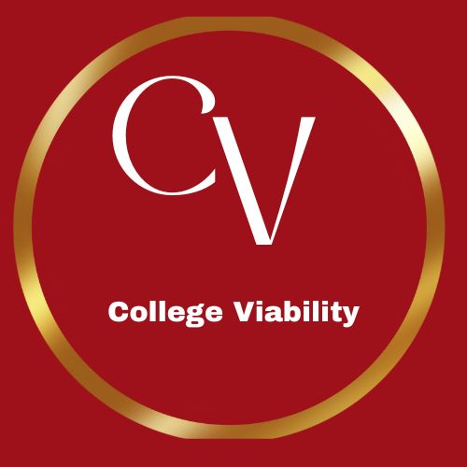

College Viability
2024 TOP / bottom
Private Colleges in the Northeast :
Health Care Programs
Fastest growing
Fastest shrinking
Data source: National Center for Education Statistics, IPEDS data base
2020-2022
Dr. Gary Stocker

Slide 2
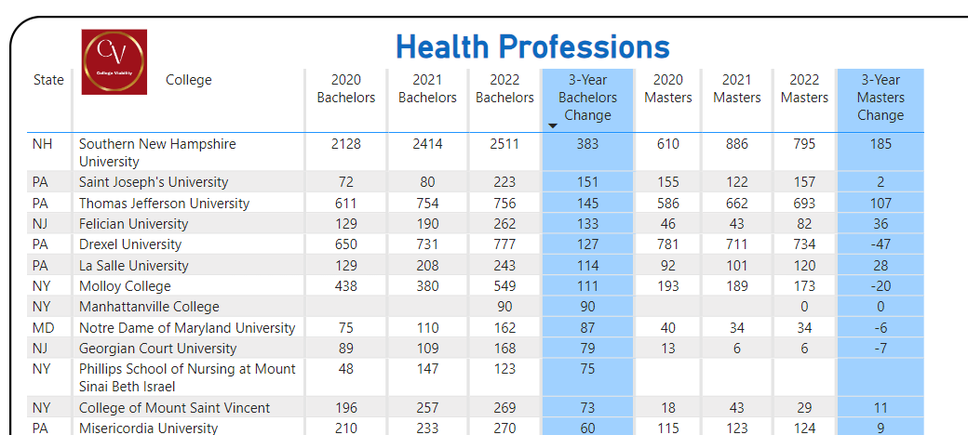
Midwest Private College Top / bottom Reports – Health Care Programs
Top Growing Bachelors

Slide 3
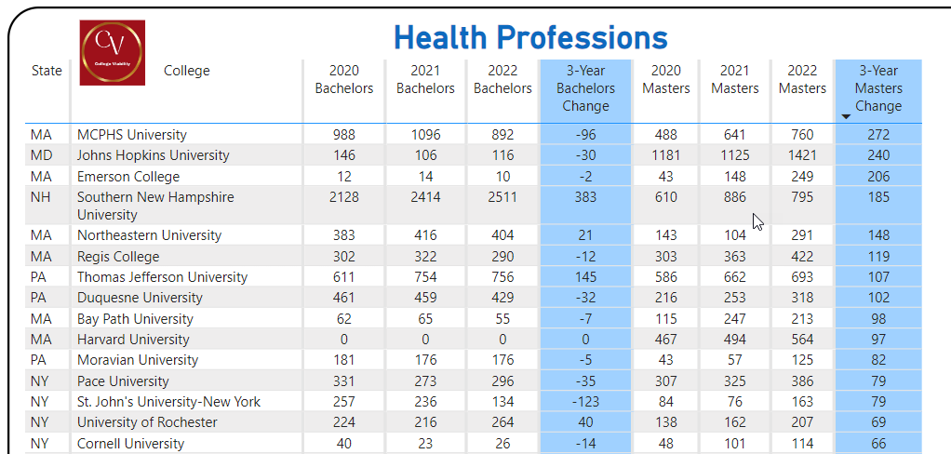
Top Growing Masters

Slide 4
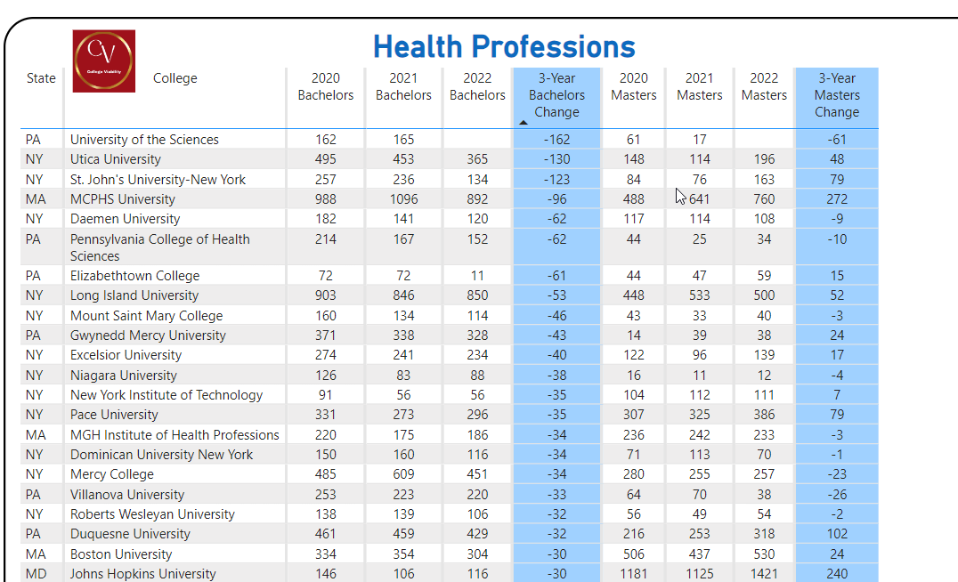
Midwest Private College Top / bottom Reports – Health Care Programs
Top Shrinking Bachelors

Slide 5
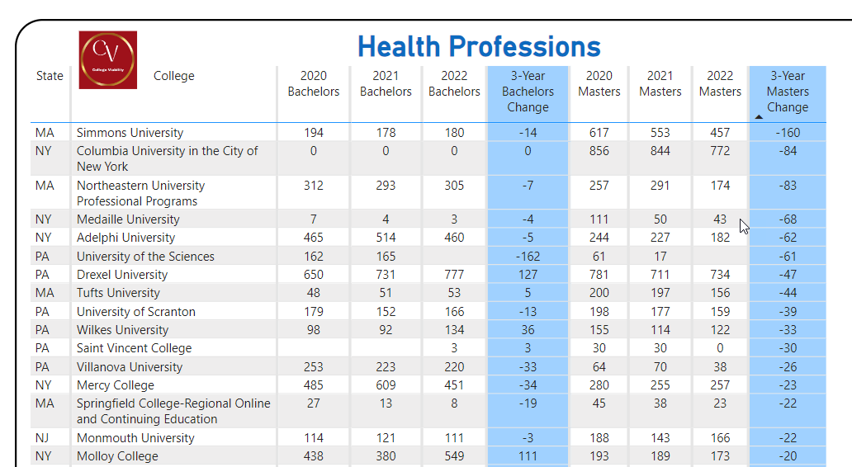
Midwest Private College Top / bottom Reports – Health Care Programs
Top Shrinking Masters

Slide 6
2024 College Viability Apps
“October Surprise” Bundle
$1,795 in College Viability Apps for only $499.
Private College Versions
  Public College Versions (2 & 4 year)
Colleges Reported: 1,297
Program Completion App
Executive Analysis version
  32 reports
Faculty and Staff version
  8 reports
Student & Family version
  5 reports
Colleges Reported: 1,579
Program Completion App
Executive Analysis version
  35 reports
Faculty and Staff version
  10 reports
Student & Family version
  6 reports

Slide 7
Why are program completion comparisons important?
For college leaders, these comparisons will provide data-driven comparisons you can use to better position your organization for strategic growth, cutbacks, and partnerships.
As a student or parent, program completion comparisons enable you to make sure the college(s) programs and majors you are considering have enough completion values to have a low risk of being cut.
Send questions or comments to gary@collegeviability.com
Notes:
Why did the enrollment decrease so much? Why is your endowment so low? What have you done to improve your graduation rates?

