Slide 1


College Viability 2024 TOP / bottom Private, Religious College Reports: United States
^{TOP} & _{bottom} Comparisons
IPEDS reports on: FTE enrollment, Tuition and Fee Revenue (2015-2022), Endowment, 4-year graduation rate (undergrads), & retention rates
Data source: National Center for Education Statistics, IPEDS data base
2015-2022
Dr. Gary Stocker

Slide 2
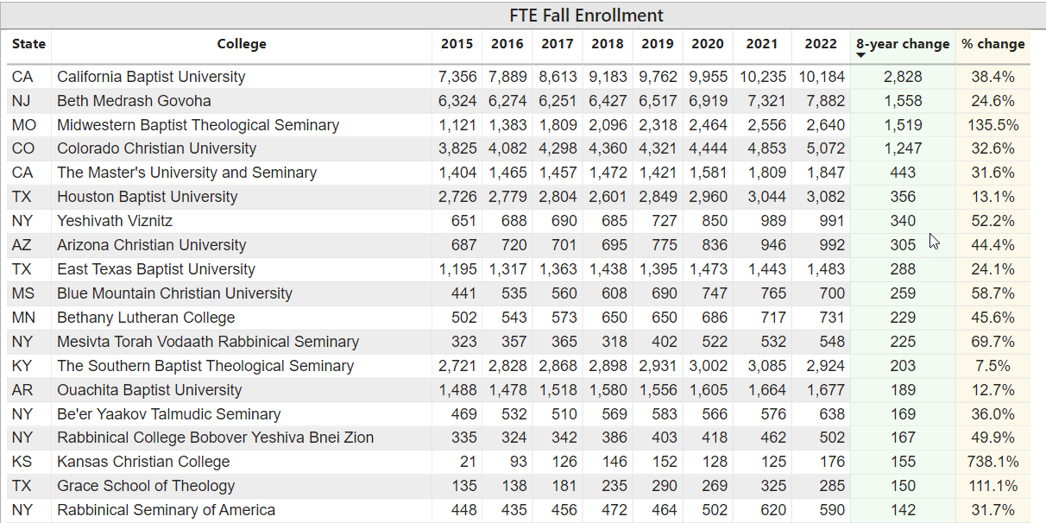
All U. S. Private, Religious Colleges Top / bottom Reports
Top
Top

Slide 3
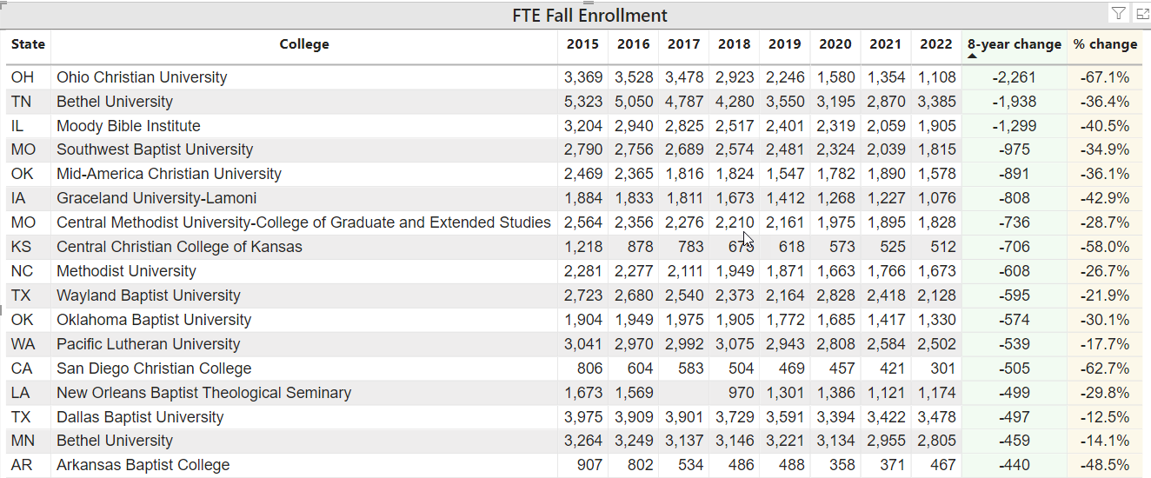
All U. S. Private, Religious Colleges Top / bottom Reports
Bottom
Bottom

Slide 4
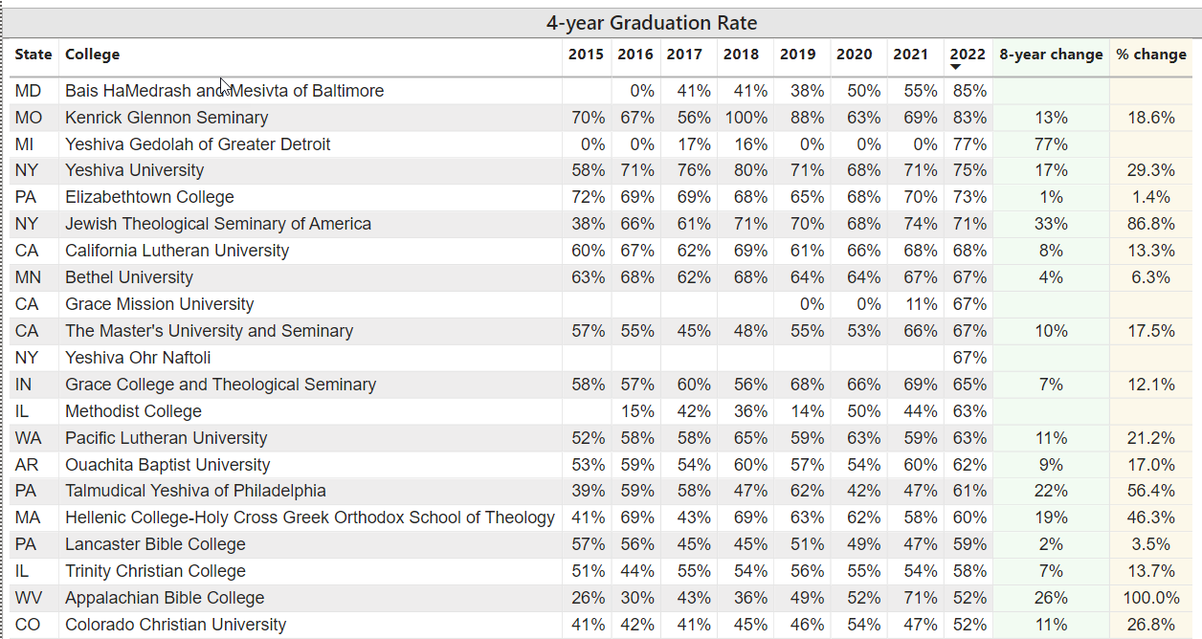
All U. S. Private, Religious Colleges Top / bottom Reports
Top
Top

Slide 5
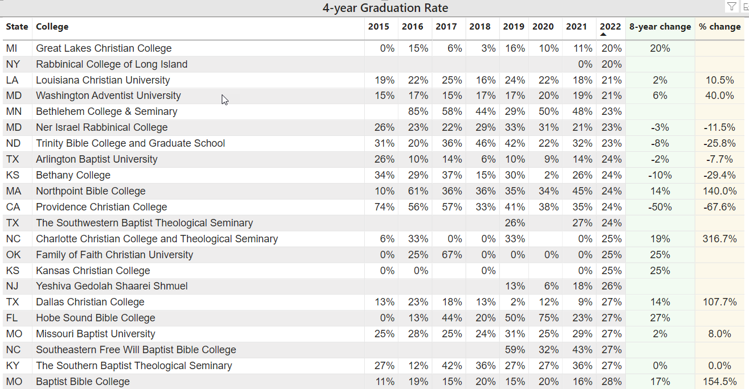
All U. S. Private, Religious Colleges Top / bottom Reports
Bottom
Bottom

Slide 6
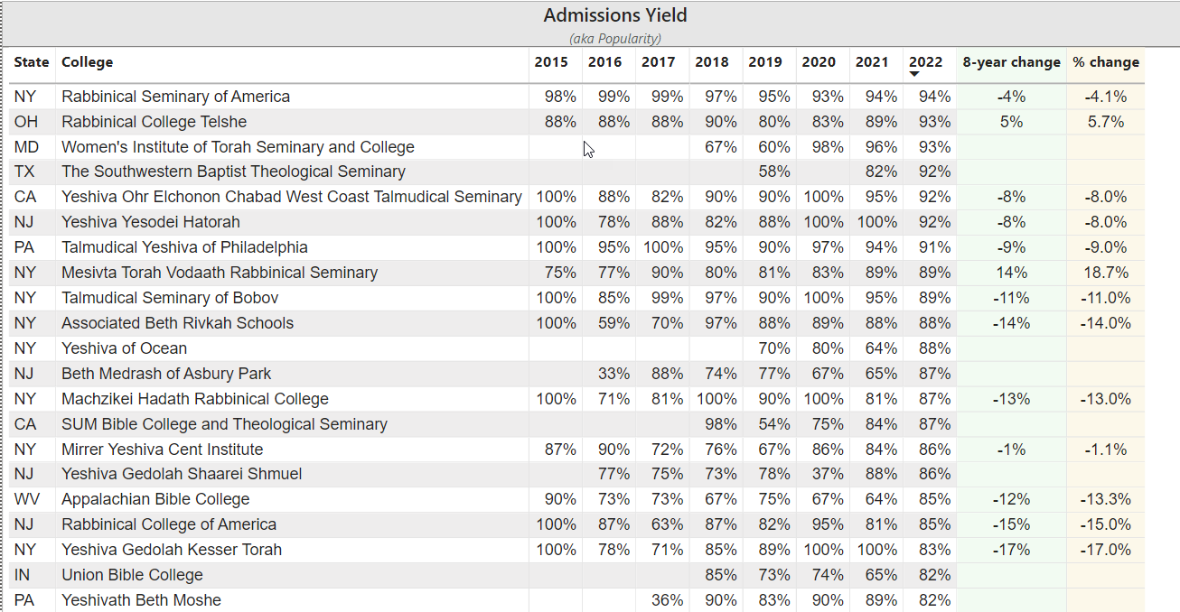
All U. S. Private, Religious Colleges Top / bottom Reports
Top
Top

Slide 7
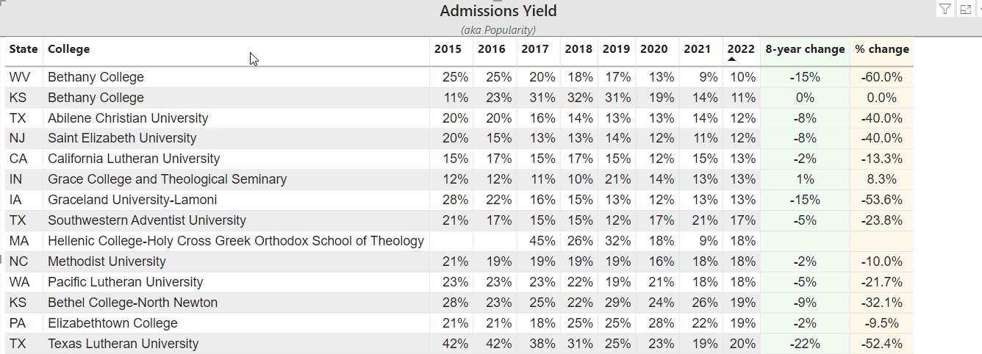
All U. S. Private, Religious Colleges Top / bottom Reports
Bottom
Bottom

Slide 8
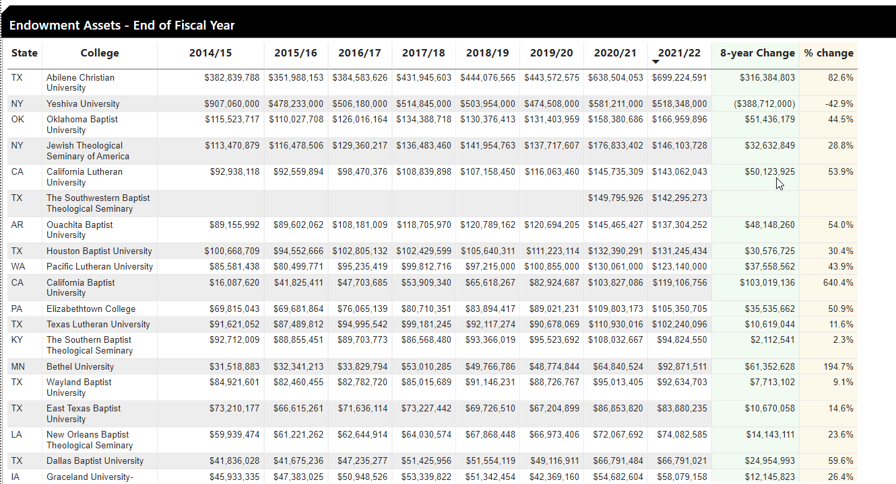
All U. S. Private, Religious Colleges Top / bottom Reports
Top
Top

Slide 9
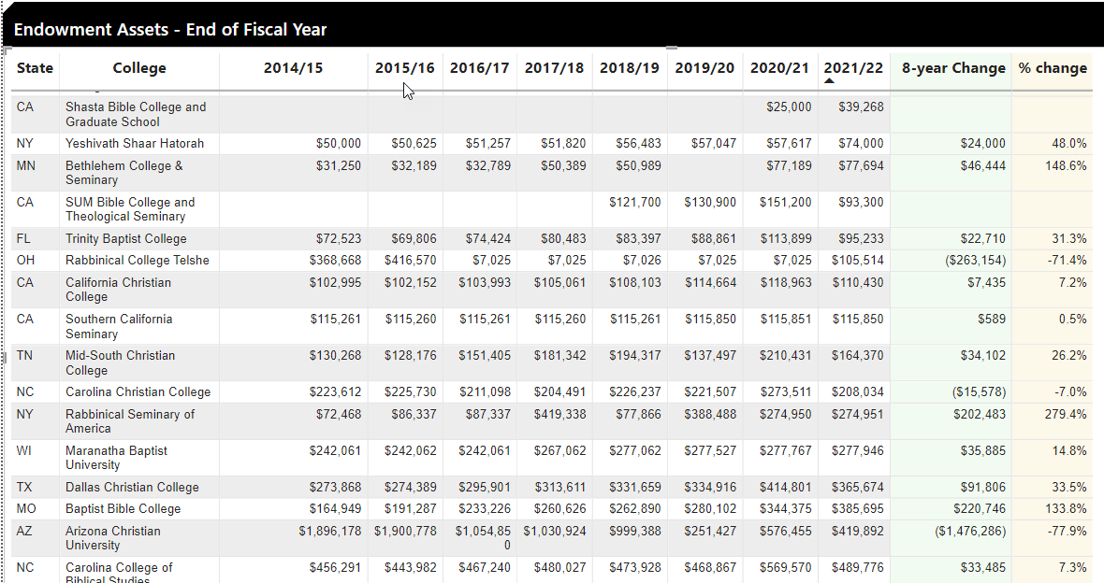
All U. S. Private, Religious Colleges Top / bottom Reports
Bottom
Bottom

Slide 10
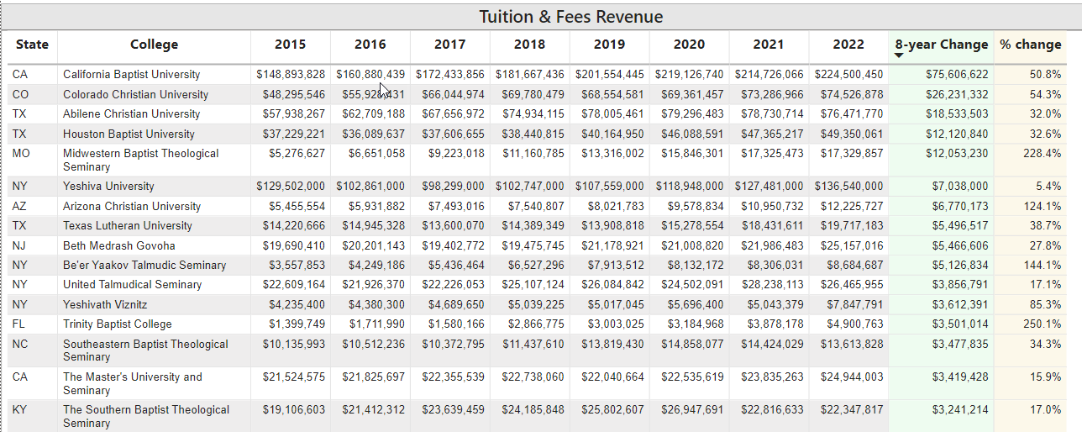
All U. S. Private, Religious Colleges Top / bottom Reports
Top
Top

Slide 11
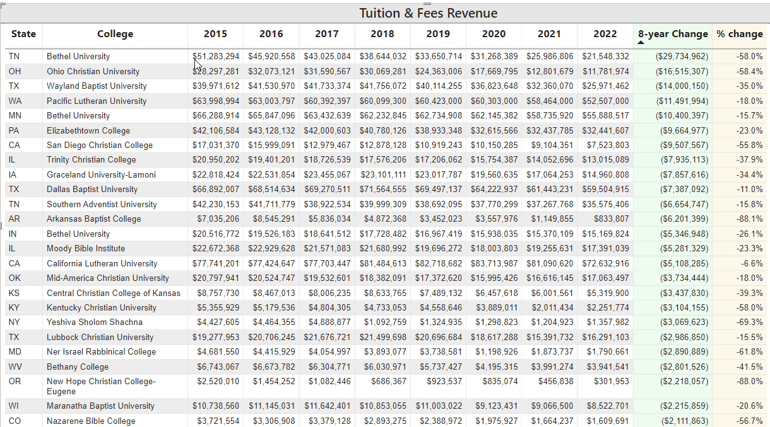
All U. S. Private, Religious Colleges Top / bottom Reports
Bottom
Bottom

Slide 12
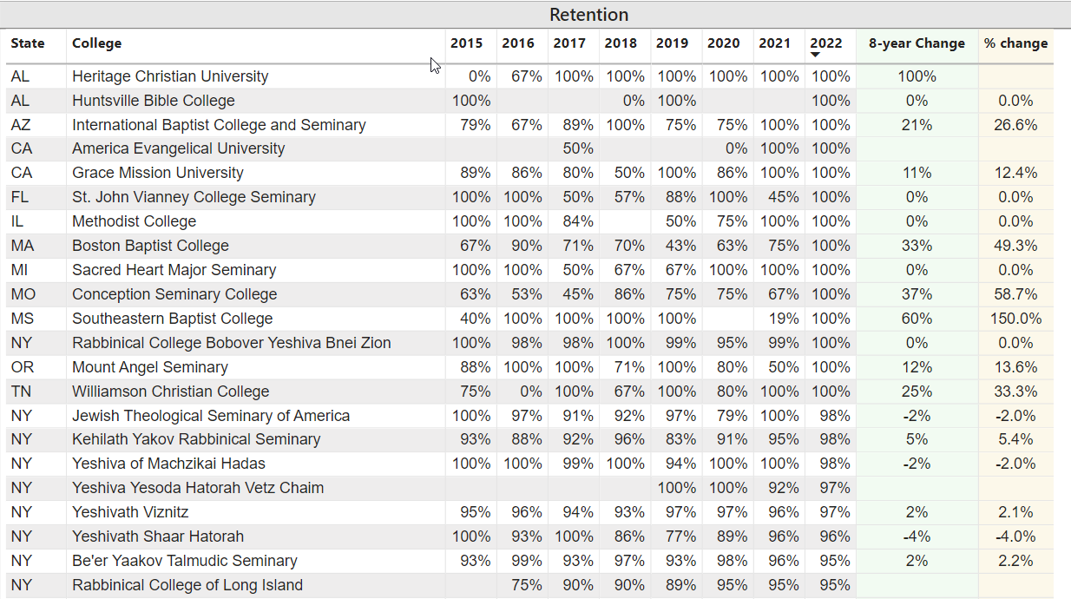
All U. S. Private, Religious Colleges Top / bottom Reports
Top
Top

Slide 13
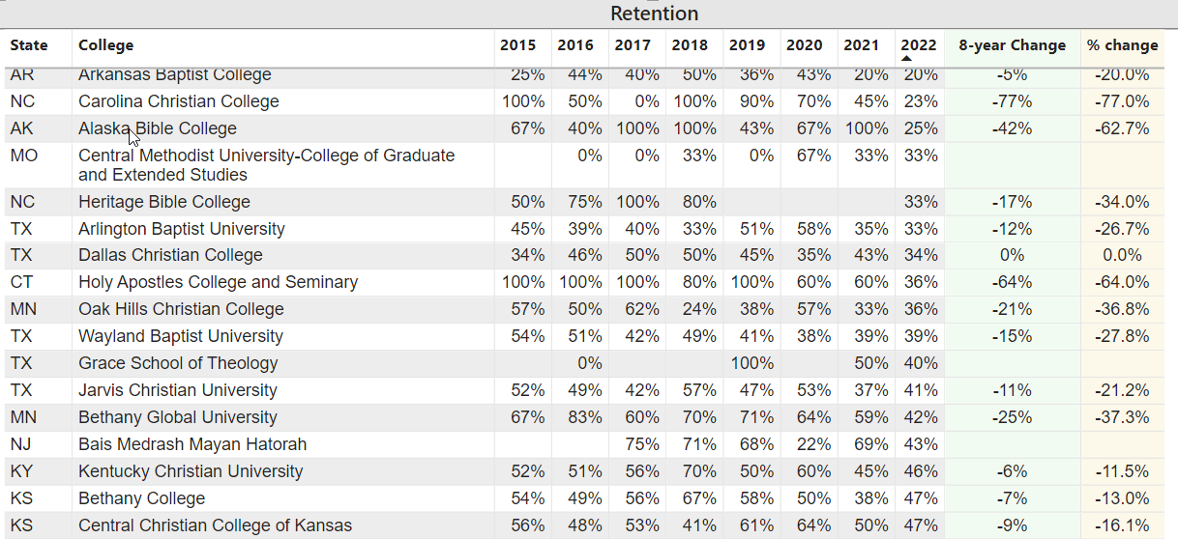
All U. S. Private, Religious Colleges Top / bottom Reports
Bottom
Bottom

Slide 14
2024 College Viability Apps
Private College Versions
Public College Versions (2 & 4 year)
Colleges Reported: 1,297
Executive Analysis version
32 reports
Faculty and Staff version
8 reports
Student & Family version
5 reports
Colleges Reported: 1,579
Executive Analysis version
35 reports
Faculty and Staff version
10 reports
Student & Family version
6 reports

Slide 15
What can you do with these data comparisons?
As a student or parent, focus on these stronger private colleges. Those colleges that are consistently in the bottom list should be considered only with aggressive questioning. ‘Let the buyer beware’ in those situations. Bad history = Bad future.
Here are some questions you can ask.
Why did the enrollment decrease so much?
Why is your endowment so small?
What have you done to improve your graduation rates?
Which programs have the largest number of students?
Which programs have the smallest number of students?
If this college has to close, how much notice will it provide students?
gary@collegeviability.com

