Slide 1
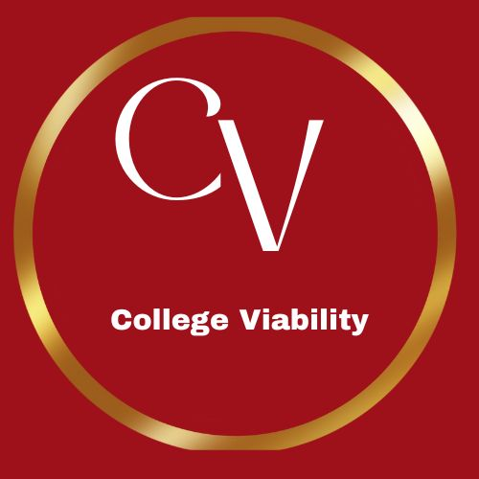
College Viability 2024 TOP / bottom Private College Reports:
Ohio private colleges that should close or merger their health care profession programs.
(2023 IPEDS data)
All reports sorted by
2023 Bachelors values
Data source: National Center for Education Statistics, IPEDS data base
Dr. Gary Stocker

Slide 2
IN, OH, MI, Private College Program Completion Top / bottom Reports
2023 Bachelor program completions in health care professions:
10-40 completions
Merge
Merge
Institution Name | Grand total (C2023_A First major Health Professions and Related Programs Bachelor's degree) | Grand total (C2023_A First major Health Professions and Related Programs Master's degree)
Franciscan University of Steubenville | 40 | 17
Mount Vernon Nazarene University | 40 | 14
Notre Dame College | 28 | 0
Heidelberg University | 25 | 13
Tiffin University | 25 | 5
Hiram College | 23
Good Samaritan College of Nursing and Health Science | 22
Malone University | 21 | 75
University of Rio Grande | 20
Union Institute & University | 17 | 40
Wittenberg University | 16
Bluffton University | 15
Ohio Christian University | 14
Denison University | 12
Wilberforce University | 10 | 5
Merger these programs

Slide 3
IN, OH, MI, Private College Program Completion Top / bottom Reports
Top Program Completion Market Share Percentages 2020-2022
Close
Close
UnitID | Institution Name | Grand total (C2023_A First major Health Professions and Related Programs Bachelor's degree) | Grand total (C2023_A First major Health Professions and Related Programs Master's degree)
200785 | Herzing University-Akron | 9
203845 | Marietta College | 9 | 40
204486 | University of Northwestern Ohio | 8
202046 | Cleveland Institute of Art | 7
206589 | The College of Wooster | 6
203368 | John Carroll University | 5 | 51
204909 | Ohio Wesleyan University | 4
202514 | Defiance College | 3
203580 | Lake Erie College | 3 | 26
245892 | Antioch University | 0 | 0
206507 | Wilmington College | 0 | 4
Close these programs

Slide 4
2024 College Viability Program Completion Apps
2,500 public and private colleges
in 16 IPEDS programs
Biology
Business, Management and Marketing
Communications& Journalism
Computers and CIS
Education
Health Professions
Homeland Security
Liberal Arts
Liberal Arts
Math & Statistics
Parks & Recreation
Philosophy & Religion
Physical Sciences
Psychology
Public Administration
Social Sciences
Visual & Performing Arts
Public and Private College App Versions Available and College Viability.

Slide 5
2024 College Viability Apps
Private College Versions
Public College Versions (2 & 4 year)
Colleges Reported: 1,297
Executive Analysis version
32 reports
Faculty and Staff version
8 reports
Student & Family version
5 reports
Colleges Reported: 1,579
Executive Analysis version
35 reports
Faculty and Staff version
10 reports
Student & Family version
6 reports
Now Available: 2024 Public and Private College IPEDS Program Completion App
Go to CollegeViability.com

Slide 6
What can you do with these data comparisons?
Use the IPEDS program completions data to see which public or private colleges have programs with strong completion numbers and/or rates.
While quantity does not always reflect quality, it is a reasonable indicator that a college will keep higher-enrolled programs and majors.
Lower-enrolled programs and majors are at increasing risk of being eliminated. While most colleges allow currently enrolled students to complete their programs, the risk of decreasing quality increases with each passing year as faculty and other leave the college.
We sort by bachelor programs. You will see some colleges have strong graduate programs in a discipline, but a lower number of completions for their bachelor programs. Our focus is to point out the comparatively weak bachelor programs.
Notes:
Why did the enrollment decrease so much? Why is your endowment so low? What have you done to improve your graduation rates?

