Slide 1
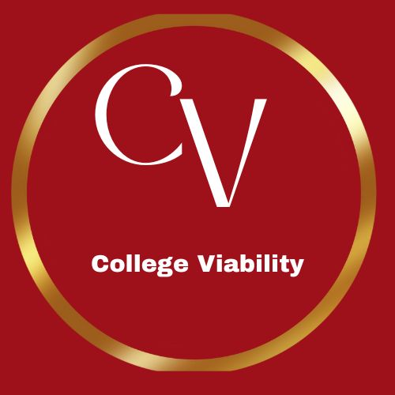
College Viability 2024 TOP / bottom Private Midwest College Reports: Health Care Programs
Fastest growing
Fastest shrinking
Data source: National Center for Education Statistics, IPEDS data base
2015-2022
Dr. Gary Stocker

Slide 2
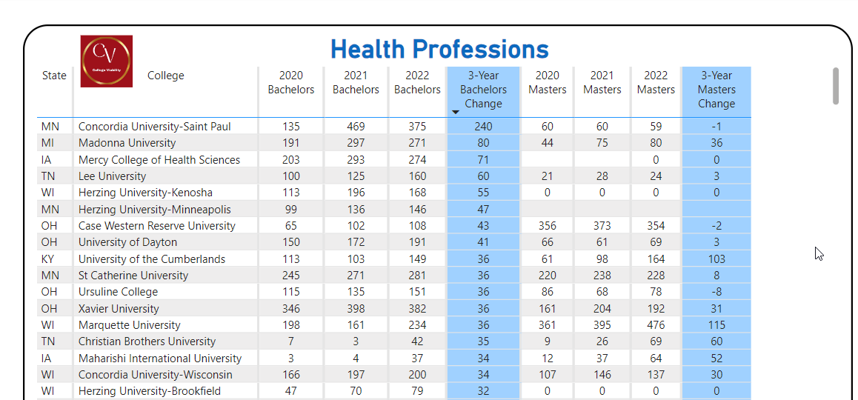
Midwest Private College Top / bottom Reports – Health Care Programs
Top Growing

Slide 3
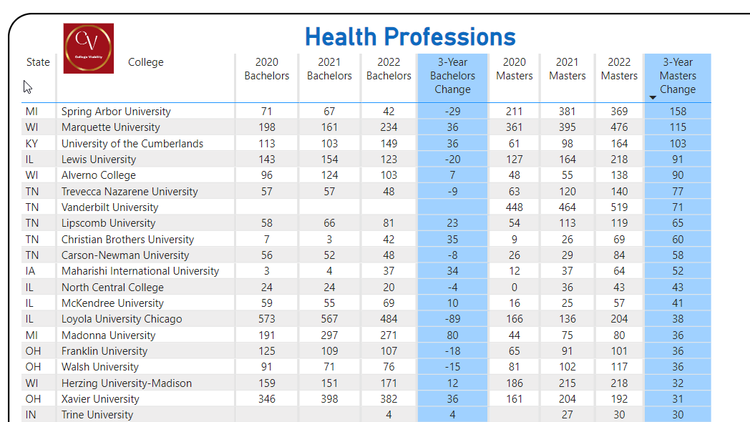
Top Growing

Slide 4
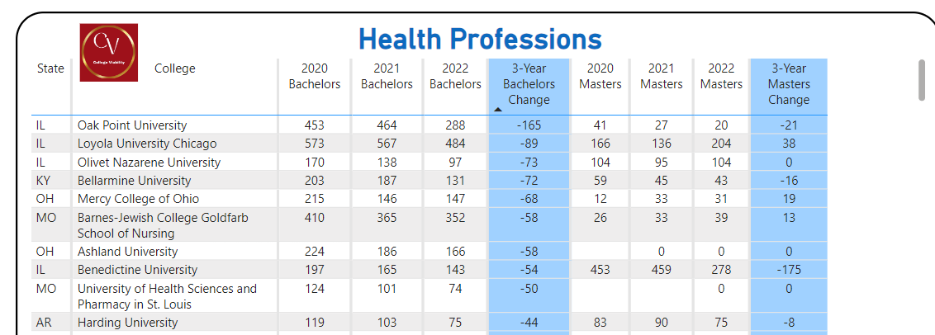
Midwest Private College Top / bottom Reports – Health Care Programs
Top Shrinking

Slide 5
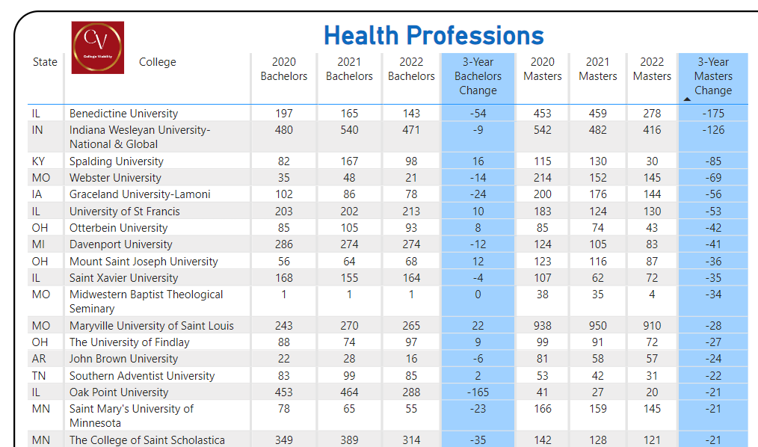
Midwest Private College Top / bottom Reports – Health Care Programs
Top Shrinking

Slide 6
2024 College Viability Apps
Private College Versions
Public College Versions (2 & 4 year)
Colleges Reported: 1,297
Program Completion App
Executive Analysis version
32 reports
Faculty and Staff version
8 reports
Student & Family version
5 reports
Colleges Reported: 1,579
Program Completion App
Executive Analysis version
35 reports
Faculty and Staff version
10 reports
Student & Family version
6 reports

Slide 7
Why are program completion comparisons important?
For college leaders, these comparisons will provide data-driven comparisons you can use to better position your organization for strategic growth, cutbacks, and partnerships.
As a student or parent, program completion comparisons enable you to make sure the college(s) programs and majors you are considering have enough completion values to have a low risk of being cut.
Send questions or comments to gary@collegeviability.com
Notes:
Why did the enrollment decrease so much? Why is your endowment so low? What have you done to improve your graduation rates?

