Slide 1
Polymers in Biomedical Applications
Fate of Polymer in the Physiology
By Binita Saha
JHU Teaching Institute Online
June 13, 2025

Slide 2
This is an original review by Binita Saha
Do not distribute without permission. Email at binitasaha@vt.edu

Slide 3

What are polymers and why learn about them?
Think about an everyday item which you think is made from polymers
Or scan this QR
Or type this in your web browser
Your answers
https://www.menti.com/al66zk6zp2ey

Slide 4
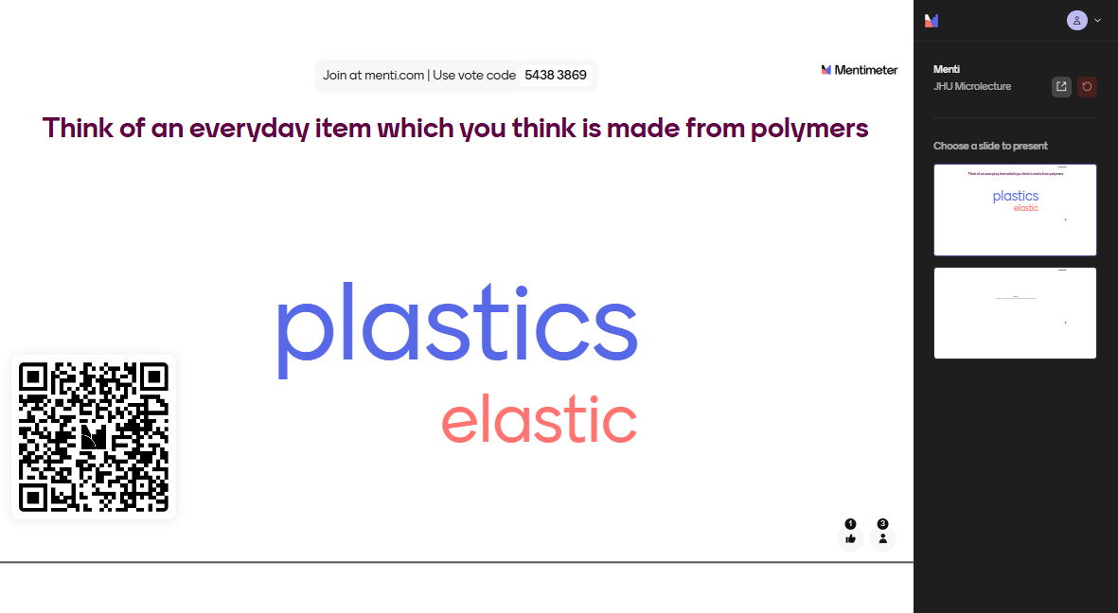

Slide 5
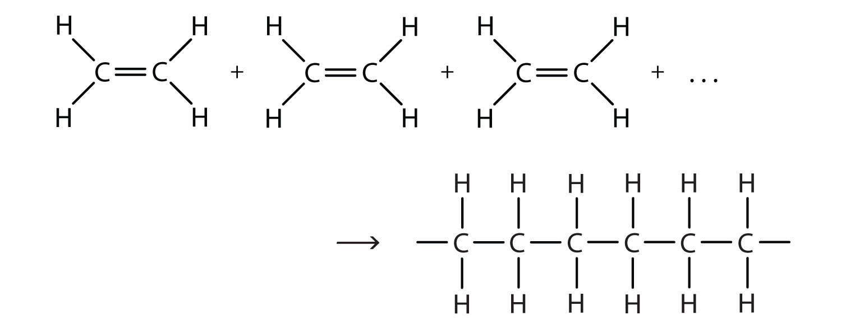
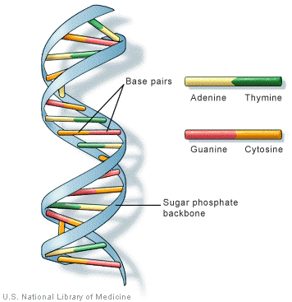
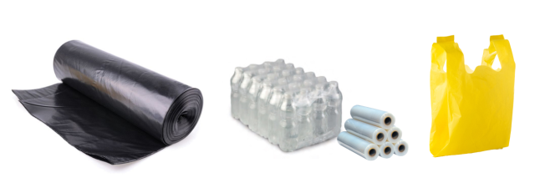
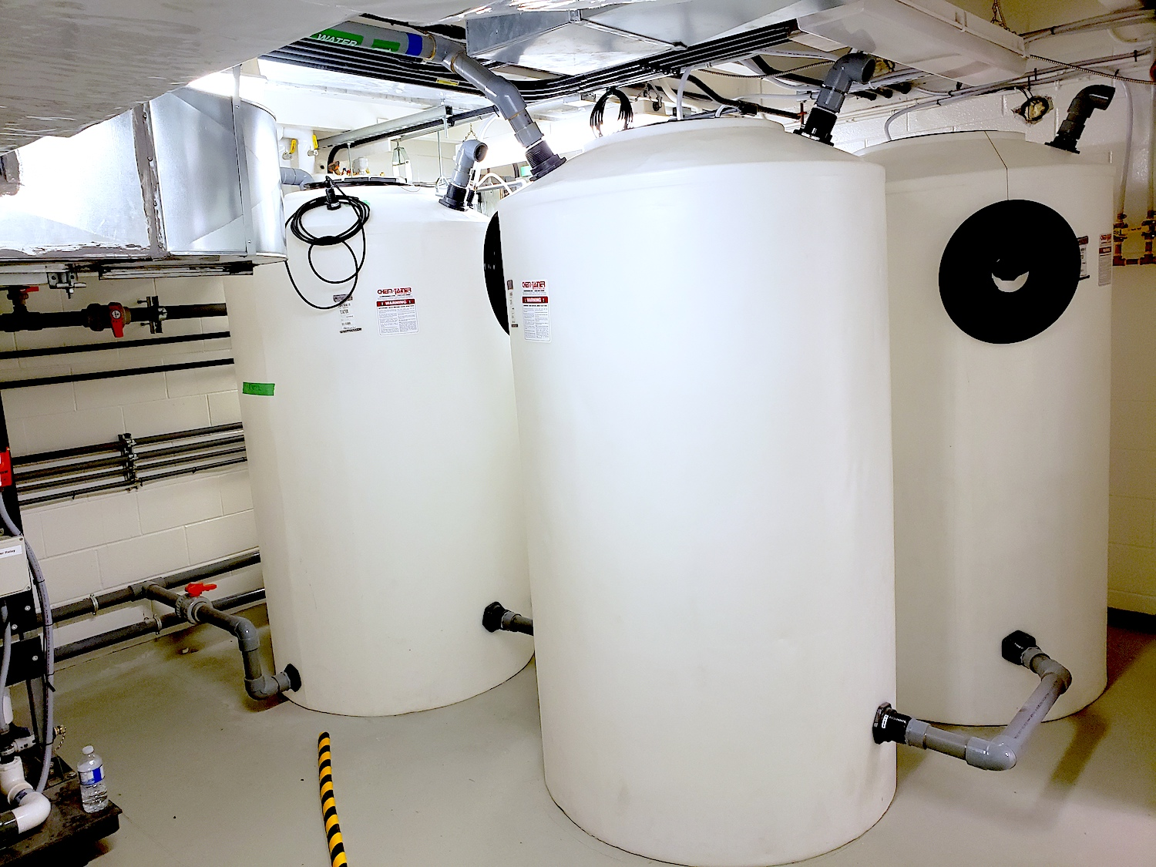
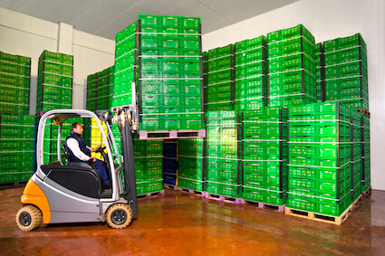
Polymers are ubiquitous and unavoidable
Mono = single
Mer = unit
This is Polyethylene
Poly = many

Slide 6
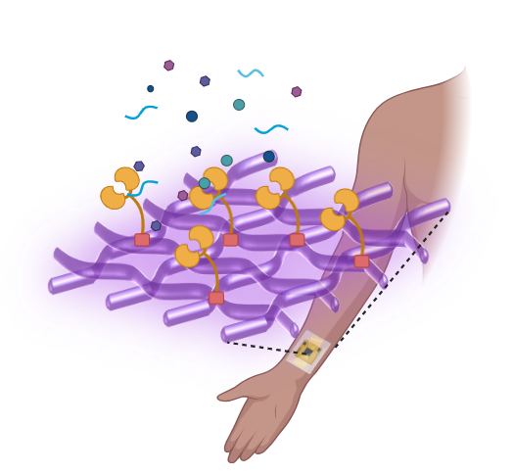
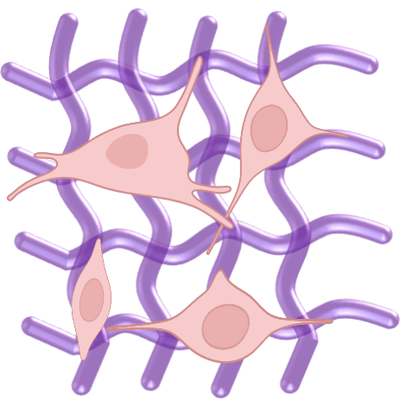
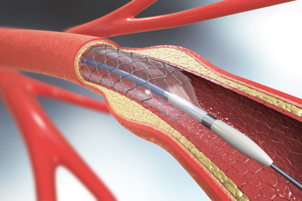
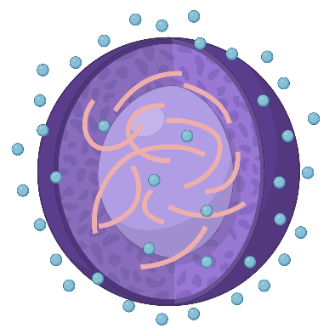
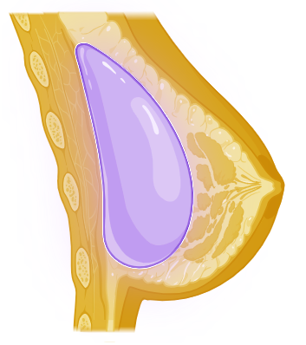
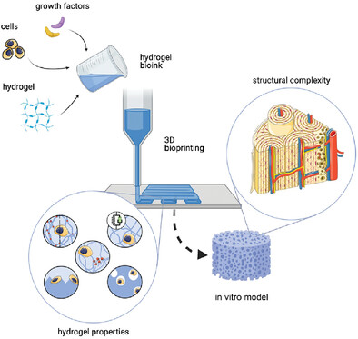
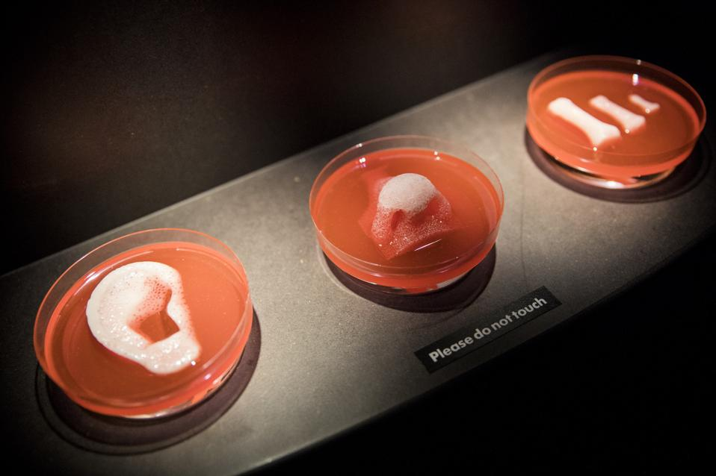
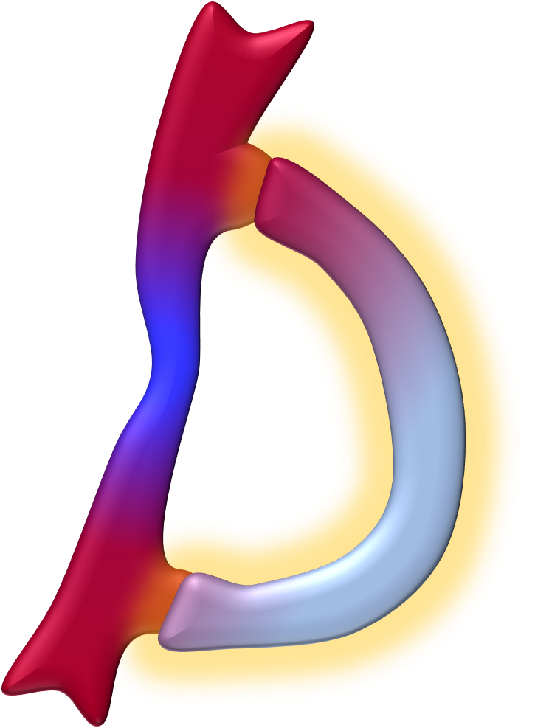
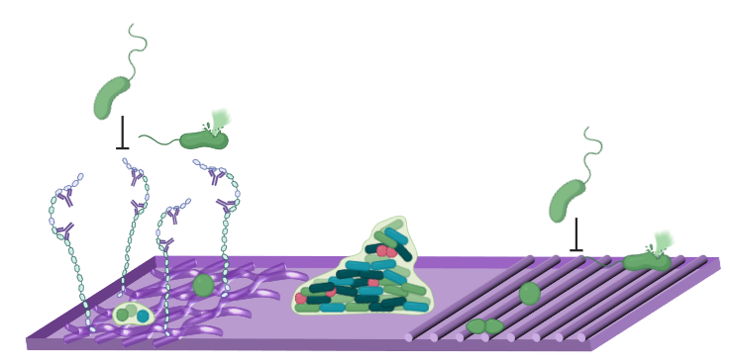
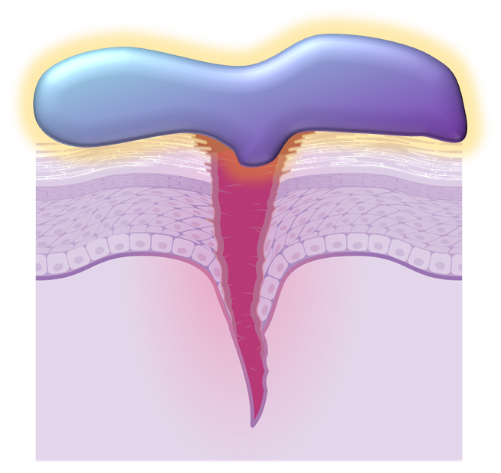
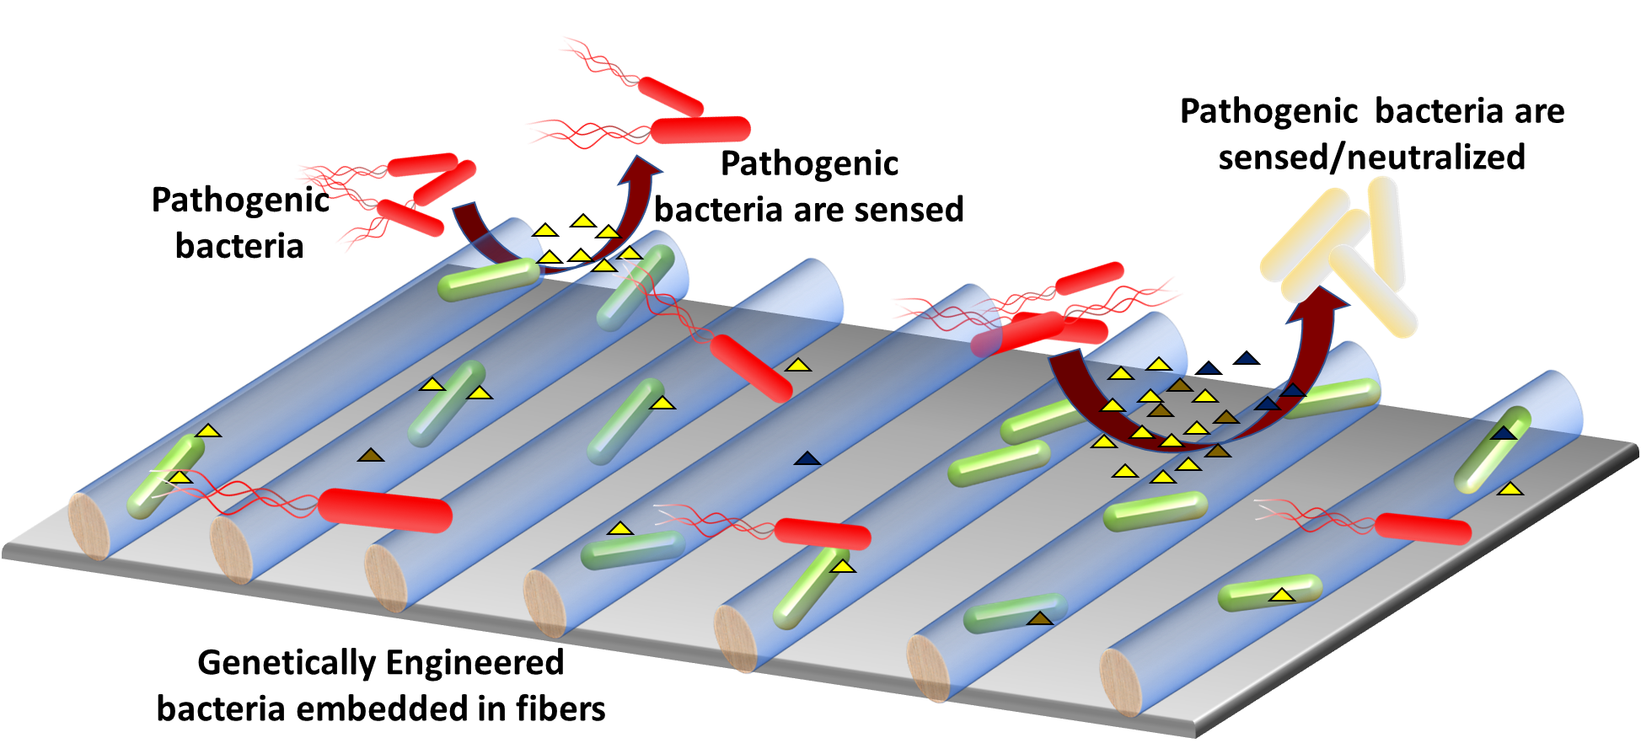
Polymeric Biomaterials
Materials designed to interact with biological systems for a medical purpose
in vitro studies
Regenerative applications
Tissue engineering
Drug Delivery
Medical Implants
Biosensing & Diagnostics
“Polymeric Materials And Coronary Angioplasty Devices.”
Accessed December 2, 2024.
W. Haseltine. William A. Haseltine PhD (blog), 2021.
Lewns et al. Advanced Materials - Wiley Online Library. 2023
Wound Repair
Vascular Grafting
Behkam Lab (unpublished)
Antimicrobial interfaces
Notes:
Tissue Engineering: Polymers provide scaffolds that mimic the extracellular matrix, supporting cell growth and tissue regeneration.
Drug Delivery: Polymeric nanoparticles and hydrogels are used for controlled and targeted delivery of therapeutics.
Medical Implants: Biocompatible polymers are integral to implants like prosthetics and artificial organs, ensuring durability and compatibility.
Biosensing and Diagnostics: Polymers are employed in devices that detect biomarkers for disease diagnosis, offering sensitivity and accuracy.
Wound Repair: Polymeric films and hydrogels enhance wound healing by maintaining moisture and delivering bioactive molecules.
Vascular Grafting: Polymers are used in synthetic blood vessels to restore circulation in damaged areas.
Antimicrobial Interfaces: Coatings with antimicrobial properties prevent infections on medical devices and implants.

Slide 7
Learning Objectives
After this micro-lecture, participants should be able to:
  List and clearly describe at least three types of polymers commonly used in biomedical applications.
  Explain the interdisciplinary contributions from engineering, bioethics, and regulatory sciences involved in polymer design and biomedical applications.
  Identify the roles and importance of specific immune cells (neutrophils, macrophages, fibroblasts) in polymer-tissue interactions.
  Accurately sequence and describe the key cellular and physiological responses occurring upon polymer implantation (protein adsorption, neutrophil recruitment, macrophage adhesion, fibroblast encapsulation).
  Match polymer properties (biocompatibility, mechanical properties, degradation profile) to relevant biomedical applications in light of physical response cellular cascades, demonstrating clear understanding of design considerations.

Slide 8
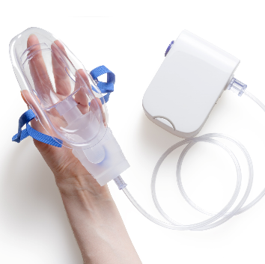
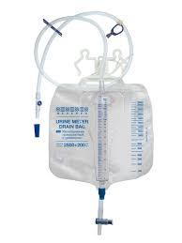
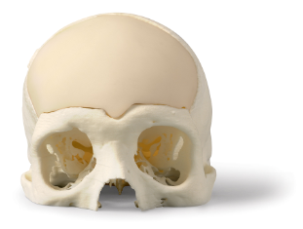
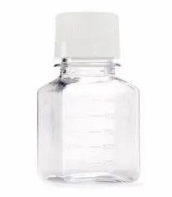
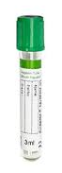
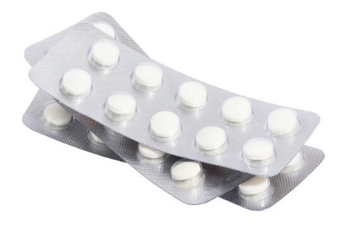
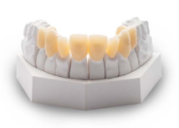
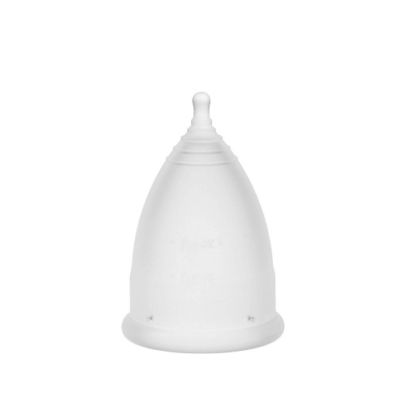
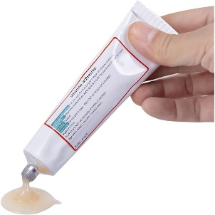
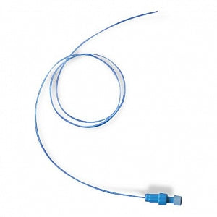
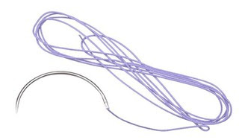
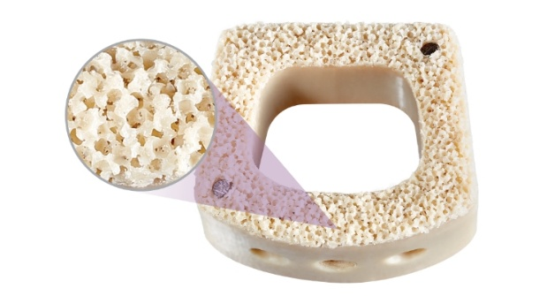
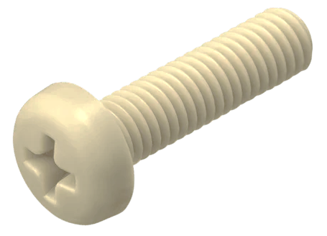
Market-popular biomedical polymers
Poly methylmethacrylate (PMMA)
Polyethylene terephthalate (PET)
Polyvinyl chloride (PVC)
Bone Cement
Dental Implants
Packaging and containers for research and healthcare
Aerosolizers, Masks, Tubing and IV/Bloodbags
Silicone Rubber
Nylon
Polyether ether ketone
(PEEK)
Menstrual cups
Silicon gels and tape for wound repair
Catheters
Sutures
Spinal implants
Medical Fasteners
Notes:
PMMA (Polymethylmethacrylate):
Used in bone cement for orthopedic surgeries.
Dental implants due to its excellent biocompatibility and mechanical properties.
PET (Polyethylene Terephthalate):
Found in packaging and containers for research and healthcare, ensuring sterility and durability.
PVC (Polyvinyl Chloride):
Utilized in aerosolizing masks, tubing, and IV blood bags, offering flexibility and chemical resistance.
Silicone Rubber:
Key material in menstrual cups, wound repair gels, and tapes, known for its softness and durability.
Nylon:
Applied in catheters and sutures, leveraging its strength and flexibility in critical medical uses.
PEEK (Polyetheretherketone):
Commonly used in spinal implants and medical fasteners, valued for its durability and compatibility with the body.

Slide 9
Polymeric Biomaterials are powered by interdisciplinarity
Medicine and Clinical Sciences
Engineering
Materials Science
Chemical
Mechanical
Electronic
Robotics
Biology
Chemistry
Pharmaceutical Sciences
Biophysics
Toxicology
Computational methods
Science
Humanities
Bioethics
Environmental sciences
Regulatory sciences
NSF, NIH and private funding foundations, have earmarked substantial funding toward interdisciplinarity¹
¹Weinberg et al., PNAS, 121, no. 32 (August 6, 2024):

Slide 10
What is the Fate of a polymer in physiology?
It can hurt you
It can dissolve
Body can form a layer around it
It can bond with living tissue

Slide 11





Immune system is the a key player in guiding the
Fate of a polymer in physiology
Monocytes
Circulating white blood cells
Non-mature immune cells
Differentiate to Macrophages
Neutrophils
First responders
Patrol the blood stream
Degrade foreign materials via enzyme
Recruit macrophages
Fibroblast (not an immune cell)
Produce the “housing” in which healing tissue cells settle during the burial process
M2 Macrophage
Anti-inflammatory
Help in “burying” foreign material and tissue healing
M1 Macrophage
Pro-inflammatory
Help in killing foreign material

Slide 12



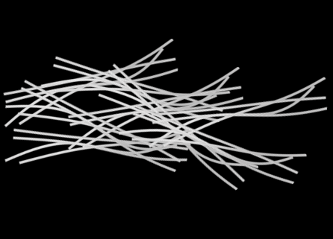

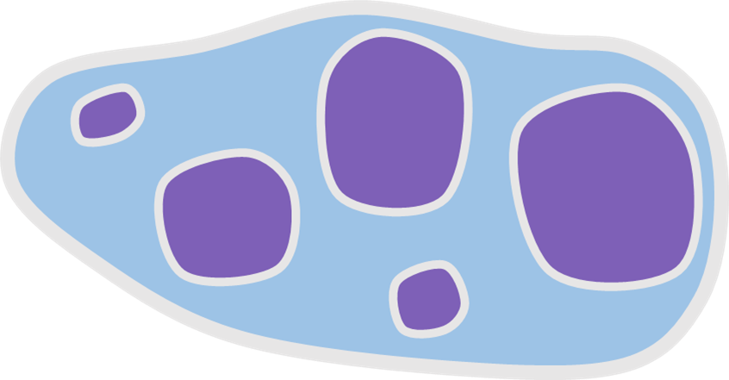

Fate of a polymer in physiology
Protein Adsorption
Neutrophil recruitment
Monocyte recruitment and M1 differentiation
Macrophage Adhesion
Fibrous
encapsulation
M1 unite to form giant cell, serving as a basis for macrophage adhesion
M₂
Monocytes differentiate to macrophages and secrete factors to recruit more macrophages
M₁
No therapy can escape, biomaterial becomes integrated
Implantation
Fibroblasts secrete tissue regenerating extracellular matrix to complete encapsulation
Recruit more blood cells or leukocytes
Antibodies release signals for recruitment of immune cells
Giant cell
Granulocytes contain enzymes to break down the surface
Anti-inflammatory signaling
M2 signals for tissue regenerating Fibroblasts
Pro-inflammatory signaling
Protein corona
Biomaterial Surface
Seconds
Minutes
Hours
Days
Weeks
Years
Acute Response
Chronic Response
Notes:
D. G. Barone et al. Frontiers in Bioengineering and Biotechnology 9 (2021).
Proteins link albumin and fibrinogen become non specifically attached
These proteins recruit larger proteins or antibodies…
These antibodies start a cascade of cellular events that make up any typical foreign body reaction, the first step being inflammation, very similar to what would happen if the body felt a cut or a lesion.
Then the first responders of the immune system arrive, the neutrophils. Neutrophils secrete enzymes to try to break down the biomaterial surface. When enough time passes and they fail, they adhere to the protein corona and start signalling using factors similar to inflammation, such as reactive oxygen species and proteolytic enzymes, these signals are similar to blood clotting. These factor essentially increase vascular permeability, and more blood rushes in. Blood contains leukocytes, these are like tiny patrollers that look for and engage in combating foreign bodies. The wave of neutrophils then attracts the second immune cell in line, the monocytes. These are kind of stem cells, they decide their function dependent on stimuli.
The monocytes continue to secrete enzymes to break down the material into small fragments. Frustrated it starts to differentiate, into macrophages. Of the M1 type.
After a couple of days, the wave of neutrophils has completely shut down and is replaced by the work of macrophages. These macrophages secrete pro-inflammatory molecules and try to invite more and more macrophages to come eat up the foreign body, or degrade it. This is the point when drug delivery therapeutics will start to leach out and release drug material. However, if the biomaterial is not meant to be degraded, this is also the point when toxic leaching of polymer material can happen.
Anyway, moving further, more macrophages arrive, and gang up together to form “Giant cells” in order to eat up more of the biomaterial. The giant cells settole down and attach to the biomaterial surface, and, at this stage they also start secreting cytoskeletal remodelling enzymes to allow these to greatly flatten over the surface to expose more the biomaterial to phagocytosis.
At this stage the natural response of the body to the lesion due to implantation is over. This phase marks the acute phase of foreign body reaction.
Now the body is convinced that this is a wound that it needs to repair, it is done fighting this guy, it now transitions to repair mode.
So these attached M1s start to express these nice anti-inflammation signalling molecules. Thes molecules as a result change tell the macrophages M1 in the vicinity to change their function from phagocytosis to tissue regenration., of the M2 macrophages. These M2 macropahges then start and sitting down on the implant, and start secreting signals to recruit tissue regerating cells. They are calling the last type of immune cells

Slide 13
List the sequence of cellular processes in order of when they occur in when a polymer interacts with the physiology
Macrophage adhesion
Fibroblast encapsulation
Protein adsorption
Neutrophil recruitment
Or scan this QR
Or type this in your web browser
https://www.menti.com/al66zk6zp2ey
Your answers

Slide 14
List the sequence of cellular processes in order of when they occur in when a polymer interacts with the physiology
Macrophage adhesion
Fibroblast encapsulation
Protein adsorption
Neutrophil recruitment

Slide 15
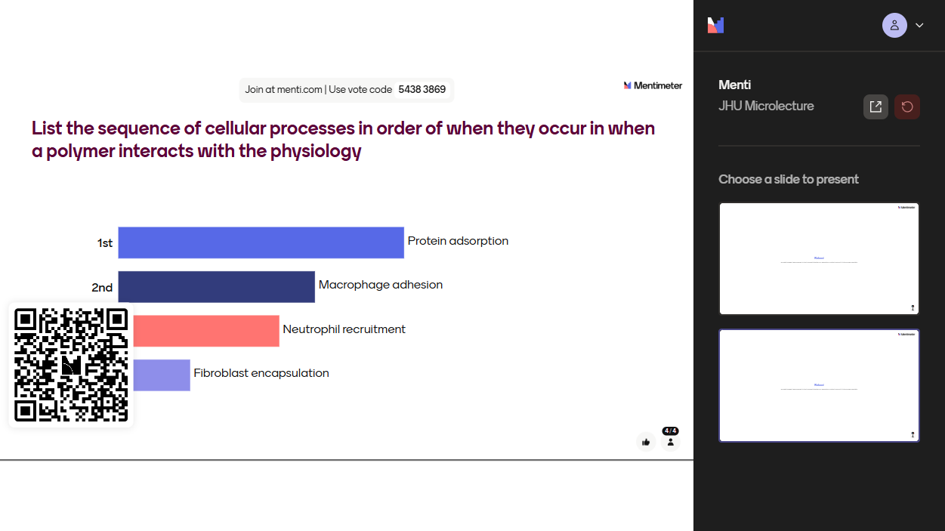

Slide 16






Immune responses guide the key considerations for innovations in polymers for biomedical applications
Biocompatibility
Degradability
Mechanical Properties
Surface Properties
Chemical Stability
Sterilizability
Notes:
Biocompatibility:
Polymers used in biomedical applications must not trigger adverse immune or inflammatory responses.
Examples: Polyethylene glycol (PEG) in drug delivery coatings, polyurethane in pacemaker leads.
Degradability:
Polymers should degrade into biologically safe byproducts that the body can excrete or absorb. For non-degradable polymers, they should remain stable under enzymatic and oxidative stress.
Examples: Poly(lactic-co-glycolic acid) (PLGA) for drug delivery, polyglycolic acid (PGA) sutures.Examples: PLGA for drug delivery systems, sutures made of polyglycolic acid.
Mechanical Properties:
Polymers must exhibit properties suited to their application, such as flexibility, elasticity, or strength, depending on their intended mechanical environment.
Examples: Hydrogels for cartilage replacement, polyethylene terephthalate (PET) in vascular grafts.
Surface Properties:
The surface characteristics of polymers, including chemistry, roughness, and energy, affect protein adsorption, cell adhesion, and tissue integration.
Examples: Modified polyethylene for orthopedic implants, polydimethylsiloxane (PDMS) in biosensors with tailored surface coatings.
Chemical Stability:
Polymers must resist degradation caused by environmental or physiological conditions if intended for long-term use.
Examples: Polyetheretherketone (PEEK) in spinal implants, fluoropolymers in vascular grafts.
Sterilizability:
Polymers must withstand sterilization methods such as autoclaving, ethylene oxide (EtO), or gamma radiation without losing structural or functional integrity.
Examples: Polypropylene in surgical mesh, polycarbonate in dialysis equipment.

Slide 17
Regulatory Perspectives
Device Classification and Risk Level¹
  Class I: Low risk (e.g., surgical gloves, bandages).
  Class II: Moderate risk requiring special controls (e.g., sutures, catheters).
  Class III: High risk and life-supporting (e.g., pacemaker leads, spinal implants).
Regulatory Pathways²
  Premarket Notification [510(k)]: For devices similar to existing FDA-approved products.
  Premarket Approval (PMA): For high-risk, novel devices requiring extensive clinical trials.
  De Novo Classification: For innovative low-to-moderate risk devices without a predicate.
  Investigational Device Exemption (IDE): For devices requiring clinical studies.
¹Van, Norman Gail A. “Drugs, Devices, and the FDA: Part 1.” JACC: Basic to Translational Science 1, no. 3 (April 2016)
²S. Ramakrishna. “Medical Devices Regulatory Aspects: A Special Focus on Polymeric Material Based Devices.” Current Pharmaceutical Design 21, (December, 2015)

Slide 18
Regulatory Perspectives
Material Biocompatibility and Stability¹
  Polymers must be tested to ensure they are non-toxic, non-carcinogenic, and biocompatible
  Evaluated under ISO 10993 guidelines
    Cytotoxicity
    Sensitization
    Systemic toxicity
    Genotoxicity
    Implantation testing
  Controlled degradation profiles to avoid premature breakdown or harmful byproducts.
  Long-term stability for non-degradable polymers in permanent implants.
Sterilizability¹
Medical polymers must be stable and compatible with sterilization methods, such as:
    Autoclaving
    Ethylene oxide (EtO)
    Gamma or electron-beam irradiation
    Chemical sterilization
¹N. Yagoubi. “Biocompatibility of Polymer-Based Biomaterials and Medical Devices – Regulations, in Vitro Screening and Risk-Management.” Biomaterials Science .(2018).

Slide 19
Regulatory Perspectives
Manufacturing and Quality Control¹
Must adhere to Good Manufacturing Practices (GMPs):
  Consistent quality in production processes.
  Documented processes to trace and audit production steps.
  Absence of contaminants and reproducibility of material performance.
Post-Market Surveillance²
Polymers must comply with post-market monitoring requirements, such as:
  Reporting adverse events.
  Addressing recalls if safety concerns arise.
¹Y. Hazar. “Regulations and Standards for Polymers in Medicine.” In Handbook of Polymers in Medicine,. Woodhead Publishing, 2023.

Slide 20
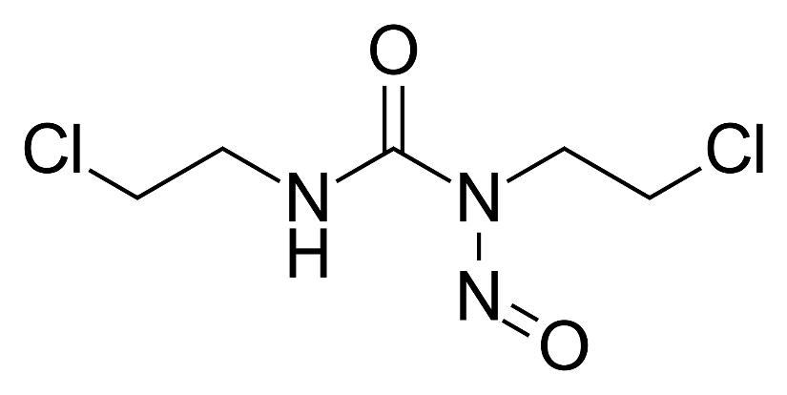
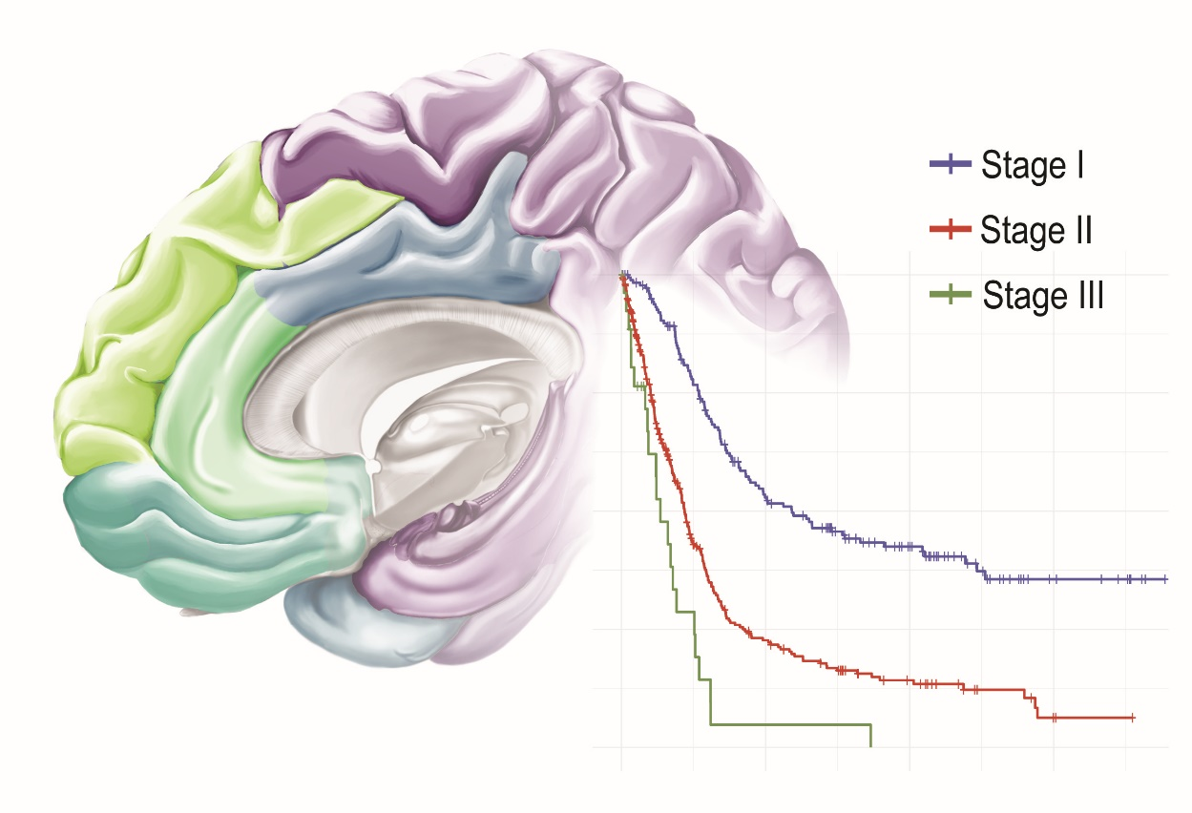
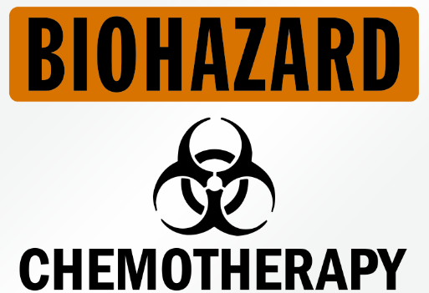
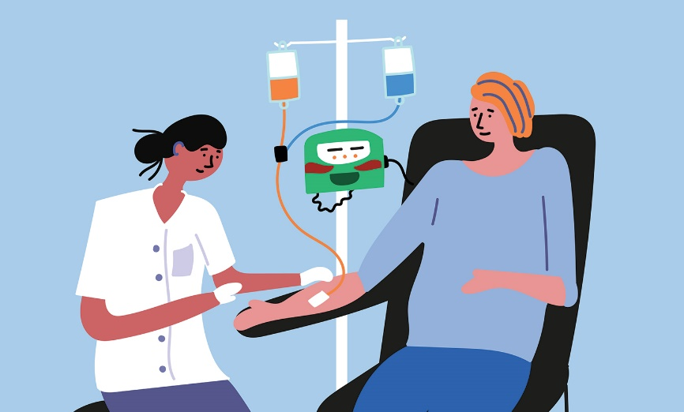
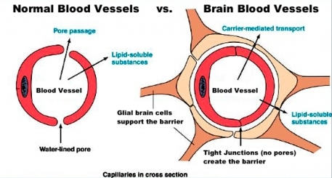
Case Study 1: Drug Delivery for Glioblastoma
The most commonly used chemotherapy was 1,3-Bis(2-chloroethyl)-1-nitrosourea
Any systemically delivered drug is toxic to normal cells
Stage III Glioblastoma
life-expectancy of 4 weeks if untreated
<1 year regardless of treatment (1980s)
Half-life of BNCU is 12 minutes and
it was applied intravenously
Blood-brain barrier prevents passage most drugs

Slide 21
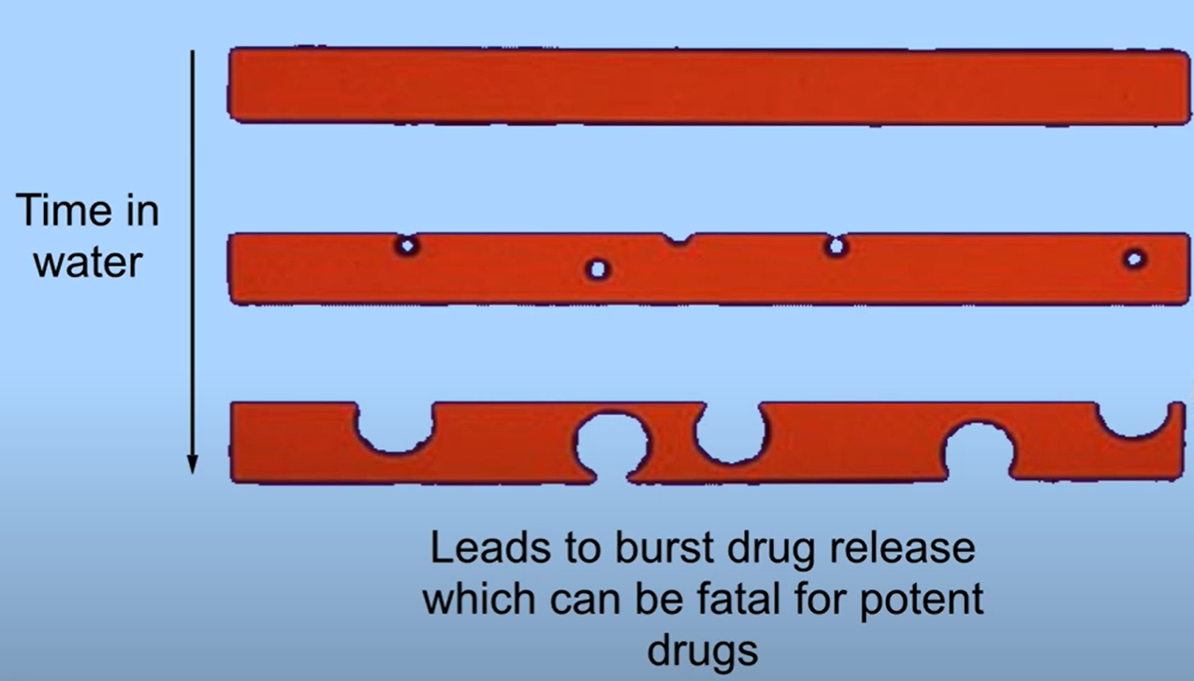
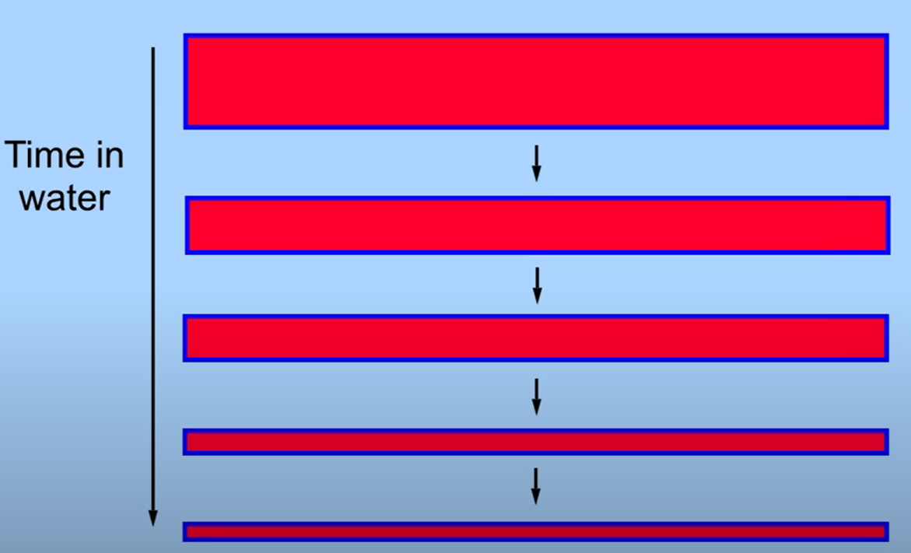
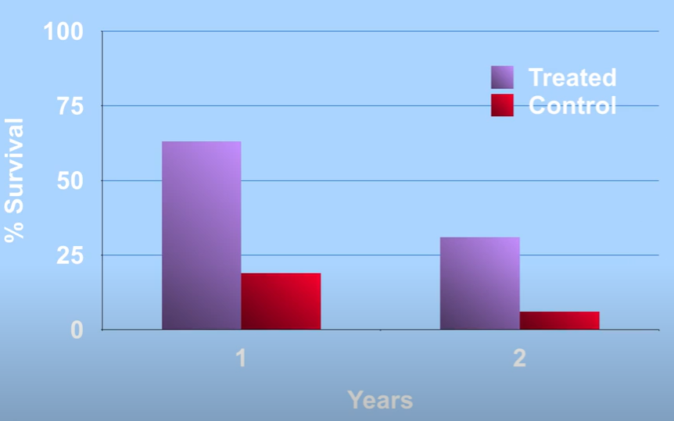
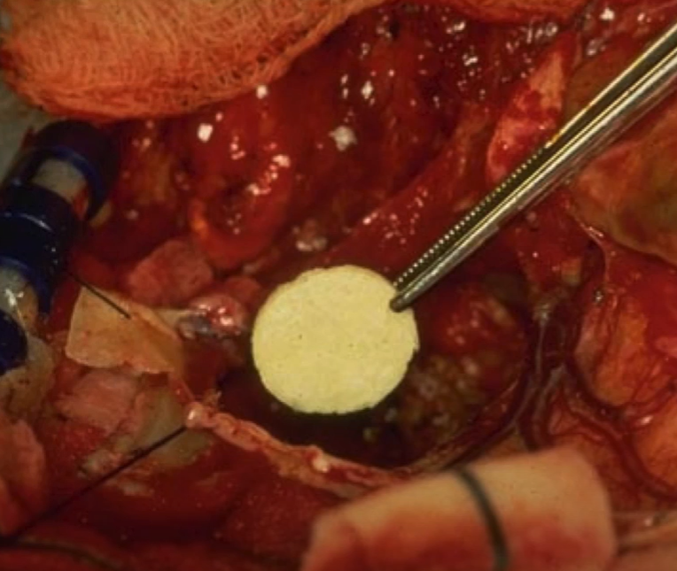
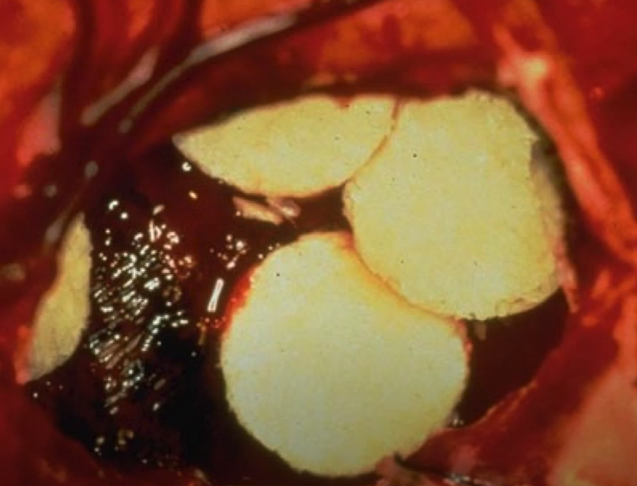

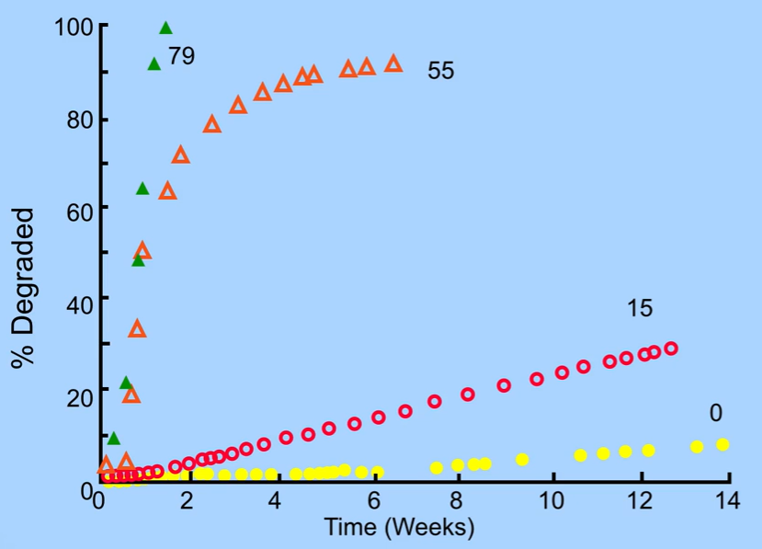
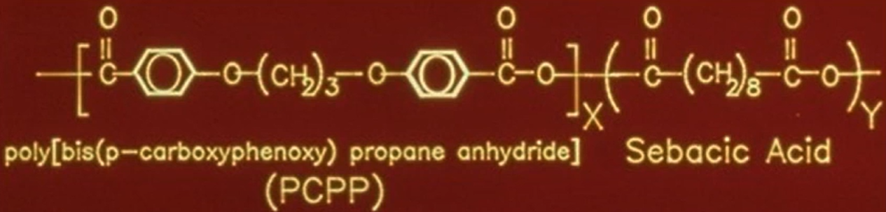
Case Study 1: A surface-eroding localized Drug Delivery system for Glioblastoma
Engineering design analysis:
Should potential polymer be degraded enzymatically or water-assisted?
What should the building blocks of the polymer be to keep water out only at the surface?
What would be the right chemical bonds that would break apart the right way?
What would be the specific units of the co-polymer building blocks to have the desired degradation profile?
Surface erosion as a function of Sebacic acid units (1983)
Other questions the FDA asked:
Will the polymer react with the encapsulated drug? (1985)
Will the polymer-drug system toxic? (1986)
The drug is poor, will it still work? (1988)
Can the drug delivery system be manufactured? (1993)
At that time the only FDA-approved degradable material was Polyester suture, but it bulk eroded, i.e. burst delivery of chemotherapy
He identified that surface erosion would solve this problem
Prof. Bob Langer

Slide 22

Case Study 1: An interdisciplinary success story of a polymer-based biomedical device
The success of Gliadel® relied on interdisciplinary collaboration between materials scientists, chemists, neurosurgeons, and oncologists.
To learn about all the awesome people involved in the study watch
Robert S. Langer (MIT) Part 3: Biomaterials for Drug Delivery Systems and Tissue Engineering
Engineering design analysis:
Should potential polymer be degraded enzymatically or water-assisted?
What should the building blocks of the polymer be to keep water out only at the surface?
What would be the right chemical bonds that would break apart the right way?
What would be the specific units of the co-polymer building blocks to have the desired degradation profile?
Gliadel® was clinically approved in 1996
It was the first FDA-approved localized polymeric drug delivery system for brain tumors
The Gliadel® wafer still remains an active treatment option for patients with high-grade gliomas
At that time the only FDA-approved degradable material was Polyester suture, but it bulk eroded, i.e. burst delivery of chemotherapy
He identified that surface erosion would solve this problem
Prof. Bob Langer

Slide 23
Final Reflection Assignment (Homework)
Using your understanding of polymer design, physiological interaction, and regulatory pathways, craft a short abstract (written or video) that describes a real-world or hypothetical polymer system used in a biomedical application. Your response must be evidence-informed and clearly show how:
  The polymer material and its key design features (e.g., degradation, mechanical stability) were selected.
  Immune or physiological response shaped the application or outcome.
  Interdisciplinary insight (e.g., chemistry, medicine, FDA policy) helped in success or contributed to failure.
  Choose ONE of the following case options:
    PMMA Bone Cement with Halloysite Nanotubes
    PLGA Nanoparticle for Cancer Drug Delivery
    Enzyme-Responsive PEG Hydrogel for Tissue Repair
    Polypropylene Mesh – Regulatory and Biocompatibility Challenges
    PLLA Bioresorbable Scaffold – Design vs. Clinical Reality
  Choose your format: written abstract (~250 words) or recorded explanation (1 min max).
  Optional: Include one cited article or review that supports your design argument (ACS Macromolecules style)
  Due: One week from class via LMS
  Rubric Provided: Yes – see next slide for rubric.

Slide 24
Final Reflection Assignment (Homework): Rubric
Criteria | Excellent (5 pts) | Good (4 pts) | Satisfactory (3 pts) | Needs Improvement (1–2 pts)
Polymer & Application Identification | Clearly identifies polymer and biomedical application, providing specific details and context. | Identifies polymer and biomedical application clearly with some detail. | General identification of polymer and biomedical application; some details unclear. | Incomplete or unclear identification of polymer and/or application.
Design Considerations | Thoroughly details polymer design considerations (biocompatibility, degradation, mechanical properties) with strong understanding. | Clearly outlines key design considerations; minor details missing. | Mentions general design considerations; lacks specificity. | Omits key design considerations or provides incorrect information.
Interdisciplinary Contributions | Clearly articulates interdisciplinary contributions (engineering, regulatory sciences, bioethics) with specific, insightful examples. | Clearly outlines interdisciplinary contributions with adequate examples. | Provides general description of interdisciplinary roles; examples lack detail. | Limited or unclear discussion of interdisciplinary contributions.
Safety & Regulatory Implications | Demonstrates deep understanding of safety/regulatory issues with accurate and specific examples. | Clearly outlines safety/regulatory aspects with good accuracy. | Generally mentions safety/regulatory issues; lacks specificity or accuracy. | Safety/regulatory considerations are unclear or inaccurate.
Reflective Analysis | Thoughtful, evidence-based reflection clearly addressing polymer success/failure; includes insightful recommendations. | Reflective analysis evident; supported by some evidence; recommendations clear but less detailed. | Basic reflection provided with limited supporting evidence; general recommendations. | Reflection superficial, unclear, or unsupported by evidence.
Clarity & Professionalism | Abstract is clear, professional, concise, logically structured and obeys time/word limit | Abstract clear, professional, minor deviation from word/time limit | Abstract generally clear but contains noticeable errors or structural issues and gravely under or over word/time limit | Abstract unclear, lacks professional tone, and contains significant errors and exceeds more than twice the word /time limit.

