Slide 1
VIRTUAL CONFERENCE EVENTS AND MEETING
What does a Nexus Virtual Event or Meeting
look like and work like?

Slide 2
We combine a Zoom web-meeting with a live webcast using the Nexus Mediasite system to engage and include large audiences to participate in discussions, responding, ask questions, survey/polling and legally voting on motions

Slide 3
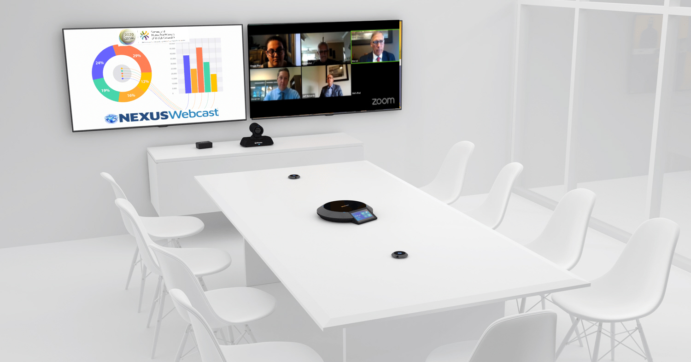
VIRTUAL EVENT READY ROOM
A room will be set up with the Zoom meeting and Nexus Mediasite webcast connectivity needed. A Nexus team of technical operators, social-distance-seated will conduct the meeting with the in-room and remote speakers.

Slide 4
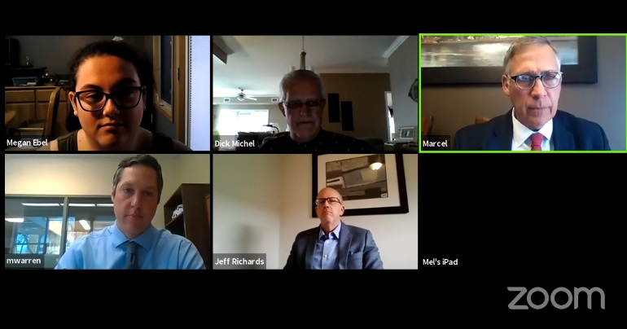
ZOOM MEETINGS SET UP TO VIEWED BY ATTENDEES
The speaker ready room is set up to include in-room and remote Zoom meeting attendees which is visible to the webcast viewer in their browsers.
Nexus Webcast viewer seen on standard browser
ZOOM meeting view in room

Slide 5
REGISTERED REMOTE ATTENDEES
Attendees register to join the webcast event, identifying themselves by their name, recognized personal email address and any other information needed to support accreditation.

Slide 6
EXAMPLE REGISTRATION PAGE

Slide 7
EXCEL REGISTRATION PAGE REPORT EXAMPLE

Slide 8
VIRTUAL EVENT/CONFERENCE
What does a Nexus Virtual Event look like?

Slide 9
VIRTUAL EVENT WEBCAST EXAMPLE

Slide 10
DUAL SCREEN INSERT SLIDES OR LIVE PRESENTATION VISUALS SHOWN SEPARATELY

Slide 11
COMMUNICATING WITH ATTENDEES
Attendees will be shown how to ask questions, or add their comments using the built-in feature on the webcast viewer

Slide 12
ASK QUESTION OR COMMENT FEATURE
Click to Ask or Comment

Slide 13
ASK QUESTION/COMMENT POP-UP

Slide 14
ASK QUESTION/COMMENT MODERATOR PAGE

Slide 15
OR - ASK QUESTION/COMMENT APPEAR MODERATOR’S EMAIL INBOX

Slide 16
POLLING ONLINE ATTENDEES
Attendees can be prompted to take an anonymous poll or vote or end of session survey using the built-in pop up feature, or can be directed to 3rd party polling or opinion sites such as Mentimeter or Slido

Slide 17
NEXUS MEDIASITE POLLING POP-UP EXAMPLE
Example multiple choice poll question

Slide 18
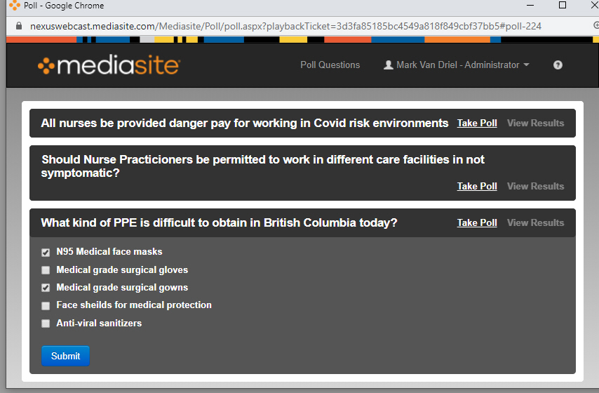
POLLING RESULTS REPORT EXAMPLE
Results from a multiple choice poll

Slide 19
NEXUS MEDIASITE POLLING POP-UP EXAMPLE
Example rating poll question

Slide 20
NEXUS MEDIASITE POLLING POP-UP EXAMPLE
Example anonymous voting poll question

Slide 21
PUBLISHING EVENT CONTENT RECORDINGS
All events are simultaneously recorded and published for on-demand.
All recorded sessions are organized and made searchable using individual links or shown in Nexus Catalogues, Channels or Showcases.
All sessions, presentations or individual segments of events are made text searchable based on titles, descriptions and any text appearing in visual slide images or optional Closed Captions.
Nexus also publishes events that can be uploaded to YouTube, Vimeo or Facebook free public video platforms.
Video contents also can be published to private hosting systems or organization server systems.

Slide 22
NEXUS records both the Zoom web-meeting session and the live webcast simultaneously.
Viewing analytic reports, registration report, and moderator message/votes are finalized and reported for meeting validation to regulators.
The meeting remains viewable for on-demand viewing for 90 days.
A digital download copy of each session is provided to organizers.

Slide 23
CATALOGUING OF CONTENT
EXAMPLE OF CATALOGUE OF PRESENTATIONS FOR ON-DEMAND VIEWING

Slide 24
CONTENT CHANNELS
EXAMPLE OF SEARCHABLE CHANNEL OF PRESENTATIONS FOR ON-DEMAND VIEWING

Slide 25
CONTENT SHOWCASE
EXAMPLE OF SEARCHABLE SHOWCASE OF PRESENTATIONS FOR ON-DEMAND VIEWING

Slide 26
QUESTIONS?

