Slide 1

Helping Families Initiative
Best Practices for Timely Data
Summer Conference 2025
Birmingham, Alabama

Slide 2

Best Practices for Timely Data: Behavior and Attendance

Slide 3
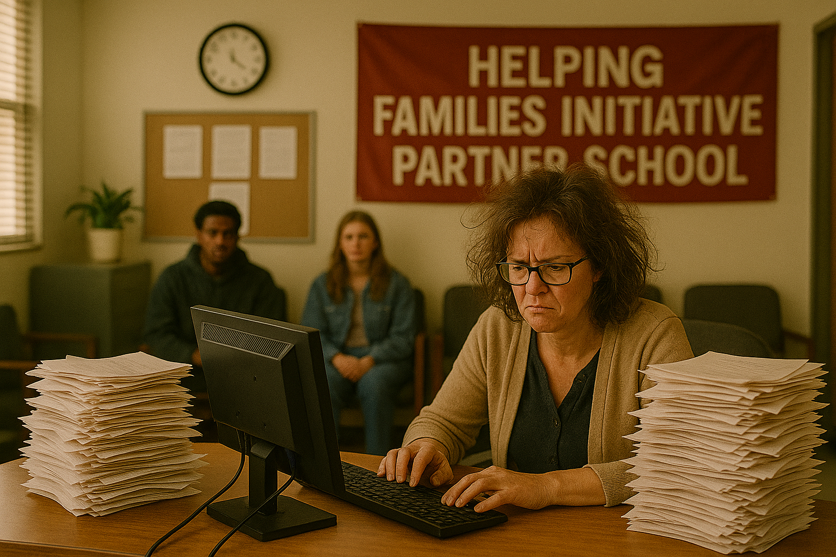
Current Situation
Attendance clerks at the school level are responsible for entering absences and excuses into PowerSchool.
Expectation: Data should be entered within one week of receiving a student excuse.
Reality: Data entry is often delayed by several weeks or even months.
Notes:
Attend school events: Participating in events like plays, sporting events, or parent-teacher conferences shows you are invested in the school's success.
Volunteer your time or talents: Offer to help with school activities, classroom support, or fundraising efforts.
Join school organizations: Becoming part of parent groups like the PTA or a school council allows you to contribute to school decisions and initiatives.
Offer support during challenging times: Reach out to staff members when they face difficulties, offering a listening ear or practical help.

Slide 4

How Do We Solve This Issue?
Cultivate the Relationship
Help Your Partner Help You

Slide 5

Relationships
Establish a Sense of Basic Trust
Notes:
A sense of basic trust if a fundamental cornerstone of every relationship. Without trust, a relationship cannot progress to the higher levels of autonomy, initiative, identity, Intimacy, generativity, or integrity

Slide 6

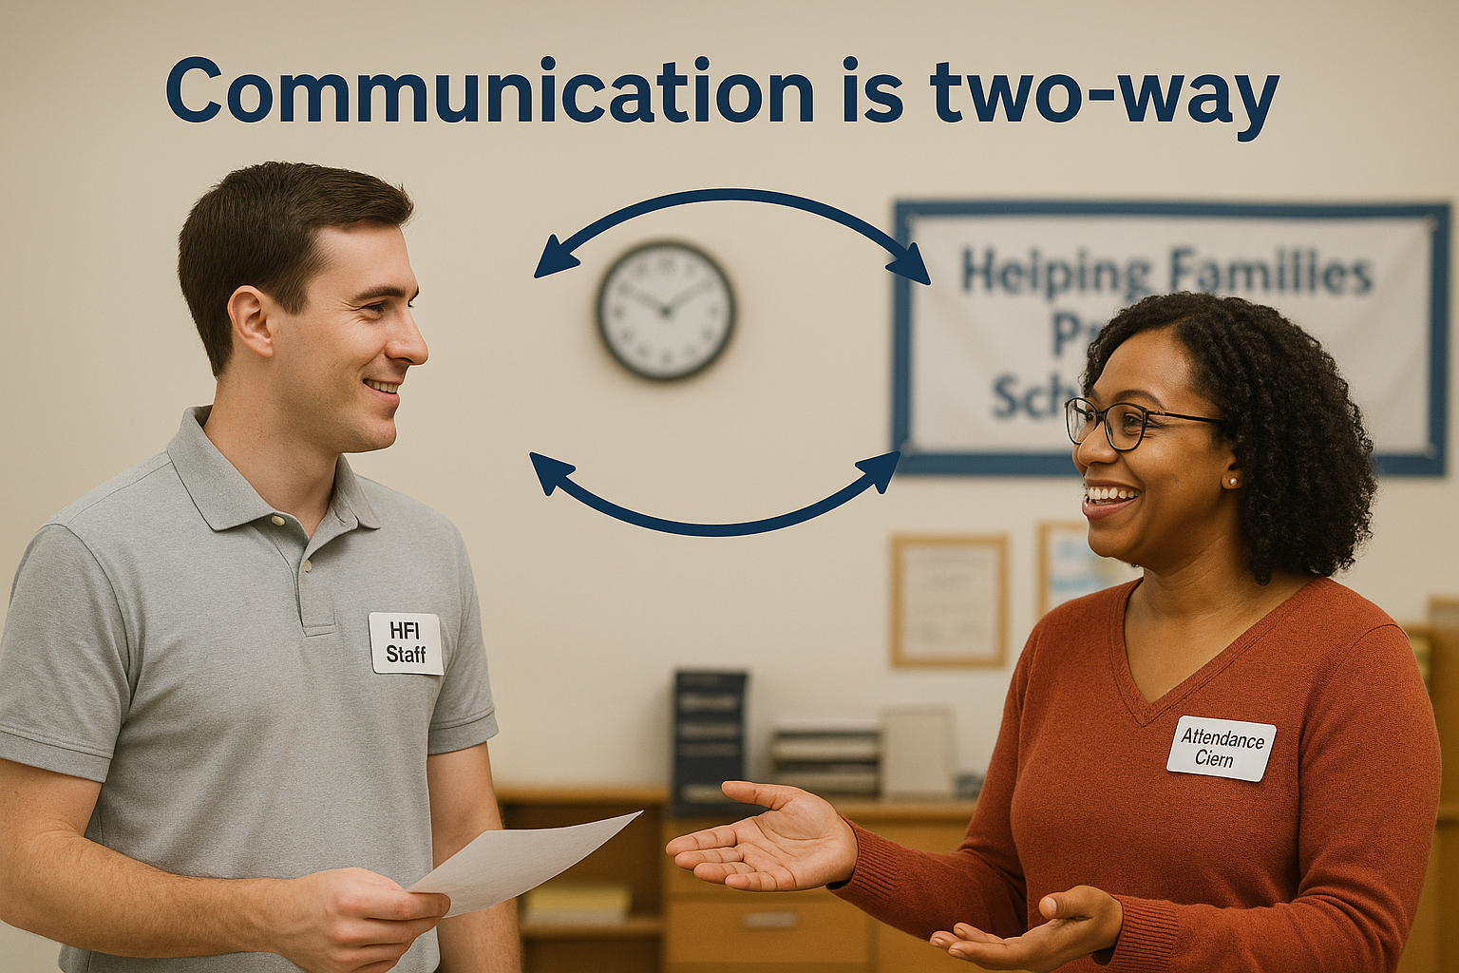
Communicate Openly and Regularly
Proactively ask school staff and administrators about their preferred methods and times for communication (e.g., email, phone calls, in-person meetings).
Notes:
Establish consistent and transparent communication channels. Be approachable, listen actively to concerns and feedback, and provide clear and consistent updates on what is happening in the school or with a particular student. Consider proactively asking about communication preferences and sticking to them. This openness fosters trust and minimizes misunderstandings,
Prioritize open and frequent communication Establishing clear communication channels and actively using them can build trust and understanding.
Establish communication preferences: Proactively ask teachers and administrators about their preferred methods and times for communication (e.g., email, phone calls, in-person meetings).
Communicate regularly: Share updates on student progress, achievements, and challenges, and encourage teachers to do the same.
Practice active listening: During conversations, give your full attention, ask clarifying questions, and show empathy to ensure you understand their perspectives.
Address concerns directly and constructively: When issues arise, approach the conversation calmly, focus on finding solutions together, and avoid blame.

Slide 7
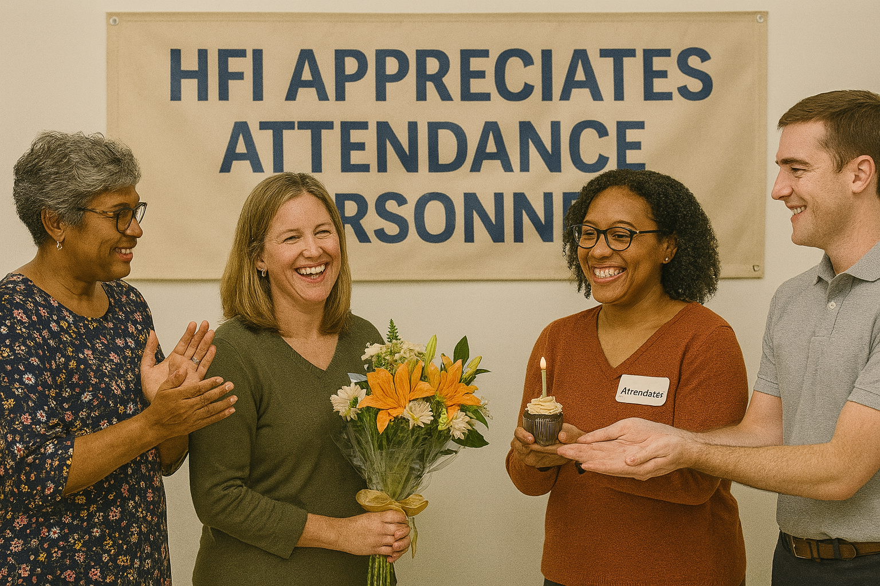
Show appreciation and recognition
Acknowledge the hard work and dedication of school staff. Express gratitude for their efforts, whether verbally, through thank-you notes, or by recognizing their contributions publicly or privately. Showing appreciation boosts morale and demonstrates that their efforts are valued and appreciated.
Notes:
Acknowledge the hard work and dedication of school staff. Express gratitude for their efforts, whether verbally, through thank-you notes, or by recognizing their contributions publicly or privately. Showing appreciation boosts morale and demonstrates that their efforts are valued and appreciated,

Slide 8

Collaborate and Share
View school staff as partners.
Actively seek opportunities to collaborate and cooperate.
Involve them in decision-making processes. For example, sharing successes, seeking input on new initiatives, or working together to address challenges fosters a sense of teamwork and shared purpose.
This collaborative approach builds trust and demonstrates that you value their expertise and insights.
Notes:
View school staff as partners in education and actively seek opportunities to collaborate and cooperate. Involve them in decision-making processes, especially those that directly impact them or students. For example, sharing successes, seeking input on new initiatives, or working together to address challenges fosters a sense of teamwork and shared purpose. This collaborative approach builds trust and demonstrates that you value their expertise and insights.

Slide 9

Engage in the School Community
Attend school events
Volunteer your time or talents
Offer support during challenging times
Notes:
Attend school events: Participating in events like plays, sporting events, or parent-teacher conferences shows you are invested in the school's success.
Volunteer your time or talents: Offer to help with school activities, classroom support, or fundraising efforts.
Join school organizations: Becoming part of parent groups like the PTA or a school council allows you to contribute to school decisions and initiatives.
Offer support during challenging times: Reach out to staff members when they face difficulties, offering a listening ear or practical help.

Slide 10
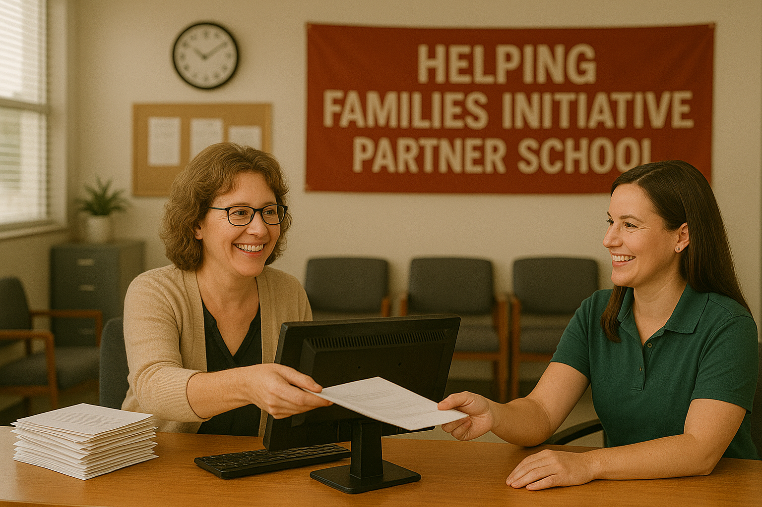
Mission Accomplished

Slide 11
Helping Families Initiative
Best Practices for Timely Data
Summer Conference 2025
Birmingham, Alabama

