Slide 1

Helping Families Initiative
Legislative Requirements for HFI
Summer Conference 2025
Birmingham, Alabama

Slide 2
Our Goal:
Focused student, family, and neighborhood interventions that prevent crimes BEFORE anyone suffers
Fair, prompt prosecution under the law AFTER crimes are committed
Support for Alabama’s students and educators
Making Life Better for ALL Alabama Citizens
Helping Families Initiative
Summer Conference 2025
Birmingham, Alabama

Slide 3
Our Promise:
Required by Alabama’s Mandatory School Attendance Act.
Education may well be the single best crime prevention technique ever invented
Helping Make Alabama’s Education Laws Benefit Everyone
Helping Families Initiative
Summer Conference 2025
Birmingham, Alabama

Slide 4
Our Compelling Focus:
The compelling Focus contains only a partial list of our customers.
There are many more.
The Compelling Focus motivates us as we think about all of our customers and what they need and what we can deliver
We help students, their families, district attorneys, service agencies, and businesses demonstrate that the benefits of Alabama’s education laws are for everyone.
Helping Families Initiative
Summer Conference 2025
Birmingham, Alabama

Slide 5

Our Compelling Focus Questions:
How does this action, attitude, thinking, or decision make Alabama’s laws benefit everyone?
Who are our customers and partners?
What are their specific benefits?
This Photo by Unknown Author is licensed under CC BY-NC
Helping Families Initiative
Summer Conference 2025
Birmingham, Alabama

Slide 6
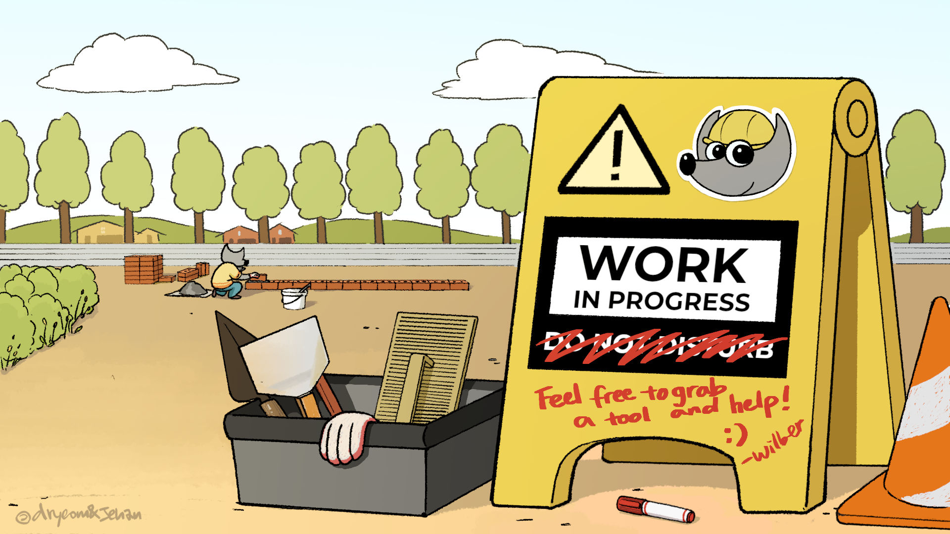
Objective 1
Increase the number of schools, school systems, students, and families served in each participating Circuit by 50% by the end of the School Year 2024-2025.
This Photo by Unknown Author is licensed under CC BY-SA
Helping Families Initiative
Summer Conference 2025
Birmingham, Alabama

Slide 7

Objective 2
Develop, install, adjust, troubleshoot, and implement our new Case Management by August 15, 2024. All Team Leaders and Case Officers must demonstrate their individual proficiency with the new Case Management System by August 15, 2024. All future Team Leaders and Case Officers must demonstrate their proficiency with the new Case Management System withing two weeks of their employment.
Helping Families Initiative
Summer Conference 2025
Birmingham, Alabama

Slide 8
Objective 3
Establish and improve the effectiveness of Helping Families Initiative Inter-Agency Teams in every participating circuit by September 30, 2024.
This Photo by Unknown Author is licensed under CC BY-SA
Helping Families Initiative
Summer Conference 2025
Birmingham, Alabama

Slide 9
Objective 4
All Helping Families Initiative Teams begin using Accomplishment Reports and filing them with the State Team every month, effective immediately.
Helping Families Initiative
Summer Conference 2025
Birmingham, Alabama

Slide 10
Objective 5
Establish a new financial reporting system beginning immediately, and a new distribution of funds system beginning October 1, 2024
Helping Families Initiative
Summer Conference 2025
Birmingham, Alabama

Slide 11
Objective 6
Establish measurements necessary to ensure our effectiveness and relevance to all Alabamians and to comply with the provisions of the Fiscal Year 2025 Appropriations Act by August 29, 2024.
Helping Families Initiative
Summer Conference 2025
Birmingham, Alabama

Slide 12


Legislative Requirements
Number of students directly served.
Individual students’ absenteeism rates before and after HFI by school system.
Number of family assessments completed.
Number of students referred to services.
Number of students receiving referral services.
Number of follow-up assessments completed

Slide 13


Data Sources

Slide 14
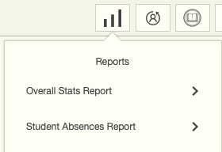
HFI Reports
Circuit Reports
State Reports

Slide 15
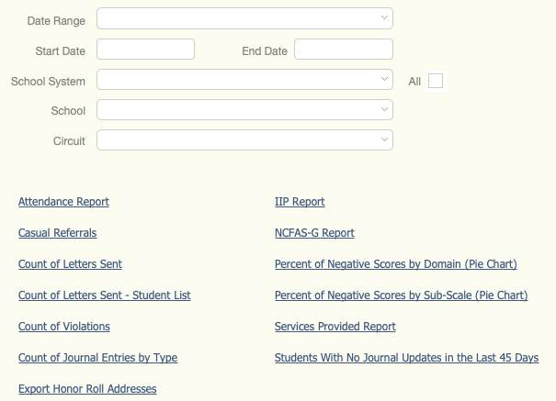
HFI Circuit Reports
Number of students referred to services.
Number of family assessments completed.
Number of follow-up assessments completed
Individual students’ absenteeism rates before and after HFI by school system.
Number of students receiving referral services.
Number of students directly served

Slide 16
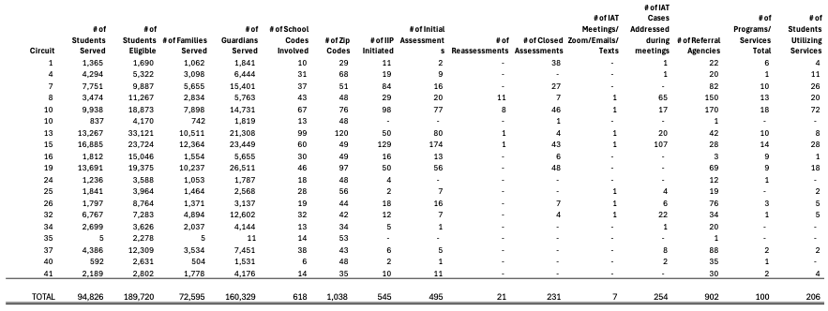
HFI State Report

Slide 17
Helping Families Initiative
Legislative Requirements for HFI
Summer Conference 2025
Birmingham, Alabama

