Slide 1
What Is Proper Farriery?
The use of anatomical reference points
The observation of physiology in statics and dynamics
Trimming for geometrical proportions
The use of shoes to protect and enhance weight bearing
The observation of stance and gait previous and prior to trimming and shoeing

Slide 2
Acknowledgements
Bob Marshall
Mark Milster CJF
Jim Keith
Dr. Mark Caldwell FWCF
Neil Madden FWCF
Mitch Taylor CJF
Werkman USA

Slide 3
Medial – Lateral Spiraling
The need to have a level landing
The need to have a slightly heel-first landing
Conformation dependent

Slide 4


Slide 5
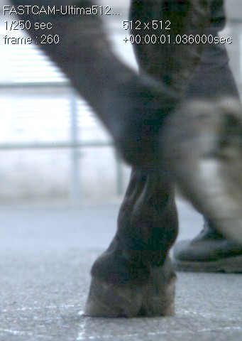
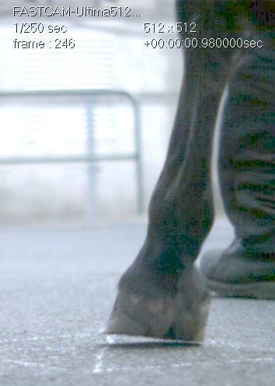
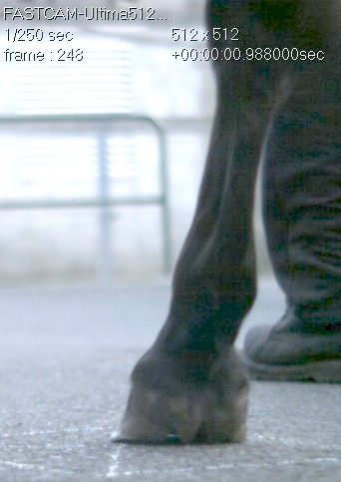
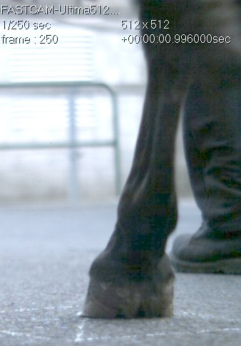
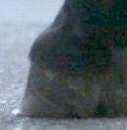
VIDEO ANALYSIS
High speed video analysis at the walk and trot not only confirmed asymmetrical landing loading pattern through the hoof with the right fore impact phase being lateral toe quarter and loading over the medial toe quarter.
It also offers an insight into the comparative movement and strain of soft tissue structures whilst under load in and around the foot as the shock waves reverberate through the limb

Slide 6
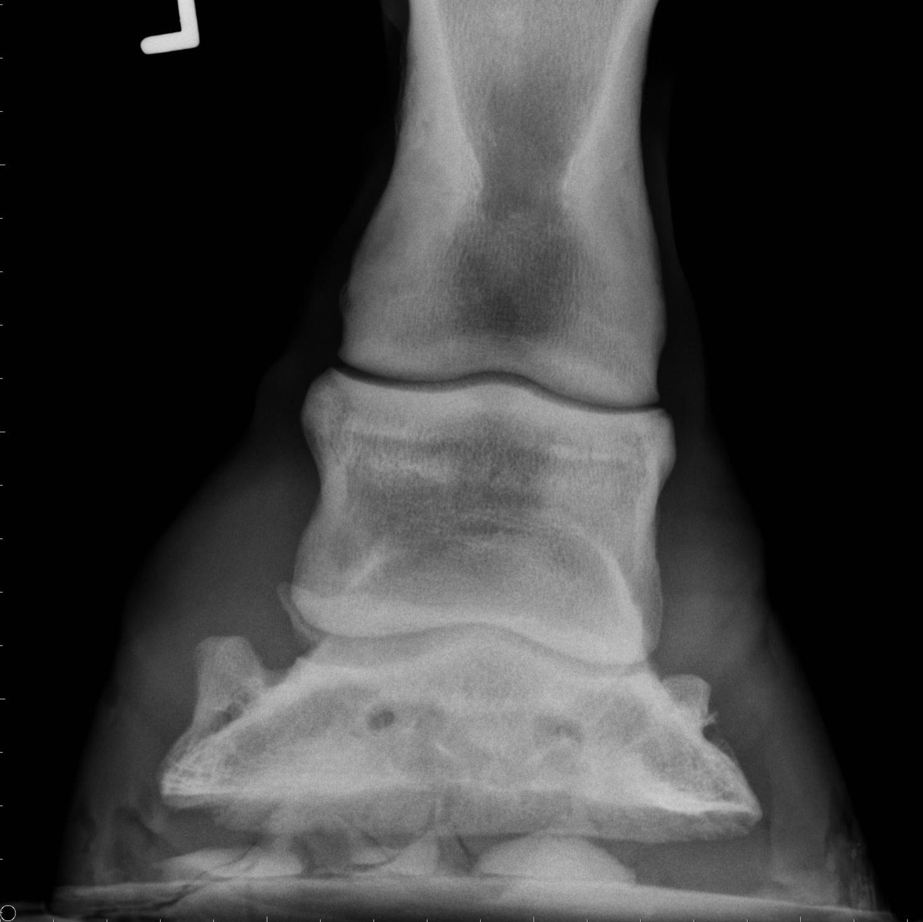
Lateral landing, medial weight-bearing

Slide 7
PHYSIOLOGICAL CONSIDERATIONS
The ground reaction force vector is projected ventral dorso medial oblique causing the medial heel bulb to sheer.
The stresses of the resultant torque forces (ACTION / REACTION) over the medial hoof capsule during the loading and stance phases lead to increased shear forces causing the foot to spin around the original point of load.

Slide 8

Three dimensional peak force contours synchronised with high speed video footage
mid stance with peak forces at medial and lateral toe quarter. Contrary to expectations the medial did not experience peak forces of the magnitude illustrated at the medial toe
peak load toe quarter as the hoof flipping over to the medial toe
1st strike,

Slide 9
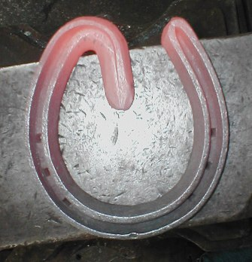
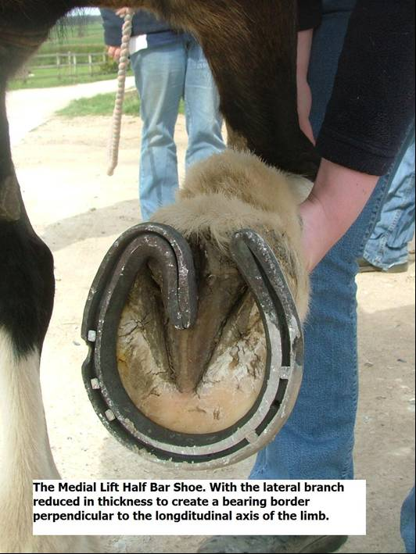
THEORETICAL CONSIDERATIONS
The direction of the frog piece and the position of the heel of the shoe mimic the heel buttress / bar interface.
When applied the last weight bearing points of the shoe are artificially adjacent to the widest point of the frog (Duckett 1990).
The half bar is fitted so that it does not extend beyond the limits of the trimmed frog, and follows the trajectory of the collateral sulci and bar which it replaces (Chapman and Platt 1984).

Slide 10
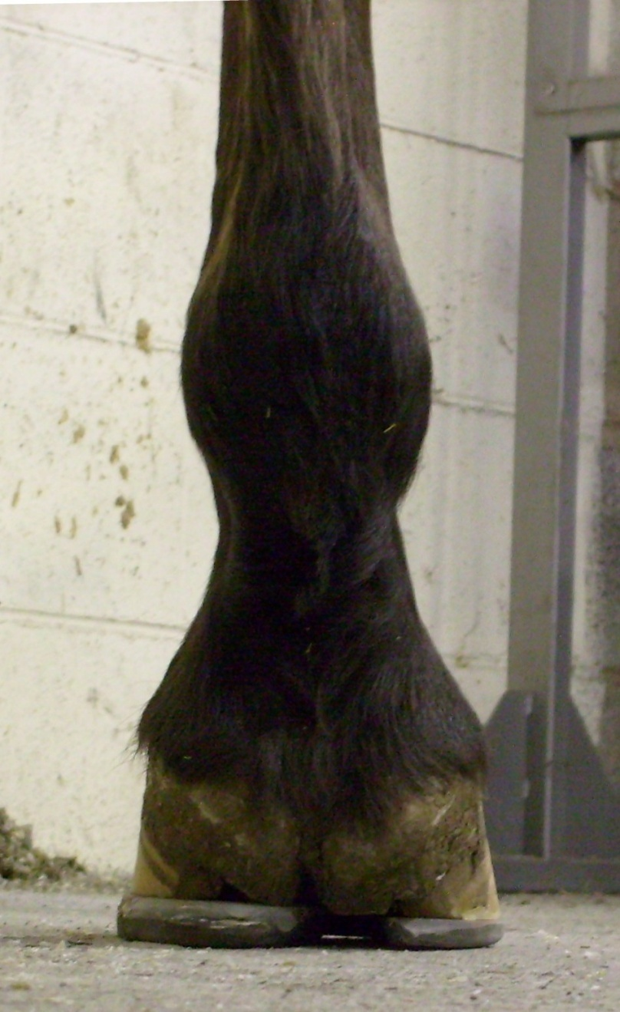
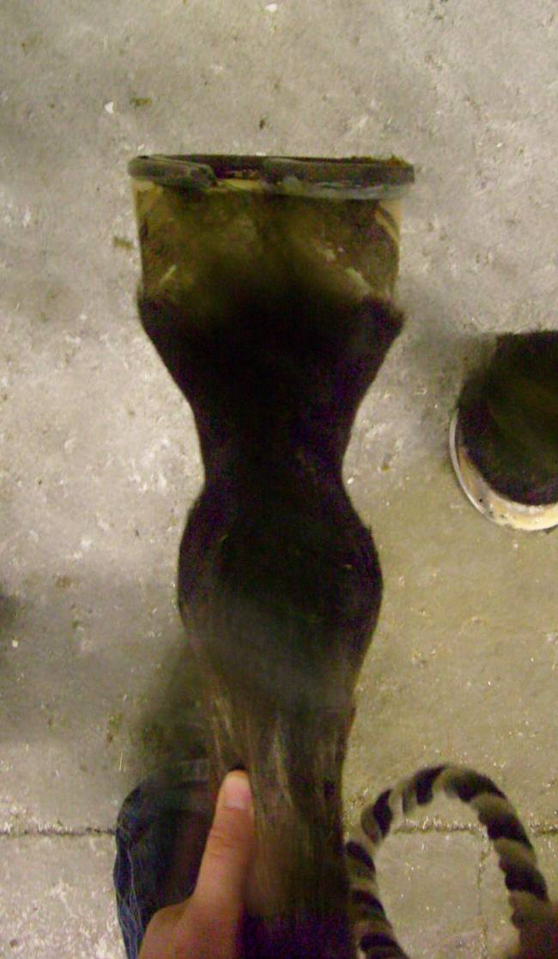
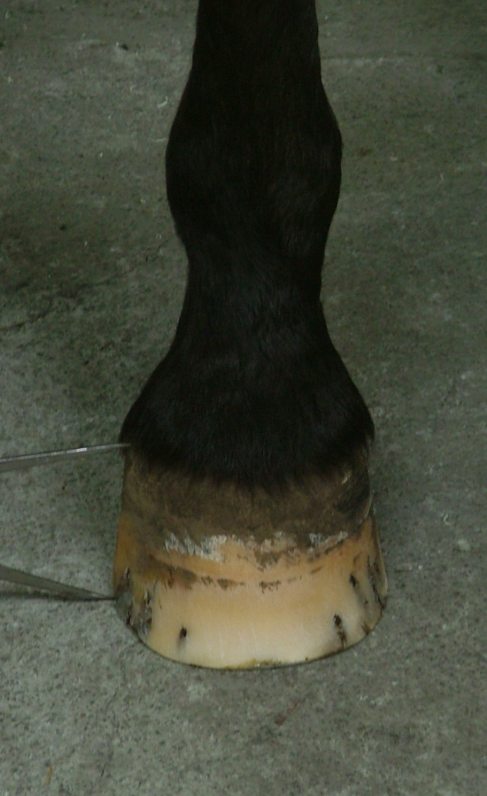
TREATMENT
Treatment was aimed at restoring the longitudinal axis of the limb perpendicular to the ground bearing border of the foot.
The bottom of the foot should mirror image the coronary band.
The object is to place ground bearing border of the foot under the static limb to produce a slight heel-first to level foot fall.

Slide 11
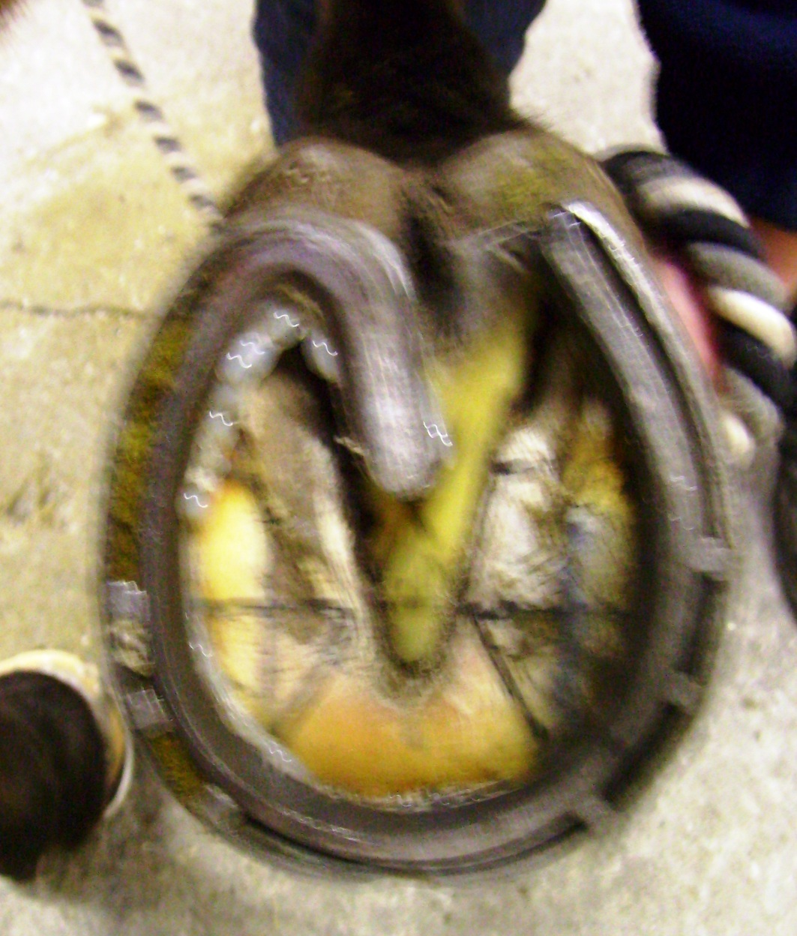
FITTING
The shoe is positioned over the hoof to external reference points identified along the solar margin.
Parallel lines perpendicular from each heel buttress intersect the white line sole junction at point of break over
Diagonal lines projected across the bearing border from heel buttress intersect at or near the centre of rotation
With the longitudinal limb axis centralized within the boundaries of the ground bearing border of the shoe.

Slide 12
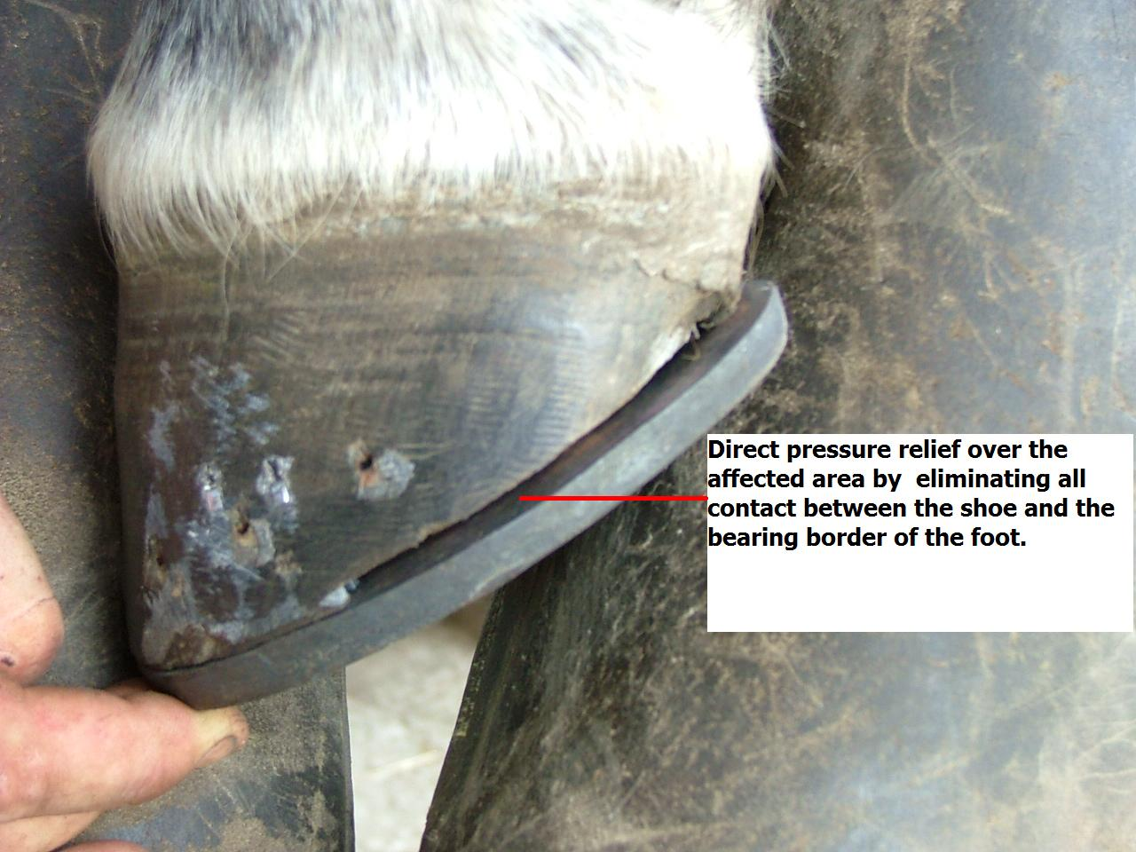
PRESSURE RELIEF
Immediately prior to application a 1/8” gap from medial quarter to heel buttress was fashioned using hoof nippers in order that there would be no direct loading of the medial heel horn,
This load being transferred to the shoe branch via positive contact of the forged frog plate in the half bar shoe.

Slide 13
RESULTS
Pre and Post Treatment peak force Vs time line 2 dimensional contour graphs.
Peak force is calculated at point on the time line 0.04, 0.08 and 0.4 seconds representative of 1st load through mid stance.
At mid stance peak force is reduced 67.7% with peak pressure reduced by 74.5% around the toe region and 45% through the heel region

Slide 14
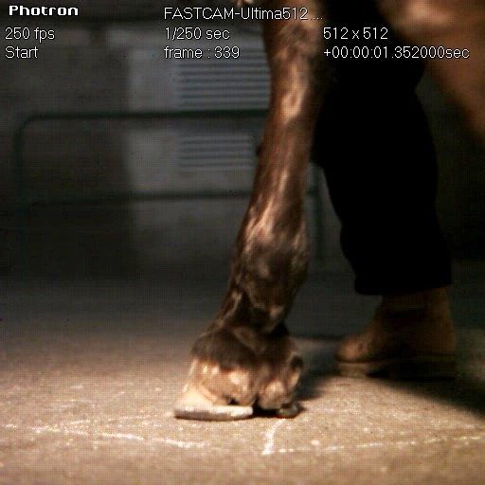
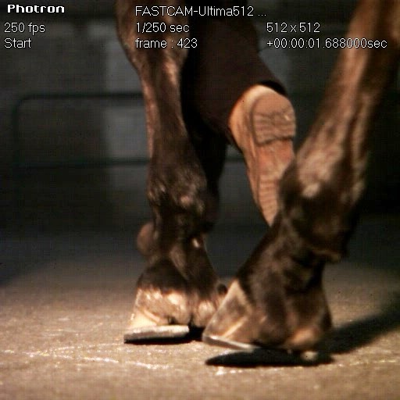
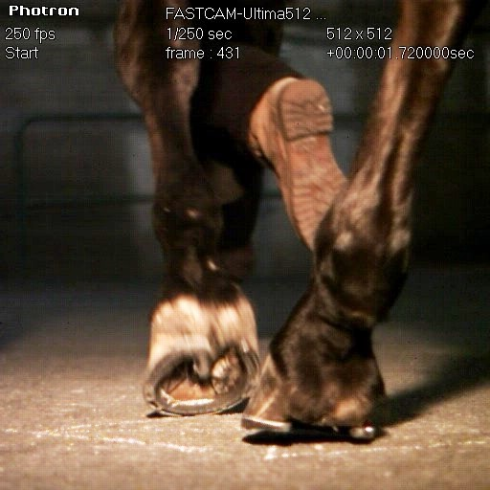
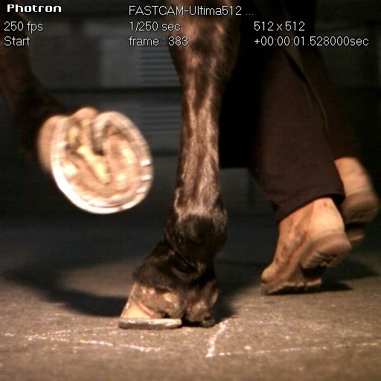
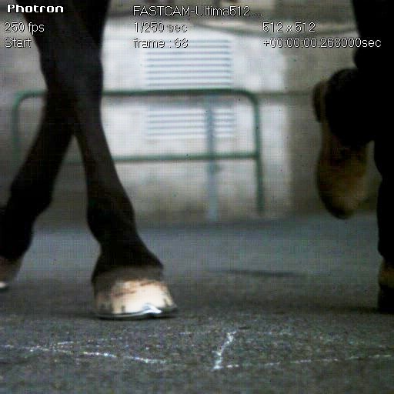
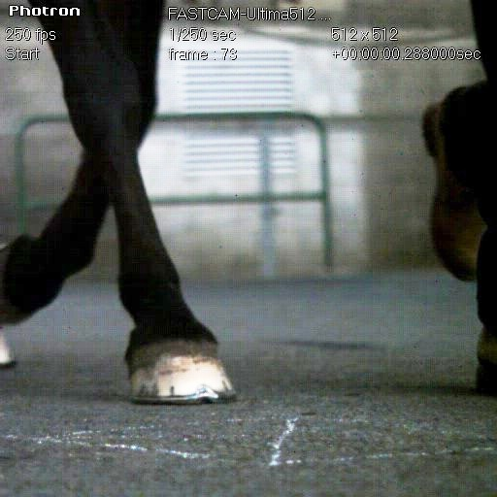
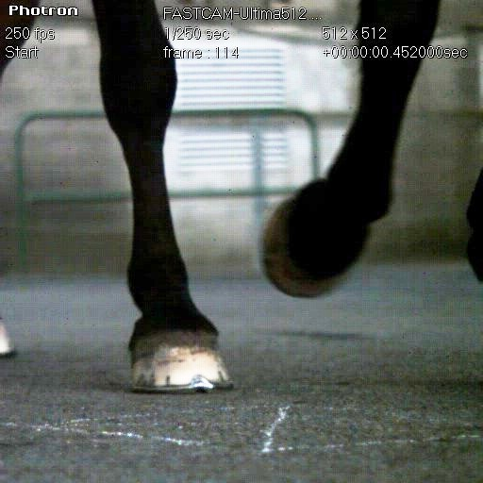
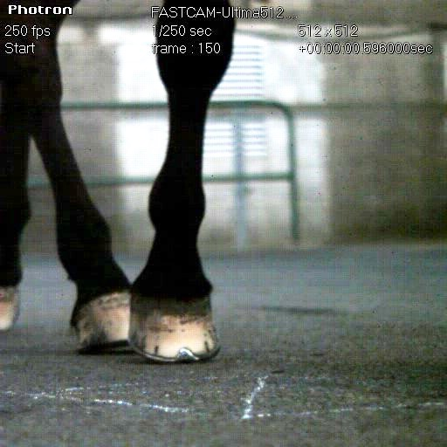
Immediately post-shoeing the horse was re-evaluated for heel-first to near level foot fall, with consideration taken into account for muscle memory.
Re-evaluated 10 days post shoeing when all lameness had been abolished. Remains in full work at this time.

Slide 15
Dorsal-palmar/plantar considerations
Historical perspective
Correct palmar angles
Functional anatomy of the foot as an arch
Phalangeal alignment
Bone remodeling considerations
Phalangeal alignment through mechanics
Phalangeal alignment through frog pressure

Slide 16

Historical Perspective
Concept of Strength & Proportion = Functionality
Xenophon 395 B.C. Writing on Horsemanship
Advises the reader on how to buy a good horse, and highlights conformation traits that are more suited to either a war horse or show horse.
“In testing the feet the first thing to examine will be the horny portion of the hoof. For soundness of foot a thick horn is far better than a thin”.
“It is important to notice whether the hoofs are high both before and behind, or flat to the ground; for a high hoof keeps the "frog,“ as it is called, well off the ground; whereas a low hoof treads equally with the stoutest and softest part of the foot alike”,
"You may tell a good foot clearly by the ring," for the hollow hoof rings like a cymbal against the solid earth”.

Slide 17
Historical Perspective
Concept of Strength & Proportion = Functionality
Xenophon 395 B.C..
“The bones above the hoof and below the fetlock must not be too straight.”
“Legs of this type are more liable to become inflamed”.
“On the other hand, these bones must not be too low, or else the fetlock will be abraded or lacerated when the horse is galloped”
“The bones of the shanks ought to be thick, being as they are the columns on which the body rests”;
“they should not be puffed out with veins or flesh; or else in riding over hard ground they will inevitably be surcharged with blood, and varicose conditions be set up”,
Xenophon 395 B.C.

Slide 18
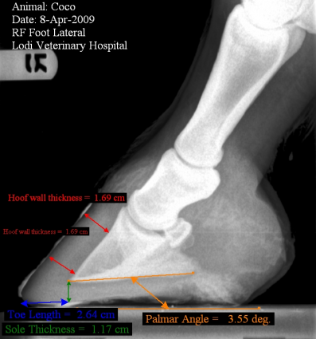
Correct palmar angles

Slide 19
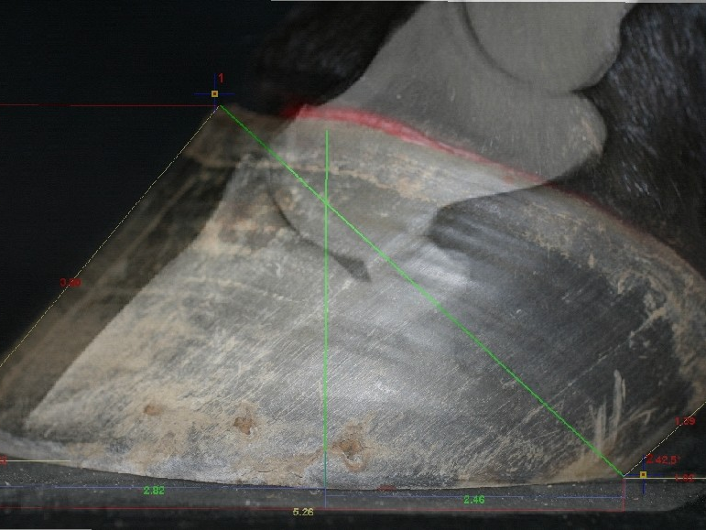
Anatomical Reference Points for Determining Geometric Proportions
Center of Phalanges
Center of rotation
Point of force
Termination of heel

Slide 20
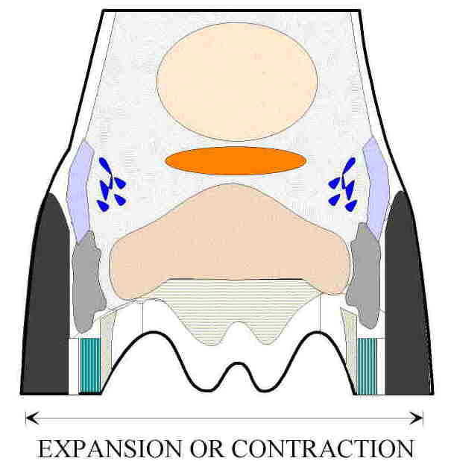
Functional anatomy of the foot as an arch
Horse’s Weight

Slide 21
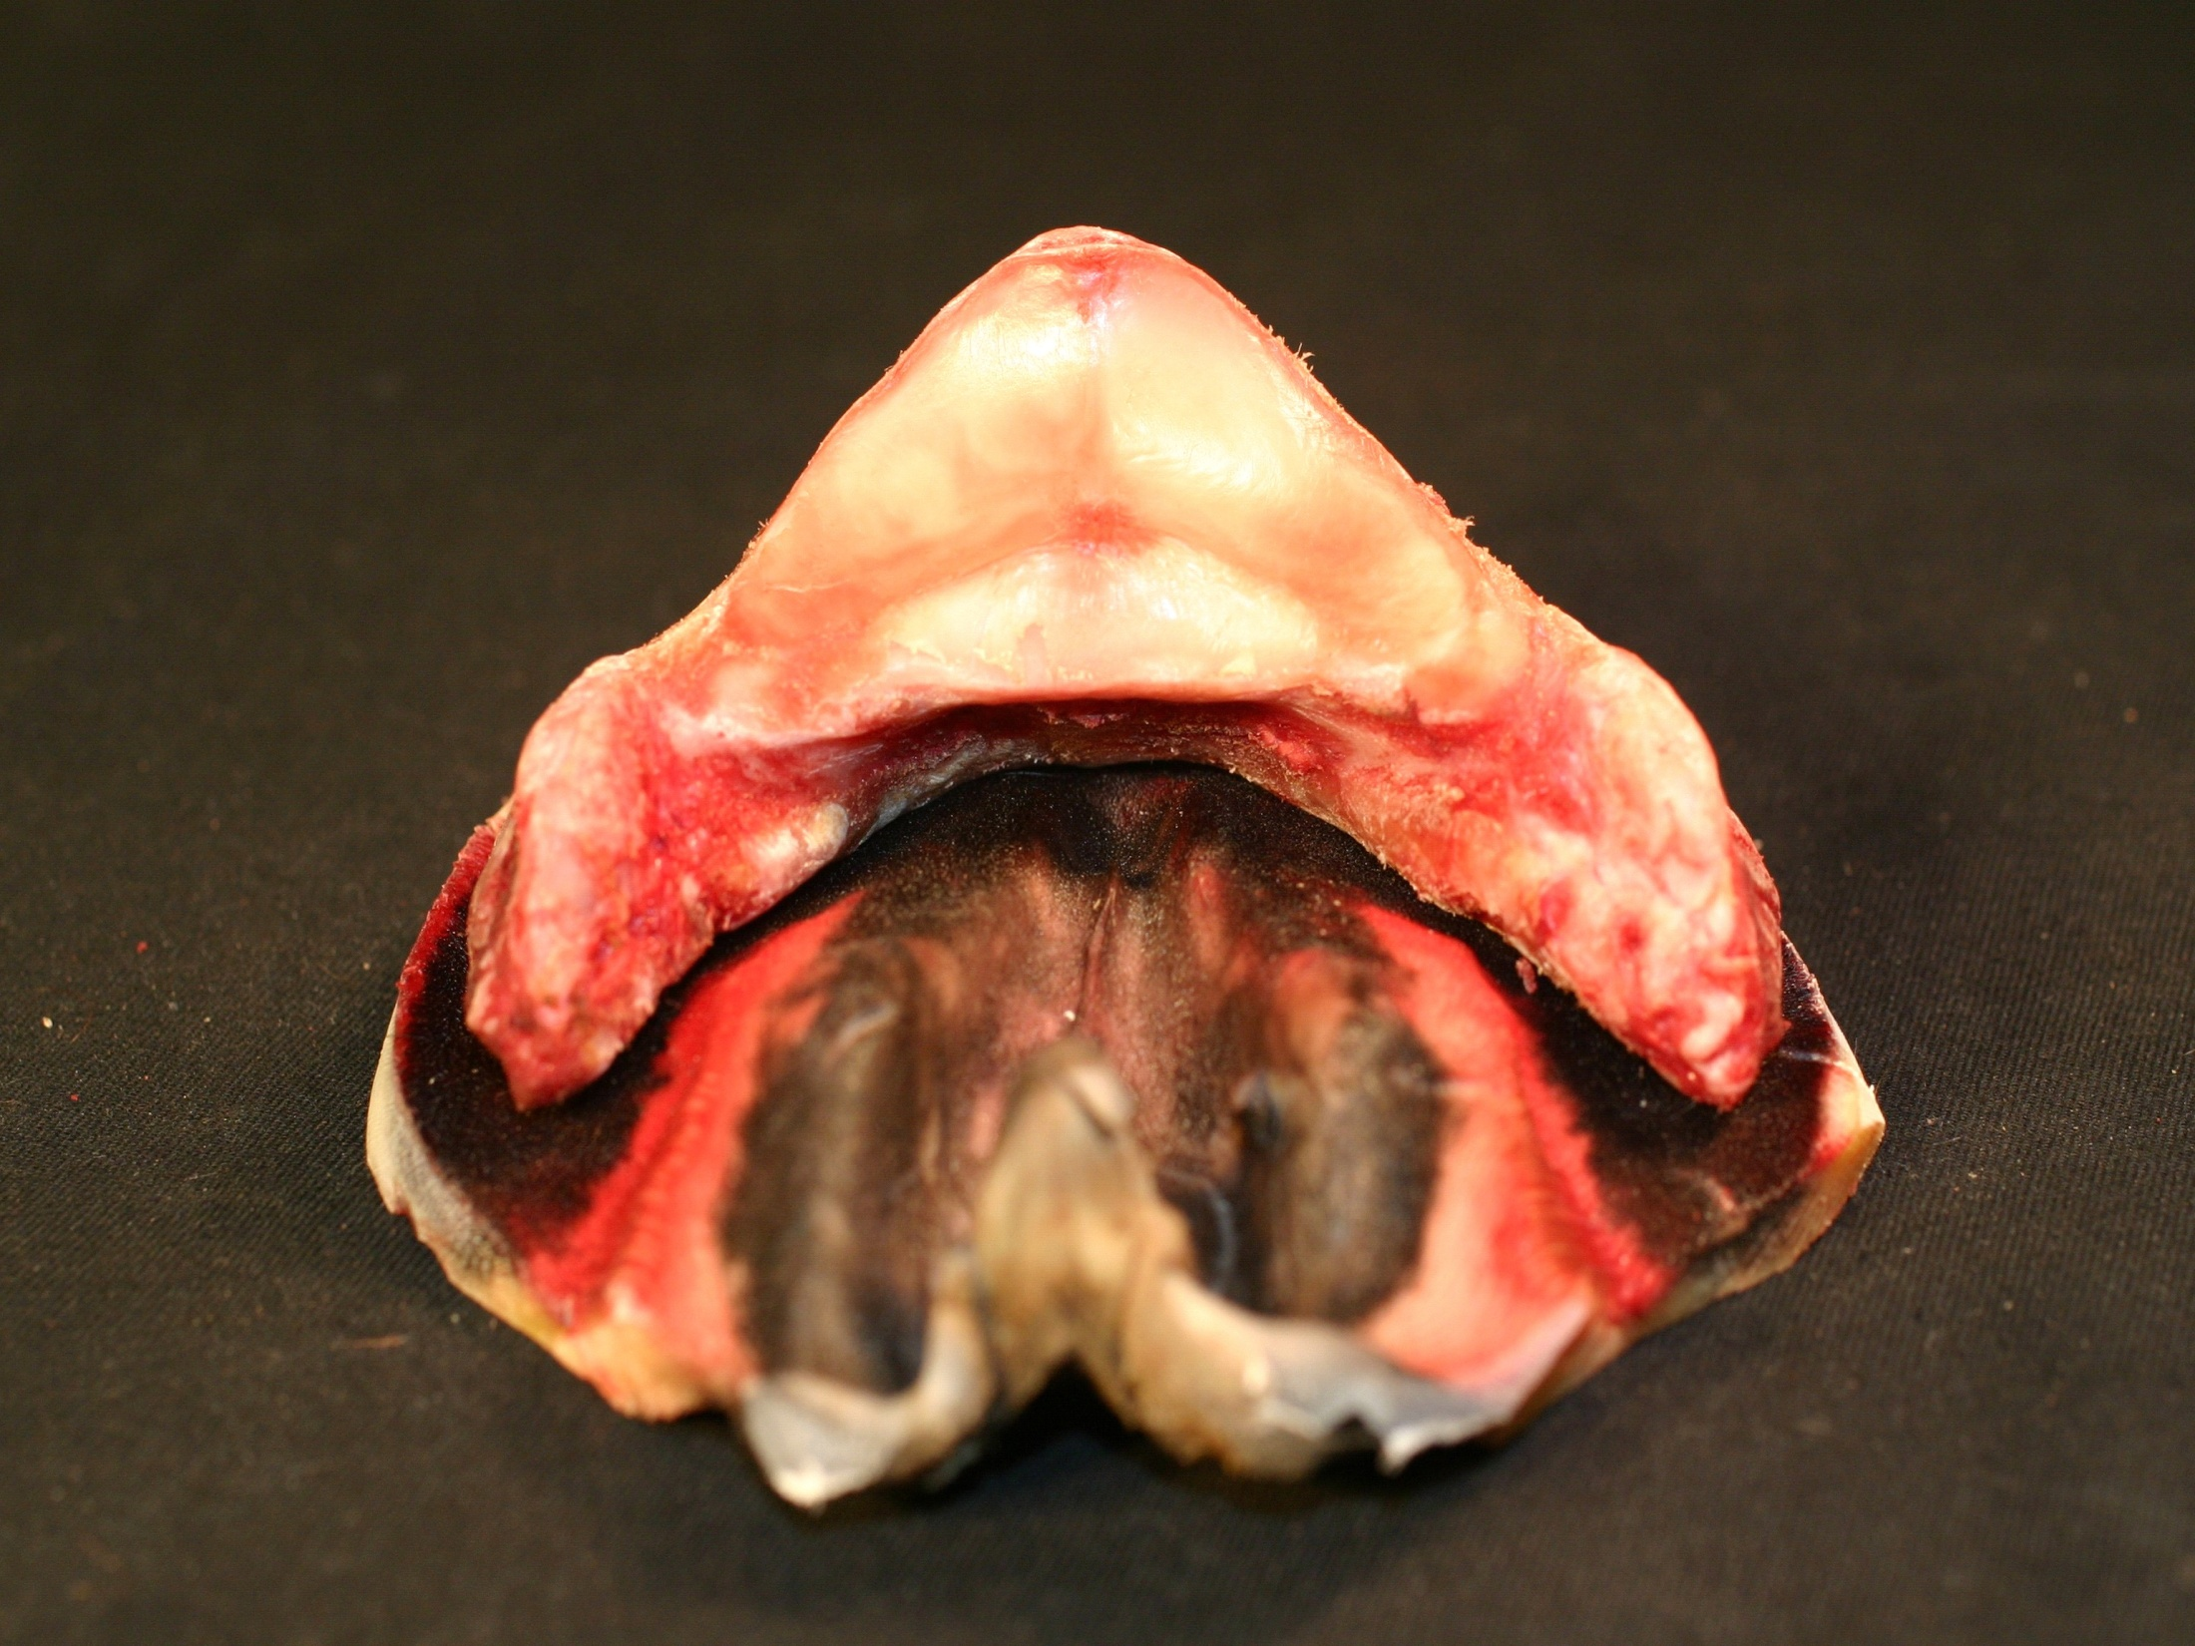
The foot’s functions are influenced by the form and shape of its parts.
Frog Stay – stabilizes the digital cushion during compression
Horse’s Weight
Mitch Taylor

Slide 22
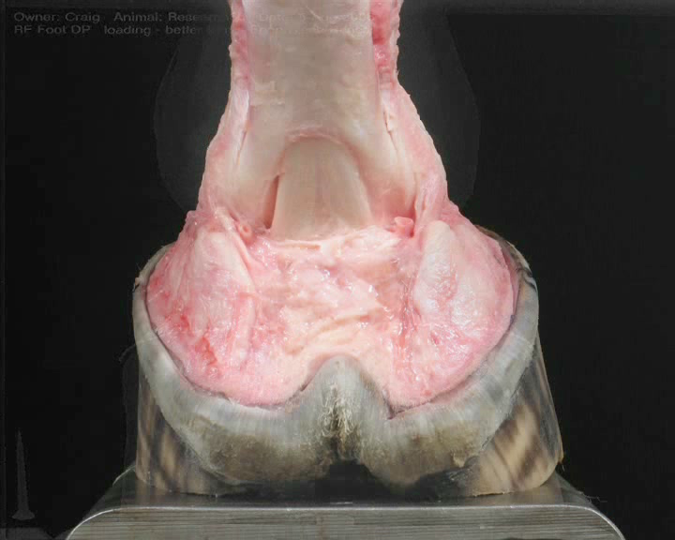
Functional anatomy of the foot as an arch in the loading phase and its influences on the hoof capsule
Notes:
How is ground reaction force absorbed in the hoof capsule?

Slide 24
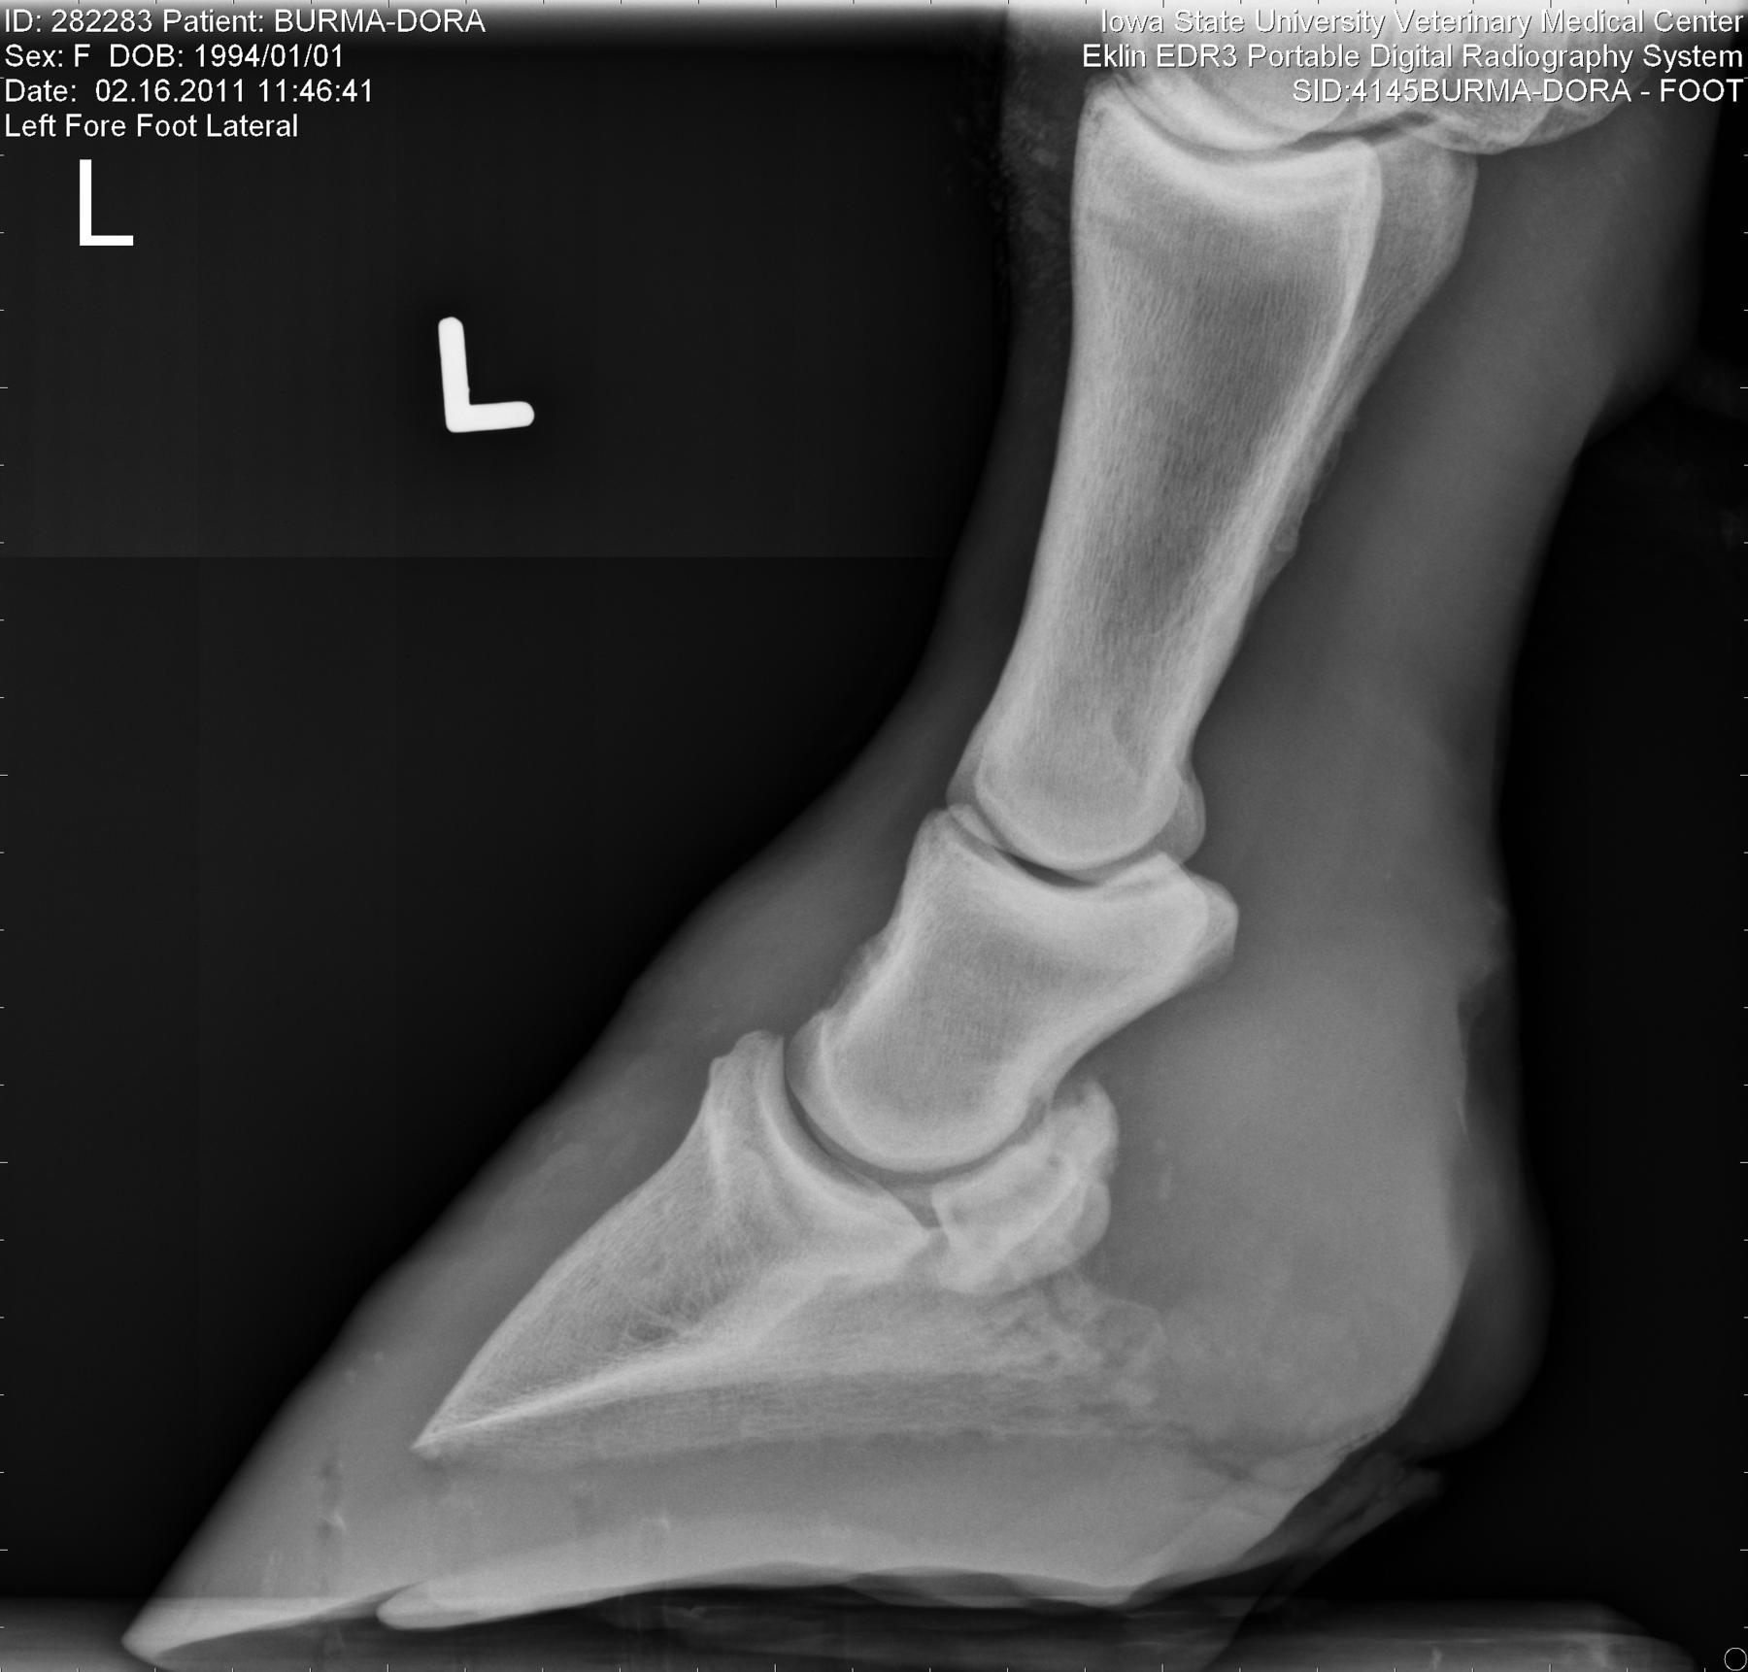
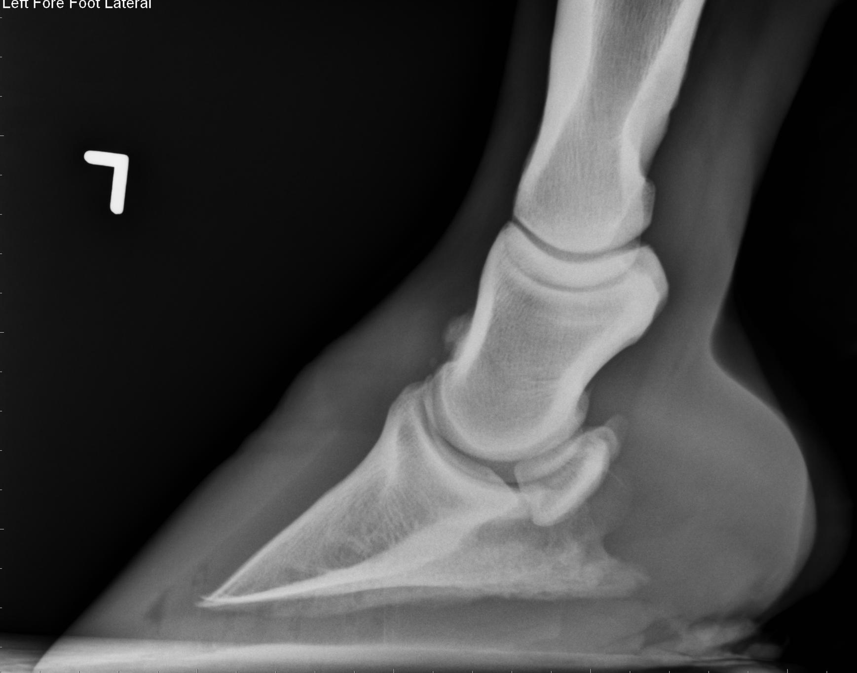
Poor phalangeal alignment with bone remodeling considerations

Slide 25
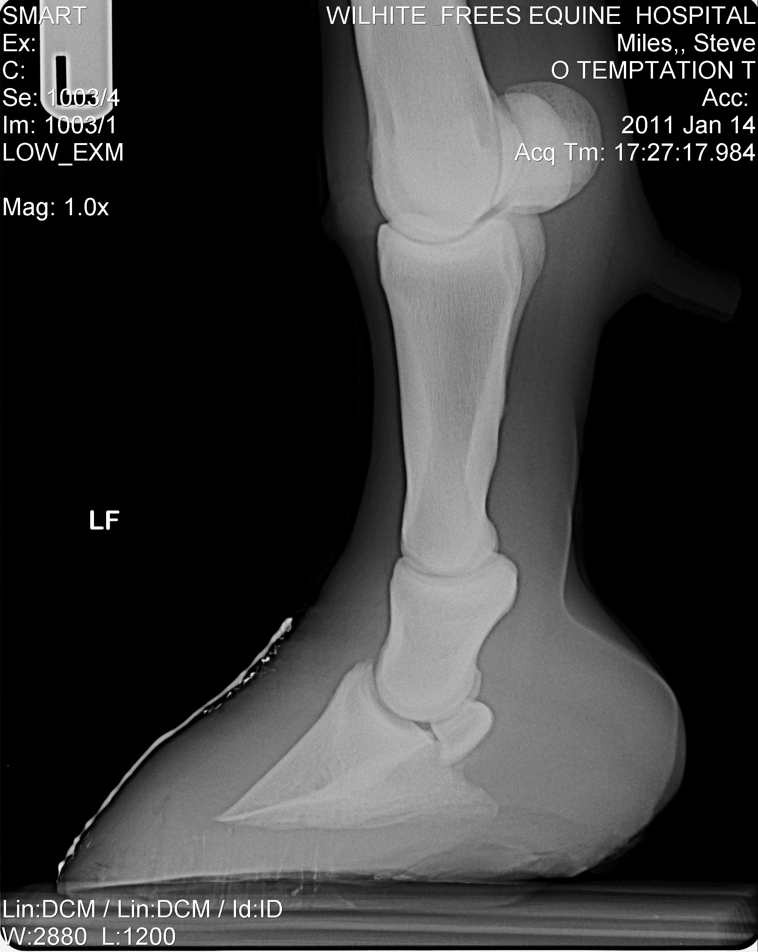
Poor phalangeal alignment

Slide 26
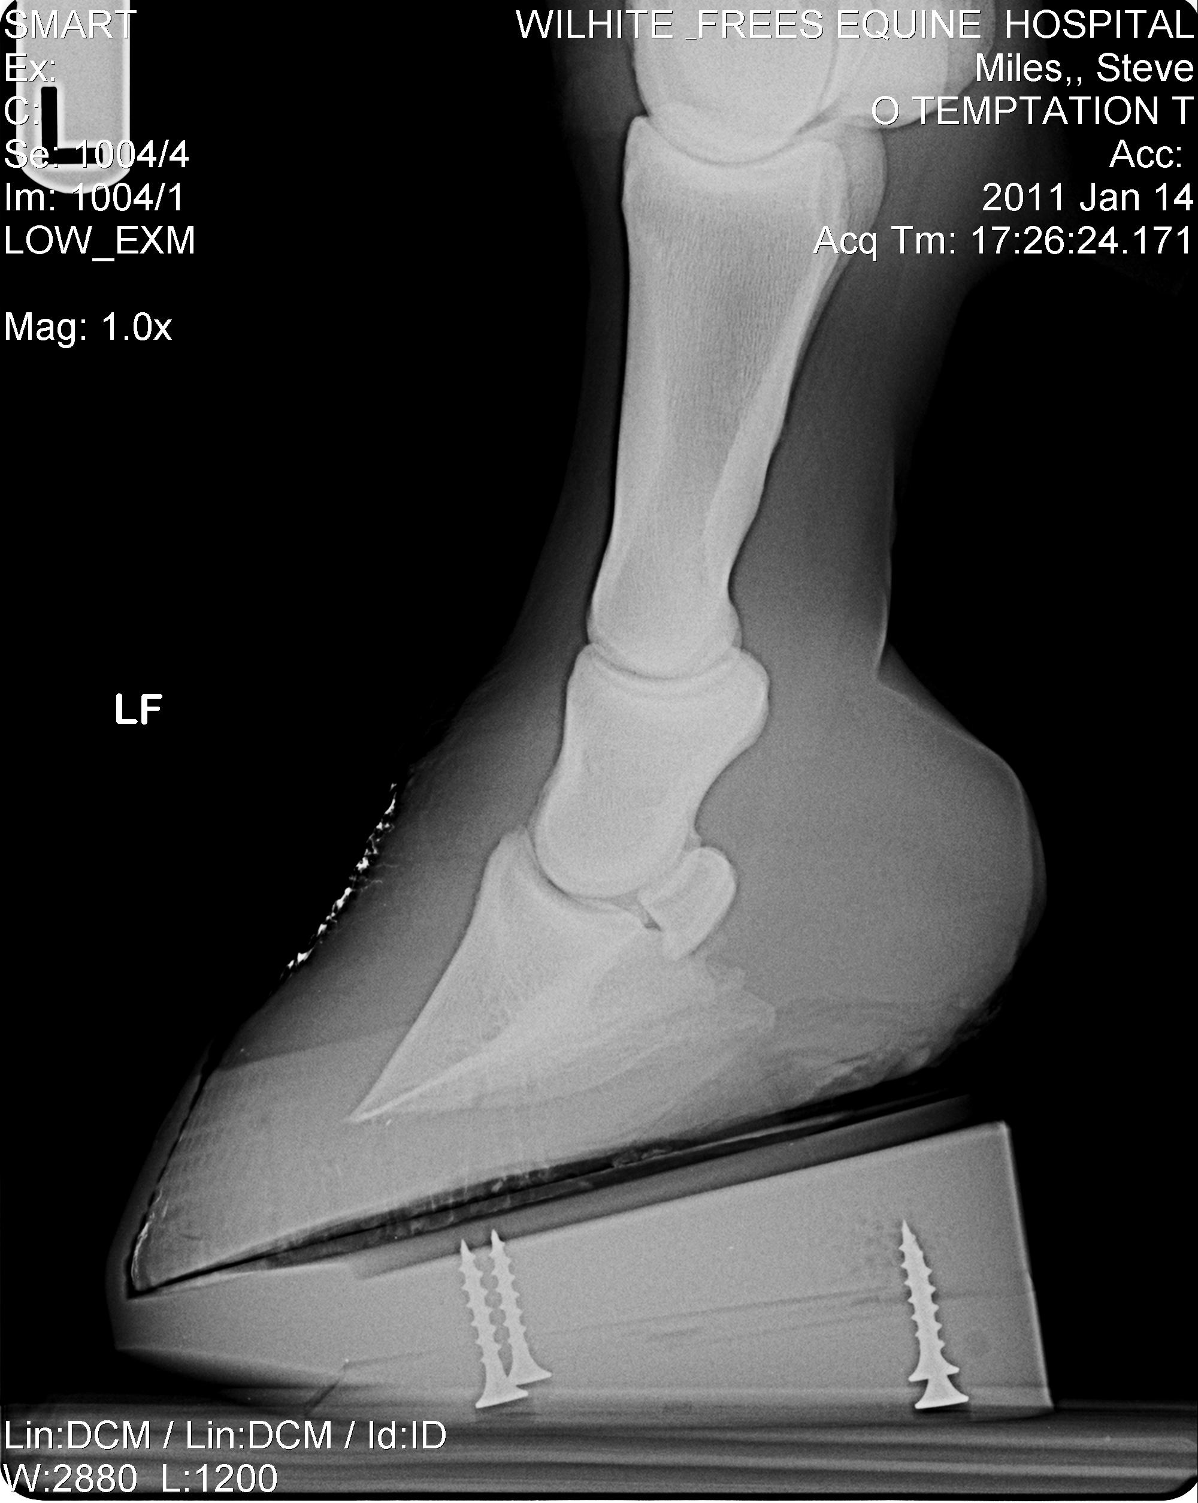
Phalangeal alignment correction through mechanics

Slide 27
Phalangeal alignment correction through frog pressure

Slide 28
Phalangeal alignment correction through frog pressure

Slide 29
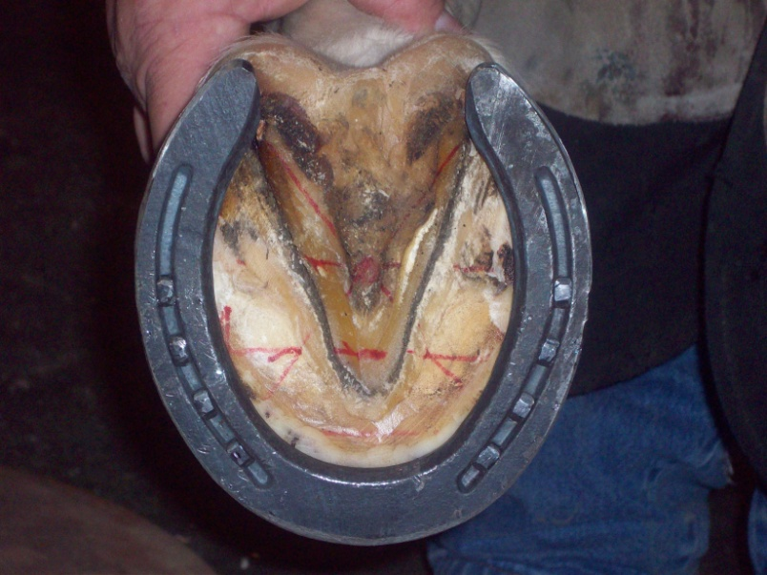
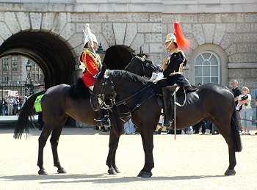
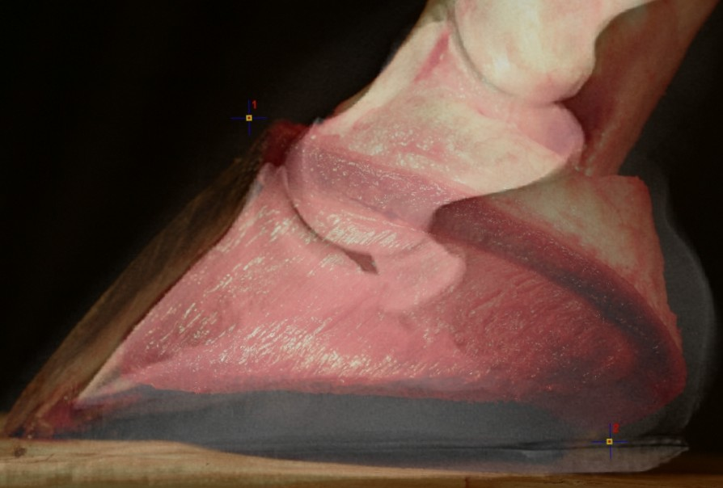
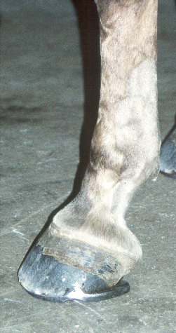
What is proper farriery?
Point of Force
Centre of Rotation

Slide 30
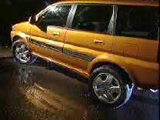

Slide 31
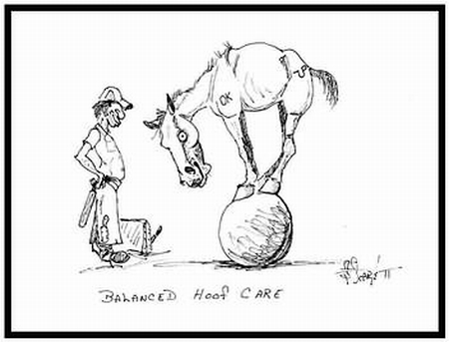
QUESTIONS?

Slide 32
Big thanks to
Mark Caldwell FWCF
Neil Madden FWCF
Bob Marshall AWCF
Mitch Taylor CJF
Scott Lambert OnTrack Equine
Mark Milster CJF
Jim Keith CJF

