Slide 1
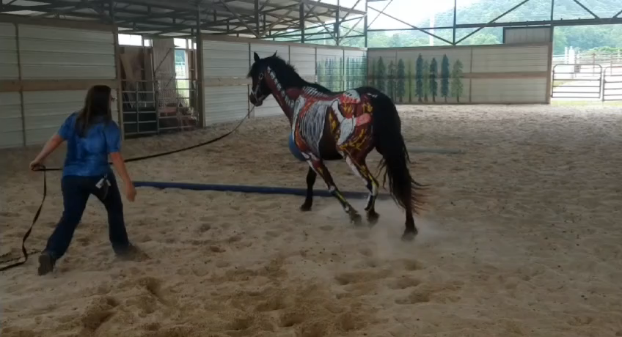
Effects of Gait Before

Slide 2
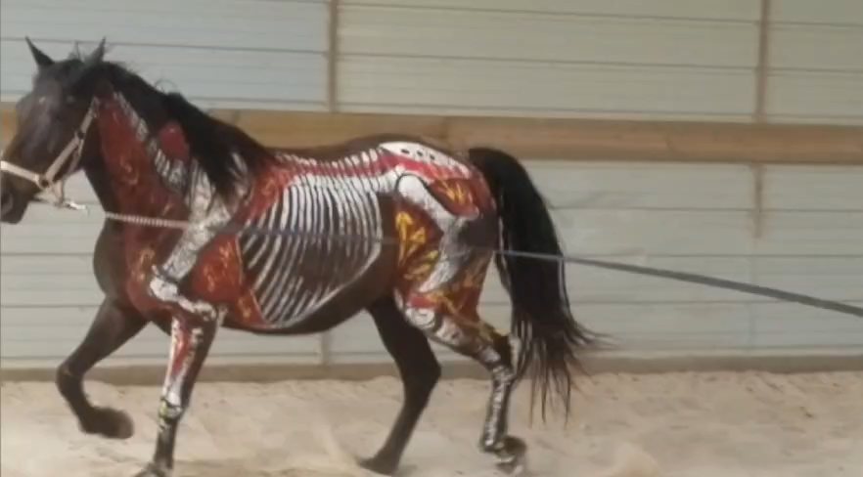
Effects of Gait After

