Slide 1
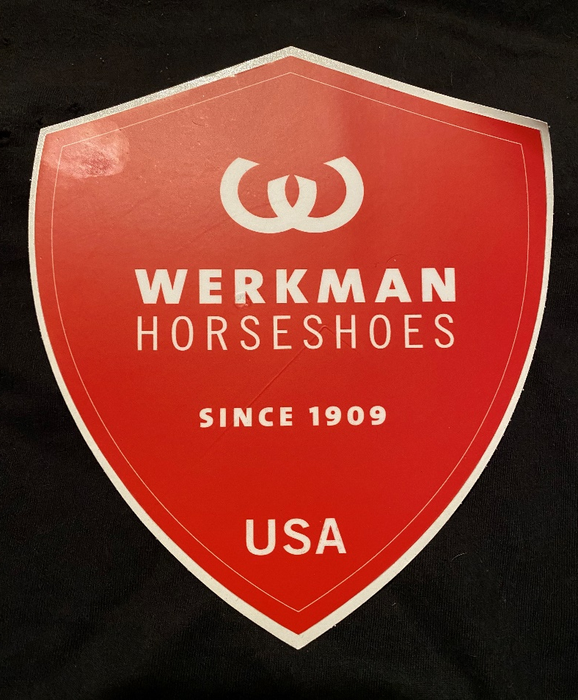


Slide 2
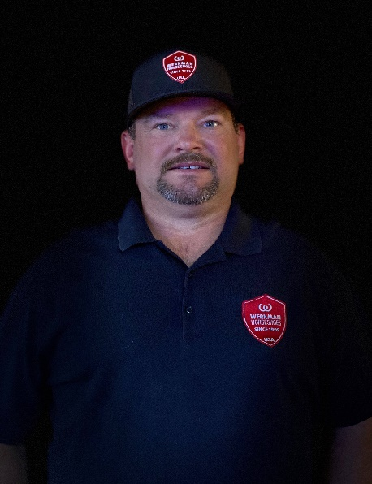
Principles of Trimming Success: Using Geometric Proportions and Spatial Dimensions to Assess Limb Balance for the Equine Foot
Jamey Carsel, CJF

Slide 3
Overview
Anatomical Reference Points
  Hoof and limb assessment
Geometric Proportions
Hoof Balance
How Energy Affects Hoof Balance
How Force Affects the Hoof
Trimming Protocol
  Footfall considerations
  Palmar angle considerations
  Phalangeal alignment considerations

Slide 4
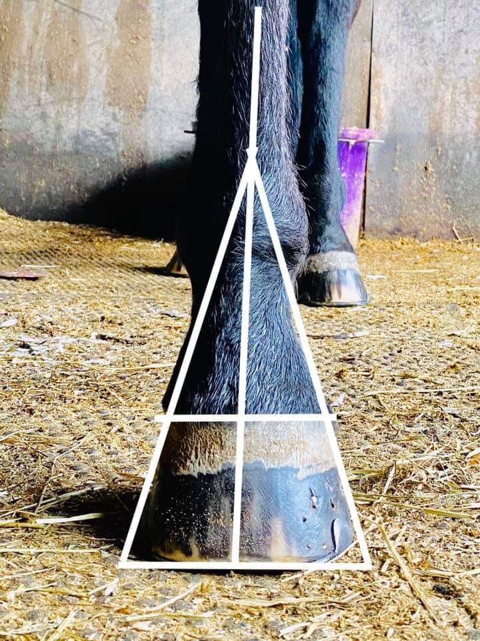
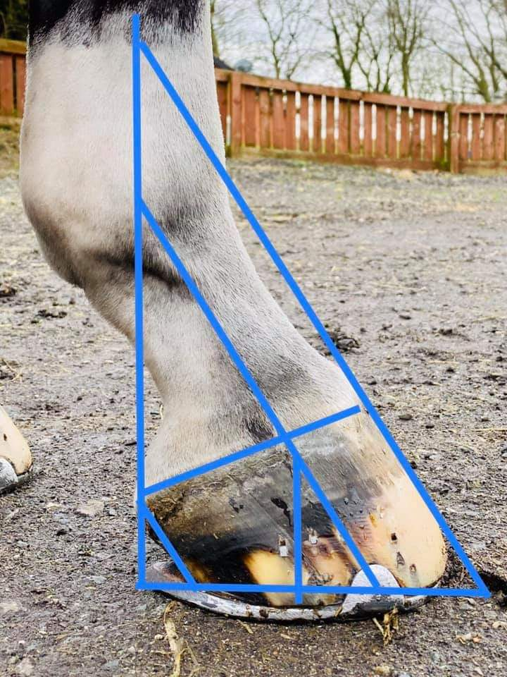
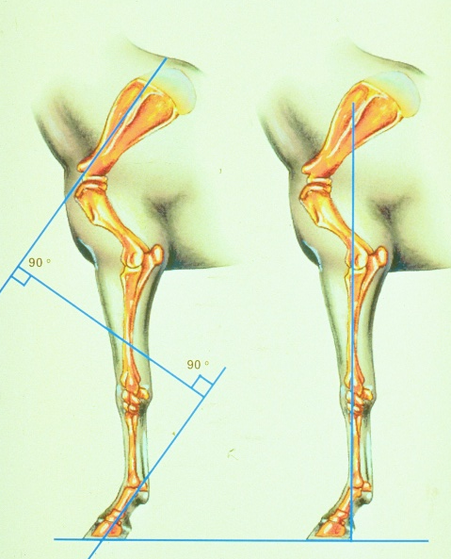
Limb assessment (ideal horse)
Proximal-Distal
Dorso-palmar
Medial-lateral (rotational)

Slide 5
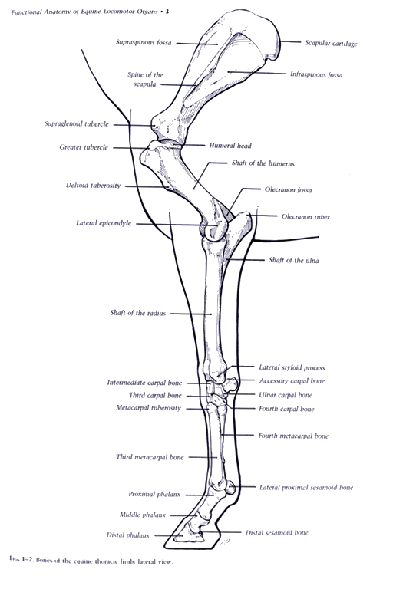
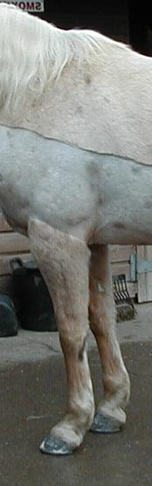
X = Proximal-distal
A plumb line dropped from the midline of the scapula will bisect the joints of the lower limb before passing to the ground just behind the last weight bearing point of the heel.
X
Z
Z
X
Photo by J. Ford RSS

Slide 6
Y= Dorso-palmar
The corresponding pastern angle should mirror the angle formed by the midline of the scapula, as well as the slope of the dorsal hoof wall and palmar heel.
X
Z
Z
X

Slide 7
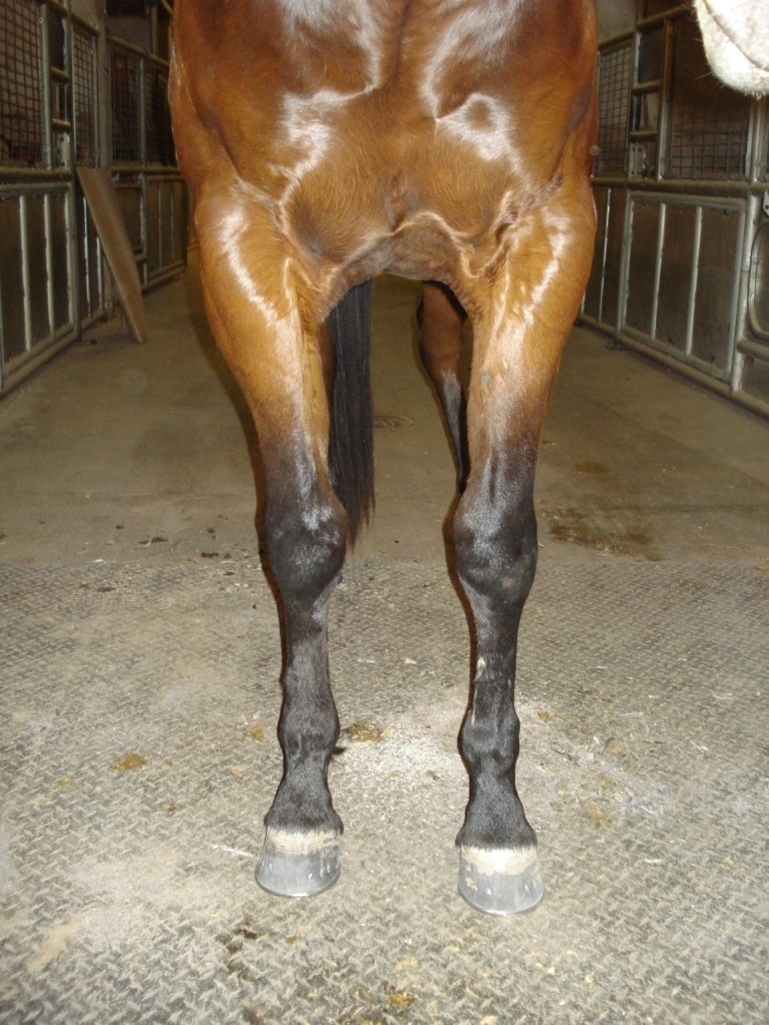
Z = Medio-lateral
A line dropped from the midline of the scapula longitudinally through the midline of the knee should bisect the foot equally. The hairline and the ground-bearing border should be perpendicular.
X
Z
Z
X

Slide 8
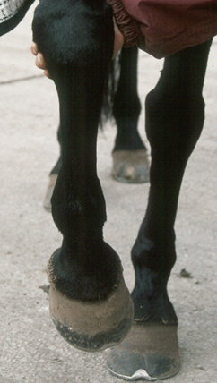
Rotational
Where the hoof rotates axially (in toward the body) or abaxially (away from the body) from its midline.
X
Z
Z
X

Slide 9
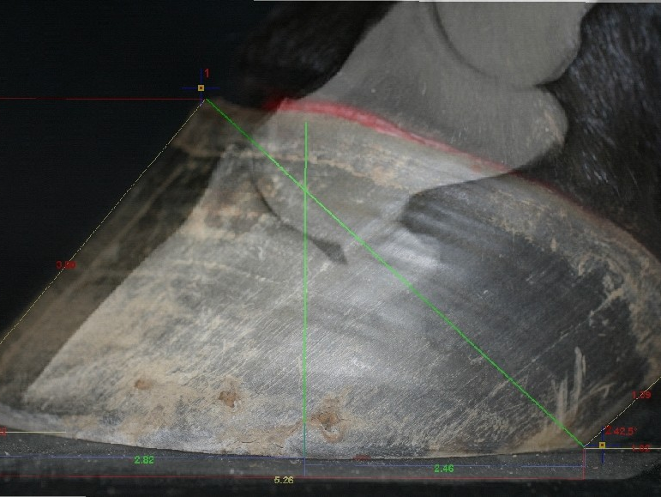
Anatomical Reference Points for Determining Geometric Proportions
Center of Phalanges
Center of rotation
Point of force
Termination of heel

Slide 10
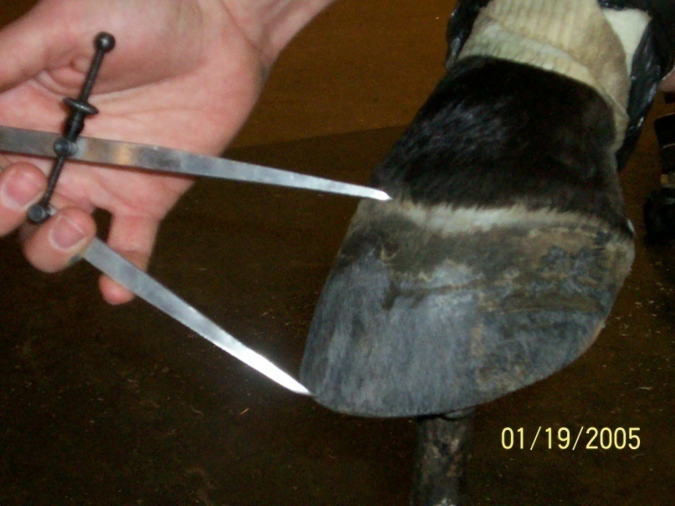
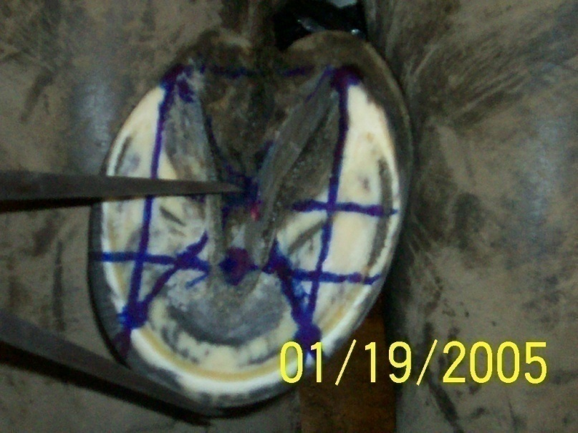
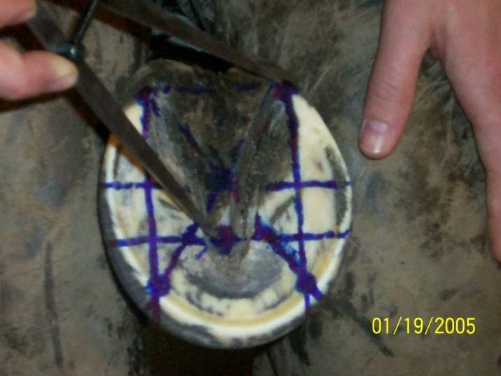
Geometric Proportions

Slide 11
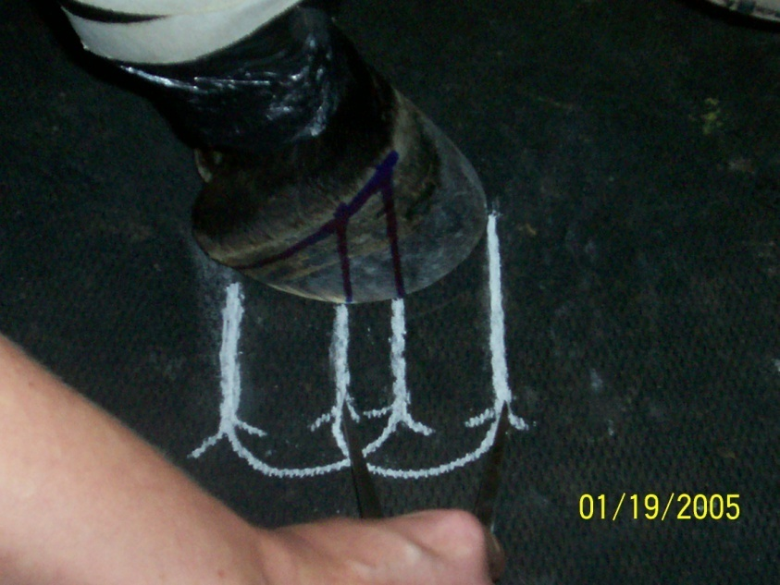
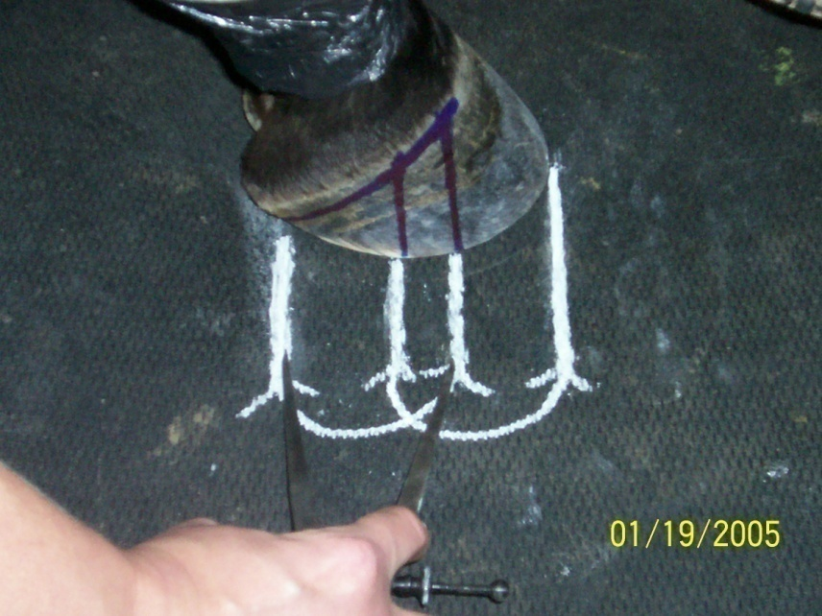
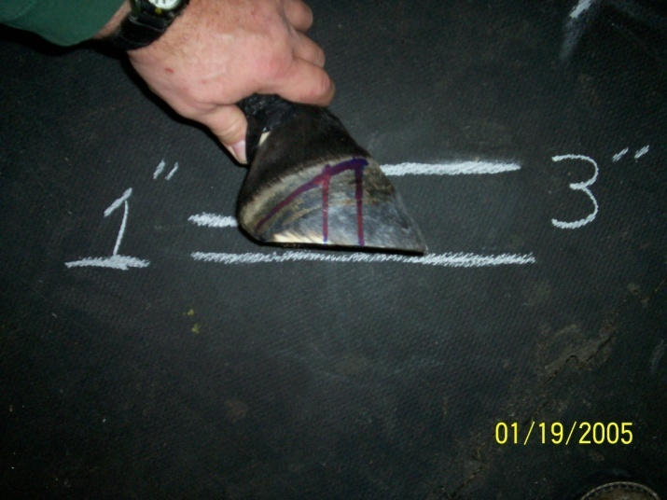
Geometric Proportions

Slide 12
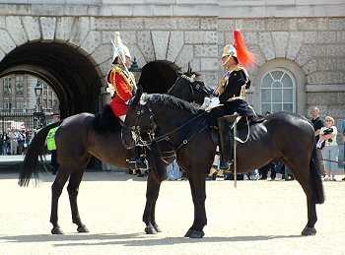
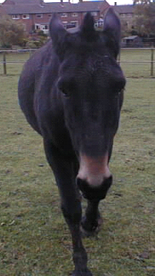
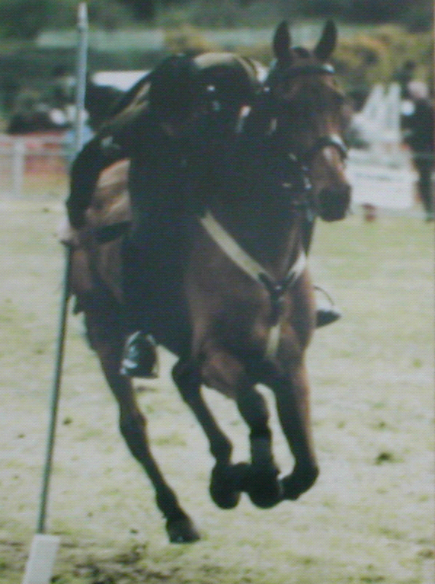
Static's, Dynamics and Kinematics
Static's
  How force affects the horse stationary
Dynamics
  How force affects the horse during locomotion
Kinematics
  How the horse moves

Slide 13

How does energy effect hoof balance?

Slide 14
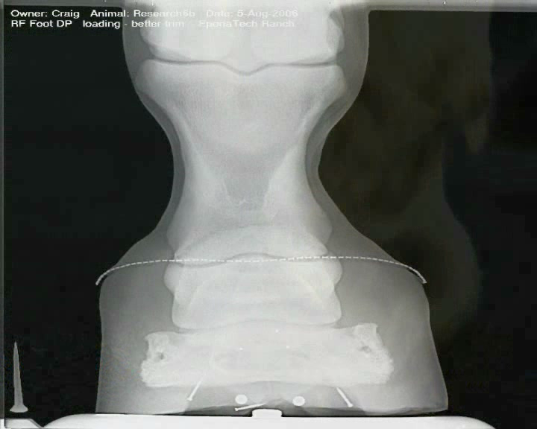
How do action force and ground force reaction affect hoof balance?
Action Force
Reaction Force
Notes:
How do action force and ground reaction force affect hoof balance?

Slide 15
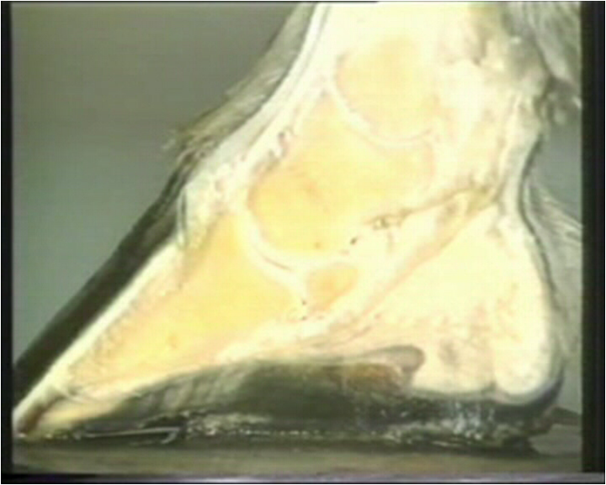
Through tensile forces in the laminar interface.
Action Force
Tensile Forces
Ground Force Reaction
Notes:
How do ground force reaction and tensile force neutralize in the hoof capsule?

Slide 16
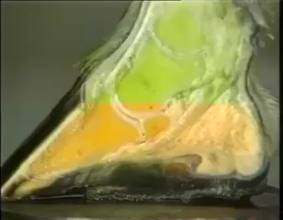
Where is ground force reaction neutralized by tensile force?
Notes:
Where is ground force reaction neutralized by tensile force?

Slide 17
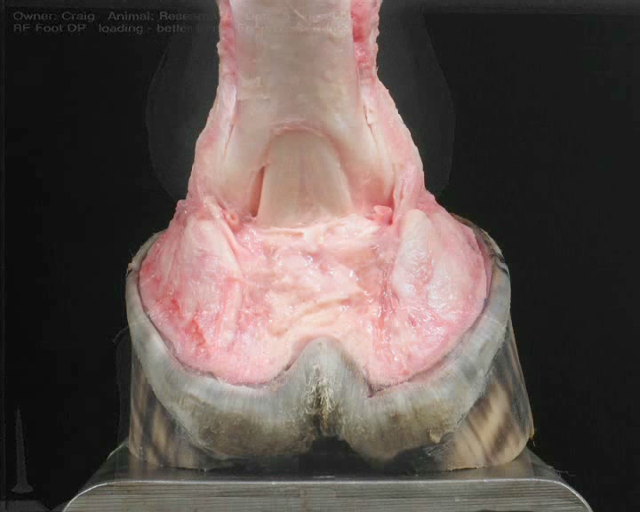
How is shock from ground reaction force absorbed in the hoof capsule?
Notes:
How is ground reaction force absorbed in the hoof capsule?

Slide 18
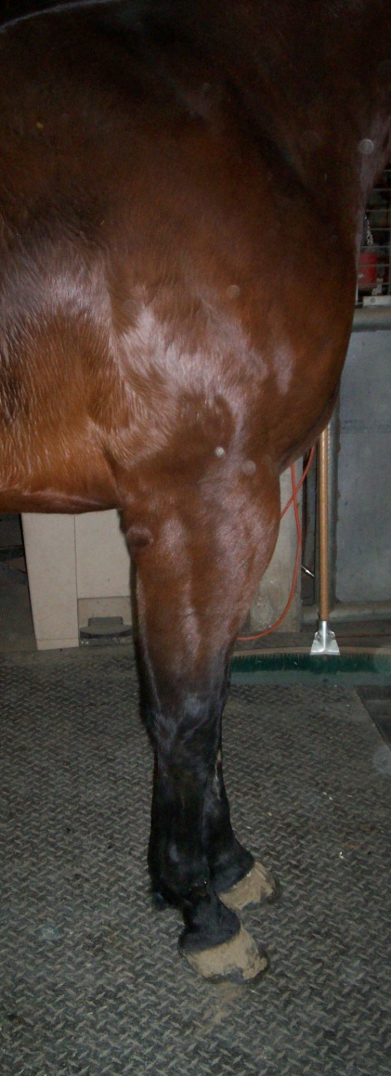
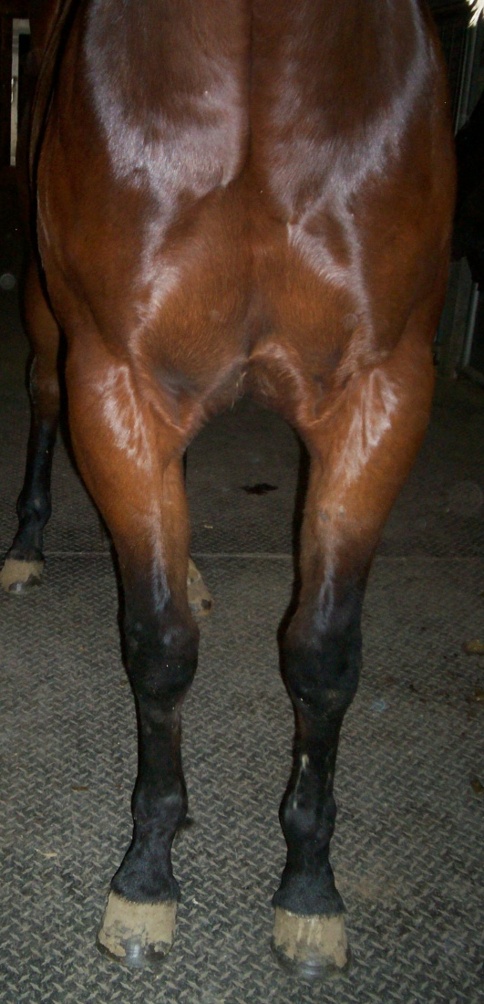
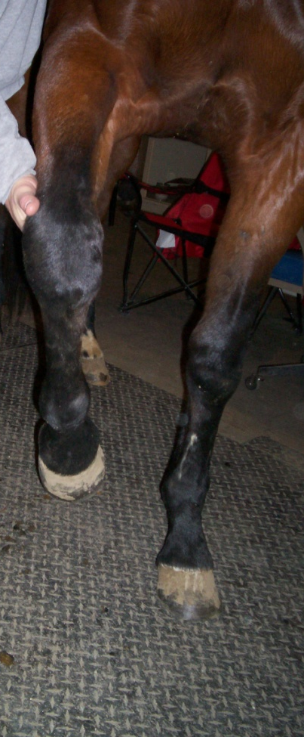
Trimming Protocol:
Limb Assessment Pre-trim
Proximal-distal
Dorso-palmar
Medio-lateral
Rotational

Slide 19
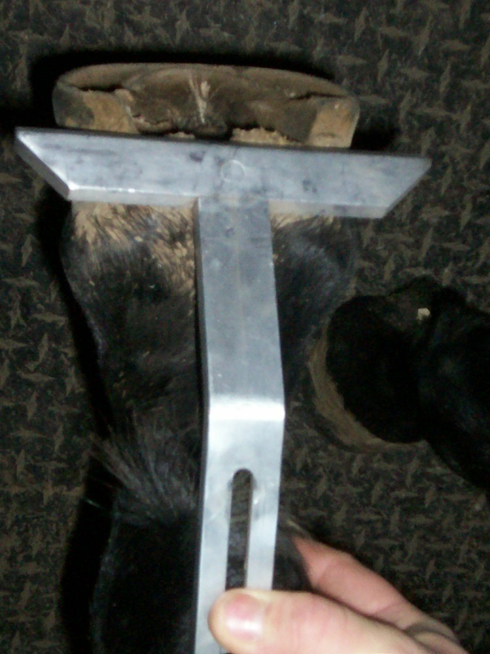
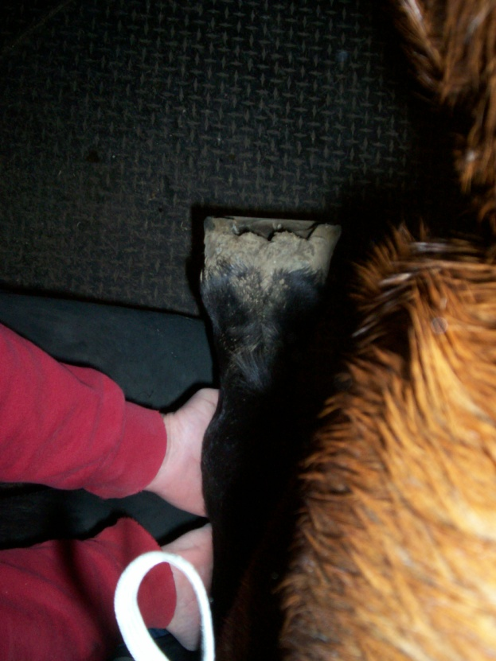
Trimming Protocol
Limb Assessment Pre-trim
Check foot for its relationship to long axis.
Check foot for its relationship to any rotational abnormality.

Slide 20
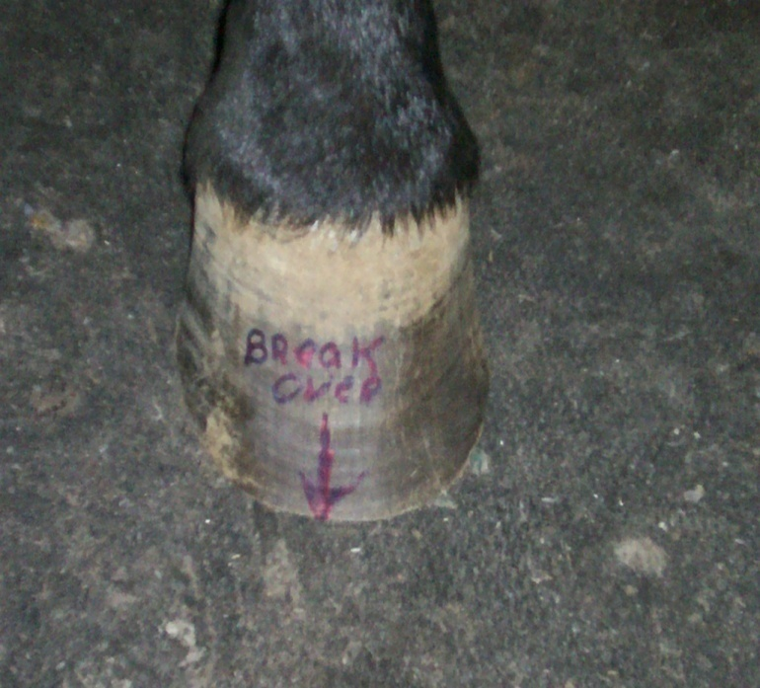
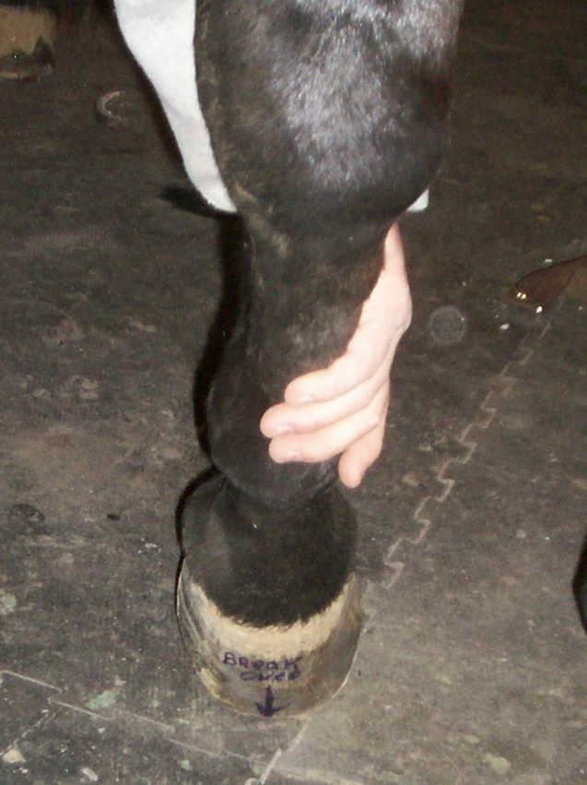
Trimming Protocol
Limb Assessment Pre-Trim
lateral
medial
Note that the foot breaks over considerably more on the lateral side with a medial toe flare.

Slide 21
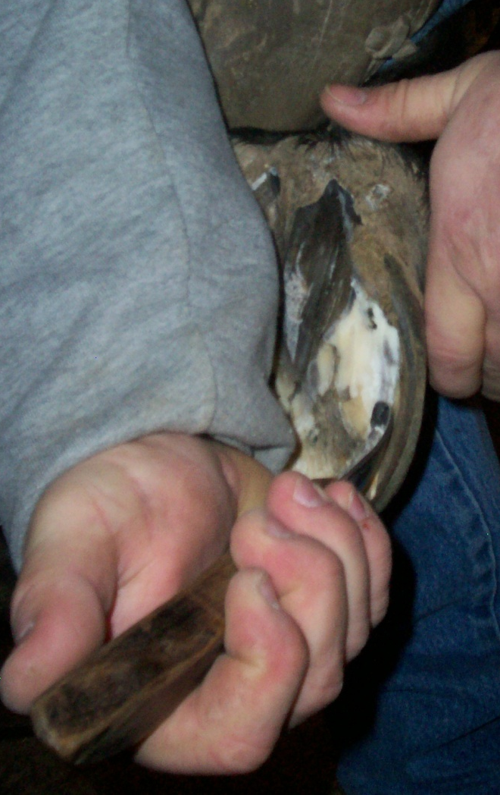
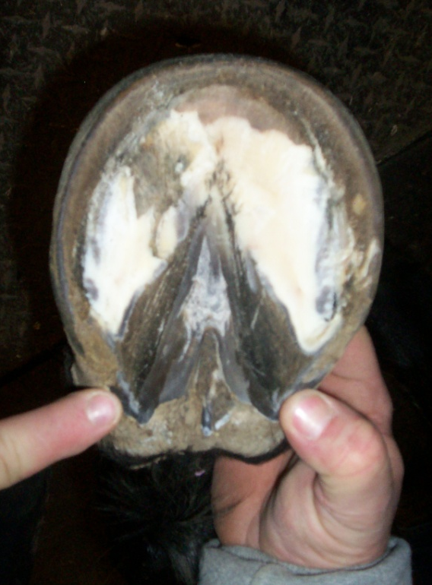
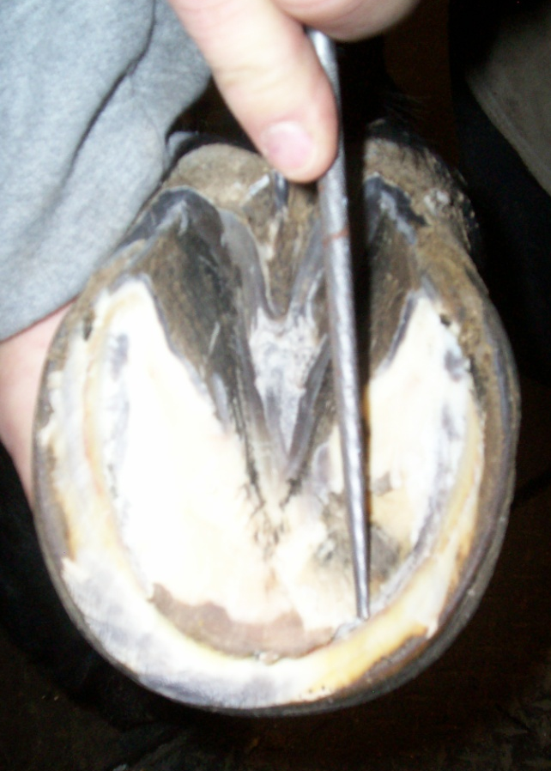
Trimming Protocol: Foot Prep
Relationship of heels to widest part of frog; identify depth of sole at seat of corn
Use knife vertically to find the solar-white line junction
Identified by waxy yellow white line at sole’s leading edge

Slide 22
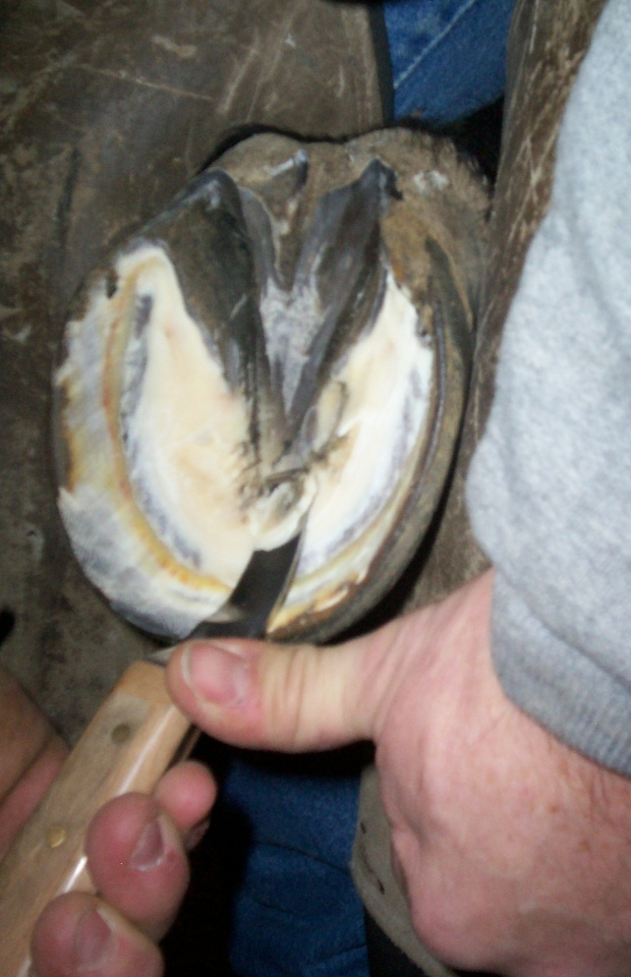
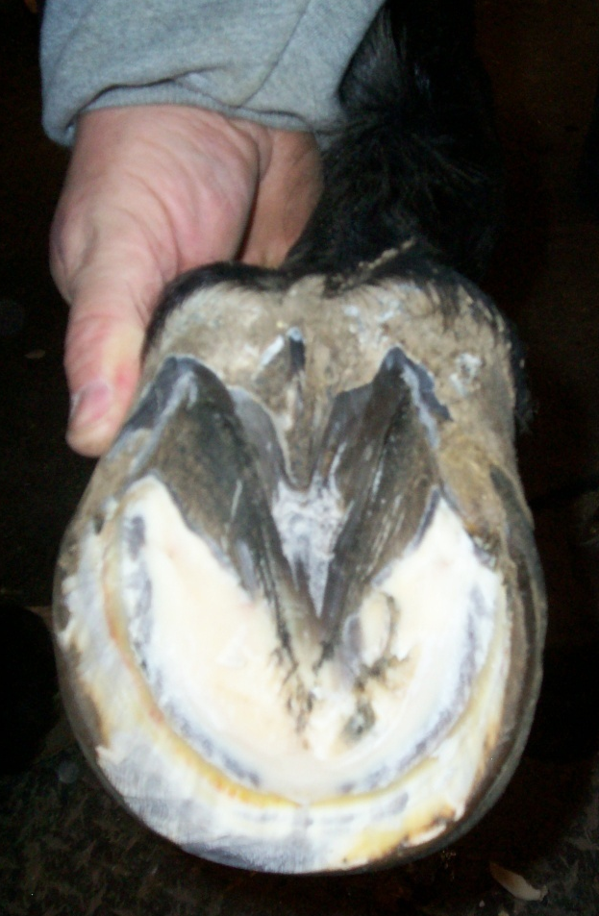
Trimming Protocol: Foot Prep
Using knife horizontally removes exfoliated sole to depth previously found
Blend ledge of exfoliated sole to natural concavity of solar hoof
Foot properly pared, ready to map

Slide 23
Trimming Protocol: Foot Mapping
1. Line through termination of heels (TH)
2. Lines from heels to white line, perpendicular to TH
Termination of Heel
3. Center of rotation (COR), parallel to TH
4. Point of Force (POF), parallel to TH, 3/8 in. behind apex of frog
Duckett’s Bridge
COR
Duckett’s Dot
POF
5. Point of breakover at white line, parallel to TH
Point of Breakover

Slide 24
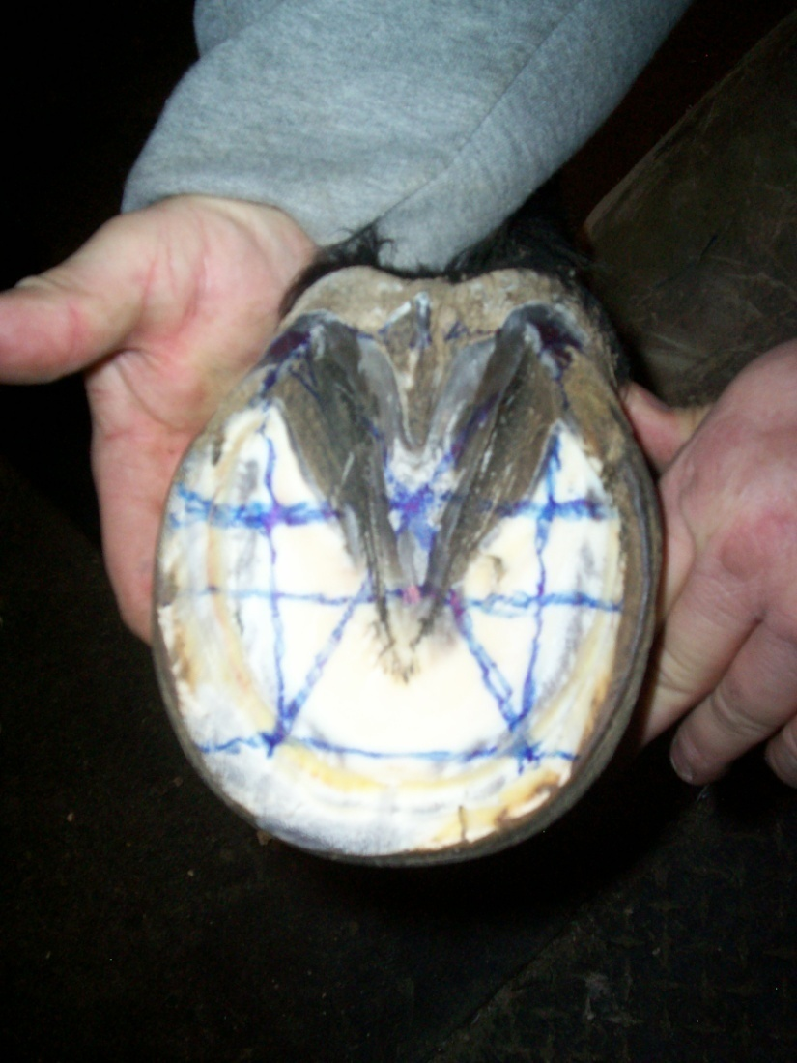
Trimming Protocol: Foot Mapping

Slide 25
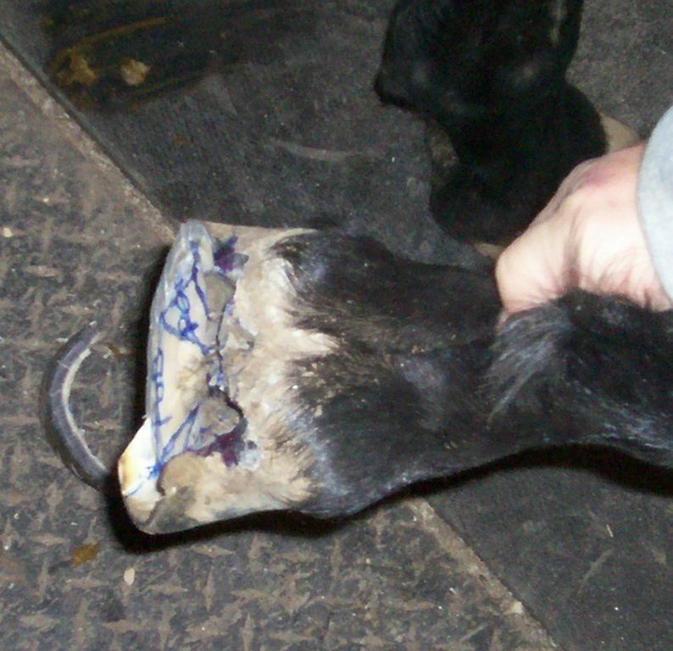
Trimming Protocol: The Trim
Trim from center of toe to the determined high side

Slide 26
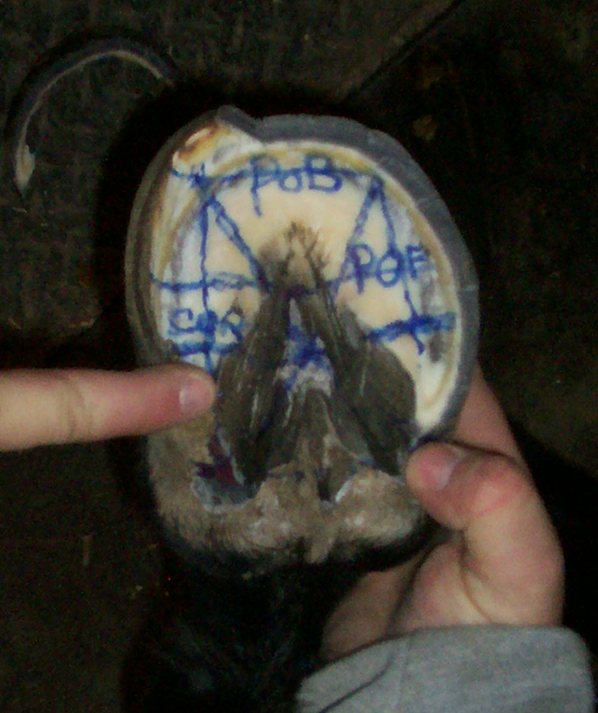
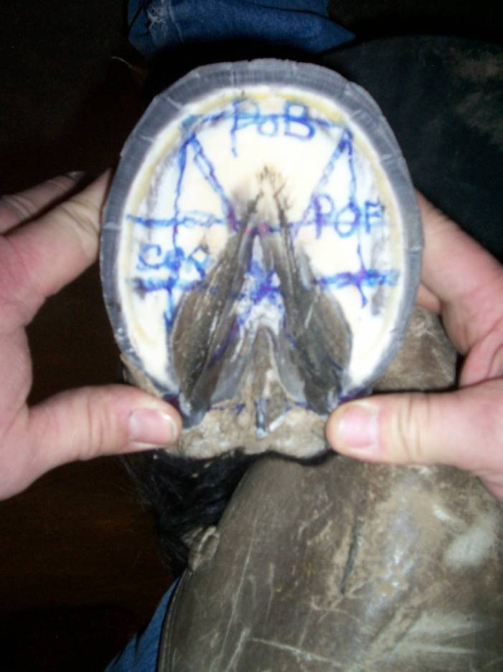
Trimming Protocol: The Trim
Note extent of basal support on medial side.
Both heels extended after trim.

Slide 27
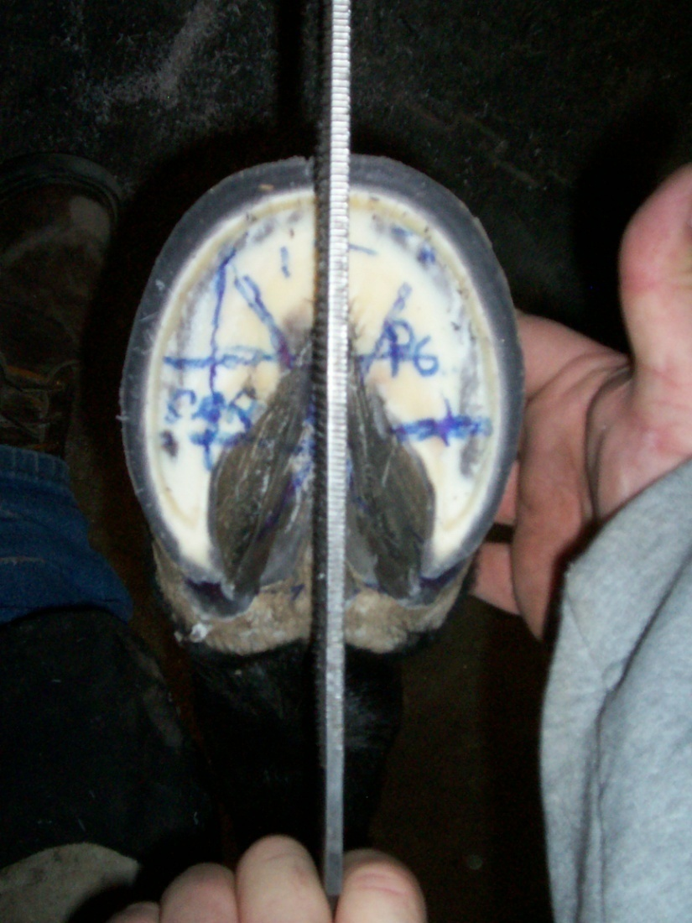
Trimming Protocol: The Trim
Check for symmetry.
Note excessive flaring on medial toe.

Slide 28
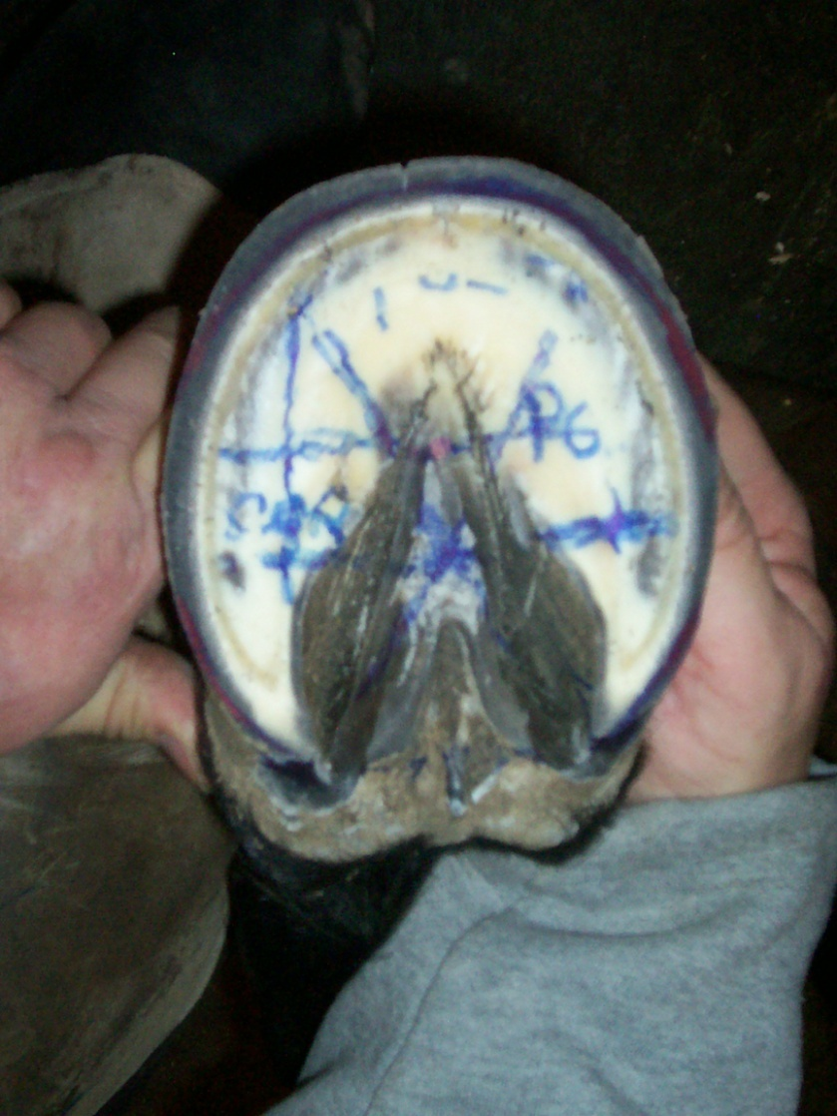
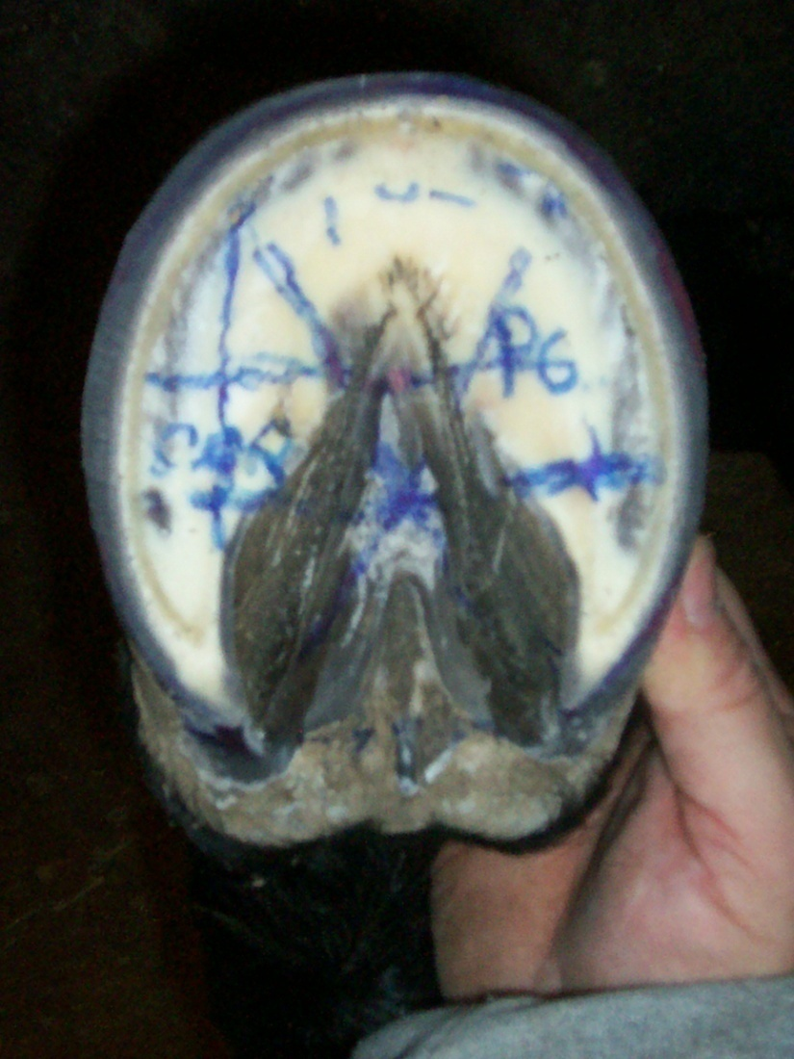
Trimming Protocol: The Trim
Foot marked to symmetry, ready for flare removal.
Flare dressed to symmetry from bottom of foot.

Slide 29
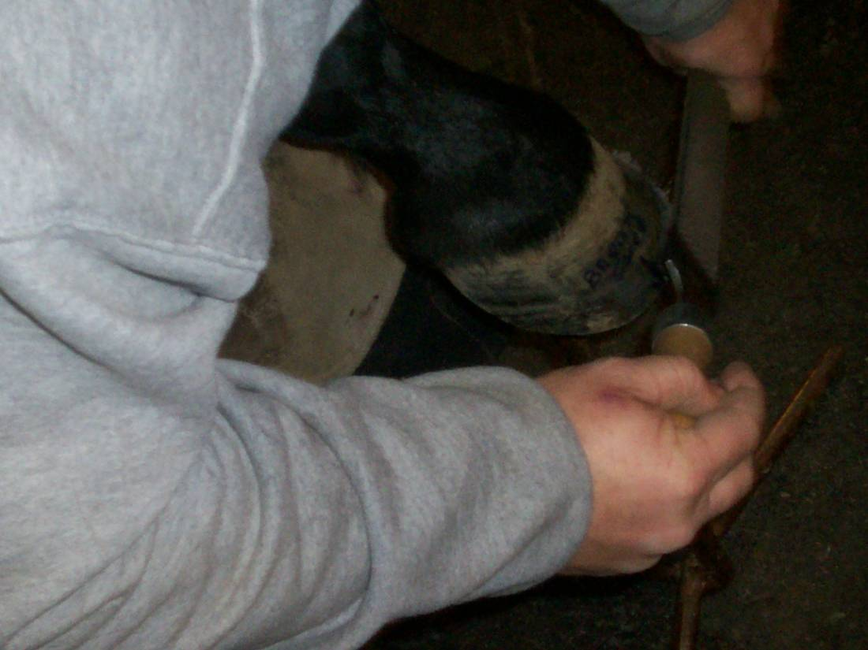
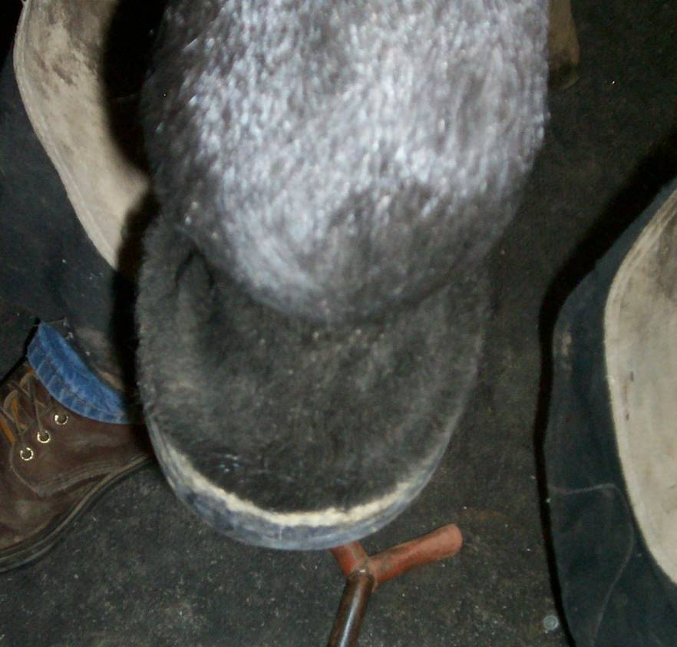
Trimming Protocol: The Trim
Medial toe flare dressed from dorsal hoof.
Hoof dressed to symmetry, matched to coronary band.

Slide 30
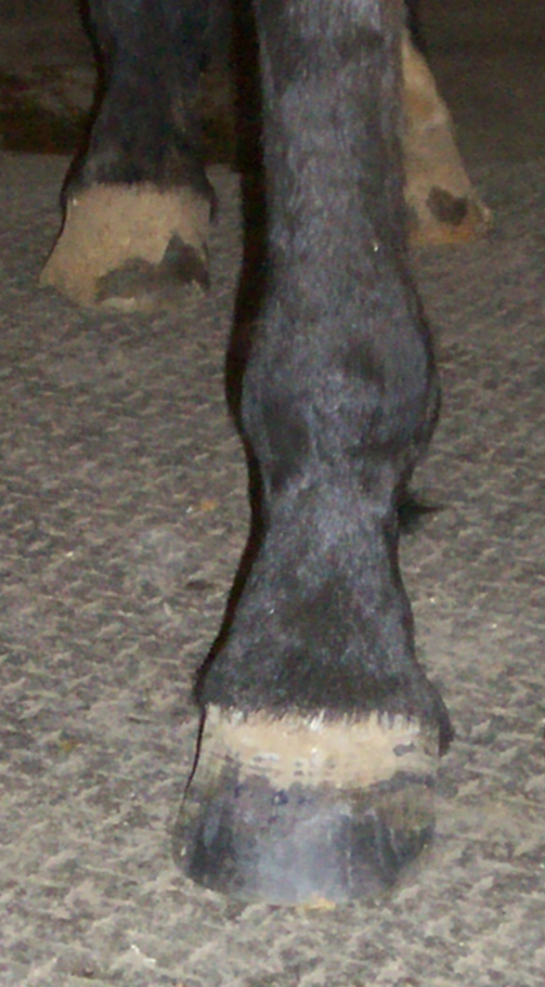

Trimming Protocol: Finished Product
Hoof brought back into basal support and symmetry.
Flares dressed and brought back to midline.

Slide 31
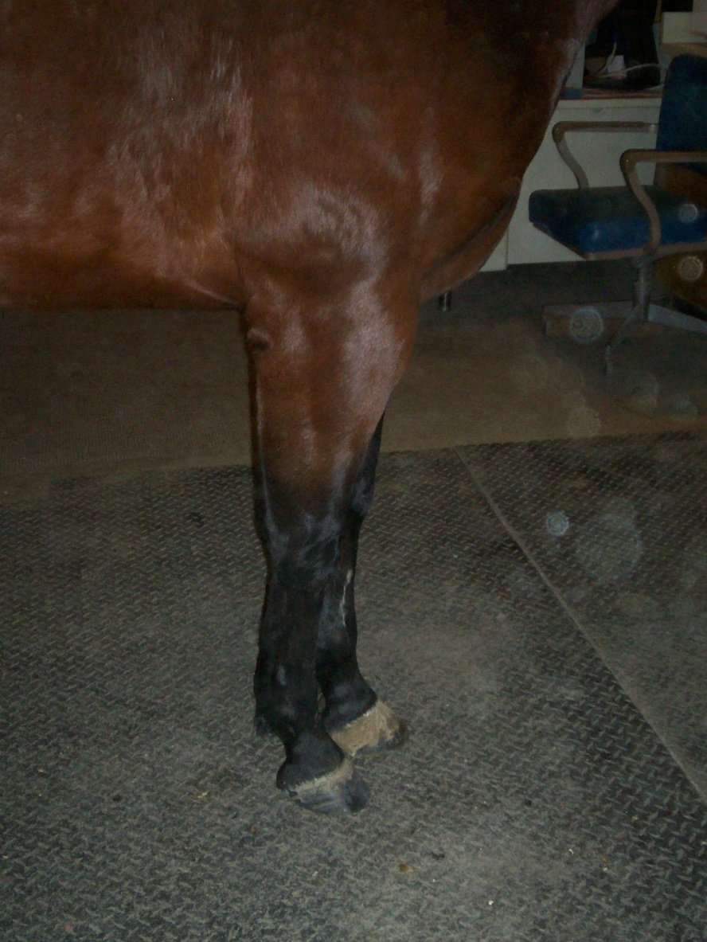
Before & After
X
X
X
Z
Z
Proximal-distal BEFORE
Proximal-distal AFTER
X

Slide 32

Before & After
Y
Y
X
Z
Z
X
Dorsal-palmar BEFORE
Dorsal-palmar AFTER

Slide 33

Before & After
X
Z
Z
Z
Z
X
Medial-lateral BEFORE
Medial-lateral AFTER

Slide 34
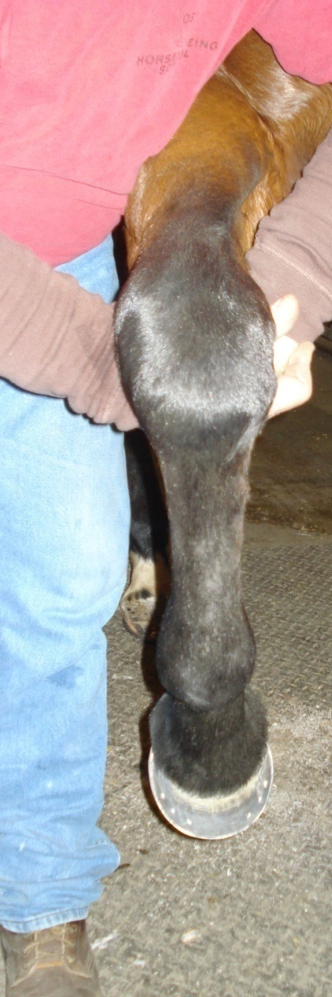
Before & After
Rotational BEFORE
Rotational AFTER
X
Z
Z
X

Slide 35
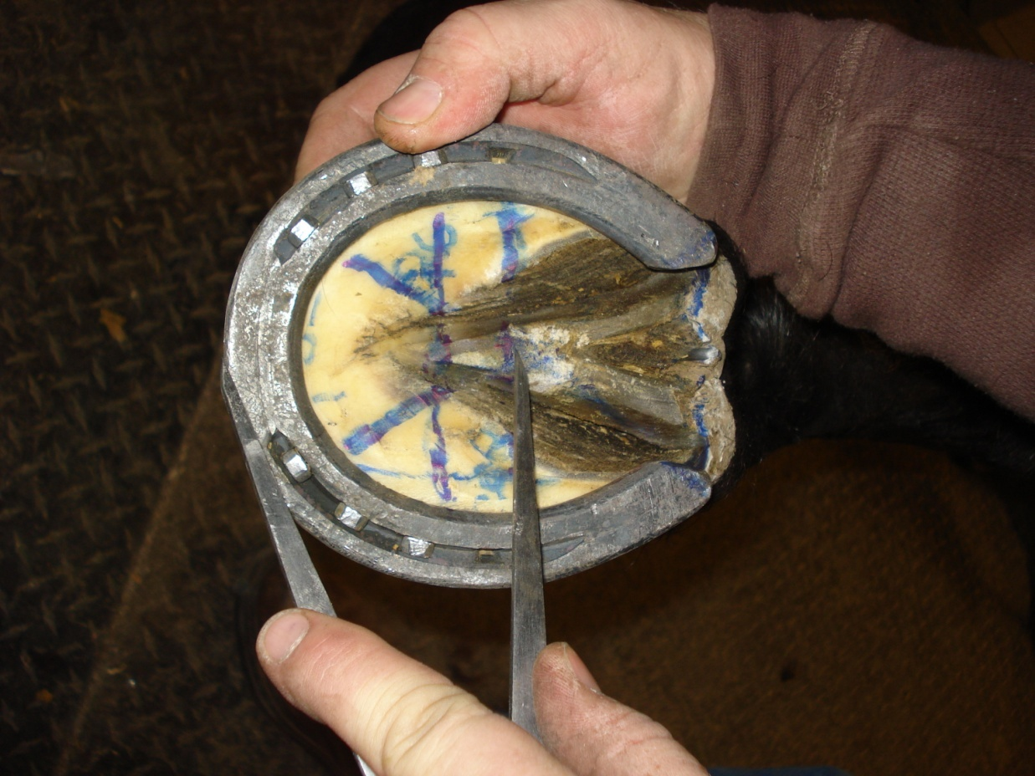
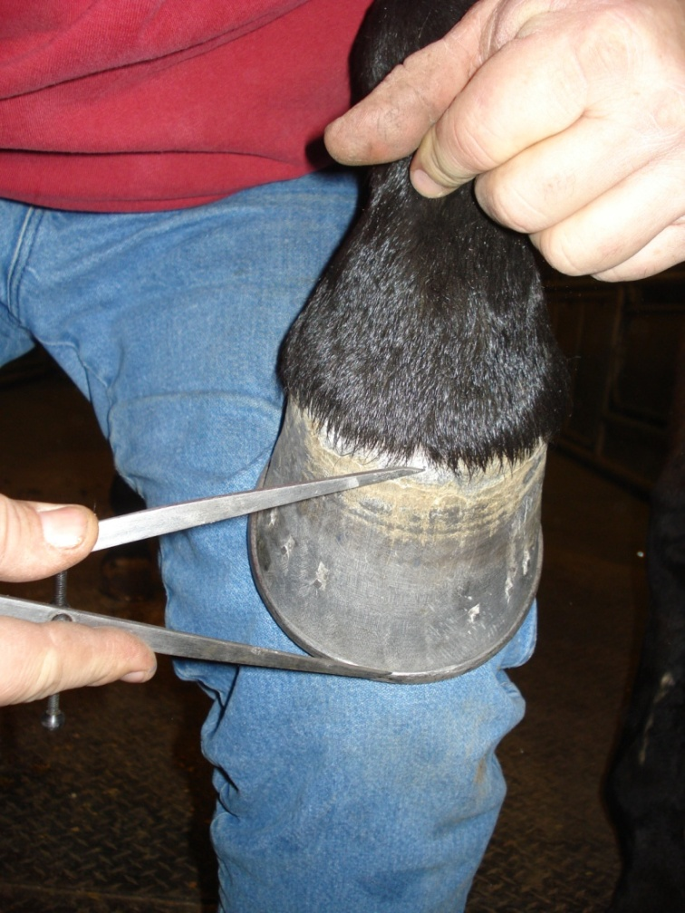
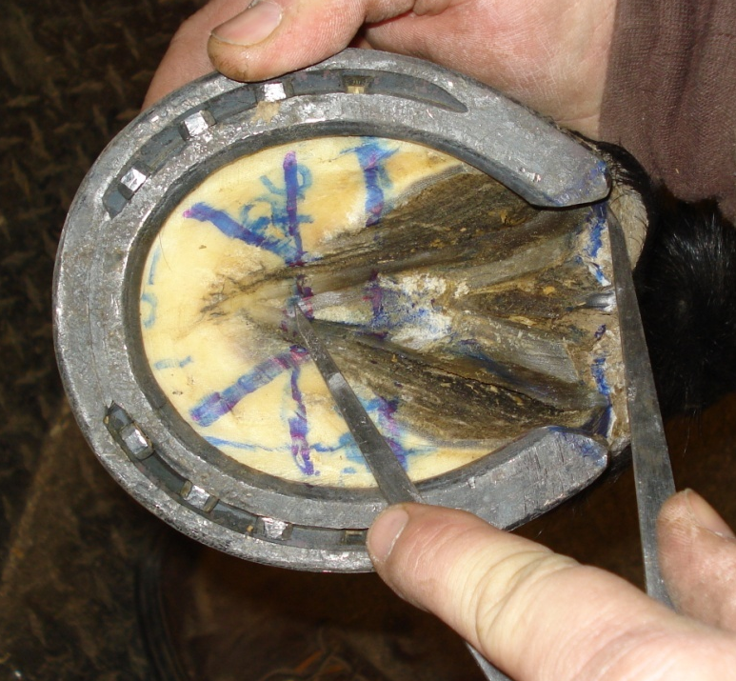
Geometric Proportions on Finished Foot

Slide 36
Equal Weight Bearing

