Slide 1

Fine Art Golfing Society
Roll of Honour 2024

Slide 2
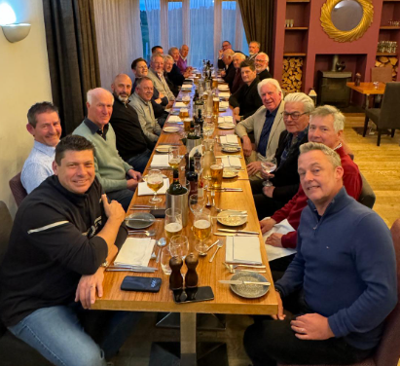
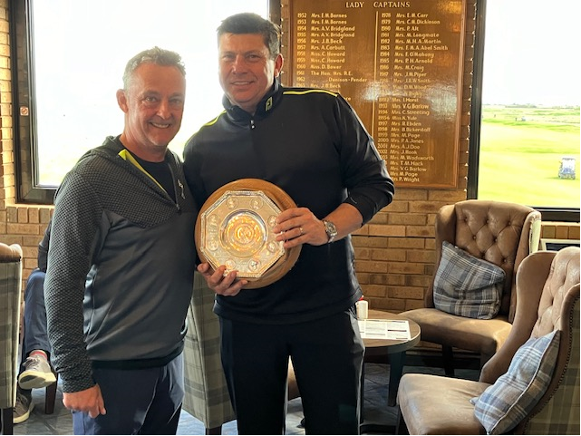

April : Princes
Baldwin Salver won by David Hughes

Slide 3
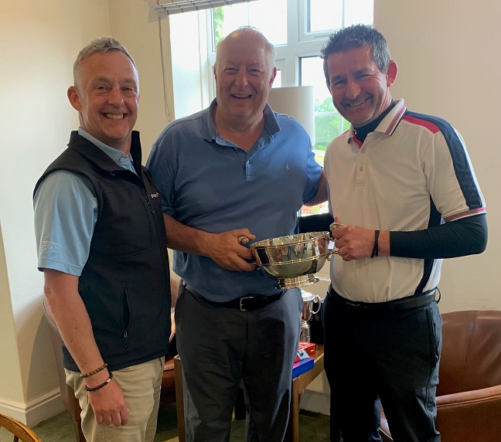
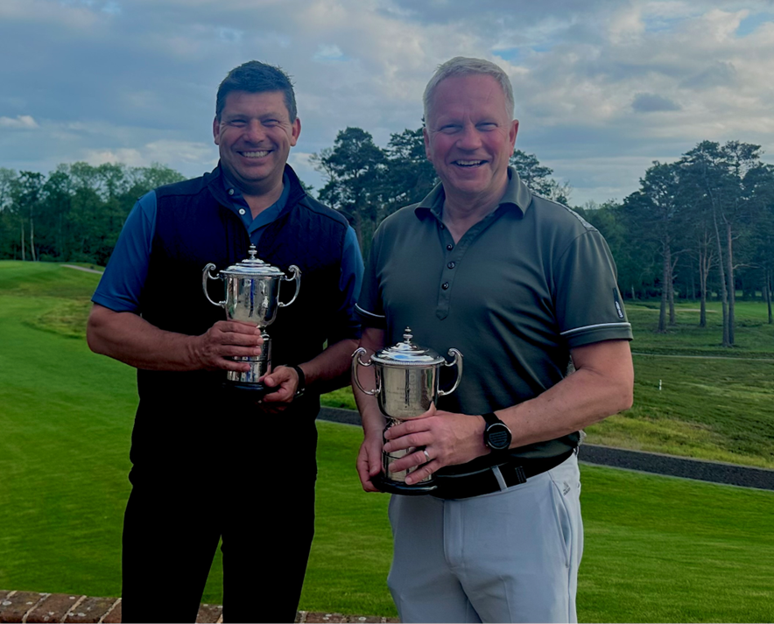

May: The Berkshire
Cecil Millar Cup won by Simon Windibank
Bailey & Stoner cups went to the Davids

Slide 4
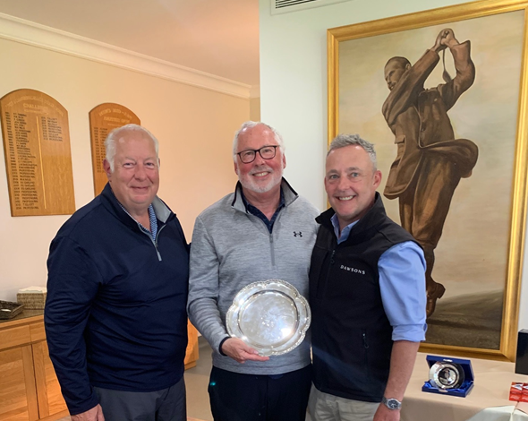
June: Hankley Common
A first time winner
Welcome Richard Dicketts to the Roll of Honour

Slide 5
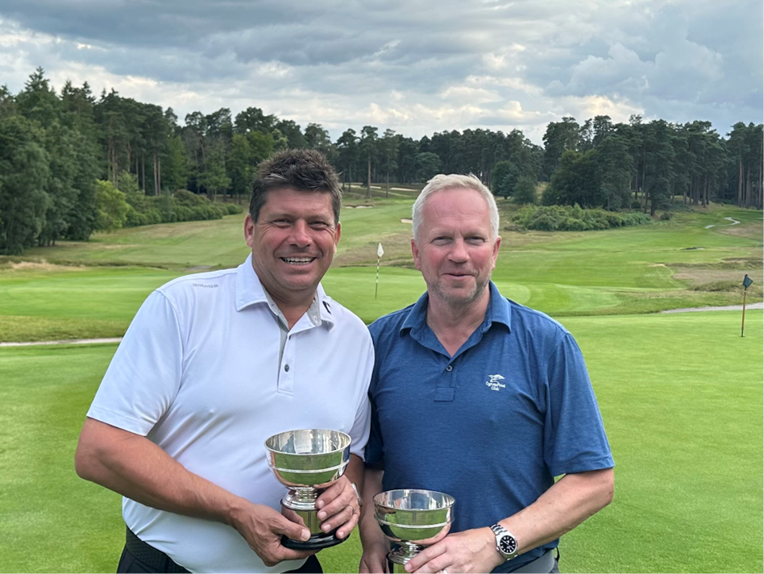
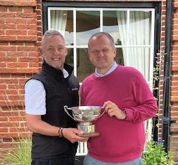
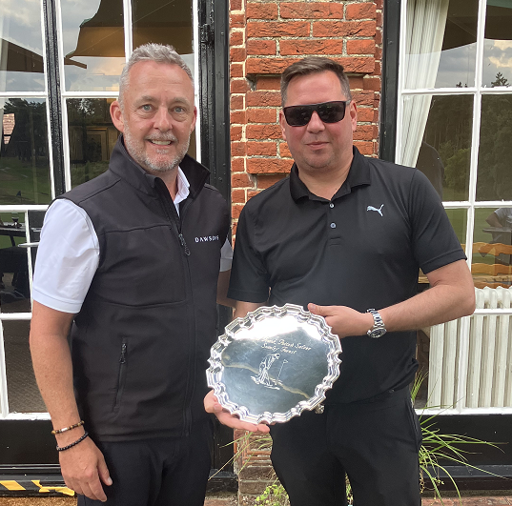

July: Swinley Forest
Patten Salver, par 3 comp
Ed Flaxman-Johnson
Lewis & Parker Cups
The Davids – again!
Omel Bowl, David Brindley

Slide 6
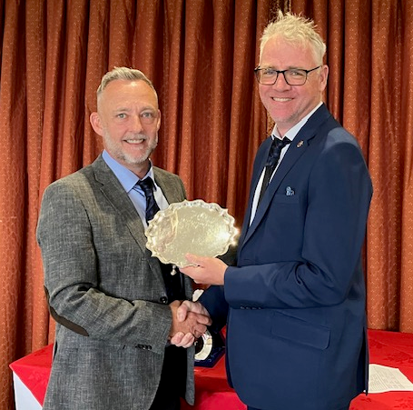
August: St George’s Hill
Captain’s Day
Fabulous new venue
Butler Salver won by Sam Loxton

Slide 7
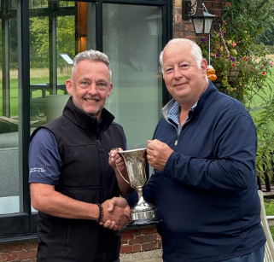
September: West Surrey
A shock winner
– the bloke on the right

Slide 8
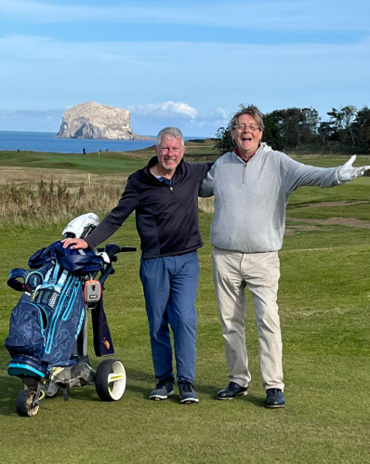
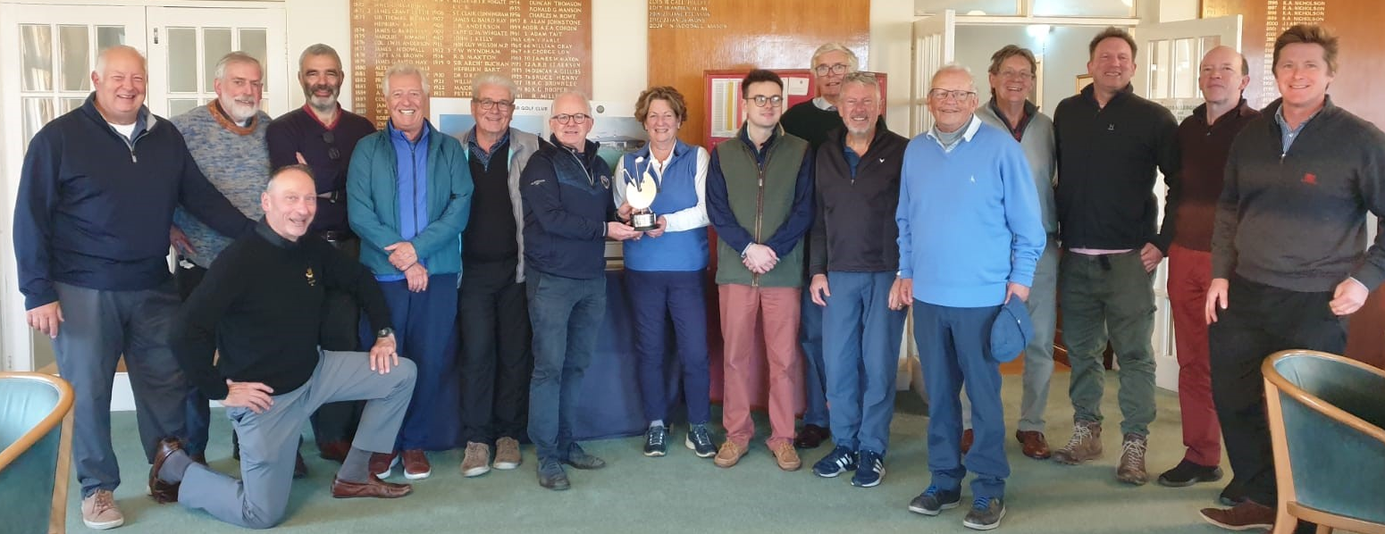
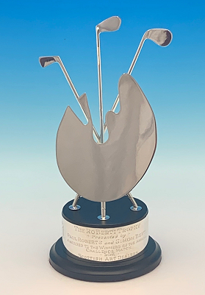
October: Scotland Tour
The odd couple
But what a team!
Another fine win

Slide 9
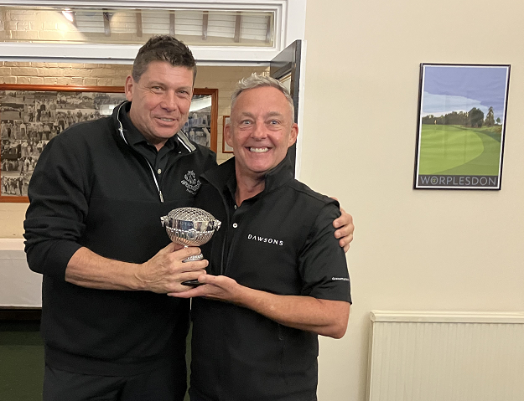
October: Worplesdon
The Captain’s Rose Bowl
A familiar winner

Slide 10
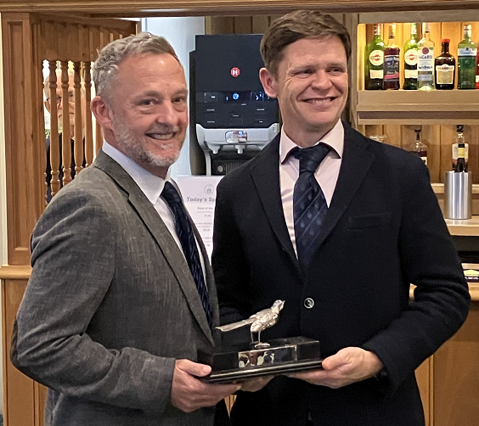
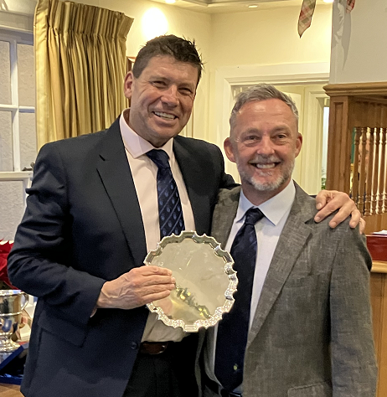
December: Woking
35 points was enough to take the Omel Salver
While the Birdie Bird found a new nest at James’ place

Slide 11
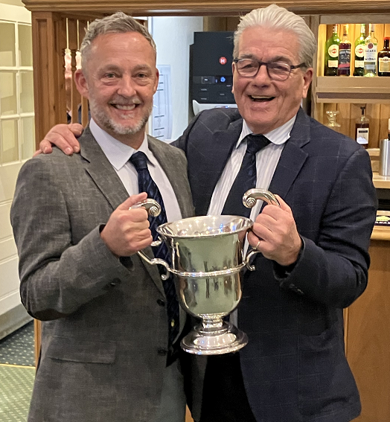
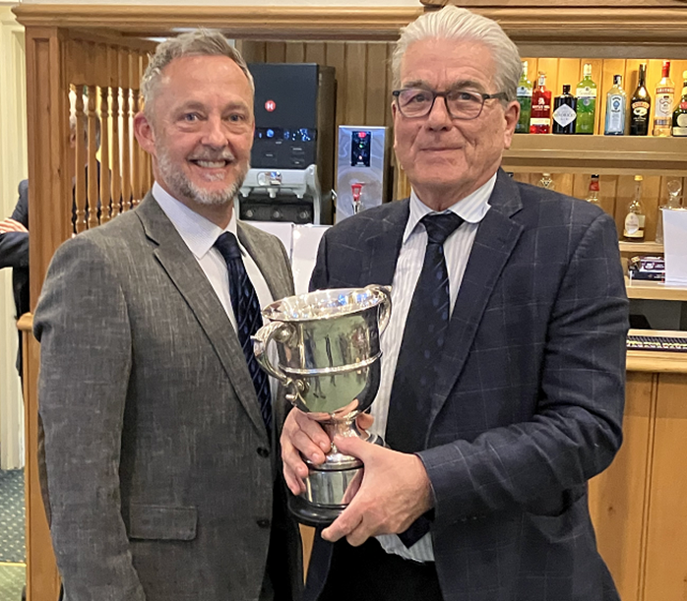

Seniors & Rabbits Cups
Hats off to Robert, with 106 points he took both the Seniors and Rabbits Cups by 6 points from Richard Dicketts, the nearest challenger.

Slide 12
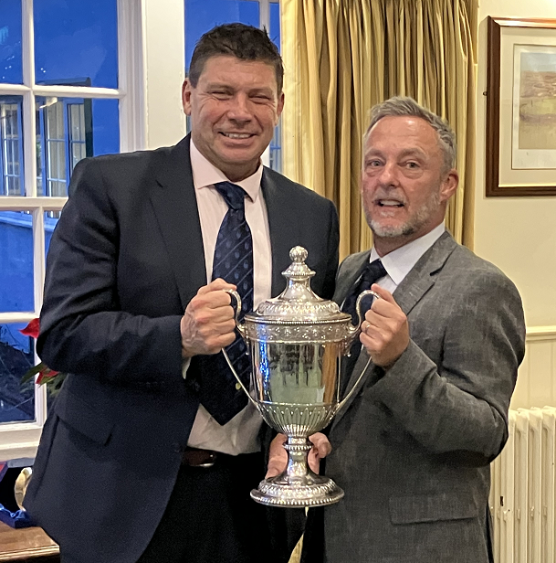
The Partridge Trophy – Golfer of the Year
Which golfer played with us 6 times this year and won a trophy at 5?
Individual wins at Princes, Worplesdon and Woking
Pairs wins at Berkshire and Swinley
There can only be one Golfer of the Year
I give you our Captain for 2025
David Hughes!!!!

Slide 13
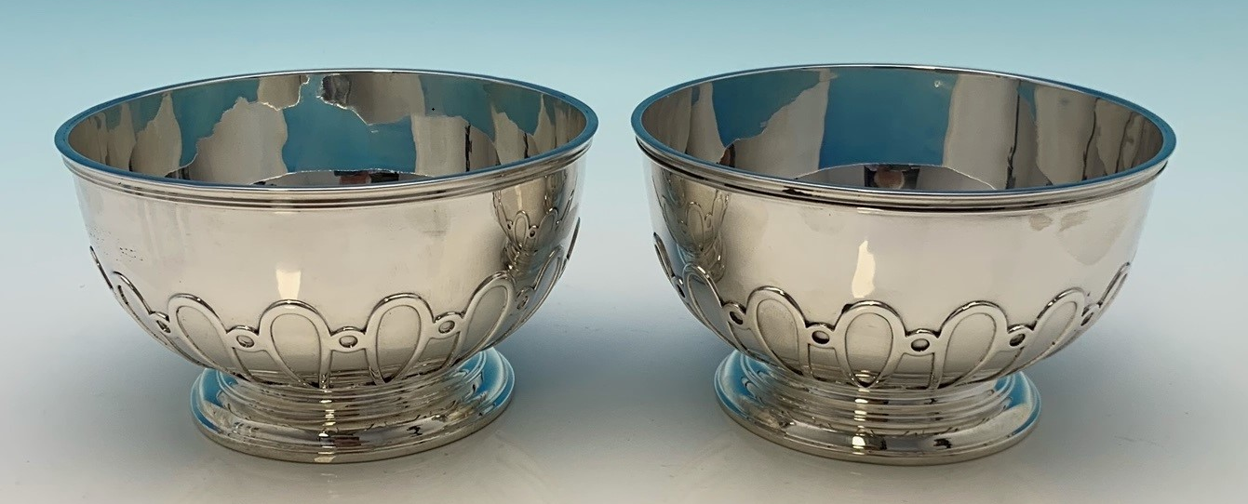
2025 – in brief, expect a note in the new year
David Hughes Captain
New trophies for Princes
  Presented by David
Season opener in Spain
Captain’s Day at North Hants
Scottish trip 29 Sep-Oct 3
Full schedule online www.fineartgolf.org

