Slide 1






Slide 2

ENROLL, ENGAGE, ATTEND CAMPAIGN
COMMUNITY PARTNER PRESENTATION

Slide 3
This year, more than ever before, we must invest in the transition back to school for both students and families.

Slide 4
IMPACT OF COVID-19 ON LEARNING
2021-2022

Slide 5
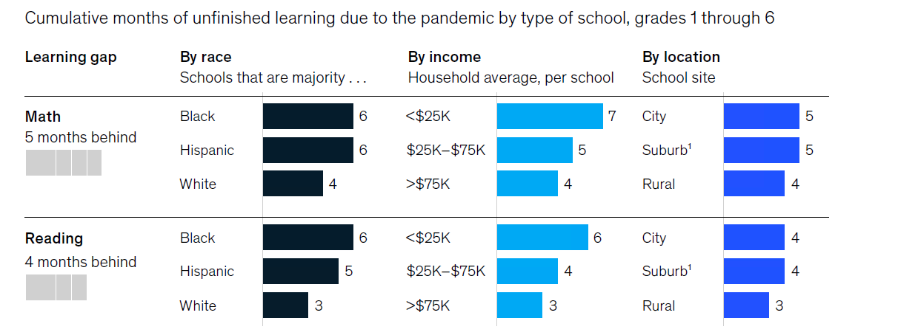
BY THE END OF 2020-2021 SCHOOL YEAR, STUDENTS WERE FIVE MONTHS BEHIND IN MATH AND FOUR MONTHS BEHIND IN READING
Source: McKinsey & Co - COVID-19 and education: The lingering effects of unfinished learning, July 27, 2021
Notes:
The impact of the pandemic was significant, leaving K-6 students, on average, five months behind in math and four months behind in reading by the end of the school year. The pandemic widened preexisting opportunity and achievement gaps, hitting historically disadvantaged students hardest

Slide 6
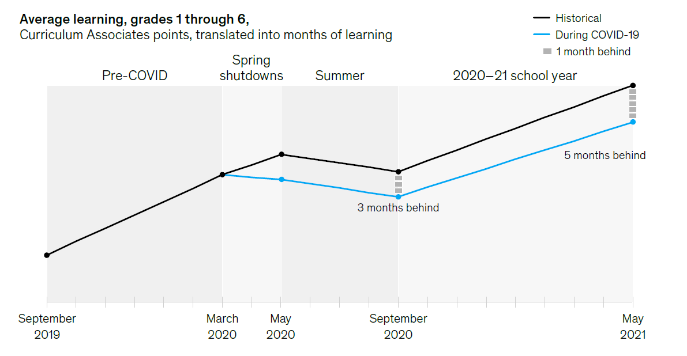
MATH LOSS OVER THE 2020-2021 SCHOOL YEAR
Source: McKinsey & Co - COVID-19 and education: The lingering effects of unfinished learning, July 27, 2021

Slide 7
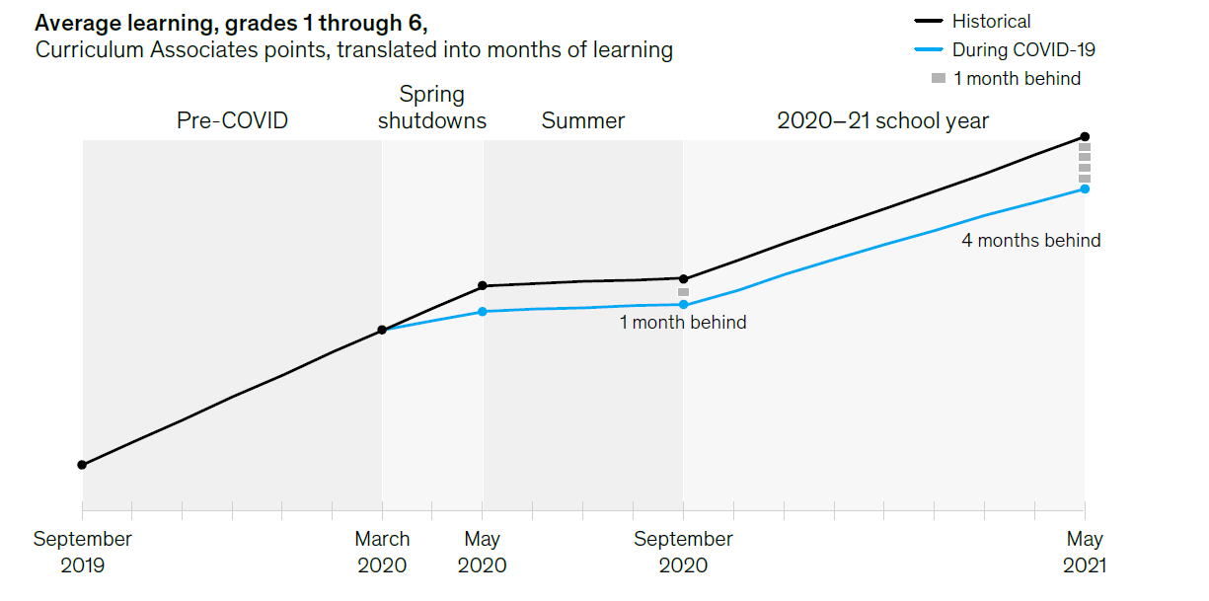
READING LOSS OVER THE 2020-2021 SCHOOL YEAR
Source: McKinsey & Co - COVID-19 and education: The lingering effects of unfinished learning, July 27, 2021

Slide 8

High schoolers have become more likely to drop out of school, and high school seniors, especially those from low-income families, are less likely to go on to postsecondary education
Estimates that an additional 617,000 to 1.2 million 8th – 12th graders could drop out of school altogether because of the pandemic, if efforts are not made to re-engage them next year
Source: McKinsey & Co - COVID-19 and education: The lingering effects of unfinished learning, July 27, 2021

Slide 9

More than 35% of parents reported being very or extremely concerned about their children’s mental health.
Source: McKinsey & Co - COVID-19 and education: The lingering effects of unfinished learning, July 27, 2021
Notes:
The crisis had an impact on not just academics, but also the broader health and well-being of students, with more than 35% of parents very or extremely concerned about their children’s mental health. Research shows that trauma and other mental-health issues can influence children’s attendance, their ability to complete schoolwork in and out of class, and even the way they learn.

Slide 10
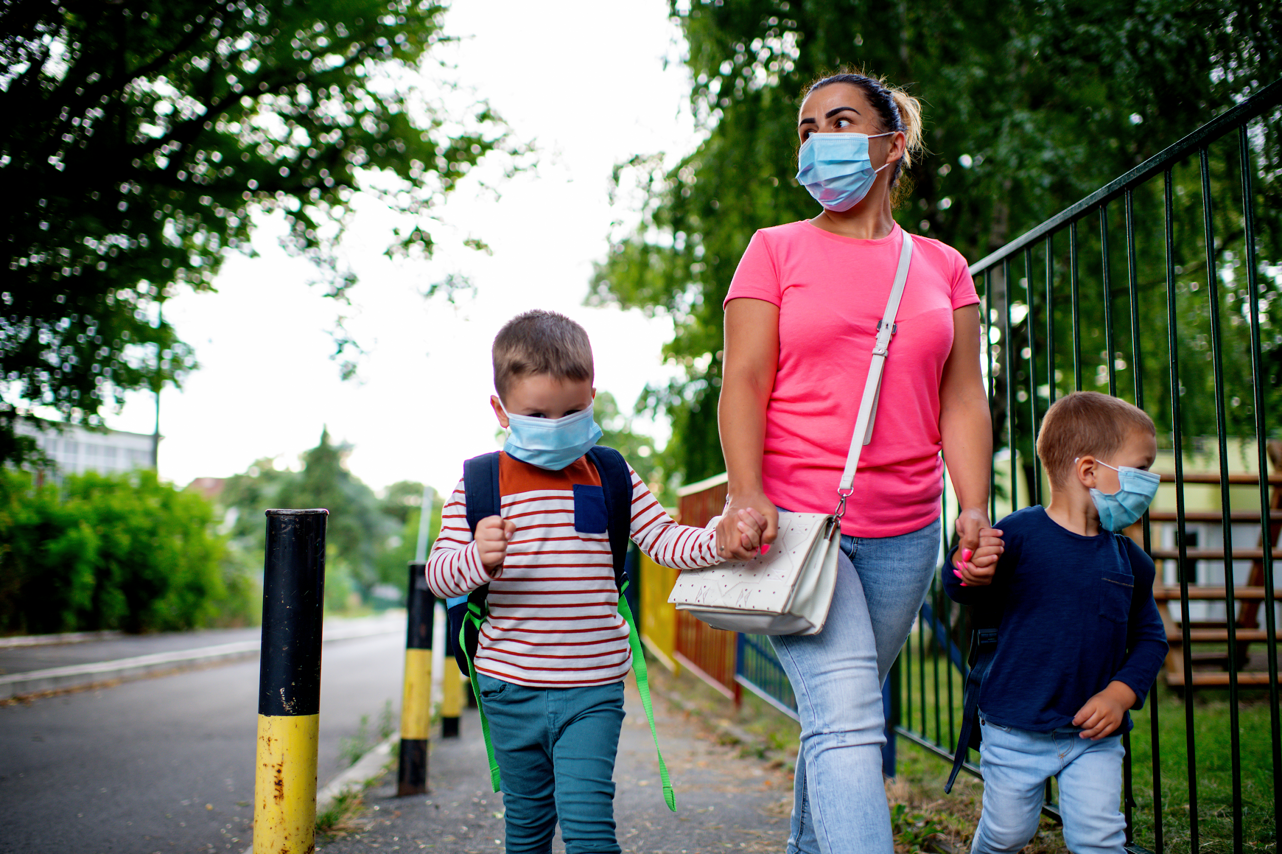
ENROLL
Nationally, K-12 enrollment dropped by roughly 3% in 2020-21 compared with the previous school year.
Enrollment of kindergarteners declined by three times as much, while the pre-K population plunged by 20%.
Source: The 74, June 29, 2021

Slide 11
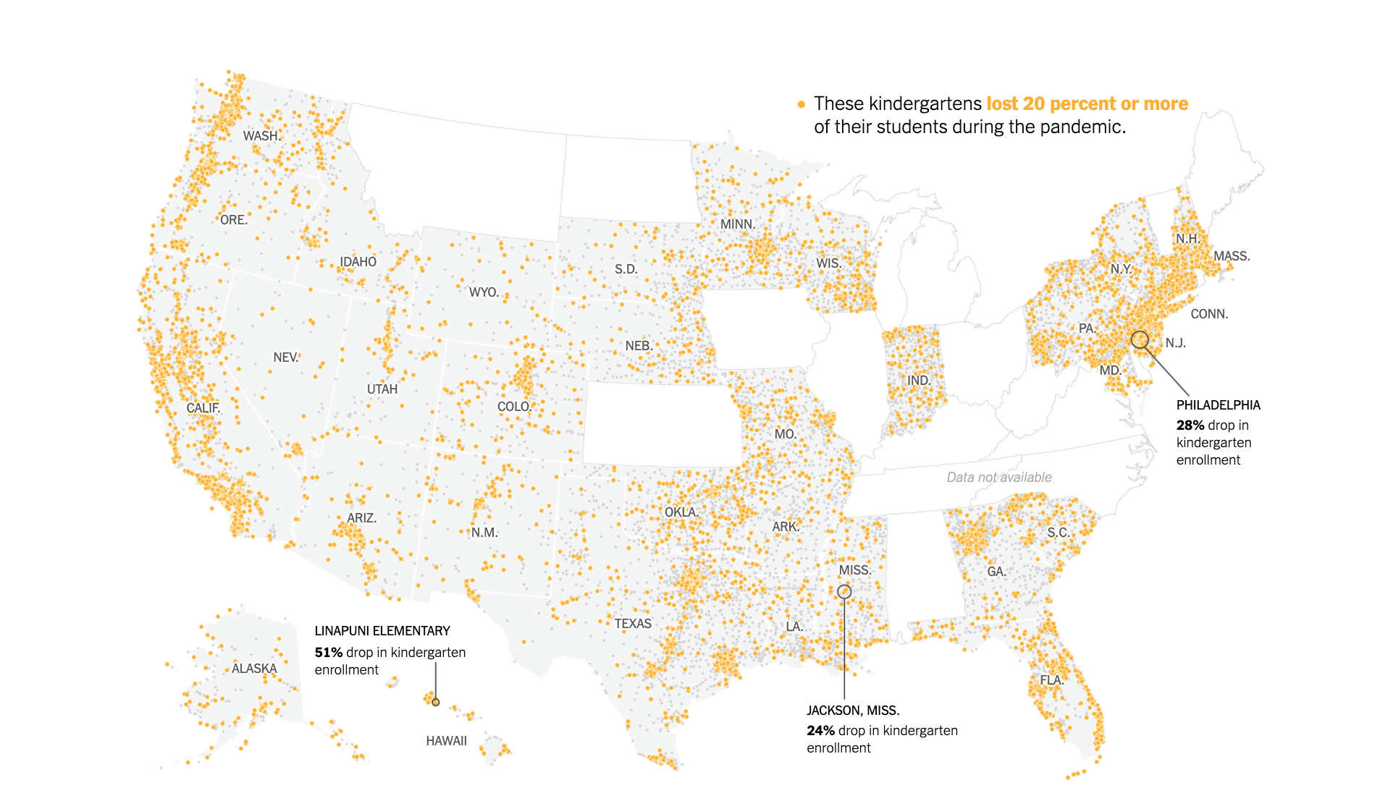
ENROLL
Source: The New York Times

Slide 12
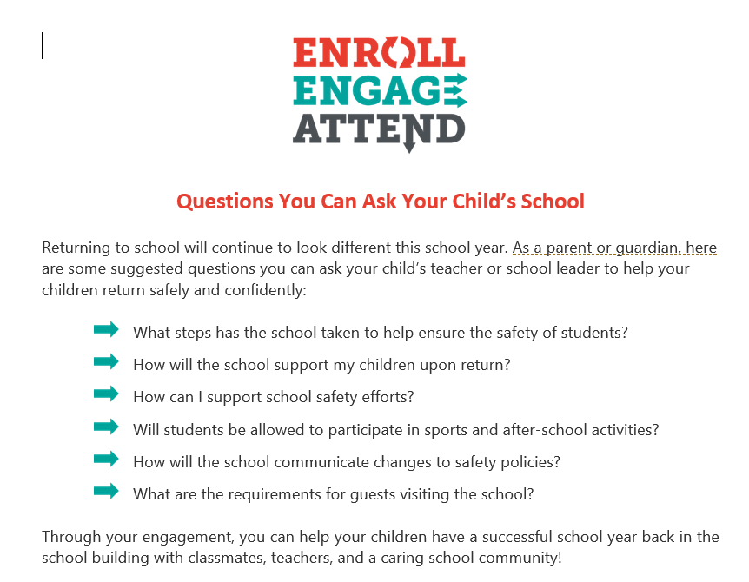
STUDENTS ARE MORE LIKELY TO ATTEND SCHOOL OR CONNECTED AND SUPPORTED
ENGAGE
Survey of 16,000 parents, suggest that 24% were not convinced they would choose in-person for their children for the 2021-2022 school year
To bring students back, schools need to reach out to families to address their concerns
Source: McKinsey & Co
Notes:
Parents underestimate the unfinished learning caused by the pandemic – 40% of parents said their child is on track and 16% said their child is progressing faster than in a usual year
While remote learning may have worked well for some students, data suggests it failed many. Approaches to accelerate learning will only work if students show up for school. “The key to going back to school is that it needs to feel safe, normal, and expected.” Schools cannot do this alone

Slide 13
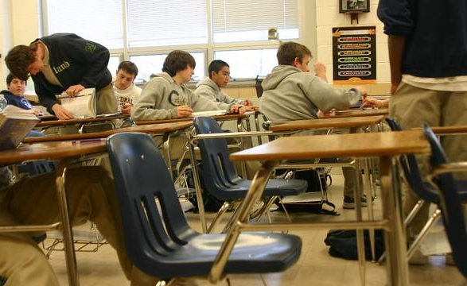
ATTEND
During 2020-21 school year, chronic absenteeism for 8th - 12th graders increased 12 percentage points
42% of students who are new to chronic absenteeism attended no school at all
2.3 million to 4.6 million additional 8th – 12th graders were chronically absent from school during 2020-21 school year, in addition to the 3.1 million who are chronically absent in non-pandemic years
Source: The 74, June 29, 2021
Notes:
Research shows that trauma and other mental-health issues can influence children’s attendance, their ability to complete schoolwork in and out of class, and even the way they learn. Student absenteeism has been far greater during the pandemic than previously reported, especially among young children and those from disadvantaged backgrounds

Slide 14
ATTEND
With millions of students learning remotely, states and districts had to rethink what it means to “attend” school, especially when students had challenges connecting to the internet during class.
The definition of attendance varied widely:
  Some districts counted a student as present if they logged in for even a minute of time.
  Some districts required a half day’s online participation.
  Some counted completed assignments or a conversation with a teacher as a sign of attendance.
As many as 19 states weren’t tracking daily attendance this fall.
The variation made it harder to know who was truly engaged in learning.
Notes:
The definition of attendance varied:
Some districts counted a student as present if they logged in for even a minute of time
Some districts required a half day’s online participation
Some counted completed assignments or a conversation with a teacher as a sign of attendance.
But the variation made it harder to know who was truly engaged in learning

Slide 15
Absenteeism is a lost opportunity to learn – not merely a lack of compliance with school rules.

Slide 16

CHRONIC ABSENCE
A CRITICAL EARLY WARNING SIGN

Slide 17
CHRONIC ABSENCE
Attendance Works defines chronic absence as missing 10% or more of school - for any reason. Students who are chronically absent are at risk academically.
Chronic absence is different from truancy (unexcused absences only).
Chronic
Absence
Excused
absences
Unexcused
absences
Suspensions

Slide 18
STRONG STUDENT ATTENDANCE =
STRONGER THIRD GRADE READING SKILLS

Slide 19

By 9th grade, regular and high attendance is a better predictor of graduation rates than 8th grade test scores.

Slide 20
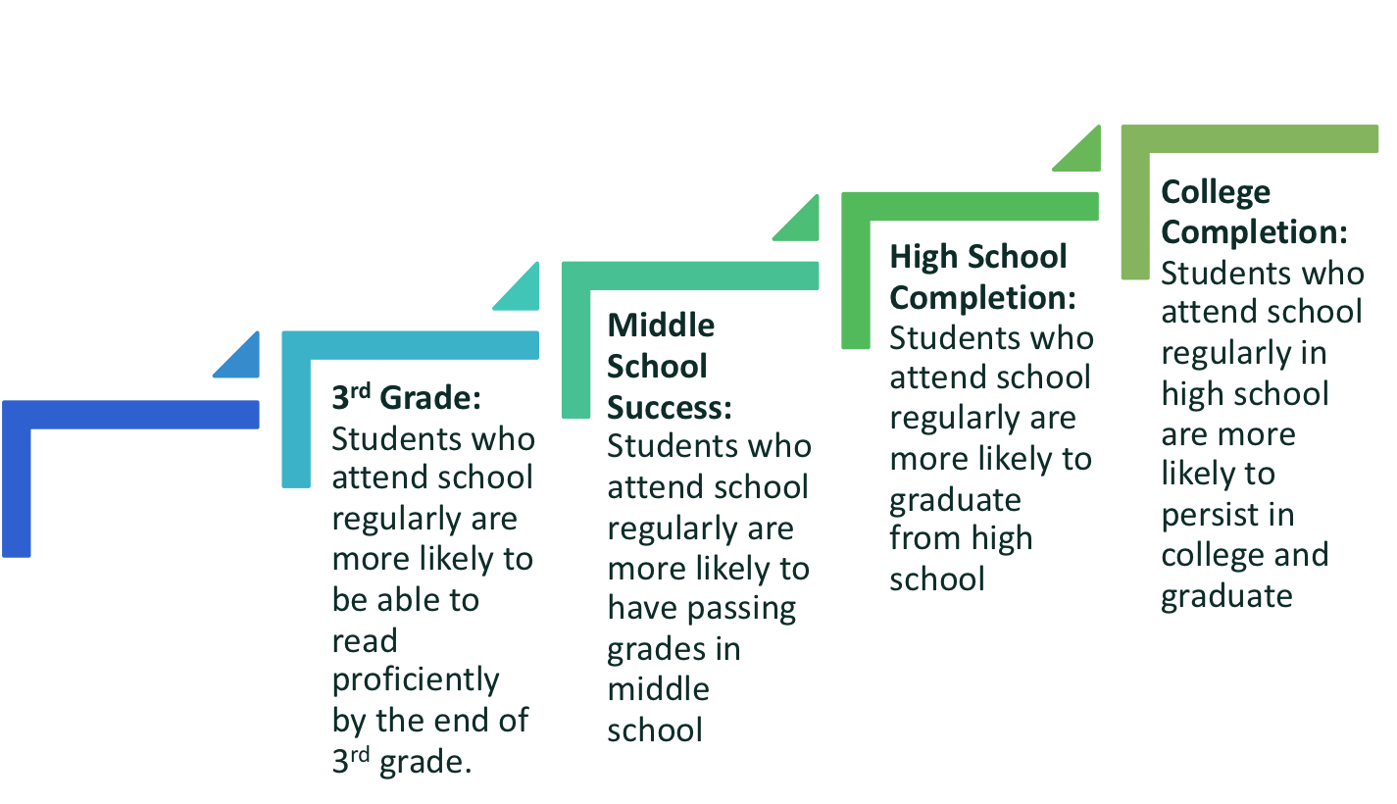
BENEFITS OF STRONG ATTENDANCE
IN ALL GRADE LEVELS
PK-1st Grade: Students who attend regularly in the early grades perform better on measures of academic and social and emotional capacities.

Slide 21
STUDENTS ARE MORE LIKELY TO ATTEND SCHOOL OR PARTICIPATE IN VIRTUAL LEARNING IF THEY FEEL SAFE, CONNECTED AND SUPPORTED
STUDENTS ARE MORE LIKELY TO ATTEND SCHOOL IF THEY FEEL SAFE, CONNECTED, AND SUPPORTED
Educators and community partners can ensure that all students are welcome and feel they belong in school. Given positive, supportive conditions, students will become engaged in learning.
Caring adults, such as teachers, mentors, and afterschool providers are critical to encouraging families and students to pay attention to absences adding up and to seek out help to overcome barriers.
Responding to the social-emotional learning goals and needs of students and families is essential, especially during the transition into this new school year.

Slide 22
HOW COMMUNITY PARTNERS CAN HELP
Help address barriers to being in school by providing food, access to physical and mental health care, financial assistance and other supports for students and families.
Reach out to local school districts and ask what is needed
Fund teacher and student needs on https://www.donorschoose.org/
Help us with our Enroll, Engage, Attend campaign – share our video, post our resources, post positive messages

Slide 23

ENTIRE COMMUNITIES MUST WORK TOGETHER TO ENSURE OUR STUDENTS THRIVE ONCE THE PANDEMIC HAS ENDED.

