Slide 1





Slide 2

Student Attendance
Learning Every Day Together | community partner Presentation

Slide 3
This year, more than ever before, there is a great need to invest in the transition back to school for both students and families.

Slide 4
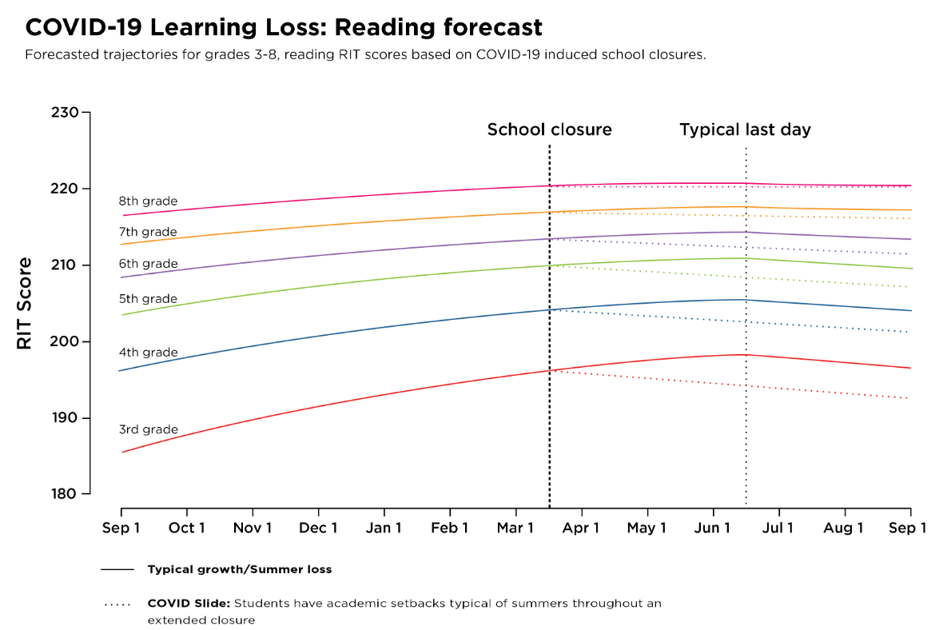
Students may begin fall 2020 with roughly 70% of the learning gains in reading from the prior year

Slide 5
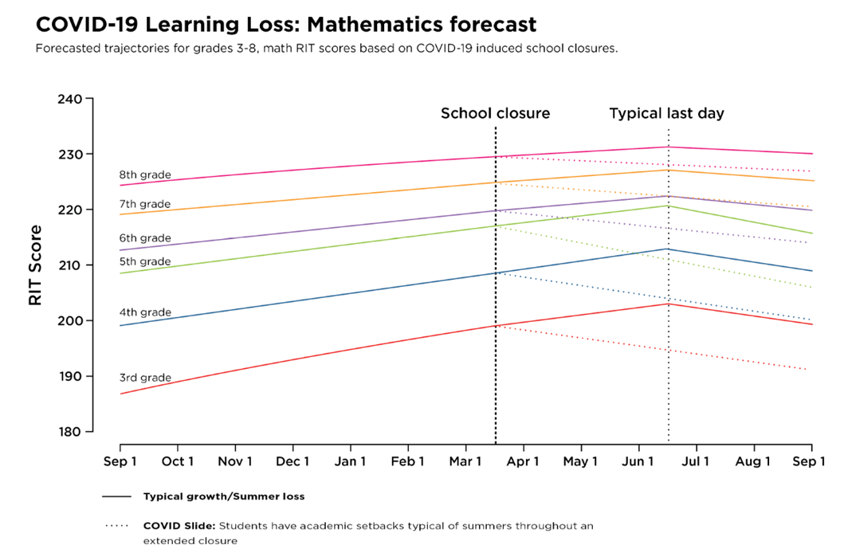
In math, students may return with less than 50% of the gains from the prior year

Slide 6

Supporting strong attendance during virtual learning

Slide 7
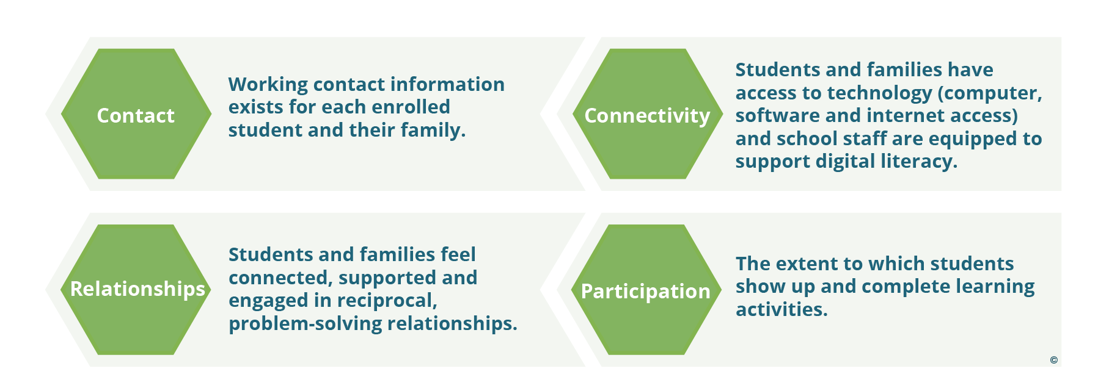
Students are more likely to attend school or participate in virtual learning if they feel safe, connected and supported
ADDITIONAL TERMS FOR “ATTENDANCE” DURING DISTANCE LEARNING

Slide 8
Students are more likely to attend school or participate in virtual learning if they feel safe, connected and supported
STUDENTS ARE MORE LIKELY TO ATTEND SCHOOL IF THEY FEEL SAFE, CONNECTED AND SUPPORTED
Educators and community partners can ensure that all students are welcome and feel they belong in school. Given positive, supportive conditions, students will become engaged in learning.
Caring adults, such as teachers, mentors and afterschool providers are critical to encouraging families and students to pay attention to absences adding up and to seek out help to overcome barriers.
Responding to the social-emotional learning goals and needs of students and families is essential, especially during the transition into this new school year

Slide 9

Chronic absence
A critical early Warning sign

Slide 10
Chronic Absence
Attendance Works defines chronic absence as missing 10% or more of school - for any reason. Students who are chronically absent are at risk academically.
Chronic absence is different from truancy (unexcused absences only).
Chronic
Absence
Excused
absences
Unexcused
absences
Suspensions

Slide 11
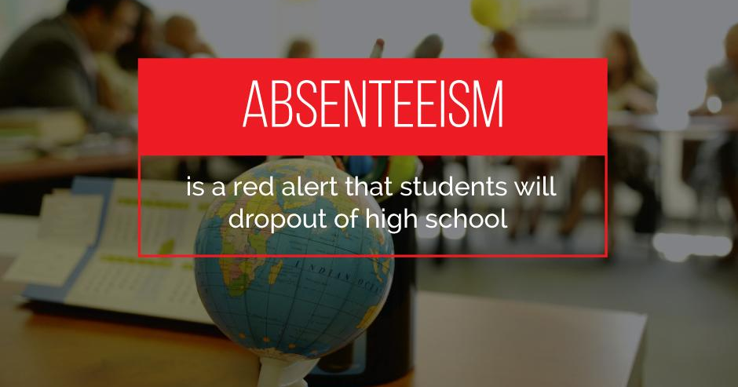

Slide 12
Strong Student Attendance =
Stronger Third Grade Reading Skills

Slide 13

By 9th grade, regular and high attendance is a better predictor of graduation rates than 8th grade test scores.

Slide 14
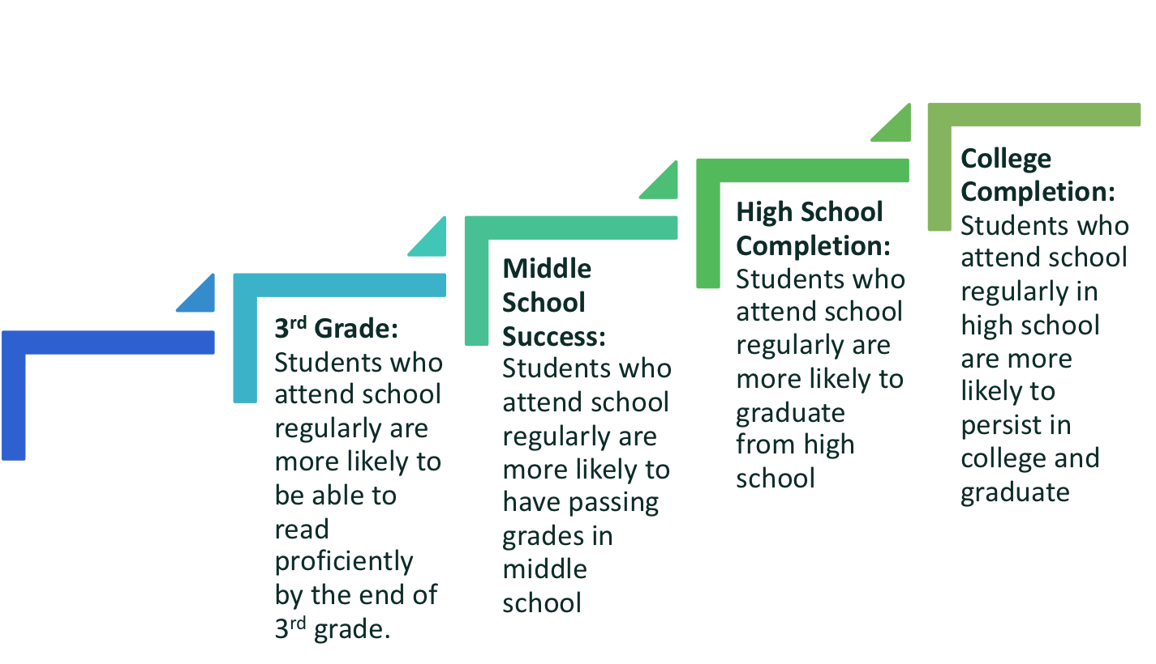
BENEFITS OF STRONG ATTENDANCE
IN ALL GRADE LEVELS
PK-1st Grade: Students who attend regularly in the early grades perform better on measures of academic and social and emotional capacities.

Slide 15
Supporting regular attendance and engagement reduces educational inequities
A consistent and predictable routine for learning every day gives children a reassuring sense of stability which many lost when school buildings closed
Chronic absence leads to students not reading proficiently by third grade, course failure in middle school and dropout in high school
Absenteeism is a lost opportunity to learn – not merely a lack of compliance with school rules.

Slide 16
Strong student participation can be achieved when the whole community collaborates with families and schools.

Slide 17
How Community Partners Can Help
Help address barriers to being in school by providing food, access to physical and mental health care, financial assistance and other supports for students and families.
Reach out to local school districts and ask what is needed
Advocate for more funding at every level to help students and schools recover from COVID-19, with funding focused on those with greatest need
Fund teacher and student needs on https://www.donorschoose.org/
Help us with our school attendance campaign – share our video, post our resources, post positive messages

Slide 18

Strong student attendance requires collaboration and trust between schools, families and community partners. Together, we can help our students learn every day.

