Slide 1





Slide 2

Student Attendance
Learning Every Day Together | Parent Presentation

Slide 3
Why School Attendance Matters
Virtually and In-person

Slide 4
Chronic Absence
Attendance Works defines chronic absence as missing 10% or more of school - for any reason. Students who are chronically absent are at risk academically.
Chronic absence is different from truancy (unexcused absences only).
Chronic
Absence
Excused
absences
Unexcused
absences
Suspensions

Slide 5
1. Student Attendance is Strongly Associated with Academic Success

Slide 6
Strong Student Attendance =
Stronger Third Grade Reading Skills

Slide 7

By 9th grade, regular and high attendance is a better predictor of graduation rates than 8th grade test scores.

Slide 8
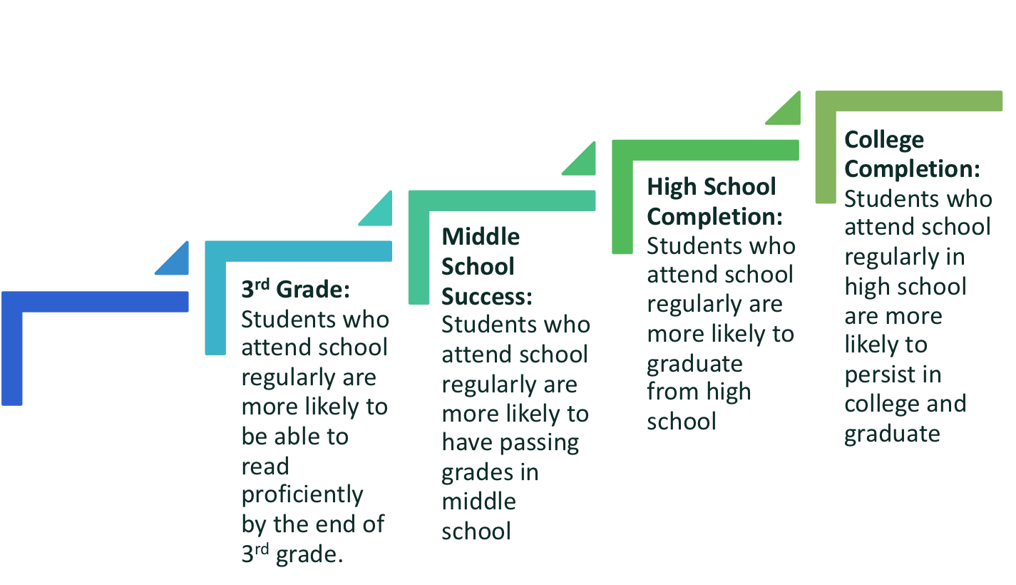
PK-1st Grade: Students who attend regularly in the early grades perform better on measures of academic and social and emotional capacities.

Slide 9

2. Strong Attendance Impacts Classroom Instruction
Teachers can introduce more new material to the classroom
Classmates learn at a faster pace when peer attendance is consistent

Slide 10

3. Strong Attendance Positively Impacts Your School’s Budget
School funding is often based on student attendance.
Every minute your child is in school helps your school’s budget

Slide 11
Making sure your child attends school regularly (in-person or online) helps students succeed and the whole school community thrive.

Slide 12
How Parents Can Support Strong Student Attendance While Students Learn Virtually

Slide 13
Partner with Your child’s Teachers
Remember that teachers are your partners – keep the communication open and reach out regularly with questions.
Familiarize yourself with your child’s e-learning platform. Ask for help!

Slide 14
Create a Learning Environment at Home
Provide a consistent and predictable routine for learning every day. This gives children a reassuring sense of stability which many lost when school buildings closed.
Ask your child’s teacher for help creating a schedule.
Find a quiet place for your child to work.

Slide 15
Set Clear Expectations for Your child
Even though children are learning from home, this is not vacation from school. Your child needs to be committed to schoolwork every day.
Check in with your child daily. If possible, create regular times for these check-ins and to answer questions.
Encourage persistence and celebrate your child’s success!

Slide 16

Successful student engagement requires collaboration and trust between families and schools.

