Slide 1

Veterans Restorative Justice Act Procedure (VRJA)
Ryan Else
1
1
1
1

Slide 2
Overview of VRJA – Minn. Stat. § 609.1056
Eligibility
  Determining if Your Veteran Defendant is Eligible
    Applicable Condition: PTSD, TBI, Sexual Trauma, Mental Health Condition
    The Condition Was Caused by Military Service
    The Offense was the Result of Condition
  Offense Eligibility
    Eligible for Stay of Adjudication
    Eligible for Departure
Supervision and Treatment Options
End of Supervision Hearing: Earning Discharge and Dismissal

Slide 3
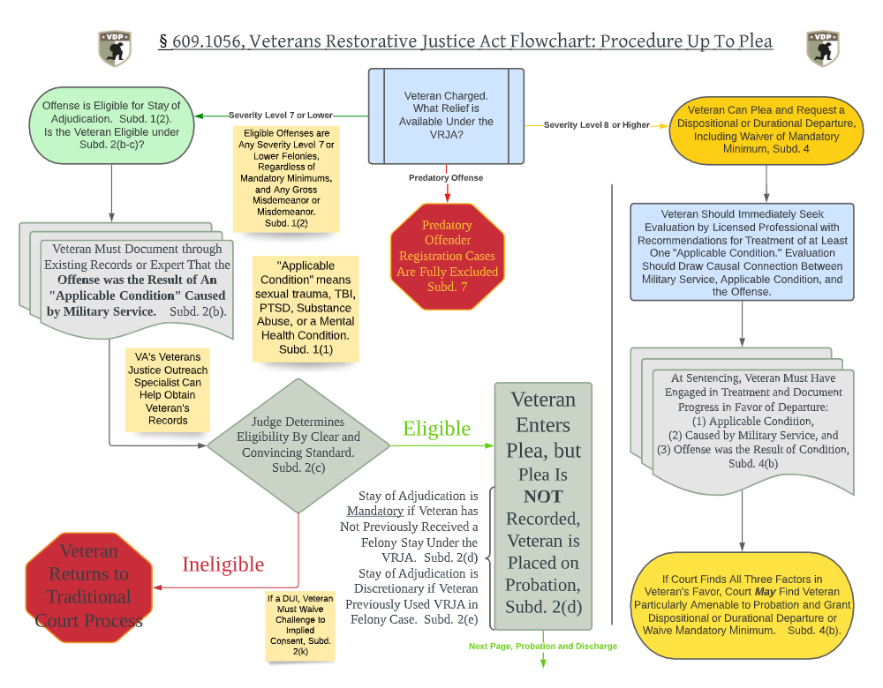

Slide 4
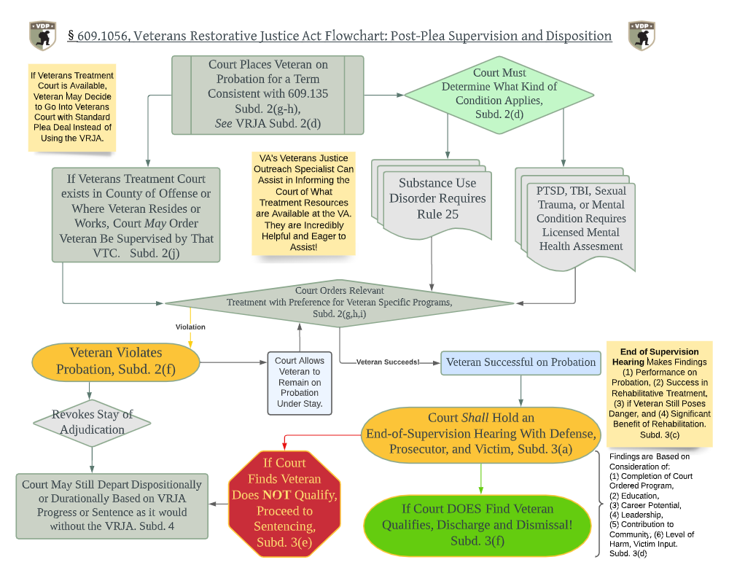

Slide 5
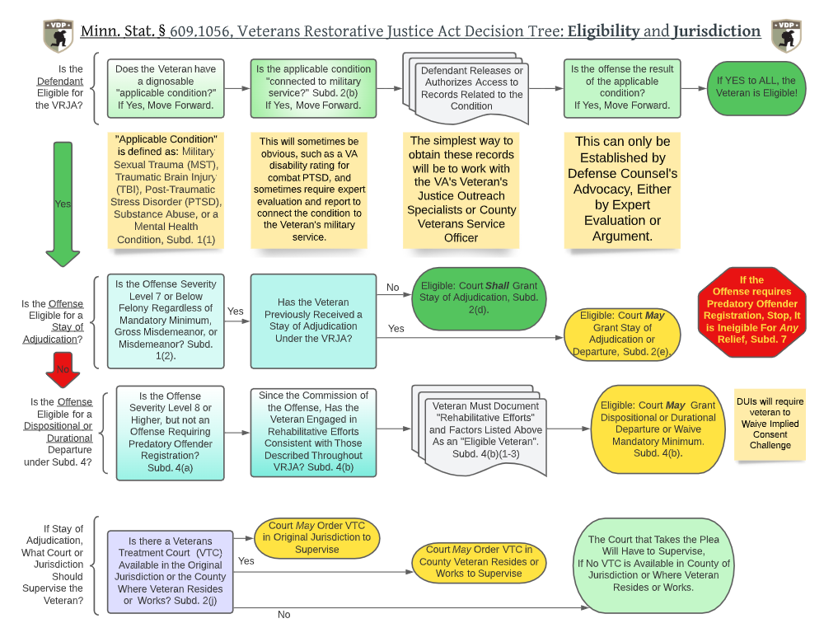

Slide 6
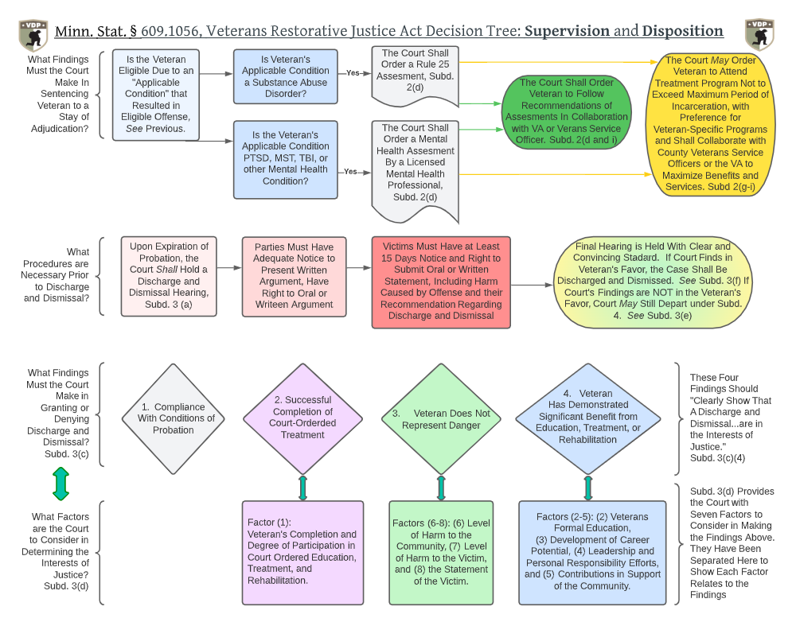

Slide 7
Questions?
Feel Free to Contact Ryan Else at ryan.else@VeteransDefenseProject.org

