Slide 1
Becoming Okay
(When You’re Not Okay):
How to decrease suffering and develop acceptance
Bryan Bushman, PhD
www.drbryanbushman.com
http://findingyourway2okay.wordpress.com

Slide 2
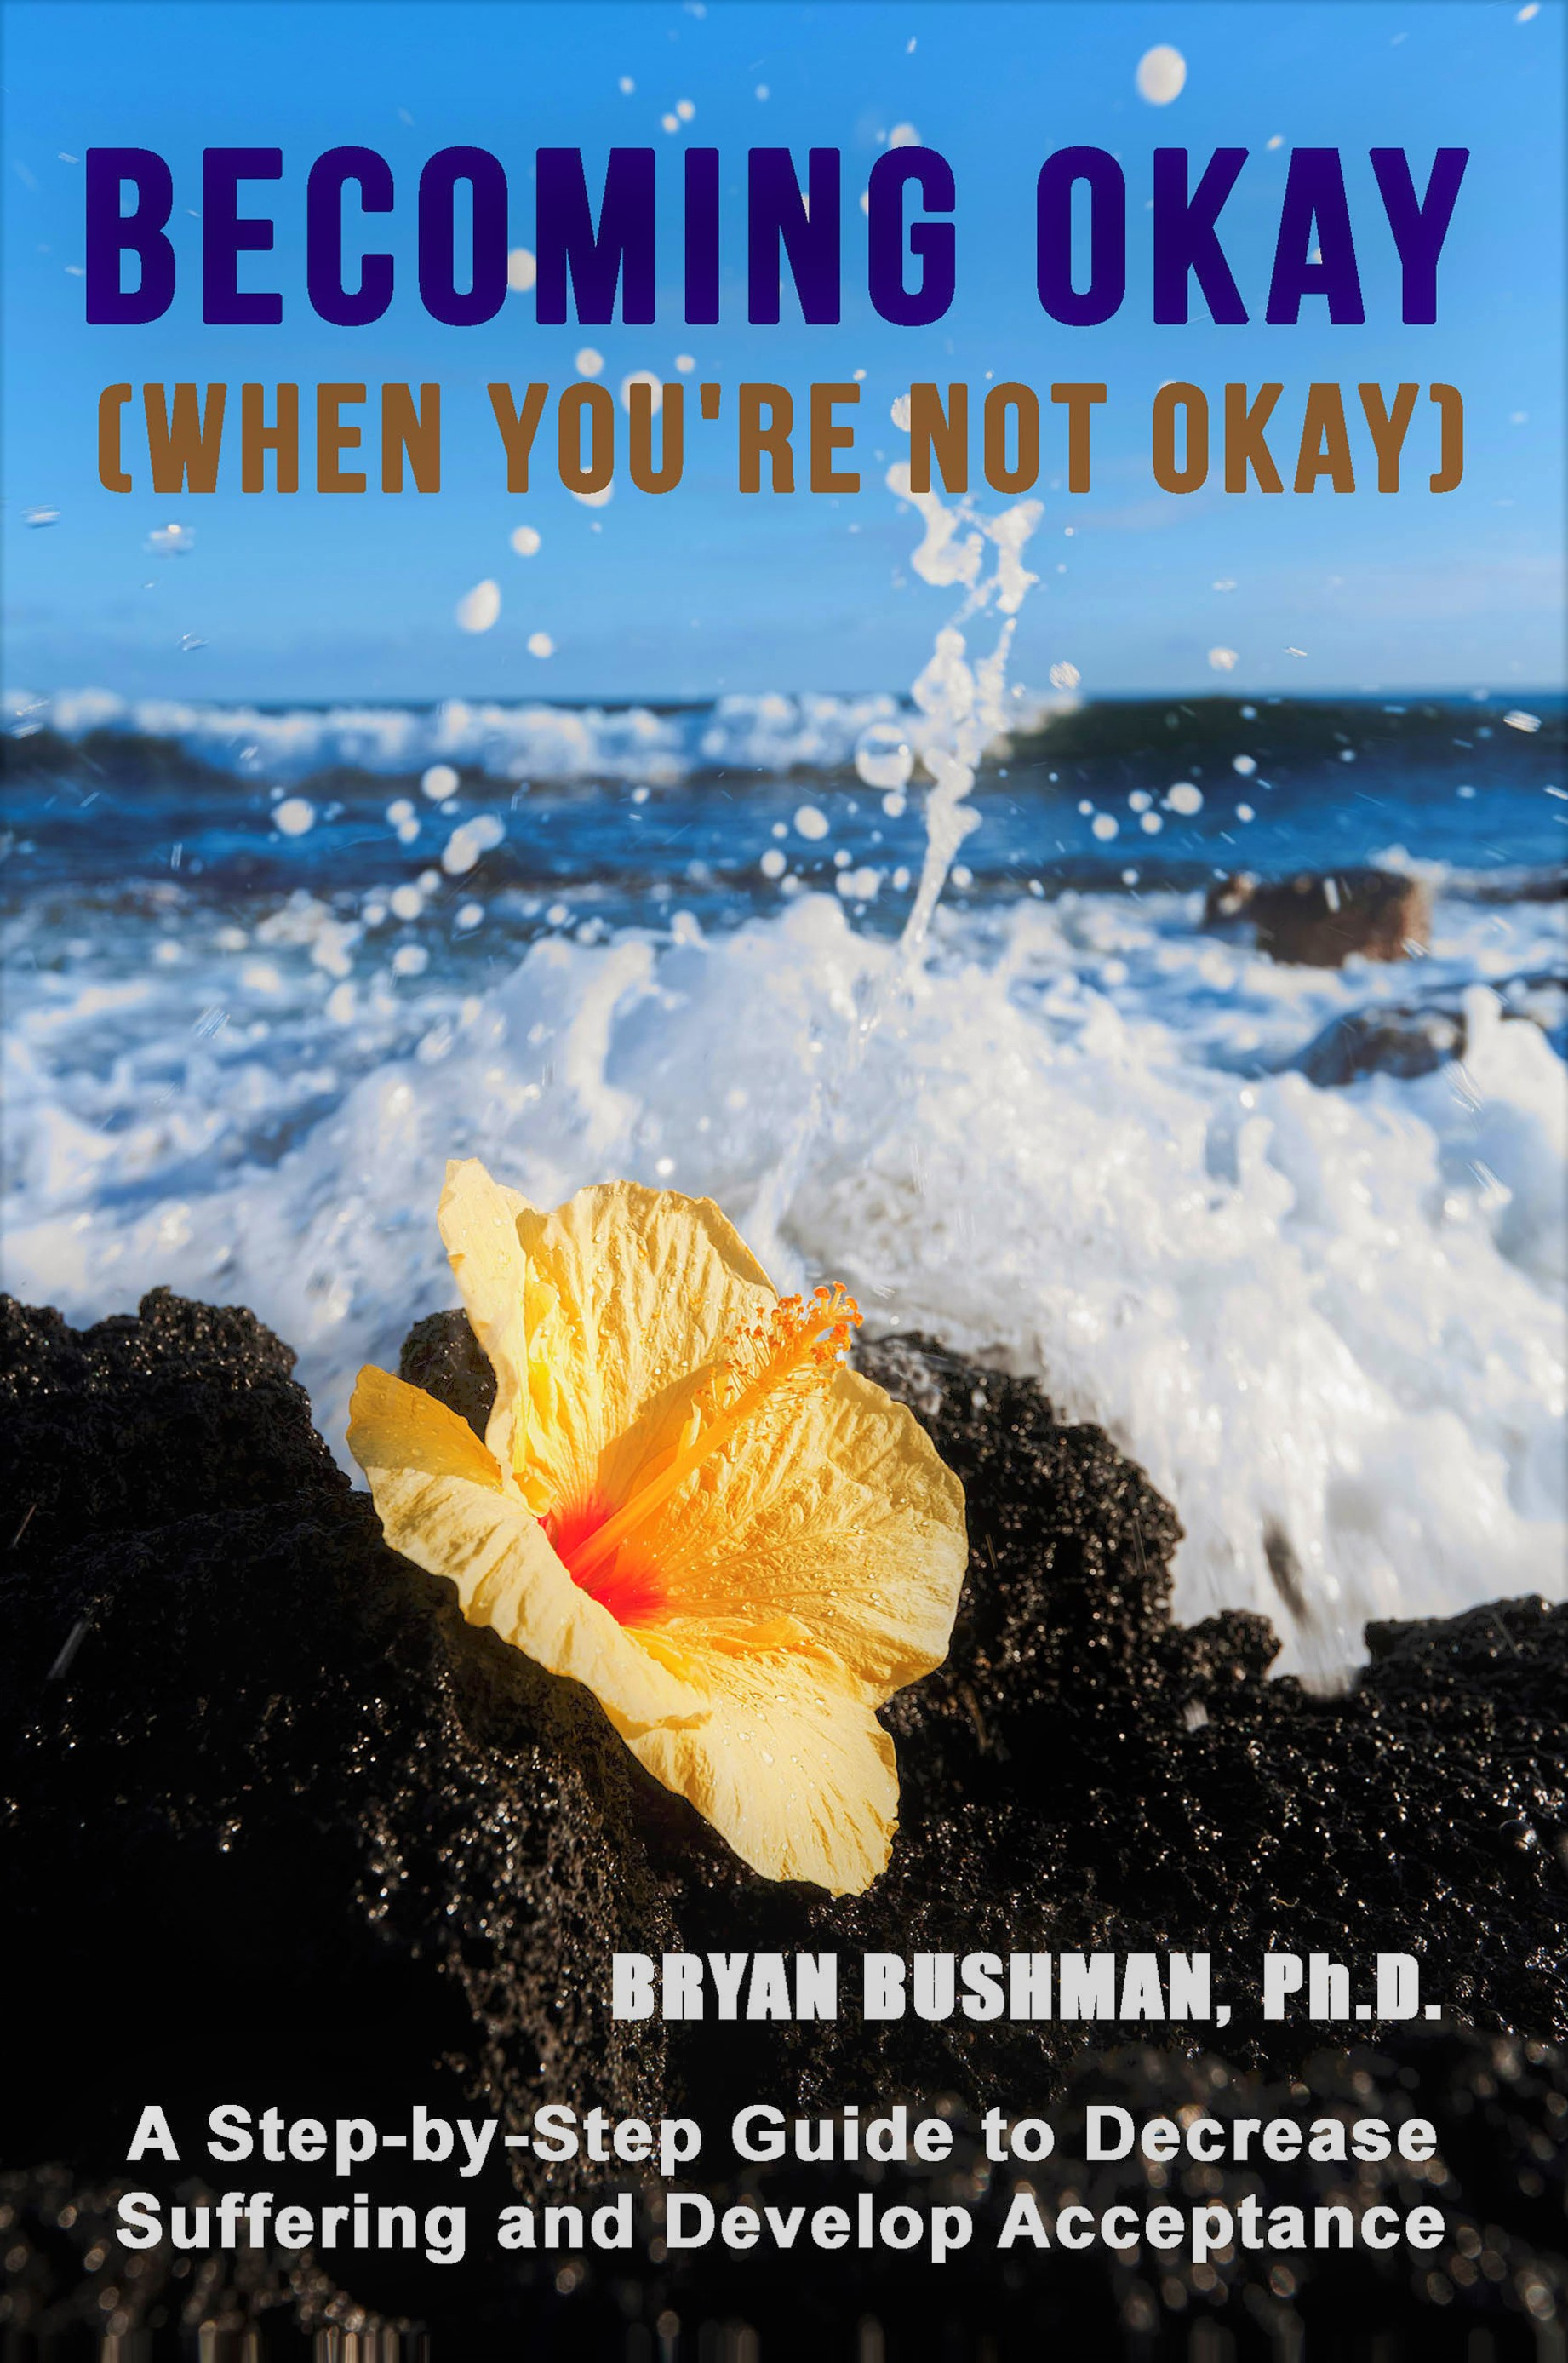
Potential Conflict of Interest

Slide 3
Presentation Outline
Identify the difference between pain and suffering
Discuss three pathways of suffering
Explore how acceptance is developed

Slide 4
William James (1902)
“A strange moral transformation has within the past century swept over our Western world. We no longer think we are called upon to face pain with acceptance. It is not expected of a man that he should endure it… The way in which our ancestors looked upon pain as an eternal ingredient of the world’s order, and both caused and suffered it fills us with amazement… to seek the easy and pleasant seems instinctive… any deliberate tendency to pursue the hard and painful as such and for [its] own sake might well strike one as purely abnormal.”

Slide 5
Pain vs. Suffering
Pain = the process of being alive
Suffering = the impulsive way we respond to pain
“When touched with a feeling of pain, the ordinary person laments… becomes distraught… contracts… so he feels two pains… just as if they were to shoot a man with an arrow and, right afterward, were to shoot him with another… so that he would feel the pains of two arrows…”
- The Buddha
“First darts are unpleasant to be sure. But then we add our reactions to them. These reactions are ‘second darts’ – the ones we throw ourselves. Most of our suffering comes from second darts.”
- Rick Hanson & Richard Mendius, Buddha’s Brain

Slide 6
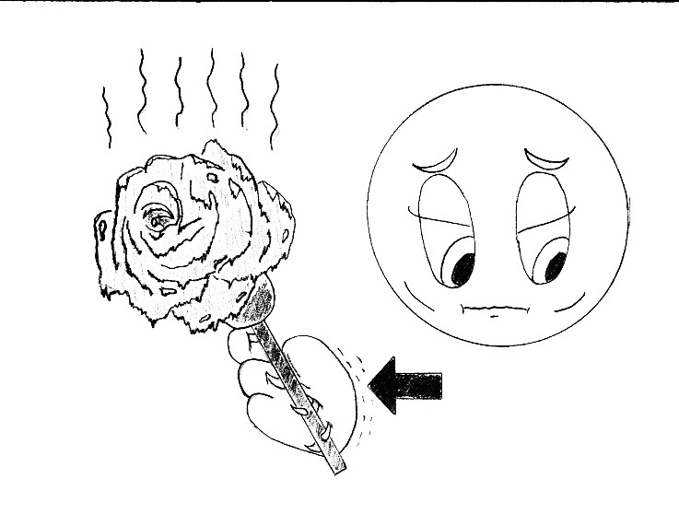
Path of Suffering #1: Avoidance
“Pushing away” emotional/ physical pain
Ignoring our pain or pretending it doesn’t exist
While in this state we…
  Escape (run away – even when we don’t have to)

Slide 7
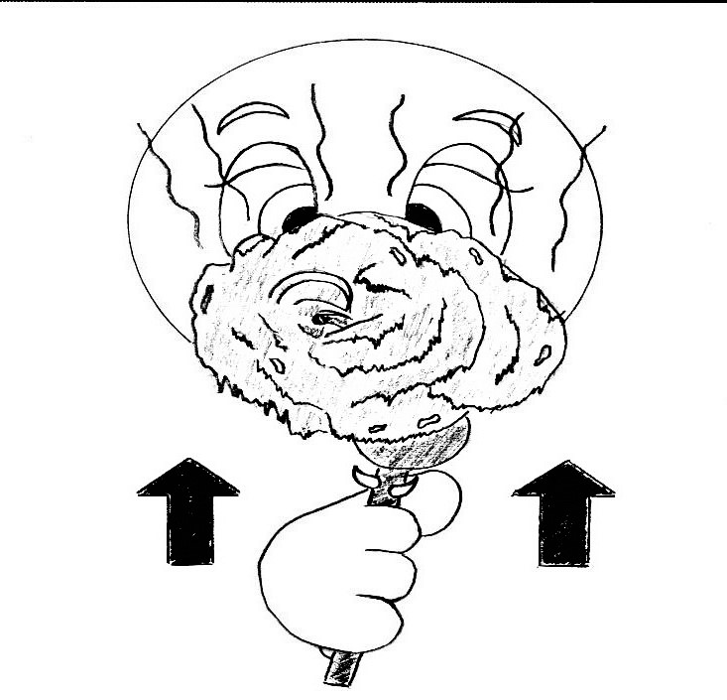
Path of Suffering #2: Fusion
Getting “lost” in our pain
Not being able to have perspective. In this state we either…
  Act In (i.e., withdraw into shame)
  Act out (i.e., go on the offense; blame others excessively)
Relationship between Fusion and Avoidance

Slide 8
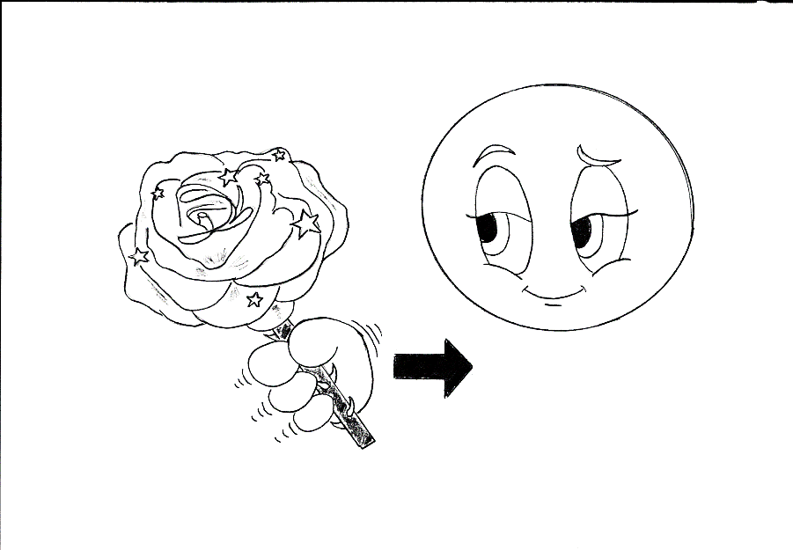
Path of Suffering #3: Craving
Holding onto the pleasure in a way that creates problems
We try to repeat pleasures – even when we know we may need to relinquish our “grip” on them
In this state we…
  Cling (i.e., hold on or try to repeat a pleasure – even when we know it isn’t good for us)

Slide 9
How to Suffer…
Internal Reactions (SIFT) – Daniel Seigel
  Sensations (rapid heart beat, mouth watering, constriction in chest)
  Images (pictures that “pop” into our heads)
  Feelings (anger, shame, sadness)
  Thoughts (“I can’t stand it!”)
Impulses: Avoid, Fuse, & Crave
Self-Defeating Behaviors
  Escape (e.g., Leave a party because we are anxious; change the subject when talking with our spouse or partner)
  Acting In/ Acting Out (e.g., shut down or “swatting flies with canon balls”)
  Cling (e.g., have that second bowl of ice cream, sleep in)

Slide 10
How to Heal (or at least not suffer more)
When it comes to Reactions and Impulses…
  Acknowledge without judgment
  Use Acceptance
When it comes to our Self-Defeating Behaviors…
  We want to replace – not “stop”

Slide 11
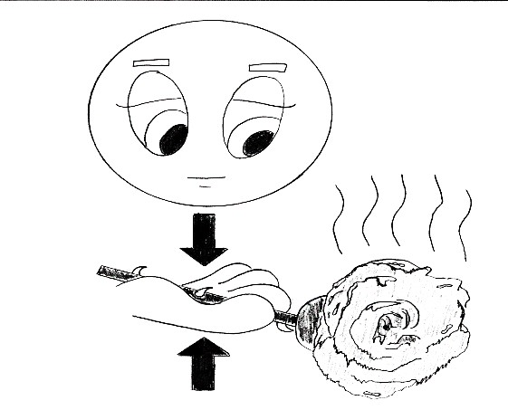
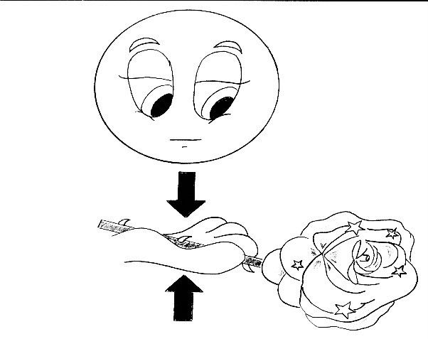
What acceptance is…

Slide 12
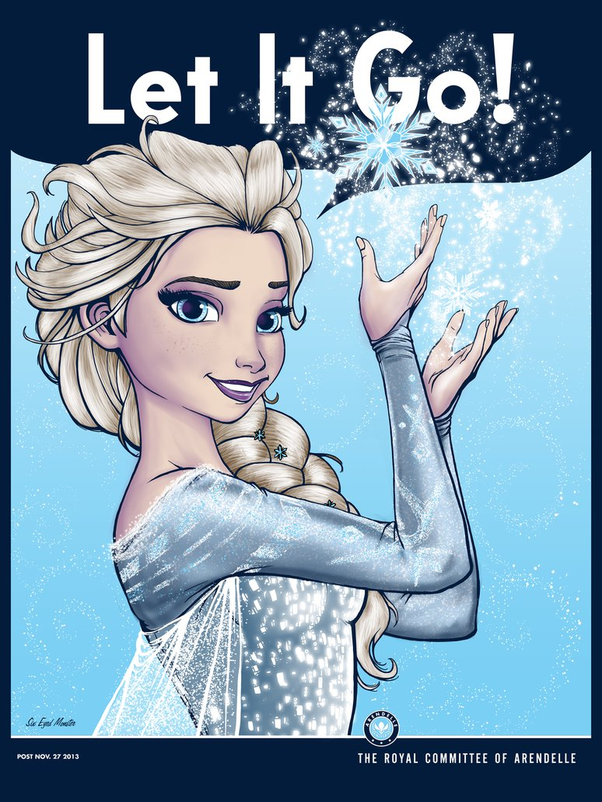
What acceptance is not…
Is acceptance simply “letting it go”?
There may be some situations where it works
Problems:
  Too simple
  Too much like avoidance

Slide 13
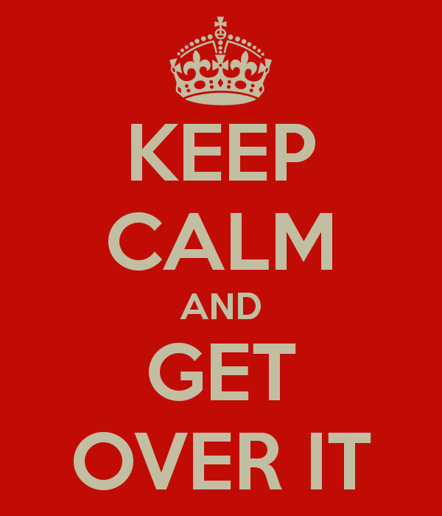
What acceptance is not…
Is acceptance code for “get over it”?
Problems:
  The best way to not get over something is to tell yourself to “get over it”?
  Harsh tone provides power to what we are trying to ignore (leads to fusion)
  Prevents learning

Slide 14
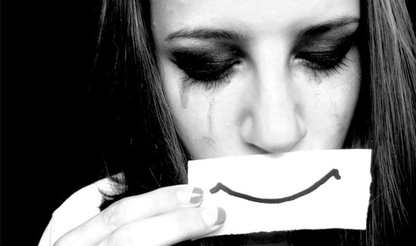
What acceptance is not…
Does acceptance mean that we like what happened or (worse) that we somehow deserve it?
Problems:
  Invalidates the self

Slide 15
Other problems with “acceptance”
Language problem: we don’t have enough words to described what other culture’s mean by acceptance
Sounds like we are “settling” or we’re letting those who hurt us off the hook
Acceptance sounds like trust

Slide 16
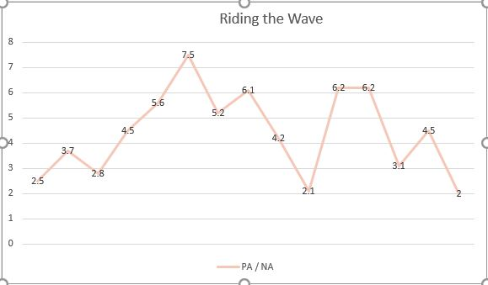
“No Feeling is Final”
POC

Slide 17
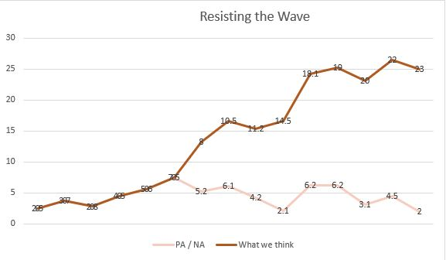
Resisting the Wave
POC

Slide 18
Good ways to not tolerate the POC (i.e., How to become impulsive and shoot yourself in the …)
“This is horrible.”
“I can’t stand it.”
“This will never end.”
“I am horrible.”
“It is too strong; I am too weak.”
“I am destined to fail.”

Slide 19
Summary
Be aware of your relationship with yourself. Practice Acceptance/ Self-Compassion
  Christine Neff (drbryanbushman.com/videos: “self-compassion meditation” and “objections to self-compassion”)
  Self-compassion is not self-pity or not being open to constructive criticism (i.e., letting ourselves off the hook)
Most “good coping” methods are less likely to work without acceptance and self-compassion
  “Validate a Feeling; Follow a Plan” ☺
  “Follow a Feeling; Invalidate a Plan” ☹
  “Invalidate a Feeling; Invalidate Yourself” ☹☹

Slide 20
To Learn more about acceptance… drbryanbushman.com or http: findingyourway2okay.wordpress.com

