Slide 1
Inert Energy F in Y database
Multiple Sclerosis

Slide 2
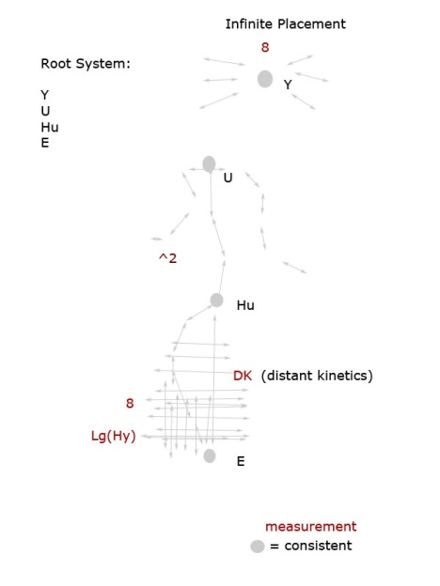
Introduction
What are a walnut, a flower, two cockroaches, and a bee? The walnut; is the heart, in relativity; that its shell must crack to get the nutrients inside of it. The nutrients are a plural power resource. The flower is the brain; it must seed to grow, and expand to bloom. Two cockroaches are the eyes; that they must react to such nuclear power and become intricate to a certain amount of pressure. The bee; is the distributer for the spinal cord; which works in nature as a derivative to any distinctive amount of measurement. It takes the nutrients from the heart, that the brain has pollinated, and sets forth to distribute it in the spinal cord, as a comb for light. (Fig. 1 Root System).
With these basic principles, it is then possible to understand and take flight of the psyche. That acts and reacts to the specific amount of chemistry igniting within the human body.

Slide 3
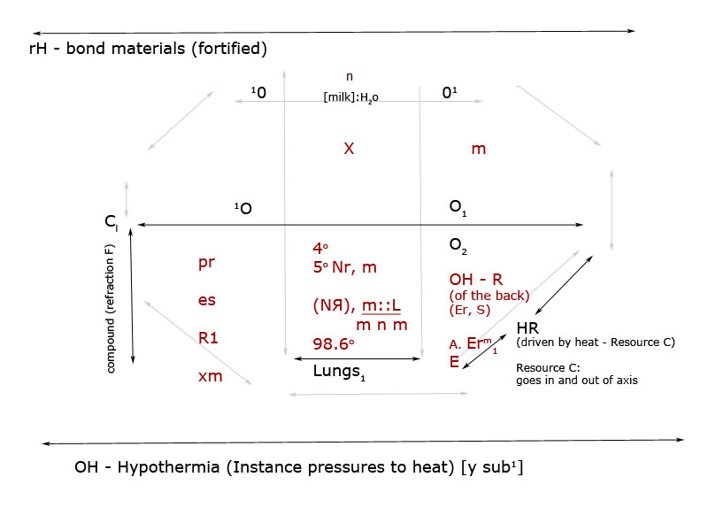
Y Format and Formula 2
Form 2; Carbon Diameter: Prefix R (heat adjacent Prefix)
Format Y:

Slide 4
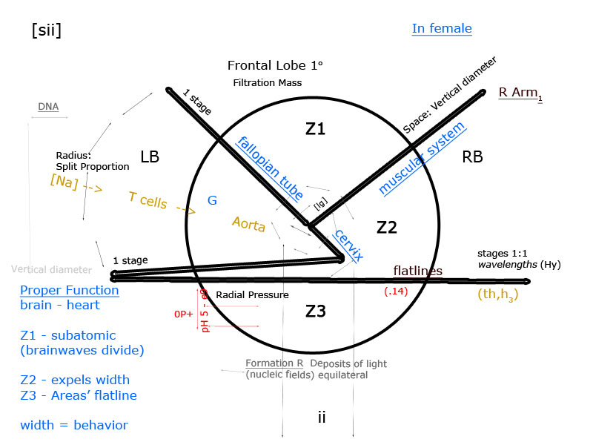
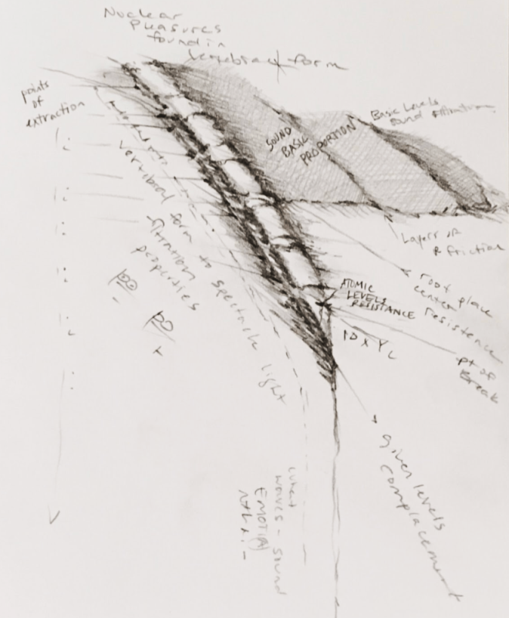
Shells (and shell breakage)
According to Principle in [Z] - (vertebral).
Root - Z: proper brain function [in F] = the proper net weight (fortified materials) belonging to the lungs in S:
Root - {aY]: S proportion (of floating ions) = hydro-thermic pressure [z].

Slide 5
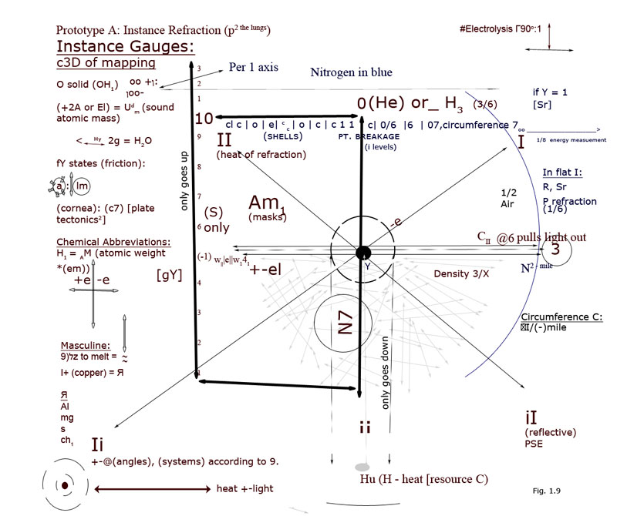
Brainwaves according to I:
[gY] net weight to the lungs in x-Sr: (c fortified by t (retraction):
Fixed weight proportion
Intensity levels I

Slide 6
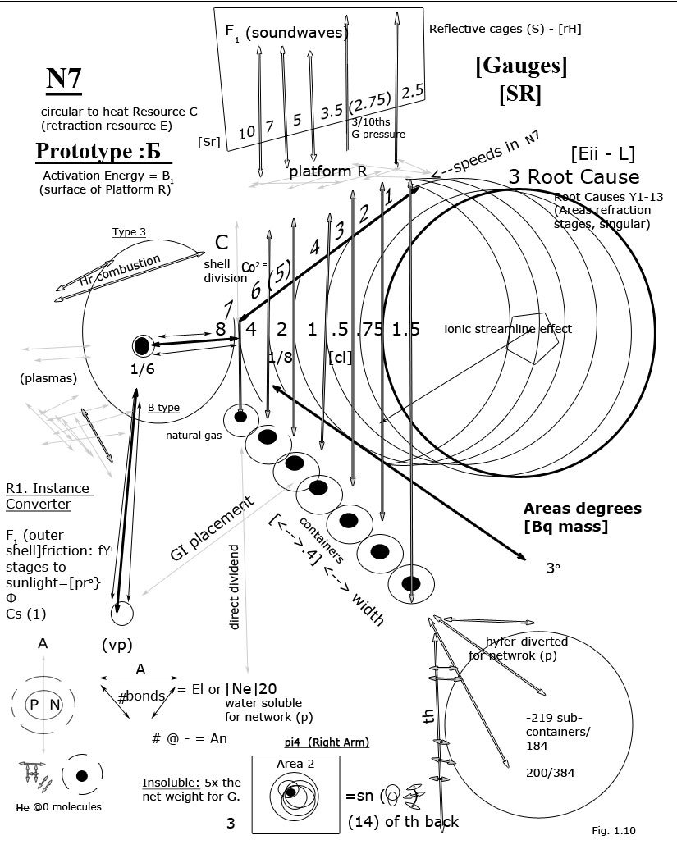
Introduction to Brainwaves:
Brainwaves cause the nervous system to react under pressure.
Given time degrees is the electrolyte to the given vertex (psychology) in the spatial structure of the heart.
The neuron sits 3/3 to voice/ volume control (epidermis radiations are rectangular): [astrophysics]; in the atrium can find the volume where time sits.
“Plantations” of the hair (follicles) – are reduced by fats from molecular forms of heat waves. [unique cell division]. [Ne20].
Heart reduces light by pressure (the axon).
Red blood cells induce heat by endorphins.
Plate tectonics come from the Root Hu or interstellar medium (a helium to heart [inert hydrogen] ratio in platform R; by decreasing width by volume).
Lucid dreaming may be analyzed in IRD from the blood stream or count in the liver.
Eyes wear a “microscopic lens (g range to P, network I) that adjusts time to the thorax by waves under pressure
The voice is the hydro-nervous system’s Co2 breakdown of hydrogen. Due in masts (malFunction F).
Net base = G scale of aerodynamics brain – cornea in b.

Slide 7
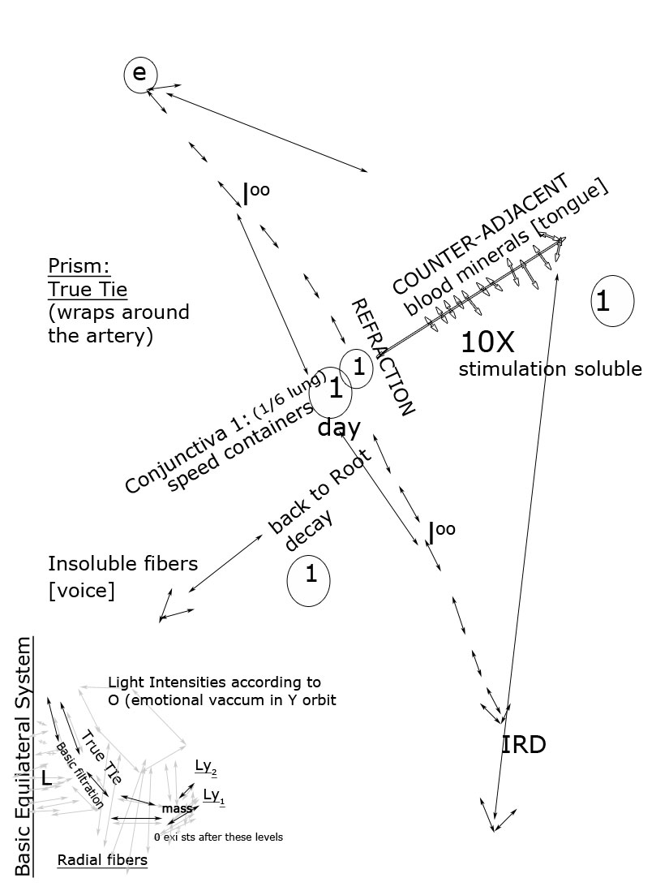
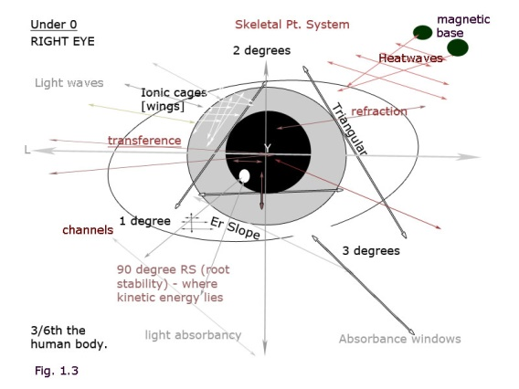
Introduction to Dream Cycles
In S (hydro-thermic radiations cause c²).
Property 1. Valence
Property 2. Brainwaves to Pressure (time is your extract to waves).
Property 3. (gS consistent: I) of the thorax
Property 4. G scale Y physics Subcological 1 (3º)
Property 5. Any inert Energy according to 1
Property 6 – 18. Advanced Cultures must adjust. (A1 or p²,N7).

Slide 8
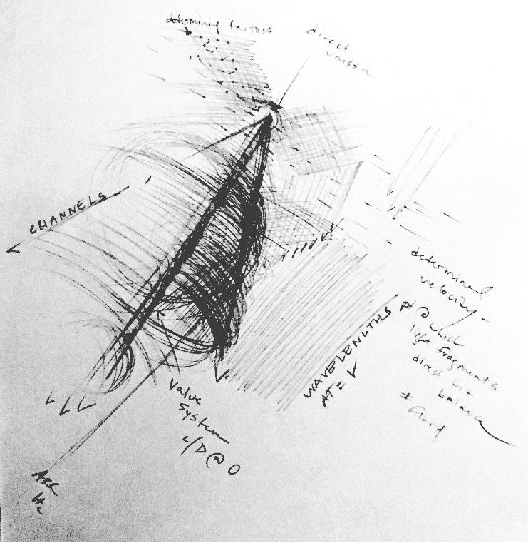
N7 Breakdown Proportion P:
Time is an even ventricle to principle.
Net weight is even principle to Vision.
Time must adjust the weight of the vortex from the back to the ([br]xe) molecular weight of the ion in (E-x2) for any psychological breakage to be a turning point in R or (z- x1 to x- y1) at0.
Nd:3 – 7 causes friction.

Slide 9
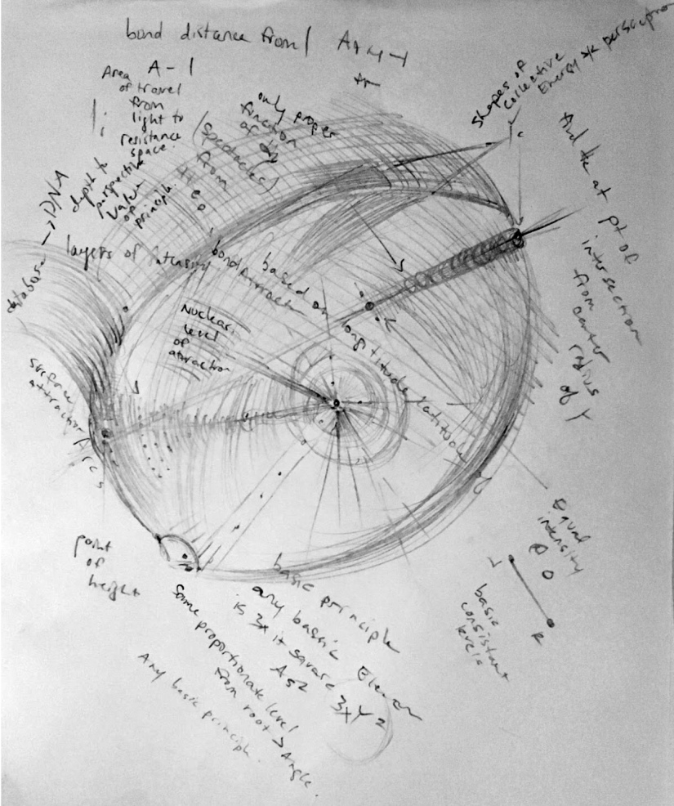
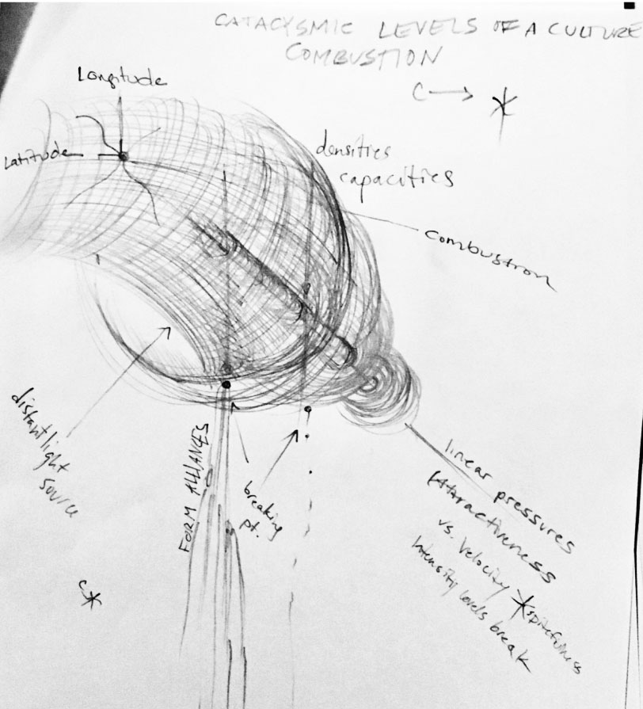
N7 Breakdown, Y Principle Axis [gY Advancement (lungs – teeth) or net R of hydrochloride].
Axis Y: +bond breakage [C] at combustion.

Slide 10
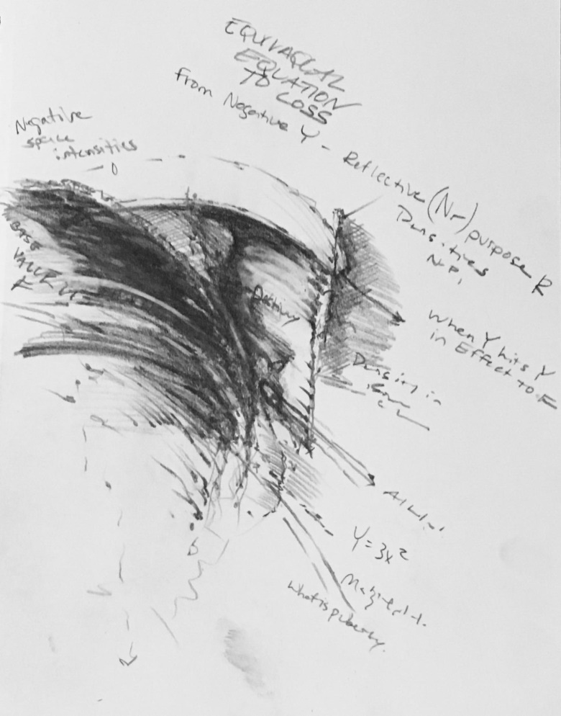
Equilateral Provision (S).
Reversed (Reversal Axis): [gY].
Electro-mitosis of the cell membrane in 3º is a melting point to longitude at 36º; this is a hyfer-refraction to brainwaves where parallel instances can occur at the mouth and hydrate from a longitudinal standpoint at c² - therefore the cn conjunction in z2 is always s consistent from the electron at -3²√7. This is where the studies of the cortex can be analyzed; releasing pressure from the heart and into the hydro-nervous system for E²: your root equation [7º/compound] Sr weight at Prefix 6 [98.6º helium pressure to the lungs] under your special spatial system that allows an infinite amount of energy to base in its storage systems for further research of the spine’s retraction [c8 – or 1] 1\8/s.

Slide 11
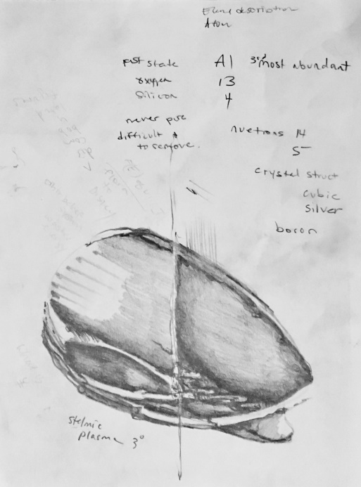
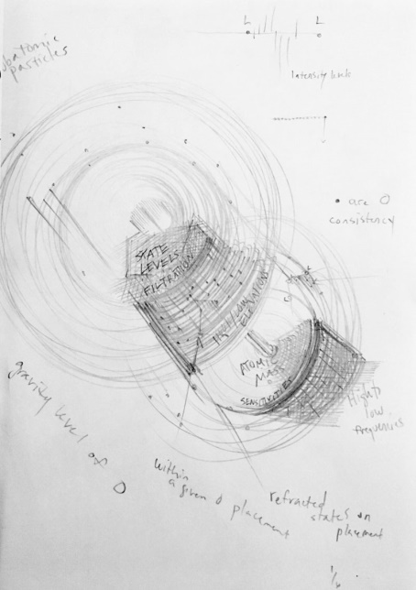
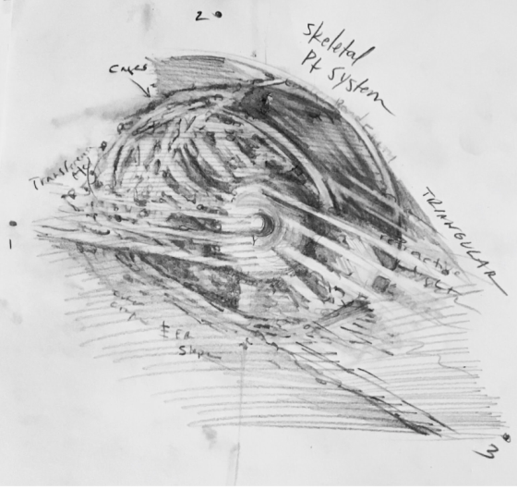
Reversal of the Spinal Cord
Refraction 7º = your stelmic system base F: [pY] atrium F (hyfer-kinetic in c) → cs in agriculture @Y from the lung = 36º
Y base

Slide 12
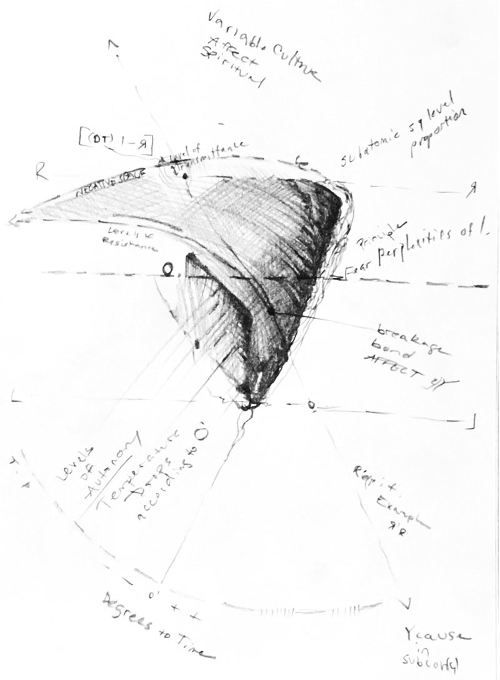
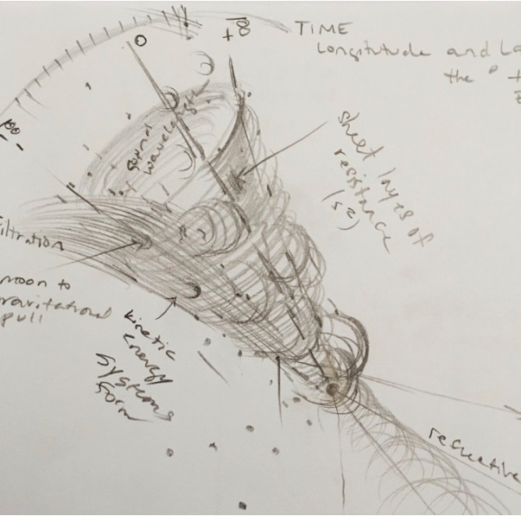
[Ar] conjunction U (stelmic base pressures: Factorial Ranges) gS.
Y1. rH – nH conjunction Q or U (vخهؤ

