Slide 1
Dream Cycles: Introduction.
Unit R.

Slide 2
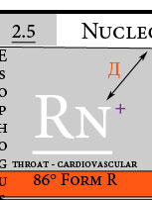
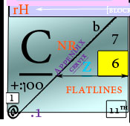
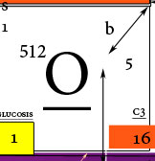
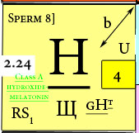
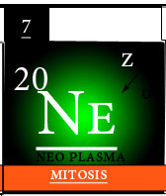
Unit R. Reality.
Male ≠ Female
Male + Female = 1 Nitrate Cell
(for proper understanding of measurement)
Which C18H24O2
Which C19H28O2
Which gains understanding Format Y of Co2 as a principle of moisture.
Which [piiº] = weight to serotonin: causes evaporation into the blood stream; Proton exponential; C13H16N2O2. (X – cornea is a division of principle N6).
cx
Ar
c7
-3.
C @ -1 [testosterone – estrogen]. H @ -4 [testosterone – estrogen]
C = Root diameter H = Root hole to conjunction in (2) levels of 4.
Subametrixs to form 2. “Oncology” to radius pH [219].
Root 4:
[Y13]: The sun.
Melatonin to the Radius is distinct.
Latitudes: c:(-6, -5), h:(12, 8)
Longitude: N2.
L @ 0

Slide 3
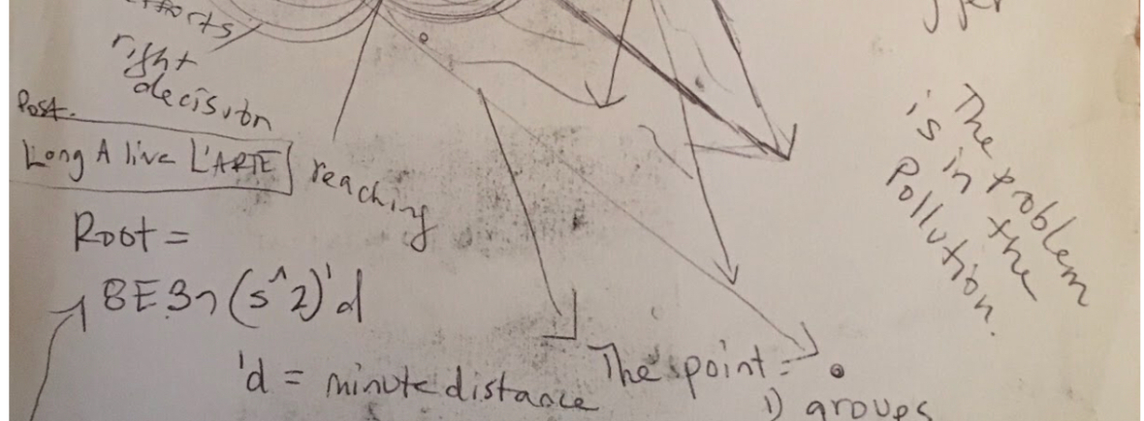
A multiplication derivative to Eye Sight To the subatomic weight of oxygen (8) by the energy (caloric intake) by 3: (serotonin by cholesterol by nerve endings) by the sulfur squared (of oxytocin) before the day
8
E
3’’’
S²
‘d

Slide 4
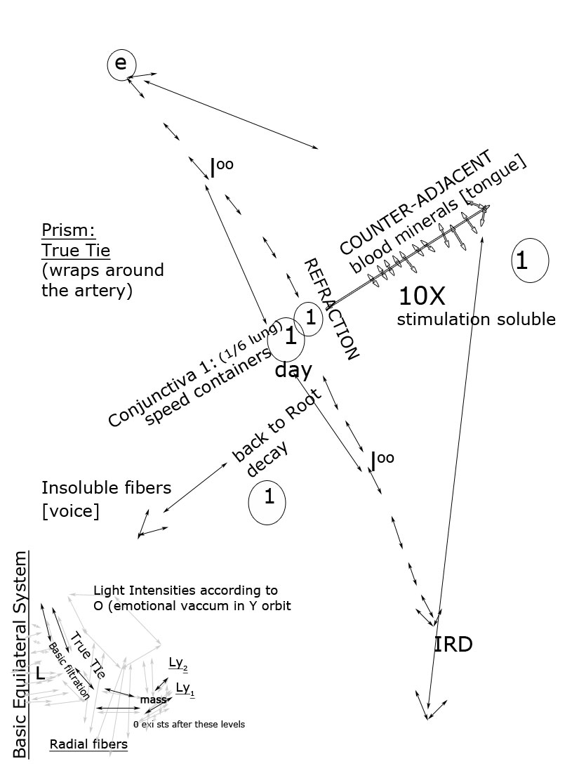
Dream Cycles (in Aerodynamics to Human blood form B)

Slide 5
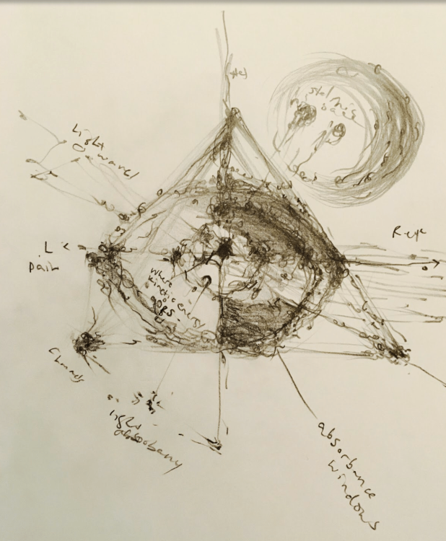
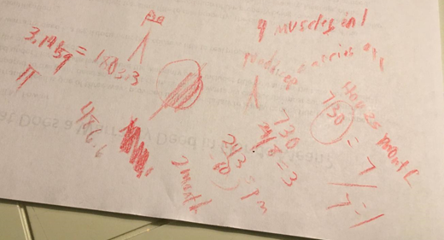
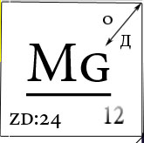
Neuro–dynamics of a bond (net principle I): Introduction for Multiple Sclerosis [pH].
Blood cultures from blood pressure: (A8 – A13) S.
Dream Cycles to Embryology: Shows that the hyfer-regenerative (digestive stages) are in [Neptune]: Neo-plasma Formulas S (D of Isotope Culture H) = the expounded weight from Formula I in the last stages of Dream cycles (5); is expound by t², which is the time expounded extraction (ts) of the membrane:
Subcology:
(tS) is at Y8 (Project Description.docx); {function F ~ [A13 to dopamine].
Therefore, the first 3 months of the child’s sleep cycles are connected still to the mother’s dream cycles. Expounded weight = GI; time extracted = S. Serotonin – health deficiency. ID form. #Protein
#in Female.
Image: Right eye, from 3º pull at radius in the atrium.

Slide 6
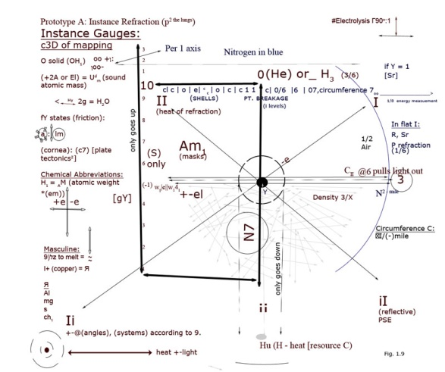
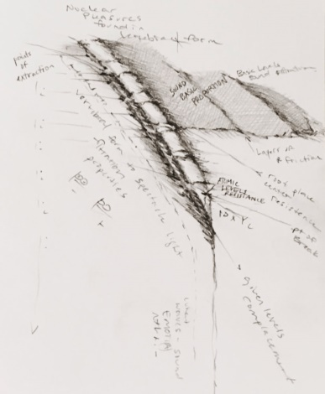
AMR reference sheet, Plate Tectonics²: Prototype B
Peptides:
Set forth I, 3º, 2+ discharge [weight]:
Delivery xyP: x10 [di].

Slide 7
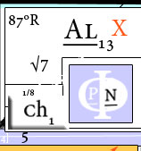
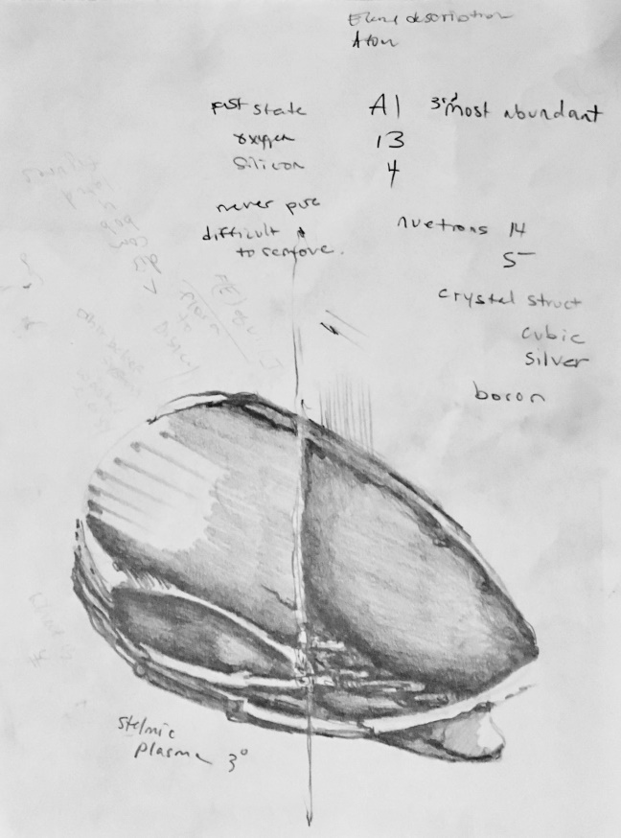
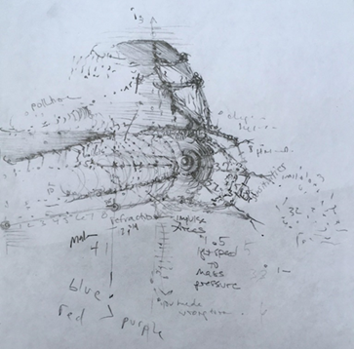
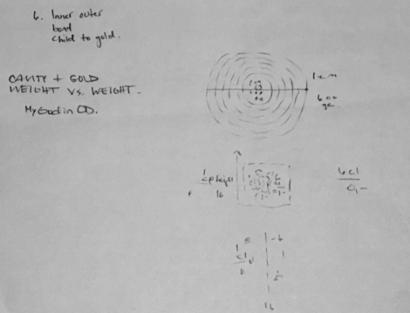
Overview Conjunction X
The Walnut.
The Heart: Formulas S (D of Isotope Culture H) = the expounded weight from Formula I in the last stages of Dream cycles (5); is expound by t², which is the time expounded extraction (ts) of the membrane:
(tS) is at Y8 (see Subcology’s project description); {function F of v12~ [A13 to dopamine].
(gS) stands for time without E [nutrition] or ovarian exact - generated from the liver. (Subconscious = 96º of chlorophyll cultures in I (p net[astrophysics]).
Why gS? The integrity of a given molecule (bond) will be found within the consistent [lung] having 2 sides, decreasing as light revolves around the sun, divided as light subtracts (which is overreaction [ovarian]) E extracts width by 2 given variables (O2, O2) [sodium]; which is your width that [muscle] must cling to [water (AH, pH)] will then be fortified c by the net principle [od8]. G gives the evidence having solidity to form the variable [molecule], evenly as 64.6 full resource circumference (32.3|32.3) as [psychology] construes magnetically. Or 1/2 of a whole conjunction by gX., your basic genetic activity rate by gravity. Gravity pulls space in the same time for Light (endorphins). The truth that all is found within is in your hydro genetic multiplication tables: c1=O8=c1; 8 of a given diameter for velocity to square split 4|1 (3). CHLOROPHYLL
A = 8 or p²
#Type A of muscular System
32.3|32.3 bent axis, ID form (b).
SA node molecular; form [plural]; 3 degrees and from chamber in light: direction of the sun rising in the East.
Neuro-diameter to Root decay. 6cl/o-

Slide 8
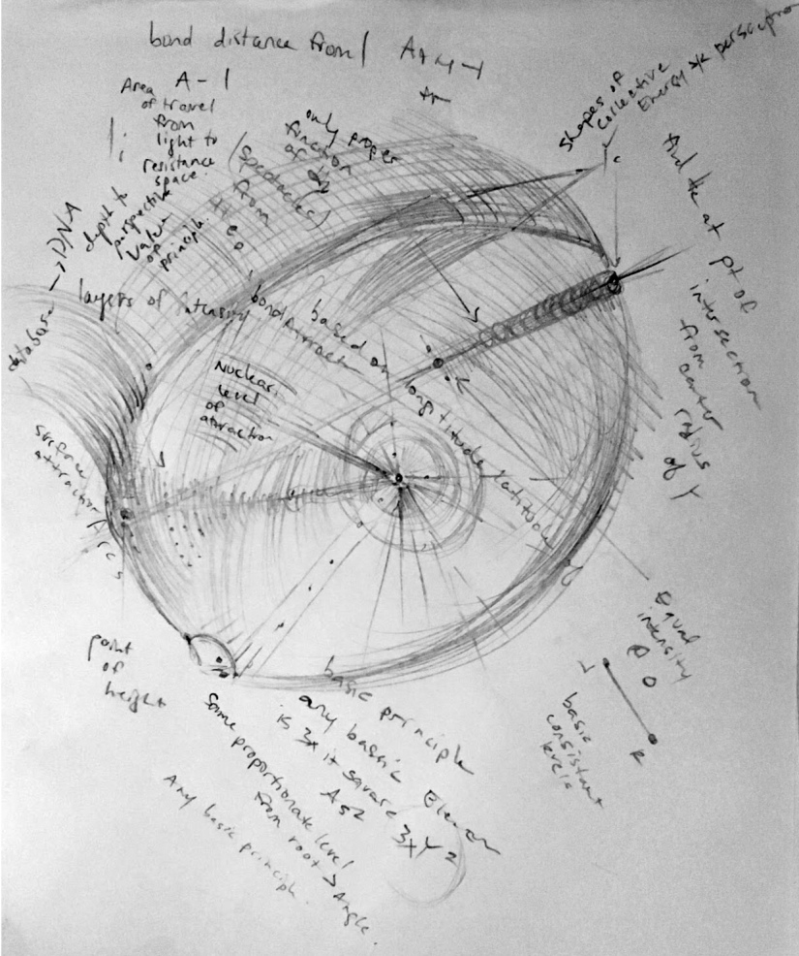
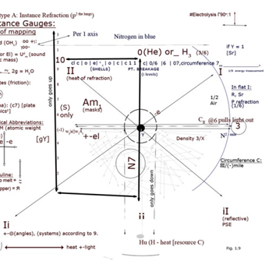
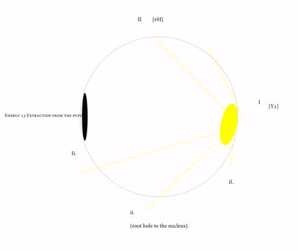
Overview X: Increasing weight (neuro-refraction). #diamonds
Ii. View p-1.
Time squared.
From 3º take instance
pressure.
2. Minus 1 from the
vertex.
Shows instance
timing.
At 3/10ths is
your variable.
5 x 5 x 5 ~~ to the lung.
#Scotoma
F1. Nucleus velocity is at 3/8ths Instance Q
Optive 1
- Of mapping.
Ii. Based on nuclear level of bond attraction (p-1).
Bond distance from 1 is (3/4 Area’s width [conjunction p]).
Attraction = Co2.
Longitude and latitude of the Nervous System (system’s Principle [p squared] is the neuron’s spatial structure in [He] (vortex of the moon; in latitudinal relationships of width; expelled by relationship’s principle: the fallopian tube).
Hydrates the body outward [plate tectonics squared].
Hormones play a role in conjunction (system’s p [net]).

Slide 9
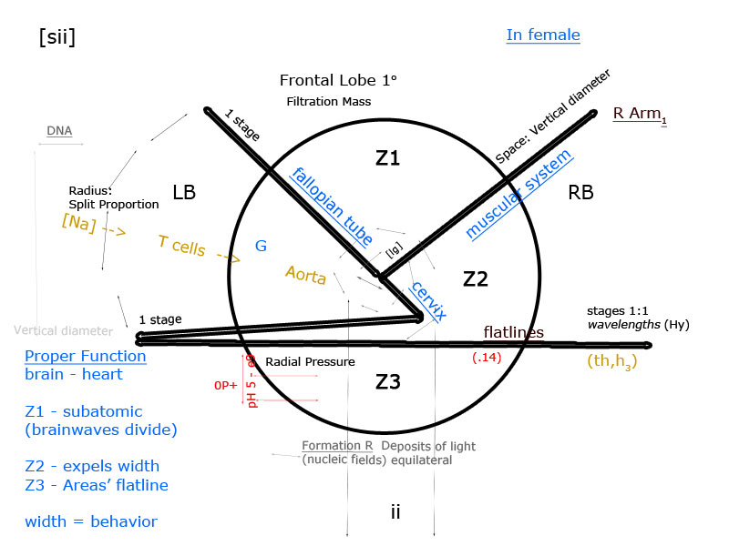
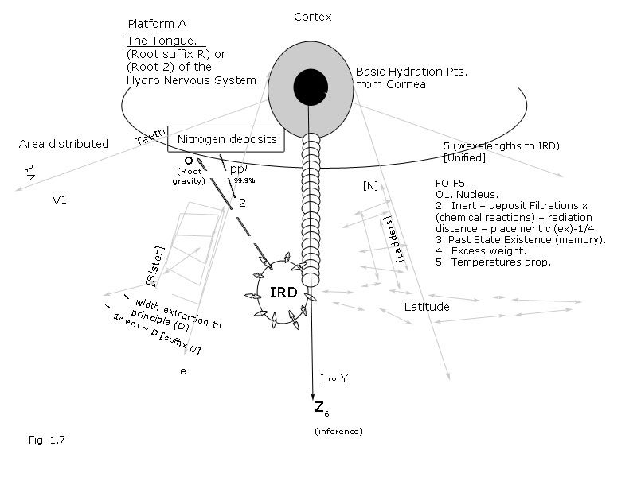
Hydro-chloride (Area conjunction root hole).
KEY POINTS: 7x7x7~ Nitrogen base in teeth. Formula P (instance waves) – throat = Formula 2. Energy is color.
N1. Nitrogen refraction (neuron) – N2. longitude base is negative mile [16.09]m p m -- N3. form solidity (in the mouth). – N4. aerial base weight = connectivity to Nitrogen (pi4). – N5. spatial distance in relativity to the mouth = root hole. – N6. dietary; the muscular-moisture’s dia-take. -- N7. Nitrogen cracks the nutshell for bleed room: -p.
5 x 5 x 5 ~~ aerial timing.

Slide 10
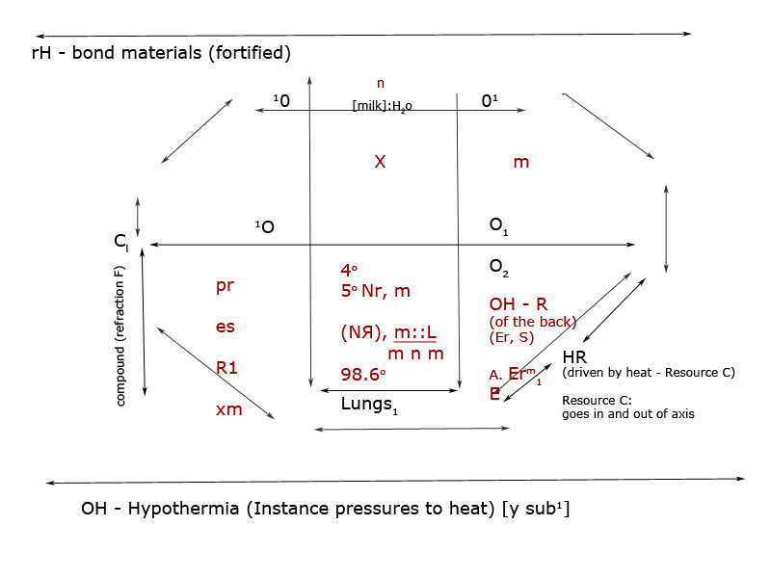
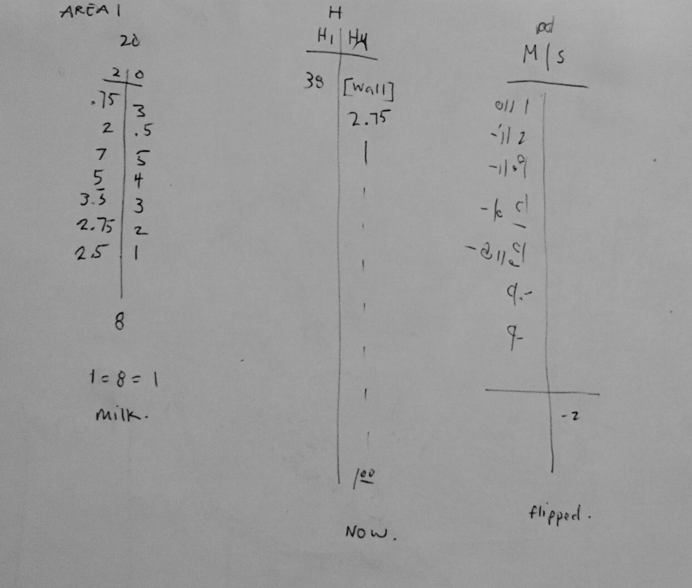
Formula 2 (instance heat waves to cl, distance E to brainwaves [UI]).
Extracts: split culture isotopes.
In Sister = Group A (Area 1 – fallopian tube [.4]). Weight to water pH\oo f+.
9x9x9~~ instance heat waves molecular form R. (-A).
Time extracts pulse → instance goes in (-|oo) → dietary (to the blood vessels) goes out (+:|oo).
-2

Slide 11
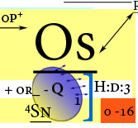
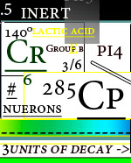
Formula R: Introduction to Density [p-1]GI.
Formula 2 in decay.
Light in
Density:
O = pH
pH = 16
Planet A -
(Type 3 according to sound).

Slide 12
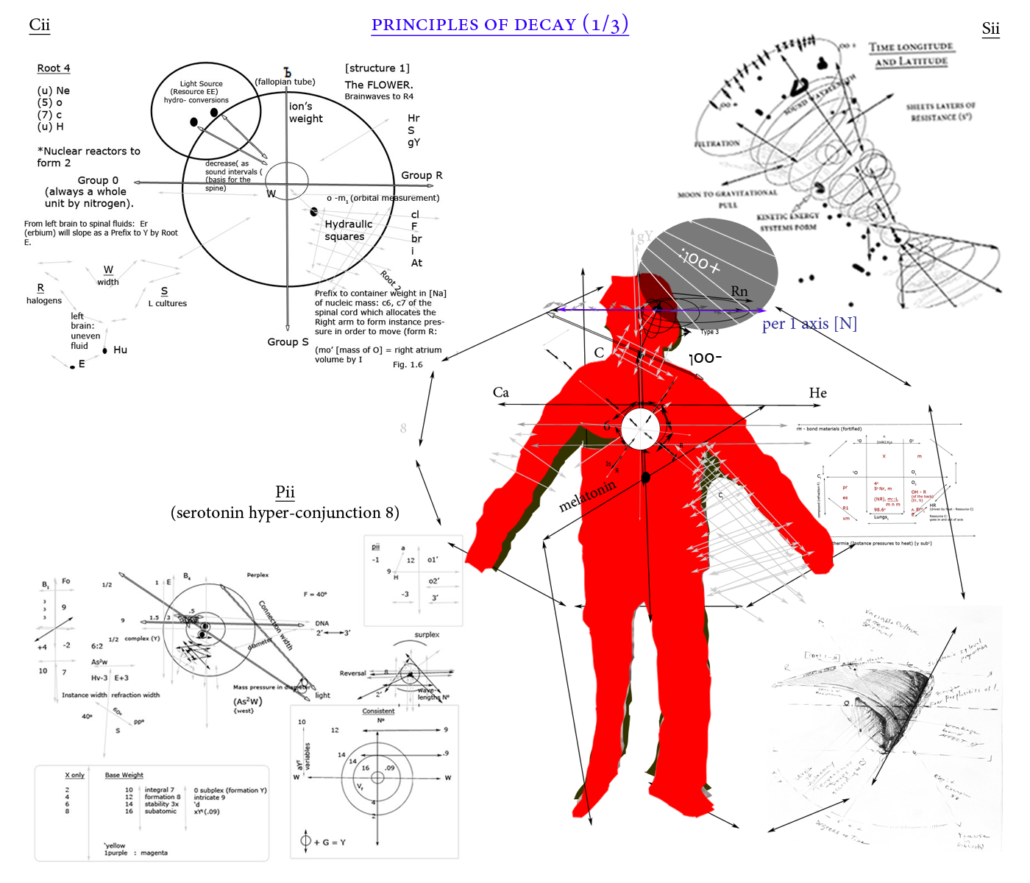
Hydro-thermic Radiations
Isotopes
6cl/o-
Group 0 – ъ.
The given Lungן capacity is mixed of botany:
1. Capitulary (Head + feet).
2. Capillary artery.
(Head of bone).
3. Ion.
4. Tooth
5. Decay.
6. Root 2 is breathing (form b) defined in capitulum:
[the flower]
0nucleus [- 6
Space ~ hemoglobin. Neurological states induce [He] by (axis):[RB – LB hemispheres], which is gas it maintains (under system pressure); gS acts as carbon dioxide does to hydro-adjacency of the lungs (the integral square to mass units). The turning point to brainwaves is in antibodies which carbon mass fields (antibodies) ARE always a reduction to eye sight, therefore Heat BEFORE Radiation is always a subject of 1 (4). Any [conductor] counter-weight exposed (in red blood cells) is the counter [co] cohesive material [to the mother]. In 8, your serotonin levels will adjunct by rhythms [right arm] to hydrate as neurotransmitters do in order to play the role in oxidation processes and in physics. This can be found in carbon (Root E) at sterilized deduction of the Cornea in (left arm energy) which wraps around the spine at [-c7]. Hyfer-conjunction (subsidized pressure to heat) is in the thorax (t9) - (multiplication tables) for molecules that burn fuels from fats {serotonin in G level] and it is Subtraction to clauses always {RB – that’s going to add molecules for (the heart’s conduction (by (axis) to heat (Heat Resource E [left brain -sternum]). In dietary physics, heat induction (valve) is to be reused and is [insoluble] (psychological Formula P of neurosis). Noble gases play an equal role in hydro-adjacency as well as to the right arm (P). The Areas pull width up to extricate as a full circle circumference (fibers). This means we have the ability to pull from the (Cornea) its root cause at brain function; and in [F] from the tongue, as the wavelengths are conjunct to the Right eye (v). #Neurotransmitters to voice = sound control.

Slide 13
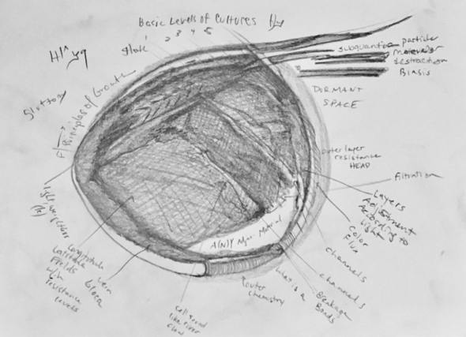
Hydro-thermic radiations cont.
Neuro-transmitters to the Eye (R).Neurological thesis holds to the bone in [noble gases] pressure as nuclear physics to biology. The Area point starts to decay at what space is wrapped around the CARUNCLE [Area’s wavelengths] from sternum under Right Eye prº (area’s radiation to sunlight). Time melts as it falls backwards [optic 1], and into Heat Absorption [Plate Tectonics (pA-c); glucosis s’y r = latitude): pi.
System’s adjunct to heat waves are left to the sternum’s Ero-plasticity {from the human eye] INTO THE MOUTH at decay systems} P (formula 2).
Right arm holds the brain’s nervous system UP; and into air ducts as left brain divides these ducts into pressures for split cultures to adjust by (Eye gradation levels [gravity]). It’s position is north: pY is the time to lightning in instance (3) degree under pressure systems of the mouth [root hole} form affect of nitrogen’s distance. #Glote
Form pressure’s Eye dissolvent is in the thalamus to [left hand/arm energy split conjunction to axis (membrane [g-scale left eye inertia .3]). Left brain.
Time has a given axis. Neuron's rich in fluoride have an un-even axis [melatonin].
8 x 8 x 8 ~~
Melatonin dissolves the instance’s nucleus from the lung to the feet into the direction of the sun. Which is always a storage unit. #heat waves

Slide 14
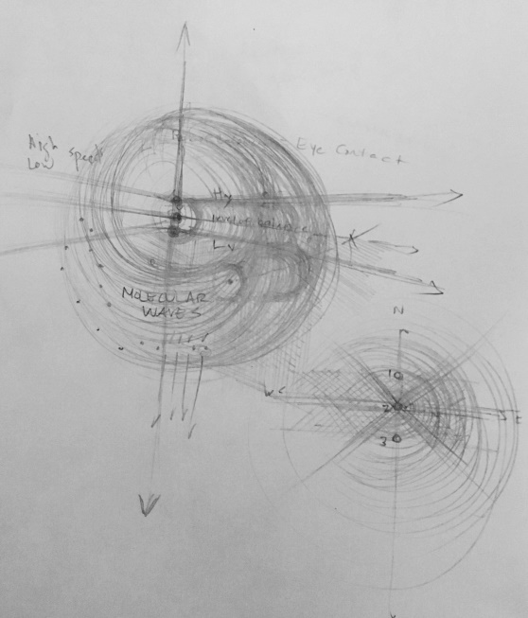
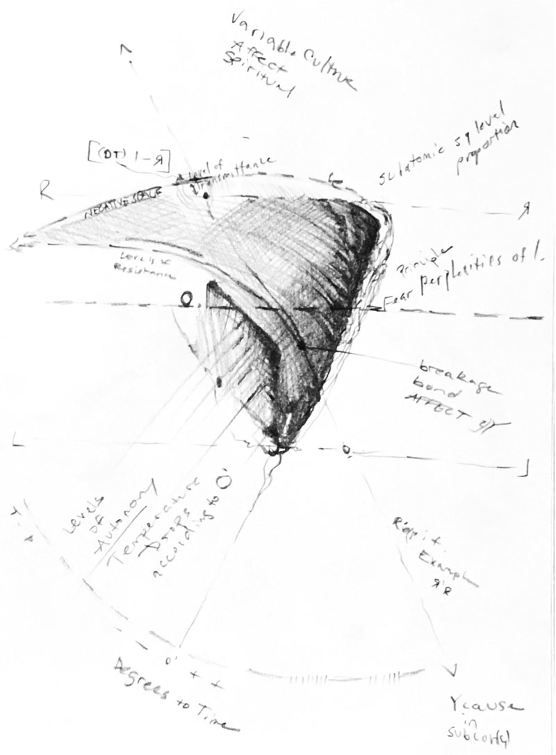
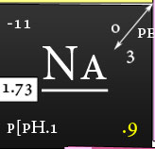
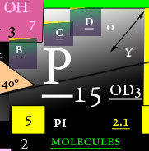
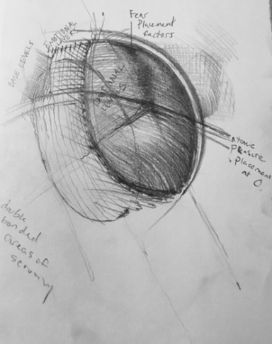
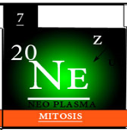
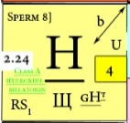
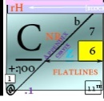
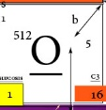
Hydro-thermic radiations cont.
fY axis (p squared to root at the thalamus [Hu} p9].
y adjusts under tones of sunlight – gravity to uneven water weight is not pulled until the affect of nitrogen undergoes sterilization processes (dream cycles (root to axis Y1) [pm].
Hydrogenation (probability factorial ranges):
Root 4 – Axis [gY}tX:
Radius At0 (storage units are diverse to electronic proportions (-).
Even bound electricity [Eii] are electromagnetic waves from the thalamus becoming degrees.
Serotonin’s dissolvent are the (brainwaves).
Step 1.Group 4 in Nitrogen Muscle formations (Areas plasmic) GI: is cervical @0.96 square root temperatures: chlorophyll (pr adjustments) [pm].
Let the volume out – In the cervical degrees of lightning we find principle squaring proportions from (left brain) into the Right atrium:
Hydro chloride in deductions become the SHEATH’S proportions of nitrogen adjustments and [Na] function is the same as (sea level) in the cavity:
find pH systems and crack the Walnut; at the Pupil[ph1.
It will square
magnetically after
it’s adjusted to
timing
(Co2)[T cell} → .
Heat adjunction to sunlight – time evolves to thalamus [Y1] #uneven tones = Root 4.
Principle Mass function: (Root 4)
[Area 2 forms your compound @ width].
→
→
→
→ Divide the blood cells into walls.

Slide 15
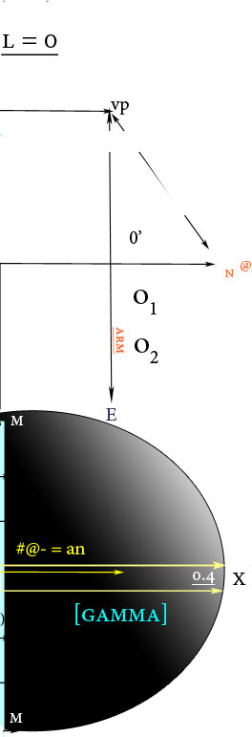
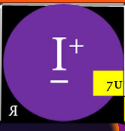
Light waves consistent the body [pi8].
Optic 1

Slide 16
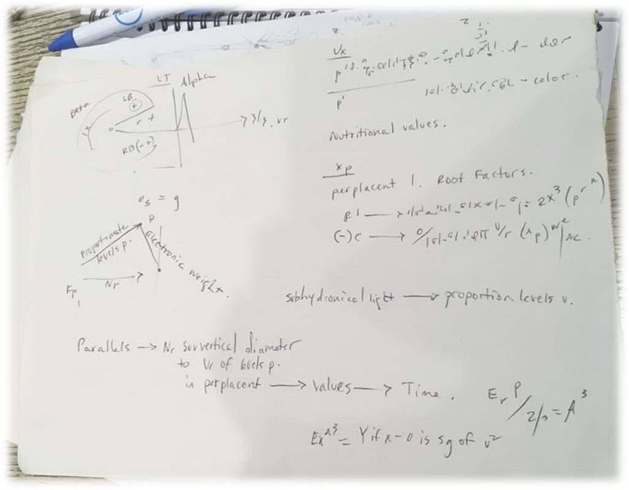
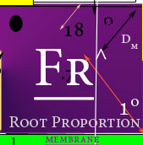
Nerve System’s Principle 8. A = 6º (Reaction time)~ neuron.
Light of the extraction: PI (principle: pulse range fr^influctuation). A to the third power is the body’s light. [pi4].

Slide 17
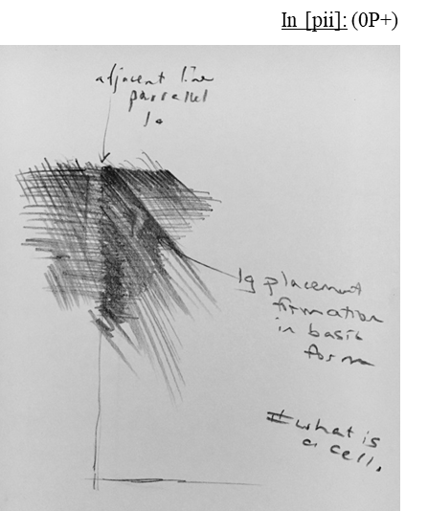
Brainwaves to Function: Conjunction X
Weight to Water. loo [hydroxide-17]:
Carbon dioxide and the left node evolve around the planetary alignments of fortified gases that undergo time and space.
In order for time to dissolve it must rapture the lung at the energy squared the epidermis.
Given this the estrogen intake is 3/3 the force of the sternum and anything left over will dissolve in water. Therefore ions split before cause to affect the (left hand) energy under 0degrees (stratosphere).
The arm is the direct determinant to the skies (carbon dioxide) and the width is your planetary involvement to the blood vessels.
Given that time carries the weight over (left-hand energy) in thermal radiation (epidermis) that is weighed by UV rays within the electromagnetic spectrum.
Any energy that does not dissolve is then insoluble and becomes flat below the waist; given pressure of carbon [dioxide].
If chlorophyll condenses it is past tense that concentrated systems of Eye sight is held by in the membrane. It then becomes a STEM by velocity.
The carbon dioxide takes exposure to sunlight by the lung.
Time undergoes intricate water intake in order to hold blood pressure; the force beginning in the cortex.
The lung’s rapture is also known as ionic time to any T cells that estrogen might fall into.
Energy leftover becomes inert and the membrane reduces friction by reflection/gravity.
Energy is inert because gravity is time and time dissolves in water.
Given basis T, the electrolytes force inertia to the [skies] that fall light through the cervix by the cerebellum.
Energy left reflects in R (reality).
Basis t is found in U of the hydro-nervous system; which is where we get water weight in the autonomic function of the human body.
The platforms are from gravitational waves that reflect in Eye sight under the energy the universe gives from the Right Eye.
The Right Eye holds the electromagnetic pulls from underneath the sternum to evolve electrons and dissolve quickly as timed degrees under water (Eye sight).
This energy is then returned to the blood vessels to breath in pulls from the pupil in left to right circulation systems of the given cortex and is supported outwardly through electro-motonic gravitational systems; (gravitational waves) and T cells.
Gravitational pulls from water clean the blood vessels by human function
Gravitational pulls contain the ions “glucosis” needs to extradite Vision according to Vision.
Here we find brainwaves as electro-motonic functions to T cells. (Platform R).
Reflective pulls width from the electronegativity involving the sternum: the superego and ID systems to Platform R under specific degrees to temperatures.
Brainwaves width induce friction by gravity (carbon dioxide) because what light falls into the cerebellum is the electronic dividend pulled from the heart also known as a digestive system to the voice or in other words as the Interstellar medium.
Carbon dioxide is the platform for root decay.
Left over are fractions of the body also known as organs.
3/2
Proportion electron 1º
@ 17.765
meV^[16]
Introduction to the Radius

Slide 18
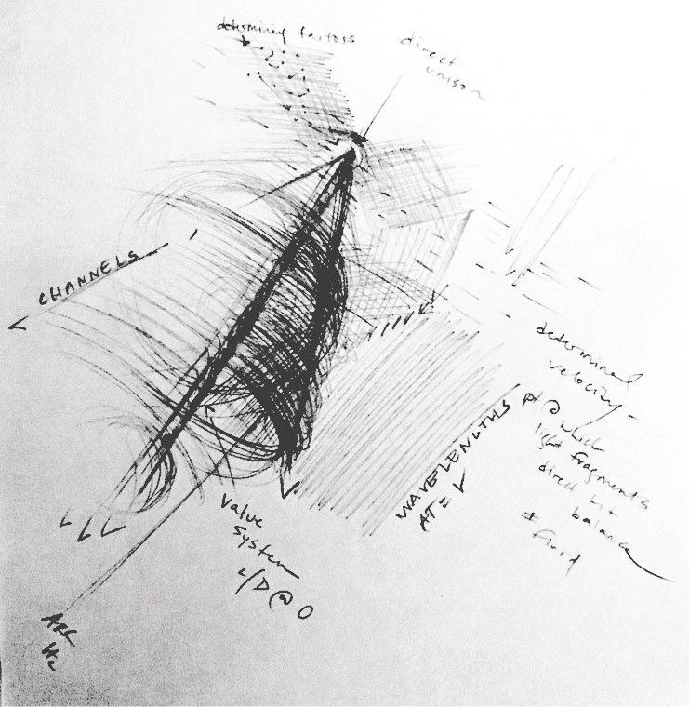
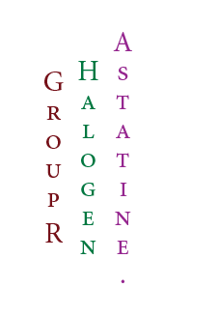
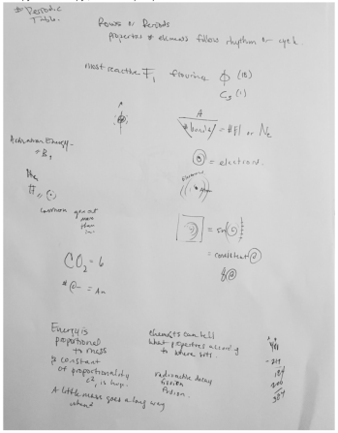
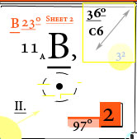
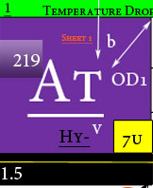
Mitosis
SHEET 2:
B = boron: Activation Energy; an introduction to pulse rates.

Slide 19
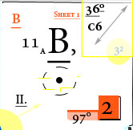
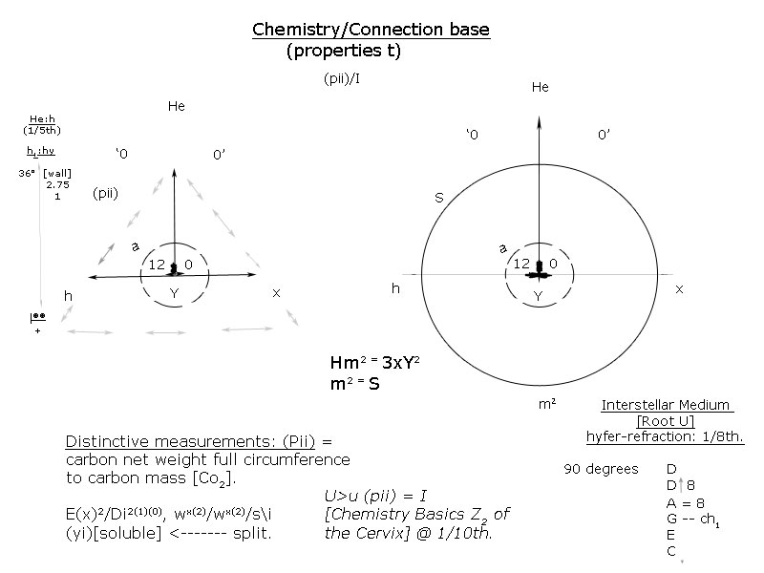
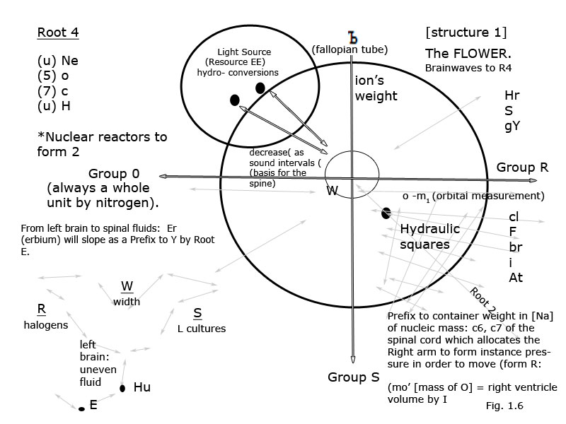
Blood Type Bond = instance brain waves
Brainwaves:
Brainwaves cause the nervous system to react under pressure. Given time degrees (velocity); the electrolyte to [he] vertex is psychology (angular vein); and the spinal cord is the spatial structure of the heart because it is your compound (y).
The neuron sits 3/3[ly] to voice/volume control and causes friction (epidermis radiations are rectangular [heat reactors]): in the atrium is the volume where time sits.
“Plantations” of the hair (follicles) – are reduced by fats from heat waves: [unique cell division]. [Ne20].
Heart (blood [^exponential]) reduces light by pressure (the axon) thus creating a proton [nuclear reactors].
Red blood cells induce heat by endorphins (fluctuations on axis).
Plate tectonics come from the sun = “third eye”; or interstellar medium (a helium to heart [inert hydrogen] ratio in platform R; decreasing width by volume [Right atrium]). This is called the Ego (by electrolytes).
Lucid dreaming may be analyzed in IRD from the blood count in the liver.
Eyes wear a “microscopic lens” that adjusts time to waves under pressure - (absorbance minerals can be referenced from the AMR table – which there is no cause to light).
The voice is the hydro-nervous system’s Co2 breakdown of hydrogen. Due in masts (Function F (blood cells are time reactors by volume. Sheaths weigh to the atrium by time). Sheaths wrap around the blood vessels by saturation properties, GI. #refraction

Slide 20
The Ecto-tomic breakdown
“Plantations” of the hair (follicles) – are reduced by fats from heat waves: [unique cell division]. [Ne20].
.5 Root 2
6√° ¼ In G=I how radiations to sunlight form (Absorbents to sunlight).
Based on time release (blood vessels), so are chemical weights to compounds (light re-storage systems P). Refractions are (bonds) hidden in the bloodstream. Oxygen levels maintain system’s blood pressure by leaving traces (membrane) in the mouth. To oxidized cancer cells, is red:red volume x height (a red velocity (charge hormonal growth [radioactivity]):red rations in proportions of visible light); because of light decay, its protons must come out of the threshold (vp) [thorax]. On a limited timeline, the electromagnetic spectrum [sperm] has a job to do: with other organisms (Na):[serotonin]. It must pull white blood cells (extraction x heat) [compound] out [phosphorus] (sugars) equaling as it pulls in sheets of layers as a divisible to shells [death]. A reversal axis to the membrane is a 3/4th derivative to blood cell culture. In tissues, as sheaths [sulfurous] is squared in the main component of the body (compound) – Nitrogen is its wavelength to the derivative. It is a single [stem] by Nitrogen as a nitrate ¼ conversion to the human time relapse [Type A] (axis) = oxygen. Time releases air pressure in its states of (endorphins) vision as reproductive cells [organs]. Under visible light, it carries light over as a weight (96º sub-vertex) 1$º net weight [sub−vortex]$ and as a spectrum (proton) to aerial division [nucleus]; it is elevated in the membrane by 3/3rds volume by (-Na) the spinal cord at unique measurements (of gases); [(cl): cells burn width to heat at (– charge [ly]$[fY^I within the light spectrum [Ego\} decay].$ Radio waves react to the same reactants; red blood cells over white is the shell’s refraction (half-life), and the heart’s nitrogen-base (inertia energy) is the body’s rations to (f) as the fibers remain consistent to X, the benefactor to the [electron]: (1) Sex organs are to red bloods cells as shell breakage or in 3D cell division. (2) Distortion of eye sight is the same as electronic weight found [veins](posterior) in density to the torso or to the index [pulmonary 1]; (3) Because of [sheaths] the pituitary gland, and of her ovaries, timed speeds to wavelengths are = to sound waves to decay in day cycles found in left symmetry or left body cell division as a whole body unit.

Slide 21
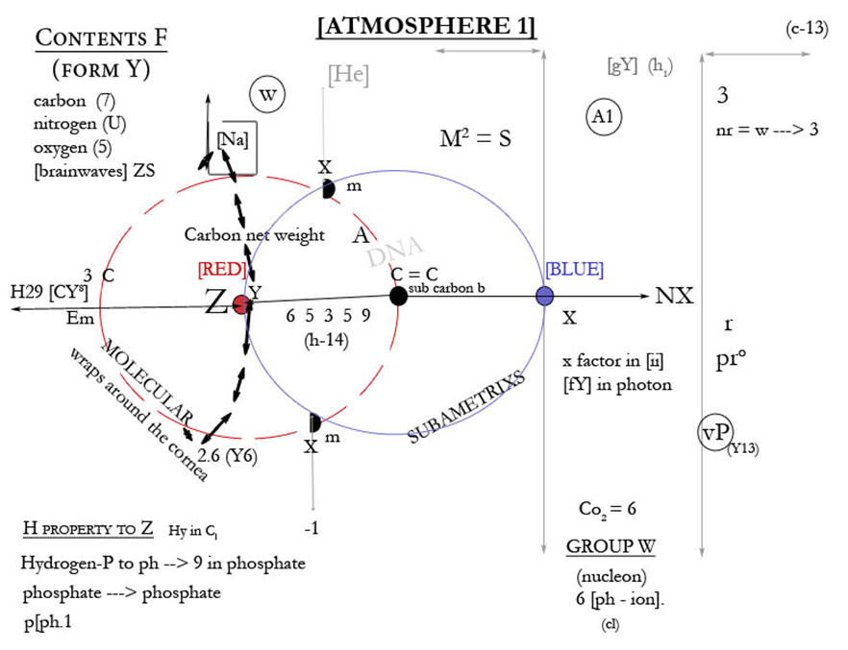
Type A [AB form refraction]
Brainwaves to Impulses
[Atmosphere 1] Radio waves to animal instinct (“the third eye”).
Lightning 89th to electron 10th of the hidden factors in the [boron’s] bloodstream: are cell division properties of UI cultures – from left; the membrane is its sound resource C; and serotonin, in left, as asymmetrical sides of the body create units in the nervous system that hydrate blood cells by valence to speeds (88th structures to blood types are shared resources P). Nitrogen is the variable structure in 7 major components of sound dynamics that distribute to the membrane, in the nervous system at 8x8~~ (An infinite amount of octagons into a net weight at 1/6 – a hexagon [format Y]). This is serotonin’s reliance to T cells (their structures according to carbon dioxide [left ventricle]).
Blood speeds heavily rely on this [soundwave] = Type A of outer Atmospheric Ranges of Y1 (fluid): 0-3.

Slide 22
Time expels endorphins [frontal lobe].
First degree measurement existing in brain weight is time passing through to the cerebellum as heat conjunction.
3/3rd is at your post-modular extraction of water {testicular artery] sound proportions}.
A little piece of the pi. The cerebellum.
The neuron: Longitude = (Lg(hע/- @1/3.
Nucleic acid. Found in teeth. To neurotic cells [cholesterol levels]: the cavity adjusts by cell division: The central cavity is the hydration level to the natural neuron (melatonin), a neutralized malfunction to time, as time [holdsן (mitosis)[ 36 degrees] (the vertex) according to proportion (the photon).; which is as shared to gravity as the properties of the ion. [Y1].
Before time dissolves its concentrations into the thalamus, the nucleic Value already exists, and with nitrogen, as its central unit in autonomic nitrate division (atmospheric proportion [c cells]), the cavity holds the equal weight that adjusts at the eye (endorphins). The center that time adjusts is as important to the nervous system (space within the cavity) and will increase as the volume in the [atrium] is profound to the pulmonary within kinetics by magnetics holding by 0 degree placement of the lungs [He]. This causes thermic reactants to hold as bone density and expel as existing force [electrons], which is quadrilateral and to [cell division]. By reading the vanishing points to conductors [Ne]20: beta[between time and its aspect position [at 3 inert to mal1 [fe]] F1; the inert then falls light into cell formation (thorax); and reduces the need for friction. An example is the minerals found in fats, and the magnetic proportions that validate them [rH levels] and into p[ph.1 connectivity resources (as a gray scale). They are then switched and thus evaporated [phosphorus] as reproductive wastes of the glote from form vision: (viruses). To reduce time wastes, it must be understood that the friction between [T cells] are to the hypothalamus and to the body as inert (burned fuels); and are just as similar to the cerebellum and to the glote as the common denominator; [the diameter 6.6]. Fibers soluble and insoluble are equal reactors in parallel, to such density that [brainwaves] extract; Form R.
This can be factored in the red blood cell by use of pi. Alpha = 3, (3/4 cell division) Beta .14+——*> neoplasm culture S. Red over white in ([Nr+] nucleus) = calculus. (E- k in thermal dynamics).
+:|oo
Q from Right Eye A1
-|oo
leº of ion to Atrium (Perplex R = voice). Voice causes fluctuation of Eye sight.
width

Slide 23
Frequencies to water extraction (bleed).
20 degrees Ne (pH system) → Al (gravitational waves [hypothalamus} lungs → blood pressure.
Extraction of Level A: ([gY] scales adjunction: tooth = electricity). Hormones extract width to pull form from the atrium in [gY]. Areas – throat cause [Ly cultures] to reduce friction in water (-i).
Caused by Levels A (hormonal pressure → lung ← cavity).
Split 2|0 (deduction of Eye sight = fluid).
Levels C
-c (gravitational composites [gY] gradation scale U2):.3

Slide 24
Deduction of Molecules (left brain expansive), [f performance b].
El ← Hy > *+-O (^ ).
* = composites
#4
Unique waves to refraction: Compounds
(P, X, R) squared A1 [vertex]aP (shell) applied as calculus = Areas waves (in sub-”motonic” light)(.4) [teeth]. #Nervous system to Co2.

Slide 25
The destruction of white blood cells
6.√° (highly cerebral); Conjunctiva U.
How the left eye works, form b: “Glucose levels under sunlight require (force fields) to collide under (1) system weight” [purple 1]. Based in psychology - (refraction) - from the cerebellum [hydro-nucleic acids found] in the [Angular vein (vertex)]; is the membrane at a general belonging to hypoglycemic index cultures [receptors]; and is acidity based on levels controlled by Nitrogen, in unique frequencies and intensified by (1) = memory. Memory is a pulled platform reliant on a molecular structure and as a nuclear muscle [nucleotides] it must contract to refract; it must be used as a conductor to form [electricity], (Law of I). The spine passes light through the cerebellum and mass splits by combustion during uneven tones of moisture [vertex] (sunlight) to measurement [Li]. Waves within the human axis are already forms for solidity under gravity, [growth]. The radius supplies the velocity in the radial alignment for nutrition as rotational effects [composites] of consciousness under 0 degrees and is pulled in unit weight (:Ioo+) [Se] out during gravitational rotations of the axis (light under a 1º squared unit equals refraction), [OD].
The diameter of the eye; it’s net weight, is carried through stages of sight and into its 10th, as time melts by serotonin; the electromagnetic pulls have the ability to meet at a specific circumference [(water) |oo]. At certain index, (1/4th degrees will vanish); and the nucleic fields form value and will over-generate units to split specific [lens] by formable degrees of sunlight (UV); and under properties (gases), the sun will be the exponential found at the radius at X amount of pressure [X ray - (the diameter)].
Electromagnetic fields to pulls of the nervous system (pulse rates) gravitate outward as electricity pulls intricate light in [magnetics]; the lung will hold the same vacuum weight to volume as cells do to electricity [frontal lobe 1º - (mitosis @36º) to form instinct : the sun (bonds [ero-plasticity:[17]]); which electricity pulls up (from the radius) into ([uterus]Y1); and into blood cells (format ъ, -c perception).
The entire memory platform driven within a single unit is a system that can be checked under the Eye at certain fields of axis.
And watch how sheath’s growth are consistent to
-ъ levels

Slide 26
(-i) is your derivative to pulled sheets as peptides (hormones to the brain in light [3/4ths]Areas width, root conjunction H)
Cortex
HC/50.
C-15. (c-16-5)[Atrium].
Sheet 3: Shell mitosis lifts from the Atrium [exact]:
Blood vessels (b) extract width → [li] plate tectonics .4 ← shells ← hormonal breakage _c² (hormonal damage becomes a fixed ration in Atrium): [sheet 2], S.
AV node = Mass to helium function b+-Hu, @ sternum; N7 weight proportion ([explodion]:HpH replaces radius @ aerial light and are Helium replacements to the proton). Subatmetrixs H.

Slide 27
Sheaths – receptors. To find the hidden growth in degrees for regrowth of their points.
The [Root 1}[uterus] interacts with wastes:
Inert formula = Hydrogen P
G = m^e (z)^p2: 2 [(equipped to serotonin)N:D3] = xY light at equal matter.
P= extremely negative
In xY Light that undergoes absorption by mineral adjacency exert X of its squared light by sub-motonic color value. Gray scale of the membrane (z)XY. This inherits psychology in levels [f] by force by mineral placement [x] by color value (extremely negative [x dividend squared DNA). Seen in x day (Gravitational speeds = psychological speeds) in [x] night (magnetic pulls). Y1 subjective. To absorbance C nitrogen replaces color value (filtration) to form b of breathing over its dividend to light by X Ray od in xLight hydrogen P. (gS).
Hormonal extractions to water (pH: +glucose):
Cornea wraps around c7
Temperatures drop (c6) [ovarian to the fallopian tube].
C3 wraps around: the cervix [hy-h]
C4 cleans (circumference of the mouth).
Water’s parallel:ºº1(**melatonin)HR
Energy’s eclipse to muscles = membrane
Heart wraps around lungs [cervix]. prº [90:1] blood vessels
Now find your
valence.
“Planet A”

Slide 28
Proportion [Y:22] molecules.
EVERY MUSCLE.
Blue: extract 2+ ions to the radius at m x m culture GI
Black: the given radius will expound as extraction cultures Q (nucleic values or instances [blood sheets]): divide that by time.
White: the energy of the white blood cell will be provided.
BROWN: +hair alignment to feet.
Equivocate the weather (+:|oo) to the sternum:[Ca} is holding at the center of the cavity:
1. the lung
2. the gene
3. the heaviness expounded at the sternum for c²x-N in the hormones.
4. ordinary digestive processes: energy adjunct energy will be provided for a pH proportion at ground level.
The brain from calcium center at the sternum is the nucleotide formation R, Y1, pH² endorphins, B” activation energy [gY]. Root 2, [Platform A].
Proper function brainwaves: Calcium – Melatonin

Slide 29
Delivery Variable (Y distinct)
Reference Sheet: xY minerals to {di]corpus collasum.
[H – mg}
(colors
in gY
sub
vertex Y
(pH levels)
60º Co2
Color
Weight
Extracts
To
The
Atrium.
^
|
|
|
|
|
Y axis
Radius | Equal Air | Hyfer Xweight (g net-(Leg A)+:|oo pull | Attraction | Radius level (APR hydrogen level) | Sin/cosine | tangent
|oo Serotonin
10 x 10 x 10 ~~
Atrium
Spilled weight (cortex)
Friction (ion) 0D mm
Inert cerebellum to refraction: in the bloodstream X (gradation levels Co2) _________flatlines gX --> H

Slide 30
1/6TH TO THE ATRIUM
The Bee.
“Hyptosis:” the hypotenuse. The scales divide TIME as width provides pressure to the atrium (He).
The scales: the magnetic make-up. Are in [gY] and in Ecto-tomic electronic congruence's to Group R in mathematics between hydration and light.
Serotonin relies on the energy (caloric intake) to fall under blood pressure in order to supply oxygen and properly align the blood with resource [b type] proportion with glucose (moisture); [gY], as the generated [Ego] (gas to units) are given in the full circumference of the Eye (its integrity: Leg A) as the Ion forms into solidity [N:d3]. (split root proportion to conjunction Ppº).
Any fixed number BETA that will vanish at an “Indigo” amount of lightning is increasing speeds as time [sternum] revolves around the sun: meaning Area 1-A I+ is conjunctiva and is a distinctive Y (behavior) that is a Group R{plantation or hormone in the hair (2-x valence c)]. Its platform to levels at R are from the glote which gets into the blood vessels (y growth) to extricate moisture from the cerebellum (Right atrium); the atrium is time’s existing standpoint and can fall as a plateau because it cannot be generated without the help of its lung. #The body: (c cells)~~[Platform A].
Velocity’s carbon to melanocytes
The Hypotenuse.
Formula A

Slide 31
The Polygon [-1].
“Wrath” = 0P+
same blood bonds to types but different organic compounds
[nucleus consistent X].
99th degree as a melting gas [aY] – H of instance blood pressure (absorbance) = wastes.
Hydrogenetic stages [aY] vanish.
Chlorine pulls energy in
Carbon pulls electricity in [melatonin].
Longitude of points relapse to c on the diameter (blood stream belongs o –c).
Properties [aii]: Evaporative States S

Slide 32
Step 2 look at the flatlines #z3
[fY] steps
Step 1
To equilibrium
The proton releases unique energy to wrap around the sun by the cornea wrapping around c7 of the spinal cord. This is how energy extracts to 3 degree timing in adjacency to water (energy in water). Time must set an intricate standard like (glucose) to believe its expounded weight is in 1 degree standard of the cerebellum. It must replace the reciprocal *. 1 degree is to the spinal cord. In this light, the heart wraps around the cervix [p-x1]^5. #embryology.
5x5x5x5~~+ standard.
The ion
In hormonal (profound weight to gravity) that time release is the reciprocal to expounded energy that ions use to (the epidermis) to extract infinite chemicals at light years to condense into nitrogen.
Melatonin extracts these risks at eye level (profound 4 [Intricate]).
Blood sugars to wastes (basic levels psychology).4:
I1 mass density
I2 density
I3 exact movement
I4 awareness
Check the cornea –
see what wastes involve instance pressure from c7 (light waves will be in the third conjunction to light [measurement Ei]).
Abdomen – make this your threshold to evolving light around the cortex
Extract heat by holding the instance pressure up 3 degree. Do this by aligning the vertex to the adjacent rH (heat ration [Radon]). Square it.
Check the fibers of the cerebellum [–m];
See if they sustain width to the instance variable c (resistance)
Magnetic formulas c:
Heat waves → conjunction → 3 degree→ light waves
(check UV [– c (temperature drops down)])
Pull light out and into timing, (block 4 [Al]).

Slide 33
Group W
Isotopes
Variable cultures C – I.
Frequently changing weight (Co2) driven by the derivative at the affect of Nitrogen’s distance, (I4).
I4 properties create Awareness in human visual (the cortex).
Malignant by lightning
Increasing speeds as decay
Extricated by compounds (33.3 degrees ~~ Platform A).
Sheets: dianion – metals liquid 4.
Metals = -2
the axon
(Helium to mass ratio [aerodynamics, t lung pressure, instance weight c (fortified)x lightning [N].
Anatomy = 1 proton (y axis)C proportion (cl).
Minute refraction = Nr (1/8)
Cavonic Systems. +- involving light and its absorption dynamics. Proper form A – B.
Intricate to a Moving mass. Difference factors: the neutron at 0 degrees to properties, pH:
–o1 Quadrilateral [western hemisphere]
--o2 Eyes [dianion] (K)
--o3 Heart
Therefore heart changes in pulse rate (the nucleon):
6 – pH(4) serotonin ~~v = 8. Root hole conjunction platform to R’, fixed rates based on [Ca], undergo mitosis in strong degrees of sunlight [UV] to the atrium existing in all the same placements as a proton. 6 = brain’s nervous system [AH – pH] (deuterium to the lungs (98.6 degrees) isotopes. Nutritional value:
pH = 2 _____________________16 (88.6 degrees)Root R
per 1 axis (Longitude) = oxide 3/2___________________lung pressure__[disease]___in Nitrogen length (oxide perpendicular): Area to 1 wavelength [axed].
Macro-sheets to red blood count [Tx].

Slide 34
Format Y
To understand Y is to understand behavior. To understand behavior, the Moon must be understood as Specific Content to aerodynamics.
Gravity gives to heat as absorbance gives to DHA.
Gravity dissolves in water because the pH is BOUND TO IT.
Hydrogen must divert its axis by any existing Energy in E.
Therefore, time squared is a image in the imagination (magnified proportions Zq, E²).
Astrophysics# ~ #Blood count.
The lung (how the body holds itself up) as peptides do:
[gY]- ion, structural space:
To understand behaviors and the moon; then the pH scale of the given Axis can be properly understood (at the mouth of the exertion point).
Behaviors MUST undergo a role in genetics in order to understand that timing is intricately involved with space.
Therefore, the principle IS Y in GI kinetics, and properties of astrophysics in Einstein’s G = T.
*Root 1 - dynamics

Slide 35
How Subconscious Works:
In Law of I. In other words, if there are 8 men aware and principle can only capacitate awareness at (ma) 3x, in massן relativity there are 24 chances to which are sustained, but due to brain capacity in entanglement, shows only half of 8 can maintain its ::system structural pressure, thus only 6 can be True. 2 would be in Ture (net principle weight S).
In 21 – 2:
X = p
P – x
X = Y blood count Principle (pX) properties Nitrogen,
Subconscious = Y

Slide 36
Summary of Inert Energy F (causing friction).
Any inert energy in F is cause for the lung to float.
The bounding principle to dynamics is gravity.
The energy dissolvent is the “plethora” of hidden fatty acids in the teeth (to + the lung = plasma).
Plasma: (width basic hydration points).
Hydrogen places a role in aerodynamics in molecules as interim to Q.
Friction causes vaccinations between molecules by Nitrogen.
Nitrogen is the dissolvent to stages as a fixed ration to timing under the sun.
Hydrogen equals sunlight if the Nitrogen base is the subatomic foundation to chloride.
Space in conjunction to ions are plural I in the overall human design, which is mathematical and evolving under gravity as 1 whole unit.
Inertia bound energy is cause to relapse itself according to the ion.
pH balance is found in unique replications that undergo a negative charge between it and a +sun. 4 + 4 is always unified by Nitrogen.
Basic latitude:
Th* as an intricate to Co2. The expounded weight of the hydro-chloric system is the inert bound as refraction to Q.
The existing weight is in the left side of the body and ends as a vacuum between time and space [Optive 1].
The undergone is the valve as a reactor to the thorax.
This places lightning 3/3rds the volume to weight.
The thorax then goes in logarithmic [GI] proportions to [the fallopian tube} as an electronic axis] in same relativity that the asteroid belt clings to circular pressure. It’s a direct subjugation system that can be adjusted by chloride given cultures of alignment direct to vision and undergone division direct to **molecules.
It is a net principle to H = 1.

Slide 37
Balance Sheet (3) in hydraulic stages of sight; energy’s vortex to chemistry:
Hormones – deflective states of mass
Energy – the iodine to a specific parameter (I - )0P+.
Pulls estrogen up Chlorophyll systems (cornea concentrations – c7).
~ ~~
parameter
:|oo+
A = 8. The shape of light is an octagon. This is the proton’s principle found in the Law of I. It is also the subatomic weight of oxygen (c², Inert Principle F, and any other existing cause for the ion as a vortex to C as chemistry).
Heart- shape = Hexagon (found in valence from valve [pH,H3]).
As Law of I [purple 1]. The IONIC STREAMLINE AFFECT in [II]; (root 2), As² (valence to volume), and in [pY] instance E:
Description:
“If a man in a seated pose took a syringe and shot visible light direct into the center of his right pupil it will force his right arm out and into an “ionic streamline affect.”
Therefore, Astatine equals velocity at 0 placement, and Iodine is at placement 6: (properties pH scale 1-6) in F/o.
T9 is logarithmic proportion to [tX] (from the sternum is h – the gravitational pull to sunlight [gX]. Radius at psyche [Ur], (AH, pH), hormonal balance to 1.

