Slide 1

Critical Thinking
Isn’t Dying.
It’s Being Outsourced.
A practical 5‑minute framework to improve decision quality: C.L.E.A.R.
Use freely • Share with your team • Adapt to your context

Slide 2
Why this matters
When the environment rewards speed and certainty,
thinking gets outsourced.
Common “substitutes for judgement”:
“Apparent improvements in
performance enabled by
Generative AI may mask
deficits in underlying
cognitive and metacognitive
processes.”
Templates & checklists
Dashboards (signal without context)
Group consensus (alignment theatre)
AI output (polish ≠ proof)
— OECD, Digital Education Outlook 2026
Goal: replace “fast answers” with better questions and cleaner decisions.
Notes:
Going to put sources in the notes so I know where to find them later….
- OECD Digital Education Outlook 2026 (quote and context): https://www.oecd.org/en/publications/oecd-digital-education-outlook-2026_062a7394-en.html
- OECD report PDF (supporting discussion of overreliance and reduced engagement): https://www.oecd.org/content/dam/oecd/en/publications/reports/2026/01/oecd-digital-education-outlook-2026_940e0dd8/062a7394-en.pdf

Slide 3





The C.L.E.A.R. framework
A simple loop for better judgement (5–15 minutes).
C
L
E
A
R
Clarify
List assumptions
Examine evidence
Argue against
yourself
Review &
update
What are we deciding?
What must be true?
What supports this?
Why might we be wrong?
What did we learn?
Tip: treat CLEAR as a loop — run it quickly, then revisit when new info appears.

Slide 4
C — Clarify
C
Clarify the decision
Purpose: align on what you’re deciding — not just what you’re discussing.
State the decision in one sentence.
Define success (what does “good” look like?).
Name constraints (time, budget, risk, compliance).
Clarify reversibility: one‑way door vs two‑way door.
Prompt: “What exactly are we deciding today — and what would make it a win?”

Slide 5
L — List
L
List the assumptions
Purpose: surface what “must be true” — so you can test it.
Write assumptions as testable statements.
Separate facts from beliefs (“we know” vs “we think”).
Cover the basics: user need, capacity, dependencies, cost, timeline.
Ask: “What are we taking for granted?”
Prompt: “If this fails, what assumption was wrong?”
Notes:
[Sources]
- No external sources.
[/Sources]

Slide 6
E — Examine
E
Examine the evidence
Purpose: avoid “signal without context” and test what matters.
What evidence supports this? What evidence would weaken it?
What data is missing or unreliable?
Prefer small tests over big debates (run a quick experiment).
Write down a disconfirming signal (what would change your mind?).
Prompt: “What’s the smallest test that reduces the biggest uncertainty?”
Notes:
- Information overload review (background context for evidence and synthesis): https://www.frontiersin.org/journals/psychology/articles/10.3389/fpsyg.2023.1122200/full

Slide 7
A — Argue
A
Argue against yourself
Purpose: reduce overconfidence and catch weak reasoning early.
Steelman the best counter‑argument (make it stronger than you think).
Run a quick pre‑mortem: “It’s 3 months later and this failed — why?”
Assign a rotating “Red Team” role for important decisions.
Separate challenge from status: critique the idea, not the person.
Prompt: “What would a smart sceptic say — and how would we answer?”
Notes:
- Psychological safety and interpersonal risk in teams (background): https://web.mit.edu/curhan/www/docs/Articles/15341_Readings/Group_Performance/Edmondson%20Psychological%20safety.pdf

Slide 8
R — Review
R
Review & update
Purpose: turn outcomes into learning — and prevent repeat mistakes.
Keep a lightweight decision log (what we chose and why).
Set a review date (especially for reversible decisions).
Ask: “Which assumption mattered most?”
Update playbooks, checklists and thresholds based on what happened.
Prompt: “What would we do differently if we ran this again next week?”

Slide 9
Put it into practice
Use this one‑page structure in meetings, docs, or AI prompts.
Decision One‑Pager
Meeting defaults (steal these):
Decision:
What are we deciding?
State the decision.
Name assumptions.
Define disconfirming evidence.
Goal:
What does success look like?
Assumptions:
What must be true?
Evidence:
What supports / weakens this?
Risks:
What could go wrong (and mitigations)?
AI prompt (copy/paste):
“List assumptions,
provide 3 alternatives,
and name what would
change our mind.”
Review date:
When will we revisit?
Optional: add a “Red Team” role for high‑stakes decisions.
Notes:
Sorry I couldn’t make this into an acronym but it is still solid ;)
Analytical thinking as a top core skill for employers (context): https://www.weforum.org/publications/the-future-of-jobs-report-2025/in-full/3-skills-outlook/

Slide 10
Make thinking visible.
Make questions safe.
Make decisions reviewable.
Insert your article link here
Suggested caption: “Critical Thinking Isn’t Dying. It’s Being Outsourced.”
Question for the audience: Where does critical thinking break down most — meetings, strategy, or leadership comms?
#CriticalThinking #DecisionMaking #Leadership #Strategy #AI
Notes:
All the sources….
- Psychological safety paper (Edmondson, 1999): https://web.mit.edu/curhan/www/docs/Articles/15341_Readings/Group_Performance/Edmondson%20Psychological%20safety.pdf
- Information overload review (Arnold et al., 2023): https://www.frontiersin.org/journals/psychology/articles/10.3389/fpsyg.2023.1122200/full
- AI hallucination classification (Sun et al., 2024): https://www.nature.com/articles/s41599-024-03811-x
- BIS FSI Insights No 63 on genAI risks (hallucination, anthropomorphism): https://www.bis.org/fsi/publ/insights63.htm
- WEF Future of Jobs 2025 skills outlook: https://www.weforum.org/publications/the-future-of-jobs-report-2025/in-full/3-skills-outlook/
- OECD Digital Education Outlook 2026: https://www.oecd.org/en/publications/oecd-digital-education-outlook-2026_062a7394-en.html

Slide 11
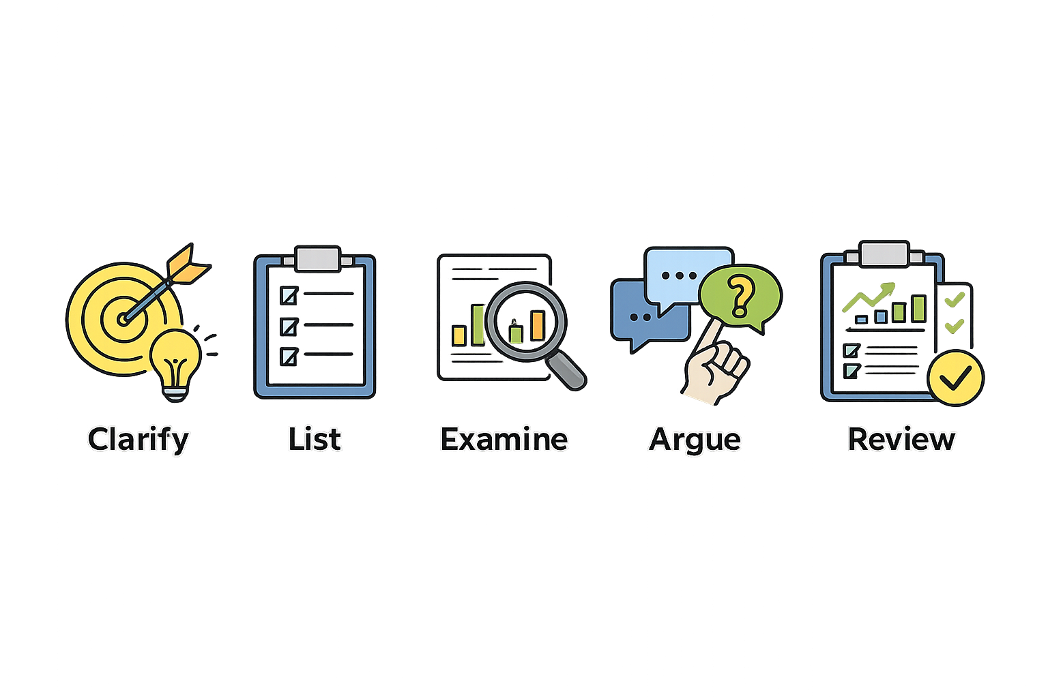
Handy icons….

Slide 12
Clarify
List
Examine
Review
Argue

