Slide 1
PROVERBS
Notes:
The Book of Proverbs is a rich source of wisdom and practical advice for daily living.

Slide 3
Notes:
Overview of Proverbs
Authorship: Primarily attributed to King Solomon, with contributions from other wise men (Proverbs 22:17, 24:23) and possibly Hezekiah’s scribes (Proverbs 25:1).
Purpose: To impart wisdom, discipline, and understanding (Proverbs 1:1-7).
Themes: Wisdom vs. foolishness, righteousness vs. wickedness, diligence vs. laziness, the fear of the Lord, and interpersonal relationships

Slide 4
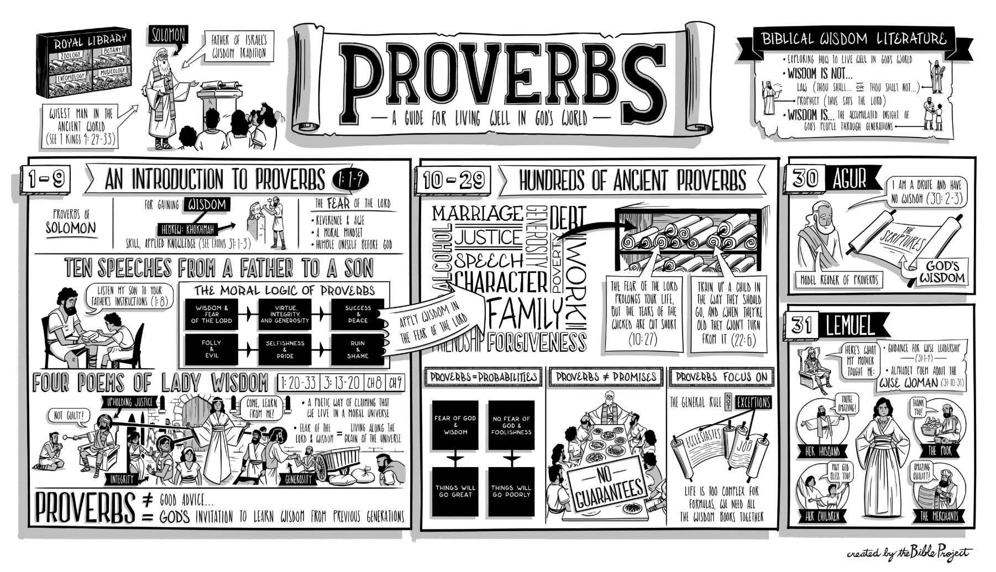
https://bibleproject.com/explore/video/proverbs/

Slide 5
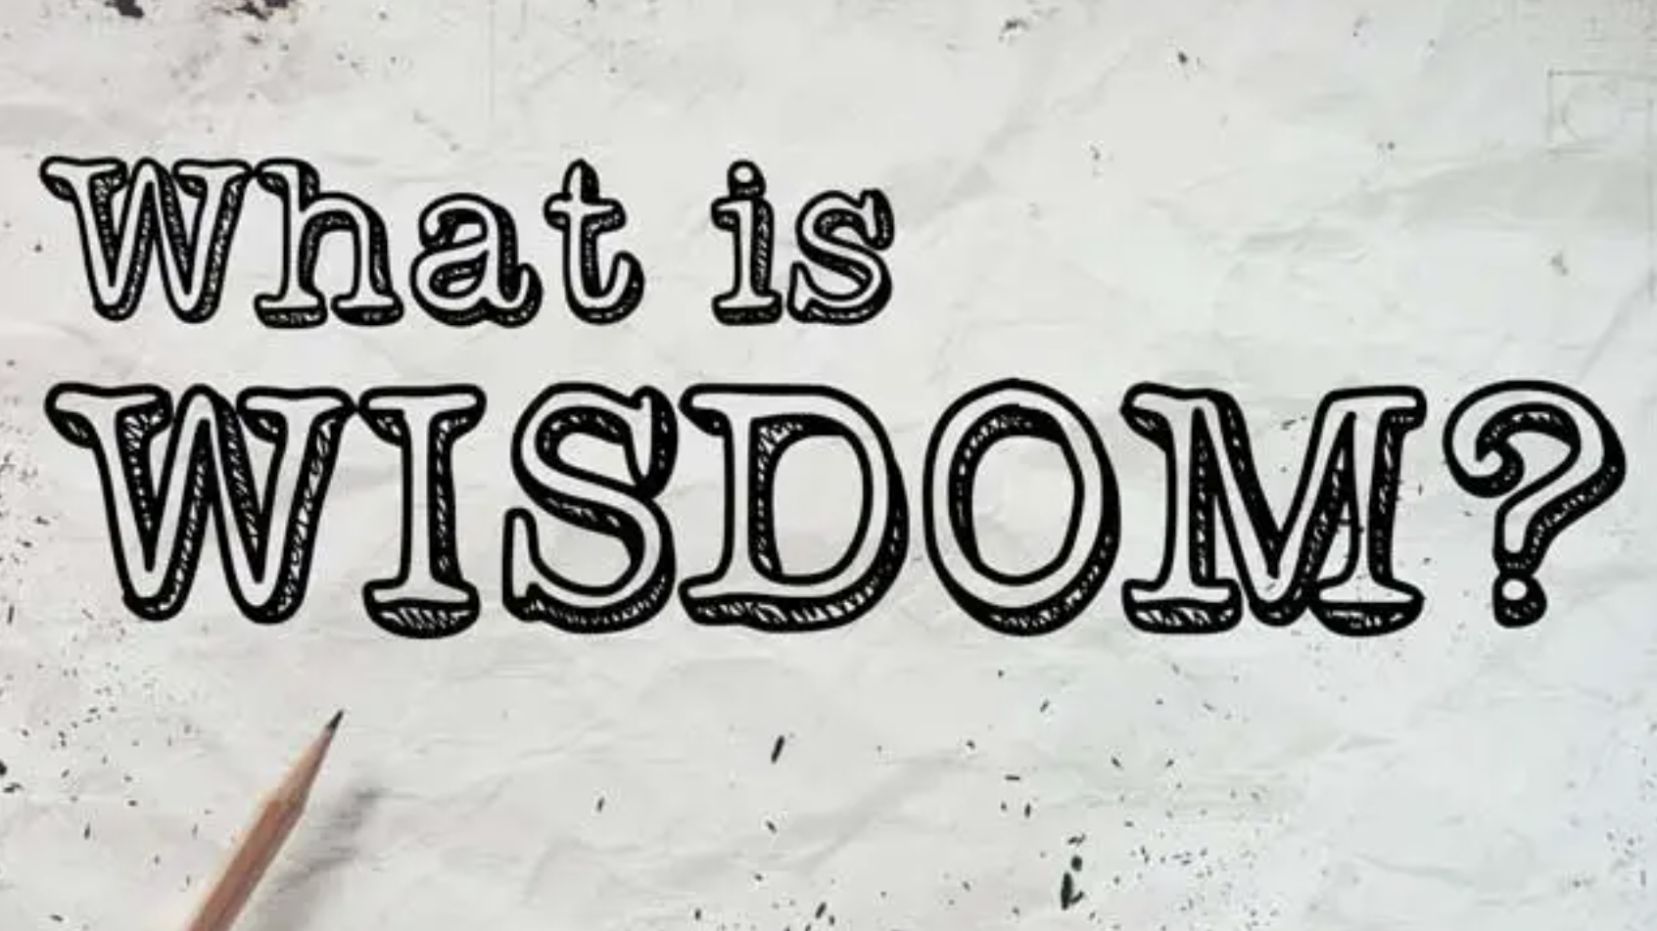

Slide 6
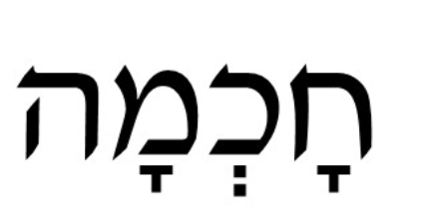
Choh-ch-mah or Chakem
Notes:
There are three words for wisdom in Hebrew.
The most common word that is rendered as wisdom is chakem and is not only found in the Bible but is a reoccurring word within extra-Biblical literature.
Chakem essentially means a high degree of knowledge and skill.
The nearest English word equivalent is “Expertise”.

Slide 7
Proverbs 1:1-6 (NRSV)-
1 The proverbs of Solomon son of David, king of Israel:
² For learning about wisdom and instruction, for understanding words of insight, ³ for gaining instruction in wise dealing, righteousness, justice, and equity; ⁴ to teach shrewdness to the simple, knowledge and prudence to the young— ⁵ let the wise also hear and gain in learning, and the discerning acquire skill, ⁶ to understand a proverb and a figure, the words of the wise and their riddles.

Slide 8
Know
Grow
Go
Show
Notes:
What is Wisdom’s Call?

Slide 9
Proverbs 1:7 (NRSV)-
⁷ The fear of the Lord is the beginning of knowledge; fools despise wisdom and instruction.

Slide 10
Fear of the Lord
Notes:
What is the Fear if the Lord?
Respect, Reverence, Awe
Beginning of Wisdom

Slide 11
Proverbs 1:8-13 (NRSV)-
⁸ Hear, my child, your father’s instruction, and do not reject your mother’s teaching; ⁹ for they are a fair garland for your head, and pendants for your neck. ¹⁰ My child, if sinners entice you, do not consent. ¹¹ If they say, ‘Come with us, let us lie in wait for blood; let us wantonly ambush the innocent; ¹² like Sheol let us swallow them alive and whole, like those who go down to the Pit. ¹³ We shall find all kinds of costly things; we shall fill our houses with booty.

Slide 12
A Fair Garland for Your Head

Slide 13
Proverbs 1:14-19 (NRSV)-
¹⁴ Throw in your lot among us; we will all have one purse’— ¹⁵ my child, do not walk in their way, keep your foot from their paths; ¹⁶ for their feet run to evil, and they hurry to shed blood. ¹⁷ For in vain is the net baited while the bird is looking on; ¹⁸ yet they lie in wait—to kill themselves! and set an ambush—for their own lives! ¹⁹ Such is the end of all who are greedy for gain; it takes away the life of its possessors.

Slide 14
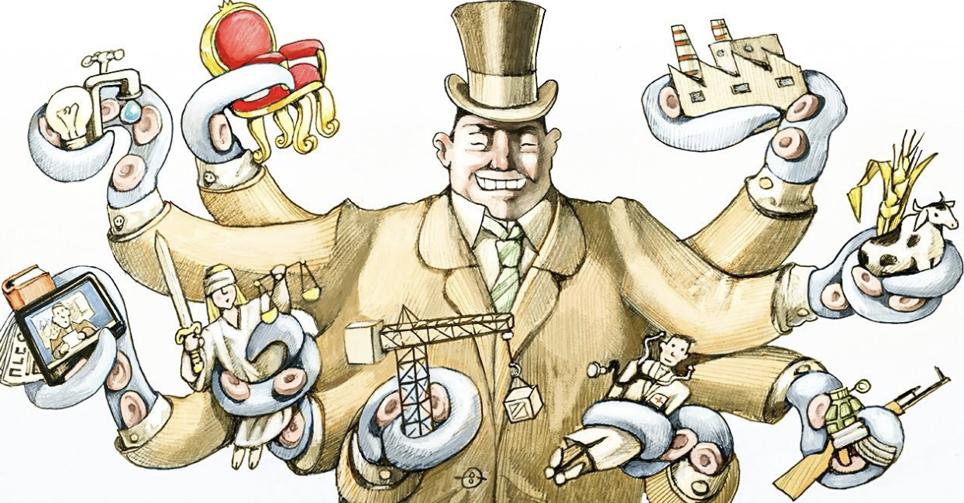
Staying True to Wisdom

Slide 15
Proverbs 1:20-27 (NRSV)-
²⁰ Wisdom cries out in the street; in the squares she raises her voice. ²¹ At the busiest corner she cries out; at the entrance of the city gates she speaks: ²² ‘How long, O simple ones, will you love being simple? How long will scoffers delight in their scoffing and fools hate knowledge? ²³ Give heed to my reproof; I will pour out my thoughts to you; I will make my words known to you. ²⁴ Because I have called and you refused, have stretched out my hand and no one heeded, ²⁵ and because you have ignored all my counsel and would have none of my reproof, ²⁶ I also will laugh at your calamity; I will mock when panic strikes you, ²⁷ when panic strikes you like a storm, and your calamity comes like a whirlwind, when distress and anguish come upon you.

Slide 16
The Spirit of Wisdom
Notes:
Is the Spirit of Wisdom the same as the Holy Spirit?

Slide 17
Proverbs 1:28-33 (NRSV)-
²⁸ Then they will call upon me, but I will not answer; they will seek me diligently, but will not find me. ²⁹ Because they hated knowledge and did not choose the fear of the Lord, ³⁰ would have none of my counsel, and despised all my reproof, ³¹ therefore they shall eat the fruit of their way and be sated with their own devices. ³² For waywardness kills the simple, and the complacency of fools destroys them; ³³ but those who listen to me will be secure and will live at ease, without dread of disaster.’

Slide 18
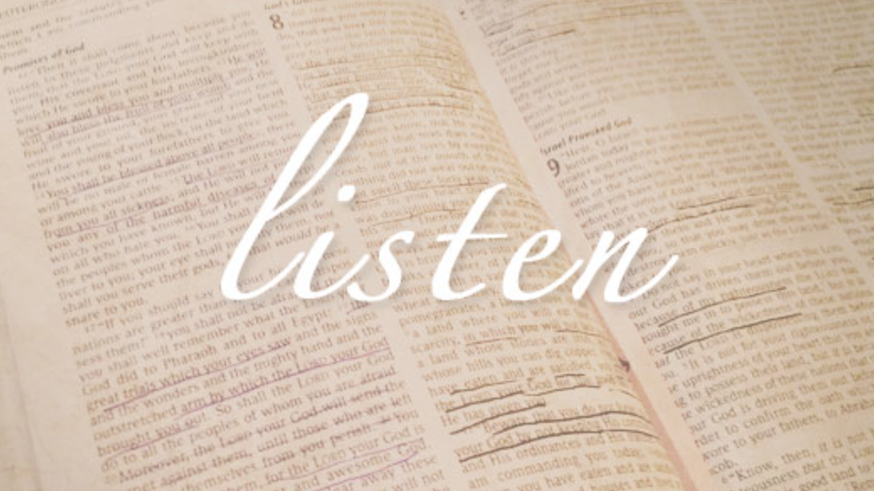

Slide 20
Listen, Reflect, Journal, Act
Notes:
Practical Application
Memorization: Choose key verses to memorize and meditate on.
Journaling: Write down insights and personal applications for each proverb.
Discussion: Study with a group to share perspectives and encourage accountability.
Action: Identify one actionable step from each study session to apply in your daily life.

Slide 21
Application

Slide 22
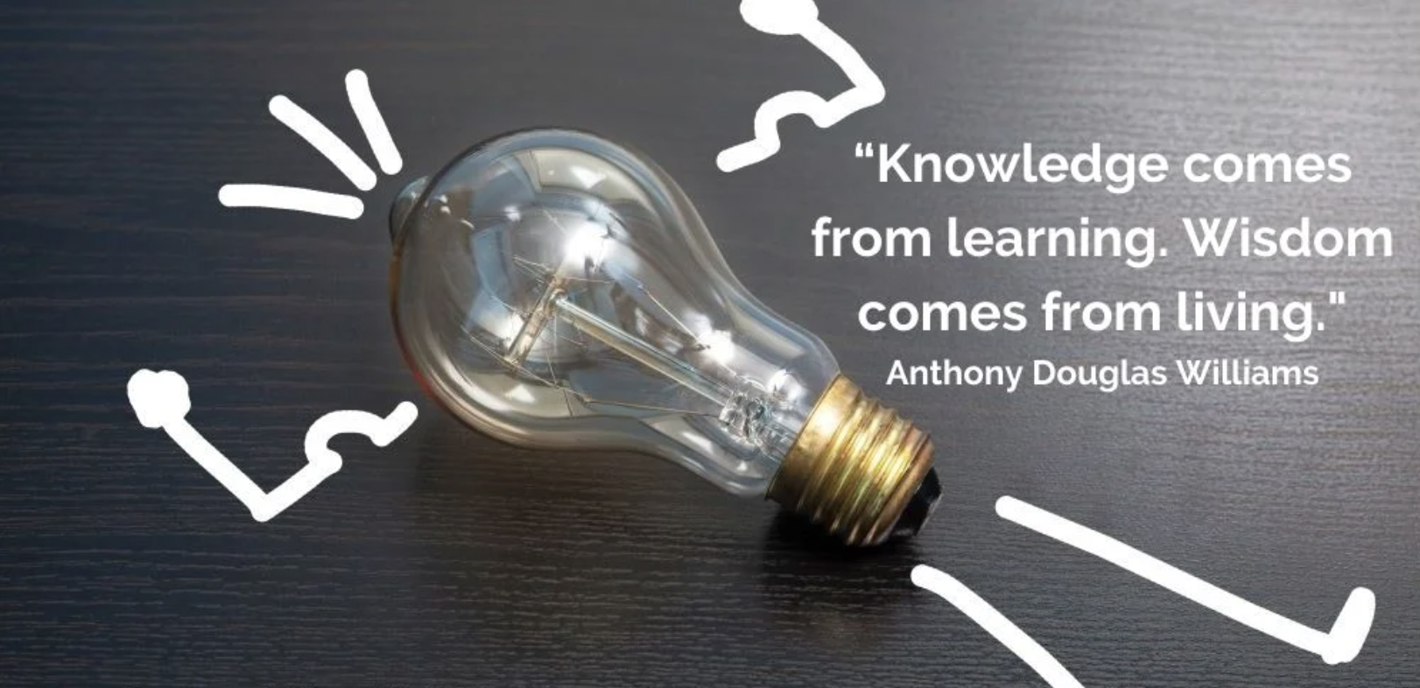

Slide 23
Adelphi Benediction
May the Lord bless you and keep you.
May the Lord make his face to shine upon you, and be gracious unto you.
May the Lord lift up his countenance upon you, and give you peace. AMEN!

