Slide 1



ONE ECM
OVERVIEW
Your Digital Information Partner

Slide 2



WHO WE ARE
Focused on Digital Transformation Solutions
15+ Years of History
We are a dedicated business serving the Enterprise Information & Legal Management (EILM) market, Cognitive intelligence (CI) and Intelligent Document Processing (IDP) to enable Digital Transformation through customer centricity.
We are an ISO Certified Company, ISO 27001:2013 Information Security Management Systems and ISO 9001:2015 Quality Management Systems, ISO 14001:2015 Environmental Management Systems, and In-Country Value (ICV) certified.
We recognize the need for a focused and experienced organization specifically focused to deliver domain expertise and successful implementations that will increase efficiency and productivity in conformity with the local archiving laws and by-laws (ISO15489) to overcome the digital disruption.
Offices in Dubai, Abu Dhabi, Beirut, Limassol, Riyadh (in process)
100+ Happy Customers
Turnkey Solutions
Customer Centric

Slide 3




WHAT WE DO
Enterprise Content Management (ECM)
Digital Assets Management (DAM)
AI, Enterprise Analytics & IOT
Electronic & Physical Records Management & Digitization
Business Process Management (BPM)
Robotics Process Automation (RPA)
Correspondence Management System (CMS)
Contract Management
Legal, Litigation & Matter Management System
All in One Monitoring
Portfolio, Project, Performance Management

Slide 4




PAPERLESS
Digital File, Content & Correspondence Management
  Digitize all paper documents and maintain a complete electronic file
  Define preconfigured filing structures and templates to ensure repeatable processes
  Use roles to adapt to different usage profile and to govern access rights
  Manage the entire life-cycle of incoming and outgoing correspondence
Case Management, Workflow, Automation and Collaboration
  Use workflow and case management to structure processes and achieve high quality
  Enable collaboration on content within teams, across departments and applications
Content Integrated with Processes & Applications
  Integrate unstructured content into business processes and context of leading application
  Easy access to all relevant documents inside and outside leading applications
Compliance, Governance and Auditability
  Secure long-term retention and governance with records management
  Maintain the full change history for important records for traceability and auditability
1
2
3
4

Slide 5

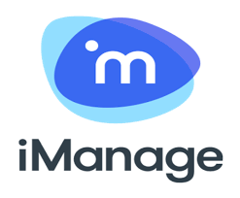






















OUR ALLIANCES
ONE ECM Content Services
ONE ECM Correspondence Management
ONE ECM ContentSynch for the Oracle Fusion Cloud Application
ONE ECM Contracts Lifecycle Management
ONE ECM Legal Inquiry & Case
ONE ECM RMS Physical Assets
ONE ECM Engineering Document Management
Core Signature
AI, Monitoring & Information Management
Productivity
Applications
Legal and Compliance
Business Applications

Slide 6
STRATEGIC ALLIANCE
Over 15+ years implementing and supporting Opentext solutions based on best practices and Lessons learned.
Unparalleled level of partnership (R&D, Sales, BVC, Support) up to executives' level.
ONE ECM has completed the trainings and achieved the certifications required to sell, implement and service OpenText solutions.
ONE ECM has full OpenText Support in the execution, support and delivery of projects.
ONE ECM delivers the solutions in conformity with the National Archives laws and by-laws.
Smart Electronic AI Driven EDRMS
Contract Management
Project Management
Legal Inquiry & Case Management
RMS Physical Assets Management
Correspondence Management
Document Change Control
Engineering Document Management
ONE ECM is the Opentext Platinum Strategic Named Partner
ECM, BPM, DAM
IOT, AI
Cognitive Capture
Legal and Compliance
Business Applications

Slide 7





























KEY CLIENTS
Government
Energy & Utilities
Telecom
Financial
Retail Legal & Other

Slide 8





EIM OFFERING
Industry
Solutions and
Applications
Financial &
Insurance
Manufacturing
Retail
Life Sciences
Utilities & Energy
Telecom
Transportation
Media
Public Sector
Horizontal
Customer
Supplier
Employee
Product
Asset
Finance
Legal
Ecosystem
integration
Product
suites
Experience
Business
Network
IoT
Process
Robotic Process
Automation
(RPA)
Content
Discovery
Cognitive
Intelligence
Analytics
AI
Engagement
Insight
Foundational
services
Cloud Managed Services Professional Services Support

Slide 9
CONSULTANCY SERVICES
Our Added Value
01
Increased time to value
02
Predictable results
03
Consistent quality
04
Greater return on your technology investment
05
Compelling Experience and Subject Matter knowledge
Notes:
Clear business goals
Leverage industry best practices
Avoid information islands / silos
Going step by step
User adoption
EIM is used best when integrated into existing business applications

Slide 10
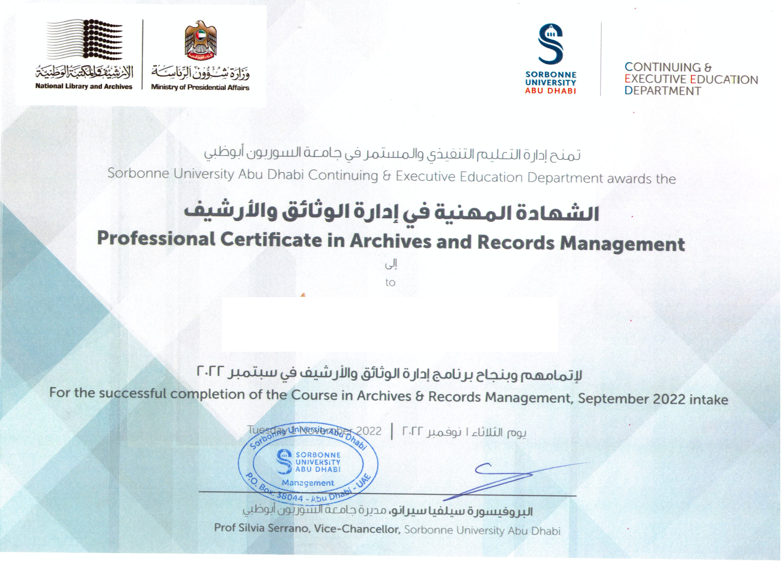
NATIONAL AND
INTERNATIONAL PRACTICES
Law No. 7 of 2008 on the National Archives, its amending laws and by-laws
Documents Accessibility Policy
Historical Archives Collection Policy
Paper and Electronic Archives Management Policy
Document Preservation Policy
NFPA13 and FM Global 6-7 Standards
ISO 15499 and ISO 16175
MoReq 2010 Standard
DoD Standard 5015.2
UKPro
ONE ECM Consultants are Certified in Archives and Records Management…

Slide 11


CLOUD SERVICES
The flexible deployment strategy
that’s right for your business
ONE ECM Cloud offering includes a foundational platform of technology services, and packaged business applications for industry and business processes, supported by comprehensive Managed Services in the Cloud.
Hybrid
Cloud
Hybrid
Cloud
Private
Cloud
Public
Cloud
EIM
as a Service
Superior
Managed Services
Secure
and Global

Slide 12

MANAGED SERVICES
2 support offices
15+ customer service staff
24/7
support
On-Premises
Hybrid
Cloud
Platform Allocation
Solution Implementation
Readiness Reviews
Deployment
Partner Onboarding
24X7 Global Technical Support
Applications Monitoring
System Monitoring
Proactive Alerts
Product Management
Release Management
Application Security Compliance
Onboarding
Global customer
service
Cloud engineering
Ongoing, renewable and repeatable services
Global consistency and repeatability
Global Customer Service
Operations & Engineering
Program Management
Incident Management
Onboarding
Focused Delivery Manager
Status and Scorecard
Governance
and Service Reviews
Implement & New Requests
Infrastructure and Operations
Change Management
Problem Management
Escalation of Infrastructure Failures
SWAT Calls
Production Service
Disruption Management
Incident Reports
Program
management
Cloud operations
Incident
management

Slide 13
Comprehensive
EIM Expertise
PROFSSIONAL
SERVICES
Dedicated Pool
of EIM Experts
Delivering EIM solutions and customer benefits
Hundreds of EIM Solutions Delivered over 10+ years
Largest EIM Delivery Practice
One Team
Expert resources
Proven methodology
Best practices
Business solutions
and packages
Products, Solutions
Services, Support
Deployment
flexibility
Ongoing management
and optimization
Reduce Risk | Quick ROI | Reduced TCO | Simplified Operations

Slide 14



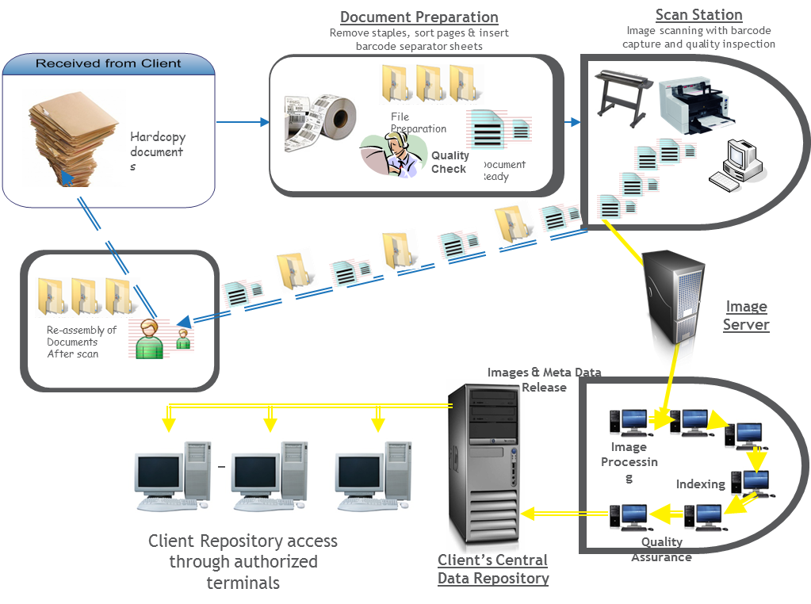
DIGITIZATION AND
RECORDS STORAGE
100+ Professionals
300,000+ Images Daily
Compliant with NFPA13 and FM Global 6-7 Standards high standards
Detection and Fighting of Fire
Flood and Pest
Direct link via auto-dialer to Civil Defense
Safety signage displayed throughout all facilities
No smoking
rated wiring
Sprinklers
Smoke and Heat Detectors
Fire-rated FM200 & Inergen Vault for Media and Critical Documents
Trained and Certified Facility Staff,
Boxes stored in elevated locations – at least 1 meter from road level and 30cm from ground level
Librarians wearing protective safety gear at all times Facilities located outside of flood plains
5 ply boxes to mitigate heat buildup & reduce water damage
Librarians wearing protective safety gear at all times Facilities located outside of flood plains
Proximity to Civil Defence Station
On-Premises
Hybrid
In our Record Centers
SCANING FLOW
Product Management
Release Management
Application Security Compliance
Global customer
service
Cloud engineering
Program
management
Cloud operations
Incident
management

Slide 15
SUPPORT SERVICES
ONEECM Support team comprises of experienced resources to support business critical application
ONEECM Helpdesk System for ticket logging, SLA and reporting
Offer onsite and offsite resourcing model
Managed Services
Proven Transition Approach
Customer Satisfaction

Slide 16
z
OUR COMMITMENTS
Approach
Consultants
Methodology
Experience & Reputation
Simplicity of Proposed Solution
Implement & run anywhere
on-premise | cloud | hybrid
Best in their field
100% product certified
Proven through
1,000+ engagements
Best practices and in-depth experience at your service
We are Committed to delivering Successful projects in time and budget

Slide 17



CONTACT US
www.oneecm.com
If you need any additional assistance, please contact us.
And do not hesitate to email us if you have any questions.
Sales@oneecm.com
00971 54 994 3426

