Slide 1
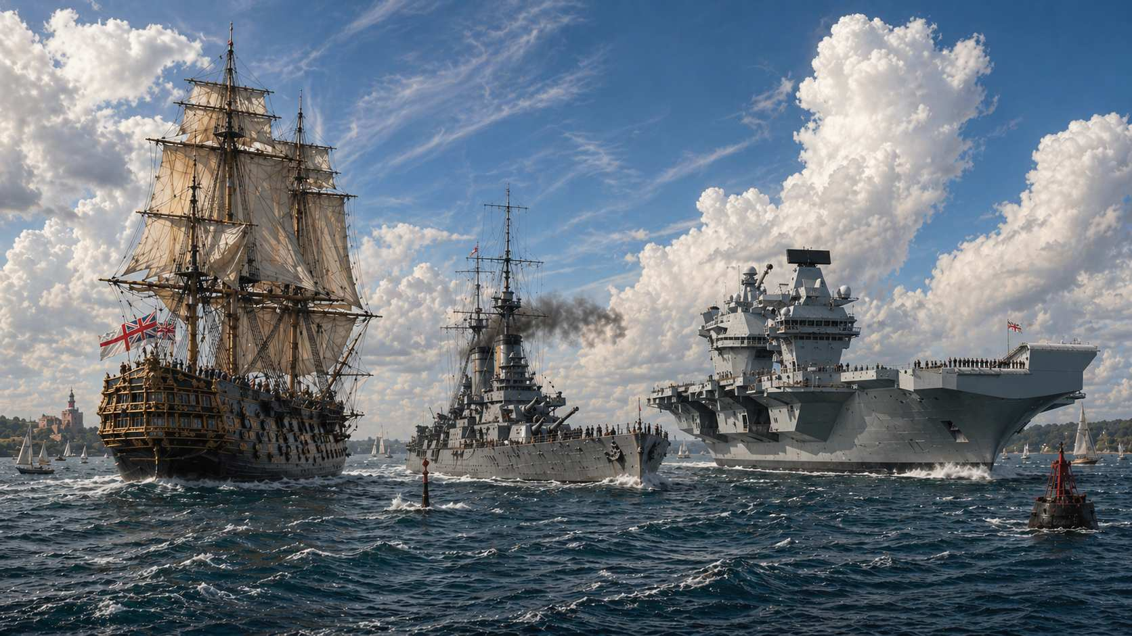

With
Rear Admiral (Retired) Simon Hardern
Anchors of Empire
A Tour Through Britain’s Historic Royal Naval Bases and Dockyards
To enhance your enjoyment of this presentation, I often use Artificial Intelligence (AI), including OpenArt AI and ChatGPT, to restore and enrich the clarity and fidelity of older illustrations and photographs,
and to bring my imagination to life through visualisations that make the impossible wonderfully tangible!

Slide 2
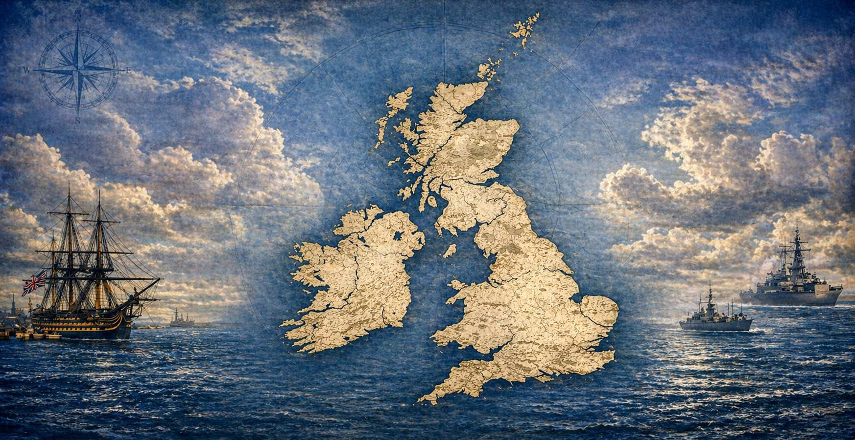
A Map of the Many Harbour and Base Locations Through Time
Scapa Flow
Loch Ewe
Invergordon
Faslane
Rosyth
Lough Swilley
Londonderry
Belfast
Liverpool
Pembroke Docks
Cork (Cobh)
Chatham
Berehaven (Bantry Bay)
Portsmouth
Portland
Plymouth

Slide 3
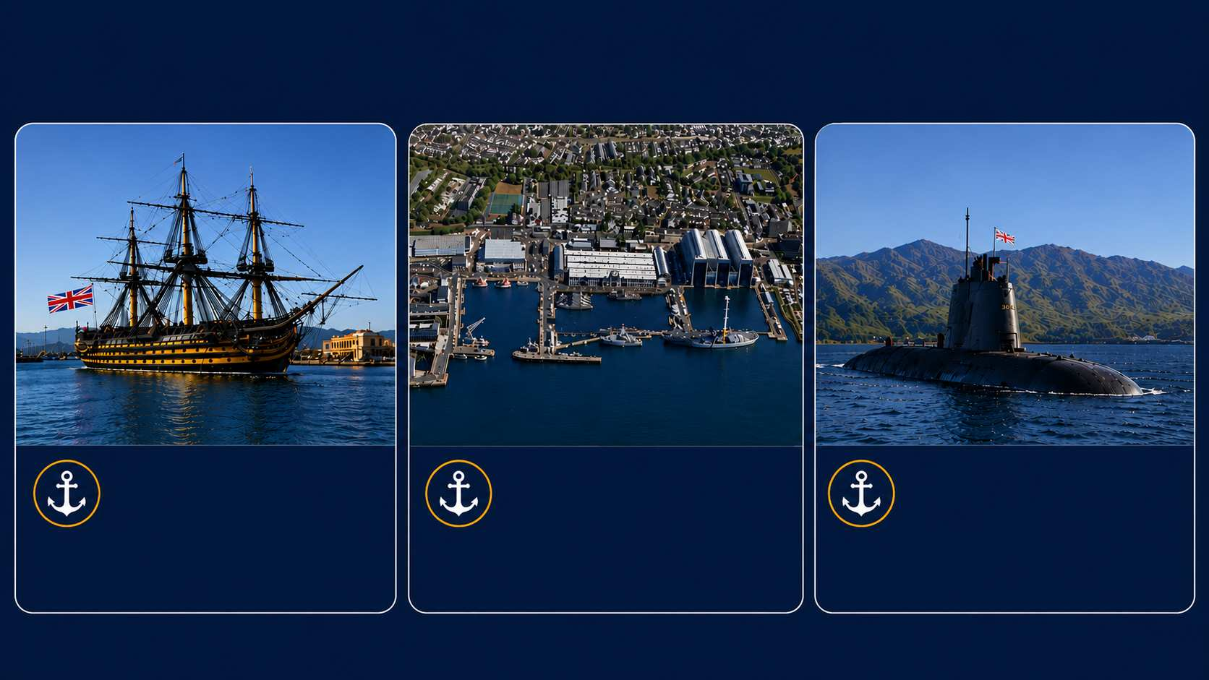
Today’s Key Naval Base and Dockyard Locations
HM Naval Base
Portsmouth
Surface fleet hub and dockyard in southern England
HM Naval Base
Devonport
(Plymouth)
Large naval base and nuclear submarine refit facility
HM Naval Base
Clyde
(Faslane)
Major base in Scotland and home to entire submarine fleet

Slide 4
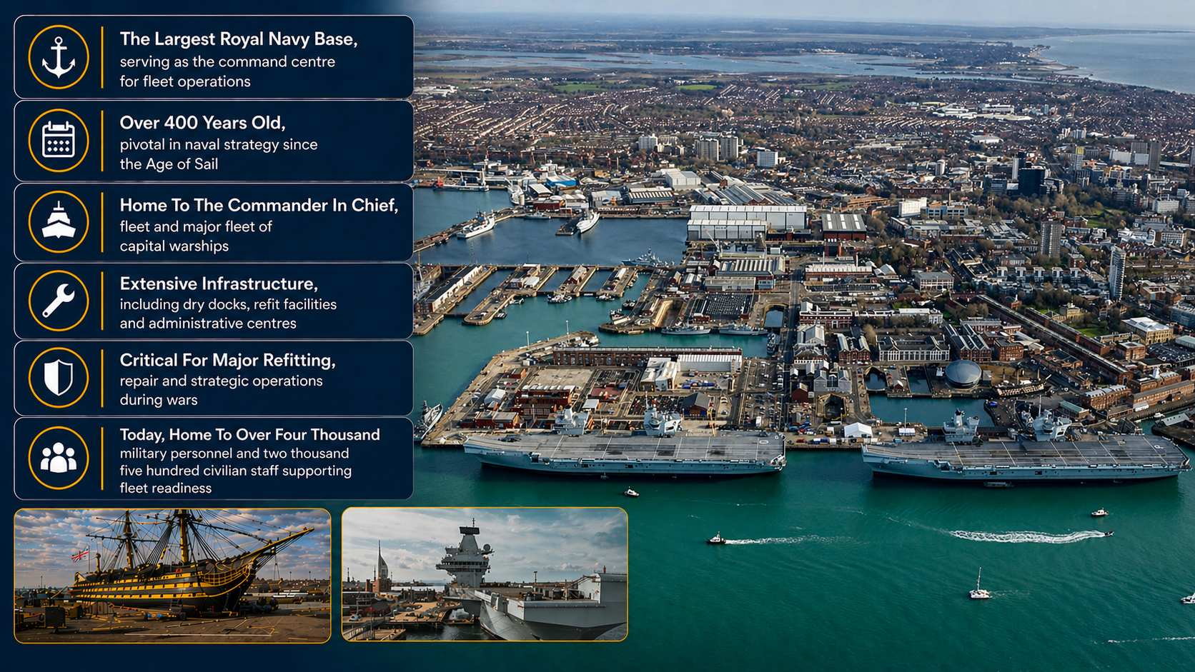
Portsmouth

Slide 5
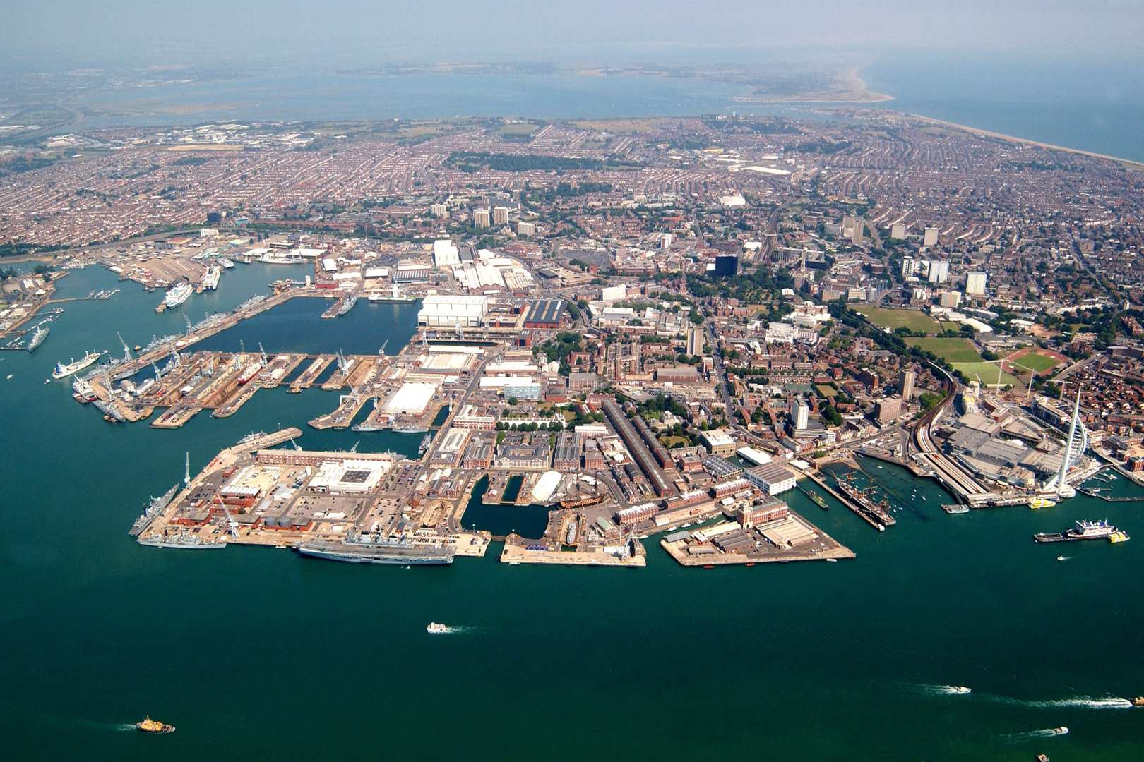
Portsmouth
1987

Slide 6
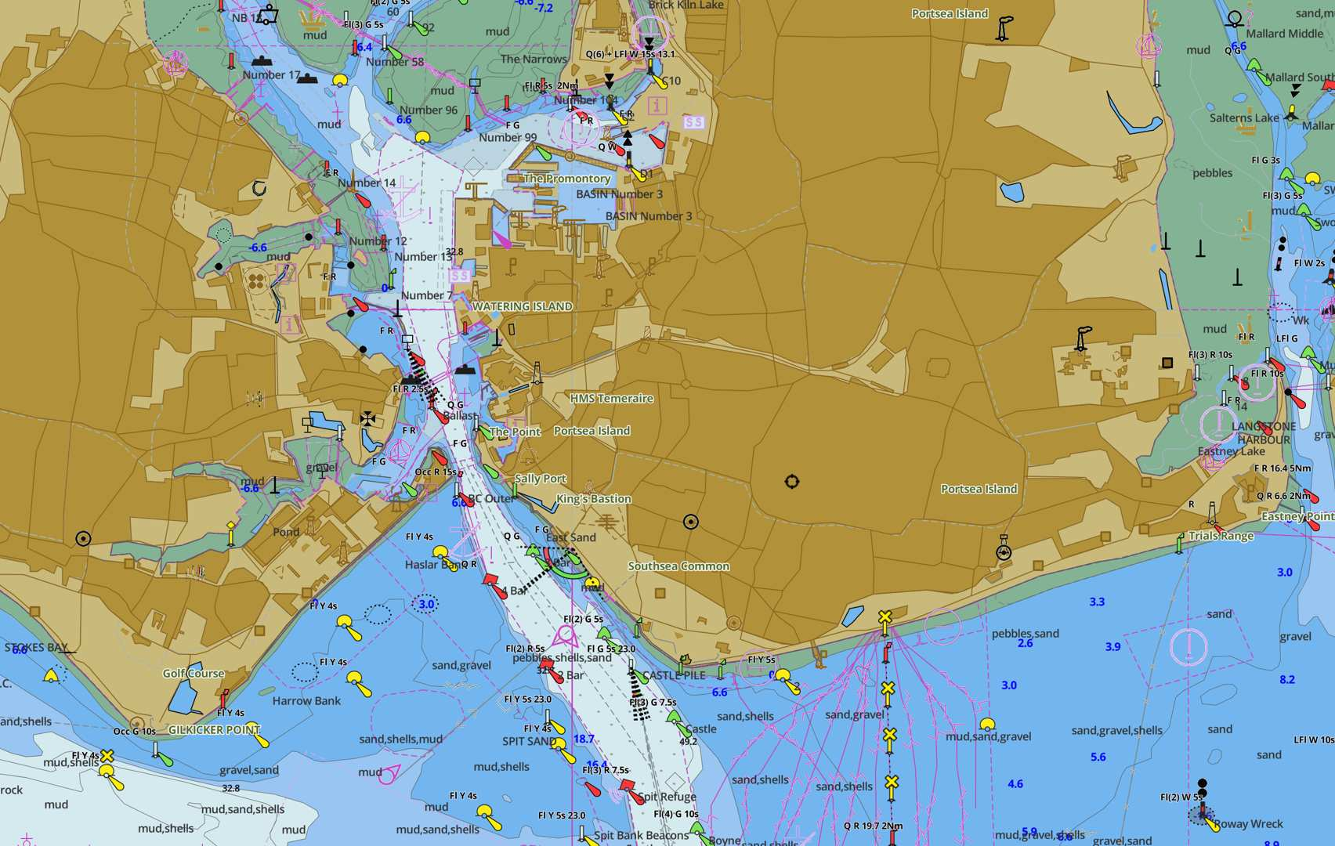
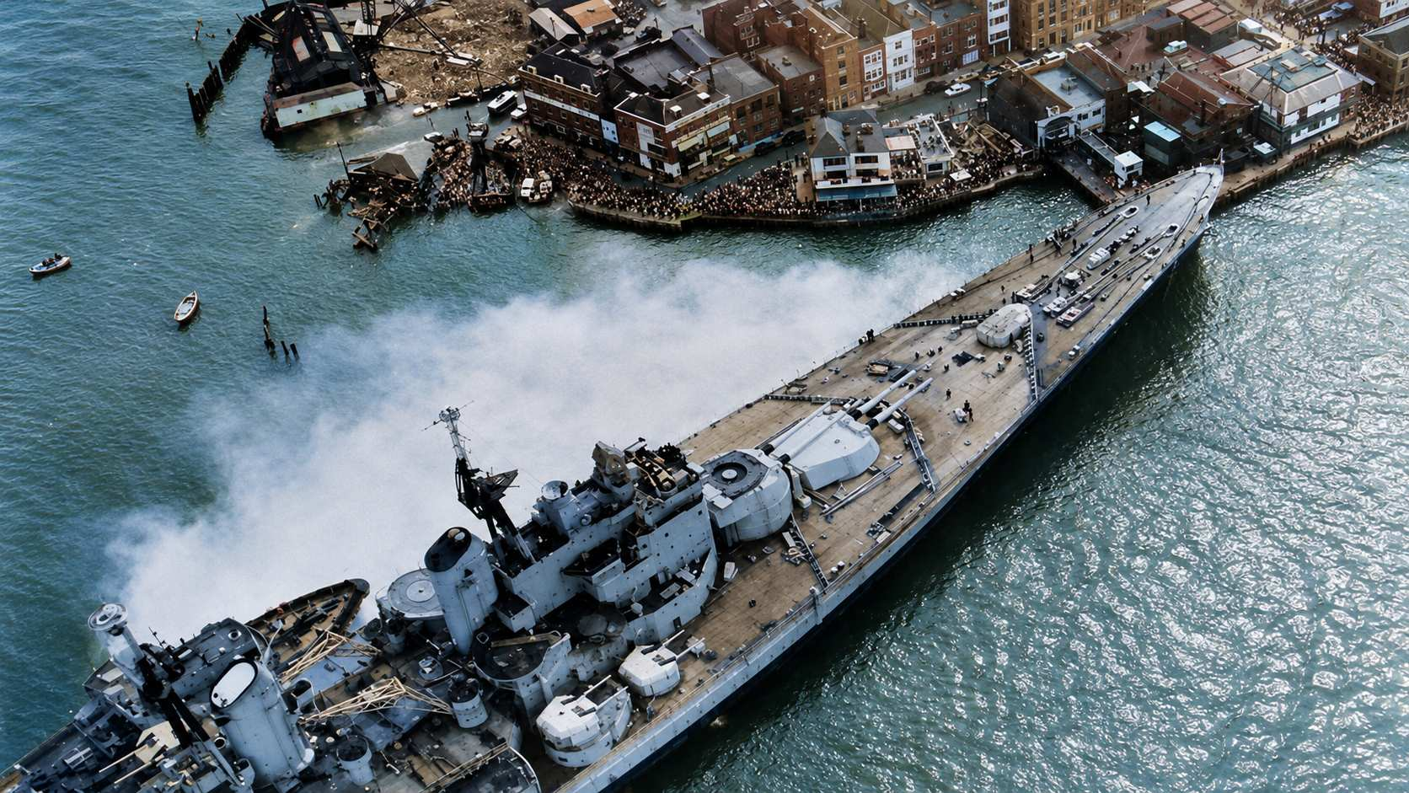

Slide 7
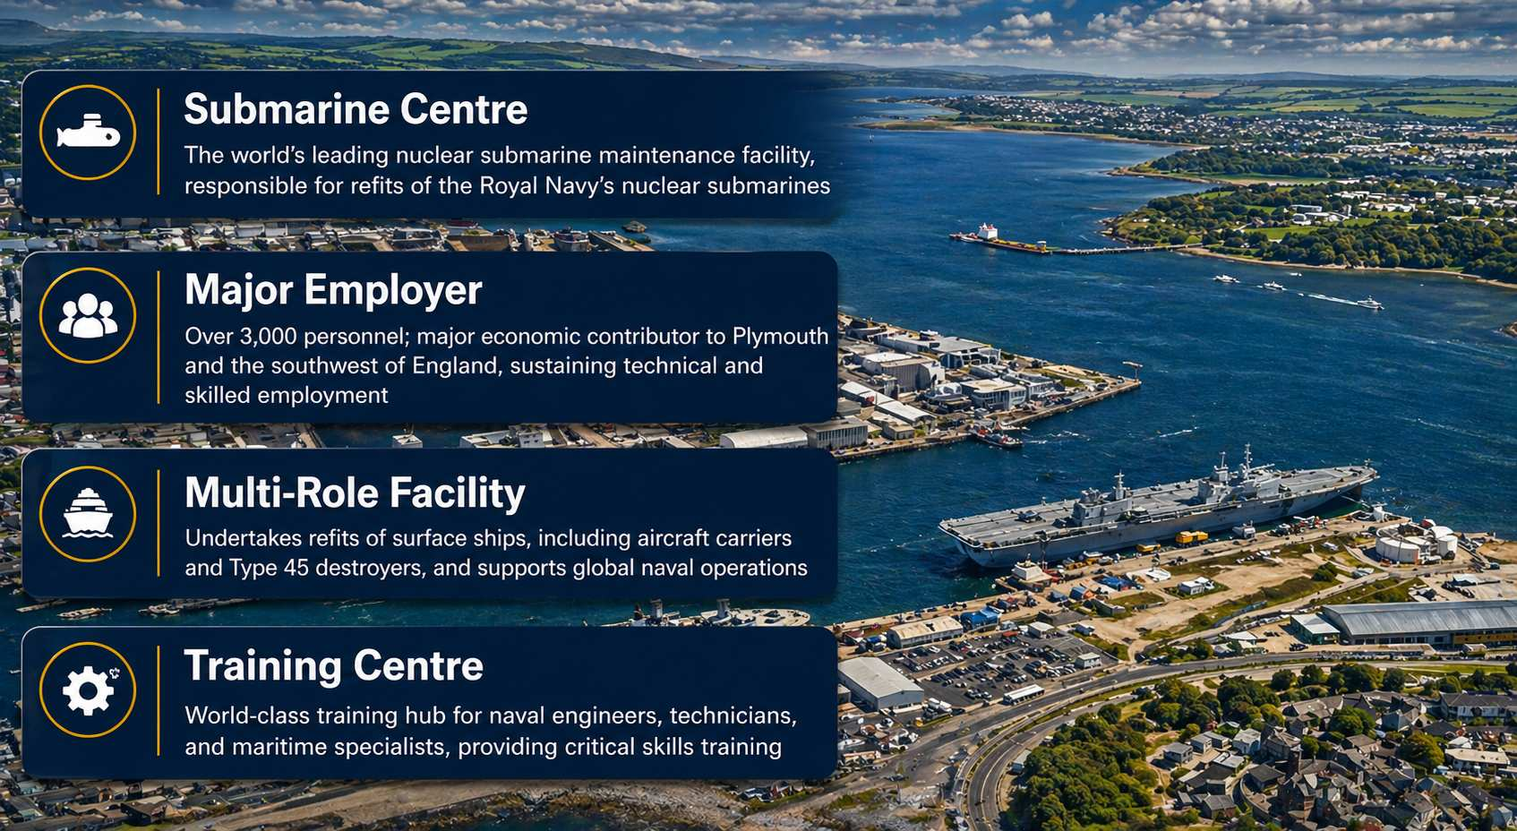
Plymouth

Slide 8
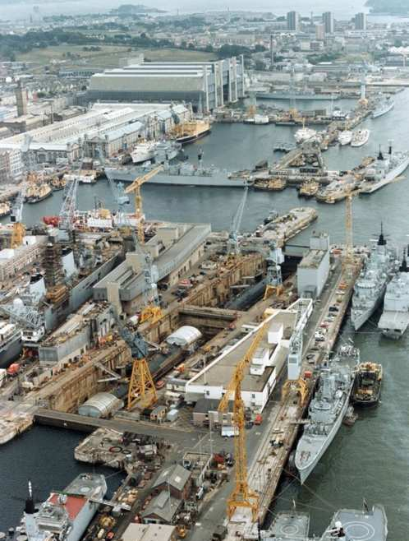
Plymouth
1987

Slide 9
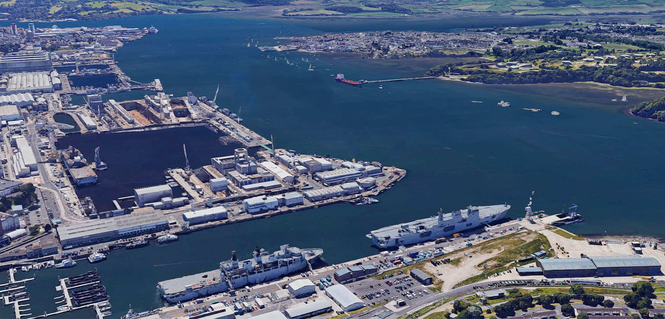
Plymouth
2017

Slide 10
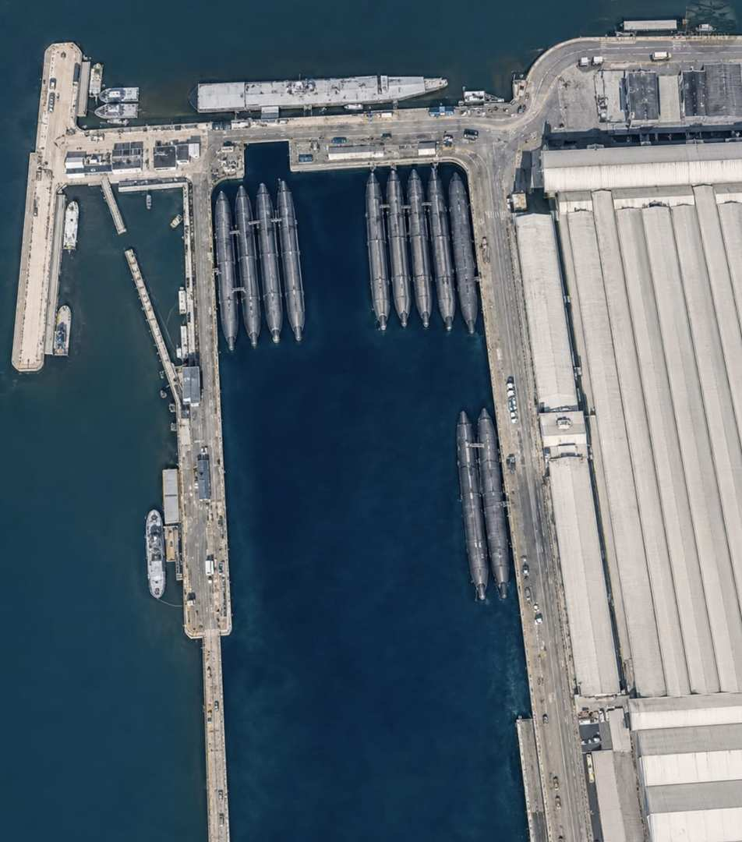
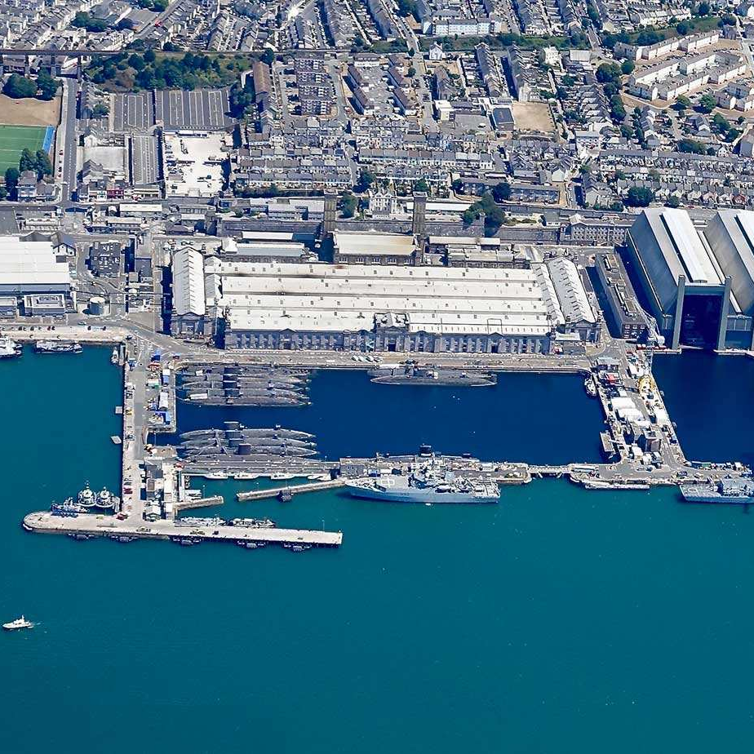
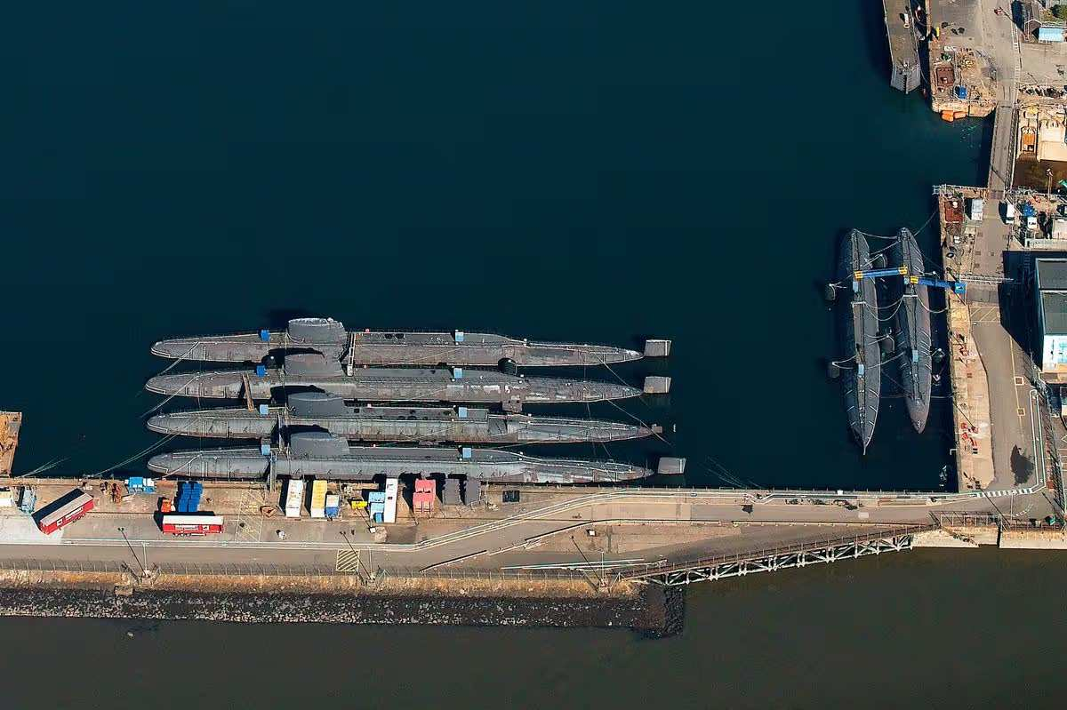
By the Way … About Nuclear Submarine Decommissioning!
The UK has three times as many nuclear submarines decommissioned than in commission - based on an extrapolation of the cost given in 2019, the cost to defuel and decommission 26 nuclear powered submarines (that is about £575M per boat!)
At HMNB Devonport, there are 15 nuclear powered submarines and 11 are still fuelled - defueling was halted in 2003 when facilities were deemed no longer safe enough to meet modern regulatory standards
At Rosyth, there are 7 nuclear powered submarines and all are defuelled . HMS SWIFTSURE is being dismantled (Jul 23-Dec 26)

Slide 11
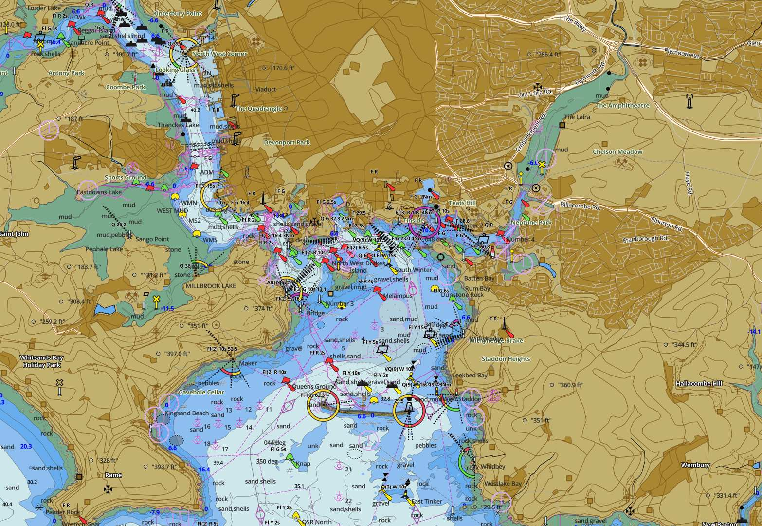
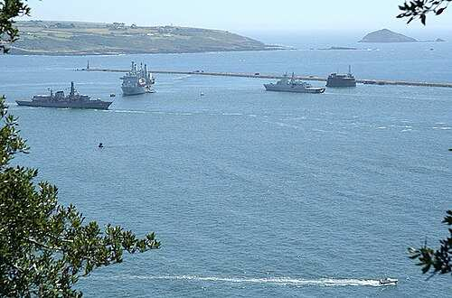

Slide 12
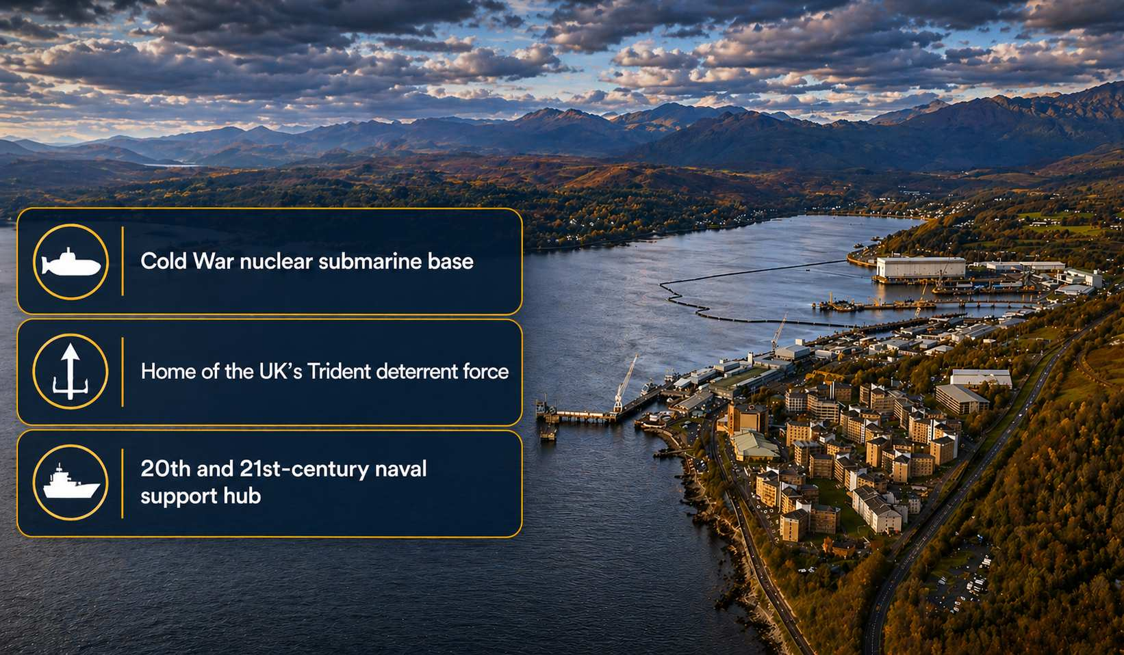
Faslane

Slide 13
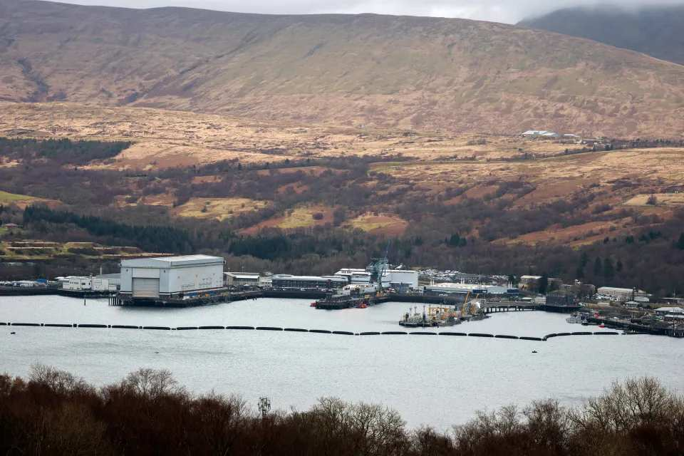
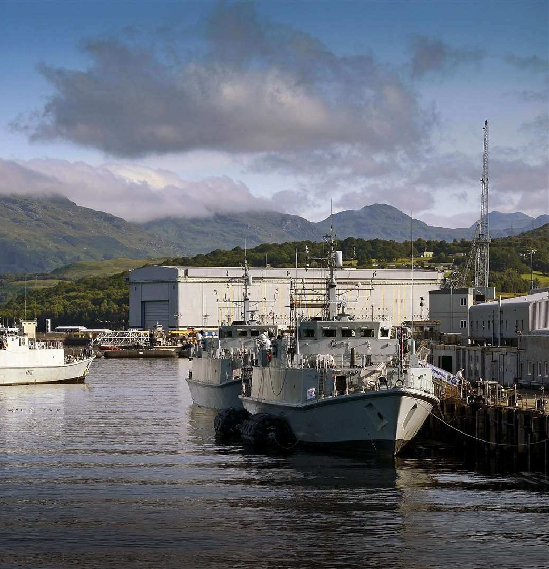
Faslane
Faslane is the second largest single-site employer in Scotland. The nuclear sector alone added an estimated £1.5 billion to the Scottish economy in 2024. HM Naval Base Clyde and its supply chain supported around 11,800 jobs in 2024 and the infrastructure programmes will see the number rise further

Slide 14
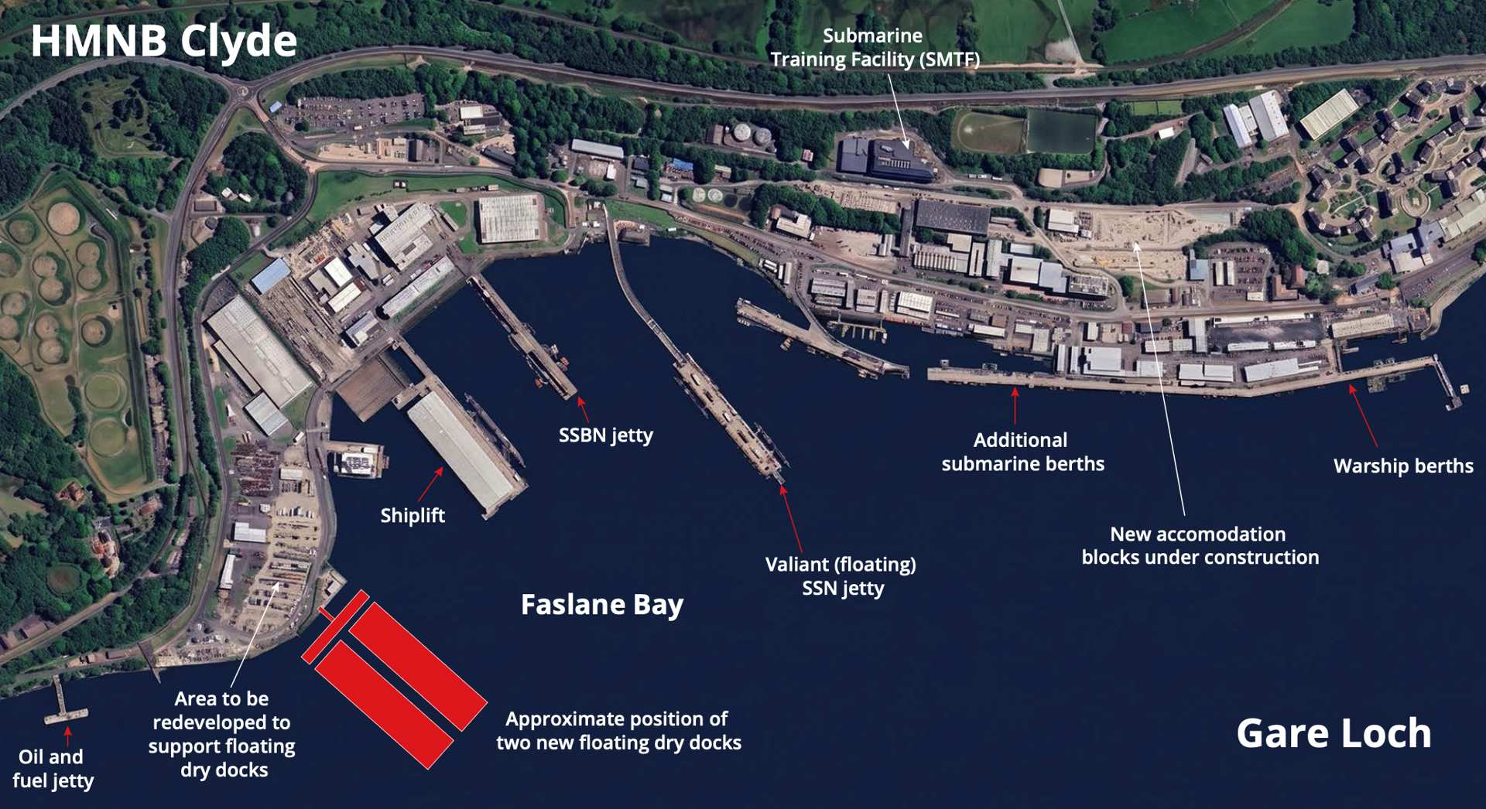
A new Transformation Programme is underway. It includes a £1.8Bn Infrastructure Programme scheduled for completion in April 2032, intended to sustain the Continuous at Sea Deterrent, through to 2067

Slide 15
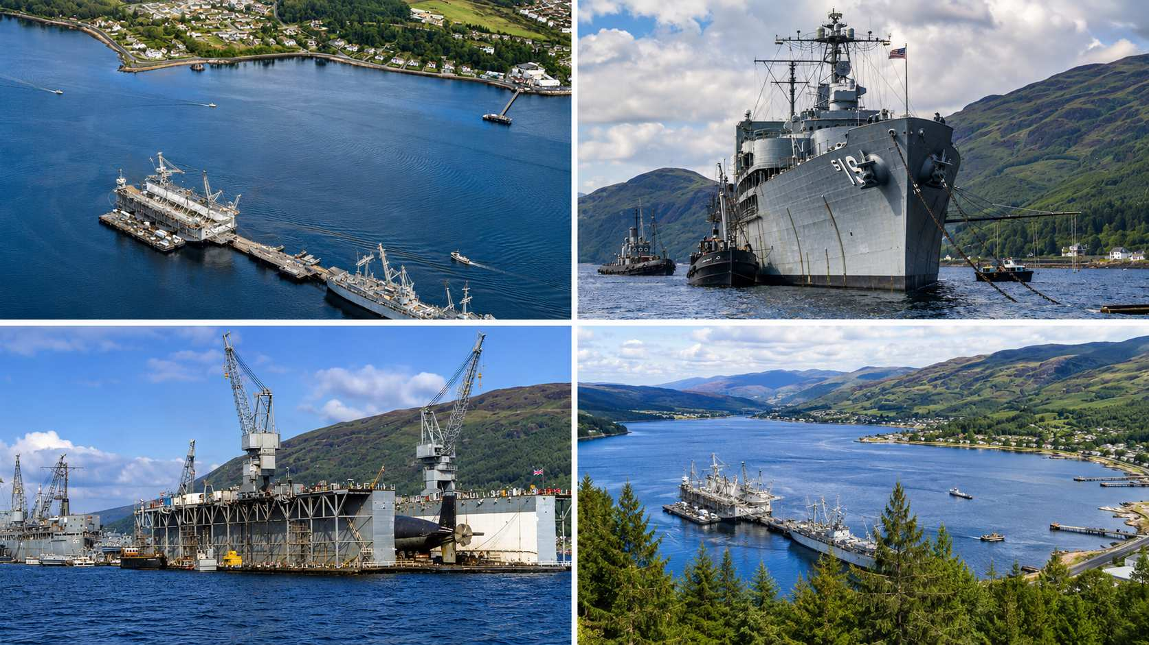
Holy Loch
Holy Loch Naval Base was established by the US Navy in March 1961 when the tender USS Proteus arrived to support the first Polaris ballistic missile submarines. At its peak, Holy Loch typically supported around 10 Polaris/Poseidon SSBNs operating from the Atlantic, providing maintenance, resupply, crew changes, and missile support. It was one of the most important NATO nuclear deterrent bases outside the United States. It closed in summer 1993
In the 32 years the base was operational, on average 200 marriages amongst US service personal and Scottish lasses were registered!

Slide 16
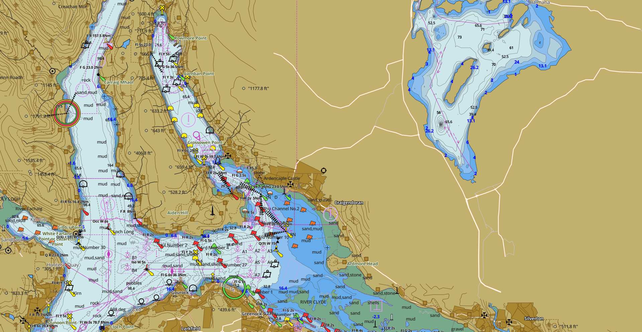

Slide 17
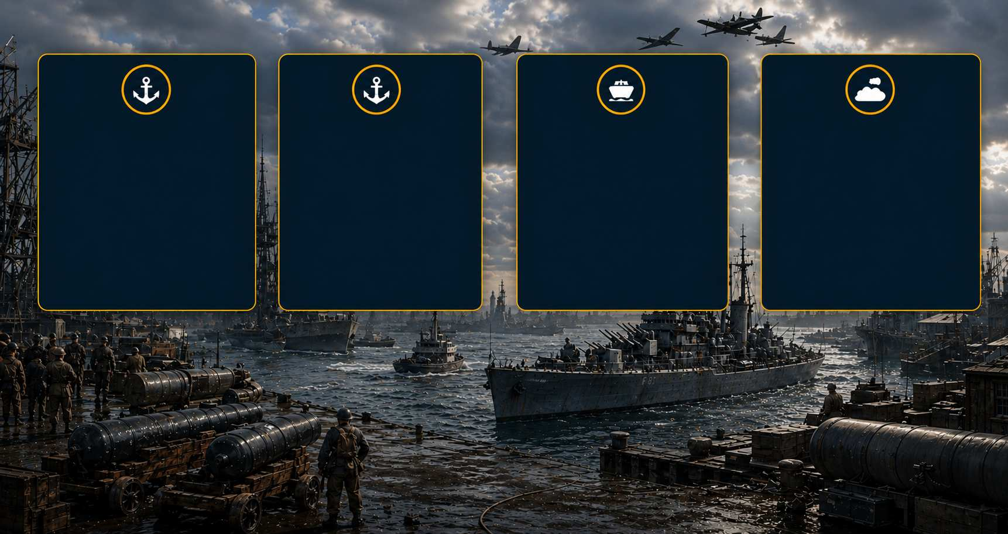
Key Bases 1914 to 1945
Londonderry
Critical WWI and WWII: anti-submarine warfare base in Northern Ireland; major convoy operations hub; thousands of merchant ships protected from U-boat attacks; vital American and Canadian naval liaison point
Scapa Flow
Orkney Islands: major fleet anchorage; home base for Grand Fleet WWI; catastrophic loss of HMS ROYAL OAK 1939 to U-boat; fortified and defended throughout WWII
Invergordon
North Sea naval base: site of famous 1931 naval mutiny; important capital ship anchorage; base for North Sea patrols during both World Wars
Rosyth
Major Firth of Forth anchorage: critical for North Sea operations; industrial repair capacity; damaged during air raids; recovery operations post-1940

Slide 18
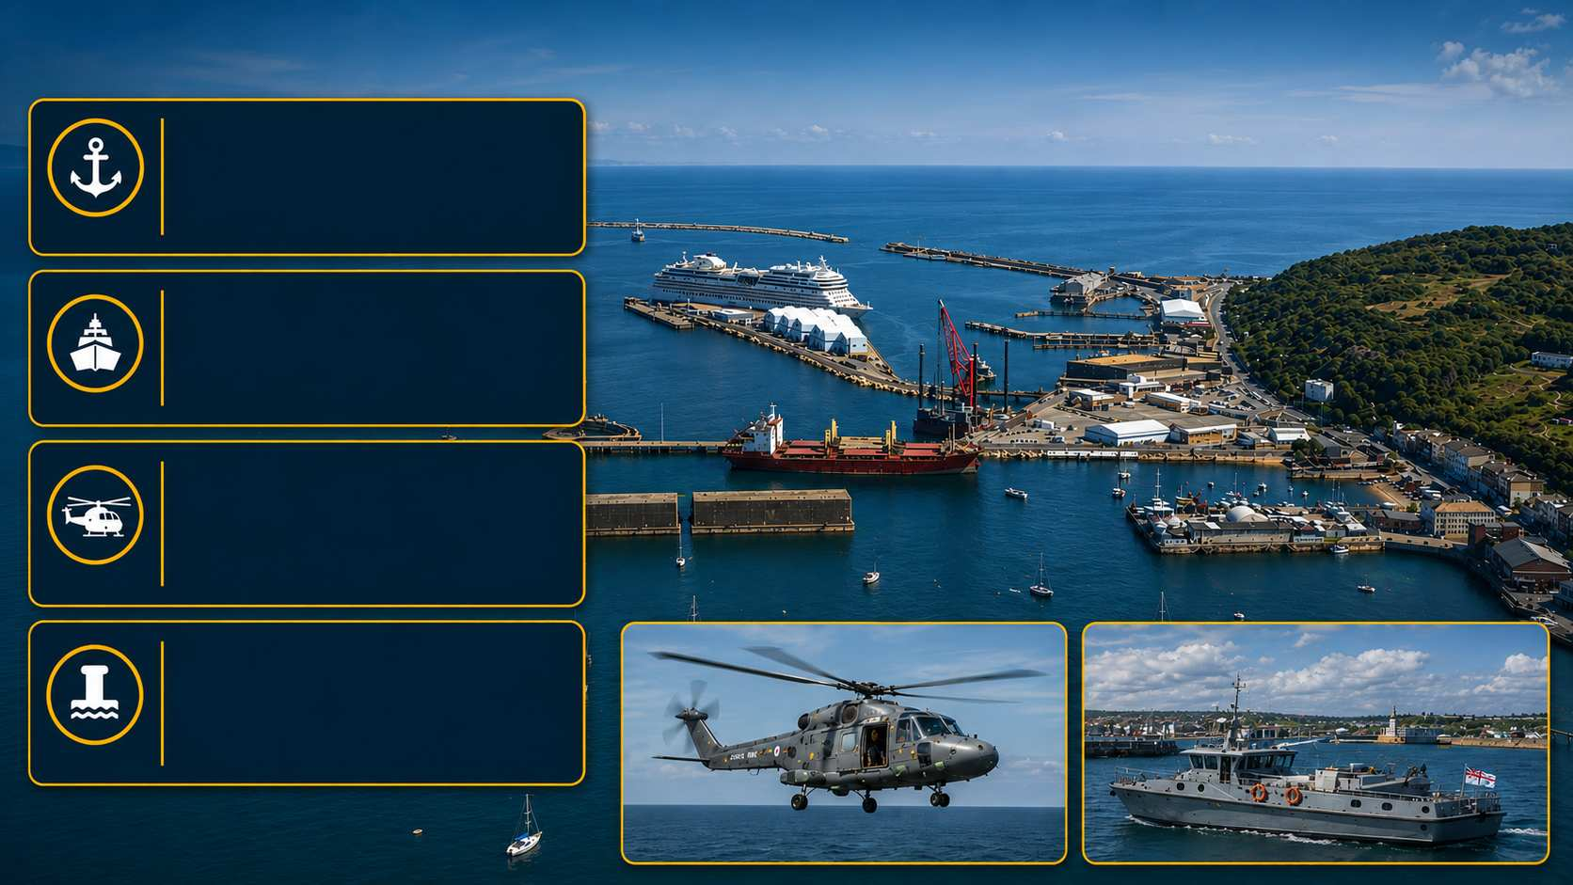
Portland Naval Base - A Living Hell for a Naval Officer
Portland
Important harbour on the Dorset coast
Strategic Base
Strategic base for the Royal Navy from 1849 - provided fleet anchorages and anti-submarine training
HMS OSPREY Base
HMS OSPREY base had a major role in helicopter operations from 1959 to 1999 for search and rescue and anti-submarine warfare
Closed in 1999
Approximately 150 years of continuous naval service came to an end - now a marina, commercial port, and heritage site

Slide 19
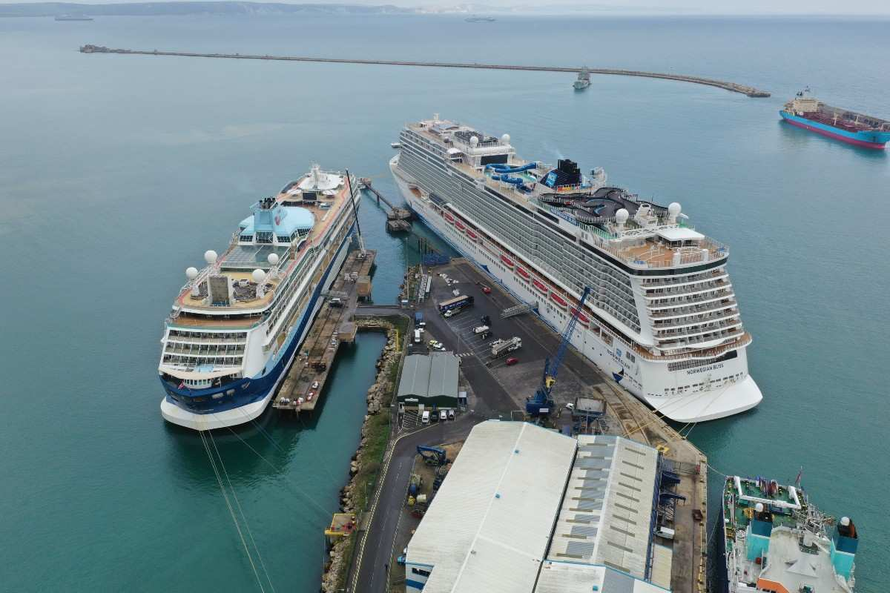
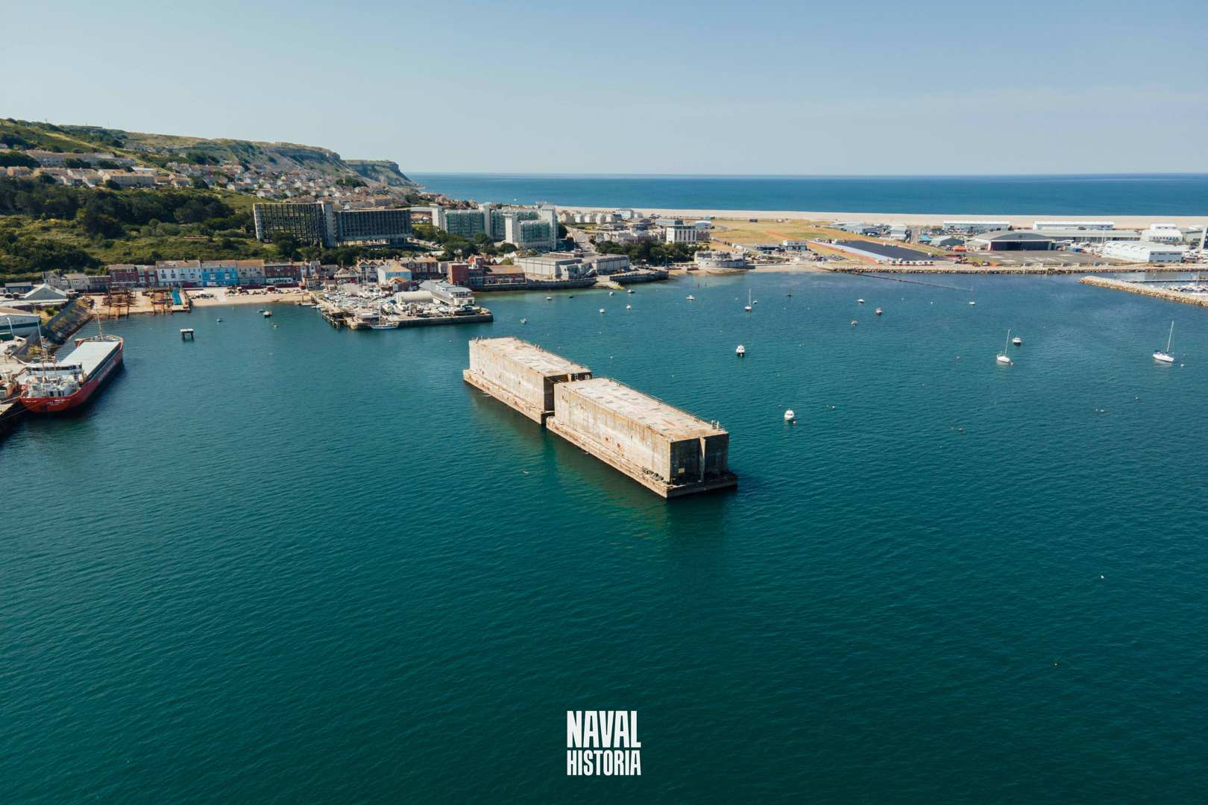
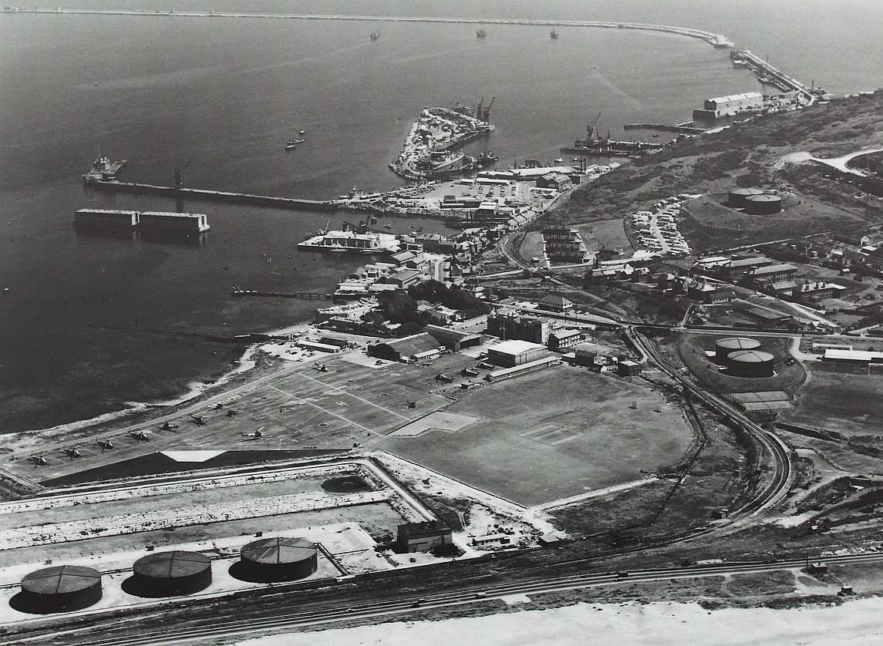
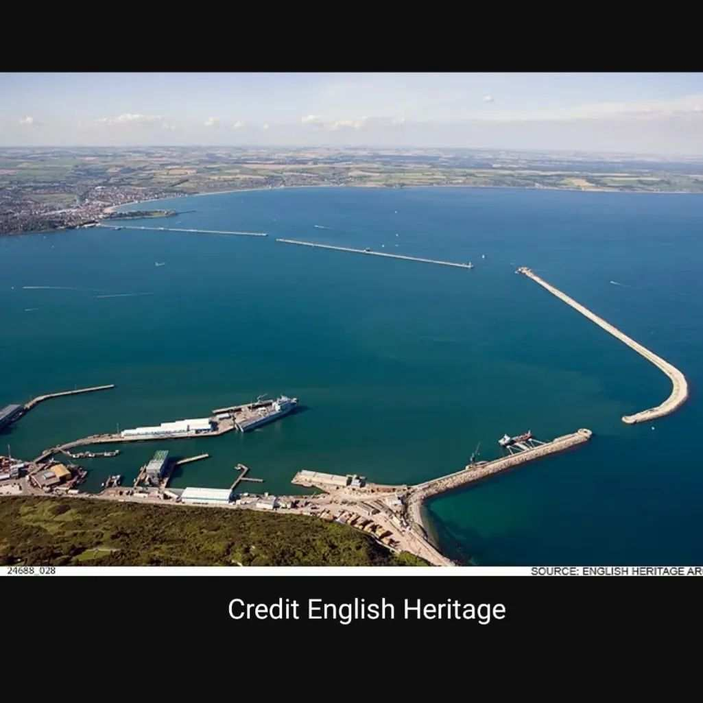
Portland

Slide 20
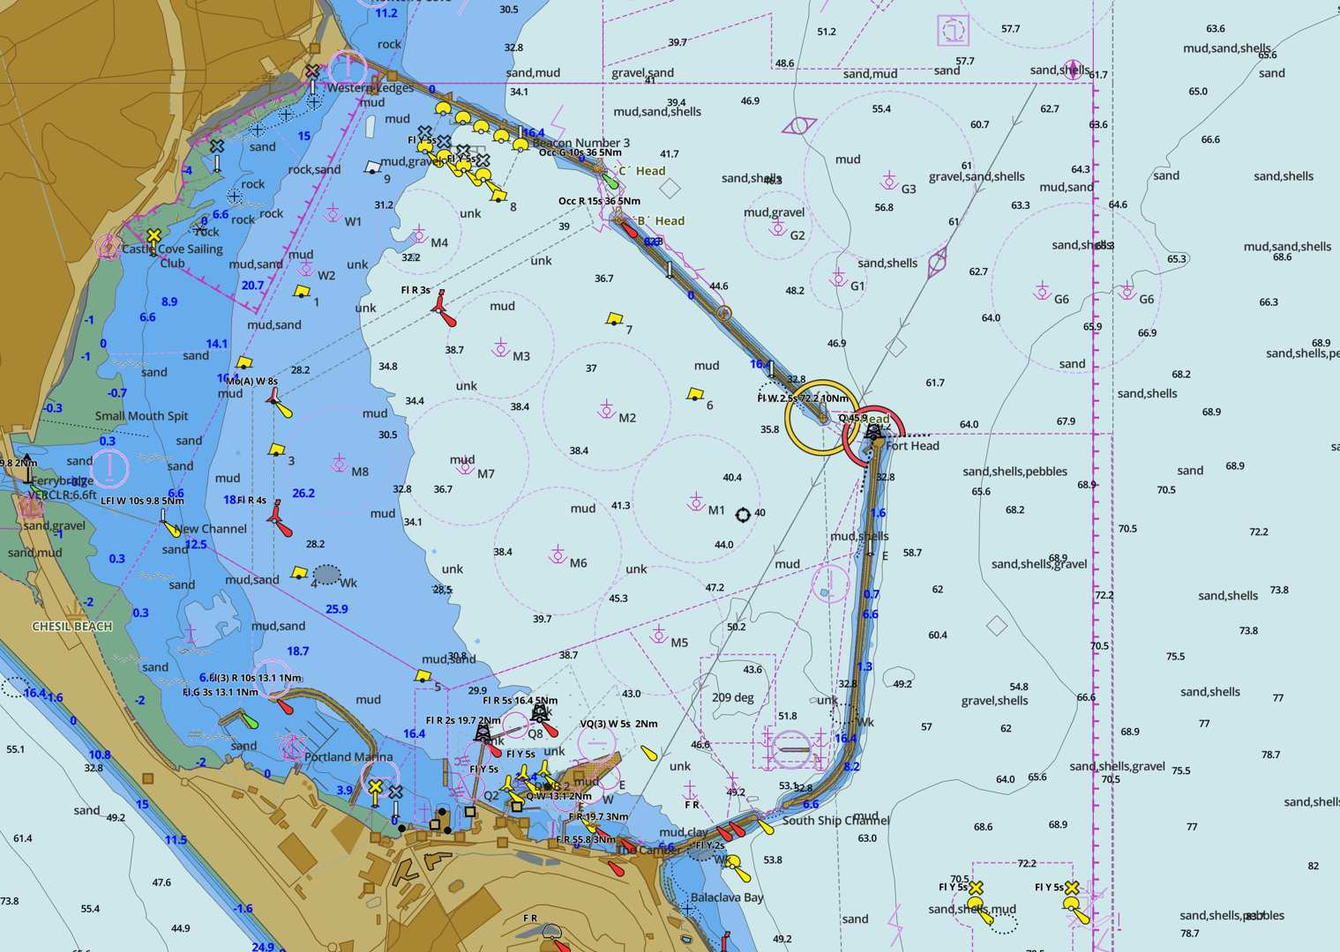

Slide 21
Pembroke Docks (Milford Haven)
Important Historic Royal Navy Dockyard
Important historic Royal Navy Dockyard in Pembrokeshire, Wales
Key Naval Base for Shipbuilding and Repair
Supported repair in the Victorian era, launching 260+ ships including Dreadnoughts
Major Repair and Refitting Base
Major repair and refitting base for the Navy during World War II
Closed in 1959
On closure in 1959 moved to commercial use and museum recognizing its naval heritage
Recognised Naval Heritage
Recognised for its important contribution to Britain’s naval history

Slide 22
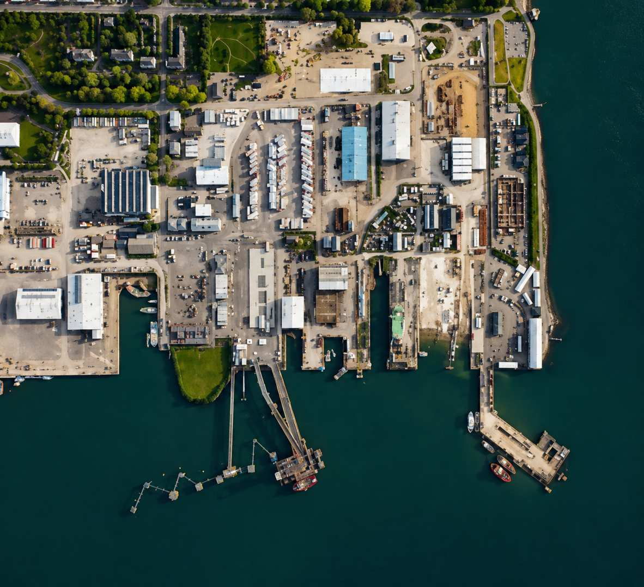
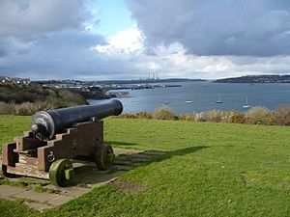
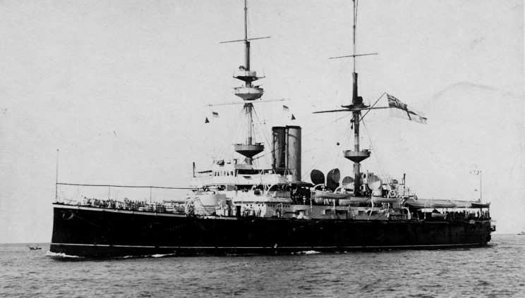
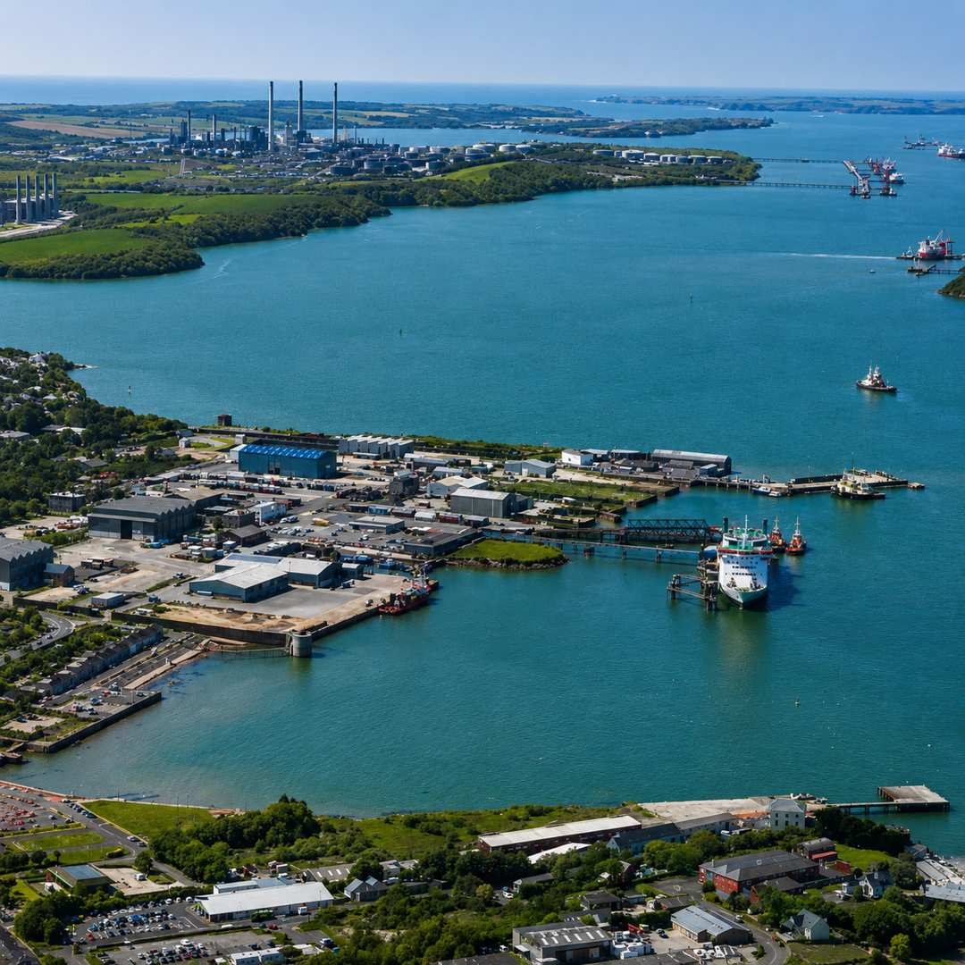
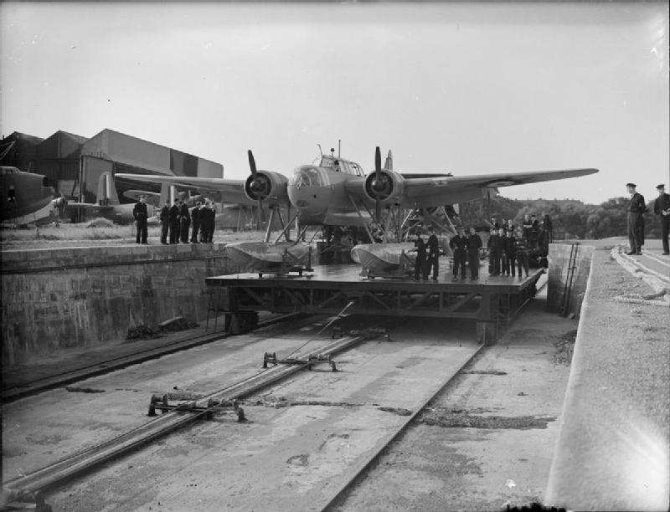
Pembroke Docks

Slide 23
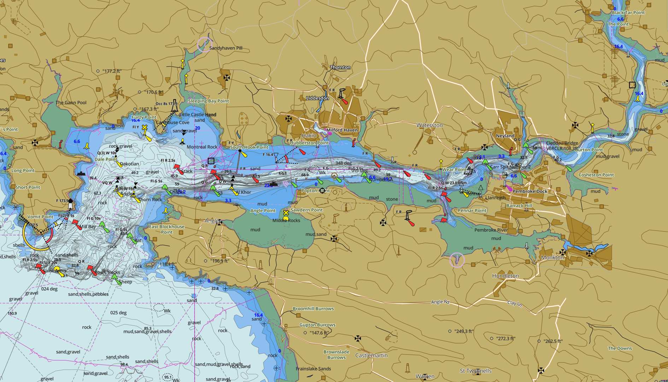

Slide 24
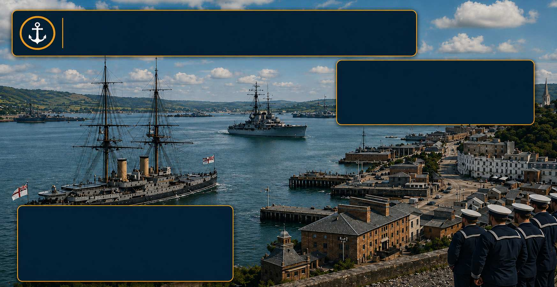
Cobh/Cork - Strategic Base until 1938
Strategic British Naval Base at Cobh (formerly Queenstown)
Used for Atlantic convoy, fleet and antisubmarine operations
Important in WWI
Strong dockyard for repair and replenishment
Focus for British and US Naval Ship Visits
Supported mining of entrance for defence. Was handed over to Irish Free State in 1938 marking the end of British military presence

Slide 25
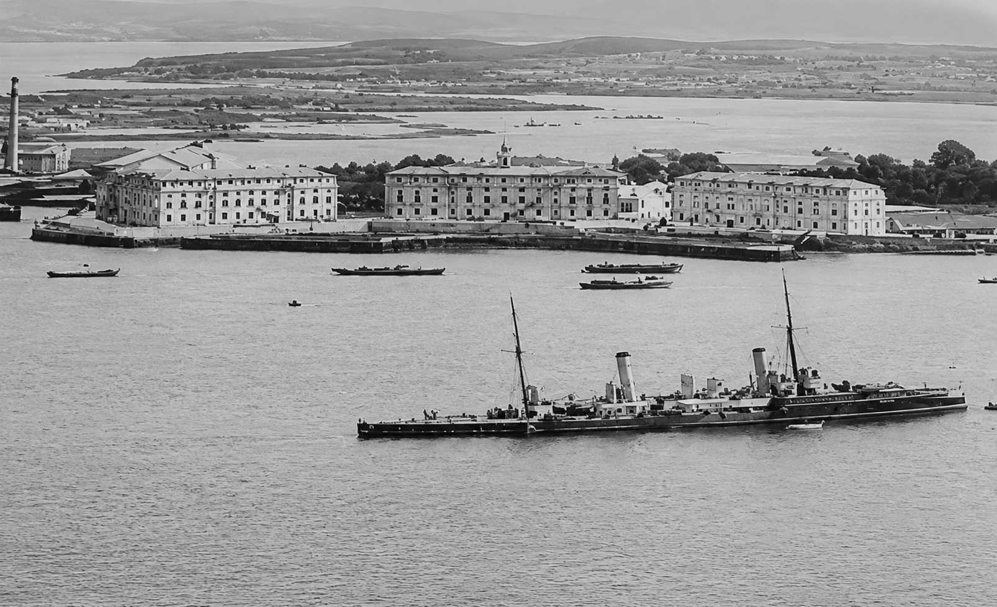
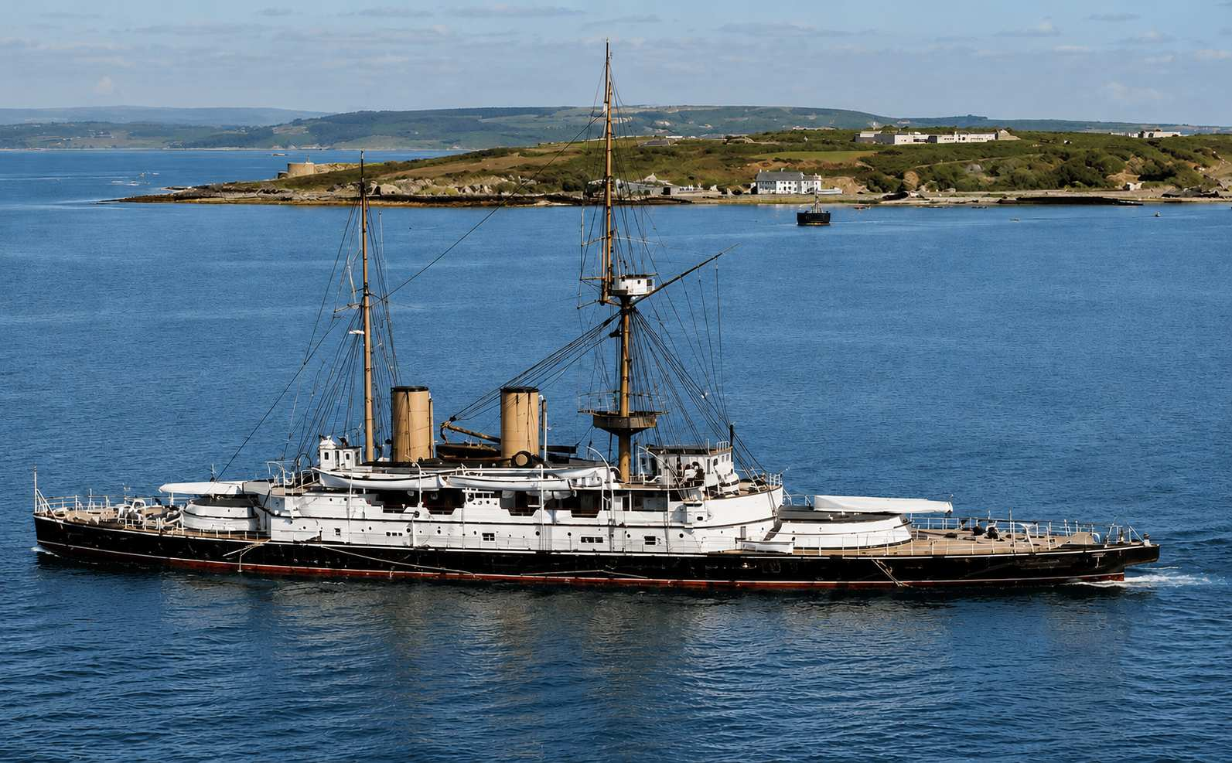
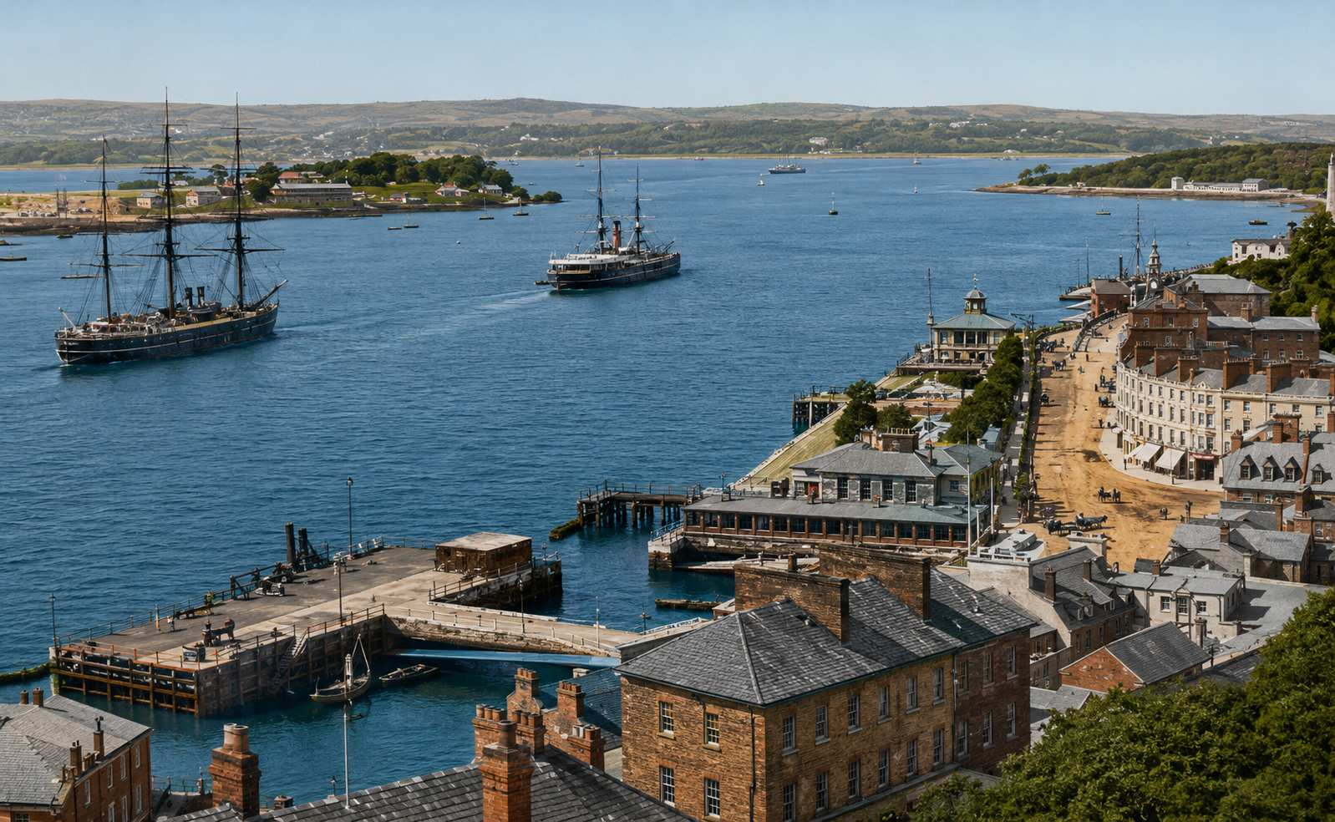
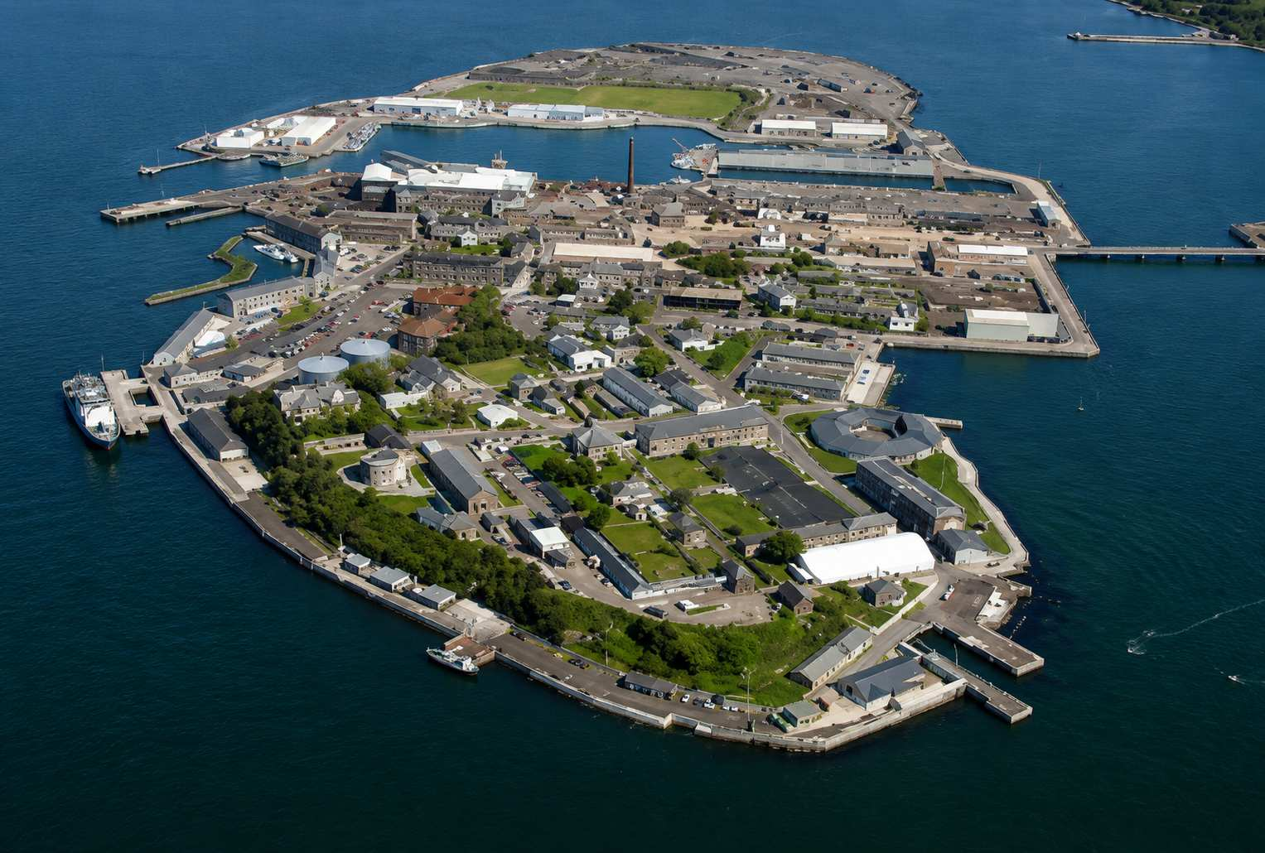
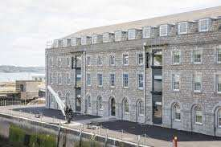
Cobh/Cork

Slide 26
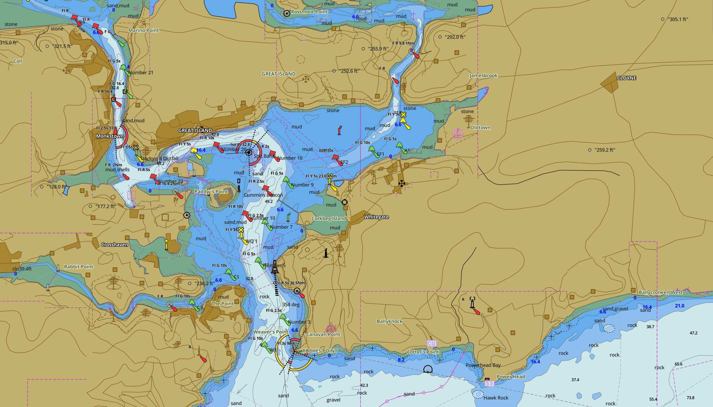

Slide 27
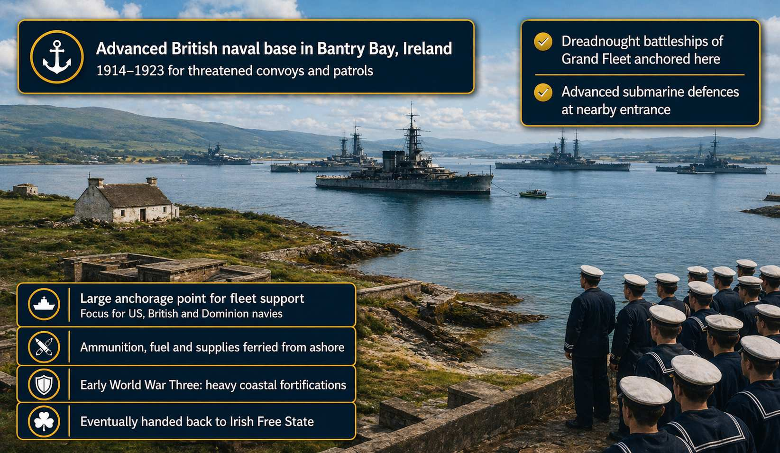
Berehaven - Guarding the Western Approaches

Slide 28
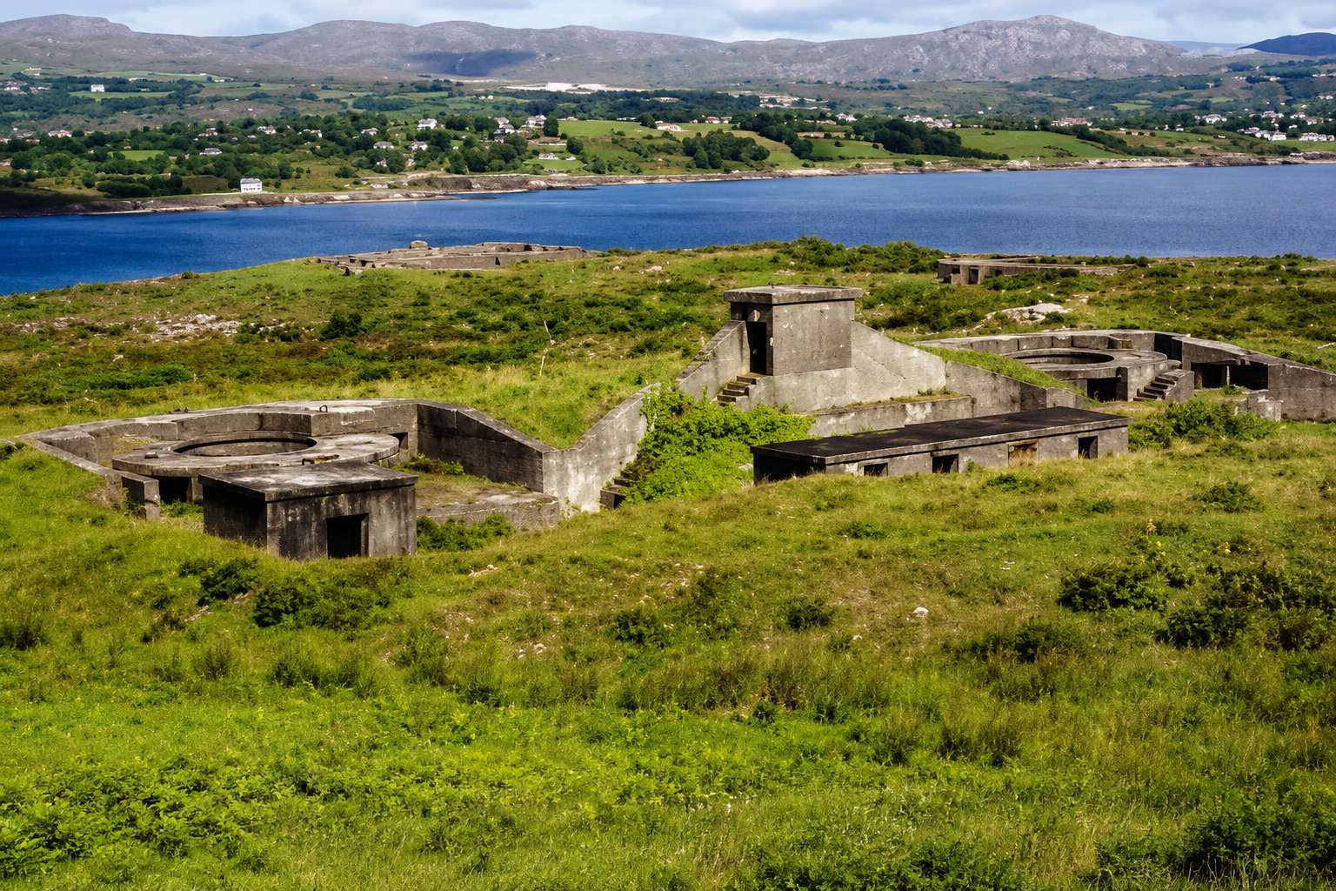
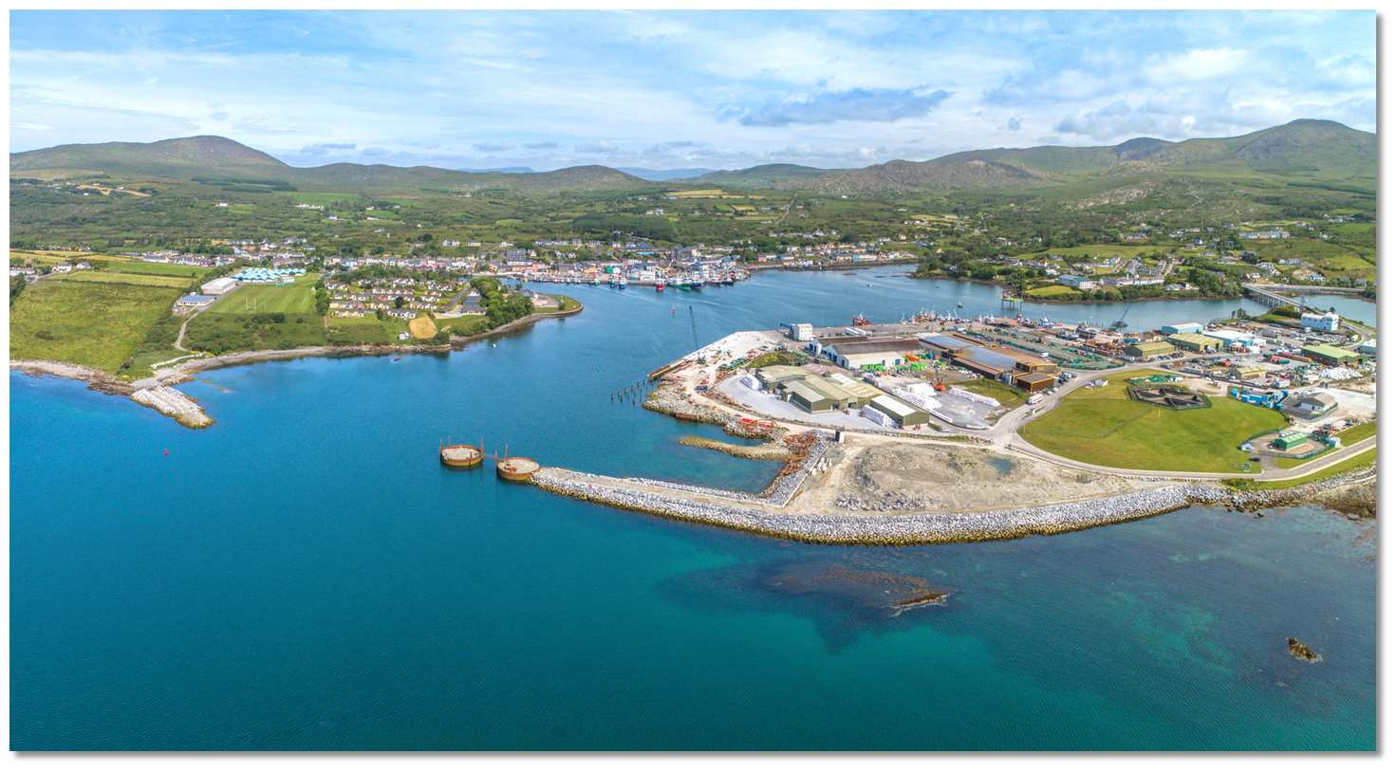
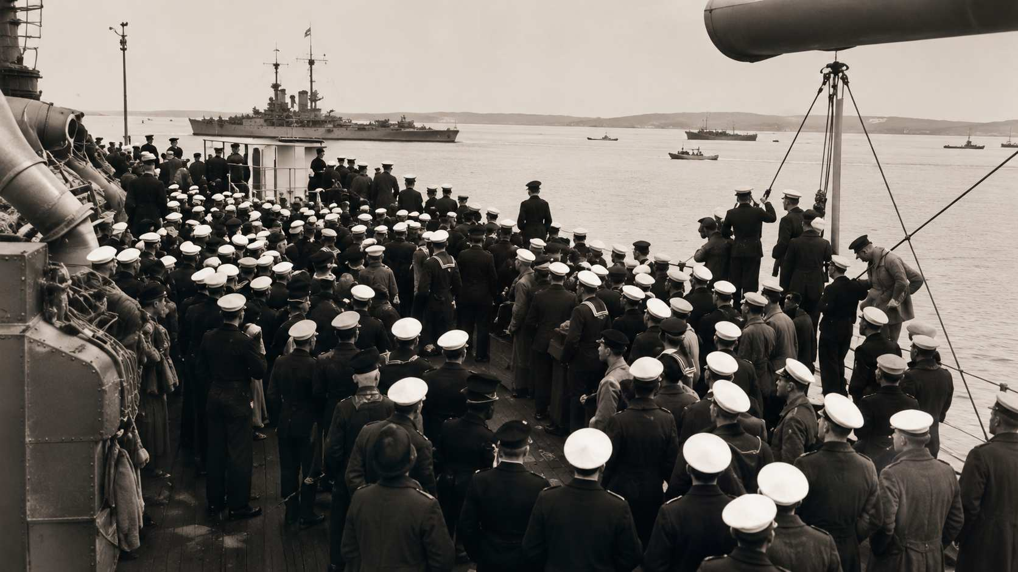
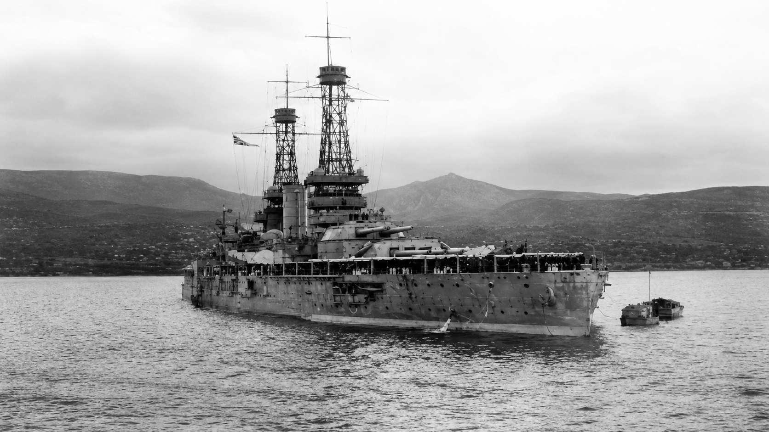
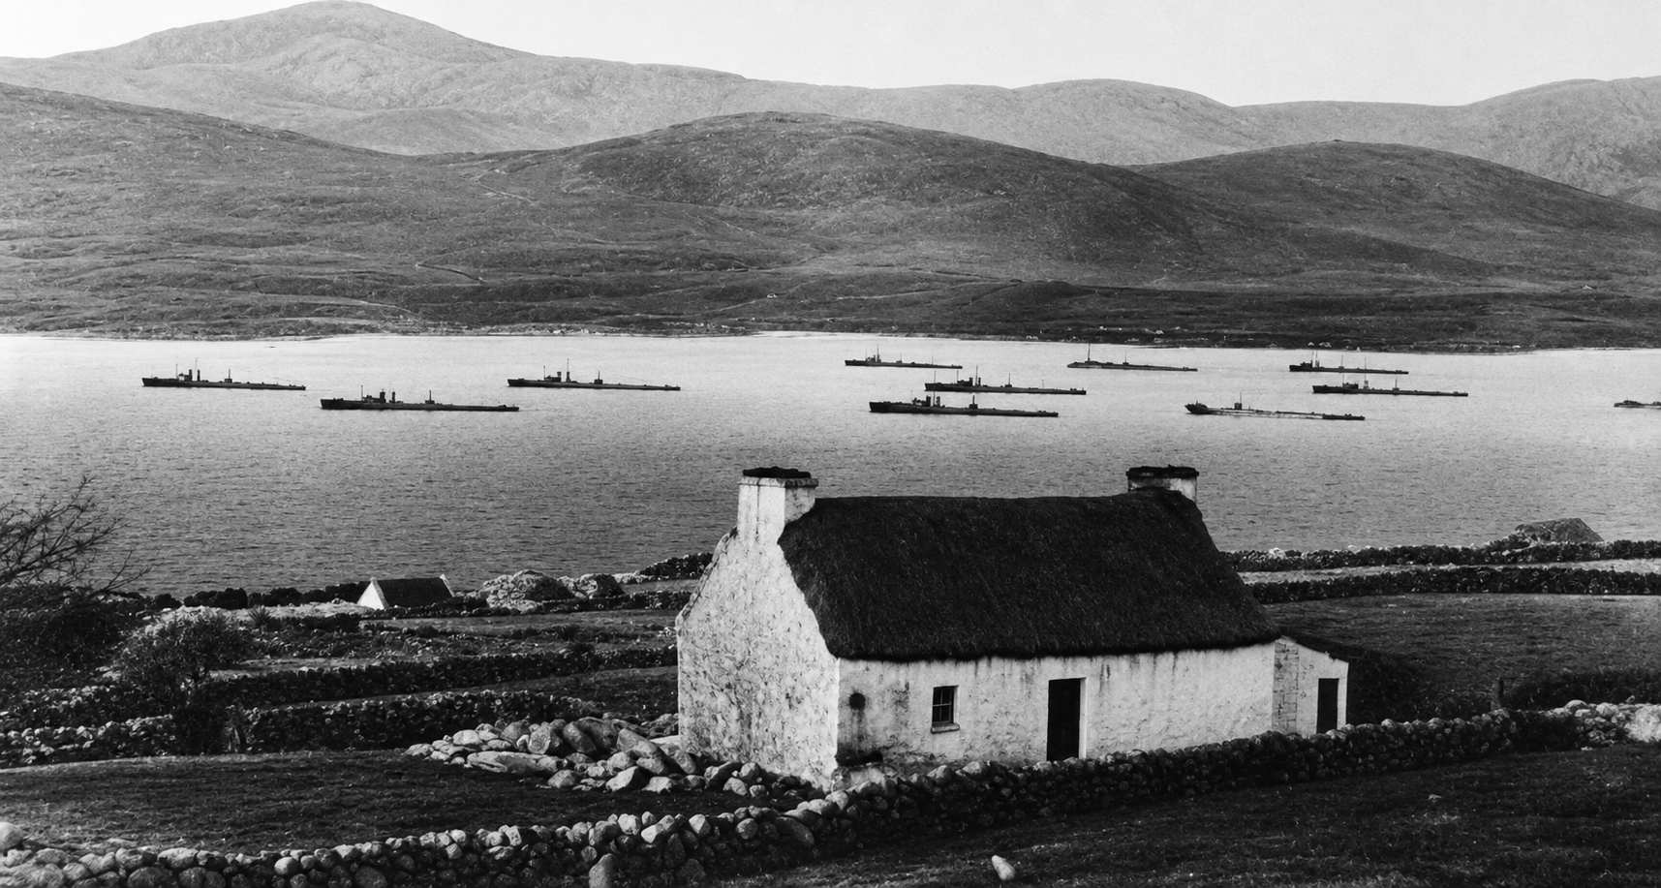
Berehaven - Guarding the Western Approaches

Slide 29
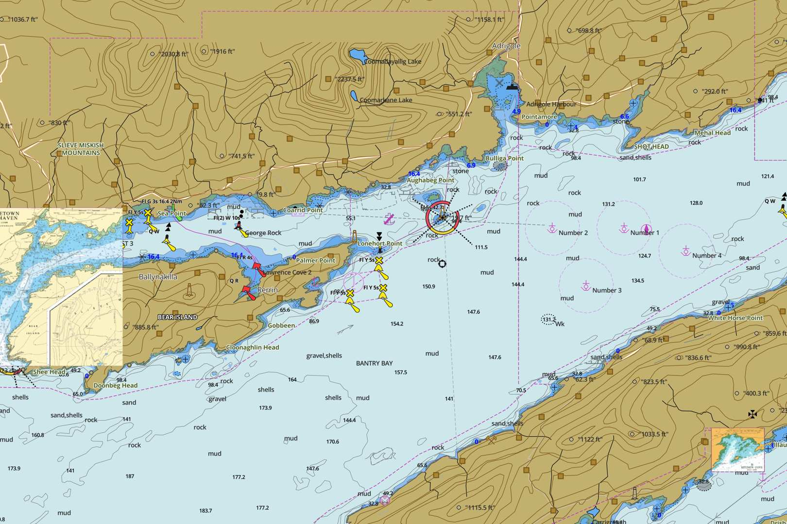

Slide 30
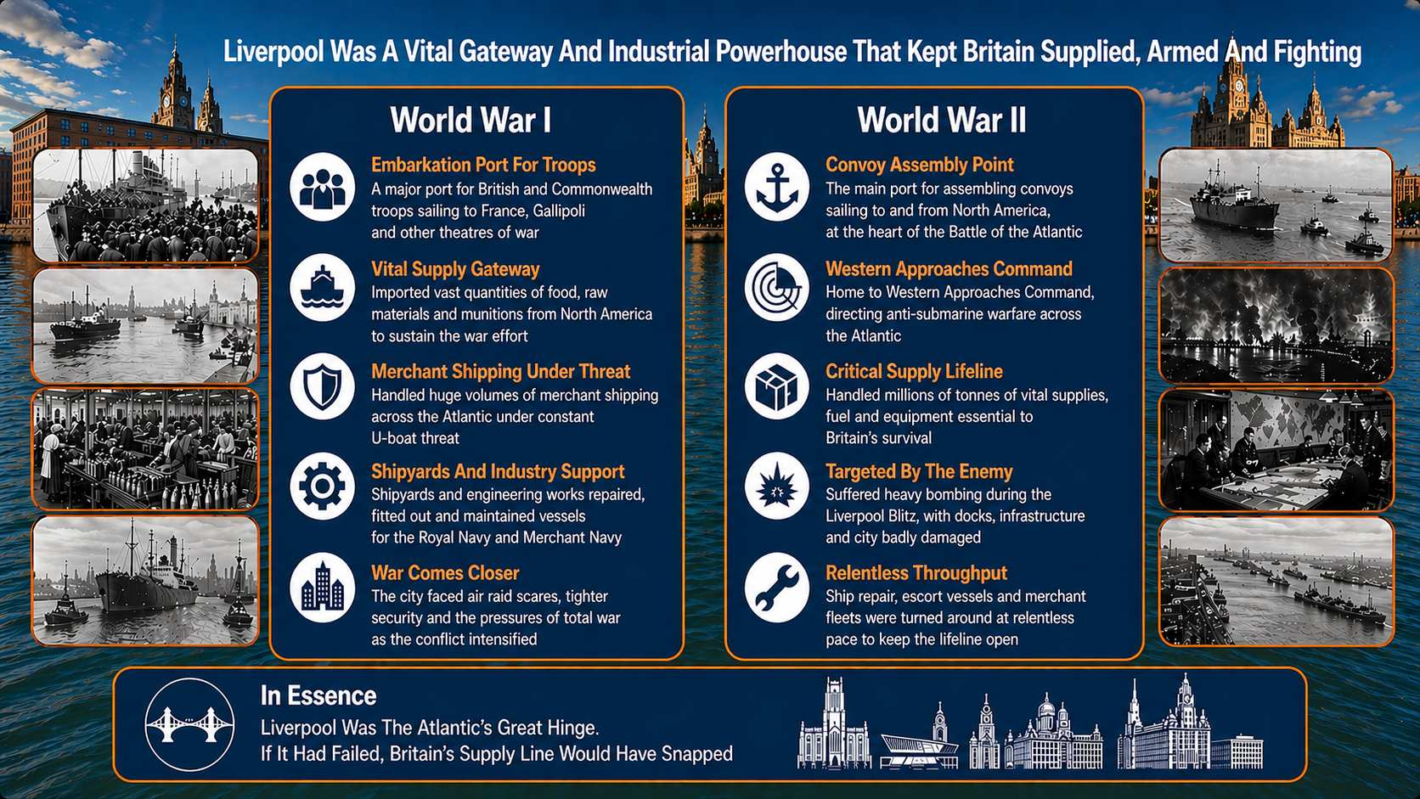
Liverpool

Slide 31
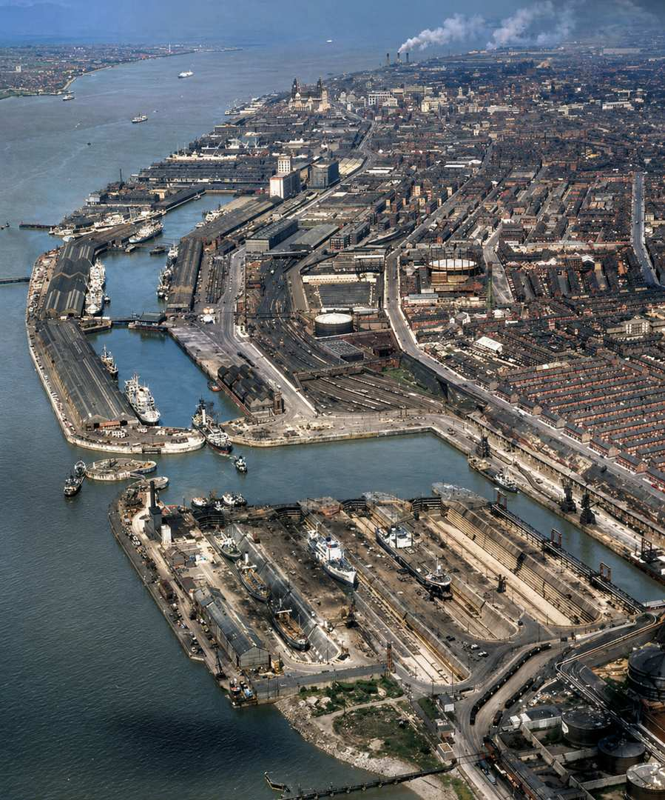

Liverpool

Slide 32


Slide 33

Lough Swilly - Home for the British Grand Fleet

Slide 34






Lough Swilly - Home for the British Grand Fleet

Slide 35


Slide 36


Slide 37

Londonderry - Key World War II Convoy Base

Slide 38





Londonderry - Key World War II Convoy Base
Over 300,000 American servicemen passed through Northern Ireland during the war, making up roughly 10% of the entire local population by December 1943. There were close to 2,000 GI Brides

Slide 39


Slide 40

Belfast - Base and Shipbuilding Heart
Important During WWI and WWII
Specialised in repairing, refitting and new ship construction
During the ‘Troubles’
The Royal Navy maintained 5 patrol boats to conduct stop and search operations of ships entering Northern Irish Waters and Ports (Belfast Lough, Lough Foyle, Carlingford Lough). Called Operation BANNER/GRENADA and based in Belfast (at Moscow Camp) close to Harland & Wolff , it ran from August 1969 to July 2007

Slide 41


Belfast - A Modern Port

Slide 42


Slide 43

Loch Ewe - Convoy Anchorage and Now NATO Fueling Jetty

Slide 44





Loch Ewe - Convoy Anchorage and Now NATO Fueling Jetty

Slide 45


Slide 46

Scapa Flow - Strategic Position Controlling North Sea Access
Strategic Anchorage
Scapa Flow is a vast, sheltered body of water in the Orkney Islands, long prized as one of the safest natural harbours in northern Europe
Royal Navy Stronghold
It served as the principal base of the Royal Navy during both World War I and World War II, anchoring Britain’s battle fleet at the edge of the North Sea
WWII Vulnerability and Response
In 1939, the battleship HMS ROYAL OAK was sunk by a German U-Boat, prompting Winston Churchill to order the construction of the famous Churchill Barriers to block eastern entrances
Modern Legacy
Today, it is a renowned site for wreck diving, maritime heritage, and quiet reflection, where cold green waters cradle history like a submerged archive

Slide 47


Slide 48

Scapa Flow - Protected Against the Elements and the Enemy

Slide 49

Invergordon - Deep Water Port
Strategic Deep-Water Anchorage
Invergordon was chosen because the Cromarty Firth provided one of the deepest, safest, and most sheltered natural harbours in Great Britain
Vital Fuel and Repair Hub
During World War I, it was developed into a full-scale repair and fuelling base, with over 40 oil storage tanks installed to support the fleet. Two floating docks were also stationed at the West Pier to handle vessel repairs
Post-War Transition and Legacy
Was closed the official dockyard in 1956, though it retained a fuel depot until 1991. Now serves as deep-water port, frequently welcoming cruise ships, the occasional warship and supporting the offshore oil and wind industries

Slide 50





Invergordon

Slide 51

The Invergordon Mutiny - September 1931
Sailors in the Atlantic Fleet at Invergordon (Cromarty Firth) learned of large pay cuts during the Great Depression
For many lower-paid ratings, the cuts were far steeper (25-33%) than expected and deeply unfair. Instead of violent rebellion, however, the men carried out a peaceful strike
Details
Crews on several warships refused to put to sea. Duties were limited to safety and maintenance only. There was never any attempt to seize ships or attack officers
Wider Impact
News of the mutiny shook financial confidence. Pressure helped lead Britain to abandon the Gold Standard
Resolution
After 2 days of protests, more moderate pay reductions (5 to 10% were negotiated. Some ring-leaders were dismissed, but authorities avoided harsh punishments

Slide 52


Slide 53

Rosyth
Built for the Royal Navy in WWI
Developed in WWI to counter the German threat in the North Sea
Expanded in WWII
Became a major ship repair and building facility
Home of the Submarine Service
Postwar it home of the Navy’s Scottish Submarine Service
Nuclear Submarine Centre
Nuclear submarine centre and supporting NATO warship refits during the Cold War era
Commercial Operations
Naval Base closed in April 1996. Now operates as a major commercial shipyard and engineering hub run by Babcock International
Aircraft Carriers and Nuclear Subs
Base for construction and refit of the RN aircraft carriers, Type 31 destroyers and decommissioning of nuclear subs

Slide 54




Rosyth

Slide 55




Building Five Type 31s
- HMS VENTURER
- HMS ACTIVE
- HMS FORMIDABLE
- HMS BULLDOG
- HMS HARDY

Slide 56


Slide 57

Chatham
Historic Dockyard
Chatham Dockyard was a cornerstone of the Royal Navy for over 400 years, building and maintaining fleets from sail to steam
Shipbuilding Powerhouse
Produced iconic warships including HMS VICTORY and many vessels that carried British sea power across the globe
Strategic Location
Positioned on the River Medway, it provided protected inland access while remaining close to the North Sea and English Channel
Closure
The dockyard closed in 1984 as part of Knott Review defence cuts, ending centuries of naval service and industry
Legacy
Now preserved as The Historic Dockyard Chatham, showcasing warship, industry and naval life

Slide 58





Chatham

Slide 59


Slide 60
The Doomsday Wreck in the Thames Estuary
The Ship
The Doomsday Wreck is an ammunition ship called the SS Richard Montgomery, a World War II American Liberty class ship that sank in the Thames Estuary in August 1944
The Problem
The Doomsday Wreck still contains approximately 1,400 tons of high explosive. The wreck currently lies in about 15 meters of water, roughly 1.5 miles off the coast of Sheerness, Kent. The remaining cargo is concentrated in the forward holds and includes over 2,000 cases of cluster fragmentation bombs, hundreds of 500lb and 1,000lb general-purpose bombs and well as standard TNT-filled munitions and white phosphorus smoke bombs
How It Became a Wreck
The ship arrived in the Thames Estuary from Philadelphia, carrying a massive cargo of munitions intended for the Allied invasion of Europe. While anchored at the Great Nore, a force-eight gale caused the ship to drag its anchor. It drifted onto the Sheerness Middle Sands, a shallow sandbank. As the tide went out, the heavily laden ship was unsupported in the middle. The hull broke its back (snapped in two) Emergency crews managed to remove about half of the cargo, but the operation was abandoned when the forward section flooded and sank completely

Slide 61





The SS Richard Montgomery

Slide 62


Slide 63

The Threat to The Thames Estuary … A Catastrophe Waiting to Happen
If It Were to Explode
Why Not Move It
- A 3,000 m high blast the entire cargo detonated at once
- A five-meter tsunami, Flooding Sheerness and Southend
- A wave travelling up the Thames to London
- A shockwave damage shattering windows and hitting oil and gas facilities
The reason the ship hasn't been cleared in 80 years is that the munitions are now extremely unstable. Fuses can become more sensitive over time due to corrosion and the formation of copper picrate (a highly sensitive explosive salt). Most experts believe that attempting to move the bombs is far more dangerous than leaving them where they are

Slide 64
Thank You
www.voyagerstories.com

