Slide 1
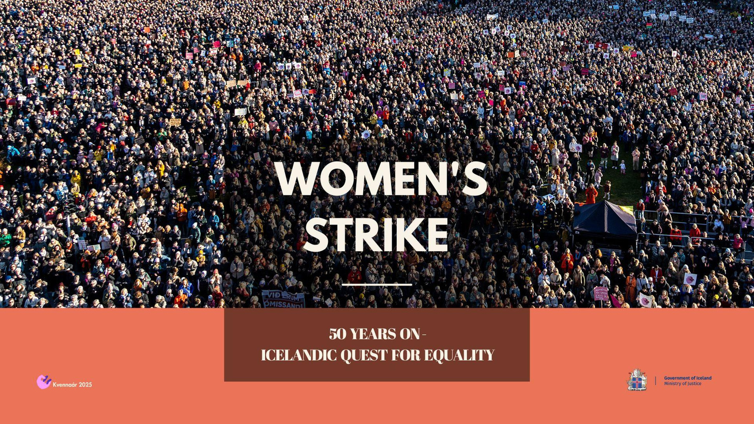


And the fight against
gender based violence

Slide 2
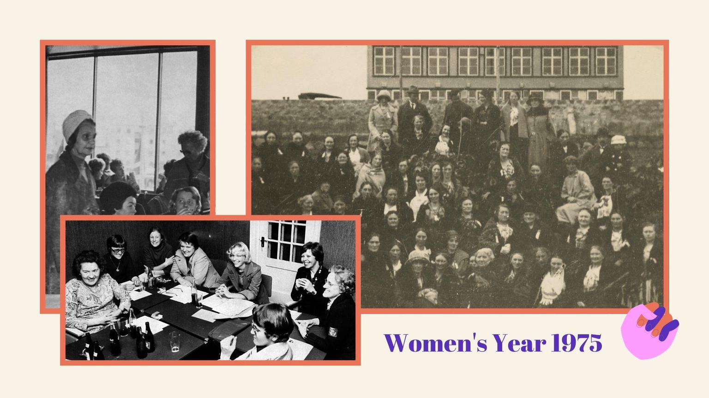

Slide 3


Slide 4


Slide 5


Slide 6
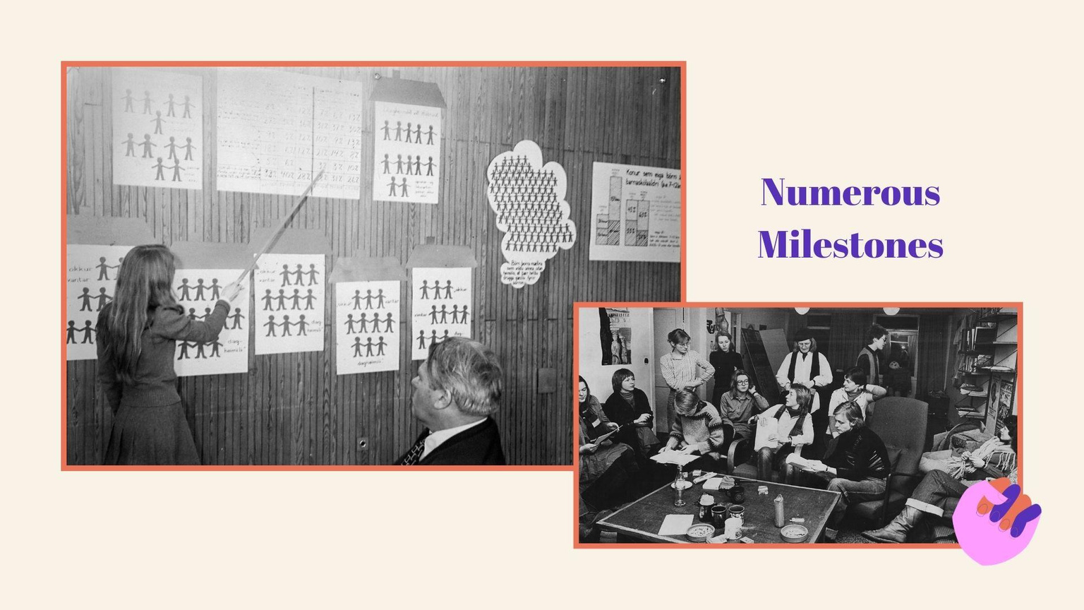

Slide 7


Slide 8


Slide 9


Slide 10
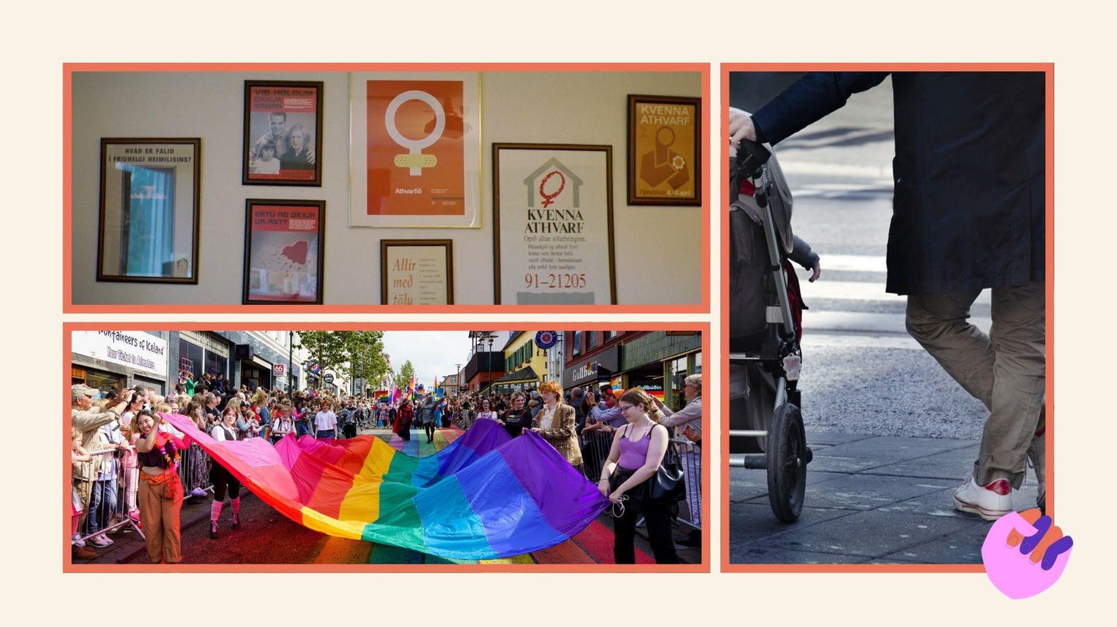

Slide 11


Slide 12
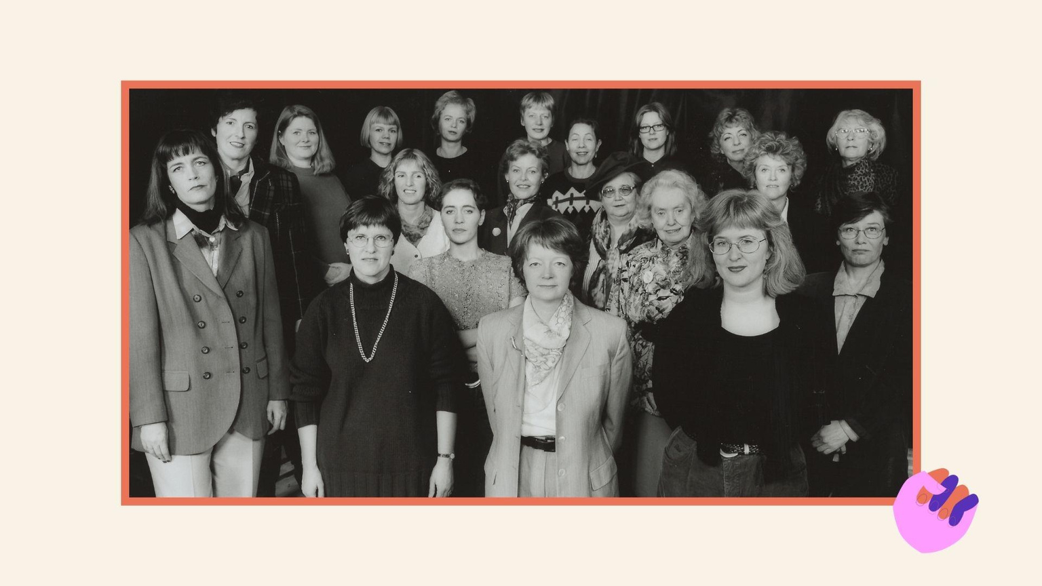

Slide 13


Slide 14
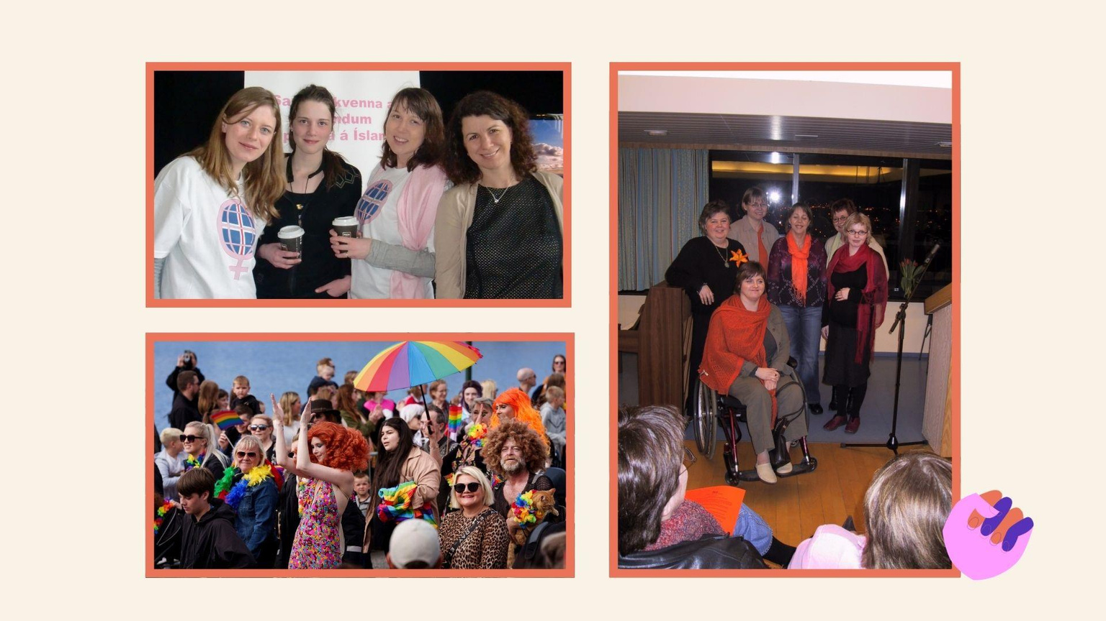

Slide 15


Slide 16
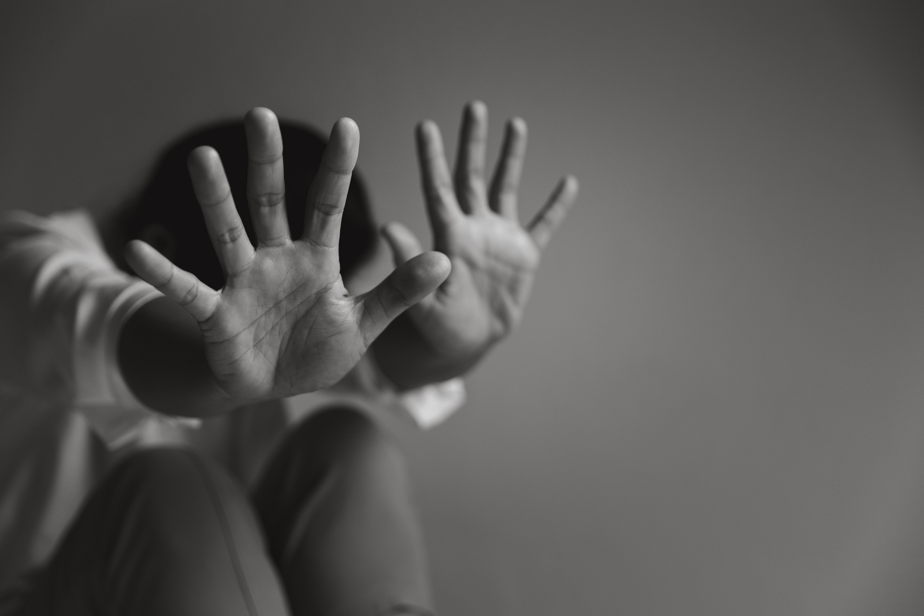
40% of women in Iceland have experienced violence.
14% of girls in 10th grade have experienced physical sexual violence by an adult, and 12% have been raped by another teenager.
11% of girls in 10th grade have experienced domestic violence, and 10% have witnessed it.
Nearly half of all girls in 10th grade have experienced digital sexual violence and/or been asked to send a nude picture of themselves to another person.
Women are the vast majority of victims and men are the vast majority of perpetrators in sexual offence cases.

Slide 17
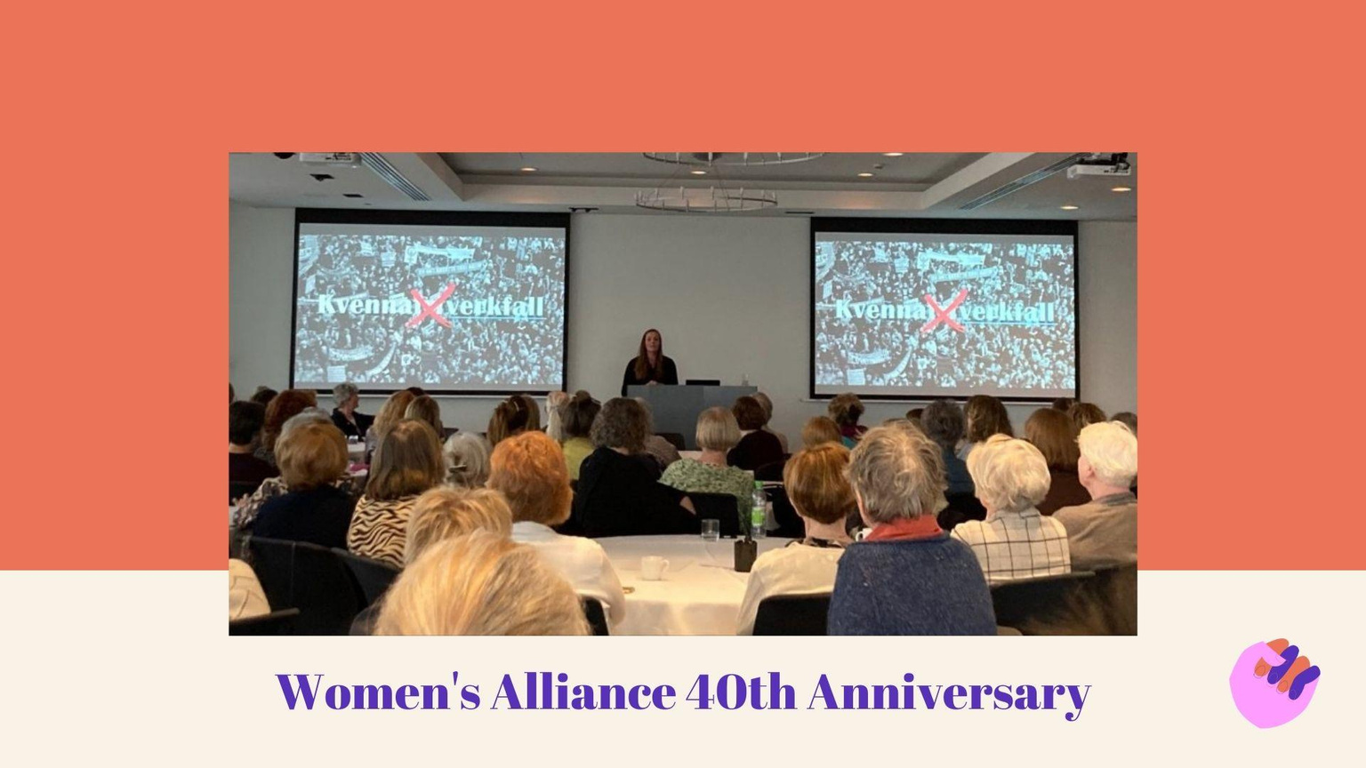

Slide 18
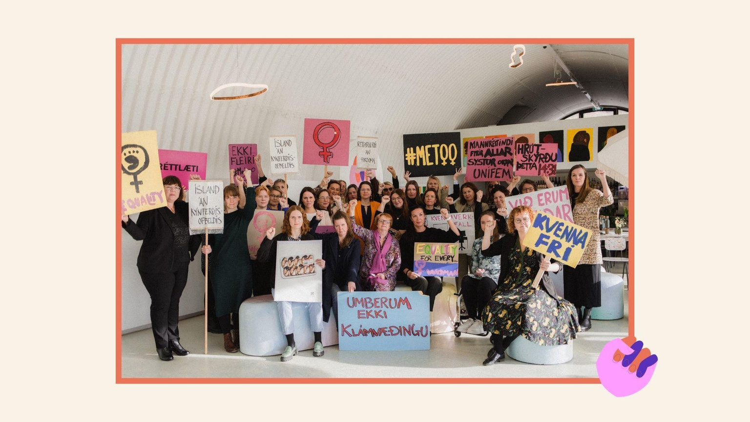

Slide 19


Slide 20
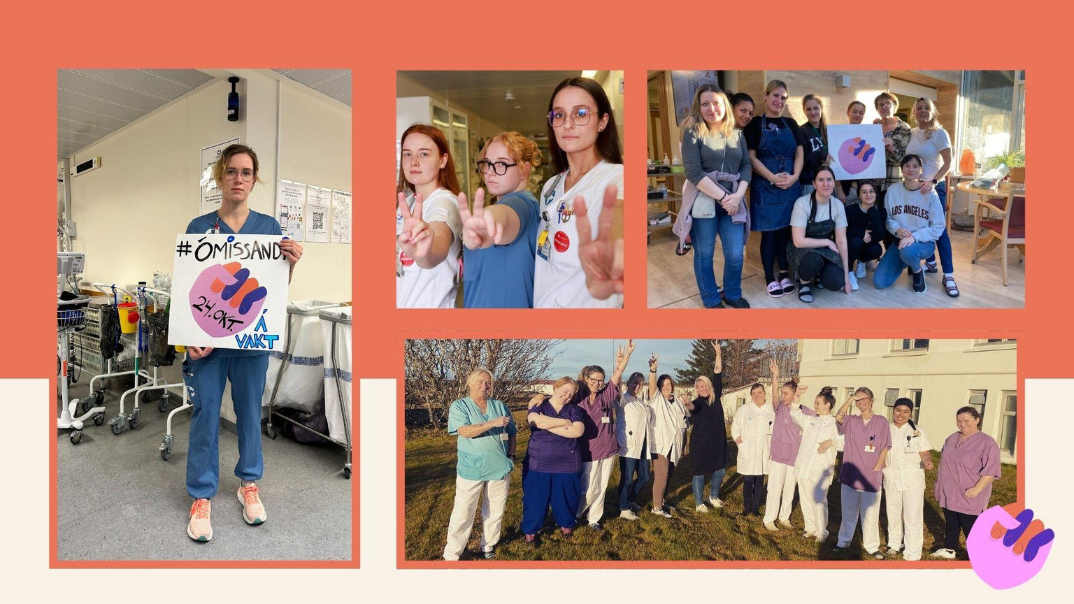

Slide 21
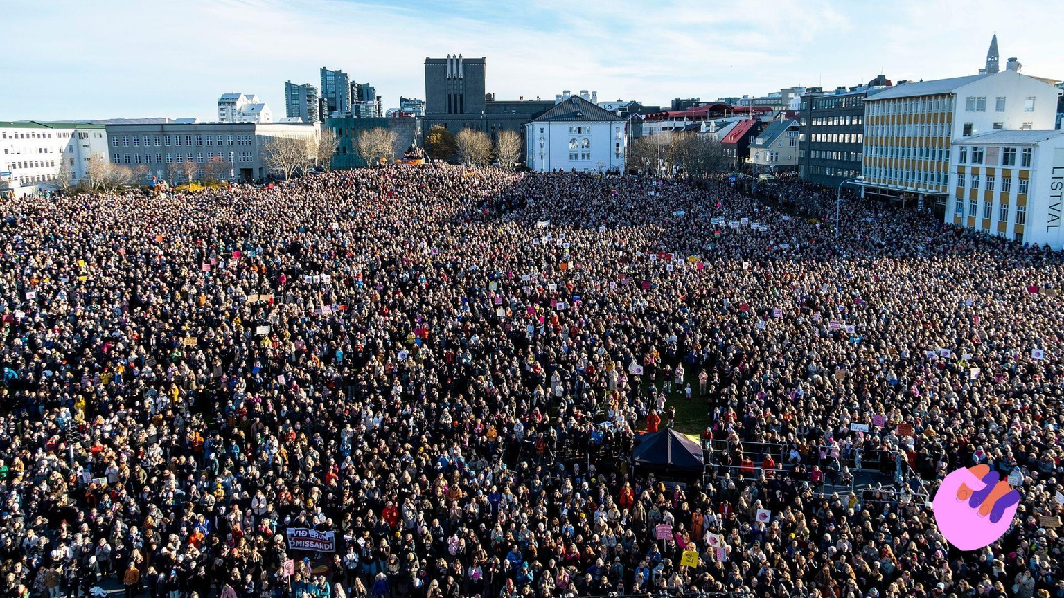

Slide 22
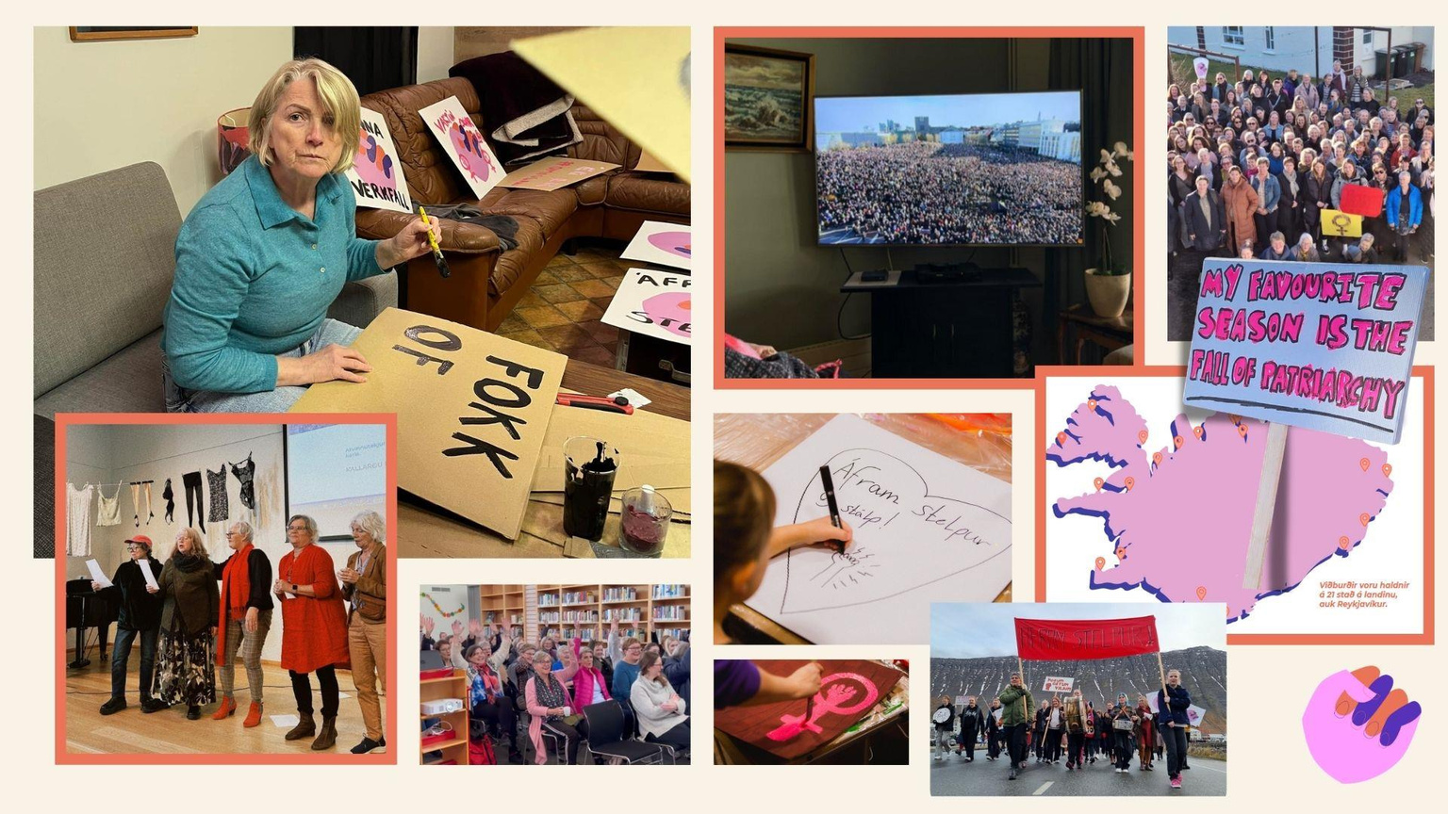

Slide 23
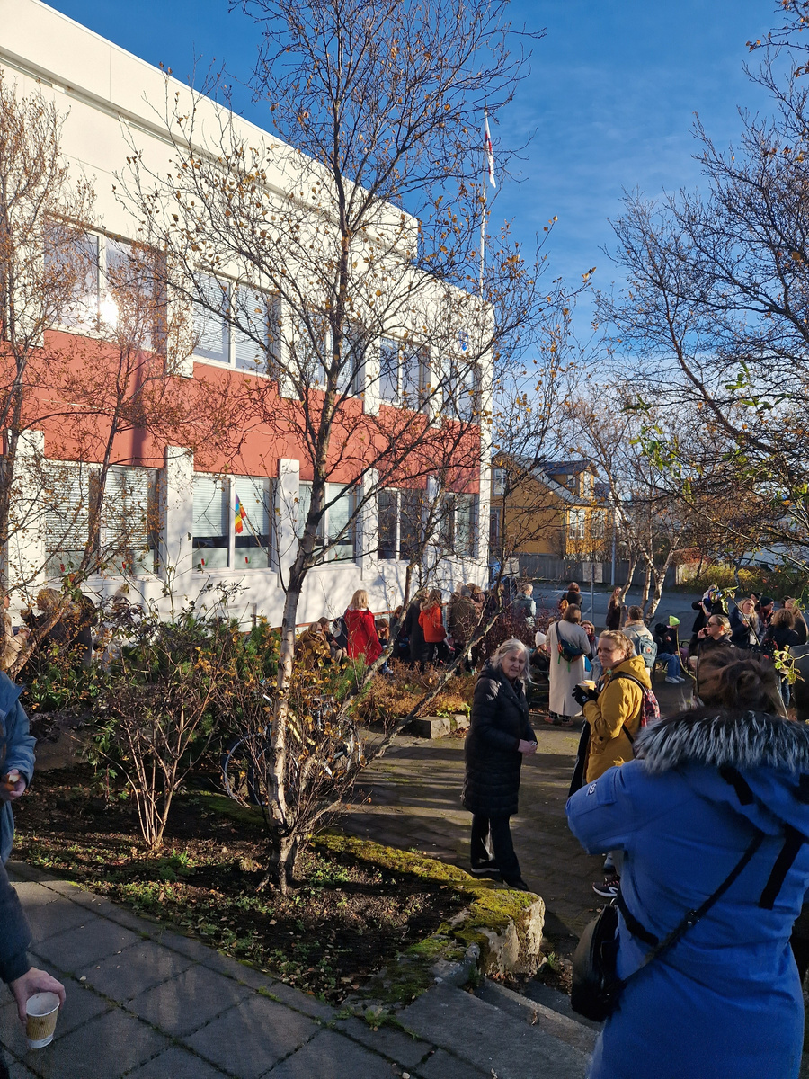

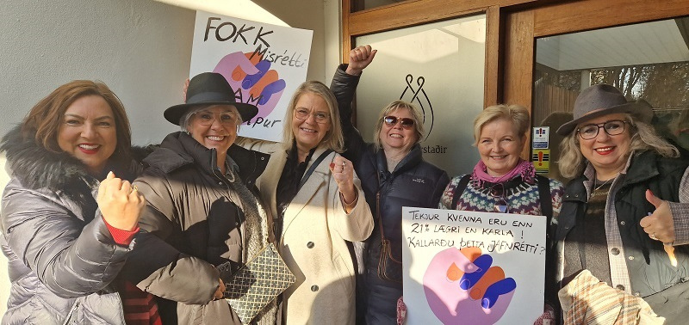
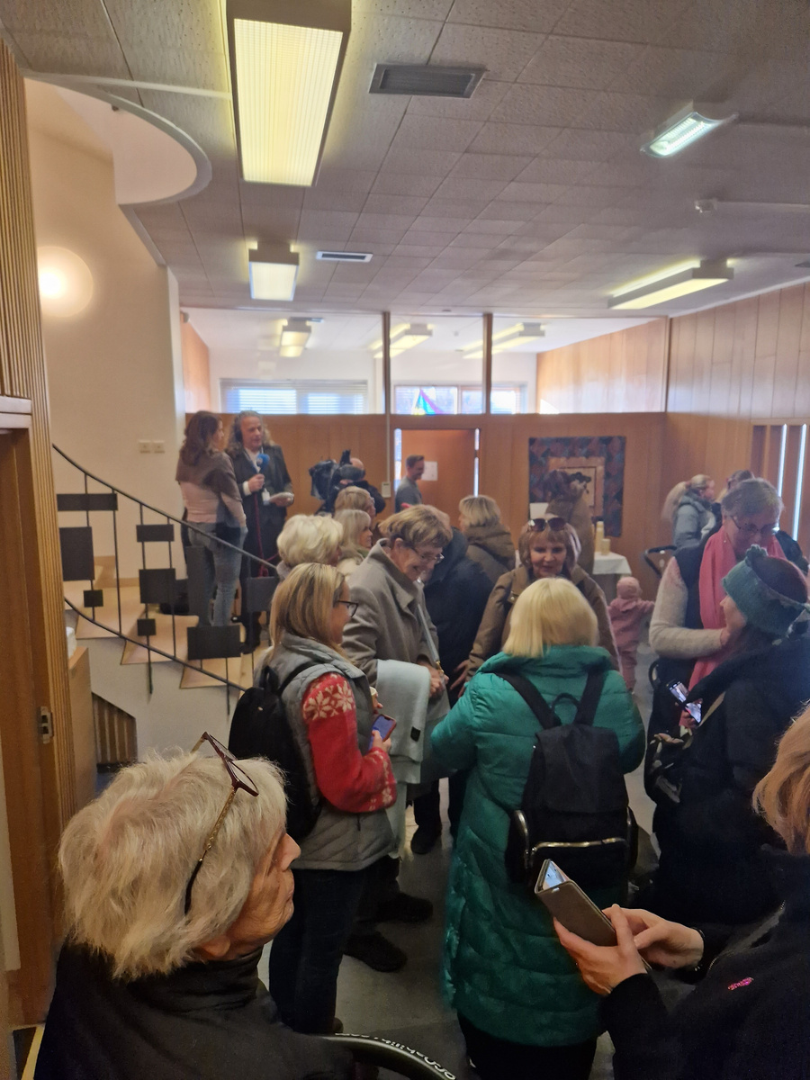
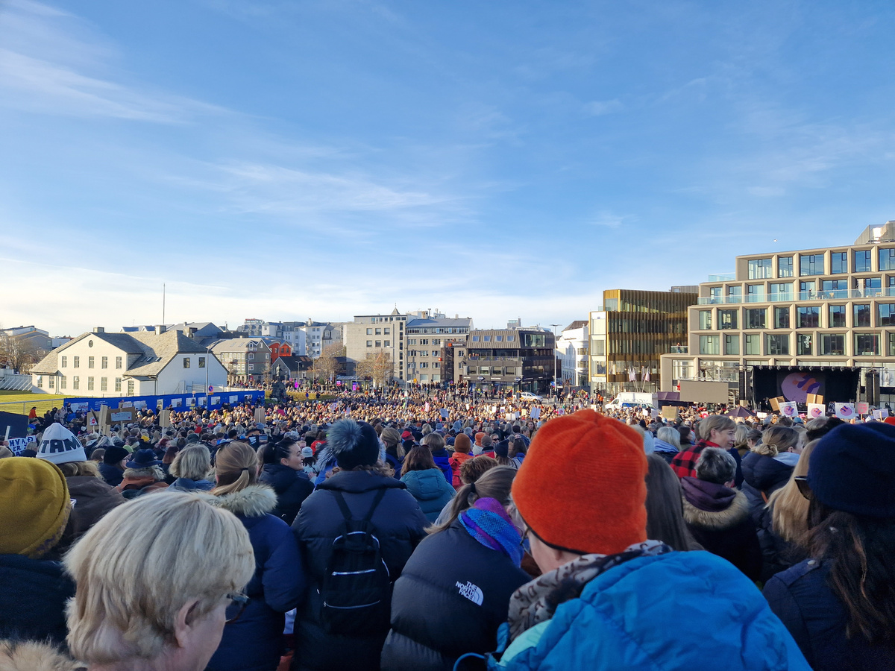


Slide 24


Slide 25


Slide 26

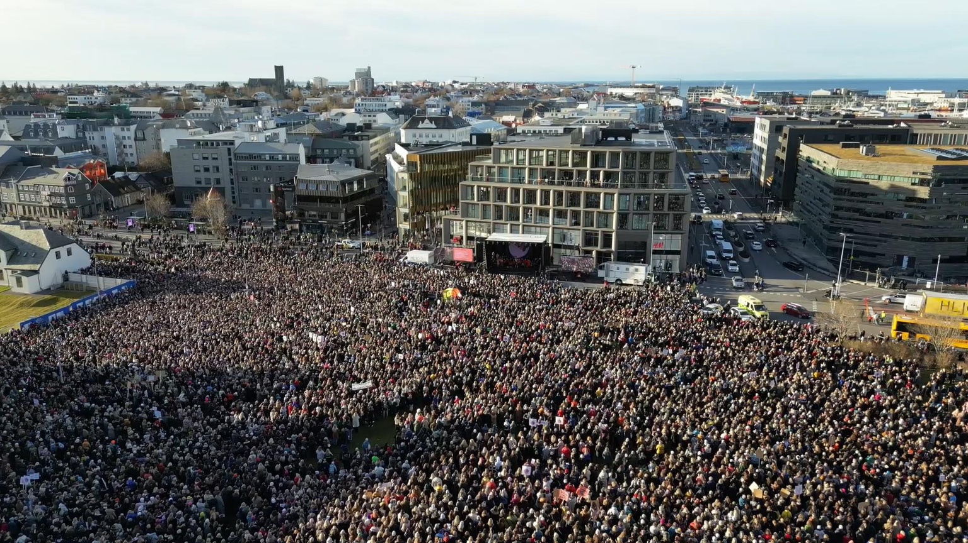
The Women’s Strike // October 24th 2025
We’ll show up until we don’t have to anymore

