Slide 1

ACWW European Area Conference 13 – 17 October 2025
Vrouwen van Nu – History
Vrouwen van Nu – Today
Textile
Oral History
Okt25/Jeanne van Poppel

Slide 2
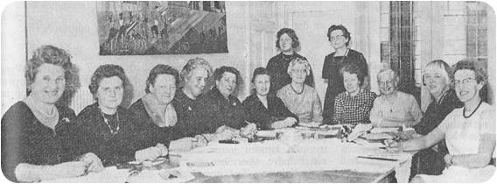
Vrouwen van Nu – History
14th of October 1930
In rural areas:
1909: the first experimental course in rural areas, Veendam
1913: the first education for teachers in rural areas in Deventer
1921: Law on technical education: from courses to village social centres
1930: Vrouwen van Nu (NBvP), mw. Wiersma-Risselada
1935 Rural Home Economics Extension Foundation
Okt25/Jeanne van Poppel

Slide 3
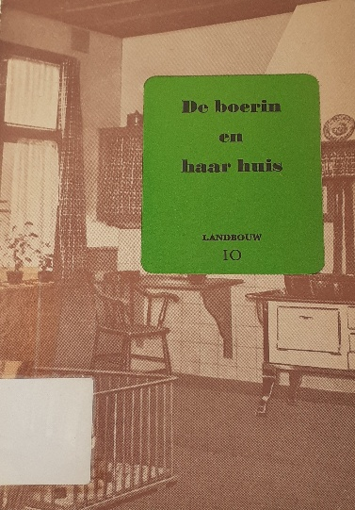
Vrouwen van Nu - History
1946: Liaison Committee of Rural Women’s Organizations
1947: 5th ACWW World Conference in Amsterdam
Publication: ‘De boerin en haar huis’ 1949
1950: Dutch Household Council on consumer interests
1950 – 1955: (International) Exchanges: Home Economics education, extension, community development
1952: 1e Exhibition Home furnishing and Clothes at the National Agricultural Fair
Okt25/Jeanne van Poppel

Slide 4
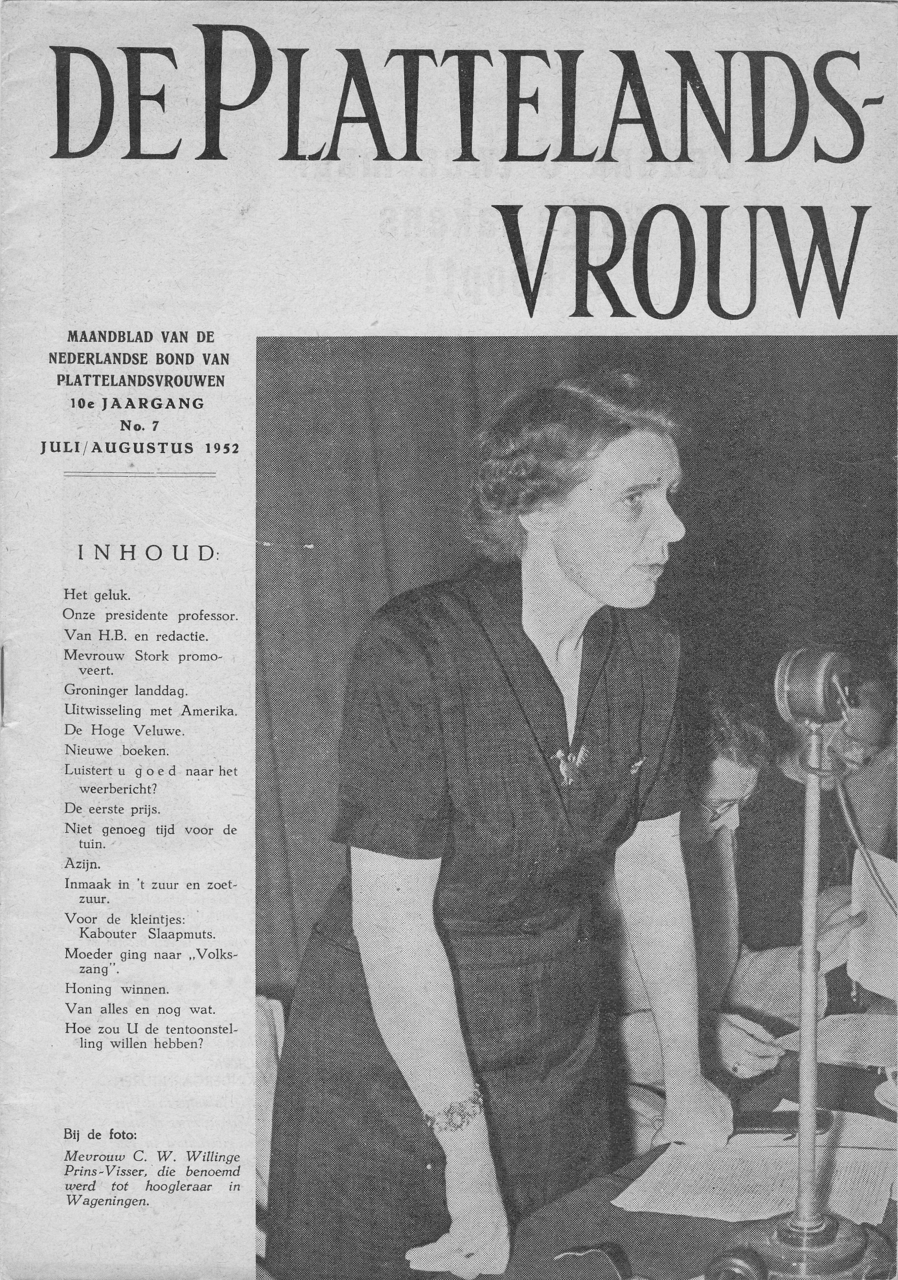
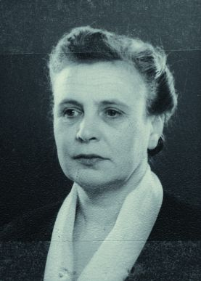
Vrouwen van Nu - History
1952: Mrs. C.W. Visser, national president
Vrouwen van Nu, first female professor at
Wageningen University
1953: Flood disaster – travel exhibitions project
Rural extension: agricultural technical, home economics, agricultural social
Mw. Elema – Bakker, Executive committee ACWW 1947 - 1959
Mw. Van Beekhoff – van Selms:
ACWW World President 1959 -1965
Okt25/Jeanne van Poppel

Slide 5
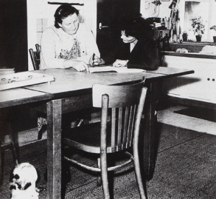
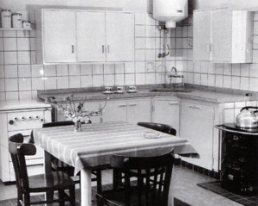
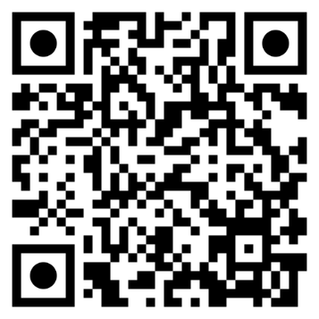
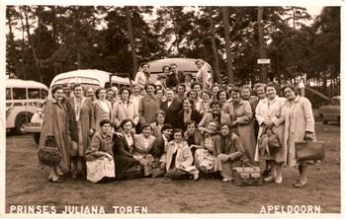
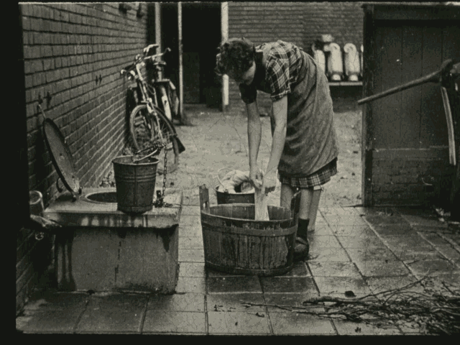
Vrouwen van Nu - History
Het platteland en wij - jubileumfilm 25-jarig bestaan Vrouwen van Nu
Okt25/Jeanne van Poppel

Slide 6

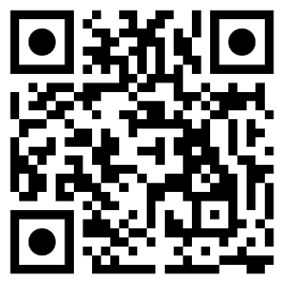
Vrouwen van Nu – Today
Project ‘Plastic en ik’
Working group PFAS (Per- and poly-Fluoro Alkyl Substances)
Storytelling women farmers
Textile
www.vrouwenvannu.nl
Okt25/Jeanne van Poppel

Slide 7
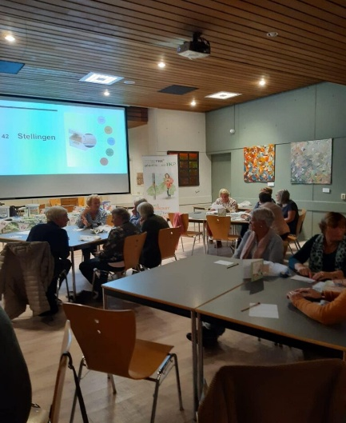
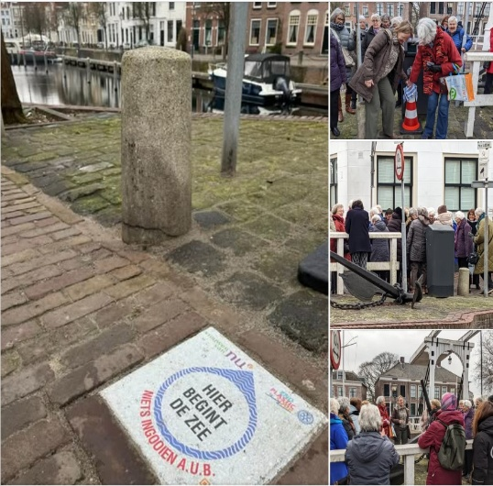
Vrouwen van Nu – Today
2022: project ‘Plastic en ik’
Toolkitt microplastics
2023: Sidewalk tile: ‘Hier begint de zee’
Okt25/Jeanne van Poppel

Slide 8
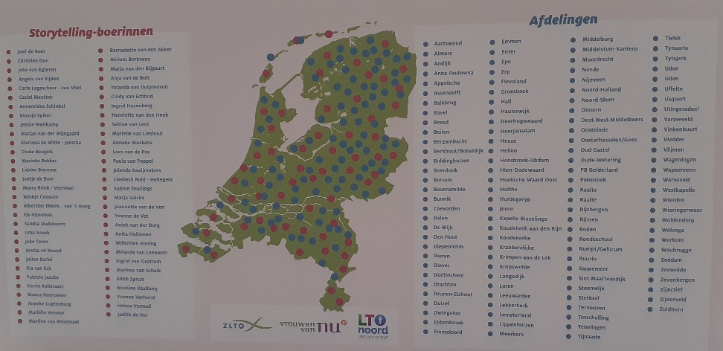
Vrouwen van Nu – Today
Storytelling women farmers: 2020 – 2024
Goal: building bridges
Training, Toolkit,
141 presentations
Okt25/Jeanne van Poppel

Slide 9
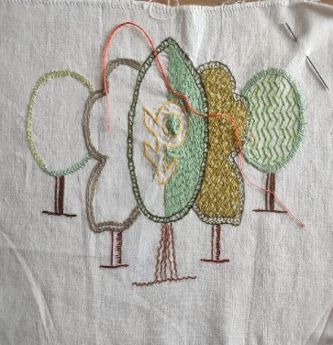
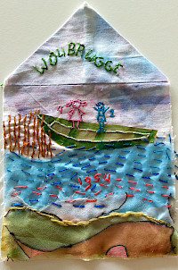
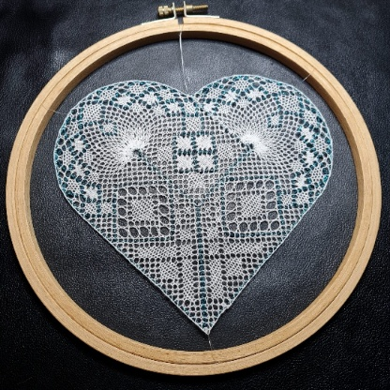
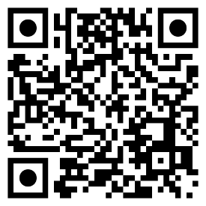
Textile
Textile Day-event 25th of October 25,
Creative Crafts Committee Vrouwen van Nu
Call for participation:
  Textile museum project on migration:
  ‘Where are you from?
- Textile exhibition in 2026
in Amersfoort ‘Inventing the Future’:
make a workpiece in an embroidery hoop
Gelderland - Vrouwen van Nu
Okt25/Jeanne van Poppel

Slide 10
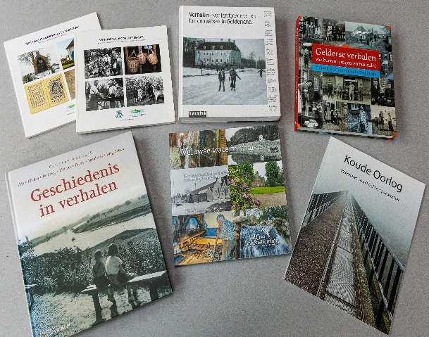
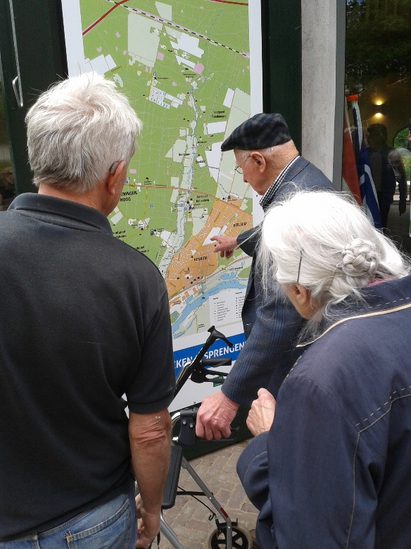
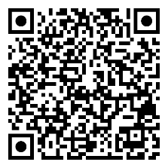
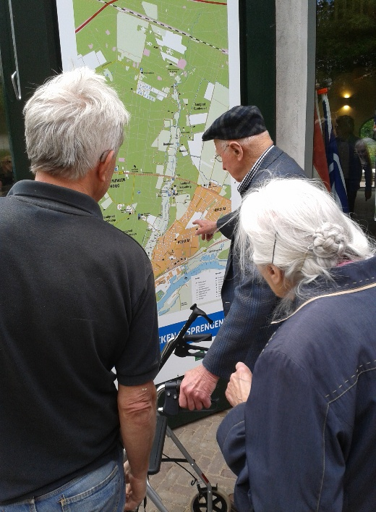
Oral history
Contribution to history:
audio-document, transcipt,
first-hand story;
motivation for interviewee and interviewer.
Working group Oral History Gelderland
Oral History Werkgroep - Erfgoed Gelderland
Okt25/Jeanne van Poppel
/
Okt25/Jeanne van Poppel
in the past and in the present.
in the past and in the present.

Slide 11
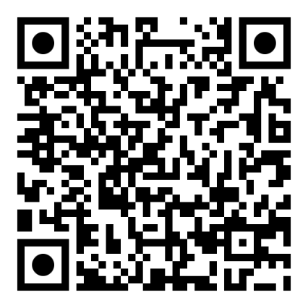
Oral History
Oral History project Education and Empowerment:
women and personal development in rural areas
in the 50s, 60s, 70s in Gelderland
First-hand stories:
Educatie en Emancipatie | Mijn Gelderland
Okt25/Jeanne van Poppel
/
Okt25/Jeanne van Poppel

Slide 12
Thank you for your attention
Jeanne van Poppel
E –mail: jmhvanpoppel@outlook.com
Okt25/Jeanne van Poppel

