Slide 1
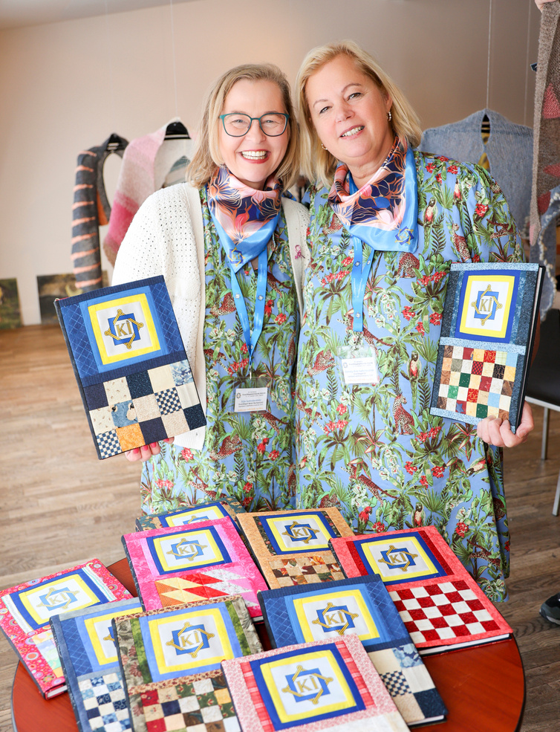
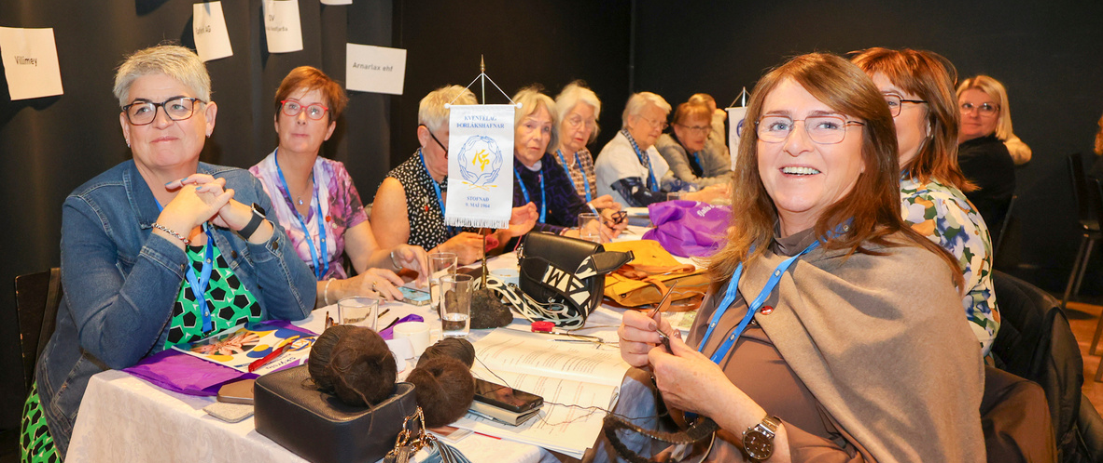

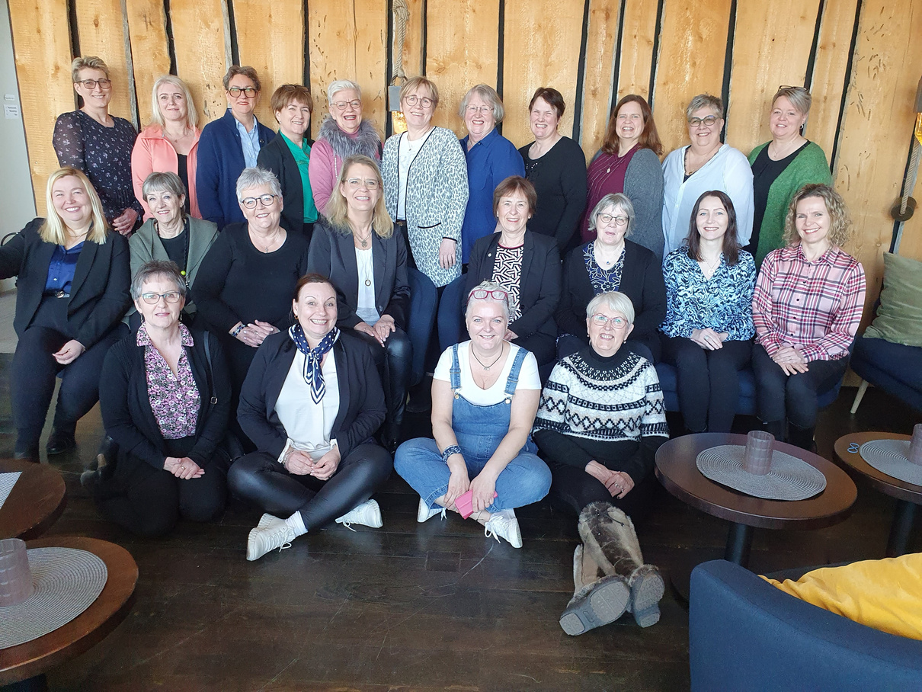

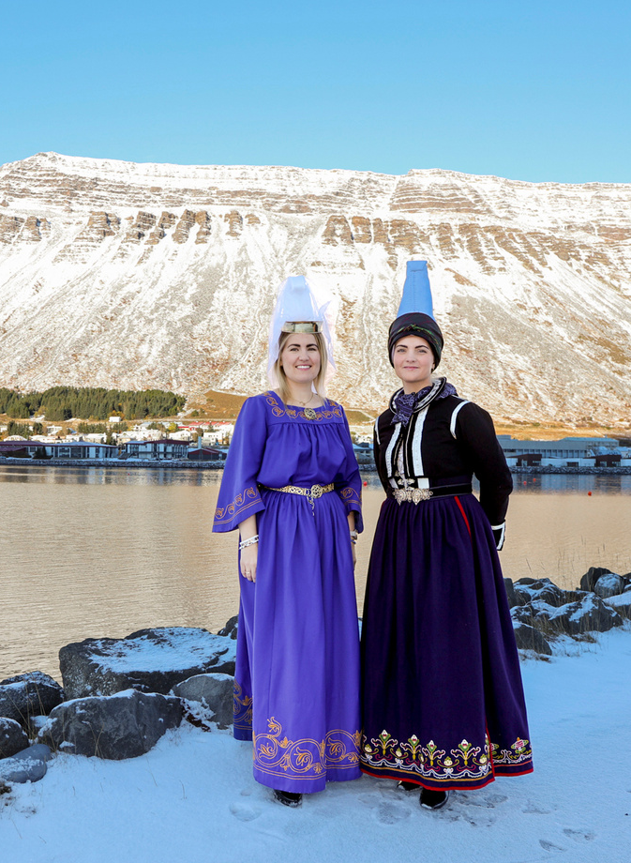
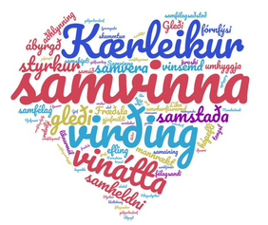
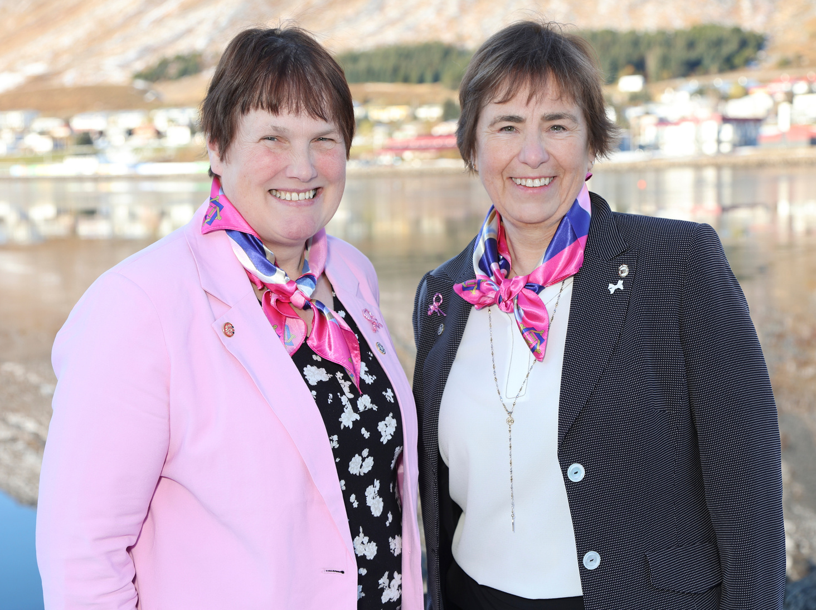
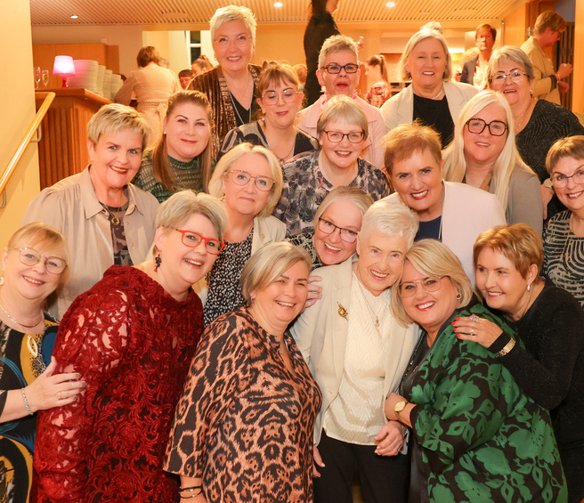
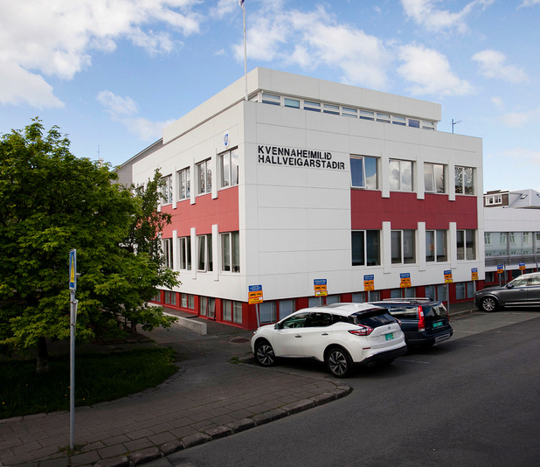
Report /highlights
Federation of Icelandic Women´s Societies

Slide 2
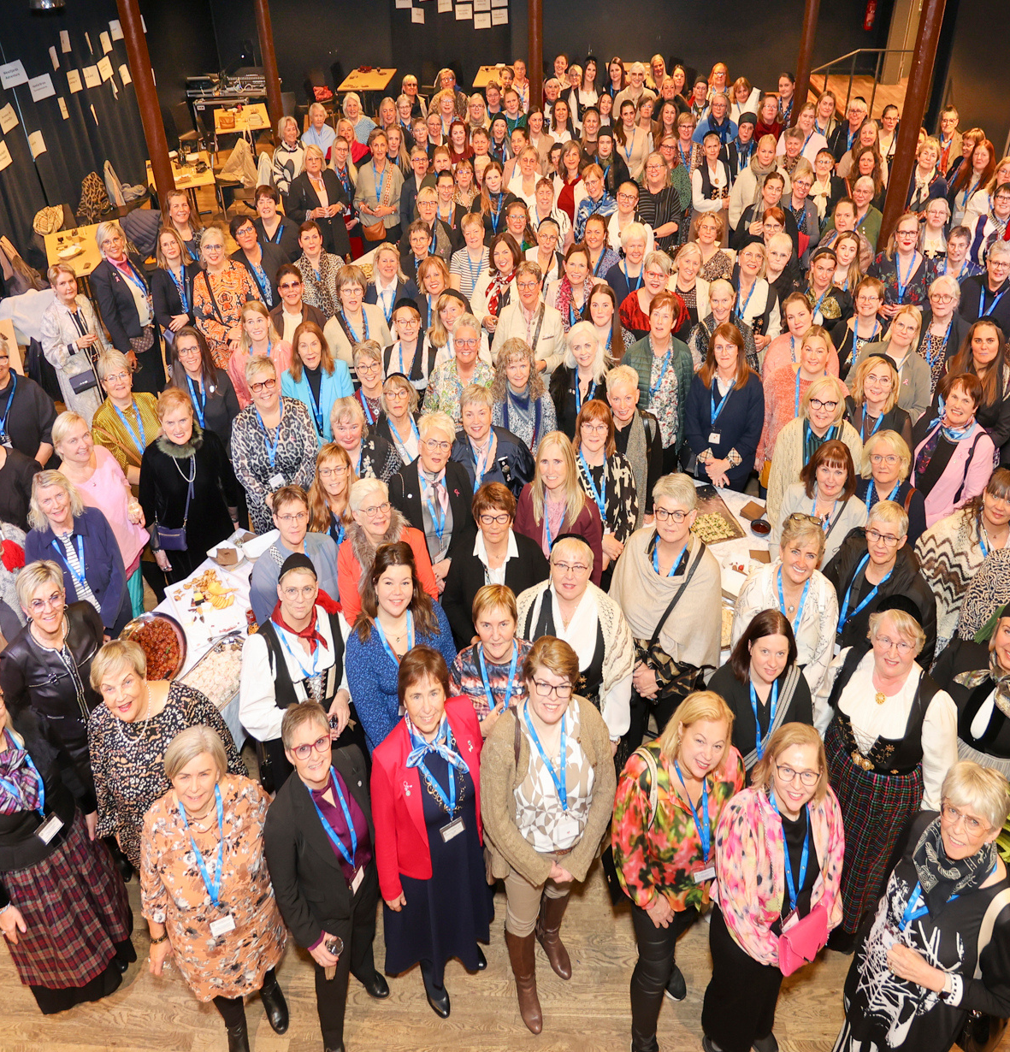
Kvenfélagasamband Íslands
Federation of Icelandic Women´s Societies
  Office in Reykjavik
  1 staffmember
  17 regional associations
  140 local Societies
  Over 4000 members

Slide 3
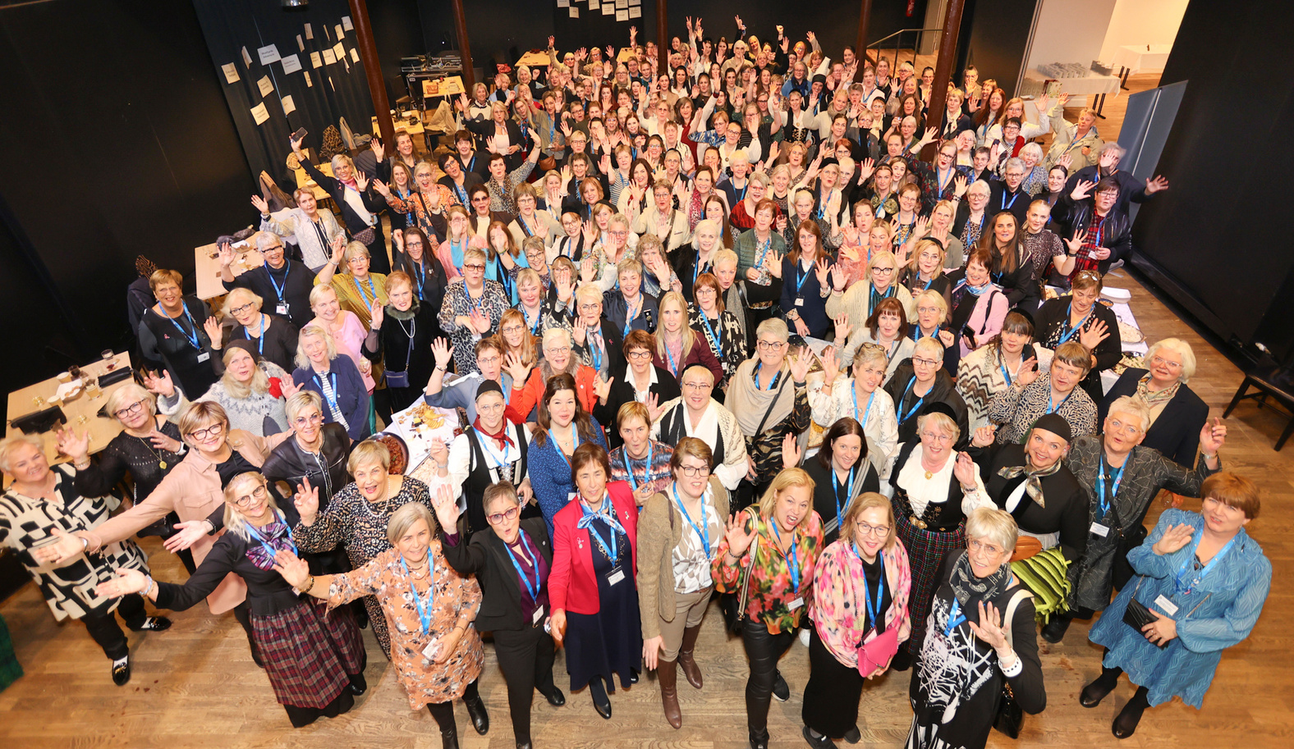
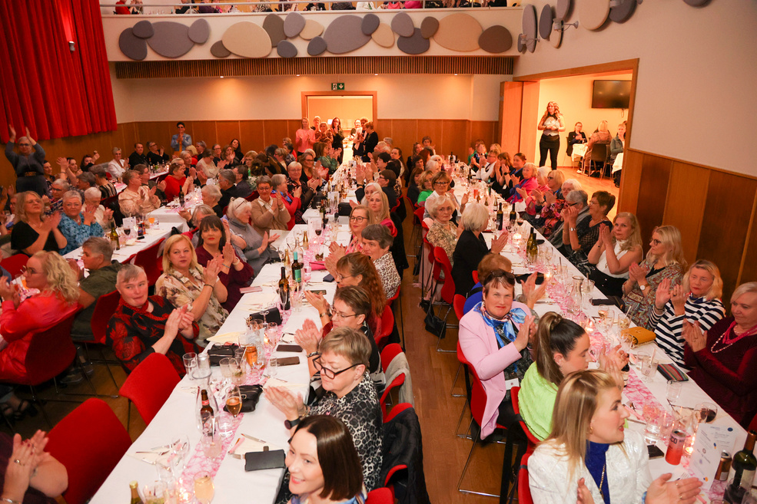
National Conference Isafjordur oktober 2024 - 220 Participants
General Assembly
Workshops
Fun

Slide 4
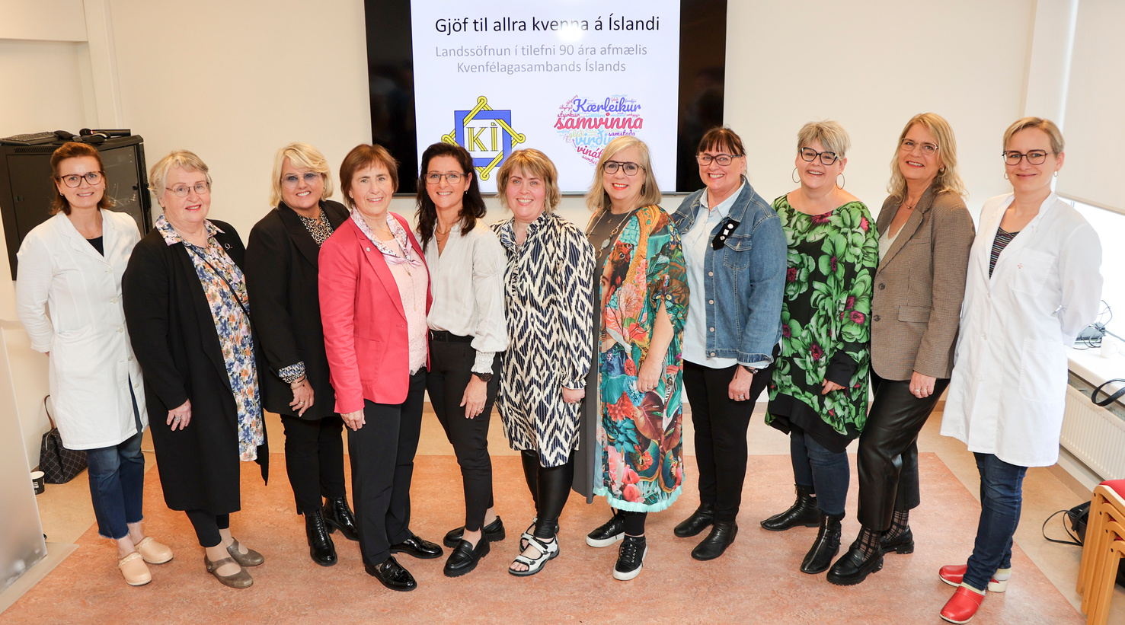
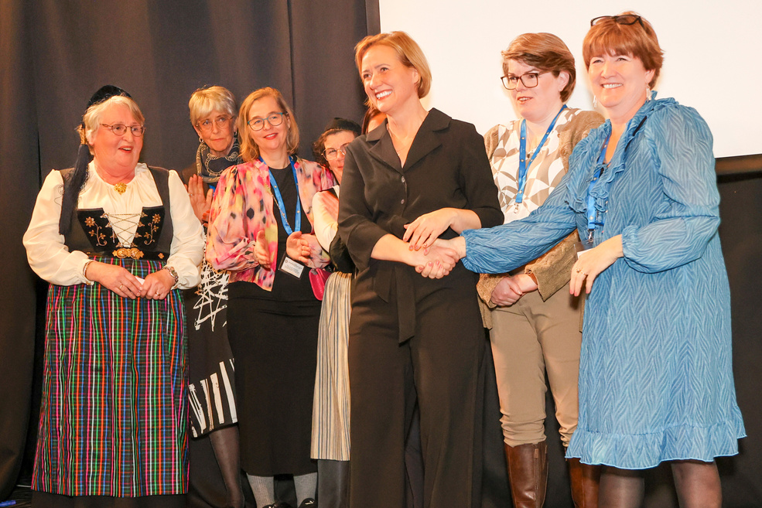
A gift to all women in Iceland
"The Women's Associations raised funds on its 90th anniversary for equipment and software, including monitors, ultrasound devices, and digital connections between rural areas and the Women's Division at the National University Hospital. This will benefit women across the country."
The gift was formally presented to various areas in 2024 and 2025

Slide 5
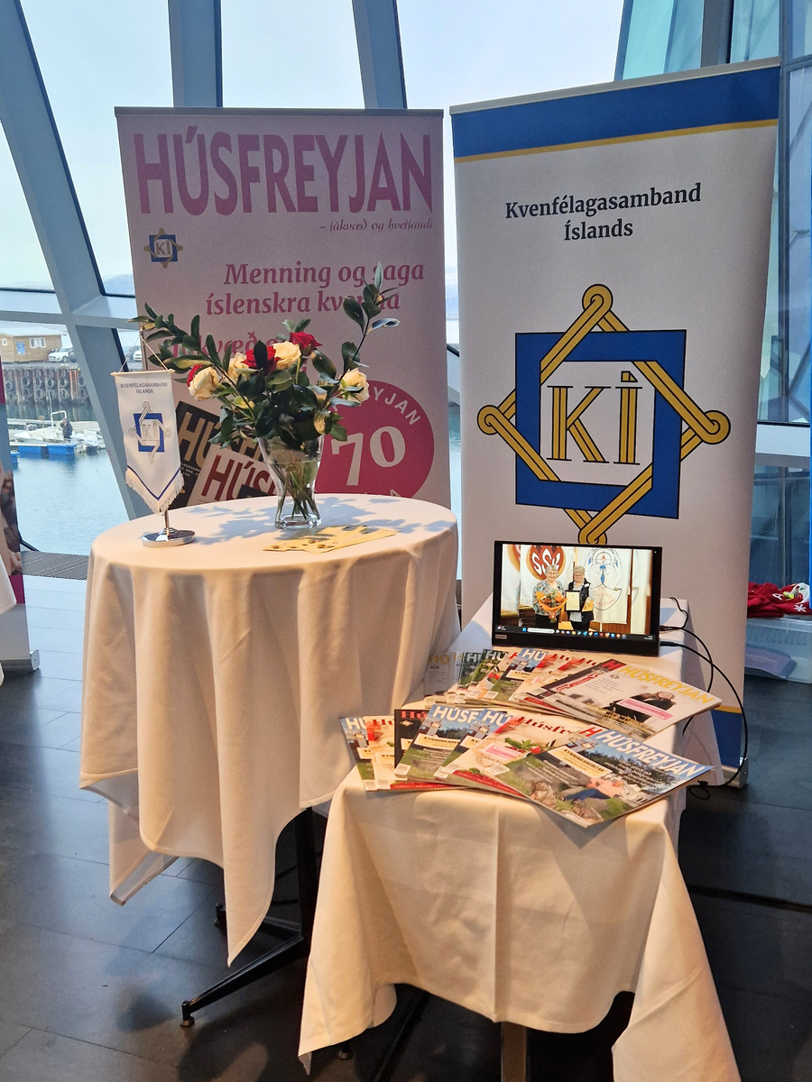
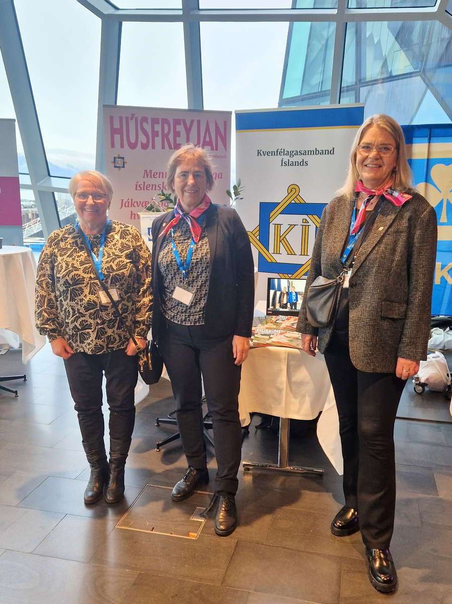
Peoples Assembly in Harpa november 2024
The role of the People's Assembly is to create a platform for a dialogue between non-governmental organizations, politicians and the public.
Non-governmental organizations play a major role in creating a better society.

Slide 6

Loneliness awareness week
3rd - 10th of October 2025
The Icelandic Women's Association received a grant to host Loneliness awareness Week, a national awareness campaign against solitude and loneliness.

Slide 7

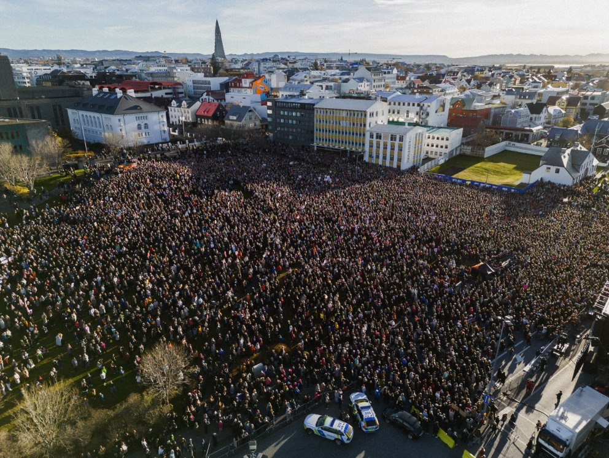
Women´s year
Why Kvennaár?
50 years ago women all over Iceland stopped their paid and unpaid jobs and brought the country to a standstill.
Record participation in the Women’s Strike in october 2023 in 21 locations across the country and the largest outdoor meeting in Iceland’s history in Reykjavík, showed that we are ready to take over from the baton from women who came before us and continue the fight against injustice. Empowerment, fighting spirit, and a clear call for change characterized this tremendous act of solidarity just like in 1975.
In order to follow the Women’s Strike, over 50 organizations of feminists, women, workers, disabled and LGBTQIA+ people are joining hands again and present our demands. We give the government one year or until October 24, 2025 to implement these demands into legislation and take action to ensure full and final gender equality.

Slide 8

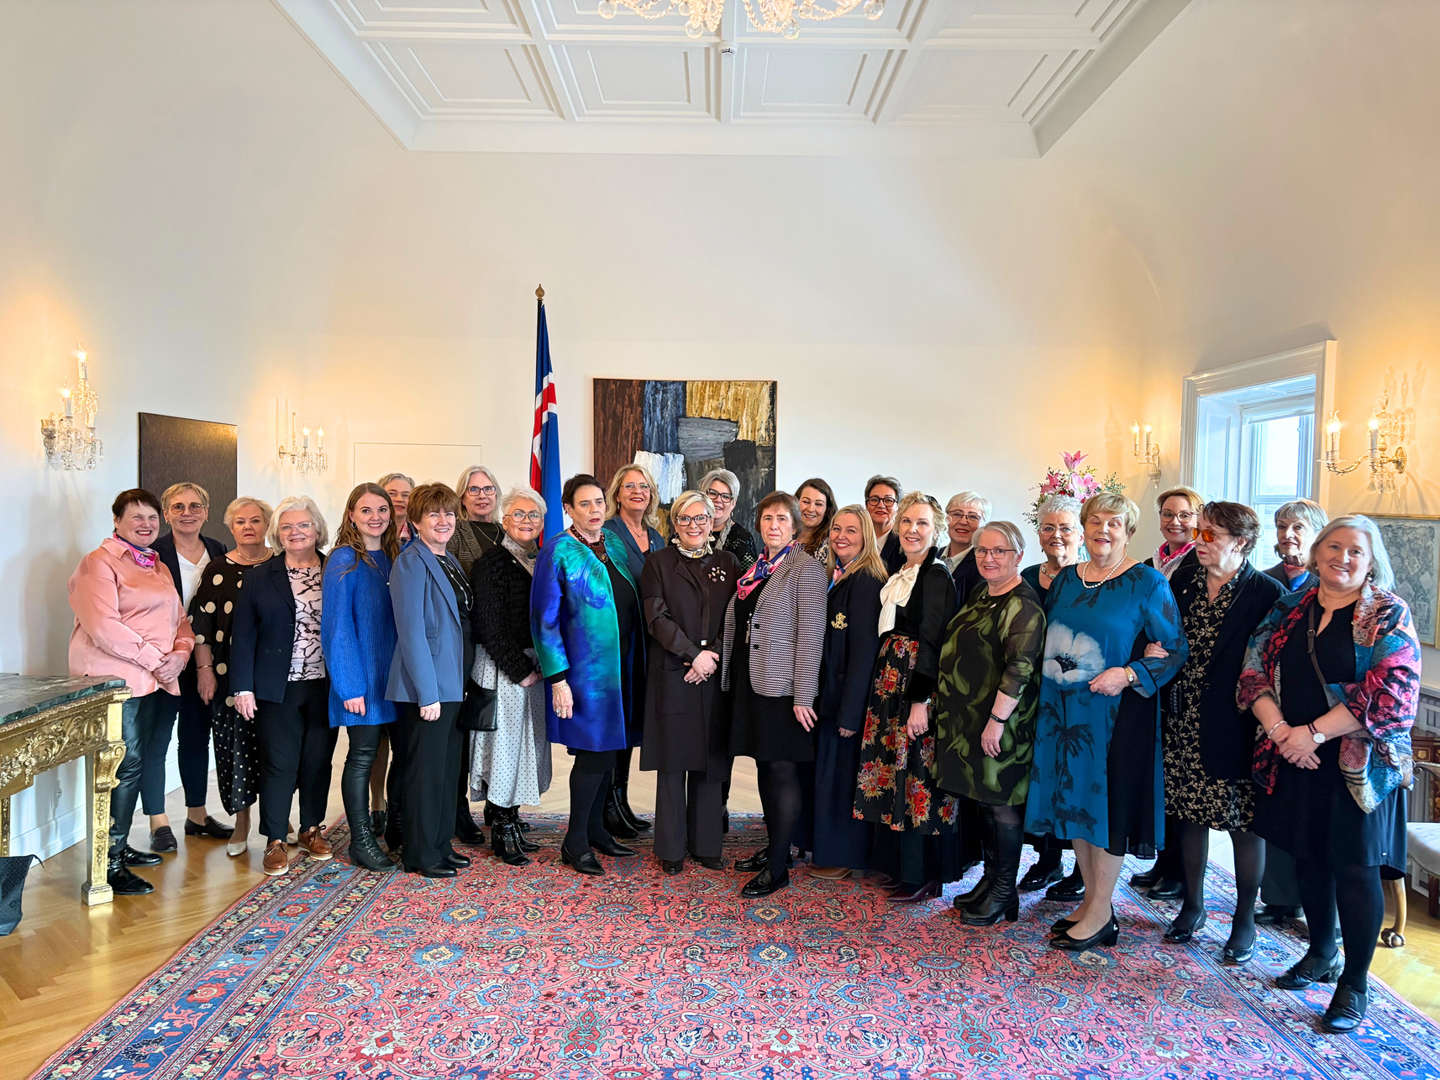
1930 - 2025
95th anniversary was celebrated on 1st of february with a reception at Bessastadir, the official residence of the President of Iceland.
Welcomed by Halla Tómasdóttir, president of Iceland

