Slide 1
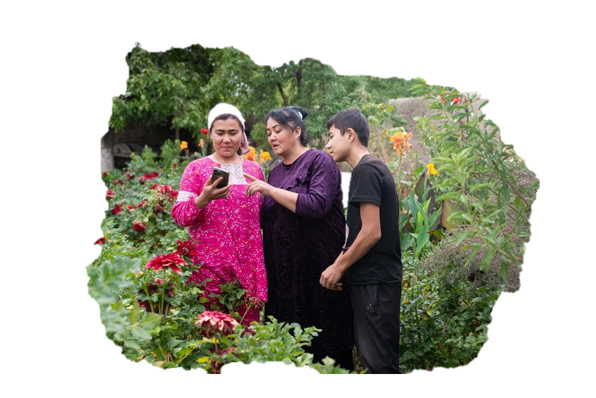

Advancing gender equality in Europe and Central Asia: FAO and CSOs
Anna Jenderedjian
Gender and Social Protection Specialist
Regional Office for Europe and Central Asia
FAO
Anna.Jenderedjian@fao.org

Slide 2



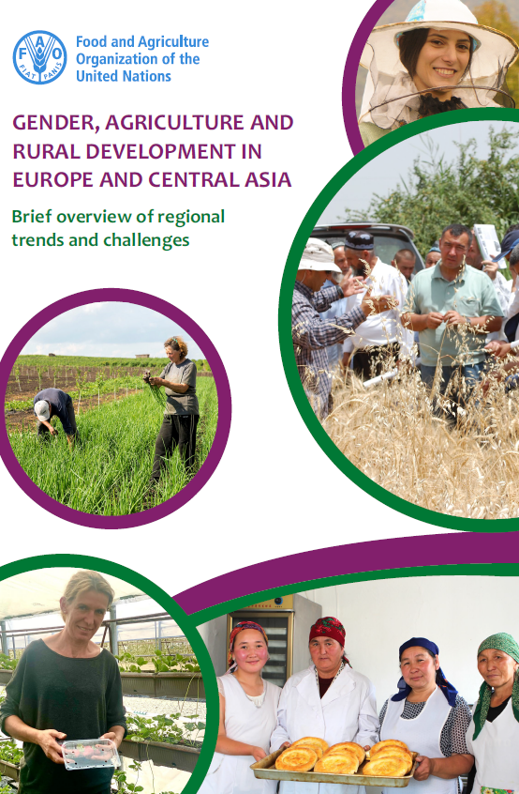
Regional Challenges: Gender issues in Europe and Central Asia
Over-represented in informal work, rural women ‘help’ family farms
Triple burden due to domestic, family farm and community work
Limited access/control over productive resources
Limited access to knowledge, technologies and rural advisory
Limited agency and participation in decision-making
Higher malnutrition and food insecurity, poorer diet quality
Vulnerabilities further compounded by conflicts and climate events
Link

Slide 3

Regional Challenges: Gender issues in Europe and Central Asia
60-87% of women in agriculture are informal or family workers
6.5-31% of agricultural holdings are managed by women
10% of women have access to Rural Advisory Services
5% of women own agricultural machinery
Lack of sex and age disaggregated data and gender statistics
Link

Slide 4
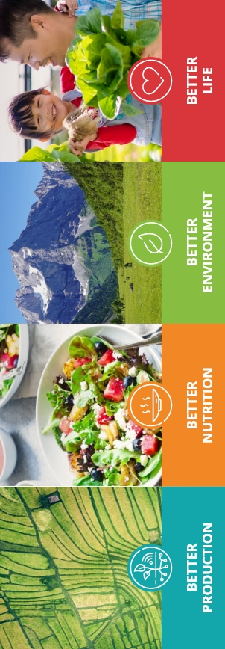
Addressing gender equality and women’s empowerment in Europe and Central Asia: FAO and CSO
FAO recognizes that CSOs play a critical role (FAO Strategic Framework 2022-2031)
Partnership and strengthened cooperation with CSOs representing rural women ensure that their views and opinions are taken into account
Increase the effectiveness of FAO field projects and programmes by collaborating with CSOs (especially targeting rural women)
Give a voice: Women-led and women CSOs representing rural women

Slide 5

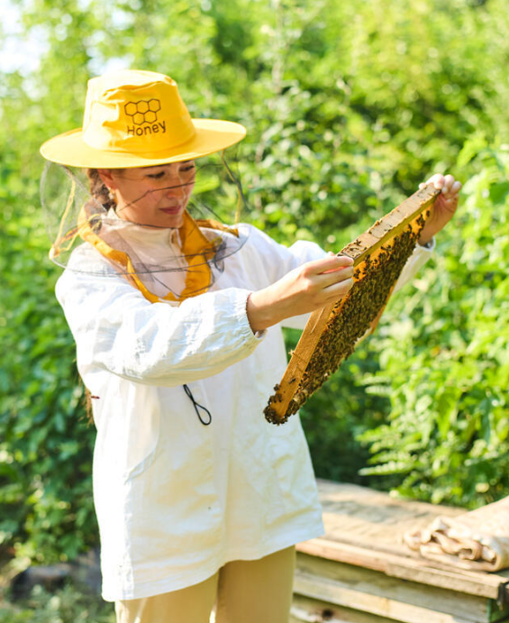
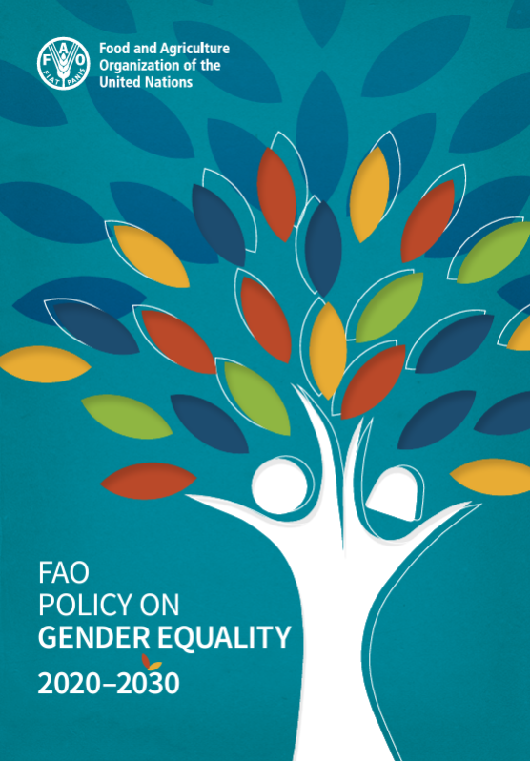
FAO Gender equality and women work n Europe and Central Asia
Implementing the Regional Gender Action Plan 2023–2026
BUILDING KNOWLEDGE
CAPACITY DEVELOPMENT
POLICY SUPPORT AND ADVOCACY
ACTION ON THE GROUND

Slide 6
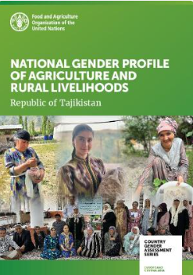
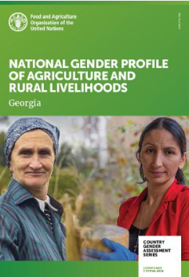
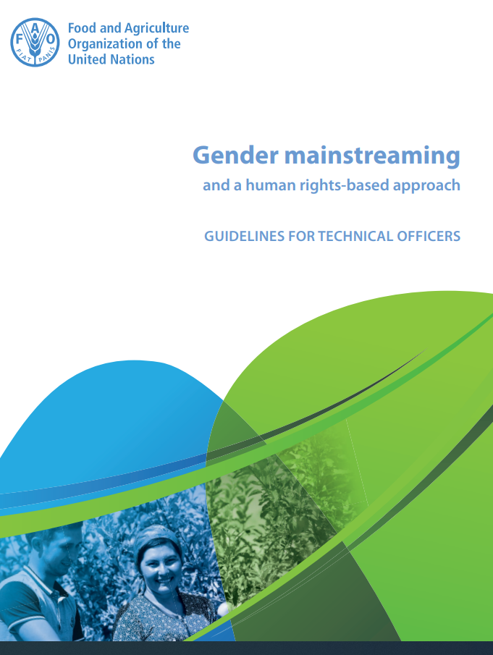
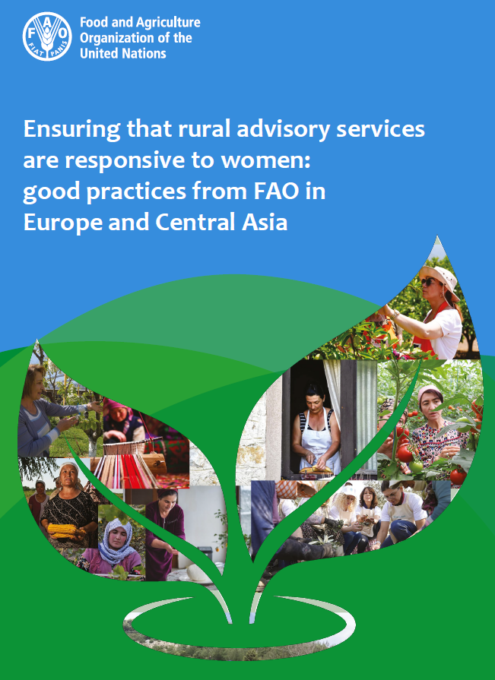
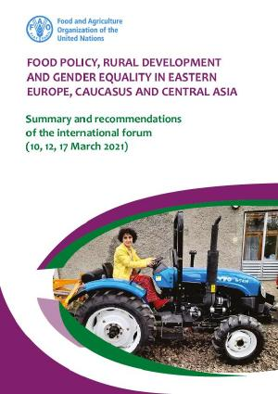
BUILDING KNOWLEDGE
More than 78 (26 since 2024) knowledge products published
CSOs play an important role
Link
Link
Link
Link
Notes:
Civil Society Organizations’ Role in FAO’s Knowledge Production on Gender Equality
CSOs play an important role in the FAO’s knowledge generation and analytical work on gender equality.
One prominent example is the CGAs, which provides a comprehensive overview of gender disparities in agriculture and rural livelihoods. The CGA employs a robust methodology that includes the analysis of national statistics—even when such data are not sufficiently disaggregated by sex or by rural/urban location in national reports.
In addition, the process involves consultations with key stakeholders, particularly representatives of CSOs, who contribute valuable perspectives during the development and validation of findings. We are particularly grateful for the contributions of CSOs in validating the findings and recommendations of the CGAs for Georgia and Ukraine, as well as the upcoming assessments for Albania and Montenegro, to mention a few.
Some of FAO’s analytical products have also emerged from policy discussions organized jointly with academia and civil society, such as the event “Food Policy, Rural Development, and Gender Equality in Eastern Europe, the Caucasus, and Central Asia: Current Trends and the Impact of the COVID-19 Pandemic,” held on 10, 12, and 17 March 2021.
Beyond the FAO-branded publications, we have collaborated extensively with various initiatives, including the Regional Gender Taskforce, to address emerging challenges such as the situation in Ukraine. These efforts have contributed to a range of knowledge products, such as “Livelihoods and Access to Work of Refugees from Ukraine in Neighboring Countries.”
.

Slide 7
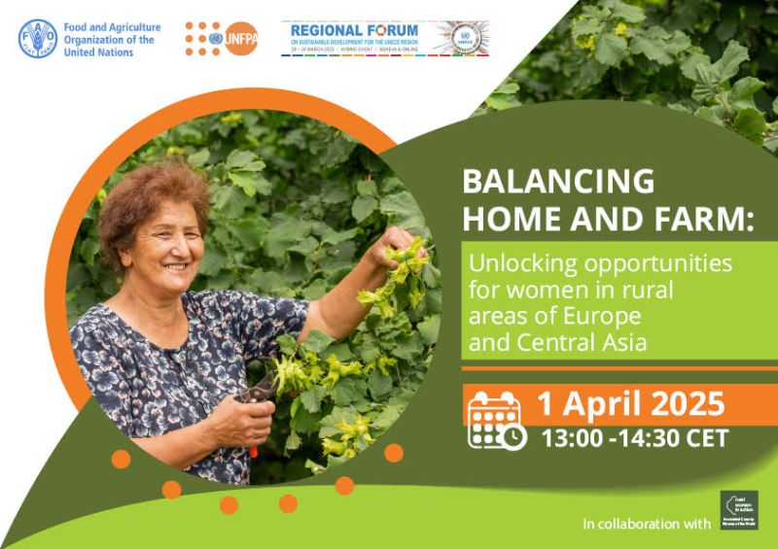
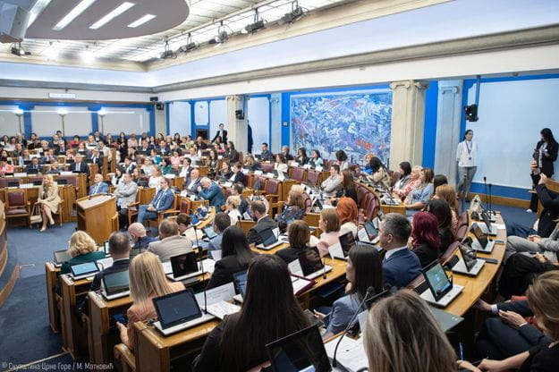
POLICY SUPPORT AND ADVOCACY
Regional policy dialogues and events, including a very successful collaboration with Associated Country Women of the World
In the countries as well:
Bosnia and Herzegovina: established a multistakeholder working group involving to enhance women’s access to financial support in agriculture
Montenegro: Parliament adopted a Declaration for stronger representation and targeted support for rural women
And many more

Slide 8
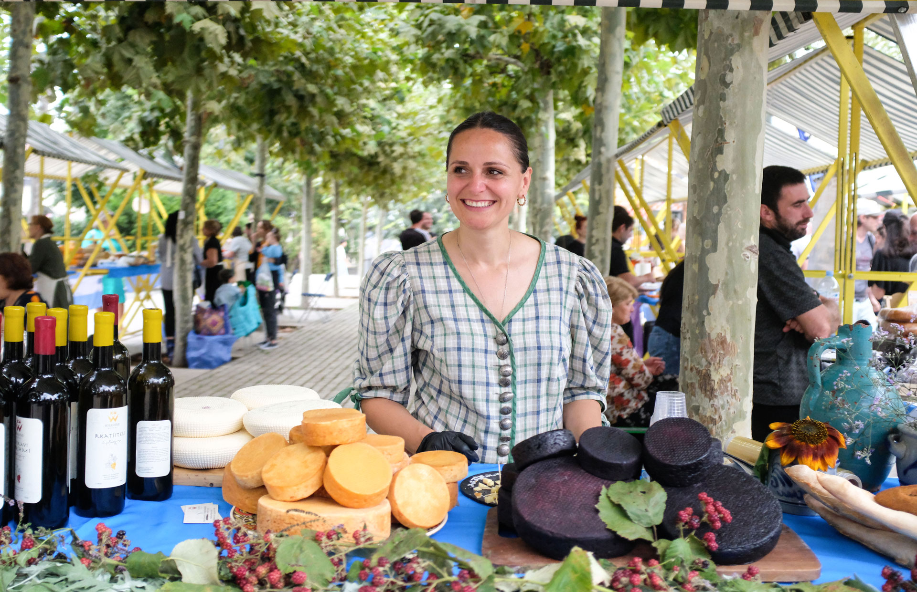
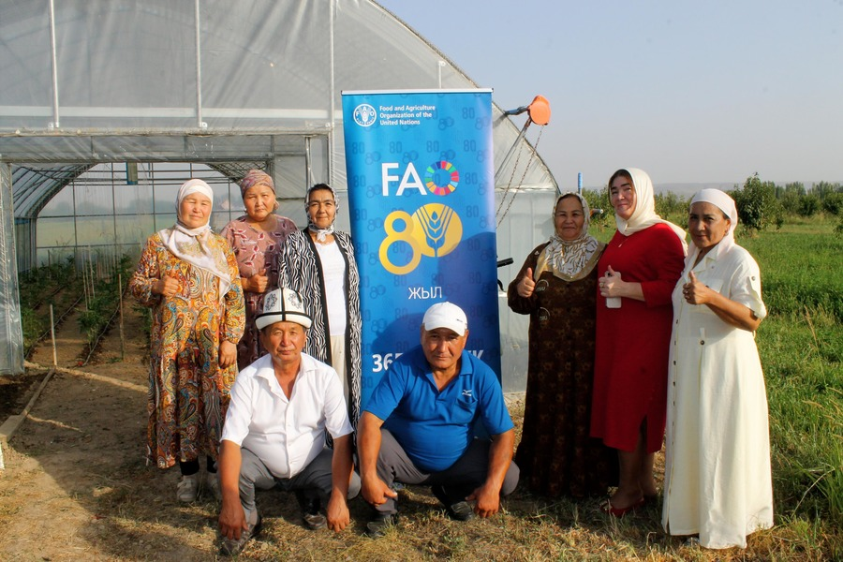
FAO Regional Response
CAPACITY DEVELOPMENT
ACTION ON THE GROUND
on the ground with the involvement of CSOs
FAO offers capacity development opportunities for a wide range of stakeholders, including civil society
-regional and subregional webinars
in-country events

Slide 9

Moving forward
CFS voluntary guidelines on gender equality and women's and girls' empowerment in the context of food security and nutrition
CSOS and grassroots organizations are essential for:
advocacy,
monitoring, and
ensuring that the voices of women and girls are heard in the implementation process.
Link

Slide 11
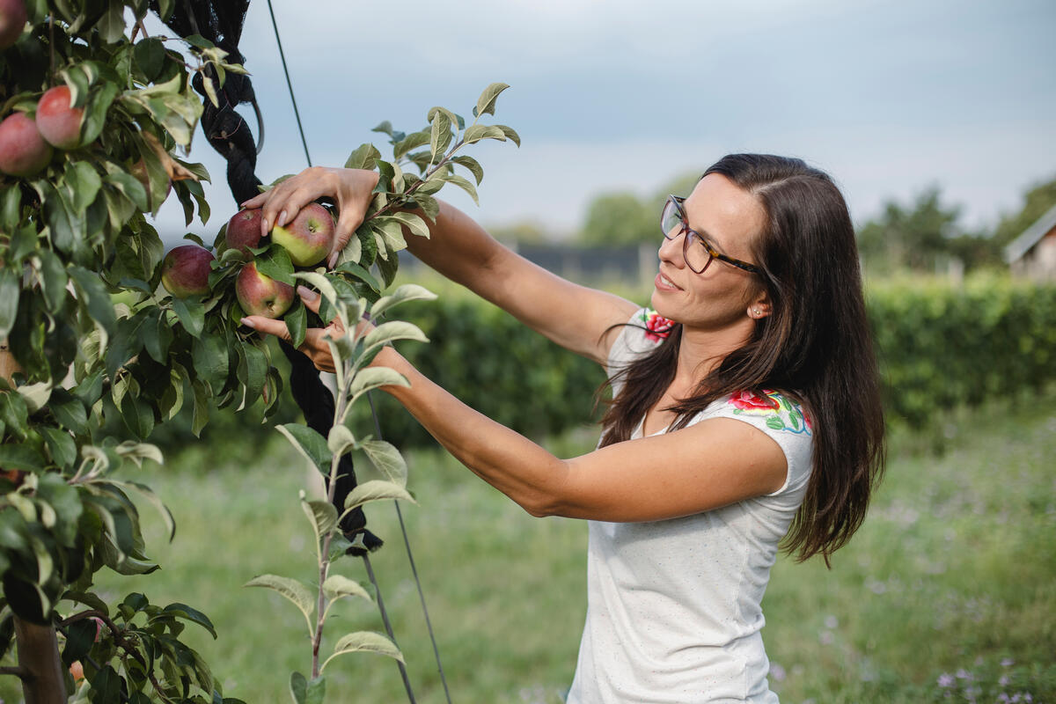
THANK YOU
REU_gender@fao.org

