Slide 1
Blue Ocean Strategy for Owner-Operators
Creating Uncontested Market Space in the Trucking Industry

Slide 2
Introduction
Traditional trucking operates in a red ocean—saturated, competitive, and price-driven.
Blue Ocean Strategy empowers owner-operators to innovate and target underserved markets with high-value services.

Slide 3
Red Ocean vs Blue Ocean
Red Ocean: Competing on price, standard services, broker dependency.
Blue Ocean: Creating new demand, tech-driven logistics, relationship-based contracts.

Slide 4
Four Actions Framework
• Eliminate: Load board dependency, broker margins
• Raise: Customer visibility, SLA performance
• Reduce: Empty miles, downtime
• Create: Direct shipper portals, subscription freight models

Slide 5
Target Market Segments
• Regional food/ag producers needing JIT delivery
• Retailers with frequent short-haul lanes
• High-value item logistics (e.g. electronics)
• Contracted customers requiring guaranteed capacity

Slide 6
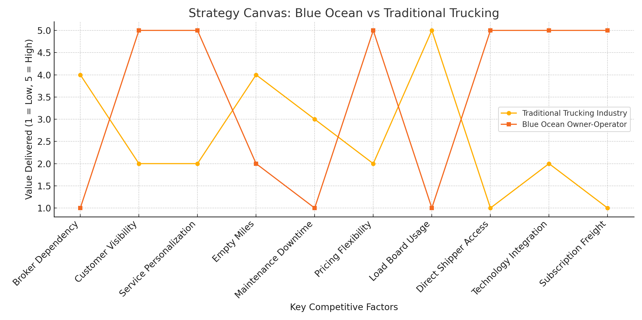
Strategy Canvas

Slide 7
Success Metrics
• Customer retention rate > 90%
• Direct contract revenue growth > 25% YoY
• Empty miles reduced < 10%
• Net operating margin > 30%

Slide 8
Conclusion
Owner-operators can escape commodity pricing by offering specialized services, driven by tech and relationships. This Blue Ocean approach creates long-term growth, profitability, and customer loyalty in the trucking industry.

