Slide 1
Grief comes in two parts.
The first is loss. The second is the remaking of life.
–Anne Roiphe
Notes:
Loss
Perception
Connections

Slide 2
Notes:
Book Cover
Camillo Golgi/Santiago Ramon y Cajal
Nobel Prize 1906
Olfactory Bulb Image
Roots, Bayous, Connections, Tracks
The Background Story
In July 1997, when I was 16, a week before my senior year in high school….
The last words my mother spoke were “I forgive you. And God does too.”
This book came to being twenty years later. After I graduated high school and college…
It began as my thesis for graduate school. It has since morphed and changed and come into its current form, including twenty-two poems of my mother’s who was a poet and playwright.
I didn’t set out to write this story. In fact I didn’t want to write this story. But I did want to explore forgiveness and listening and the way time is constantly moving, what actions are necessary to heal when all we want to do is stop.
I of course couldn’t address forgiveness without my mother’s last words and so the process began. I began revisiting the events and the memories surrounding her death. I began exploring Eric Kandel’s metaphor for how learning and memory takes place.
The most surprising emergence is my desire to reach to the man who murdered my mother. Realized his humanhood. …

Slide 3
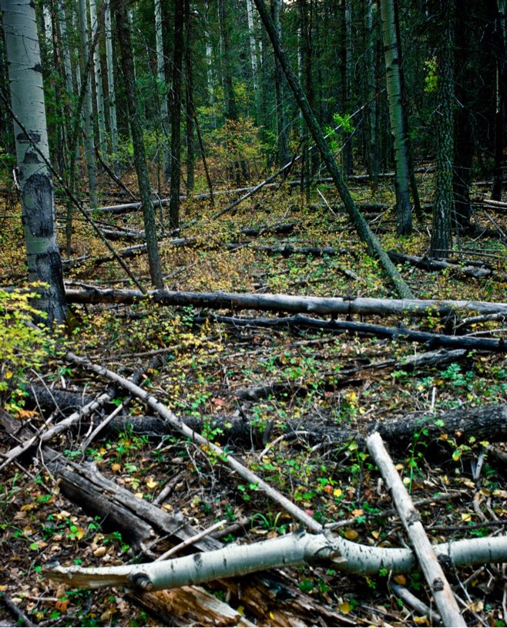
Notes:
Pathways in the brain

Slide 4
Points to Ponder
Are you aware of the brain from which you live?
Are you more likely to react or respond?
Where do you spend your in-between time?

Slide 5
Notes:
pg 13 There are only two choices in a neuron: to fire or not to fire. This firing, or not firing, results in our actions: to speak or to remain silent, to move or to stay still. Each of our actions, the movement of one foot in front of the other or the muscles of the mouth opening, the tongue touching the teeth to form sound, each decision distills back to the neuron.
Beginning in the space of our mind, the neuron electrifies the message of intended action down the length of its axon to the synaptic terminal. Here, there is space. The synaptic cleft, like the space between one star and another or the space between your face and the face of another, is where the message changes from electrical to chemical. Where the message, like words being spoken, changes from the thoughts in our heads to the sounds that transverse across and enter the ears listening. If the ears hear the words they are computed back into thought. Or in the case of a neuron, back into electrical code and the process repeats. One neuron whispering into the ear of another. This pathway establishes our habits and thoughts, our perceptions and memory. The brain from where we live.
Sometimes we are aware of the words we will speak before they leave our mouths. Consciously thinking about what and how we will voice the thoughts inside our head. Which course of action we will pursue. Often, though, the words are of impulse—an instantaneous reaction to other words spoken around us, or to us. The mind cycling through the rolodex of memories and experiences, choosing a lightning quick path to proceed. The past, present in each moment, creates the space for how we move forward.

Slide 6
Points to Ponder
Are you aware of the brain from which you live?
Are you more likely to react or respond?
Where do you spend your in-between time?
Notes:
Points to Ponder
In TBI rehab, Default Mode Network…
Take a moment and consider your general state of being…
where does your mind go when it’s not actively being used? Where do you want your mind to go?

Slide 7
Notes:
Pg 47 My mother kept a prayer garden in the backyard. Each morning before dawn, before the light ushered in the demands of day, she woke and sat next to the concrete birdbath carried from house to house to house, and the flowers planted and pruned each season. Roses, violas, butterfly weed. She didn’t wear slippers or shoes, just barefoot, skin to concrete, cool and damp in the early Houston hours. The morning after she didn’t come home I find a baby sparrow in the garden next to the birdbath, under the pine tree. If I can nurse the bird back to health my mother will be OK. I make a home for the bird in a shoebox, cut grapes for it to eat, and keep it on my bedside table for two nights.
Daniel Kahneman, Nobel Prize winner in Economics for his work with Amos Tversky on decision making, discusses the natural human tendency to find causality in the world around: a large event is suppose to have consequences, and consequences need causes to explain them. Somehow causes bring meaning. If we can find causes or intentions then it helps to understand the place from where the effect was born.
In 1839, the anatomist Mattias Jakob Schleiden and Theodor Schwann formulated the now ubiquitously accepted fact of cell theory. The theory is composed of three basic precepts: First, all living organisms are made of cells (I am you and you are me). Second, the cell is the basic unit of life (Distilled to form, we are the same). Third, all cells are generated by other pre-existing living cells (Those before to those after).

Slide 8
Practice
I am you and you are me.
Distilled to form we are the same.
Those before to those after.

Slide 9
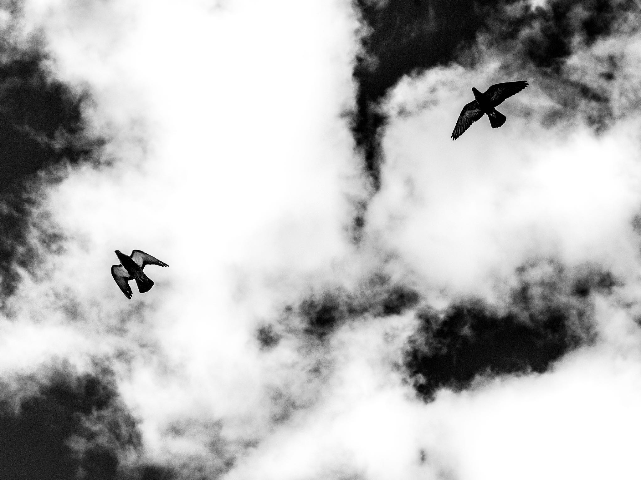
If all possibilities once were,
then the possibility of what might be
lays infinitely ahead.
Notes:
Exercise: Think of someone whom you’re having a difficult time with…maybe even just simply don’t like. Bring them to mind….Now, with the knowledge that they are of the same matter as you, that we are all of the same, that they are you…does this change anything? Do the perceived walls, the perceived differences start to evaporate?

Slide 10
Points to Ponder
Is healing possible without action?
Is healing possible with time alone?

Slide 11
Notes:
pg 71 My father tells me one morning while driving to church, a counselor told him to expect a year of grieving for every year they were married. He says, So I guess I have eighteen more years to go. He says it like he has no other choice. He has been committed and must serve out the allotted time. The first year gapes the holes left by her. Emptiness highlighted by the details we were afraid of forgetting, but too painful to consistently remember. All time became slotted into before and after, until one day, not long ago, I realize We’ve lived longer without her than with her. This time before and time after has become balanced by the outstretch of time that lays ahead: a slow incline to the peak, a tumbling fall to the point of ever after, the unknown trek into the after-after.

Slide 12
Points to Ponder
Is healing possible without action?
Is healing possible with time alone?

Slide 13
Notes:
pg79 Grief is a multifaceted response to loss, particularly when the loss is irrevocable. Although conventionally focused on the emotional response, grief also has physical, cognitive, behavioral, social, and philosophical dimensions. Our brains will often ignite physical responses when faced with psychological issues. We change the paradigms from where we view the world. How we interact with others. Elisabeth Kübler-Ross in her 1969 book, On Death and Dying, first discusses the five stages of grief: Denial/Isolation. Anger. Bargaining. Depression. Acceptance.
Before he killed her she said, I forgive you and God does too. I’ve often wondered when—exactly—did she speak these words. I imagine it was after the initial shock of being attacked. After the hypothalamus sent a message to the adrenal glands to produce adrenaline. After the initial increase in heart rate and respiration. After the muscles in her legs felt heavy and light at the same time. I don’t imagine it was her initial response. And I don’t imagine she screamed the words. I wonder how close he was. If his ear was near her lips when the words left her mouth. Or was he leaving. Was he walking away, his back turned to her and from the ground, hidden by the tall grass, did she say, I forgive you. And God does too?
For a long time I said to myself, how could I not? But he never factored into the equation. It wasn’t a person that needed forgiving, it was the entire situation. All of the circumstances that led to the consequence at hand. Too many what ifs to counter the one big cleft we found ourselves standing on. Life needed forgiving, not him. He became insignificant in the process as soon as punishment was set. What she did do with her words was open the door to acceptance. Acceptance that life, no matter how hard we try or how hard we fight it, will ever be as it was. Forgiveness comes after. After the necessary stops, cycling through, denial into anger into depression, they catch us thick and flatten into our road ahead. Returning, each time a new experience, each time familiar from before, remembering. Sometimes they catch us whole and their richness provides movement. Sometimes they catch us stuck. Without feeling. Just a body in motion. Time dictates we are always moving forward, even when grief dictates we stop.

Slide 14
Points to Ponder
Is partial forgiveness possible?
Notes:
Here is a question I still struggle with…have I forgiven the man who killed my mother? I have forgiven life. I’m so incredibly grateful for the life I have. For where I am right now and that would not be possible without the exact alignment of everything thus far. A point of difference between life and the man who killed my mother is life didn’t have a choice, it happened, it was part of the larger picture. The man had a choice. Why does this change my perception?

Slide 15
Notes:
Practice
Inhale: Space
Exhale: Let go

Slide 16
Notes:
pg 107 Sufism is a branch of Islam and follows the teachings of the Qur’an. The religion of the Sufi, like the root of most religions, is Love. The path to reach Truth, Understanding, God—stems out of this Love. Love is the path; loss is often the way. Rumi, one of Sufism’s major teachers writes, Sorrow…violently sweeps everything out of your house, so that new joy can find space to enter. It shakes the yellow leaves from the bough of your heart, so that fresh, green leaves can grow in their place. It pulls up the rotten roots, so that new roots hidden beneath have room to grow. But joy doesn’t immediately follow sorrow. The in-between is what matters. The in-between is the process, that which creates who we are. Being in the in-between, allowing emptiness to be the space inhabited, to become the new way, holds space for when the joy arrives.

Slide 17
Notes:
pg 115 Concentration camp survivor and philosopher, Viktor Frankl asked himself while in the concentration camp, Has all this suffering, this dying around us, a meaning? For, if not, then ultimately there is no meaning to survival; for a life whose meaning depends upon such a happenstance—as whether one escapes or not—ultimately would not be worth living at all. After the death of his son, Ralph Waldo Emerson refers to it as courting suffering. He writes, there are moods in which we court suffering, in the hope that here, at least, we shall find reality, sharp peaks and edges of truth. By feeling we find truth. By feeling we know in this moment we exist. To be alive and not feel is contradictory to the very essence of living. The preposition of a, as in alive, is a reduced form of the Old English preposition on, meaning in, into, or toward. In life. Into life. Toward life. To be alive doesn’t require constantly being on, but rather moving towards an existence. It’s messy. Feeling truth—feeling emotions we don’t want to feel. That’s vulnerability. Feeling unsafe inside ourselves, moving into what we don’t know, places we haven’t been. Guided only by the simple desire to be clean.

Slide 18
Points to Ponder
Where is your vulnerability? Those places that make you uncomfortable.
Is it fear or discomfort with the unfamiliar?
Notes:
Where is your vulnerability? What makes you uneasy? Is it fear or discomfort with the unfamiliar?
Vulnerability is necessary. Feeling what we don’t want to feel. It’s not about being perfect, but it is about trying. Moving towards the life we want to inhabit. Beginning in the space of our minds.

Slide 19
Notes:
Closing

