Slide 1
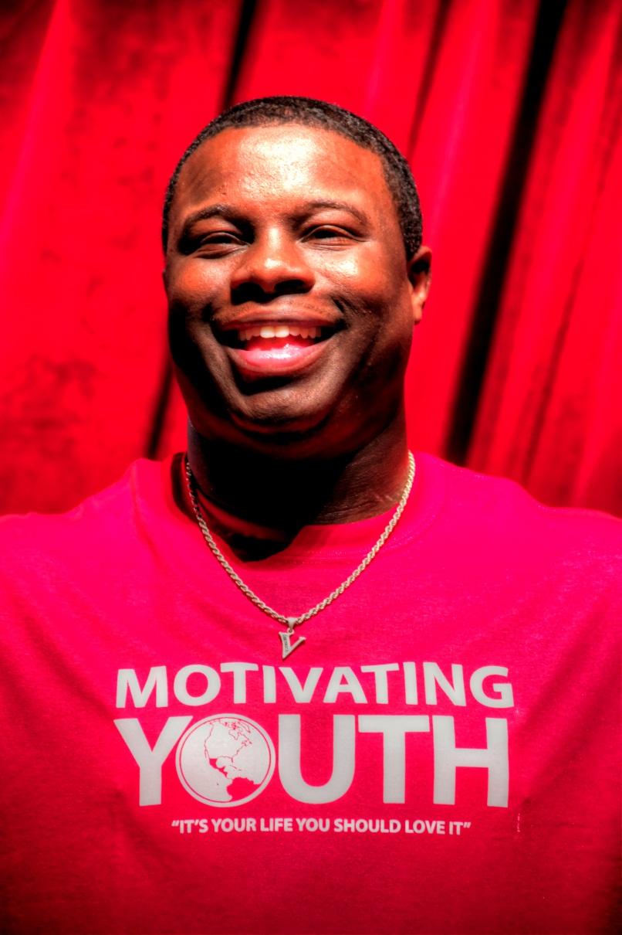

doIN’ big Things
F.O.C.U.S
Presented by:
Vernon King Jr.
C.E.O & Founder of the
Motivating Youth Company
It’s your life, you should love it!

Slide 2





Connect with MYC:
Motivating Youth
WWW.MOTIVATINGYOUTH.COM
MYC_LIFE
Motivating Youth
MYC@MOTIVATINGYOUTH.ORG
(Check your brochures for this information)
DOIN’ BIG THINGS

Slide 3
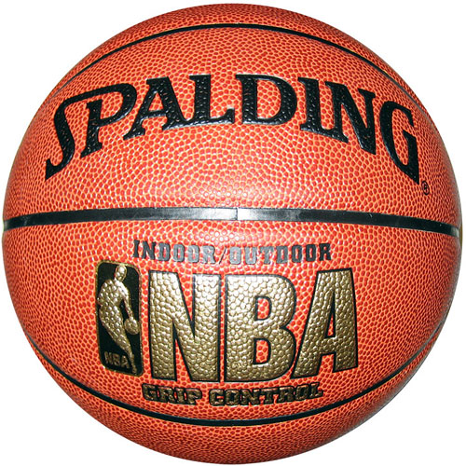
Where does doing something BIG start?
1
2
3
4

Slide 4
essence of Value
Knowing your essence of VALUE,
(What makes you, YOU) is the key, to the confidence
that you NEED to achieve
BIG, HUGE, GIGANTIC, THINGS!
DOIN’ BIG THINGS

Slide 5
OK, I’m Confident,
NOW WHAT?
F.O.C.U.S
DOIN’ BIG THINGS

Slide 6

F – follower
What are characteristics of a
Follower?

Slide 7
F – Following
A leaders future success is measured by the positive influences such as; People, Places, and or Book that he or she allows constructively into their life.
Mentors
Books
Teachers
Instructors

Slide 8
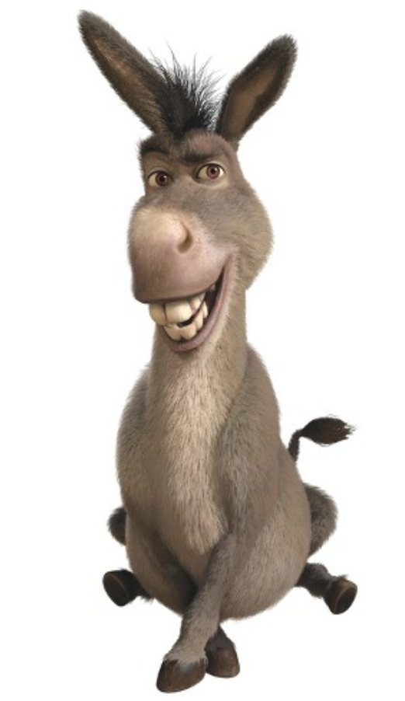
O:
OBSTACLES

Slide 9
C – Citizenship
“One disciplines himself, by doing positive things when there is no obligation”
- VK
WHEN NO ONE IS WATCHING!

Slide 10
U – Understanding
The Motivation
Why is this even important? In my life?
To society?
To the world?
To my family?
My Career?
My Job?
My Image?

Slide 11
S – Success
WIN BIG!

