Slide 1
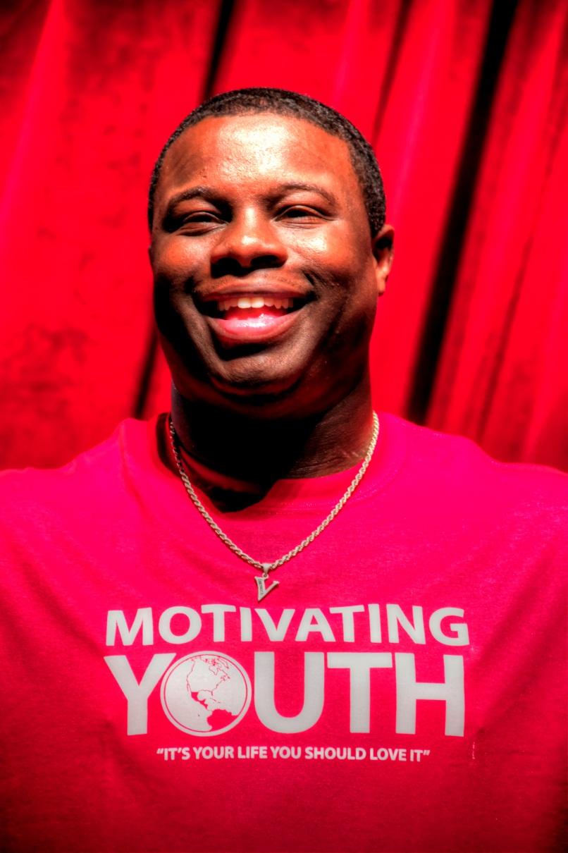

doIN’ big Things
S.M.A.R.T
Presented by:
Vernon King Jr.
C.E.O & Founder of the
Motivating Youth Company
It’s your life, you should love it!
Notes:
!

Slide 2





Connect with MYC:
Motivating Youth
WWW.MOTIVATINGYOUTH.COM
MYC_LIFE
Motivating Youth
MYC@MOTIVATINGYOUTH.ORG
(Check your brochures for this information)
DOIN’ BIG THINGS

Slide 3
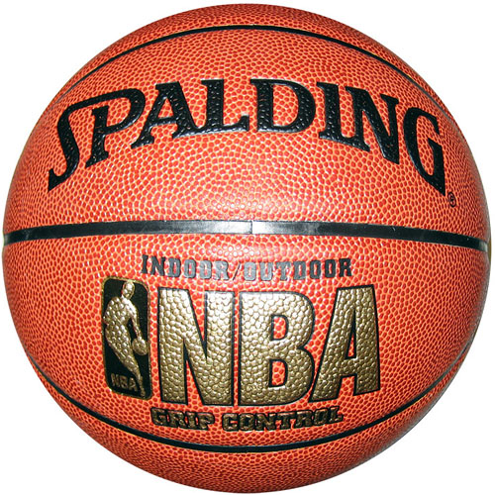
Where does doing something BIG start?
1
2
3
4

Slide 4
essence of Value
Knowing your essence of VALUE,
(What makes you, YOU) is the key, to the confidence
that you NEED to achieve
BIG, HUGE, GIGANTIC, THINGS!
DOIN’ BIG THINGS

Slide 5

S – Specific
(your Exact Goal)
When setting a goal be specific in what you are trying to accomplish!
EXAMPLE: Instead of, “I want to start a Business”
Say, “I want to start a business working with kids, teens & young adults”

Slide 6

M – Measurable
(The time YOU will need to complete thAT goal)
ASK YOURSELF:
Did the goal you set, allow you to predict the time of completion around the rest of the things going on in your daily life?

Slide 7

A – Action Required
(Steps I need to take)
1st = RESEARCH

Slide 8

R – Relevant
(The Motivation)
ASK YOURSELF
WHY IS THIS IMPARTANT?
To society? To the world? To my family? My Career?
My Job? My Image?

Slide 9

T – Track

Slide 10
WIN BIG

