Slide 1


I.M.P.A.C.T
WORKSHOP
Presentation
Presented by:
Vernon King Jr.
C.E.O & Founder of the Motivating Youth Company
It’s your life, you should love it!

Slide 2






Connect with MYC:
Motivating Youth
www.MOTIVATINGYOUTH.COM
MYC@MOTIVATINGYOUTH.ORG
MYC_LIFE
Motivating Youth
I.M.P.A.C.T
Check your brochures also for this information!

Slide 3
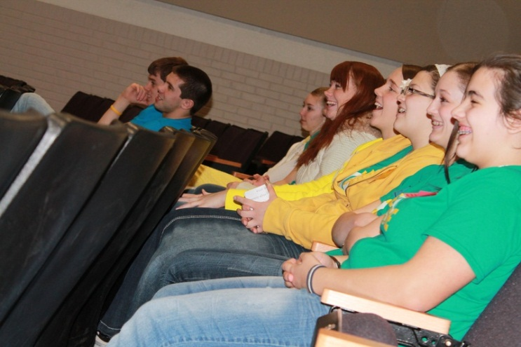
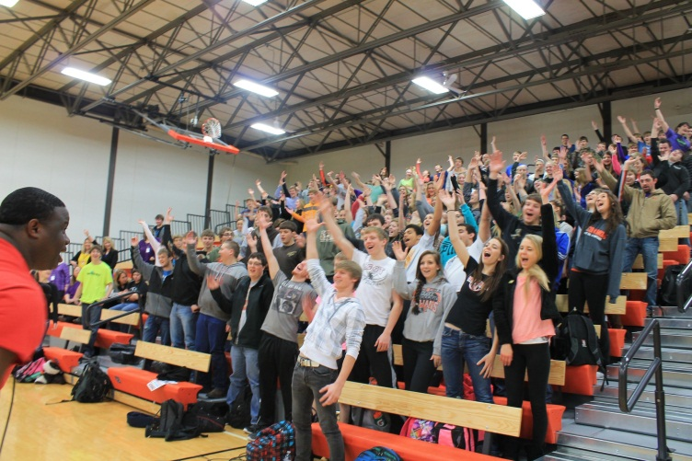
I.M.P.A.C.T
A Strategy that will allow you to improve student, faculty and administration success at your school(s), in your classroom(s), and or youth recreational facilities!
I.M.P.A.C.T

Slide 4

Inspired
How are you preparing yourself!
Knowledge
wisdom
motivation!
“For me it’s remembering the mentors, teachers, and influential people that got me where I am today. I want that for the students and individuals I am in front of every opportunity I receive”
– Vernon King Jr.
I.M.P.A.C.T

Slide 5

Motivate
Articulation Theory – A cultural Communication term that asks the question, What does this subject have to do with my life, or this society?
GEOLOGY
I.M.P.A.C.T

Slide 6
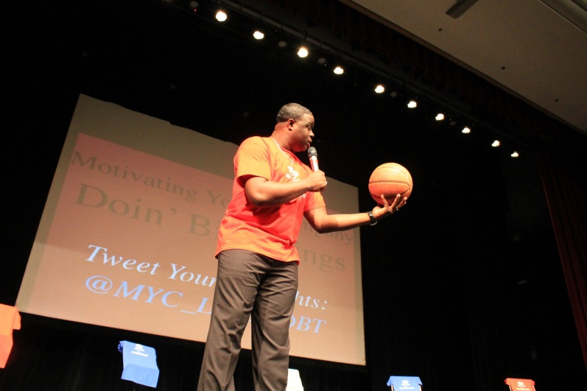
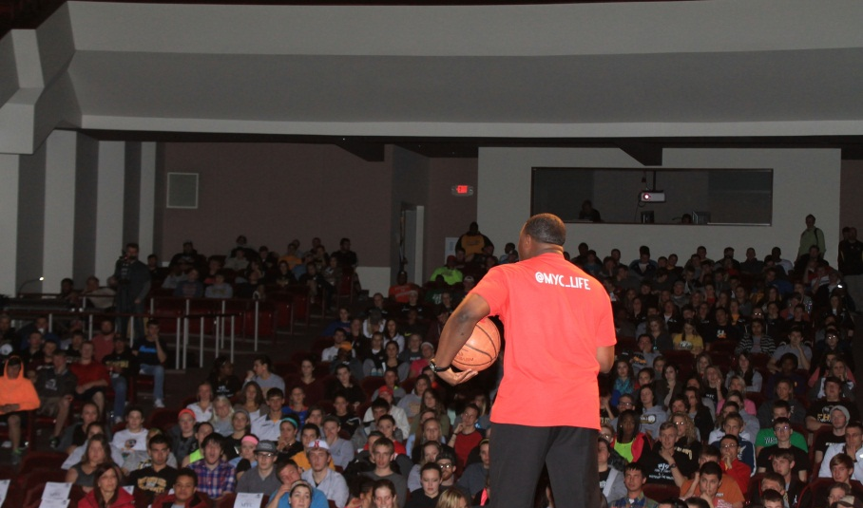
presentation
CREATIVE, ENGAGING PRESENTATIONS IS THE KEY!
I.M.P.A.C.T

Slide 7
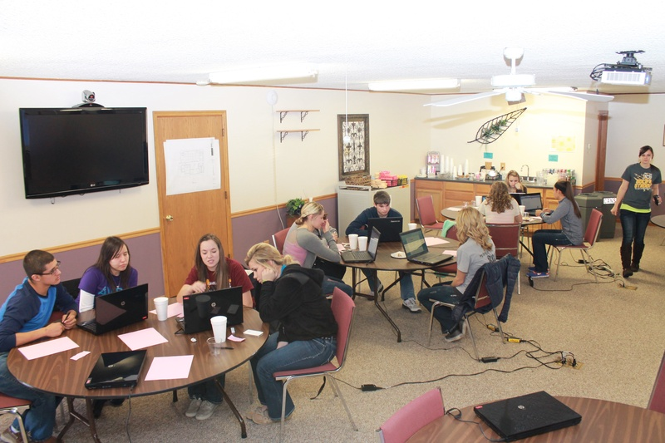
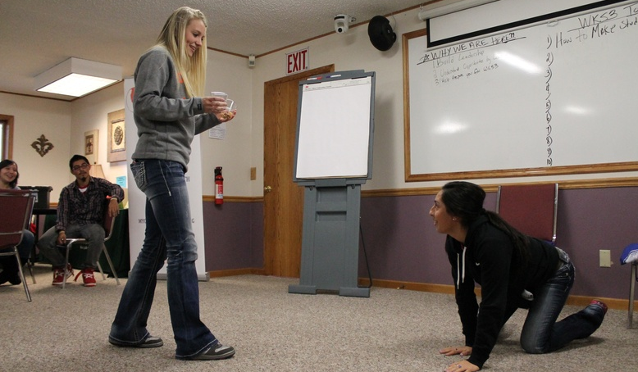
Act Creative
AFTER YOUR CREATIVE PRESENTATION, GIVE THEM CREATIVE OPPORTUNITIES TO PERFORM IT HANDS ON!
Act Creatively!
I.M.P.A.C.T

Slide 8

test
Testing their understanding of the material…
THEN
Have you Looked at results & Self Evaluated?
Question to self….
What could I do better next time?
I.M.P.A.C.T

Slide 9
Groups
Discuss strategies you implement at your campuses that others here could add to the their I.M.P.A.C.T Strategy technique?

Slide 10
What are some tools you can use to continue your IMPACT into those individuals lives?
I.M.P.A.C.T

Slide 11

I – Ways to Inspire/Motivate oneself?
Mental:
Mentors
Books
Stories
Personal story that influenced you in the past
Quotes
Religious practices
Physical:
1) DO YOU NEED YOUR COFFEE?
(Lovely Girlfriend)
2) Exercise… etc
I.M.P.A.C.T

Slide 12
M – Ways I can Motivate my staff, teachers, students?
Motivational tips students like to see/hear, to get them motivated for a presentation opportunity.
Articulation Theory – What does this subject have to do with my life, and/or to this society?
Competitions at the end of the lesson!
A song (Happy)
A Video (A Video of what your going to teach that worked for something or someone)
I.M.P.A.C.T

Slide 13
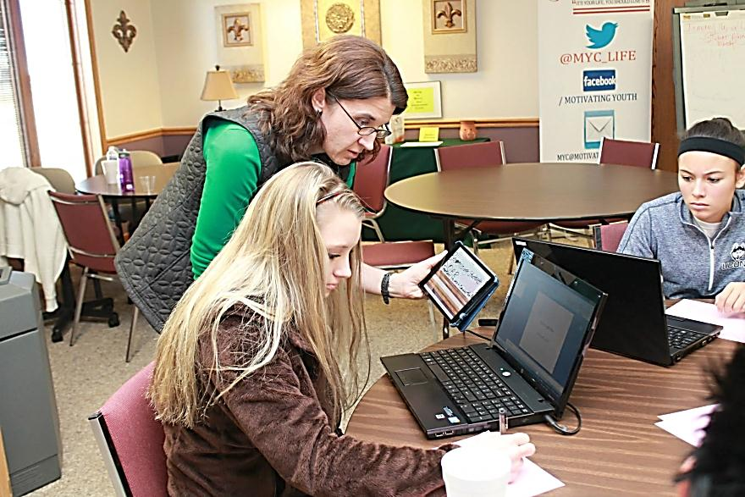
P – how can I present this creatively?
What are you doing to present the information that you want them to know creatively?
Articulation Theory
PowerPoint's
Handout’s
Personal Stories
“Have different techniques for different individuals, Think of it of as a heterogeneous class (Different Learning styles) instead of homogenous class
(Everyone has the same learning styles).” – Dr. Hsin-Yin Yang
I.M.P.A.C.T

Slide 14
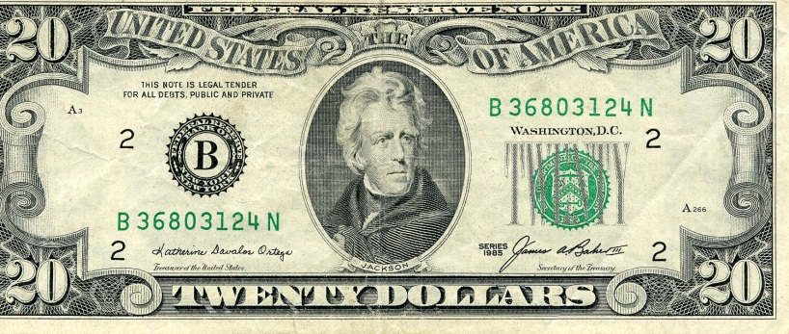
How can I guide them to Act Creative?
The Hands on Approach
Group Work
Research, Research, Research – Presentations
Homework
EXAMPLE:
Budgeting in High School - $20 budget report
I.M.P.A.C.T

Slide 15
T – How do I Test for results?
How are you testing the results both for the students and for your self?
For Student Results:
Paper tests
Individual or Group Presentations
Paper Reports
For Self Evaluations:
Student surveys
Set test overall average goal(s)
Ask yourself. what can I do better next time? Write that down!
I.M.P.A.C.T

Slide 16
QUESTIONS ON
I.M.P.A.C.T?

