Slide 1
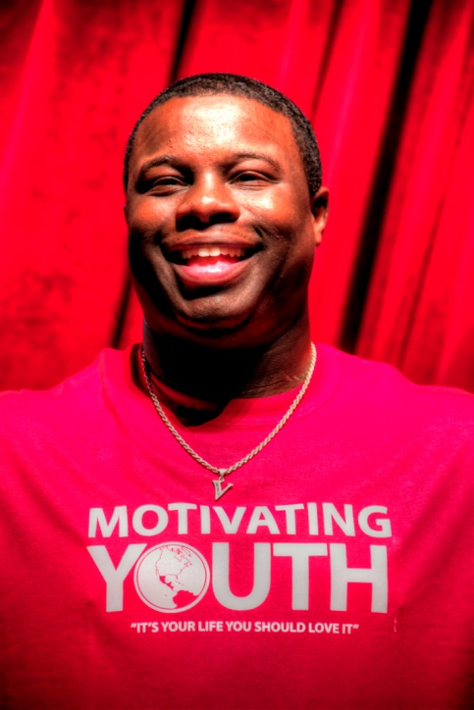
Motivating Youth Company
“It’s your life, you should love it”
YAB Presenter
Vernon King Jr.
C.E.O.
& Founder of
The Motivating Youth Co

Slide 2
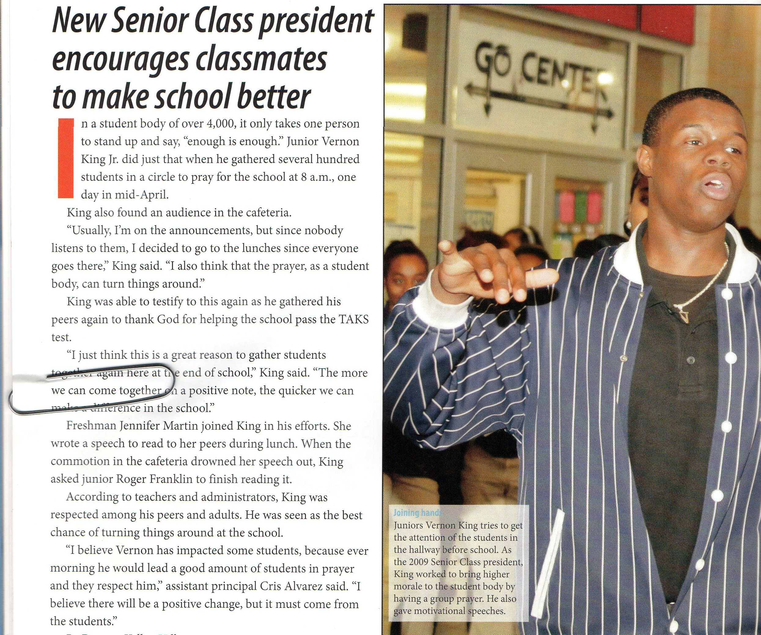

Slide 3
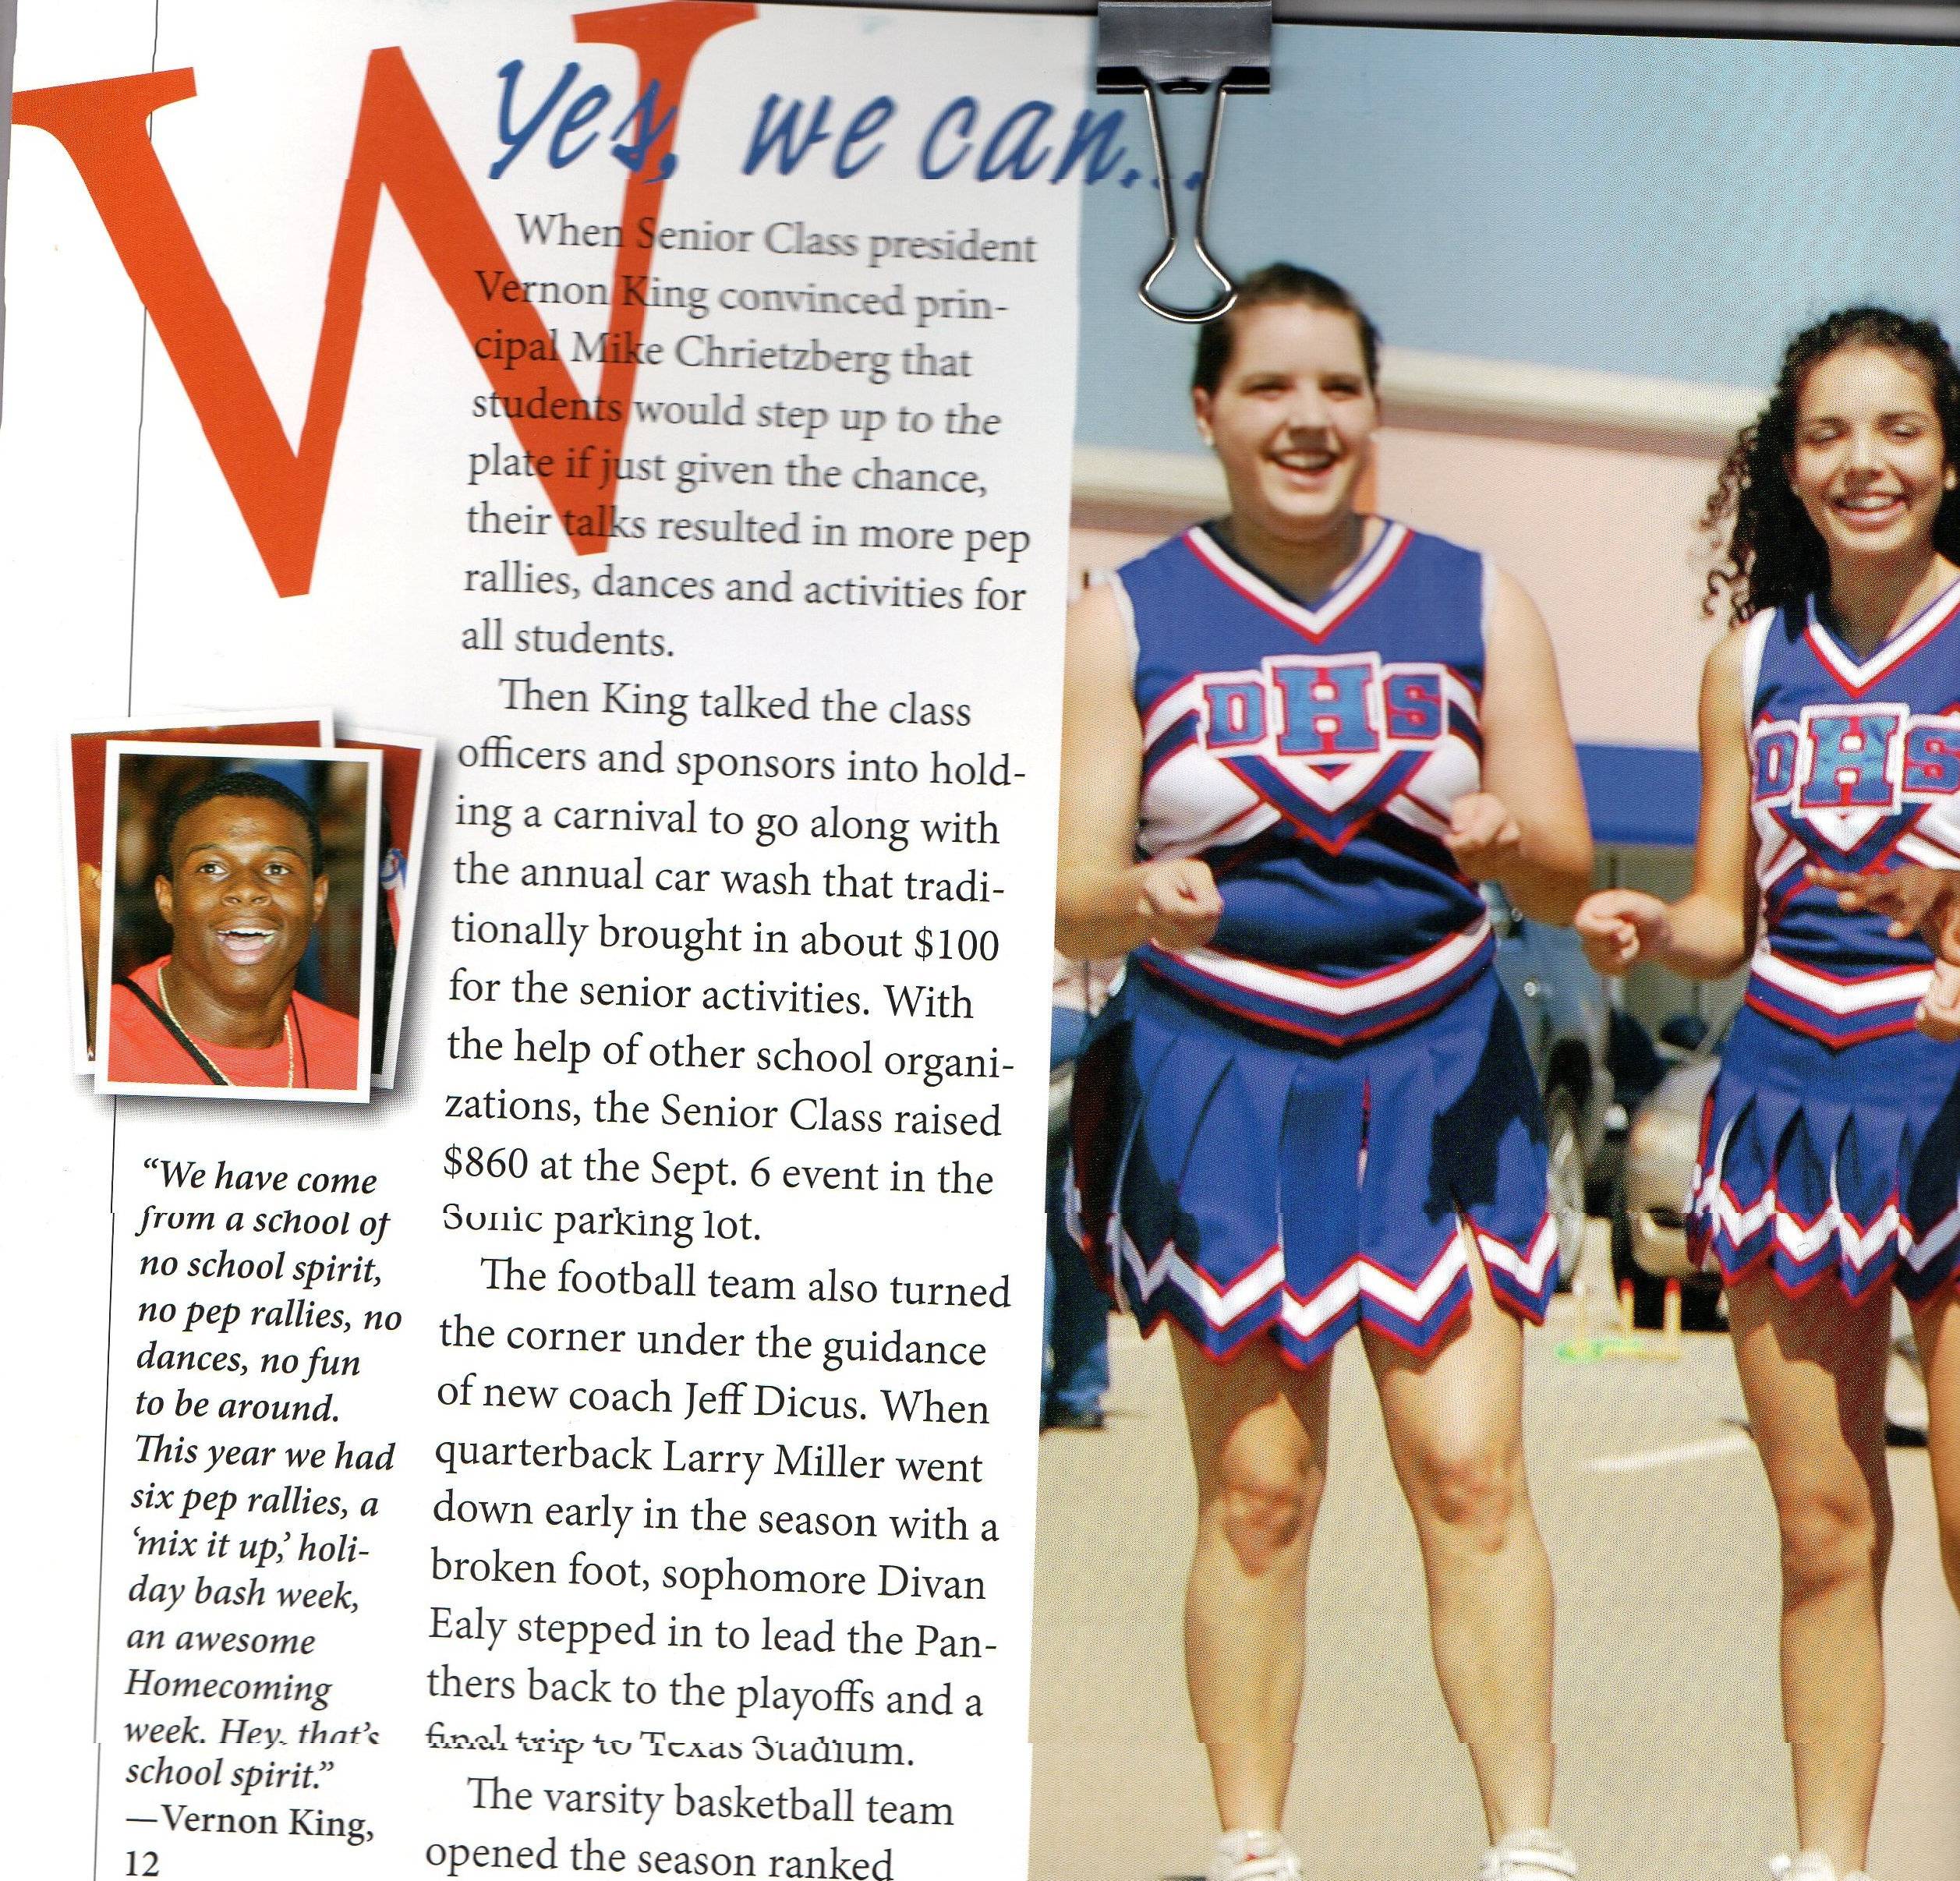

Slide 4
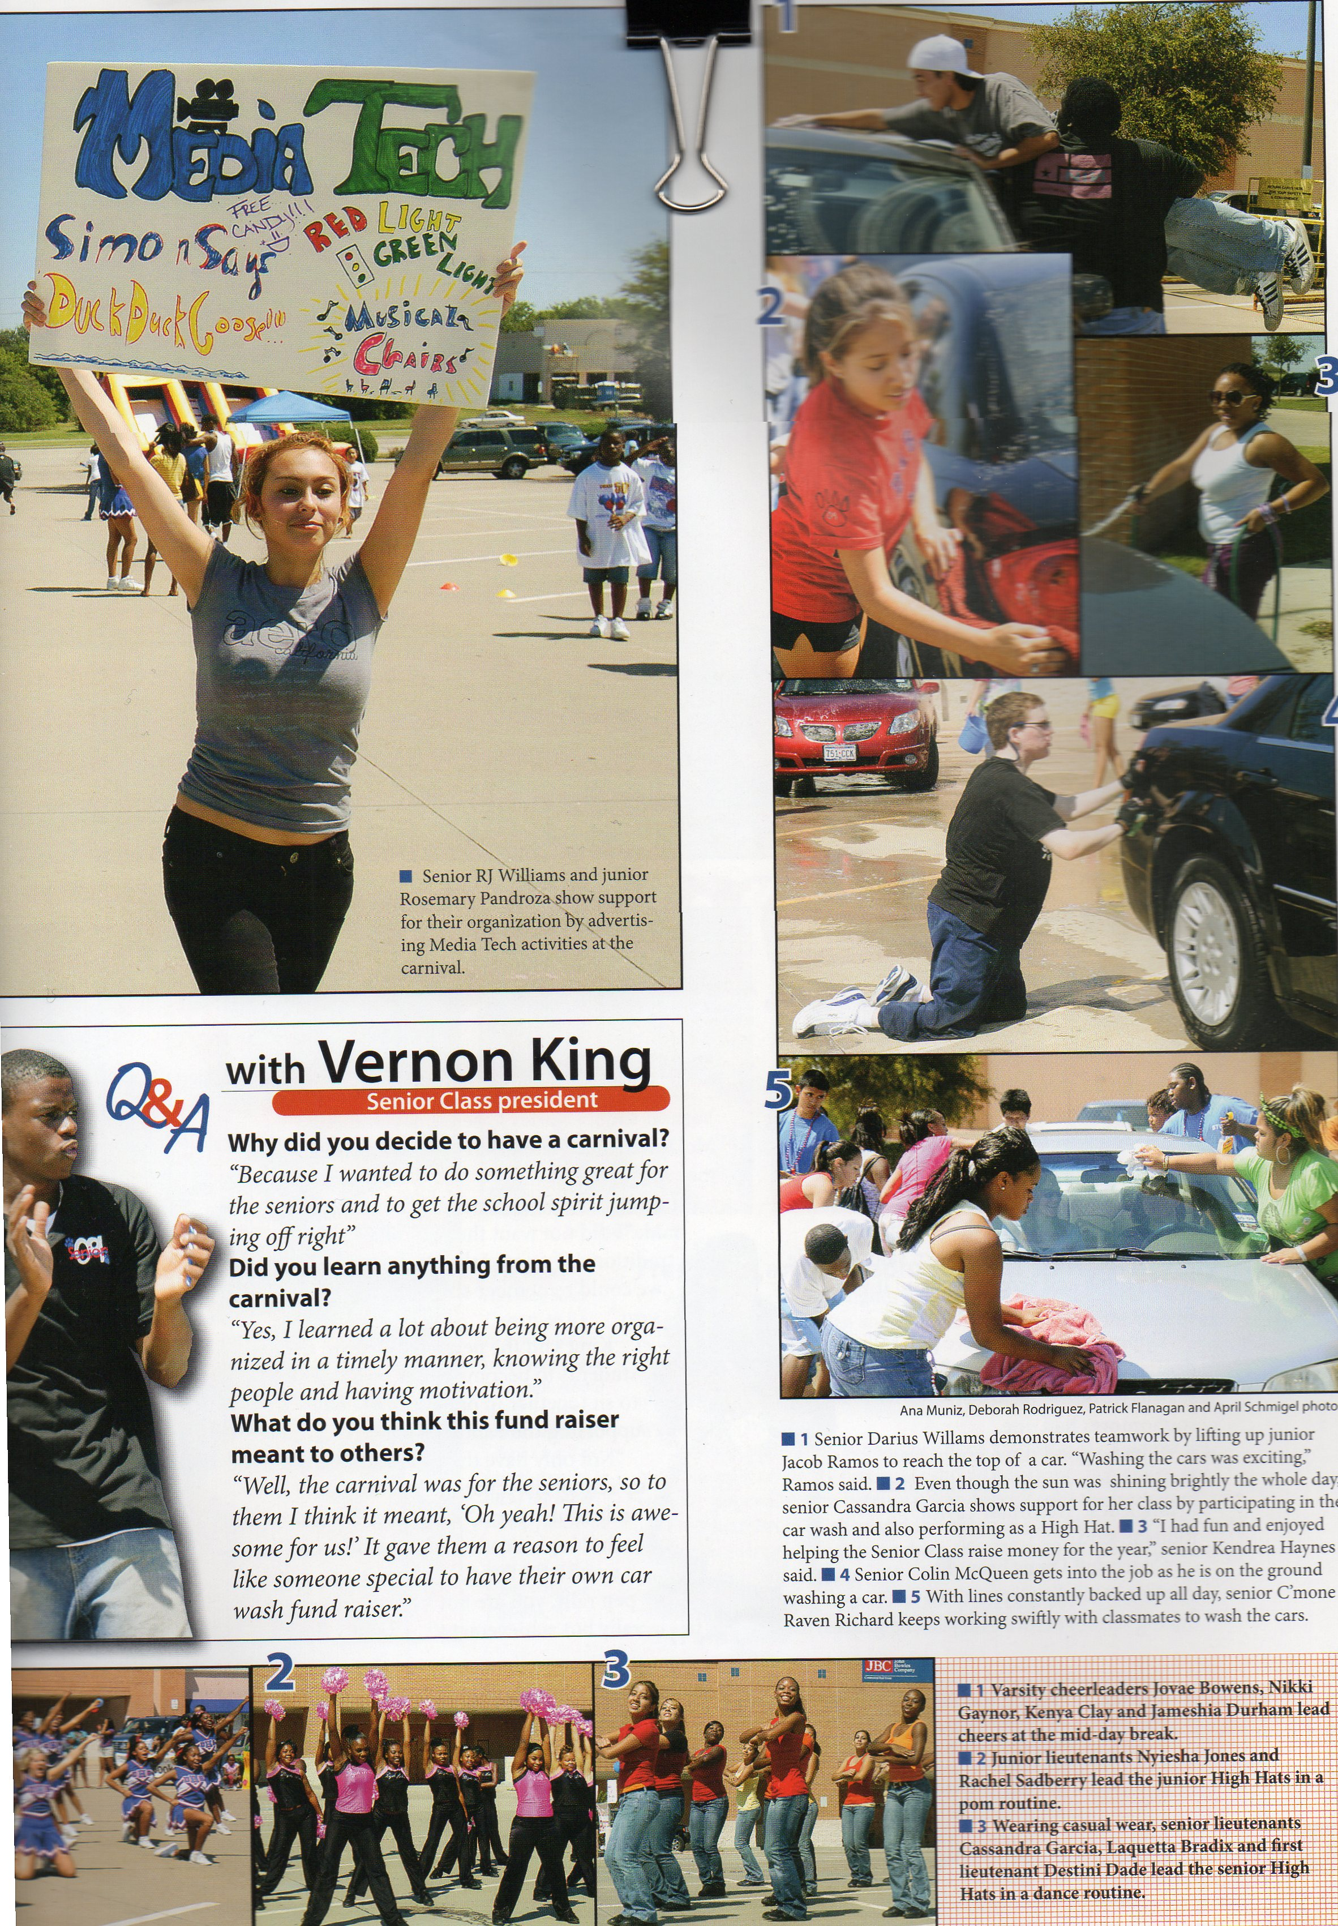
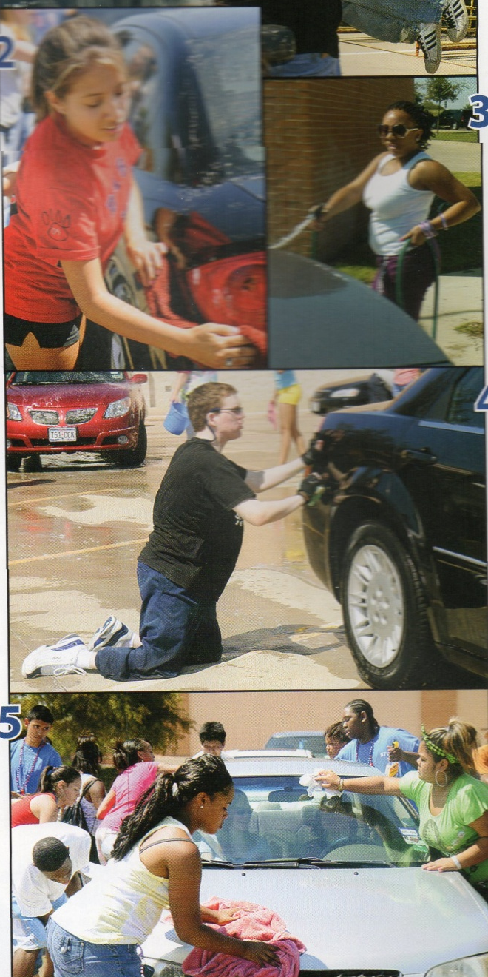

Slide 5
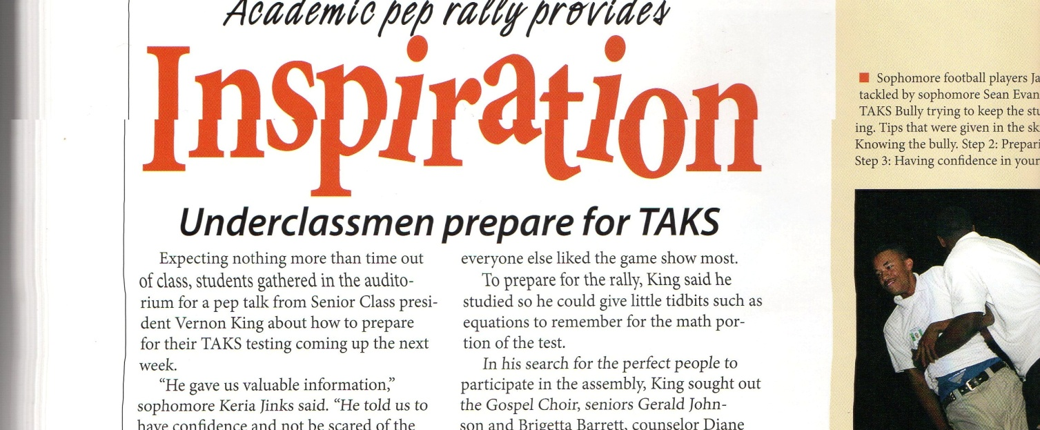
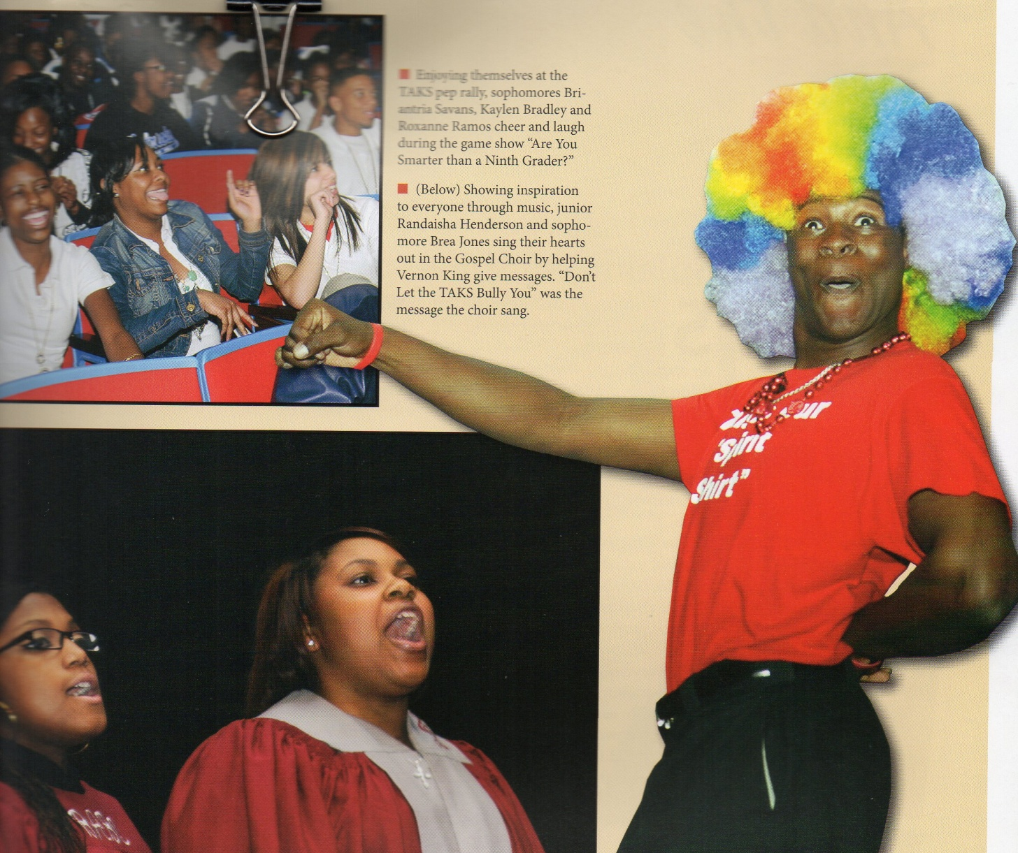

Slide 6
Trustworthiness

Slide 7
Respect

Slide 8
Responsibility

Slide 9
Fairness

Slide 10
Caring

Slide 11
Citizenship

