Slide 1
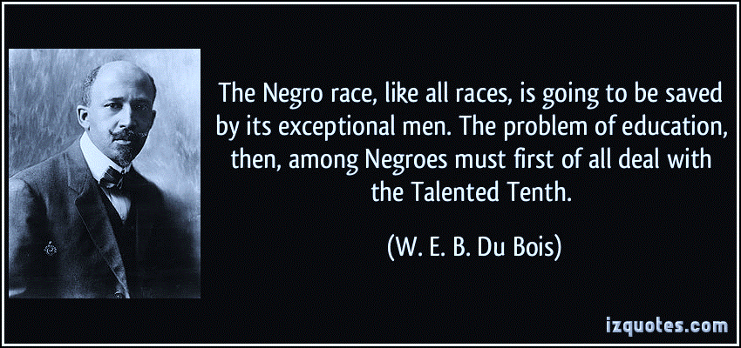
FIVE CHALLENGES
IN THE AFRICAN AMERICAN COMMUNITY
Generational Wealth Gap
Wealth Management Gap
Financial Advisor Gap
Mentorship/Leadership Gap
Business Ownership Gap
Notes:
The Negro race, like all races, is going to be saved by it’s exceptional men. The problem of education, then, among Negros must first of all deal with the Talented Tenth. W.E.B Du Bois
How did we get here?
Talented Tenth, (1903), concept espoused by black educator and author W.E.B. Du Bois, emphasizing the necessity for higher education to develop the leadership capacity among the most able 10 percent of black Americans, one in 10 black men becoming leaders of their race in the world through methods such as continuing their education, writing books, or becoming directly involved in social change.
Du Bois was one of a number of black intellectuals who feared that what they saw as the overemphasis on industrial training would confine blacks permanently to the ranks of second-class citizenship. In order to achieve political and civil equality, Du Bois stressed the importance of educating African American teachers, professional men, ministers, and spokesmen, who would earn their special privileges by dedicating themselves to “leavening the lump” and “inspiring the masses.” The phrase Talented Tenth first appeared in Du Bois’ The Negro Problem (New York, 1903).
Booker T. Washington asserted that vocational education, would give blacks an opportunity for economic security, which he considered was more valuable to them than social advantages, higher education, or political office. In return for basic education, and vocational training, African Americans would remaining peaceful and socially separate from whites and the white community would accept responsibility for improving the social and economic conditions of all Americans regardless of skin color. This notion of shared responsibilities is what came to be known as the Atlanta Compromise which whites agreed to fund in exchange a passive Negro labor force with no social or political voice or power.
How do you think this worked out for African Americans?

Slide 2
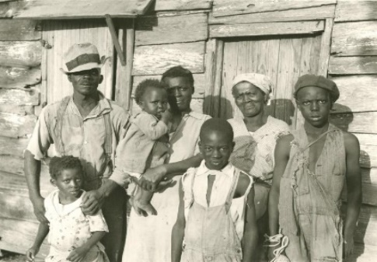
CHALLENGE NUMBER ONE
GENERATIONAL WEALTH GAP
Statistics Show Materialistic African-American Spending Habits Keep
Black Communities Poor & White Corporations Rich
Federal and state policy during the reconstruction era emphasized wage labor, not land ownership, for African Americans.
Freedman's Bank started in 1865 as a leading financial institution of African Americans.
Speculative investments by white businessmen put Freedman's Bank into debt with unsecured loans.
Freedman’s Bank’s failure was devastating to the newly emancipated black community.
Failure of this bank and the loss of hard earned savings led to a fear of
financial institutions amongst the black community.
This practice of distrust, passed down through generations.
This created a culture of spending hard earned wages on depreciating
products and services.
African-American purchase habits are painting a vivid picture of this
damaging trend.
Notes:
Federal and state policy during the reconstruction era emphasized wage labor, not land ownership, for African Americans. As the Civil War drew to a close, the United States Congress and President Lincoln established the Freedman’s Bank on March 3, 1865 to help newly freed Americans navigate their financial lives. Five weeks after the creation of the Freedman’s Bank, President Lincoln was assassinated.
Freedmans Bank maintained some 37 offices in 17 states, including the District of Columbia. At its height, the Bank had over 480k accounts/over $4 million dollars in individual accounts as a leading financial institution of African Americans. The Bank attracted a large number of cultural societies, churches, charities, numerous hospitals, and schools and trust accounts. Noted community leaders and civil rights activists formed the management of several trusts and held other important positions in the bank. A large number of African American soldiers and veterans of the Civil War held savings accounts in the banks.
A series of increasingly speculative investments brought the bank into debt. One example was the Seneca Sandstone Company. The owner of the Seneca Quarry, Henry D. Cook, had taken out unsecured loans from the bank to fund ongoing risky investments in the Quarry. With the Panic of 1873, (financial crisis that triggered a depression in Europe and North America that lasted from 1873 until 1879) the indebted Seneca quarry could not pay its debts back, which in turn helped undermine the Freedman's Bank. Both institutions went bankrupt, and the bank closed its doors in 1874. Thanks to Cooke, who also sat on the boards of both the quarry company and the Freedman's Bank, the Seneca Stone Ring Scandal and speculative investments brought the bank into debt which caused it to fail.
Understand, the person that provided the Freedman's Bank loan was Cooke himself, who sat on the board of both the quarry and the bank. And yes, that was quite illegal, even then. Congress investigated and recommended that Henry Cooke and others be indicted, but no one ever was found guilty. An 1874 court of inquiry cleared Howard of negligence.
Freedmans Bank’s failure was devastating to the newly emancipated black community. Failure of the bank and the loss of hard earned savings led to a fear of financial institutions among of the black community. This was practice of distrust, passed down through generations, and is why most African Americans today don’t trust financial institutions. This also created a culture of spending hard earn wages on deprecating products and service in fear of losing it, associating how well we are living by acquiring material stuff as a sign of wealth by purchasing goods and services from other ethic groups making them wealthy as African American comminutes fall father behind economically.
While still struggling to get ahead in terms of long-term financial gain, recent statistics on African-American buying power are painting a vivid picture of just how much damage this counterproductive trend is doing in our communities.

Slide 3

AFRICAN AMERICANS ANNUALLY SPEND
$3.3 billion on tobacco
$3.0 billion on whiskey, wine, and beer
$20 billion on Automotive Purchases
$3.1 billion leisure time
$3.5 billion on toys, games, & pets
$19 billion telephone services per year
$1.2 billion on beauty and grooming
$17 billion charitable giving
$13 billion gambling
$29.3 billion on apparel and footwear
$120 billion on Food and Dining Out
$23.6 billion for health care
$321 million on books
African-American consumers have unique behaviors from the total market.
They are more aggressive consumers of media and watch more television (37%) than any other ethnic group.
African Americans shop more frequently, making more shopping trips than any other ethnic group.
Buying power currently stands around $2.1Trillion. If categorized as a nation ourselves we would be one of the top 15 most powerful nations in the world.
Notes:
African-American consumers have unique behaviors from the total market. They are more aggressive consumers of media and watch more television (37%) than . More likely to have a smart phone, 16% compared to 4% of Caucasians, spend more than twice the time at personal hosted websites.
African Americans shop more frequently, making more shopping trips (8 times more), purchase more ethnic beauty and grooming products (9 times more) than any other ethnic group.

Slide 4

CHALLENGE NUMBER TWO
WEALTH MANAGEMENT GAP
African Americans make up 14% of the American population and only have 2% ownership of total wealth of this country: Home ownership is only 45.7% compared to 51.1% Hispanics, 61.7% Asian and 74.3% Caucasians. We only own 2.8% of the Businesses compared to 6.5% for Hispanics, 10.6% Asians and 70.8% Caucausians.
African Americans do not invest money in stocks & mutual funds
African Americans historically invest money into products with low rates of return:
BANKS
CREDIT UNIONS
SAVINGS & LOANS
CASH VALUE LIFE INSURANCE POLICIES (IUL’S/Index Universal Life)
Average net worth of African Americans is $44,900 Average net worth of Caucasians is $285,000
We must realize that Home ownership, Business ownership and Investments are the real indicators of progress and True Wealth.

Slide 5


CHALLENGE NUMBER THREE
FINANCIAL ADVISORS GAP
African-Americans make up just 2% of all Financial advisors
Caucasian communities have financial companies
Fidelity Investments
Merrill Lynch
Ameritrade
Edward Jones
Charles Schwab
African American communities have loan companies
Cash advance
Payday loans
Title loan
Lack of African Americans licensed in the investment industry
Lack of financial education on how money works in our community
Only 6% of every dollar is spent with black owned business
In the Jewish community the dollar stays there for 21 days
In the African American community the dollar stays there 6 hours
In the Caucasian community the dollar stays there 17 days
In the Jewish community the dollar stays there 20 days
In the Asian community the dollar stays there 30 days

Slide 6
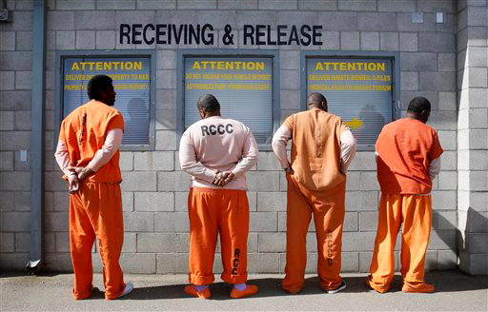
CHALLENGE NUMBER FOUR
LACK OF MENTORSHIP/LEADERSHIP
The African American make up 14% of the US population and 38% of the
prison population, as a result the African American male is absent from the home.
African American males have greater chance of spending time in prison at some point in his life. 5.5 times Higher than White Males.
One out of Nine African American men born will be incarcerated.
African American males have the highest incarceration rate of any race/ethnicity.
More African American males are in prison than are enrolled in colleges and universities.
Zero Tolerance of schools have an adverse affect on African American children.
35% of African American children are expelled at some point in their school careers.
Nationwide, African-Americans represent 26% of juvenile arrests.
Private for-profit prison companies in the United States have funneled more than $10 million and have spent nearly $25 million on lobbying efforts. Daily fees for Beds, Bank Financing for Daily Operations and Expansion and(REITs/Real Estate Investment trusts) which allow them to AVOID THEM PAYING TAXES are just a few ways they make money for our Incarceration.
When white voters perceive more African Americans in the prison population, they support harsher laws.
Private prisons’ revenue is $3.5 billion in annual revenue.
The prison system fast tracks more African Americans to serve time in private institutions.
Disproportionately high number of African American men are among police shooting victims and we are killing ourselves.
There are more African American men incarcerated in the US than the total prison populations in India, Argentina, Canada, Lebanon, Japan, Germany, Finland, Israel and England combined.
Notes:
An African American male born in 1991 has a 29% chance of spending time in prison at some point in his life.
One out of nine African American men will be incarcerated between the ages of 20 and 34.
Black males ages 30 to 34 have the highest incarceration rate of any race/ethnicity.
Several studies have concluded that overall, more African American males are in prison than are enrolled in colleges and universities.
Zero Tolerance policies as a result of perceived problems of school violence; adverse affect on black children.
35% of black children grades 7-12 have been suspended or expelled at some point in their school careers compared to 20% of Hispanics and 15% of whites.
Nationwide, African-Americans represent 26% of juvenile arrests, and 44% of youth detained, 46% of youth are judicially waived to criminal court, and 58% of youth are admitted to state prisons.
Private prisons for-profit prison companies in the United States have funneled more than $10 million to candidates since 1989 and have spent nearly $25 million on lobbying efforts.
They now rake in a combined $3.3 billion in annual revenue and the private federal prison population more than doubled between 2000 and 2010.
The system is fast tracking more African Americans to prison and they are more likely to serve time in private prisons, which provide less sufficient health care and educational programming than equivalent public facilities.
Disproportionately high number of African Americans men are among police shooting victims. The police don't show as much care when they are handling incidents that involve young African American men and women, so shoot and kill.
Stanford psychology researchers discovered that when white voters perceive more black Americans in the prison population, they support harsher laws.

Slide 7




CHALLENGE NUMBER FIVE
BUSINESS OWNERSHIP
African Americans do not teach entrepreneurship to their children
What We Were All Taught From Childhood:
Do well
in school.
Go to
college.
Work for a
good company.
Get a
good job.
African American owned businesses make up only 2.8% of all US business, employ 1.6 Million people with average revenue less than $100,000 per year.
Hispanic owned businesses make up 6.5% of all US business, employ 1.6% of employed workers and have average revenue of $152,000 per year.
Asian owned businesses make up 10.6% of all US business, employ 2.5% of employed workers and have average revenue of $338,000 per year.
Caucasian owned businesses make up 70.8% of all US business; the small businesses average revenue is $250,000 to $1 million and major corporation’s average revenue is billions of dollars per year.
Notes:
African American owned business makes up only 7.1% of all US business, employ only .08% of employed workers and have an average revenue of $72,000 per year.
Hispanics owned business make up 8.0% of all US business, employ 1.6%, of employed workers and have average revenue of $152,000 per year.
Asian owned business makes up 11% of all US business, employ 2.5% of employed workers and have average revenue of $338,000 per year.
Caucasian business makes up 89% of all US business, small business average revenue is $250,000 to 1m and corporations is millions –trillions per year.

