Slide 1
What Side Do You Want To Be On?
Employee Income based on position not the person Income is fixed Take Vacations when they allow Job/Boss controls your lifestyle MAKE OTHER PEOPLE MONEY
Business Owner Owns a System Has others working with them Unlimited Income potential via Franchising, Network Marketing SYSTEMS MAKE THEM MONEY
Self-Employed Own a job Examples: Doctor, Lawyer, Real Estate Agent, Lawncare, Barber, Beautician Must be personally involved to increase income MAKE THEIR OWN MONEY
Investor Have money working for them They buy Businesses/Systems Enjoy Complete Freedom Travel all over the World Live the American Dream THEIR MONEY MAKES THEM MONEY
90% of the People and 10% of the Money 10% of the People and 90% of the MONEY

Slide 2
YOU Are In Control
Keep Your
Job
And Build Your
Business
Keep Your
Job
Until You Build Your
Business

Slide 3

WOULD YOU OWN A
FRANCHISE?
WHY OR WHY NOT?

Slide 4
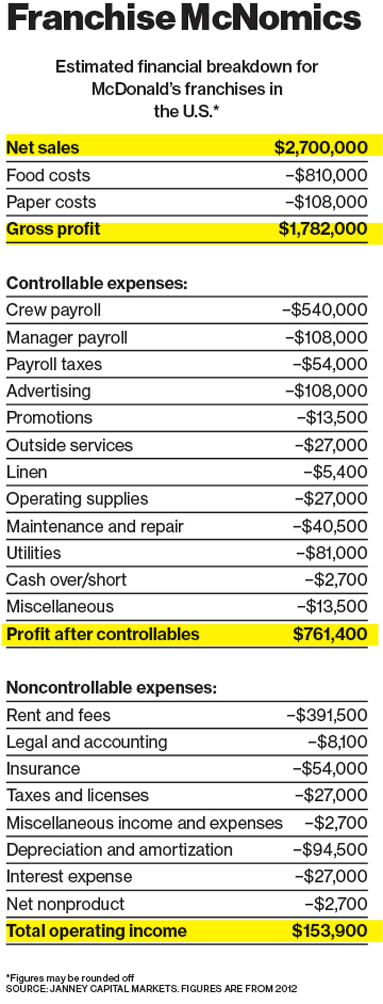
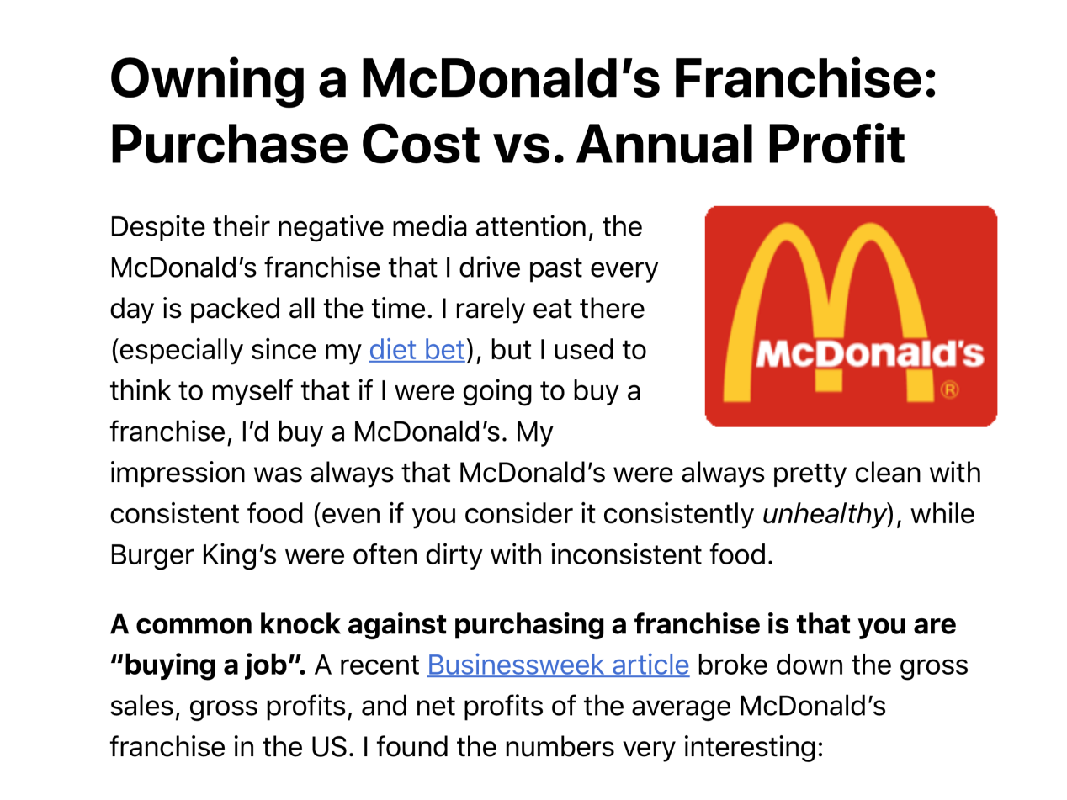
WHAT WE DO KNOW!!
Cost to Purchase: $1m - $2.2 million
Must Have $500k in Liquid capital (non-borrowed)
Franchise Fee US: $45,000
Royalty Fee: 4% of gross sales
Advertising fee: 4% of gross sales
Hamburger U-TRAINING Center
RDM: Curriculum used to Teach How to Run McDonalds Systems
Must go through 12 to 18 months of training before earning a dime signing a contract
\
Must prove that you know All of McDonalds Systems from Shift Supervisor to General Manager before you can take control of the Franchise
The Franchise Owner didn’t want to flip hamburgers or cook French fries They wanted to OWN the Business
Net profit after all expenses - $150,000
The Average McDonalds Franchisee Owns 6

Slide 5

WHAT IF?????????
You hired your best friend / Mother in your Business:
Dish Washer, Cook, Cashier, Shift Manager, Store Manager, or General Manager
They don’t show up or take the job serious
WOULD YOU SHUT DOWN YOUR BUSINESS?
WHY?

Slide 6

WOULD YOU OWN A
BUSINESS/FRANCHISE?
WHY OR WHY NOT?

Slide 7
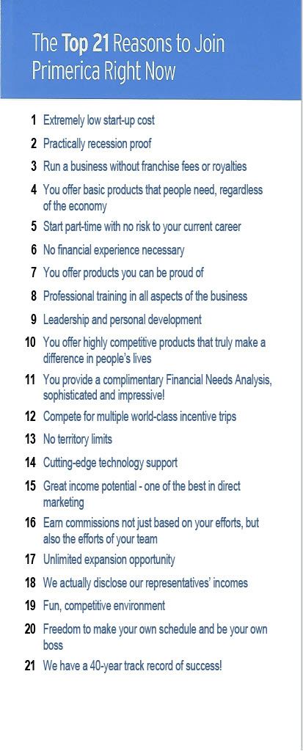
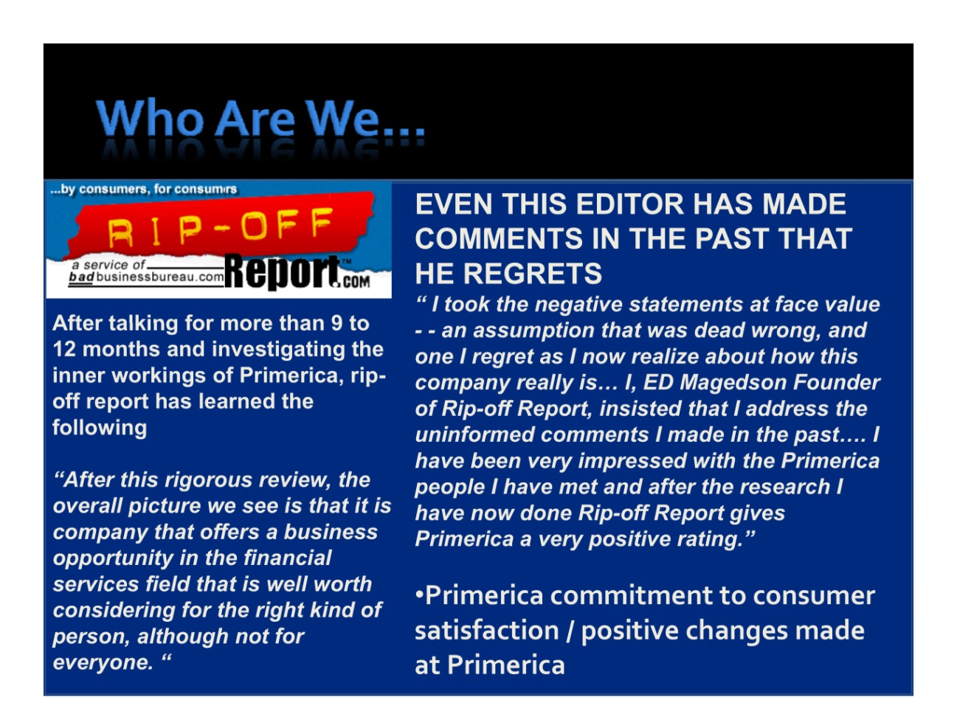

WHAT WE DO KNOW!!
Within 18 months you can be an RVP / Franchisee (Avg Income of an RVP / Franchisee is $160k year)
While you’re’ learning the Systems & Building the Business / Franchise you could potentially earn $25k - $50k!
When you become an RVP / Franchisee: They give you $15k of stock. ($10k invested in company stock back in the 80’s held for 20 years was worth $6.2m)
        Low Startup Cost Website Publicly Traded Company: PRI Bonus’s Overrides Ownership
  NoTerritory Restrictions PFSU - Licensing & Training POL (24HR Training) Trips (2/yr)
  Cutting Edge Technology No Franchise/ Service or Royalty Fee Expansion and Growth Potential
    Equity Opportunities UNLIMITED MARKET / UNLIMITED REFERRALS BUSINESS PLAN COACH
    We offer the Best Financial Products Made in America to Middle Income Families.
    We are so good at Distribution that OTHER COMPANIES create Financial Products for us to Distribute

Slide 8
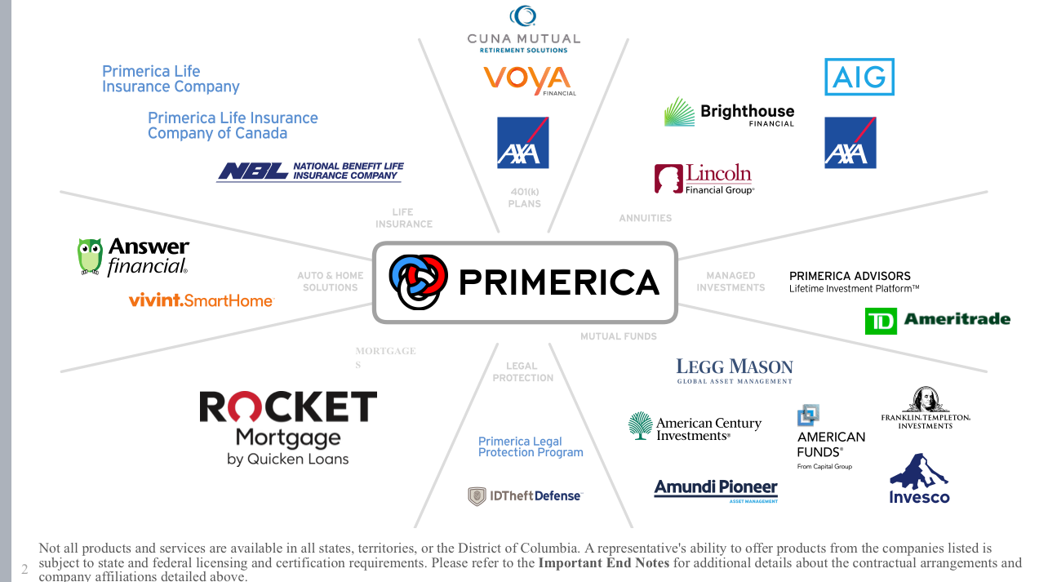
Life Insurance
341.1 million
Population
100 million
No Coverage
(GoFundMe)
9 out of 10 that have it are underinsured by $500,000
WHAT’S MISSING IN YOUR BUSINESS?
47.9 million
African Americans
14.4%
of U. S. population
$2 TRILLION in SPENDING POWER
But ONLY 2%
OWNERSHIP
Median Networth
$44,000
vs
$284,000
Average Rate of Return
1 - 4% vs 10 - 12%
Less than 2%
African American are financial advisors
FINANCIAL TSUNAMI
U.S. HOUSEHOLDS
$70 TRILLION
IN PERSONAL WEALTH
$20 TRILLION
MONEY MARKETS,CDS AND BANK SAVINGS ACCOUNTS
TOTAL $90 TRILLION WEALTH TRANSFER NEXT 20 YEARS
Auto & Home Ins
Wrong Deductibles
Wrong Coverages
$500.00 avg annual savings
Jobs
PNN & Primerica
Affiliates
Self Employed
Business Ownership
DISTRIBUTION
Walmart, McDonalds, Amazon, Primerica
PNN & YOU??
See who’s knocking on your door or in your home from anywhere. You can Open and Lock your doors Remotely
Mortgage: Monthly vs bi-weekly payments
Consolidate debt by using the Equity in your Home
Need Wills & Attorney Access
PASSION ! !

Slide 9
RVP/ Franchisee Compensation
Contract Level | Total Comp | RVP Spread | Overrides/ Profits
Rep 25% | $250 | 85% | $850
Sr. Rep 35% | $350 | 75% | $750
DIS 50% | $500 | 60% | $600
DIV 60% | $600 | 50% | $500
RL 70% | $700 | 40% | $400
SRL 80% | $800 | 30% | $300
RVP 110% | $1100
Total Base Shop Payout | 110%
Contract Level | Total Comp | RVP Spread | Overrides/ Profits
Rep 25% | $250 | 85% | $850
Sr. Rep 35% | $350 | 75% | $750
DIS 50% | $500 | 60% | $600
DIV 60% | $600 | 50% | $500
RL 70% | $700 | 40% | $400
SRL 80% | $800 | 30% | $300
RVP 110% | $1100
Total Base Shop Payout | 110%
Part-timers are happy because they are making more money
part-time in their business than they can make on a part-time job

Slide 10

WHAT WE DO KNOW!!
We Have More
6 and 7 Figure Income Earners
Than Any
Company in America.
IT

Slide 11
WHAT IF?????????
You hired your Best Friend/ Mother in your Business:
Reps, Sr. Reps, Districts, Divisions, Regional Leaders, Regional Vice Presidents
BUT they don’t show up or take your Business serious …
WOULD YOU SHUT DOWN YOUR BUSINESS??
WHY?

Slide 12


Franchisee
RVP/ Franchisee
Store Manager
Regional Leader
Dish Washer
Cook
Cashier
Shift Manager
Rep
Sr. Rep
District
Division
* Both have internal systems in place to allow promotions.
* Most people don’t move up past Cashier or District Because they are Satisfied
WHY?
They don’t want the Responsibility of being a LEADER!

Slide 13
36 - 120 Months Focus on Expansion
BUILDING PROFITABLE RVP’S/FRANCHISEES
START BUILDING EQUITY WEALTH
$15,000
X 10 =
$150,000
IN STOCK
Historical fact
$10k invested in our company stock in the ‘80s
and held for 20 years was worth $6.2m!

Slide 14
$750,000 Power Builder NSD/Franchisee
$195k thru 2nd / $20k Base Shop/NSD
Become an NSD
Build Residual Income
$754,298.00
ANNUAL INCOME
$2,800 Base Shop Bonus
$3,938 Power Builder
$16,275 Leadership Development Bonus
NSD
$20k/$195k thru 2nd
Focus:
EXPANSION
15% 1st Override
7.5% Power Builder
10% RVP Bonus
7% SVP Bonus
4% NSD Bonus
43.5% Total
*Assumes generating monthly premium of $5,000 in personal, District Leaders generating $5,000 and Division Leaders generating $10,000, yielding $3,444/mo. in life commissions; $1,850/mo. in securities commissions, for total commissions of $5,294/mo. Assumes all products remain in force for 12 months. Commissions include cash flow that is received over 12 months from month of sale, with 75% advance of 1st year life commissions and subject to deferred compensation account withholding. Annual cash flow assumes the same level of activity over the 12-month period.
In the 12-month period ending in December 2024, Primerica paid a total of $1.2b in compensation to its sales force, at an average of $7,757 per life licensed representative.
SVPs
$20k
RVP
$10k
RVP
$15k
RVP
$10k
RVP
$10k
RVP
$10k
10% 2nd Override
4% NSD Bonus
14% Total
10% 2nd Override
7% SVP Bonus
4% NSD Bonus
21% Total
RVP
$20k
RVP
$15k
RVP
$15k
RVP
$10k
RVP
$10k
RVP
$10k
RVP
$10k
RVP
$10k
Now You Are Building RVPs/Franchisees That Are Building RVPS/Franchisees

Slide 15

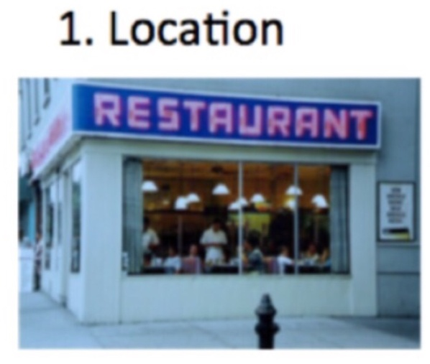
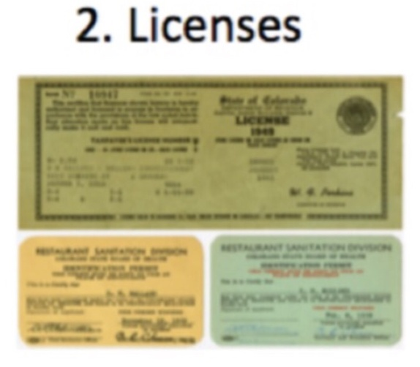


WHAT’S THE BIG PICTURE??
$1.2m to $2m to Purchase Plus
$500k Liquid non-borrowed Assets
$124/$25
Whether it’s McDonald OR
YOU NEED 4 THINGS
Use our Offices until
You open Yours
ZOOM
Business Licenses:
Life/SIE/S6/S63/S26
You’re in Business
YOUR CERTIFIED FIELD TRAINER WILL
HELP YOU BUILD THESE 2 AREAS
Cost to get started: $124 - Balance funded by Primerica/Affiliates
($2,000 to $6,000 depending on your state)

Slide 16

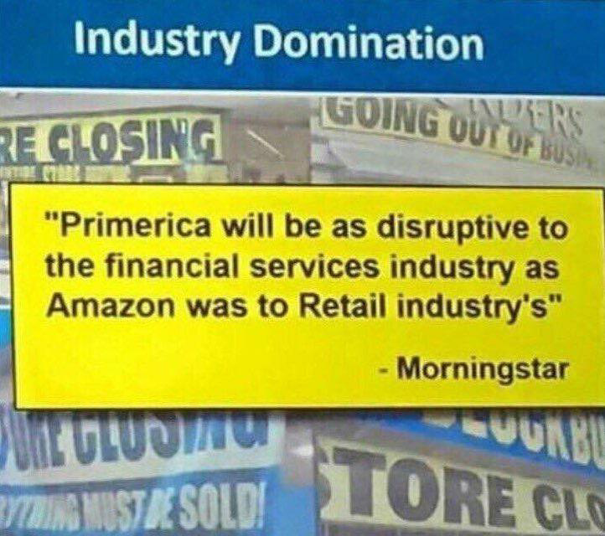
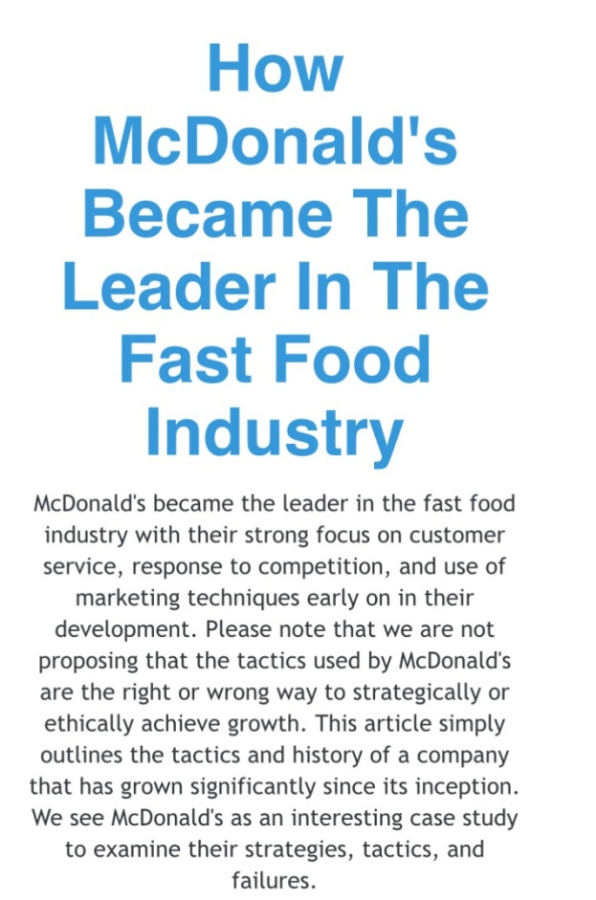
WHAT’S THE BIG PICTURE??
Right PLACE
  Right TIME
Get 3 of your Core 7-10 in 1st 30 days and find
out from your Sponsor/Coach the Incentives
To help you get your Business started
2 most important requirements
for major success:
1. Being in the Right place at the Right time
2. Doing something about it
-Ray Kroc,
Ray Kroc did, WILL YOU?
Capital isn’t scarce, Vision is
-Unknown

Slide 17
Next Steps
1
2
3
Fill out your IBA / Goal Sheet
Pay your Licensing Fee
Register for Licensing Class / All Can Be Done Through ZOOM
Calculate your FIN / PIN and Implement your Personal Plans
Attend Licensing Class
Get Licensed in 7 Days
Start the Field Training Process
Schedule a Date and Time With Your Field Trainer and RVP TO Launch Your Business
THE SECRET:
WE ARE ALL WORKING TOGETHER
-SAM WALTON

