Slide 1
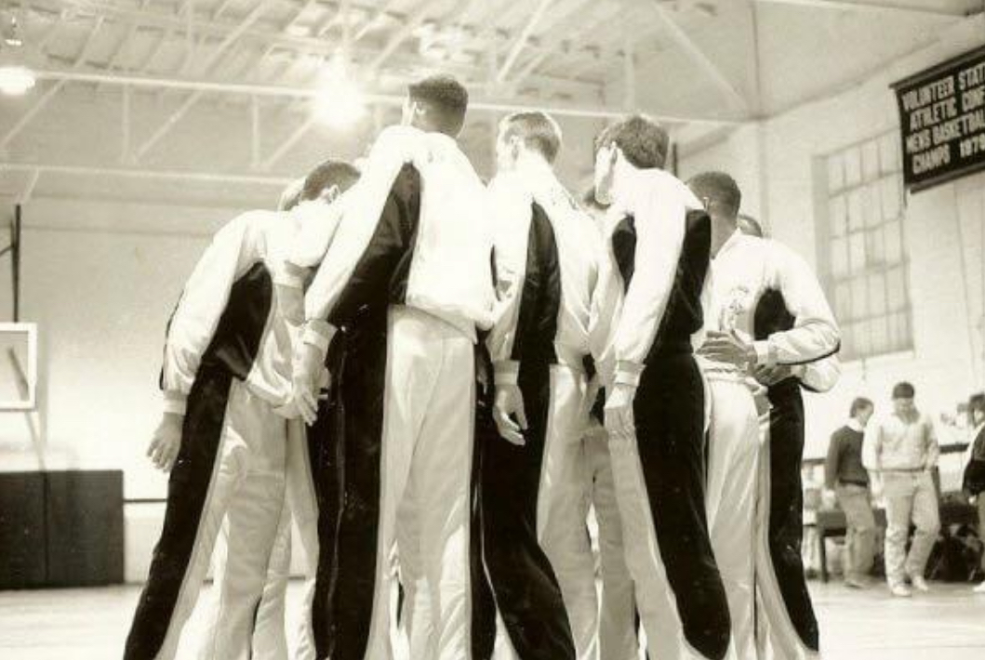

A SIMPLE BUSINESS PLAN
FOUR PHASES OF SUCCESS!!
4 Things To Do
Learn it • Do it • Teach it • Teach Others How to Teach Others

Slide 2
PHASE I – LEARN (New Recruits)
Objective: Understand the Fundamentals & Build a Foundation
1) TALK 2) HIRE 3) HELP 4) BUILD MARKETS
Set Appts
Give Winning Presentation
Company
Concept
Compensation
Commitment
Crusade
Make Money
Personal
New Recruits
Clients
Prospecting

Slide 3
PHASE I – LEARN (New Recruits)
Objective: Understand the Fundamentals & Build a Foundation
1) TALK 2) HIRE 3) HELP 4) BUILD MARKETS
For New Recruits:
• Are you learning how to Talk, Hire, Help, and Build Markets the right way?
• Have you attended your orientation and FTOs this week to get in the game?
• Who are you shadowing in the field to master the playbook and learn by example
For Field Trainers:
• How well are you demonstrating core skills to your new teammates on the court (in the field)?
• Are you consistently reinforcing the duplication mindset so they can run the same plays without you?
• What’s your personal story, and how are you using it to build your new recruit’s confidence and belief?

Slide 4
PHASE II – DO (District Leaders)
Objective: Execute What You’ve Learned — Game Time
For New Recruits:
• Are you stepping up and taking your own shots — setting appointments, giving presentations, and closing business?
• Are you tracking your goals — how many calls, appointments, and new recruits each week?
• When pressure hits, do you follow the playbook or try to freelance?
For Field Trainers:
• Are you giving your team the confidence to execute without you always calling the plays?
• How are you leading by example — showing them what work looks like?
• Are you celebrating wins to build momentum and belief?

Slide 5
PHASE III – TEACH (Division / Reg Leaders)
Objective: Multiply Yourself — Train the Team
For Upcoming Leaders:
• Are you taking time to teach others what you’ve mastered, or just focused on your own goals?
• Do your recruits know how to Talk, Hire, Help, and Build Markets because of you?
• Can your team win without you in the room — or are you still the only producer?
For Future RVPs:
• Are you building systems that duplicate, or just personalities that depend on you?
• How are you coaching belief and leadership instead of micromanaging performance?
• Who are you intentionally developing to be your next leader in your leg?

Slide 6
PHASE IV – DEVELOP (Building Leadership)
Objective: Build Leaders Who Build Leaders — Create a Dynasty
For Developing Leaders:
• Are you teaching others how to teach, not just how to sell?
• Are you running the system — or running from it?
• Are you producing independent leaders who can run their own offense?
For Visionary Coaches (RVPs & Builders):
• Who on your team is ready for the next level, and how are you preparing them?
• Are you focused on titles or transformation — building real people, not just promotions?
• What kind of legacy are you leaving — a highlight reel or a championship program?

Slide 7
THE CHAMPIONSHIP FORMULA
It’s not about doing everything —
it’s about mastering the few things that matter.

Slide 8
THE CHAMPIONSHIP FORMULA
It’s not about doing everything —
it’s about mastering the few things that matter.
Talk. Hire. Help. Build Markets

Slide 9
THE CHAMPIONSHIP FORMULA
It’s not about doing everything —
it’s about mastering the few things that matter.
Talk. Hire. Help. Build Markets
When you can run that play flawlessly — and teach it to others —
the scoreboard takes care of itself.

Slide 10
MASTER THIS
&
THE BALL-GAME IS
OVER

