Slide 1

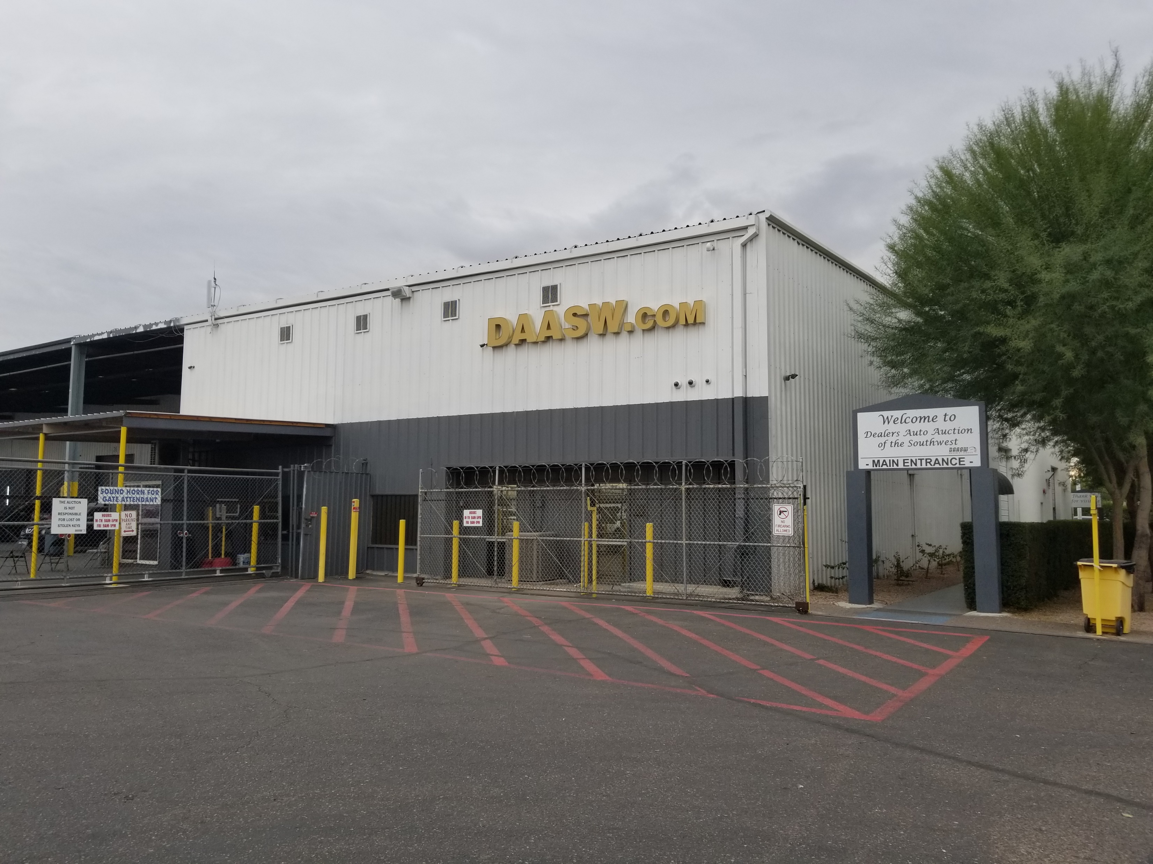
19th Ave & Pima Rezone
January 6, 2022
Neighborhood Meeting

Slide 2
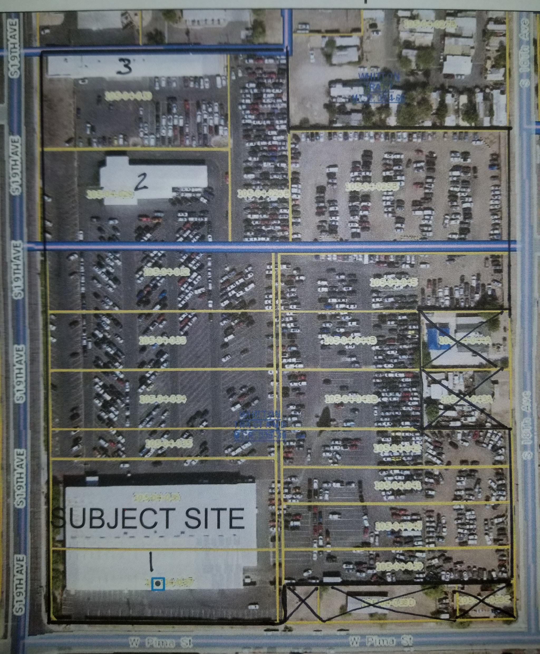
Rezoning Certain Parcels to A2
Request to rezone certain parcels within an existing business development, there are multiple small parcels that are either R-4 or C-3 within the operating A-2 business.
The business itself has been operating at this location for 19 years so this is NOT a new business. The entire area of the business is being combined into ONE parcel to clean up property issues.
There is no proposed redevelopment at this time, the replat of the lot with all parcels combined within the lot is to be one zoning classification.

Slide 3

Benefits of Approved Zoning
The property will be ONE zoning classification.
The existing buildings will be on ONE zoning rather than Mixed.
This will eliminate issues with not using the smaller parcels with less zoning such as parking when parking only is not allowed ie R-4.
The REPLAT of all the parcels into ONE large parcel and the consistent zoning throughout would allow improvements in the future. It will resolve building code issues with the existing buildings crossing property lines.
The approval of the rezoning would not have any adverse affect on the neighborhood
  The business has been there, operating for approximately 19 yrs this rezone would not increase what’s already in use for the business.

Slide 4
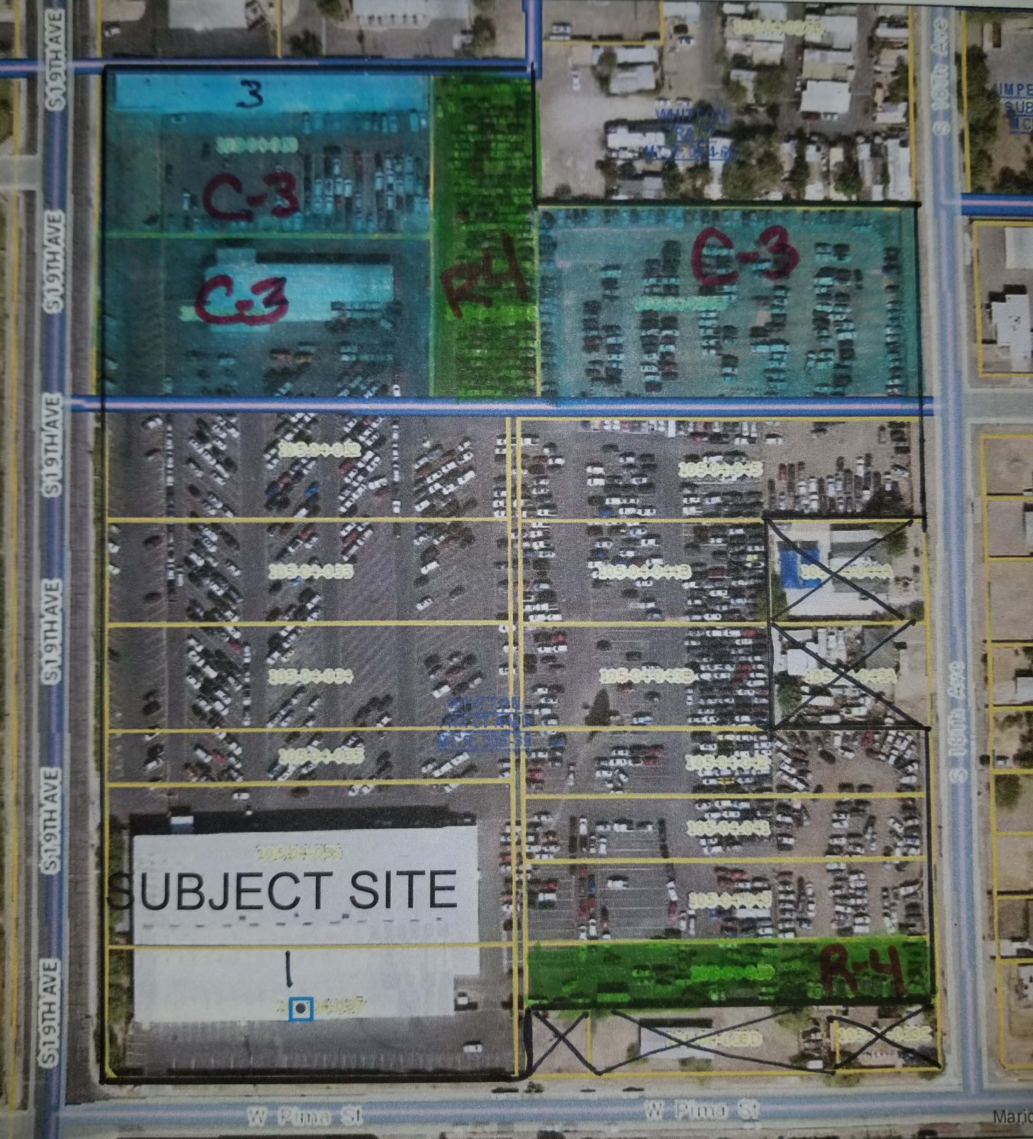
The Green Highlighted parcels are the C-3 to be changed to A-2
Combined is 4.14 acres
The Blue Highlighted parcels are R-4 to be changed to A-2
Combined is 1.29 acre
A rezone of 5.43 acres total in an existing 14.8 acre site.

Slide 5


Question/Answers

