Slide 1
Welcome!
814 W. Jefferson Rezoning to C-3 Z-50-20
Rezoning of 814 W. Jefferson St Informational neighborhood meeting via Google Meets 6pm

Slide 2
Request to Rezone from C-3 SP MOD to C-3 MOD
Property was rezoned previously for the special use pertaining to a bus repair or maintenance yard/shop
It has remained vacant for years
There are no proposed development plans for the site, owners wish to lease out the buildings for potential allowable uses for the two buildings under the C-3 MOD zoning.

Slide 3
Pro’s vs Cons
Approval of this zoning lifts the Special Permit and opens up the opportunities for other uses in the zoning classification.
Allows for business growth for the community, to serve the community.
Is in alignment with the General Plan for the area.
There really are none. The bus system is changing, the light rail has picked up a lot of that commute service and serving the downtown area.
Limits growth currently, doesn’t lend to small business or any other purpose.

Slide 4
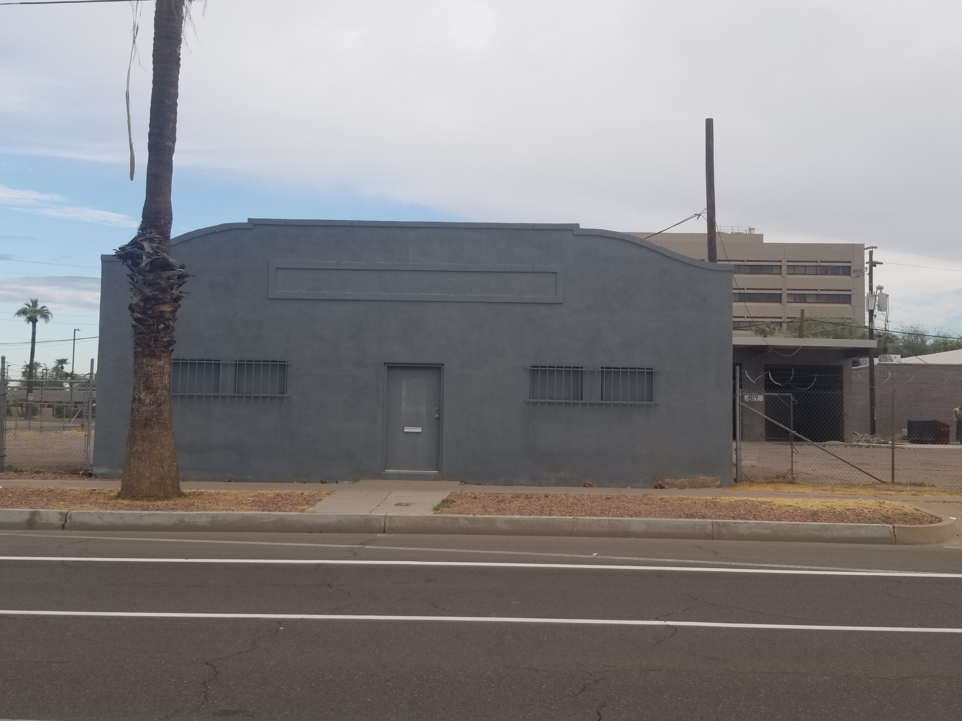
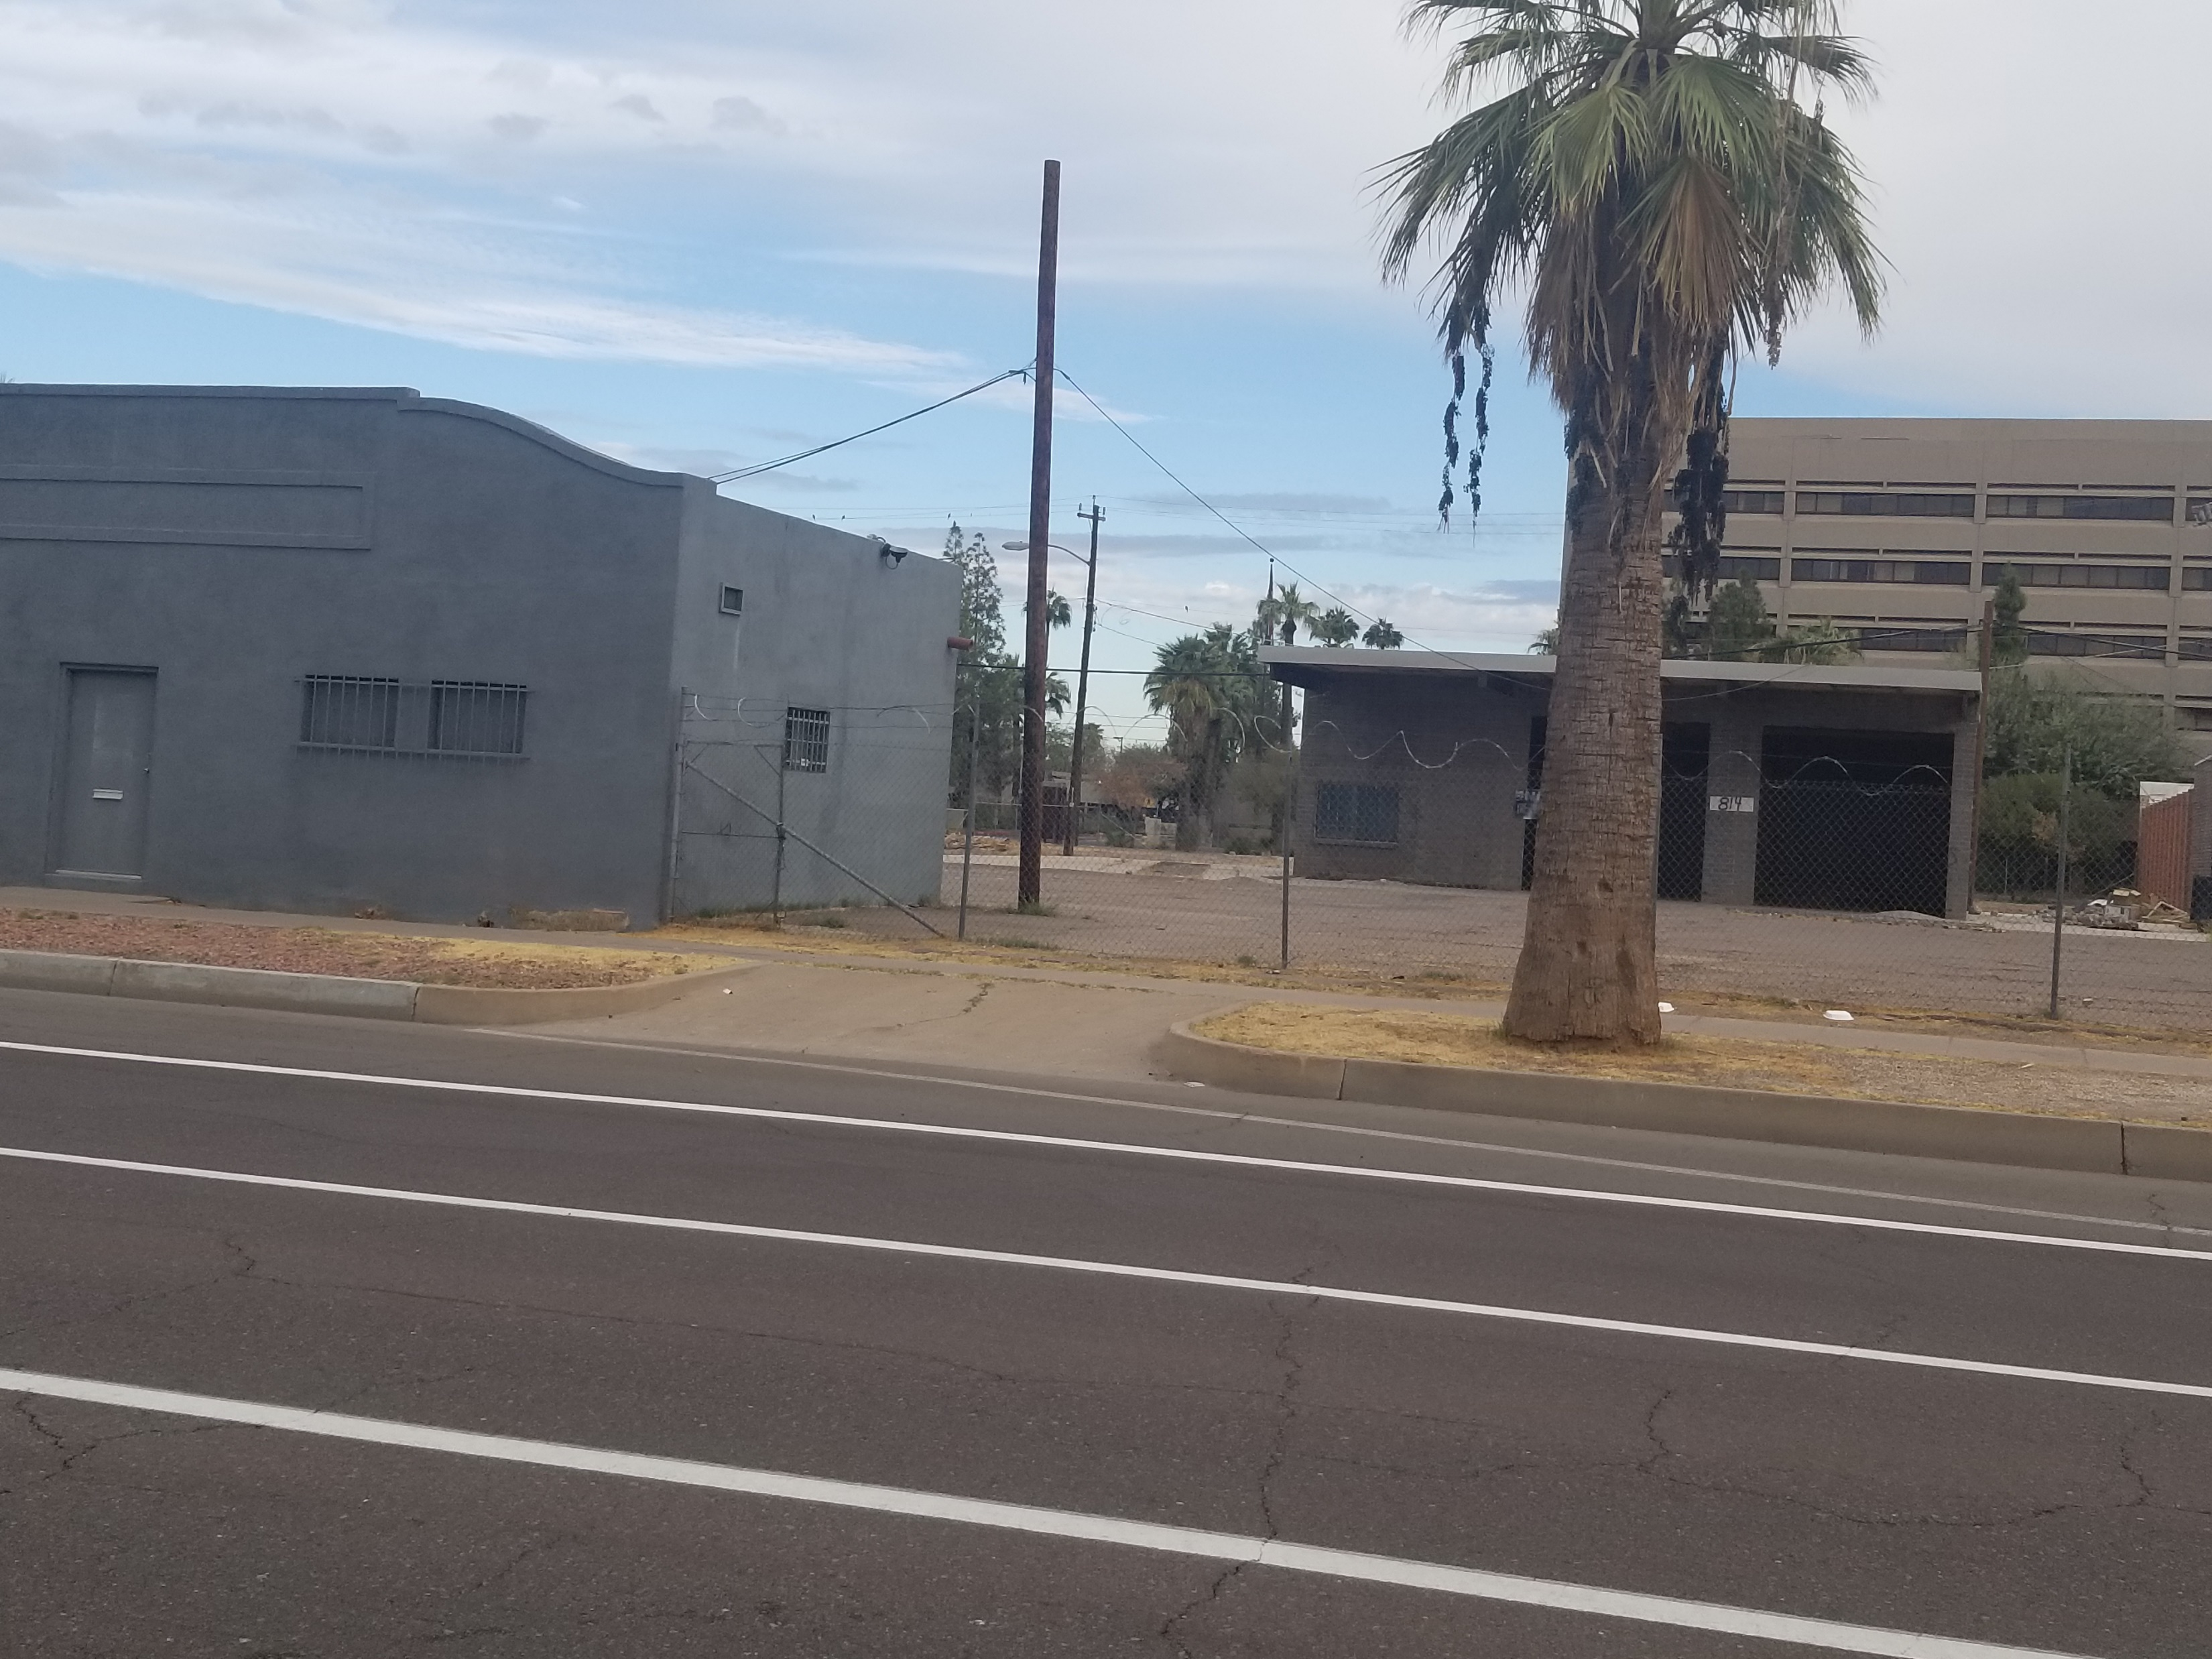
Existing Buildings

Slide 5
Zoning Map

Slide 6
Why approval makes sense….
This property has sat vacant since the bus business left.
Other small businesses have tried to get permits to open but could not with this Special Permit still attached to this property.
The neighborhood would benefit from having an occupied property eliminating blight, illegal dumping, illegal activity.
Providing a service or downtown office space or something that supports the the growing downtown residential communities.
The owner is in a “hold” position from doing any other kind of business with the SP still in place.
Promotes new business, new oppoturnities.

Slide 7
Thank you for your support.
Leodra Bowdell
480-205-4828
Leodra@phoenixpermitservices.com
www.phoenixpermits.net
Any feedback, questions, concerns….please contact me.

