Slide 1


Little League
Rules Meeting for the
2023 International Tournament
Presented by
Notes:
Next Slide is . . .

Slide 2
Agenda
Meet the Instructors
Safety and Equipment
Rule Differences between Regular Season and Tournament Play
New Tournament Rules for 2023
Points of Emphasis
Notes:
Next Slide is . . .

Slide 3
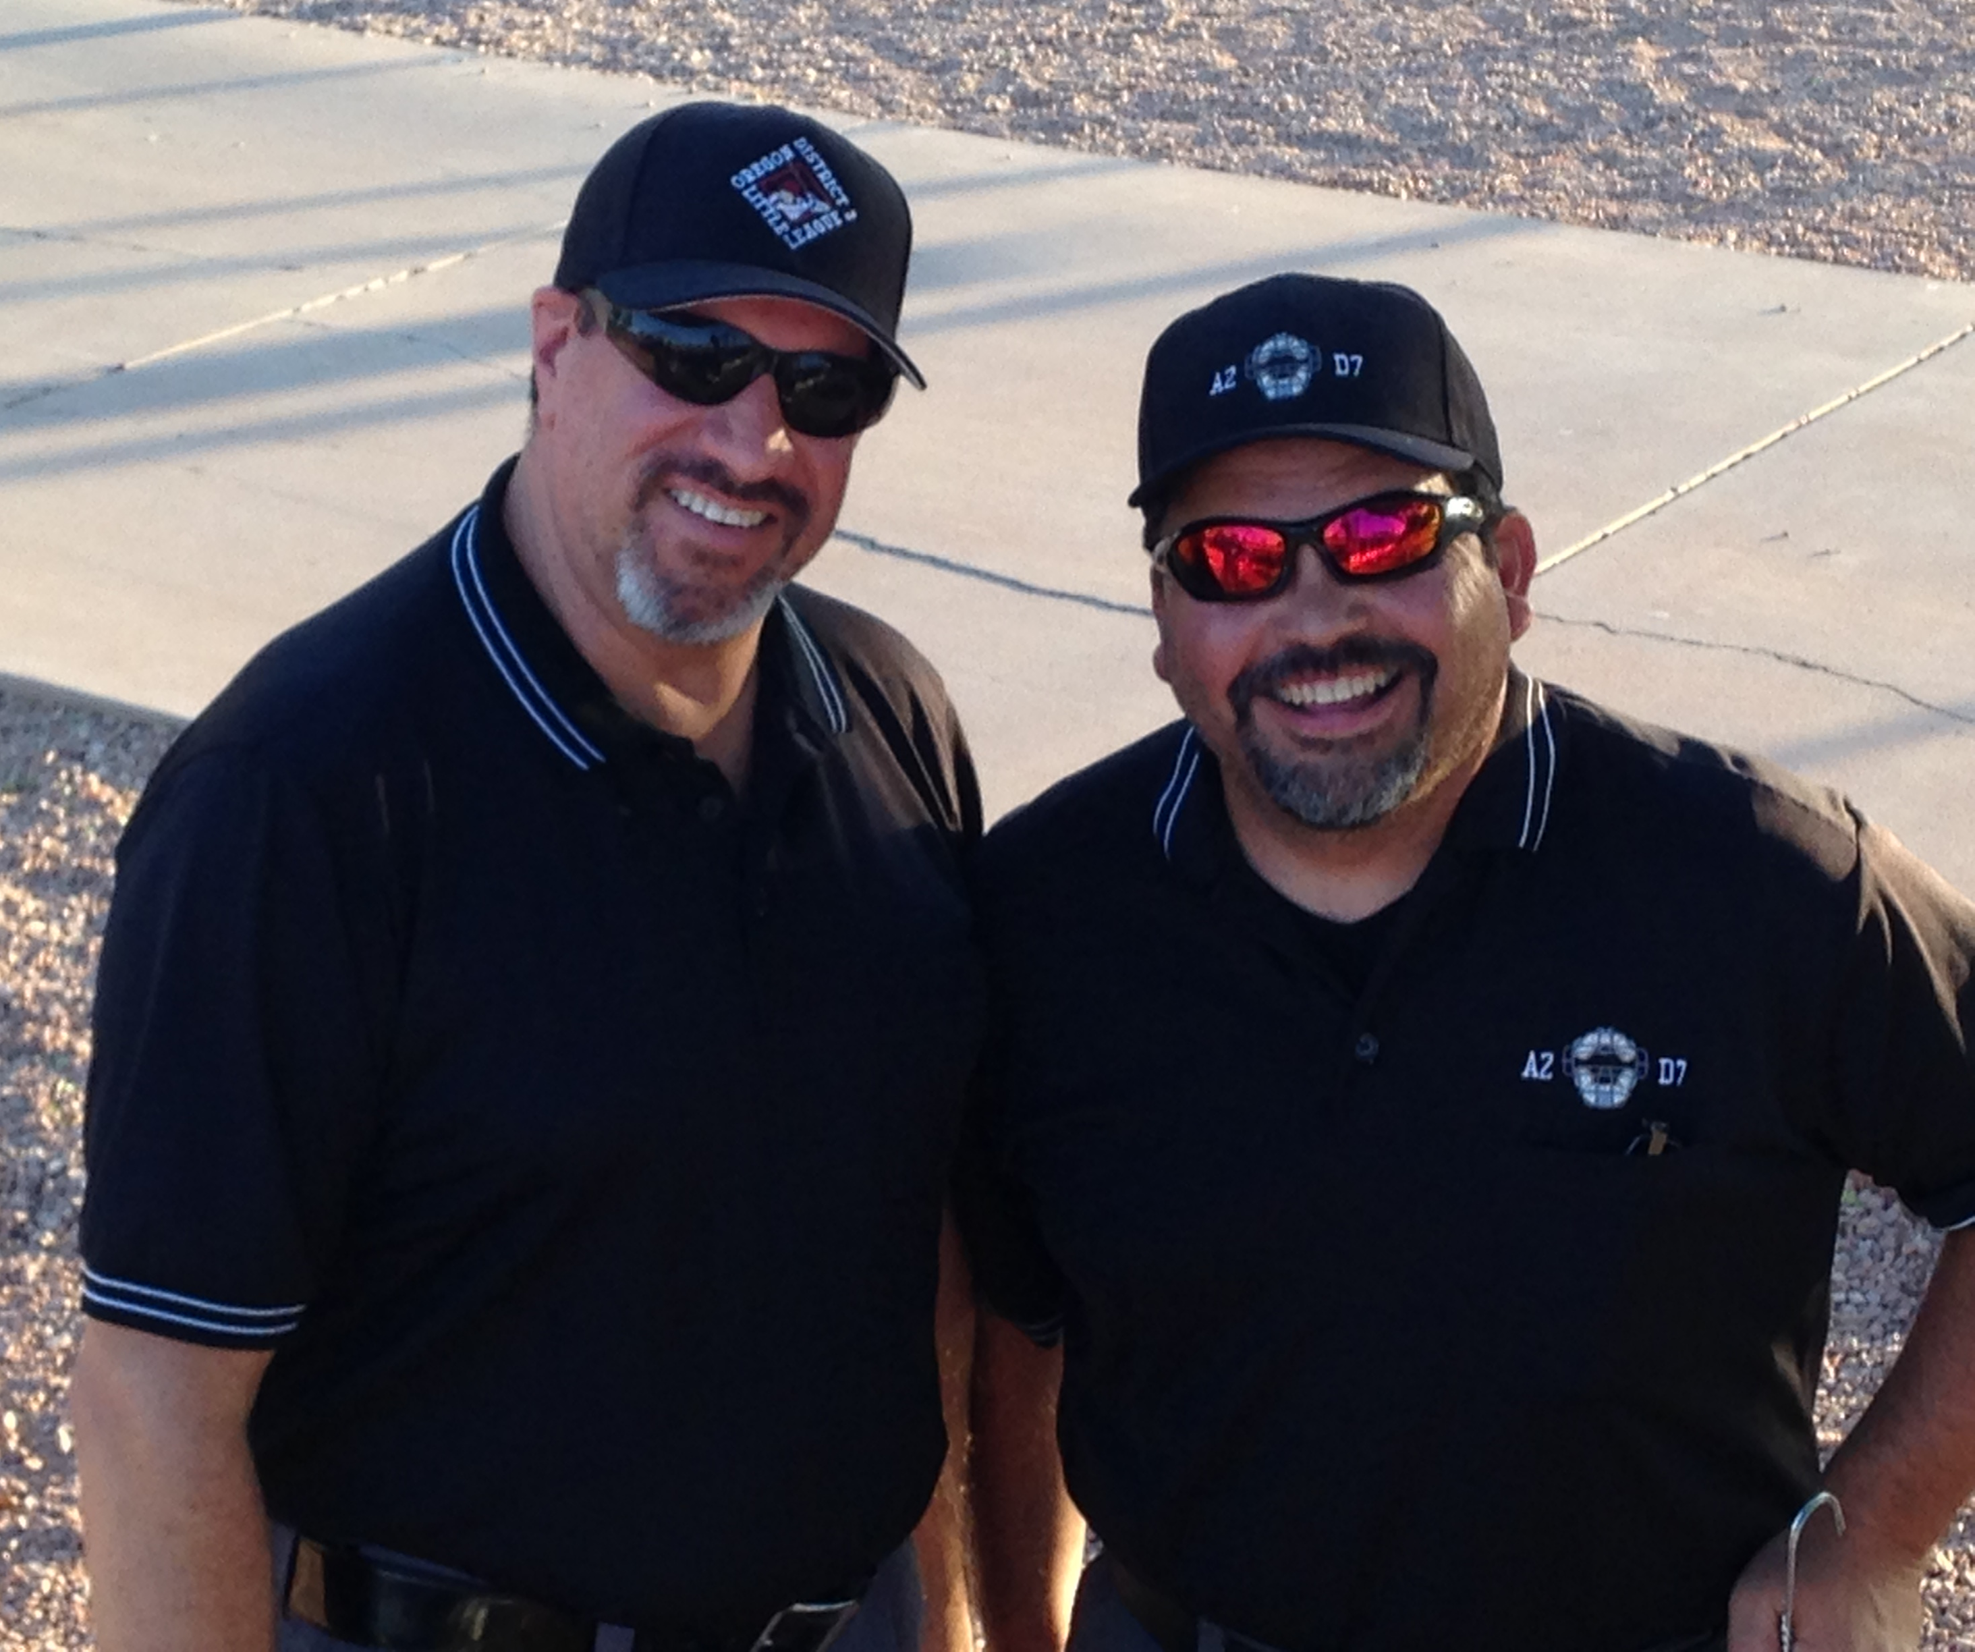
Instructors
Douglas Singer
West Region Umpire
(602) 930-6863
azllump19@gmail.com
Notes:
Next Slide is . . .

Slide 4
Safety &
Equipment
Notes:
Next Slide is . . .

Slide 5
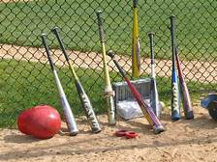
Equipment Checks
Teams should be prepared for an equipment check before every game
  Helmets
  Bats
  Catcher’s gear
Please line up all equipment along dugout fence
as soon as possible so the games can start on-time
Notes:
Next Slide is . . .

Slide 6
Rule 1.10
Baseball non-wood bats
The complete logo must be visible.
8-10 9-11 10-12 | Intermediate Juniors | Seniors
USABat | USABat or BBCOR | BBCOR
Notes:
Next Slide is . . .

Slide 7
Rule 1.10
Softball non-wood bats
The logo must be visible.
 | All Levels of play
 | BPF 1.20
Notes:
Next Slide is . . .

Slide 8
Rule 6.06(d)
Batter enters batter’s box with an illegal bat
Batter is out
Manager and player are ejected
Offense loses one adult base coach for the remainder of the game
If illegal bat is identified after batter uses it
In addition to the above penalties,
  All runners return to previous base
  unless defense elects the results of the play
Notes:
Next Slide is . . .

Slide 9
Rule 1.11
Any part of the pitchers exposed undershirt must be of a solid color
Not white or gray
Neoprene sleeves must be covered by an undershirt
Teammates may wear shirts with different length sleeves, but each player’s sleeves must be of the same length
Notes:
Next Slide is . . .

Slide 10
Rule 1.11
Defensive players may wear play calling bands
Must be on wrist or forearm
Pitchers may only wear on glove hand
  Not white, gray or optic yellow
Notes:
Next Slide is . . .

Slide 11

Rule 1.16
Use of a helmet is required for all batters, base runners and non-adult base coaches
Helmets may not
be repainted
contain tape or re-applied decals
have a mirror-like finish
Notes:
Next Slide is . . .

Slide 12
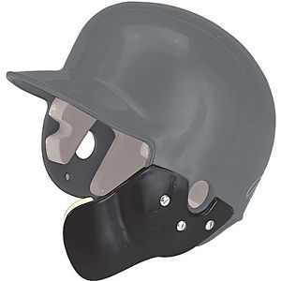
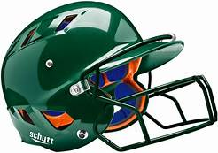
Rule 1.16
Altering helmets in any way can void manufacturer’s warranty
Anything attached at time of purchase is approved
Stickers are not approved without letter from manufacturer
Notes:
Next Slide is . . .

Slide 13
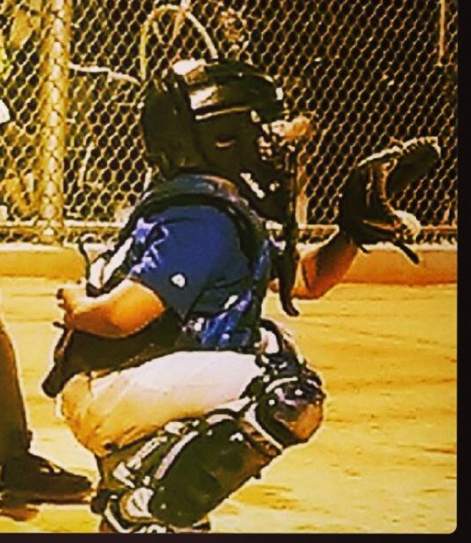
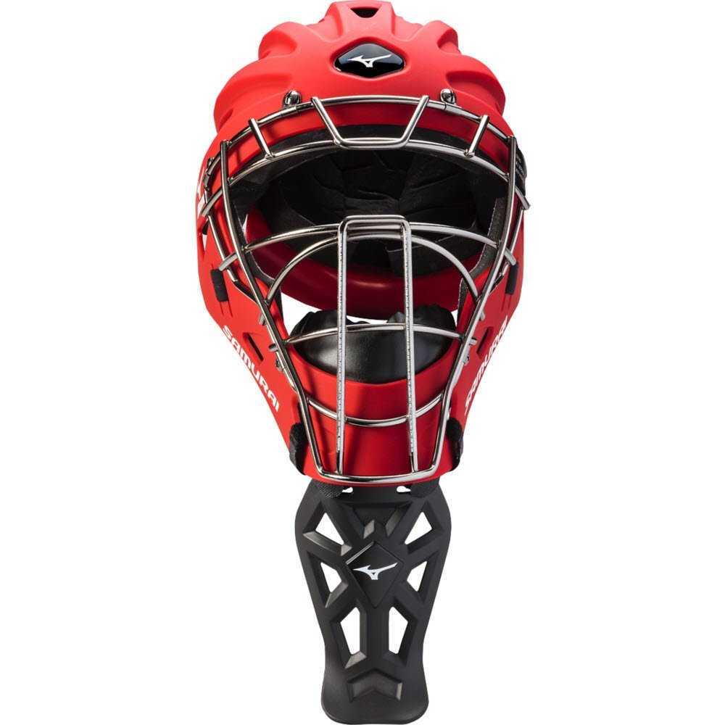
Rule 1.17
Dangling throat guards are required at all levels of play whenever a catcher’s mask is required
There are NO exceptions
This includes
Hockey mask style helmets
Masks with wire extensions
Notes:
Next Slide is . . .

Slide 14
Rule 1.17
Catcher’s masks are required:
Any form of infield/outfield practice
Pitcher warm up
Games
Notes:
Next Slide is . . .

Slide 15
On-Deck Batter
8-10 / 9-11 / Little League
The on-deck batter is not allowed, at any time, regardless of field design or presence of a safe area.
Intermediate / Juniors / Seniors
The on-deck batter is permitted
Notes:
Next Slide is . . .

Slide 16
Rule Differences Between
Regular Season and Tournament
Notes:
Next Slide is . . .

Slide 17
Rules
No local rules are to be used
All rules are per the Little League Official Playing Rules
Local “ground rules” still apply
  Field conditions
  Establishment of live ball/dead ball territory
Notes:
Next Slide is . . .

Slide 18
Warming up the Pitcher
Regular Season
Tournament
Managers or coaches may warm up the pitcher
New for 2023
Managers or coaches may NOT warm up the pitcher at any place or any time
Violations can be treated as unsportsmanlike conduct, with removal of the manager or coach from the rest of the tournament
Notes:
Next Slide is . . .

Slide 19
Batting Order
Regular Season
Tournament
Continuous batting order
League option
Continuous batting order
Required
All players present at start of game
Does not apply to Senior League
Notes:
Next Slide is . . .

Slide 20
Game Duration
Regular Season
Tournament
Shortened games
Time limits
Drop dead
  League options
Full regulation games
No time limits
8-10 / 9-11 / 11-12
  6 innings
Juniors / Seniors
  7 innings
Notes:
Next Slide is . . .

Slide 21
Runs per Inning
Regular Season
Tournament
Limits on runs scored per inning
League option
No limits to runs scored
Notes:
Next Slide is . . .

Slide 22
“Mercy” Rule
Regular Season
Tournament
15 run lead after 3 innings
10 run lead after 4 innings
8 run lead after 5 innings
League options
15 run lead after 3 innings
10 run lead after 4 innings
In effect, not optional
Notes:
Next Slide is . . .

Slide 23
Pitching Substitutions - Baseball
Regular Season
Tournament
A pitcher removed from the mound cannot return as pitcher
* Intermediate / Junior / Senior *
A pitcher removed from the mound but stays in the lineup can return to the mound once per game
Notes:
Next Slide is . . .

Slide 24
Pitching Substitutions - Softball
Regular Season
Tournament
A pitcher removed from the mound cannot return as pitcher
A pitcher removed from the mound but stays in the lineup can return to the mound once per inning
8-10 / 9-11 / 11-12
Cannot return to mound if pitcher removed for a substitute
Juniors / Seniors
Can return to mound if substitution rules are not violated
Notes:
Next Slide is . . .

Slide 25
Other
Tournament Rules
Notes:
Next Slide is . . .

Slide 26
Who’s the Home Team?
For all games, home team is determined by a coin toss.
Coin toss shall be performed by an authorized representative of the Tournament Director.
Home team shall occupy the 3rd base dugout
Notes:
Next Slide is . . .

Slide 27
Managers and Coaches
A maximum of three (3) adults, who are named on the official affidavit will be permitted to act as managers/coaches for that game.
The adults must be listed in the affidavit or must be authorized temporary replacements as noted on the affidavit.
Base coaches may be adults or players.
One adult must remain in the dugout at all times
Notes:
Next Slide is . . .

Slide 28
Number of Players
Teams must have at least 9 players to start the game
  The game is considered started at the plate meeting
Teams must have at least 9 players to continue the game
If, at any time, a team has less than 9 players, the game will be suspended and be referred to the tournament committee.
Notes:
Next Slide is . . .

Slide 29
Mandatory Play
Regular Season
Tournament
Each player shall have a minimum of 1 at-bat and play 6 defensive outs
Use of Continuous Batting Order
Everyone bats
No defensive requirement
Notes:
Next Slide is . . .

Slide 30
Continuous Batting Order
Should a player be absent from the game at the time of their scheduled at-bat, the spot in the line-up will be skipped, with no penalty to the offensive team.
Example:
  Debbie is the 3rd batter in the line-up
  Debbie has not arrived when it is her turn to bat
  The 4th batter in the line-up becomes the batter
  No out is recorded, and Debbie retains her 3rd spot in the line-up
Notes:
Next slide is . . .

Slide 31
Courtesy Runner
Each team is allowed the use of a courtesy runner
For pitcher or catcher only
With two outs
Runner must be the player who made the last out
Notes:
Next Slide is . . .

Slide 32
Pitching Limitations
Under no circumstances shall a player pitch in three (3) consecutive days
Notes:
Next Slide is . . .

Slide 33
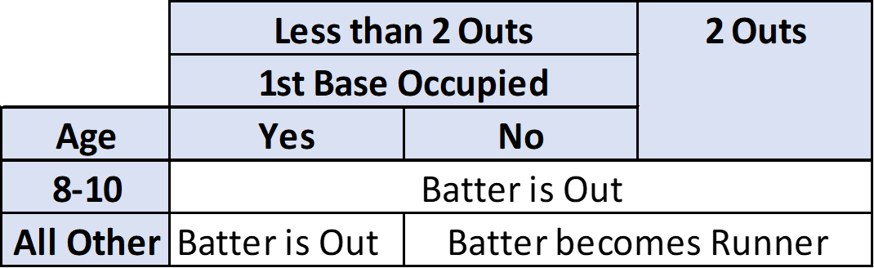
3rd Strike Not Caught
Notes:
Next Slide is . . .

Slide 34
One Foot in the Batter’s Box
If the batter leaves the batter’s box or delays play and none of the exceptions apply, the umpire shall warn the batter.
  This is umpire judgment
After one warning on the batter, the umpire shall call a strike.
Any number of strikes can be called until the batter re-enters the batter’s box, or until the third strike is called.
Notes:
Next Slide is . . .

Slide 35
Intentional Base on Balls
If the defensive team wishes to give the batter an intentional base on balls:
Manager must request time and inform plate umpire
No pitches need to be thrown, but any remaining pitches will be added to pitch count
Batter will be awarded first base
  The ball is dead - - no other runners may advance (unless forced)
Notes:
Next Slide is . . .

Slide 36
Intentional Base on Balls
An “unpitched” intentional base on balls is allowed to each player only once per game
All other intentional walks requires pitches to be thrown
Intermediate/Juniors/Seniors
Conventional pitches must be thrown
Notes:
Next Slide is . . .

Slide 37
Pitching Limits - Baseball
Maximum number of pitches in a day
Note that the limitation is based on league age and not level of play
Age | 7-8 | 9-10 | 11-12 | 13-16
Maximum Pitches per Day | 50 | 75 | 85 | 95
Age | 7-8 | 9-10 | 11-12 | 13-16
Maximum Pitches per Day | 50 | 75 | 85 | 95
Notes:
Next Slide is . . .

Slide 38
Days Rest - Baseball
Mandatory days rest based on pitch count, and level of play
Age | 1-20 | 21-35 | 36-50 | 51-65 | 66+
Juniors and Below | 0 | 1 | 2 | 3 | 4
Age | 1-30 | 31-45 | 46-60 | 61-75 | 76+
Seniors | 0 | 1 | 2 | 3 | 4
Notes:
Next Slide is . . .

Slide 39
Days Rest - Baseball
If the pitcher reaches a days of rest threshold while facing a batter, the pitcher will only be required to observe the calendar days of rest for the threshold he/she achieved prior to the at bat.
Example:
A pitcher has thrown 33 pitches. The next better comes in and fouls off 10 pitches before he gets a base hit. The manager removes the pitcher. The pitcher is required to rest 1 day.
Age | 1-20 | 21-35 | 36-50 | 51-65 | 66+
Up to 14 | 0 | 1 | 2 | 3 | 4
Notes:
Next Slide is . . .

Slide 40
Pitching Limits - Softball
8-10 / 9-11/ 11-12
12 innings per day maximum
  A single pitch shall constitute an inning
Juniors / Seniors
No limitations
Notes:
Next Slide is . . .

Slide 41
Days Rest - Softball
8-10 / 9-11/ 11-12
7 innings pitched in a calendar day requires 1 calendar day of rest
  A single pitch shall constitute an inning
Juniors / Seniors
No limitations
Notes:
Next Slide is . . .

Slide 42
Switching Pitchers and Catchers - Baseball
Any player that has caught 4 or more innings is not eligible to pitch that calendar day
Any player that has caught 3 or more innings and thrown 21 or more pitches cannot return to catcher that calendar day
Any player that has thrown 41 or more pitches cannot catch that calendar day
NOTE: A single pitch shall constitute an inning
Notes:
Next Slide is . . .

Slide 43
Extra Innings
If at the end of regulation, the score is tied, teams will play one extra inning under normal scoring provisions
If after that extra inning, the score is still tied, the following will be applied to that, and each subsequent, inning:
The next scheduled batter shall bat and is considered the first batter for that inning.
The last scheduled batter for that inning shall be placed at 2nd base.
Rules regarding substitutions for the runner at 2nd base still apply.
Notes:
Next Slide is . . .

Slide 44
Points of Emphasis
Notes:
Next Slide is . . .

Slide 45
The following organizations will be at the game to scout your child:
Notes:
Next Slide is . . .

Slide 46
Base Coach’s Box
Coach’s Box is 8 feet x 4 feet
60-Foot Field
  Coach’s Box is 6 feet from foul line
90-Foot Field
  Coach’s Box is 10 feet from foul line
Base Coaches are required to stay in their box, unless necessary to avoid being in the play
Notes:
Next Slide is . . .

Slide 47
Line-Up Card
A properly completed line-up card is required to be presented to the home plate umpire at the plate meeting
Player name
Player number
Player position
Notes:
Next Slide is . . .

Slide 48
Must Slide Rule
There is no “must-slide” rule . . . It does not exist
Runner must:
  Slide
  Avoid
  Retreat
  Surrender
Notes:
Next Slide is . . .

Slide 49
The Strike Zone
The space over home plate which is between the batter’s armpits and the top of the knees when the batter assumes a natural stance.
The umpire shall determine the strike zone according to the batter’s usual stance when that batter takes a swing.
Notes:
Next Slide is . . .

Slide 50
The Strike Zone
The space over home plate which is between the batter’s armpits and the top of the knees when the batter assumes a natural stance.
The umpire shall determine the strike zone according to the batter’s usual stance when that batter takes a swing.
Notes:
Next Slide is . . .

Slide 51
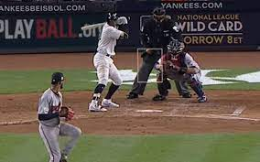
The Strike Zone
This is NOT the strike zone
Notes:
Next Slide is . . .

Slide 52
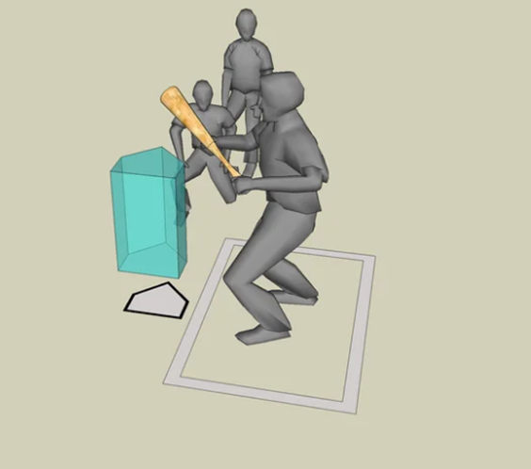
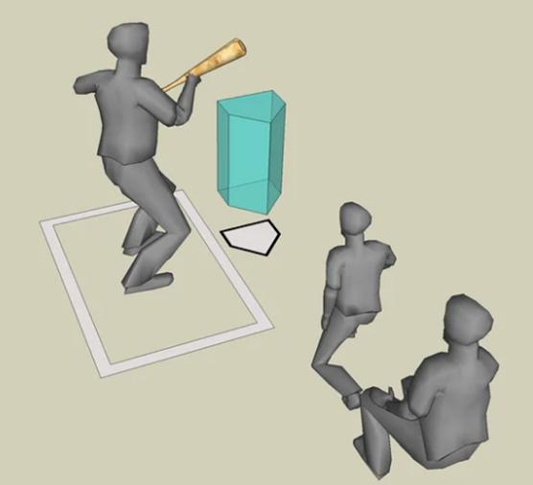
The Strike Zone
THIS is the strike zone
Notes:
Next Slide is . . .

Slide 53
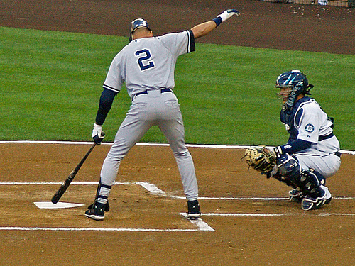
The Strike Zone
Over home plate
Notes:
Next Slide is . . .

Slide 54
Runner Leaving Early - Baseball
8-10 / 9-11 / Little League only
Runners may not leave their occupied bases until the pitch reaches the batter
Penalties and runner placement will be assessed in accordance with Rule 7.13
Whether a runner leaves early is umpire judgment
Notes:
Next Slide is . . .

Slide 55
Calling Time
No player or manager can call “time-out”
  Players and managers request a time-out
  Only the Umpires can call a time-out
Umpires are under no obligation to grant a time-out request
Umpires will not grant requests for time-out to kill the play, or to protect runners
Notes:
Next Slide is . . .

Slide 56
Unsportsmanlike Behavior
Stealing Signs
The stealing or relaying of signs to alert the batter of pitch selection and/or location is unsportsmanlike behavior.
If, in the judgment of the umpire(s), this behavior is occurring, both the player and the manager may be ejected from the game.
It is the discretion of the umpire to decide if the action is blatant and consistent to the point where ejection is warranted.
This is NOT a protestable decision.
Notes:
Next Slide is . . .

Slide 57
Unsportsmanlike Behavior
Bat Flips
Flipping the bat, or other demonstrations, are considered unsportsmanlike behavior and can result in ejection.
Don’t do it!
This is NOT a protestable decision.
Notes:
Next Slide is . . .

Slide 58
Unsportsmanlike Behavior
Communication Devices
Communication devices are not allowed to be used by any players, managers or coaches once the game has started
If a communication device is observed by an umpire or any Tournament official, the individual using such a device shall be removed from the game.
Notes:
Next Slide is . . .

Slide 59
Unsportsmanlike Behavior
Communication Devices
Electronic devices used for keeping score are permissible, however, the umpire has the right to verify that the device is being used strictly for its intended purpose.
Individuals who are required to carry communication devices (such as first-responders) are provisionally exempted, but must let the plate umpire know prior to the beginning of the game.
Notes:
Next Slide is . . .

Slide 60
Unsportsmanlike Behavior
Chanting and Noisemakers
Chanting and cheering from the dugout is permissible, as long as it is not meant to disrupt the pitcher - - this is umpire judgment
Artificial noisemakers are not permitted
No walk-up music or broadcasted player announcements are permitted
Notes:
Next Slide is . . .

Slide 61

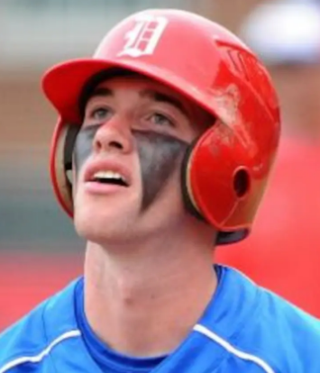
Unsportsmanlike Behavior
Eye Black
Allowed
Not Allowed
Notes:
Next Slide is . . .

Slide 62
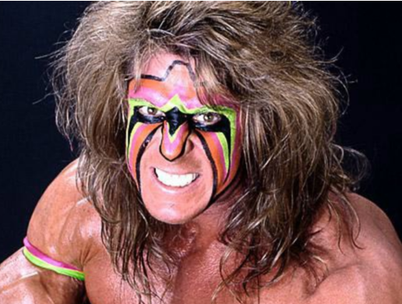
Unsportsmanlike Behavior
Notes:
Next Slide is . . .

Slide 63
Defensive Visits
The manager may request time and visit with any member of the defense.
A visit with ANY member of the defense is a charged visit to the pitcher
On the 2nd charged visit in any inning, the pitcher MUST be removed.
On the 3rd charged visit during the game, the pitcher MUST be removed.
  Visits start over upon change of pitcher.
  8/9/10 – 3rd charged visit in an inning or 4th in a game
Notes:
Next Slide is . . .

Slide 64
Defensive Visits
Injury visits do not count as charged visits, however . . .
If an umpire hears any discussion other than the status of the injury and the health of the player, the visit will count as a charged visit.
  Yes . . . the umpires will accompany the manager during the injury visit
Side note: should a player come out of the game due to injury or illness, that player cannot return without written clearance from trained medical personnel
Notes:
Next Slide is . . .

Slide 65
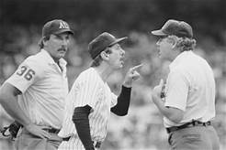
Appeals
Appeals must be made during a live-ball situation
Appeals must be made before the next pitch or play
Appeals will NOT be considered for umpire judgment
Notes:
Next Slide is . . .

Slide 66
Asking for Help
By rule, umpire judgment can not be appealed or protested
However, umpires want all calls to be correct . . .
Notes:
Next Slide is . . .

Slide 67
Asking for Help
Should you wish to discuss a call with an umpire
Request time - - - from any umpire
When granted time, approach the umpire who made the call
Discuss the issue
Return to dugout and await the decision
Notes:
Next Slide is . . .

Slide 68
Asking for Help
Asking for help just because you don’t like the call will be summarily dismissed
  “Hey blue, I think he was safe. Can you get some help?”
Asking for help because of something factual may be considered
  “I think the 1st baseman pulled his foot”
Remember, the umpires have no responsibility or obligation to check with their partner(s) or to “hear you out”
Notes:
Next Slide is . . .

Slide 69
Protests
Protests for improper rule application must be made before next pitch or play
  If a protest is filed, play will cease until a ruling is made
Protests for the use of an ineligible player must be made prior to the next game
  The use of an ineligible player shall result in the team being disqualified and removed from the International Tournament
Protests will NOT be considered for rulings involving umpire judgment
Notes:
Next Slide is . . .

Slide 70
Between Innings
Pitcher has up to one (1) minute or up to eight (8) warm-up pitches
  The clock starts upon the 3rd out
Leadoff batter only is permitted in front of their dugout
Managers/coaches are not allowed in fair ball territory
Base coaches must stay in their dugouts until catcher throws to 2nd base
Notes:
Next Slide is . . .

Slide 71
7.08(f) Runner hit by batted ball
A base runner hit by a batted ball is NOT automatically out
This is umpire judgment, based on the position of the runner and any fielders in the vicinity
Notes:
Next Slide is . . .

Slide 72
Questions???

