Slide 1

District 13
All Star
Scorekeeping
Training

Slide 2
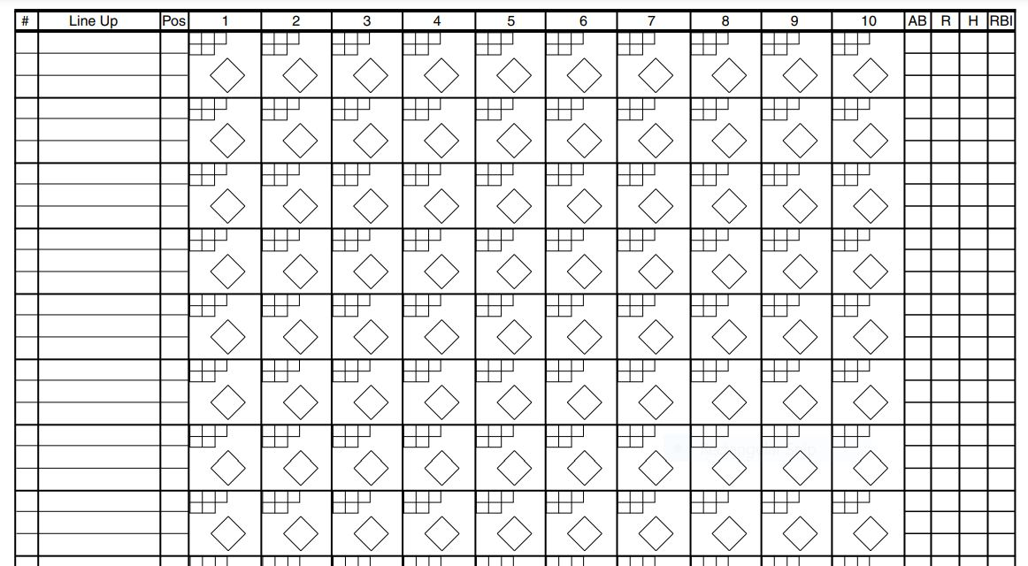
Scorekeeping – score sheet

Slide 3
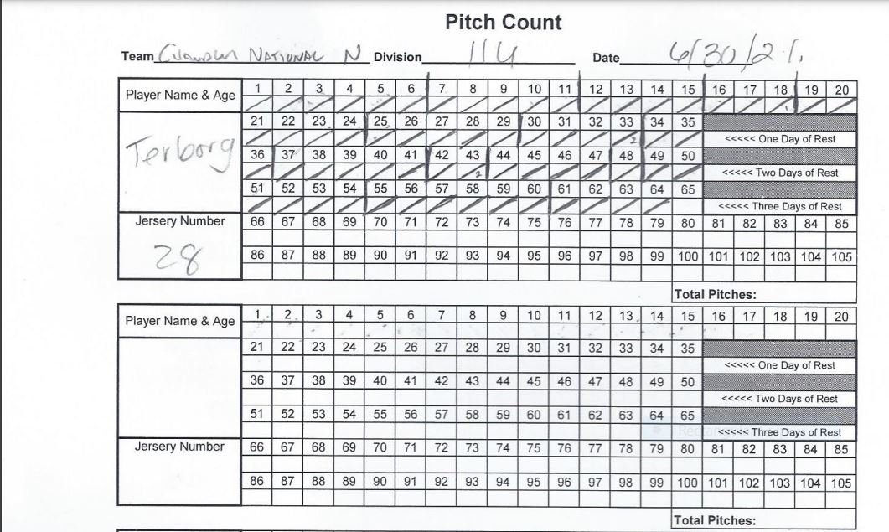
Scorekeeping – pitch count

Slide 4
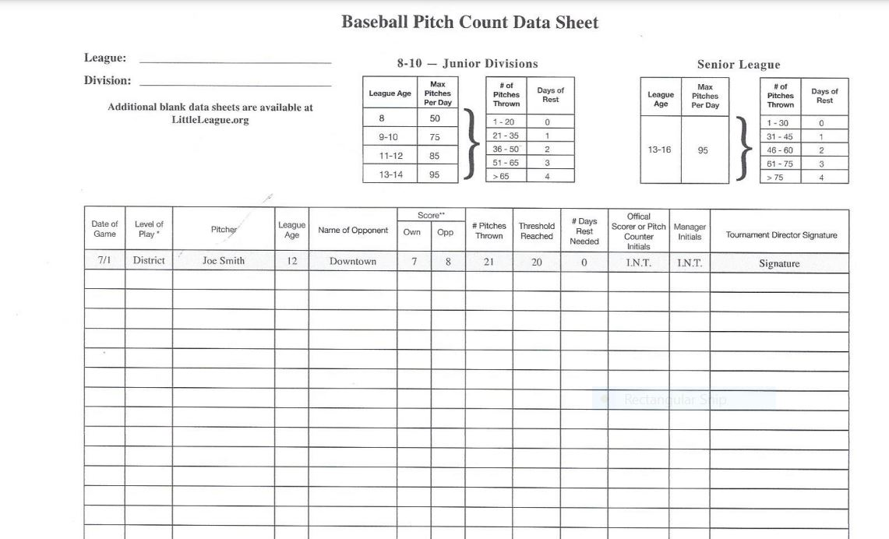
Scorekeeping – pitch count sheet

Slide 5
Questions?
Need help?
http://az13llb.com or
  Jeni Hurst – jenihurst@cox.net
  Susan Blank – susan.blankross@gmail.com

