Slide 1

District 13
All Star
Affidavit &Team Book
Training

Slide 2
Agenda
Team Book
Affidavit
Questions

Slide 3
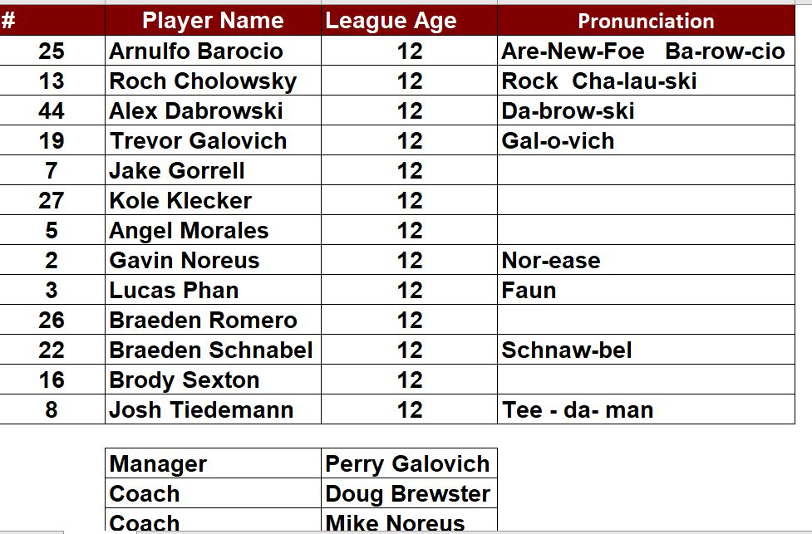
Team Book
Roster
  Player’s Name
  League Age
  Jersey number
  Pronunciation if necessary
  Managers and Coaches names

Slide 4
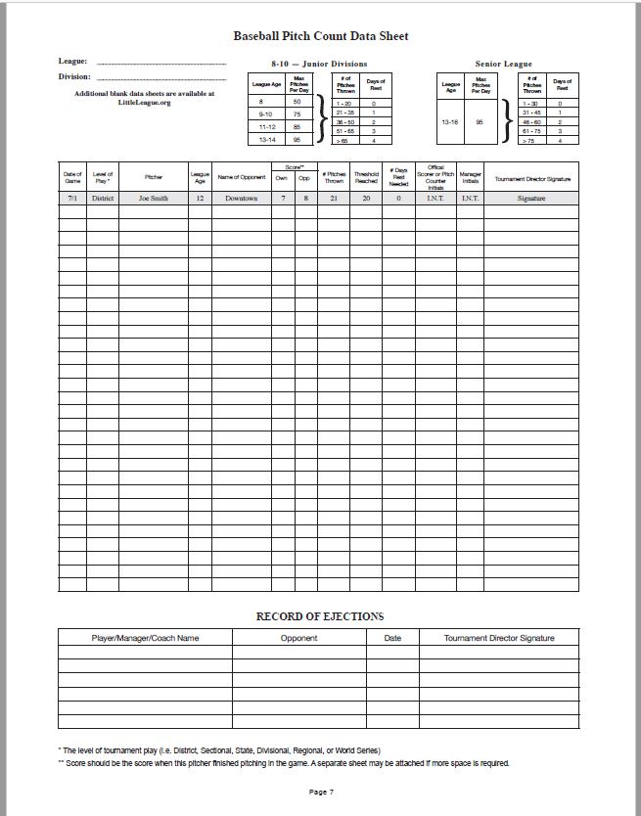
Team Book
Pitch Count Data Sheet

Slide 5
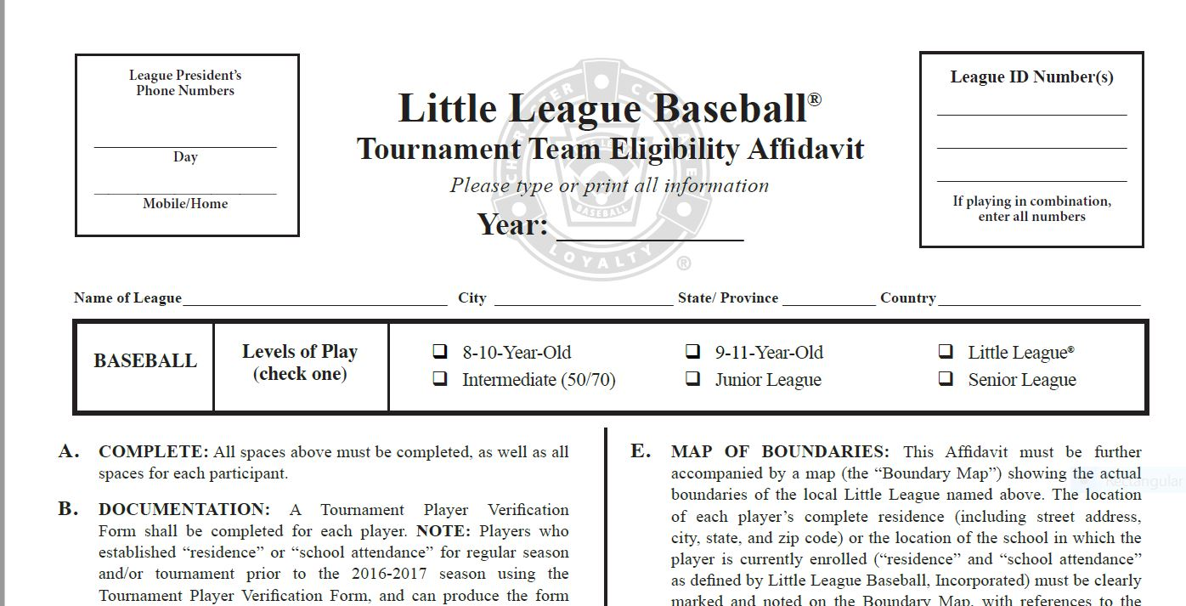
Team Book
Affidavit

Slide 6
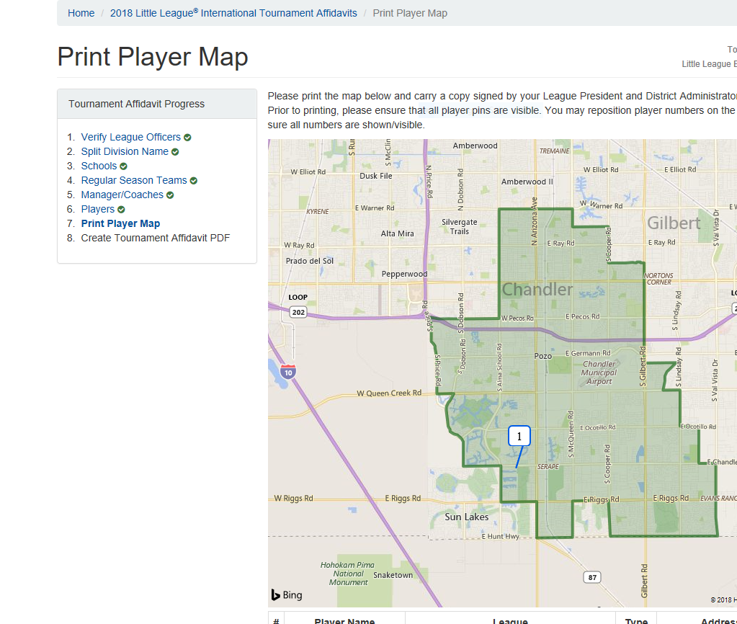
Team Book
Boundary Map with players plotted
  Automatically done in the online affidavit
  Must print separately from affidavit

Slide 7
Team Book
Player packet
  Suggest using a plastic sleeve with a label for each player
  Paperwork order as follows
    Player verification form – filled completely out and needs to be signed by parent, league president and district administrator.
    Original birth certificate. Will be given back once verified. Does not need to remain in the book.
    3 Proof of residency documents or Waiver form or school enrollment form
      Grid of documents to follow
    Medical Release form
    Players who can produce a proper Tournament Verification packet from a past season, with proper proof of residency and signatures will not need to complete a new form.

Slide 8
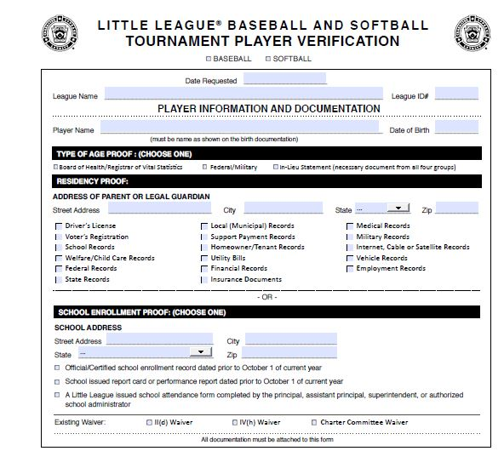
Player Packet
Verification Form

Slide 9
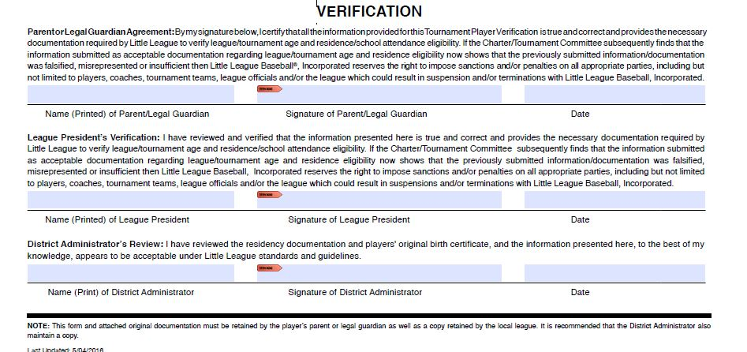
Player Packet
Verification Form

Slide 10
Proof Of Age Requirements
Each player must have an acceptable proof of age presented to the District Administrator
The proof of birth date documents must personally be inspected by the local Little League President, Player Agent, AND District Administrator (or his/her designated appointee) prior to the team’s first game and before the DA certifies the eligibility affidavit
Proofs of age are not carried with the tournament and affidavit and shall be returned once certified
  Statement in Lieu of Acceptable Proof of Birth must be carried with the affidavit

Slide 11
Team Book
Proof of residency – Dates Matter
Your proof of residency must be dated between:
2/1/21 – 2/1/22

Slide 12
Proof of residency
Group I
Group II
Group III
1. Driver’s License
2. School records
3. Vehicle records (i.e., registration, lease, etc.)
4. Employment records
5. Insurance documents
1. Welfare/child care records
2. Federal records (i.e., Federal Tax, Social Security, etc.)
3. State records
4. Local (municipal) records
5. Support payment records
6. Homeowner or tenant records
7. Military records
1. Voter’s Registration
2. Utility bills (i.e., gas, electric, water/sewer, phone, mobile phone, heating, waste disposal)
3. Financial (loan, credit, investments, etc.) records
4. Medical records
5. Internet, cable, or satellite records

Slide 13
Proof of residency
A player will be deemed to reside within the league boundaries if:
  A. His/her parents are living together and are residing within such league boundaries, OR;
  B. Either of the player’s parents (or his/her court-appointed legal guardian) reside within such boundaries.
“Residence,” “reside,” and “residing” refers to a place of bona fide continuous habitation. A place of residence once established shall not be considered changed unless the parents, parent, or guardian makes a bona fide change of residence.
Residence documents must contain the full residence which includes parent(s) or guardian(s) name, street address, city, state, and zip code information, dated or in force between February 1, 2021 (previous year) and February 1, 2022 (current year), from one or more documents from the three groups

Slide 14
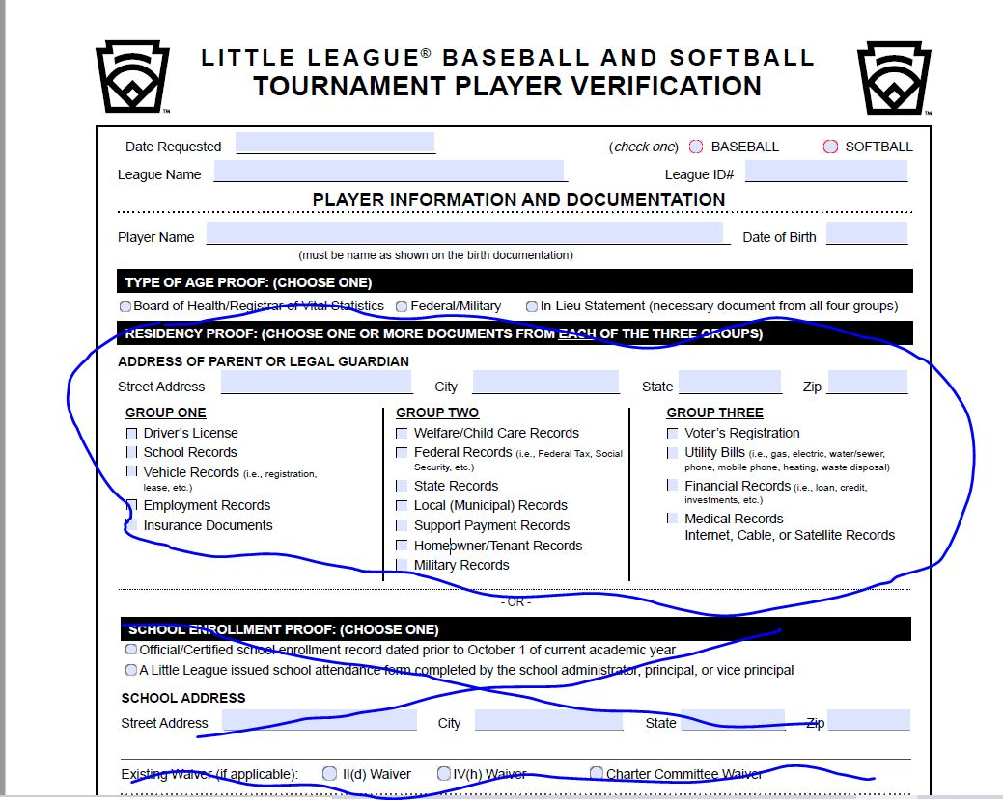
Player verification – Proof of residency

Slide 15
Proof of school attendance
A player will be deemed to attend school in the boundaries if:
  A. The physical location of the school where he/she attends classes is within the boundaries established by the local league.
    NOTE: This excludes home schools, cyber schools, sports-related schools, sports academies, preschools, or after school where a student participates outside of the primary school the player is enrolled.
“School attendance” refers to the (place) physical location the player in question attends school during the traditional academic year. Once established, a location of school attendance shall not be considered changed unless the child is enrolled and attends another school or is no longer enrolled in or attending the previous school.
School attendance shall be established and supported by a document indicating enrollment for the current academic year, dated prior to October 1, 2021, and with the physical location of the school

Slide 16
Proof of School Attendance
School attendance shall be established and supported by a document indicating
enrollment for the current academic year, dated prior to October 1, 2021, and with the physical location of the school, from ONE of the following categories to determine school attendance by such player:
Official/Certified School enrollment record dated prior to October 1, 2021
A Little League-issued school attendance form completed by the principal, assistant principal, or administrator authorized to sign on behalf of the school

Slide 17
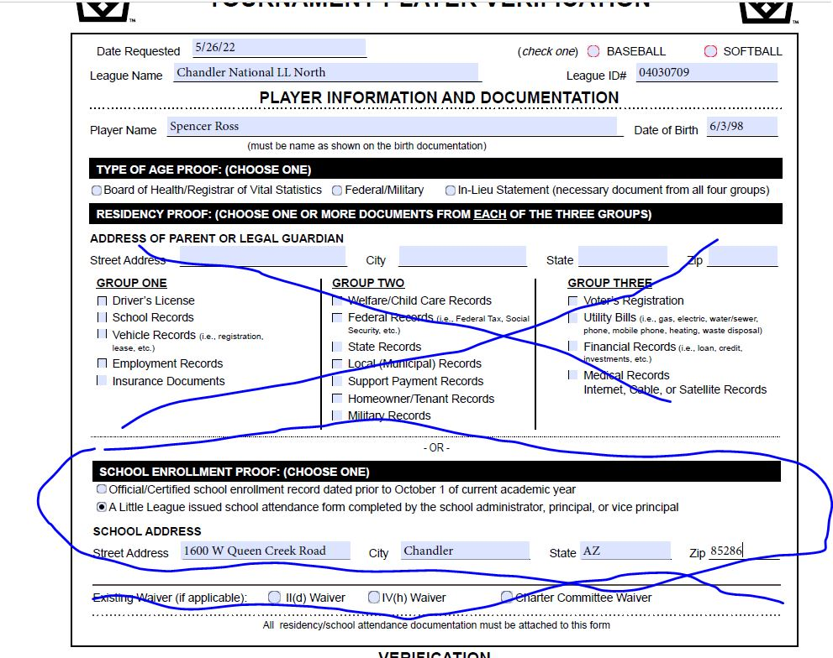
Player verification – school exemption

Slide 18
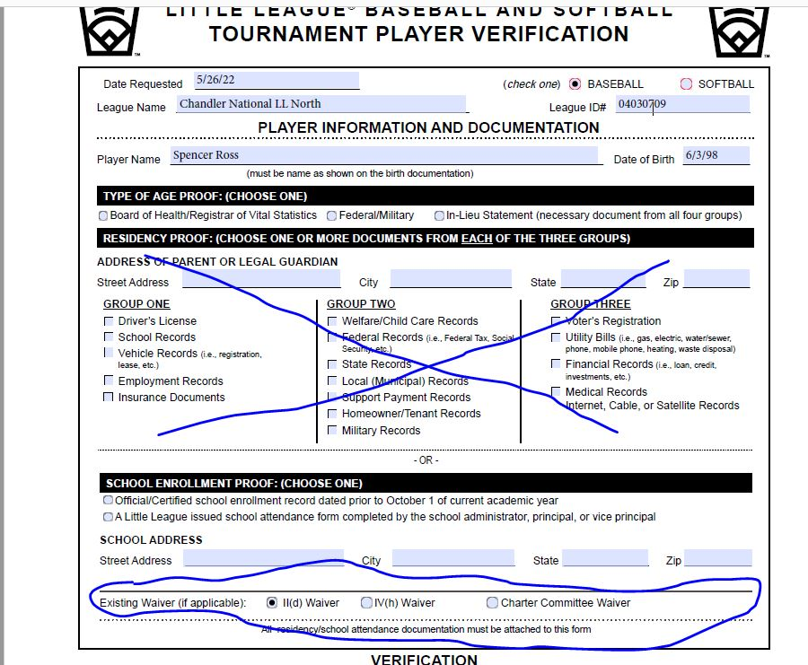
Player Verification- Existing waiver as proof of residency

Slide 19
Team Book
Proof of residency – What we look for
  Address on Proof of residency is the same on all documents and matches the player verification form.
  The address includes a zip code.
  The name on the proof of residency documents can be tied to the player.
  Somewhere on the document we can find a date that falls between 2/1/21 to 2/1/22.
  If the player is playing on a IId waiver there must be documentation from the address or school that had been in boundaries.
  Valid school enrollment form that is signed by a principal or administrator.
  All documents are signed that need to be signed.

Slide 20
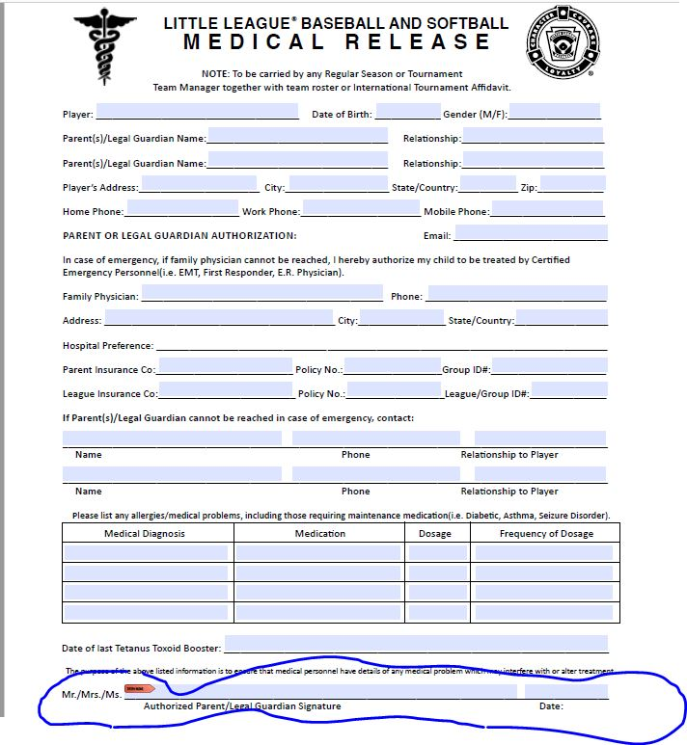
Team Book
Medical Release Form:

Slide 21
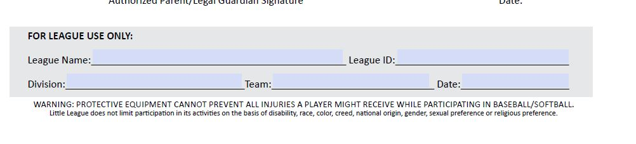
Team Book
Medical Release Form:

Slide 22
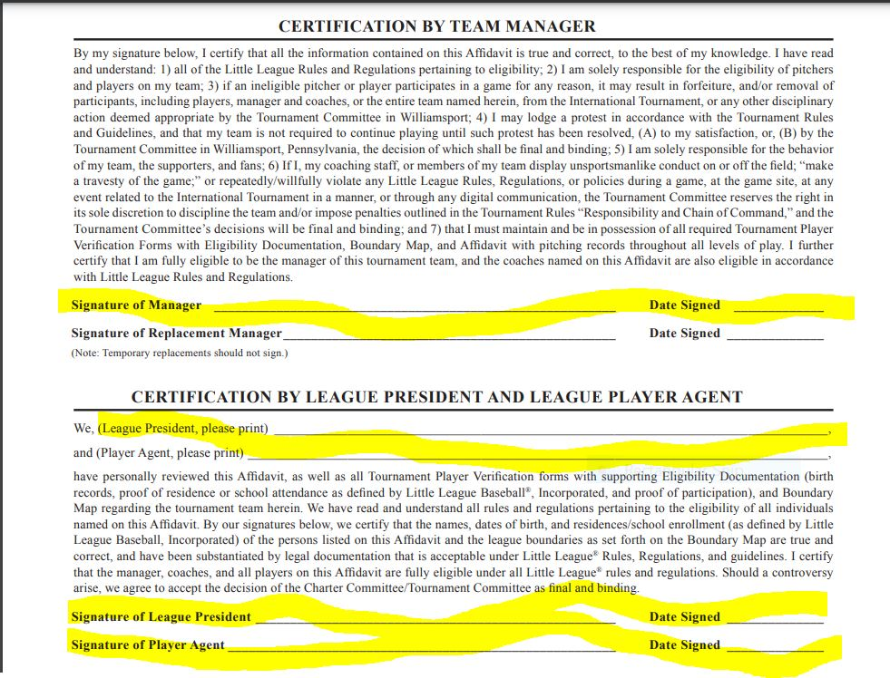
Affidavit signature page

Slide 23
Team Book
    Questions?

Slide 24
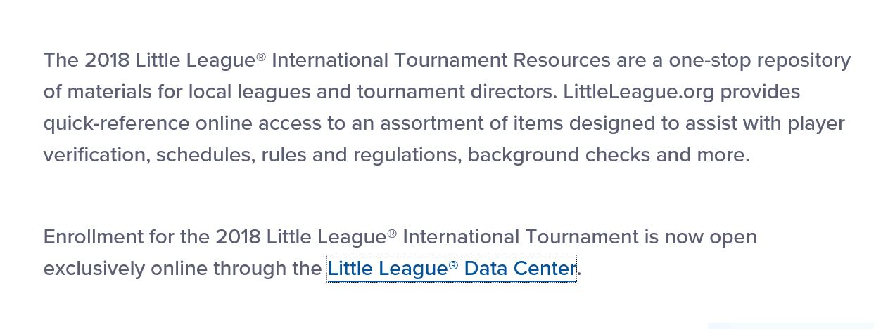
Affidavit
Must have permission granted to fill out the affidavit.
Access thru this website:
  Littleleague.org then click on Tournament Resources
  Scroll down until you find “Little League Data Center” click on this.

Slide 25
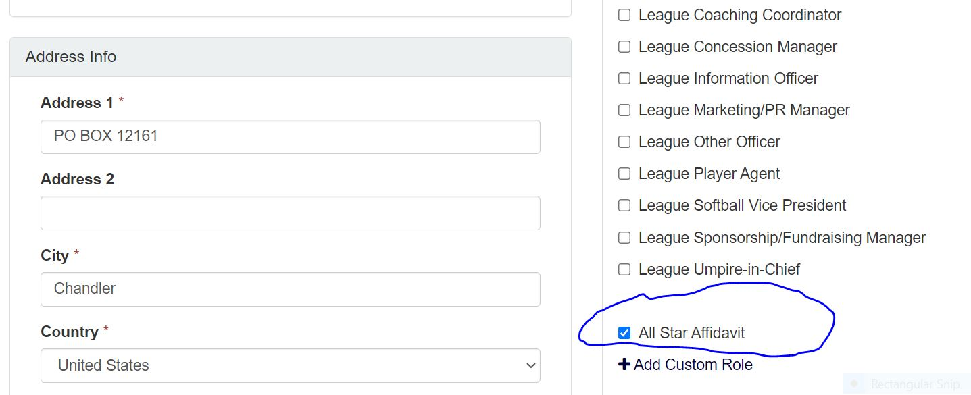
Affidavit
League official must grant the person doing the affidavit book permission.
Home > Manage Officers > Edit Officers

Slide 26
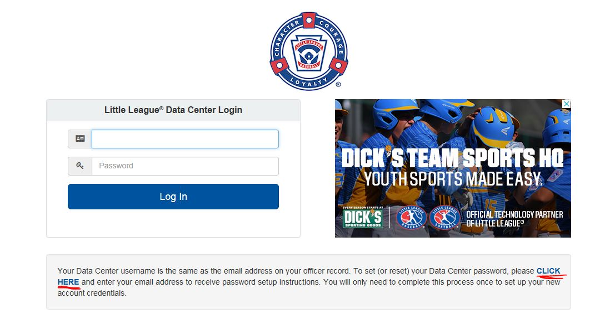
Affidavit
Logging in

Slide 27
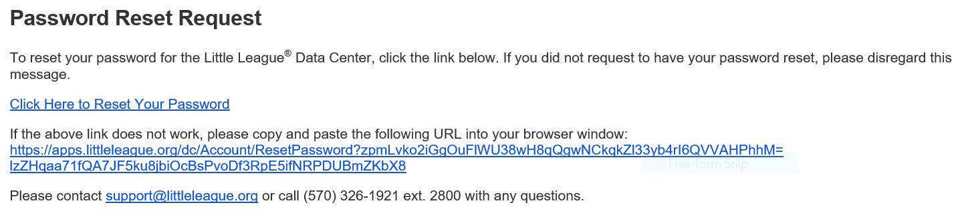
Affidavit
Getting your password or resetting your password:

Slide 28
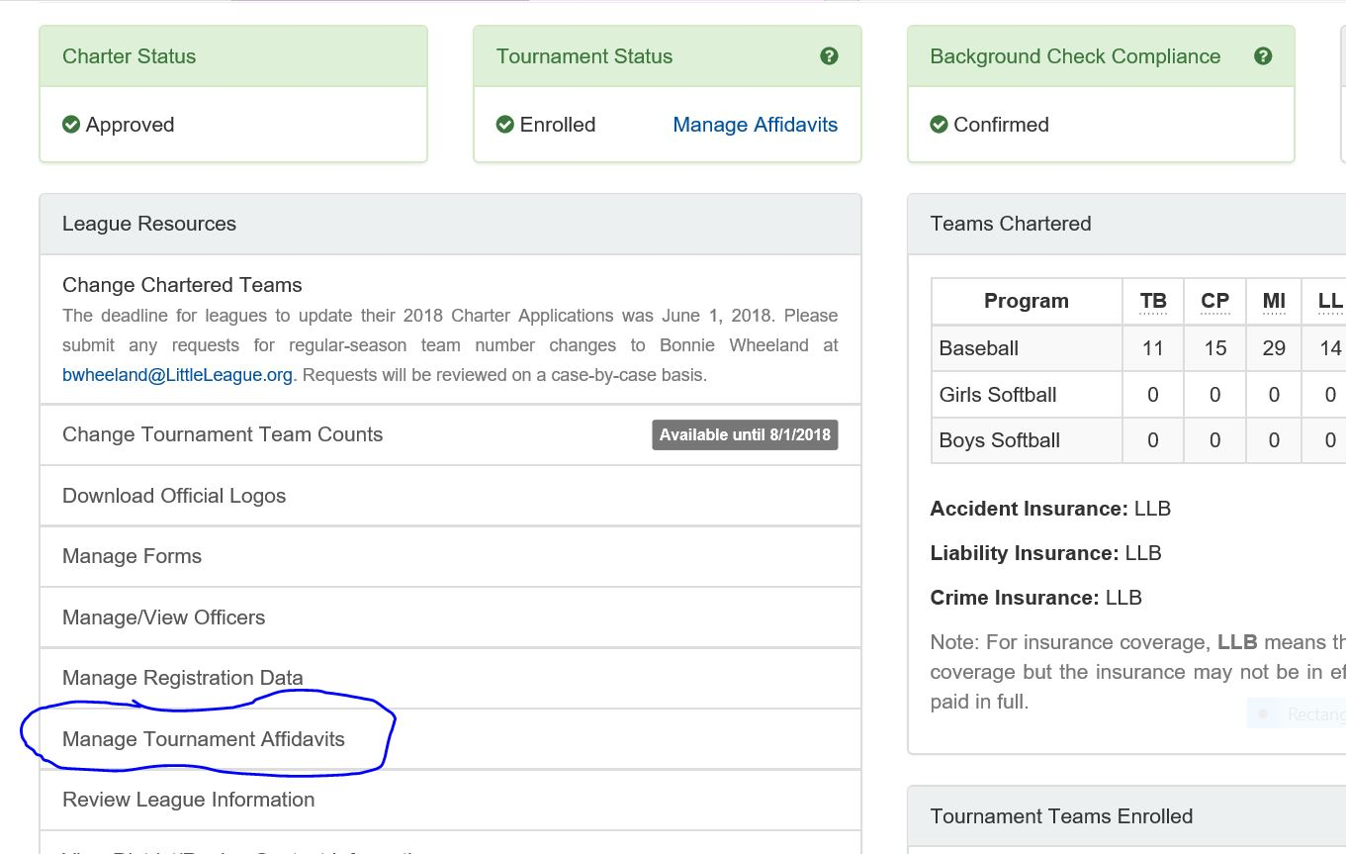
Affidavit
Getting started:

Slide 29
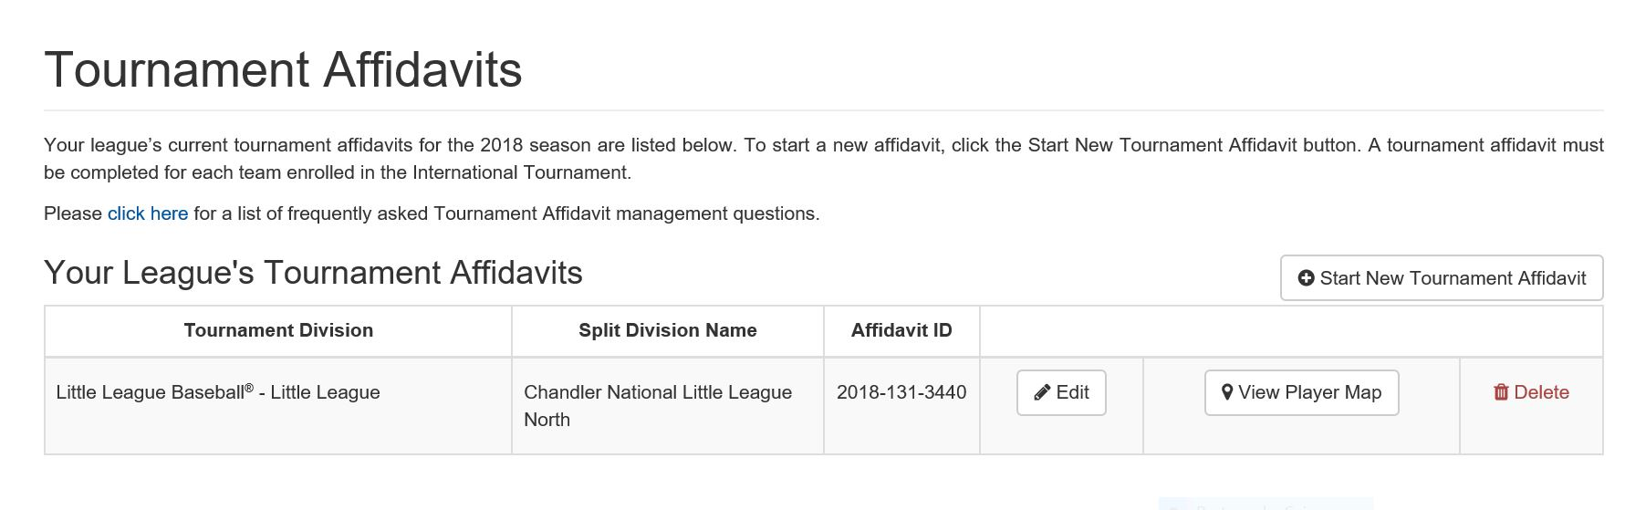
Affidavit

Slide 30
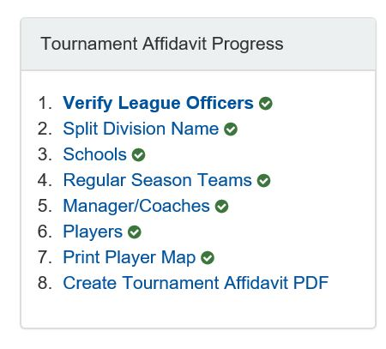
Affidavit
Affidavit sections:

Slide 31
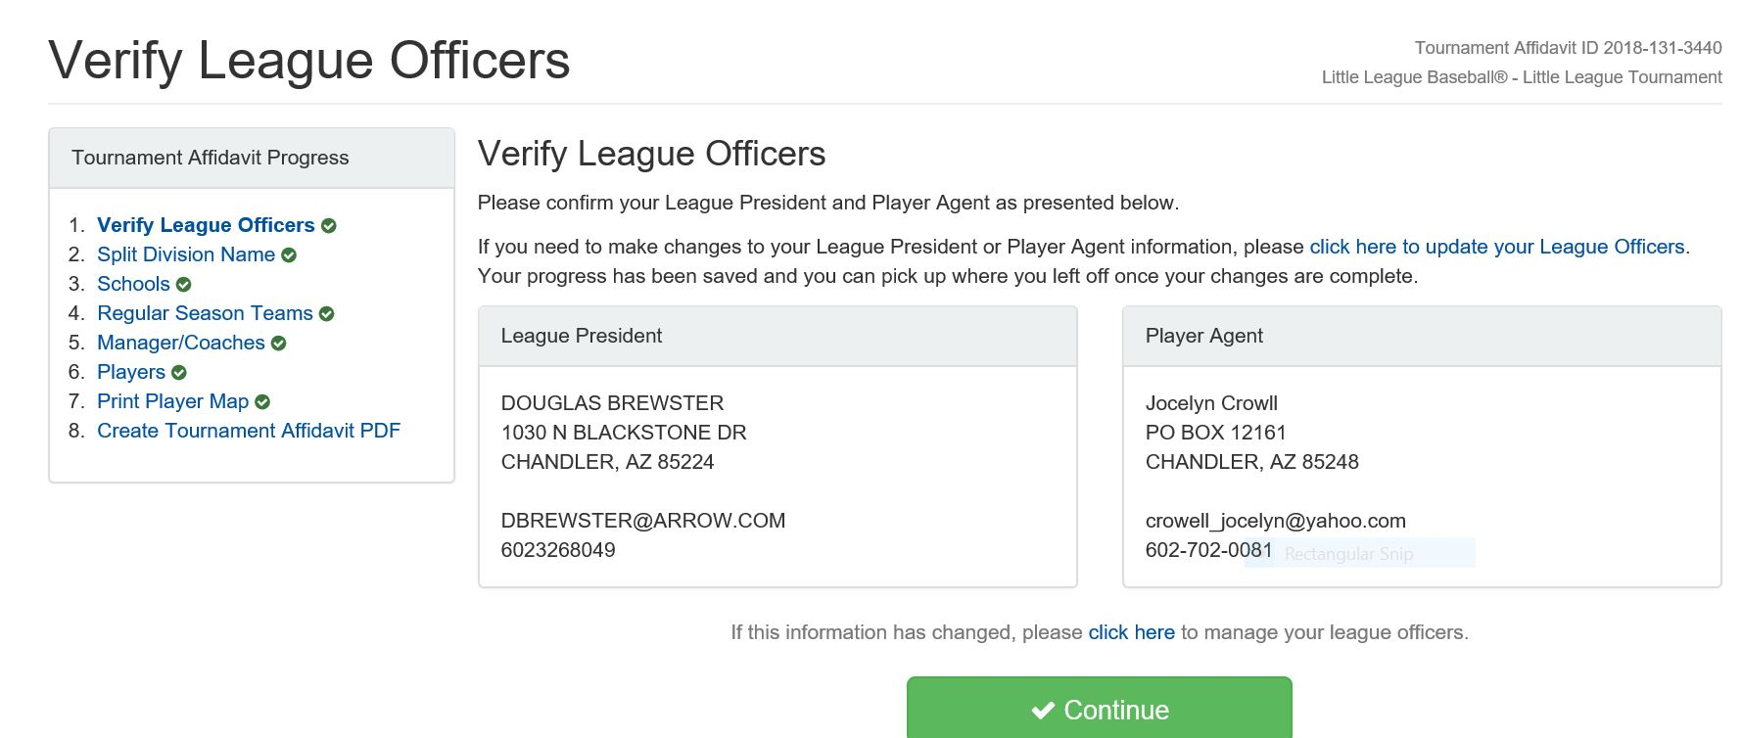
Affidavit

Slide 32
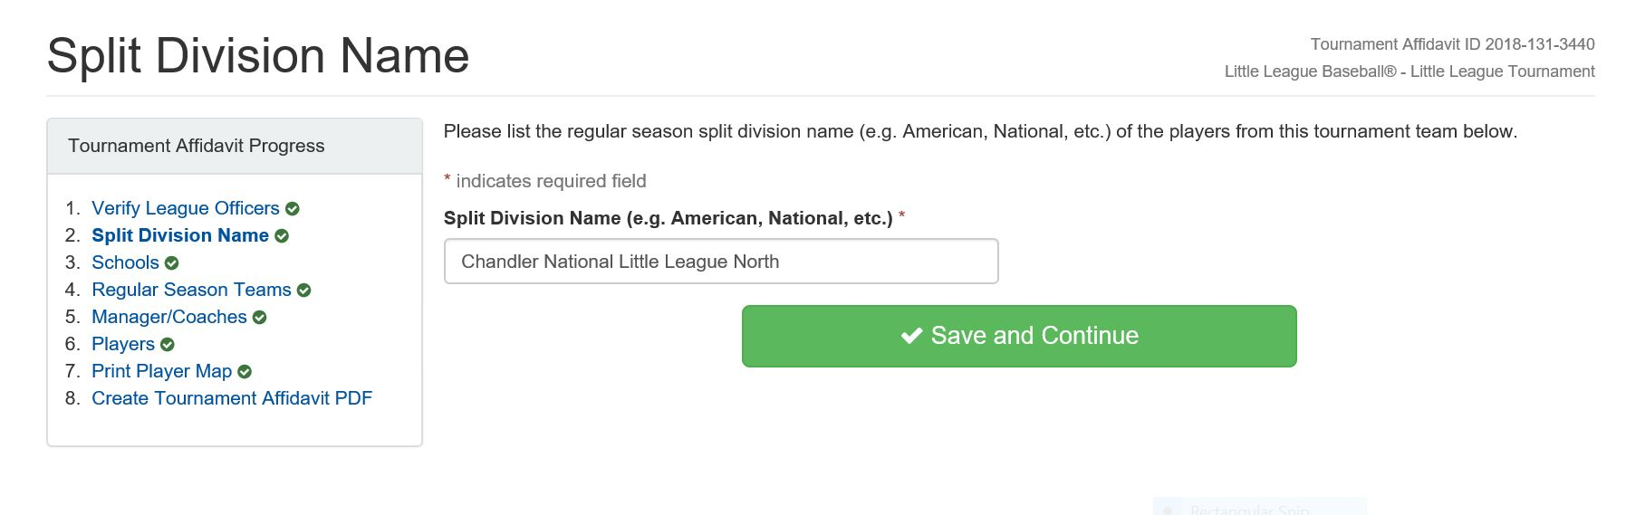
Affidavit

Slide 33
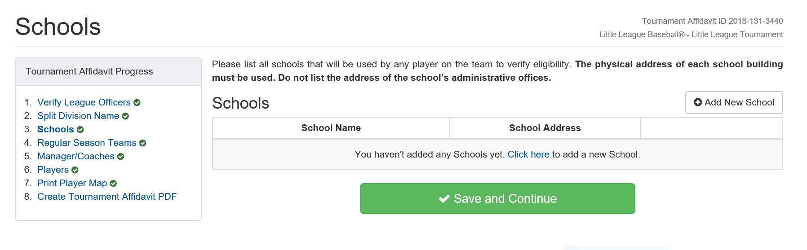
Affidavit

Slide 34
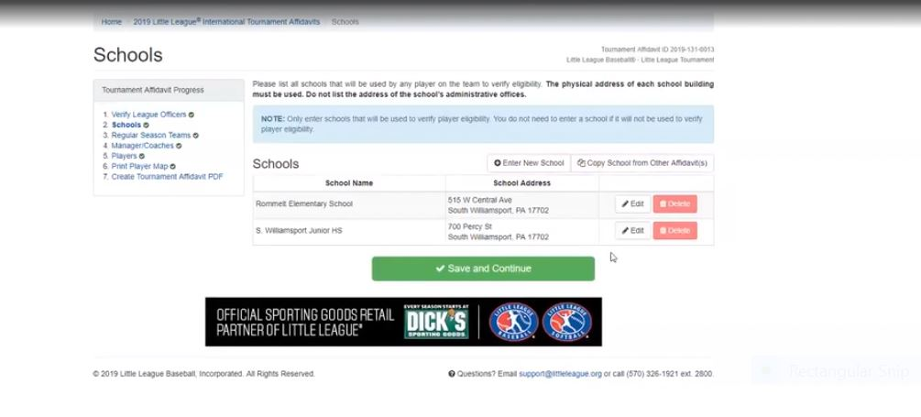
Affidavit

Slide 35
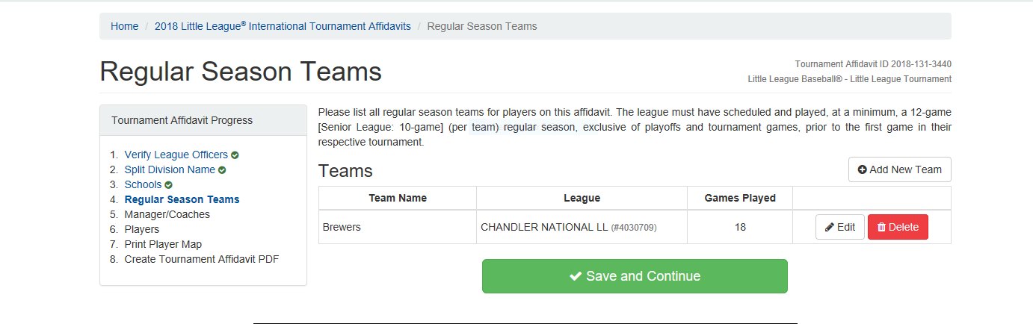
Affidavit

Slide 36
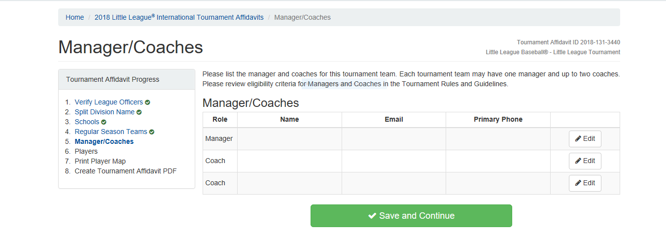
Affidavit

Slide 37
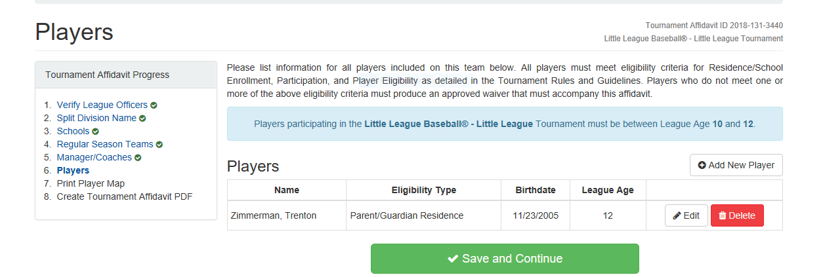
Affidavit

Slide 38
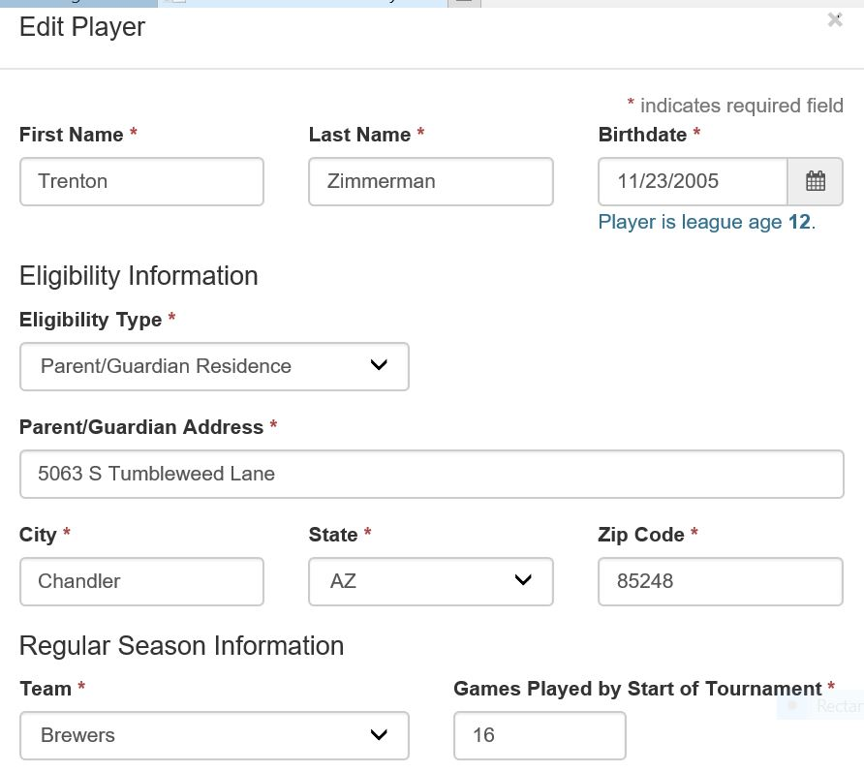
Affidavit
Player information continued:

Slide 39
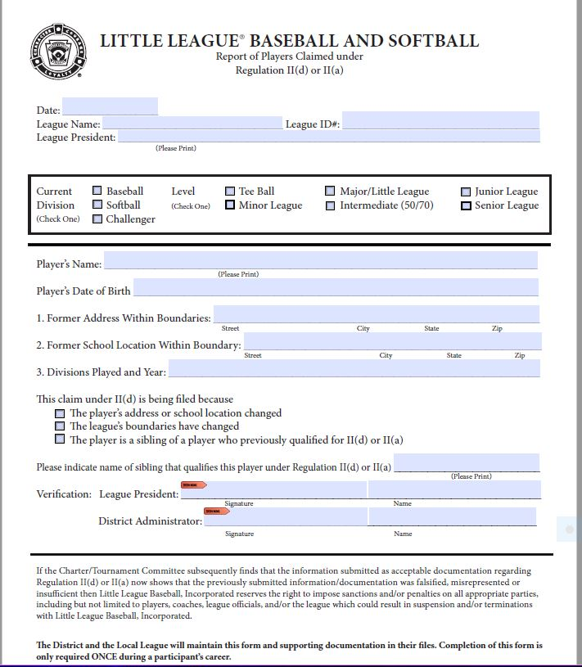
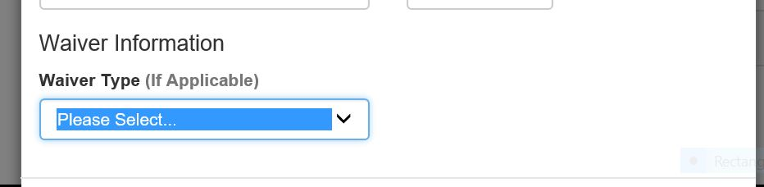
Affidavit
Player information:

Slide 40
Affidavit

Slide 41
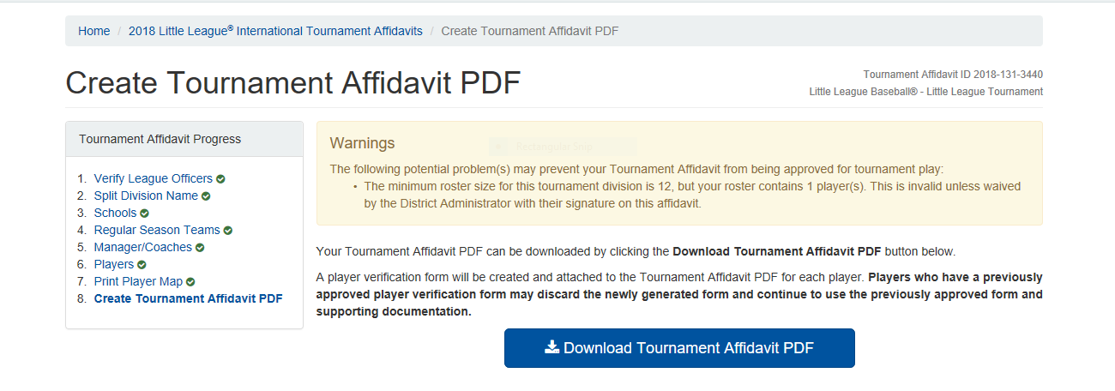
Affidavit

Slide 42
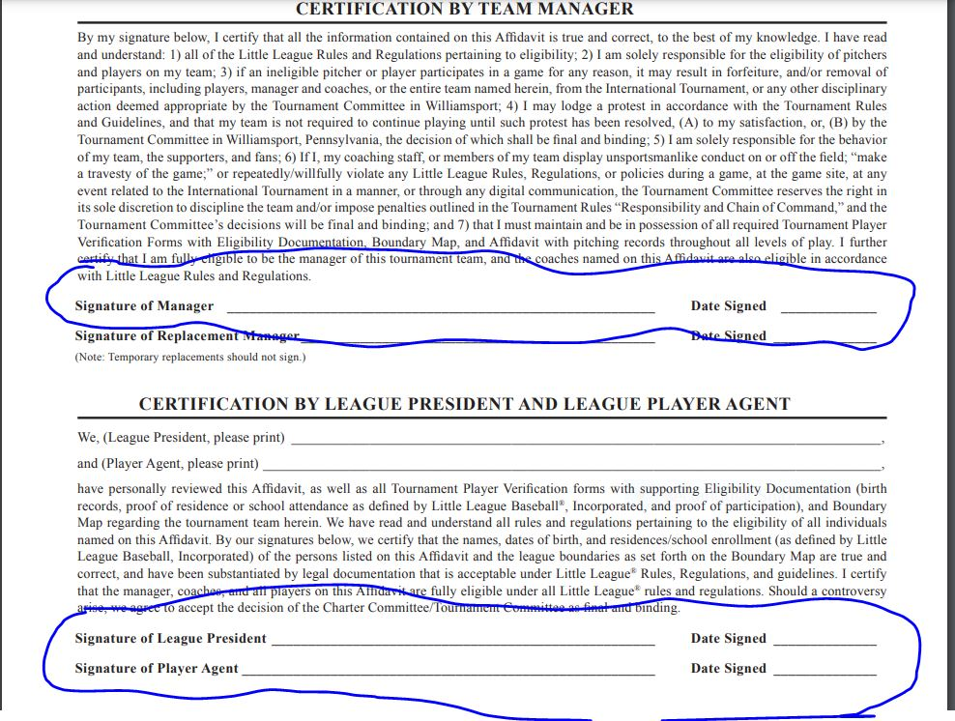
Affidavit

Slide 43
Questions?
Need help?
http://az13llb.com or
  Jeni Hurst – jenihurst@cox.net
  Susan Blank – susan.blankross@gmail.com
Book certification:
  Tuesday June 14, 2022 – Barros – 1880 S Alma School Road, Chandler
  Thursday June 16, 2022 – Barros – 1880 S Alma School Road, Chandler

