Slide 1
District 13 All Star Affidavit &Team Book Training

Slide 2
Agenda
Team Book
Affidavit
Questions

Slide 3
Book Order
Roster
Pitch Count Data Sheet
Affidavit
League Boundary Map
Player Packets
Helmet waivers

Slide 4
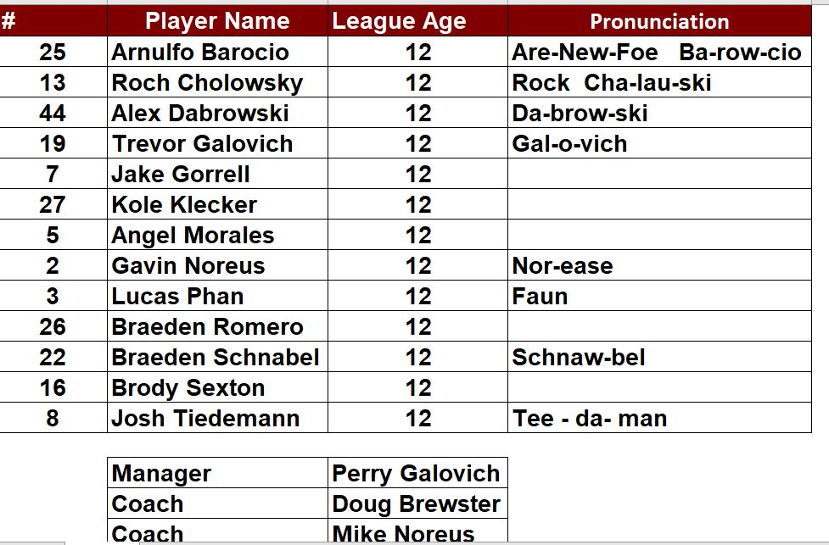
Team Book
Roster
Player’s Name
League Age
Jersey number
Pronunciation if necessary
Managers and Coaches names

Slide 5
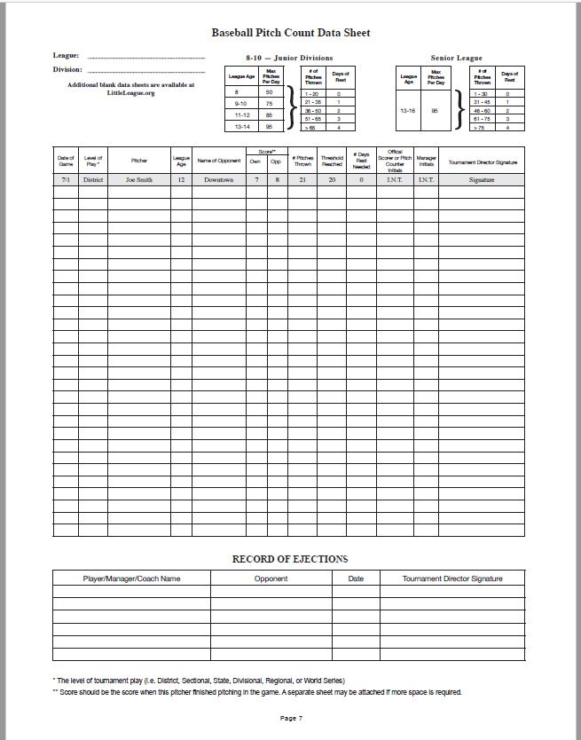
Team Book
Pitch Count Data Sheet

Slide 6
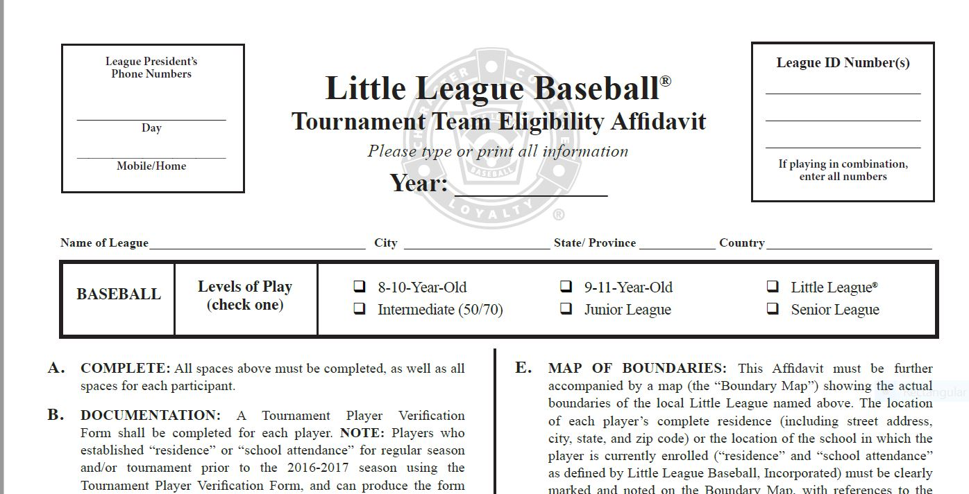
Team Book
Affidavit

Slide 7
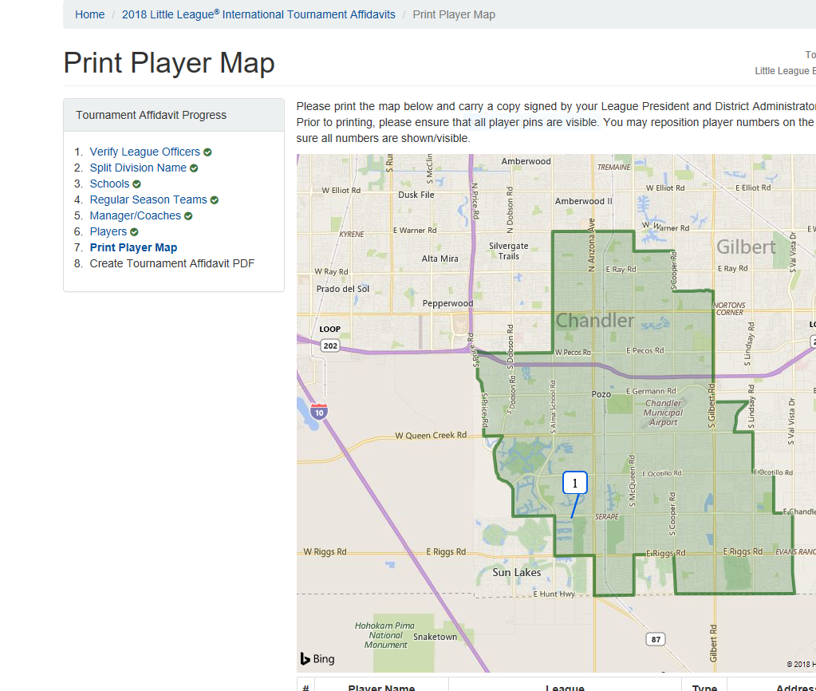
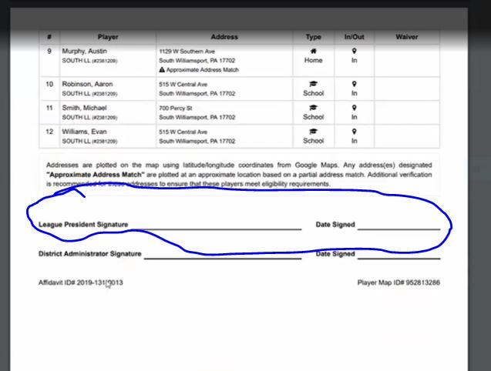
Team Book
Boundary Map with players plotted
Automatically done in the online affidavit
Must print separately from affidavit

Slide 8
Team Book
Player packet
Suggest using a plastic sleeve with a label for each player
Paperwork order as follows
Player verification form – filled completely out and needs to be signed by parent, league president and district administrator.
Original birth certificate. Will be given back once verified. Does not need to remain in the book.
3 Proof of residency documents or Waiver form or school enrollment form
Grid of documents to follow
Medical Release form
Players who can produce a proper Tournament Verification packet from a past season, with proper proof of residency and signatures will not need to complete a new form.

Slide 9
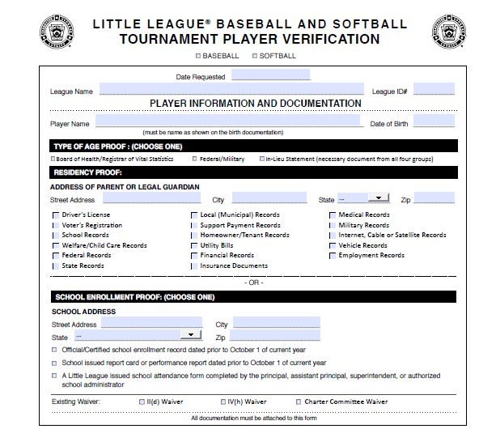
Player Packet
Verification Form

Slide 10
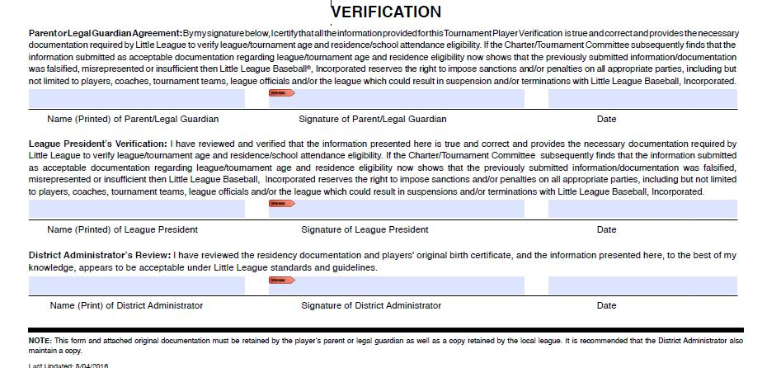
Player Packet
Verification Form

Slide 11
Proof Of Age Requirements
Each player must have an acceptable proof of age presented to the District Administrator
The proof of birth date documents must personally be inspected by the local Little League President, Player Agent, AND District Administrator (or his/her designated appointee) prior to the team’s first game and before the DA certifies the eligibility affidavit
Proofs of age are not carried with the tournament and affidavit and shall be returned once certified
Statement in Lieu of Acceptable Proof of Birth must be carried with the affidavit

Slide 12
Team Book
Proof of residency – Dates Matter
Your proof of residency must be dated between:
2/1/22 – 2/1/23

Slide 13
Proof of residency
Group I
Group II
Group III
1. Driver’s License
2. School records
3. Vehicle records (i.e., registration, lease, etc.)
4. Employment records
5. Insurance documents
1. Welfare/child care records
2. Federal records (i.e., Federal Tax, Social Security, etc.)
3. State records
4. Local (municipal) records
5. Support payment records
6. Homeowner or tenant records
7. Military records
1. Voter’s Registration
2. Utility bills (i.e., gas, electric, water/sewer, phone, mobile phone, heating, waste disposal)
3. Financial (loan, credit, investments, etc.) records
4. Medical records
5. Internet, cable, or satellite records

Slide 14
Proof of residency
A player will be deemed to reside within the league boundaries if:
A. His/her parents are living together and are residing within such league boundaries, OR;
B. Either of the player’s parents (or his/her court-appointed legal guardian) reside within such boundaries.
“Residence,” “reside,” and “residing” refers to a place of bona fide continuous habitation. A place of residence once established shall not be considered changed unless the parents, parent, or guardian makes a bona fide change of residence.
Residence documents must contain the full residence which includes parent(s) or guardian(s) name, street address, city, state, and zip code information, dated or in force between February 1, 2022 (previous year) and February 1, 2023 (current year), from one or more documents from the three groups

Slide 15
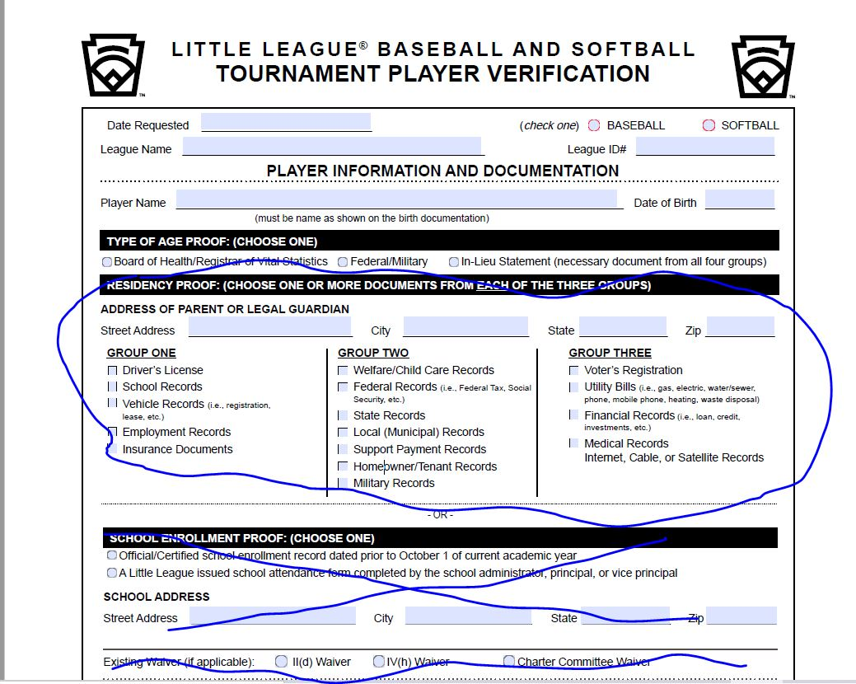
Player verification – Proof of residency

Slide 16
Proof of school attendance
A player will be deemed to attend school in the boundaries if:
A. The physical location of the school where he/she attends classes is within the boundaries established by the local league.
NOTE: This excludes home schools, cyber schools, sports-related schools, sports academies, preschools, or after school where a student participates outside of the primary school the player is enrolled.
“School attendance” refers to the (place) physical location the player in question attends school during the traditional academic year. Once established, a location of school attendance shall not be considered changed unless the child is enrolled and attends another school or is no longer enrolled in or attending the previous school.
School attendance shall be established and supported by a document indicating enrollment for the current academic year, dated prior to October 1, 2022, and with the physical location of the school

Slide 17
Proof of School Attendance
School attendance shall be established and supported by a document indicating
enrollment for the current academic year, dated prior to October 1, 2022, and with the physical location of the school, from ONE of the following categories to determine school attendance by such player:
Official/Certified School enrollment record dated prior to October 1, 2022
A Little League-issued school attendance form completed by the principal, assistant principal, or administrator authorized to sign on behalf of the school

Slide 18
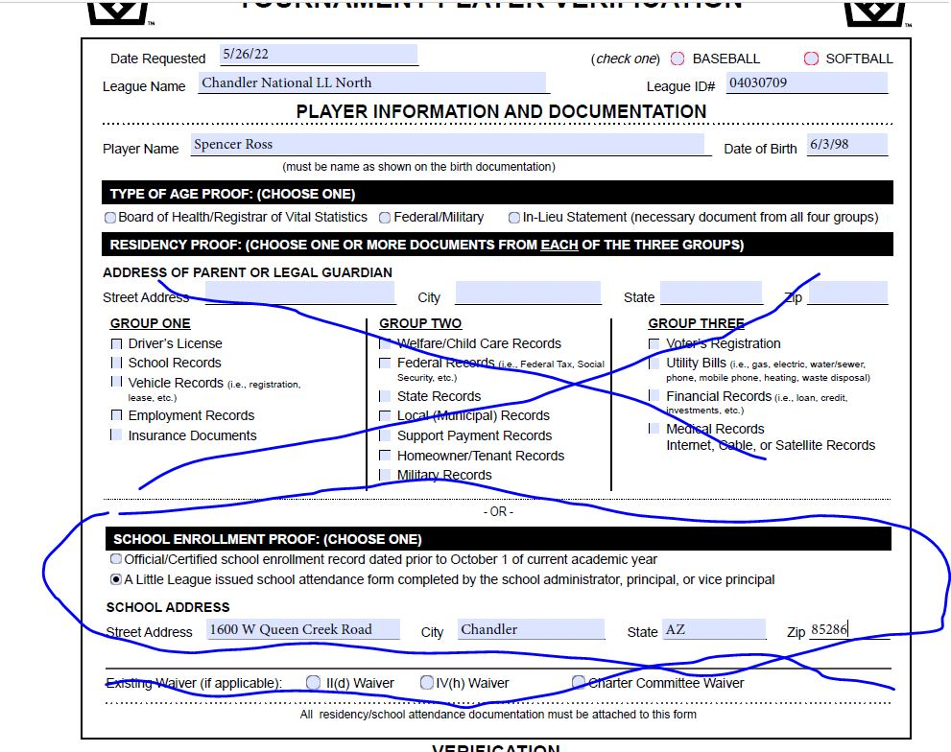
Player verification – school exemption

Slide 19
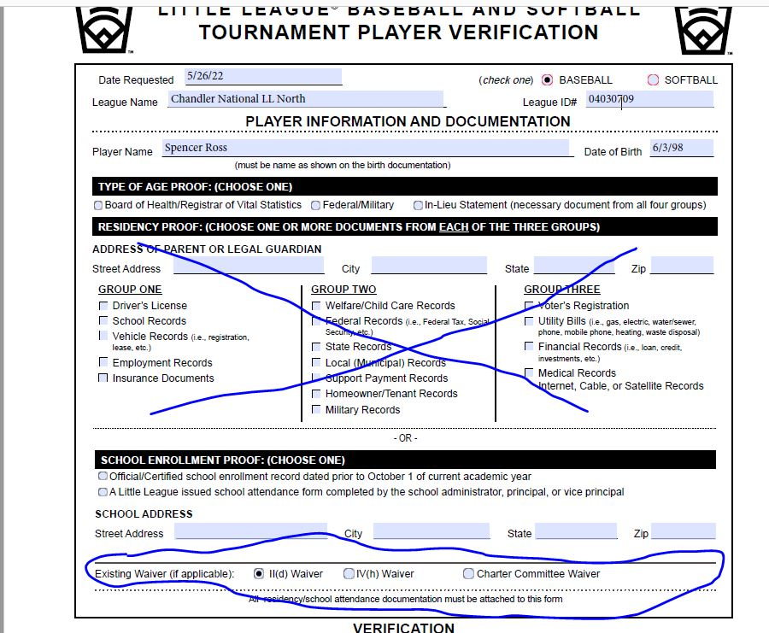
Player Verification- Existing waiver as proof of residency

Slide 20
Team Book
Proof of residency – What we look for
Address on Proof of residency is the same on all documents and matches the player verification form.
The address includes a zip code.
The name on the proof of residency documents can be tied to the player.
Somewhere on the document we can find a date that falls between 2/1/22 to 2/1/23.
If the player is playing on a IId waiver there must be documentation from the address or school that had been in boundaries.
Valid school enrollment form that is signed by a principal or administrator.
All documents are signed that need to be signed.

Slide 21
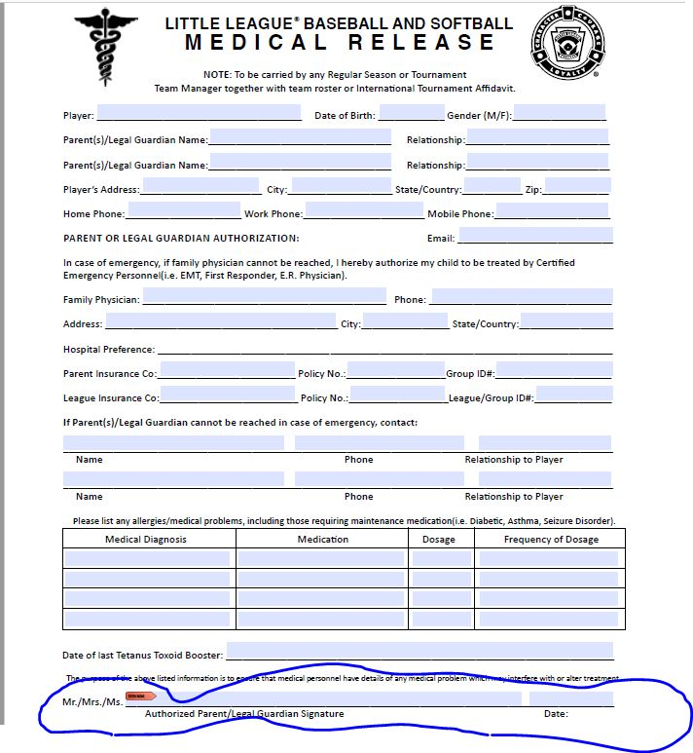
Team Book
Medical Release Form:

Slide 22
Team Book
Medical Release Form:

Slide 23
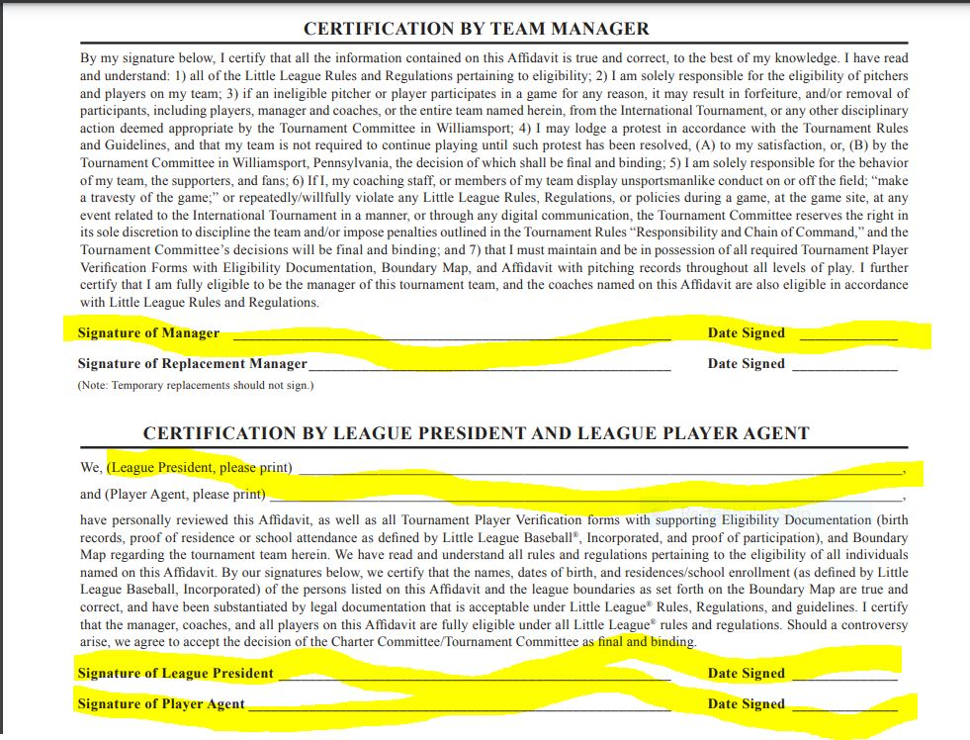
Affidavit signature page

Slide 24
Team Book
Questions?

Slide 25
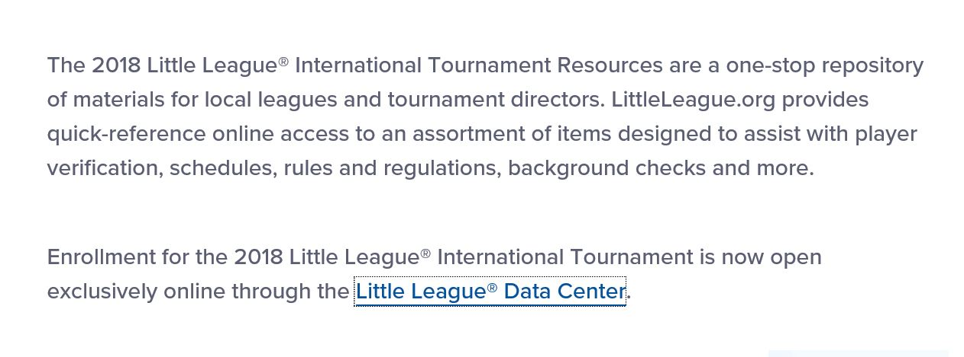
Affidavit
Must have permission granted to fill out the affidavit.
Access thru this website:
Littleleague.org then click on Tournament Resources
Scroll down until you find “Little League Data Center” click on this.

Slide 26
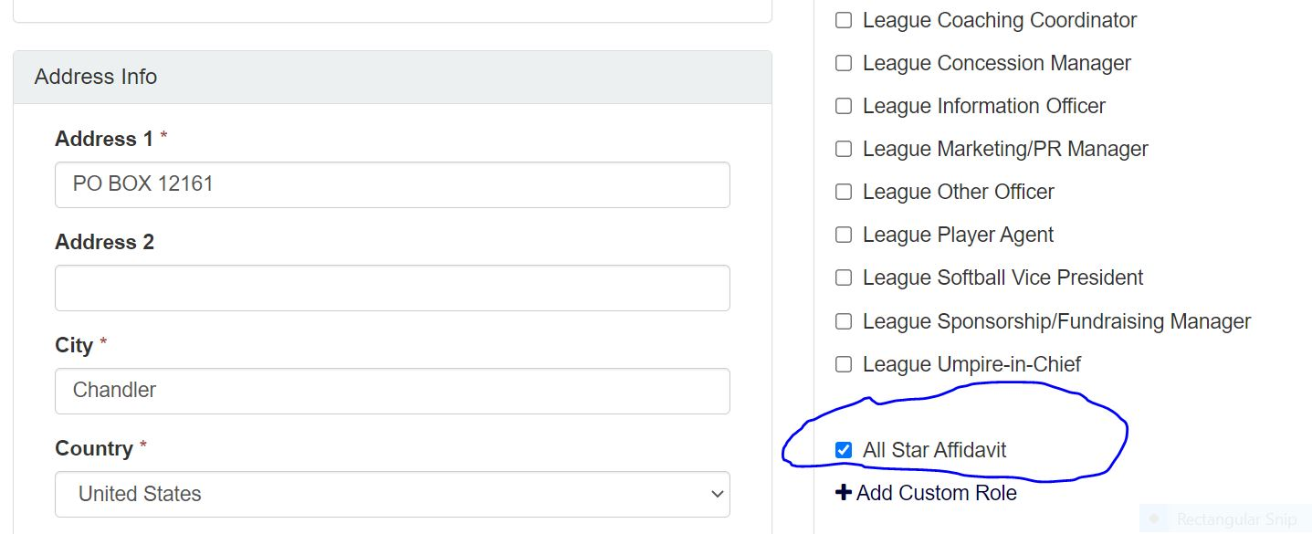
Affidavit
League official must grant the person doing the affidavit book permission.
Home > Manage Officers > Edit Officers

Slide 27
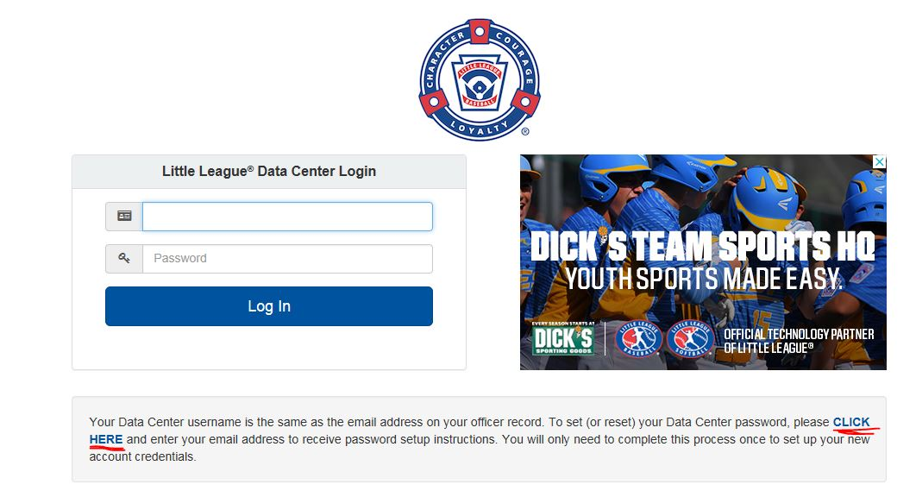
Affidavit
Logging in

Slide 28
Affidavit
Getting your password or resetting your password:

Slide 29
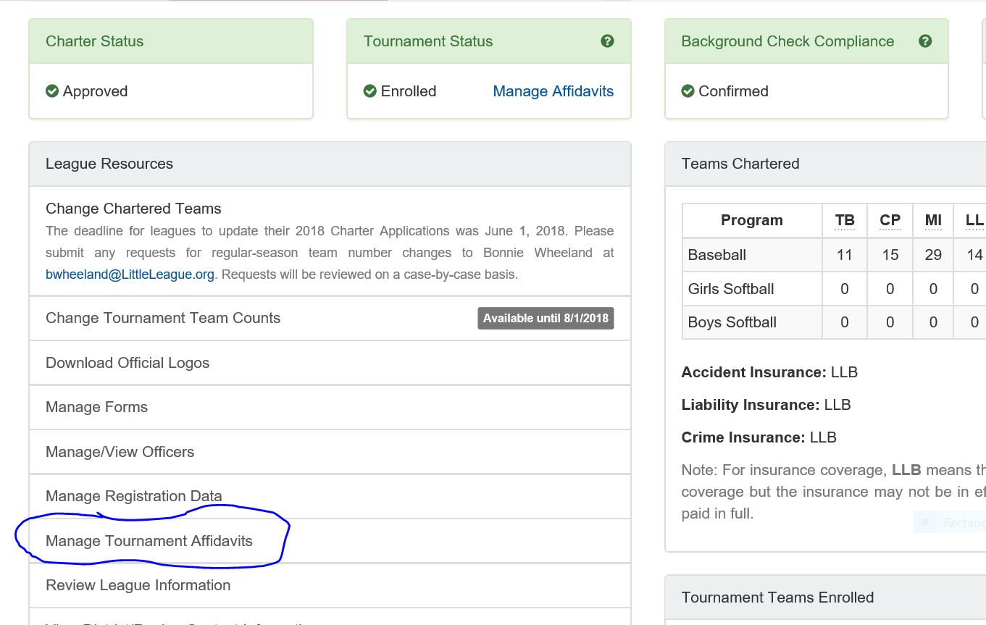
Affidavit
Getting started:

Slide 30
Affidavit

Slide 31
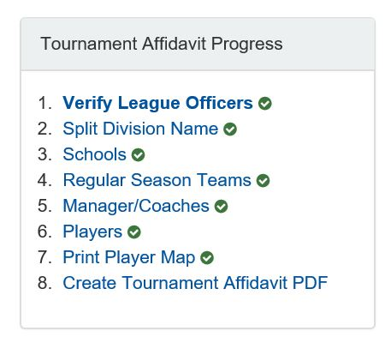
Affidavit
Affidavit sections:

Slide 32
Affidavit

Slide 33
Affidavit

Slide 34
Affidavit

Slide 35
Affidavit

Slide 36
Affidavit

Slide 37
Affidavit

Slide 38
Affidavit

Slide 39
Affidavit

Slide 40
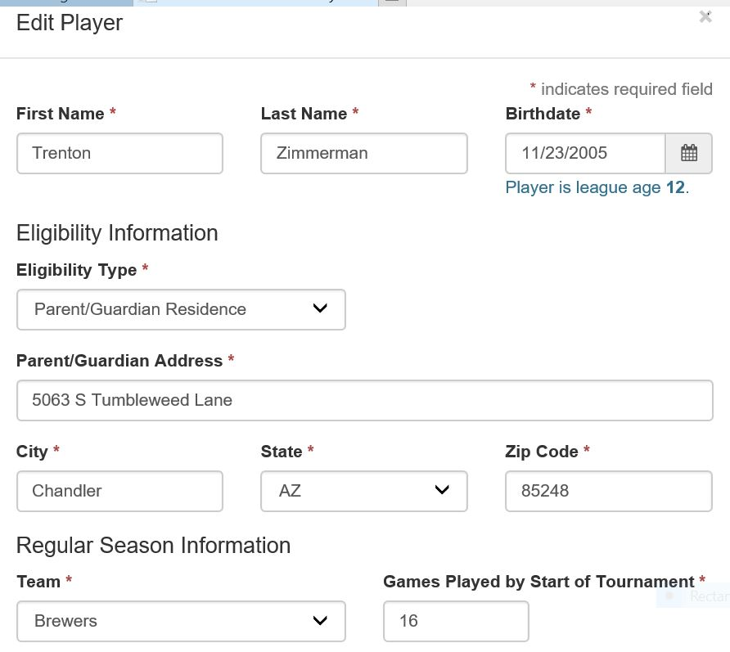
Affidavit
Player information continued:

Slide 41
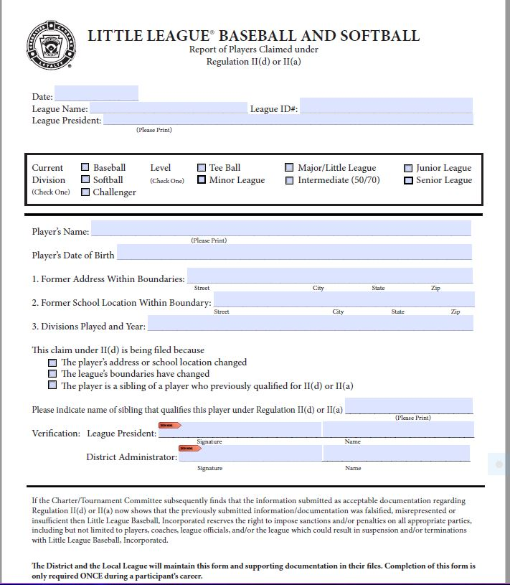
Affidavit
Player information:

Slide 42
Affidavit

Slide 43
Affidavit

Slide 44
Affidavit

Slide 45
Questions?
Need help?
http://az13llb.com or
Jeni Hurst – jenihurst7@gmail.com
Susan Blank – susan.blankross@gmail.com
Book certification:
Saturday June 10, 2023 – Tri-City Baptist Church during team pictures
Tuesday June 13, 2023 – Barros – 2935 S Alma School Road, Chandler
Thursday June 15, 2023 – Barros – 2935 S Alma School Road, Chandler

Slide 46
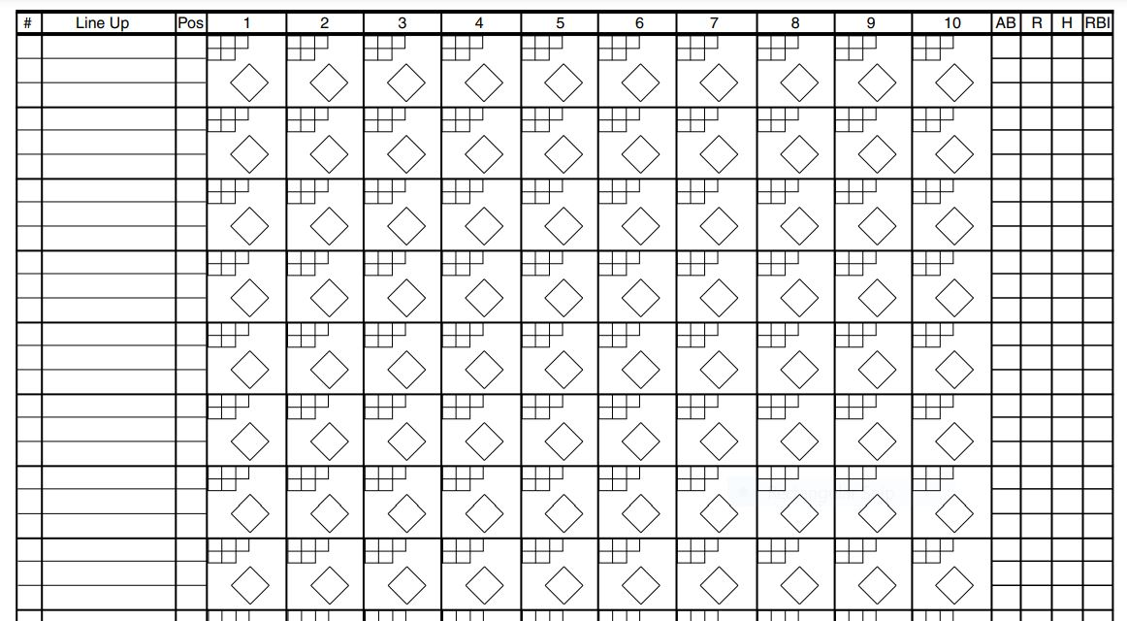
Scorekeeping – score sheet

Slide 47
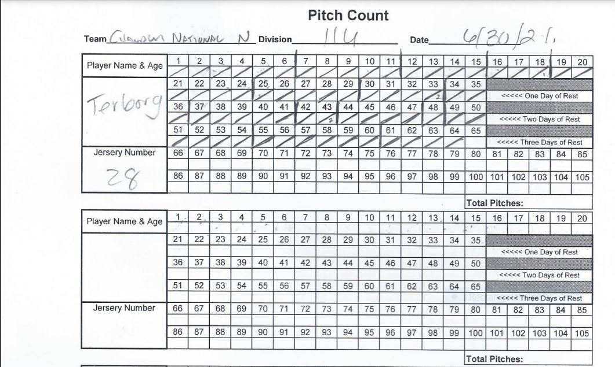
Scorekeeping – pitch count

Slide 48
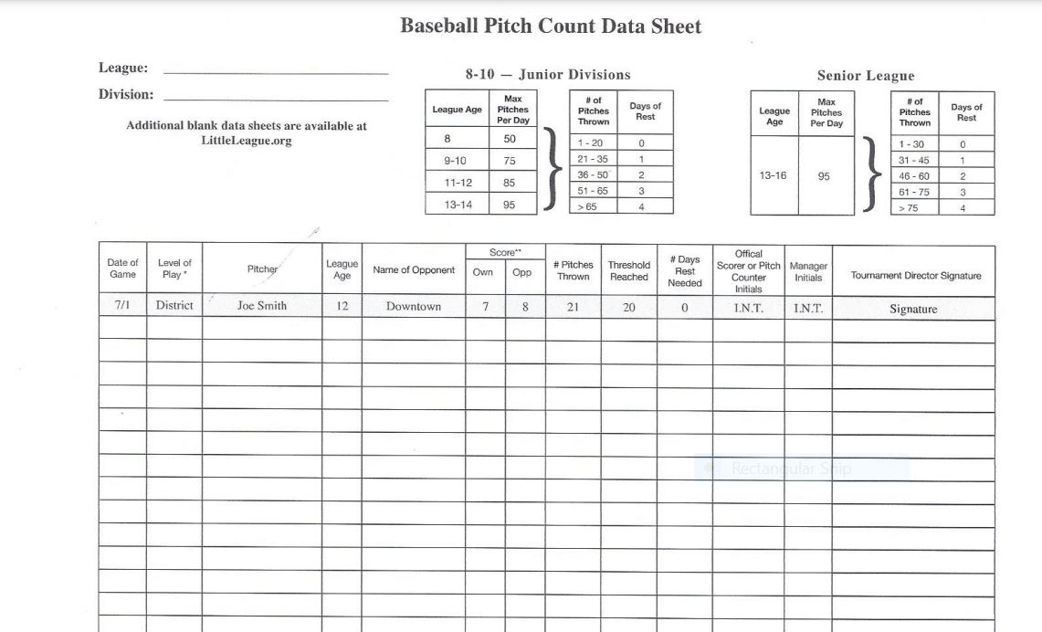
Scorekeeping – pitch count sheet

