Slide 1



Little League
Rules Meeting for the
2025 International Tournament
Presented by
Notes:
Next Slide is . . .

Slide 2
Safety &
Equipment
Notes:
Next Slide is . . .

Slide 3
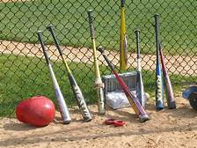
Equipment Checks
Umpires are no longer required to check equipment:
  Helmets
  Bats
  Catcher’s gear (dangling throat guard)
It shall be the duty of the team manager to ensure all equipment is legal and proper for play according to Little League rules.
PENALTY: If illegal equipment is used during the game, the manager of the team will be ejected. The player utilizing the illegal equipment shall also be ejected. BOTH manager and player shall serve 1 game suspension.
Notes:
If in doubt, ask Tournament staff or Umpire.
Better safe than sorry.

Slide 4
Rule 6.06(d)
Batter enters batter’s box with an illegal bat
Batter is out
Manager and player are ejected
Offense loses one adult base coach for the remainder of the game
If illegal bat is identified after batter uses it
In addition to the above penalties,
  All runners return to previous base
  unless defense elects the results of the play
Notes:
Next Slide is . . .

Slide 5
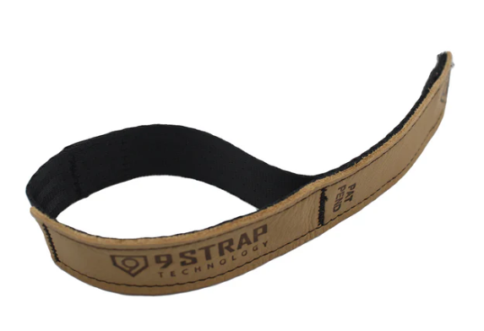
Rule 1.10
Baseball non-wood bats
8-10 9-11 10-12 | Intermediate Juniors | Seniors
USA Bat | USA Bat or BBCOR | BBCOR
Rule 1.10 – A.R.2: No bat in any level of Little League Baseball/Softball is permitted to be altered. Products such as, but not limited to, pine tar, choke-knobs, choke up assists, thumb protectors, and 9 Straps are considered alterations or modifications to the bat and are not permitted.
Notes:
Pine tar can be cleaned off.

Slide 6
Rule 1.11
Any part of the pitchers exposed undershirt must be of a solid color
Not white or gray
Neoprene is allowed on pitcher provided
  One solid color;
  Not white or grey
Notes:
Next Slide is . . .

Slide 7
Rule 1.11
Defensive players may wear play calling bands
Must be on wrist or forearm
Pitchers may only wear on glove hand
  Solid color
  Not white, gray or optic yellow
Notes:
Next Slide is . . .

Slide 8
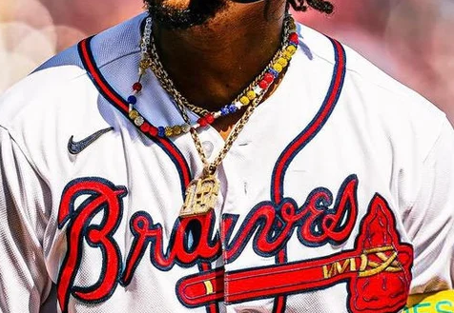
Rule 1.11(j)
Rule 1.11(j): Any jewelry worn by a player that poses harm to injury will be subject to removal.
Exception: Medical alerts permitted
Notes:
Players may be asked to tuck into Jersey.

Slide 9

Rule 1.16
Use of a helmet is required for all batters, base runners and non-adult base coaches
Helmets may not
be repainted
contain tape or re-applied decals
have a mirror-like finish
No stickers that is excessive in usage, offensive or has inappropriate references (drugs/alcohol)
Notes:
Next Slide is . . .

Slide 10
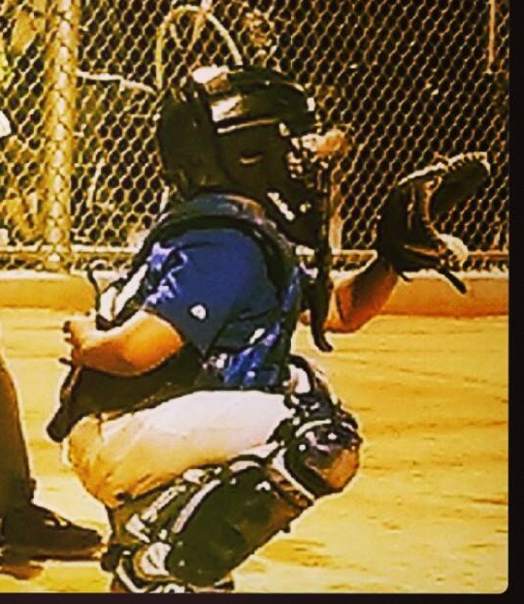
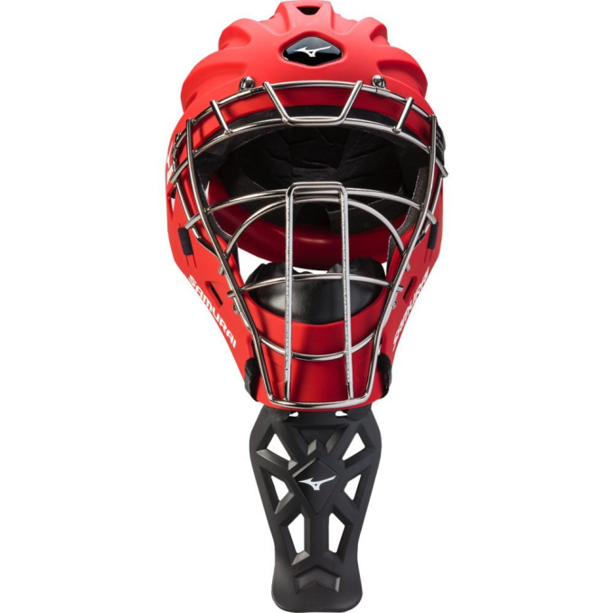
Rule 1.17
Dangling throat guards are required at all levels of play whenever a catcher’s mask is required
There are NO exceptions
This includes
Hockey mask style helmets
Masks with wire extensions
Notes:
Next Slide is . . .

Slide 11
Rule 1.17
Catcher’s masks are required:
Any form of infield/outfield practice
Pitcher warm up
Games
Notes:
Next Slide is . . .

Slide 12
On-Deck Batter (during play)
8-10 / 9-11 / Little League
The on-deck batter is not allowed, at any time, regardless of field design or presence of a safe area.
Intermediate / Juniors / Seniors
The on-deck batter is permitted
Notes:
Next Slide is . . .

Slide 13
Electronic Equipment
A manager or coach is permitted to use ONE WAY electronic devices from the dugout to the catcher.
To the catcher ONLY
Must be inside the dugout when utilizing it
One way: no air pods, apple watches, radios etc.
Notes:
Next Slide is . . .

Slide 14
Lightning Protocols
Lightning will be monitored by the Tournament Director
Should the game be delayed for lightning:
Immediately proceed to a safe area
  Cars or buildings
Do not leave the ballpark.
Manager will be contacted by the Tournament Director.
Notes:
Next Slide is . . .

Slide 15
Rule Differences Between
Regular Season and Tournament
Notes:
Next Slide is . . .

Slide 16
Rules
No local rules are to be used
All rules are per the Little League Official Playing Rules
Local “ground rules” still apply
  Field conditions
  Establishment of live ball/dead ball territory
Notes:
Next Slide is . . .

Slide 17
Warming up the Pitcher
Regular Season
Tournament
Managers or coaches may warm up the pitcher
Managers or coaches may NOT warm up the pitcher at any place or any time
Notes:
Next Slide is . . .

Slide 18
Batting Order
Regular Season
Tournament
Continuous batting order
League option
Continuous batting order
Required
All players present at start of game
Does not apply to Senior League
Notes:
Next Slide is . . .

Slide 19
Game Duration
Regular Season
Tournament
Shortened games
Time limits
Drop dead
  League options
Full regulation games
    No time limits
10 / 11 / MAJ
    6 innings
JRs / SRs
    7 innings
Notes:
Next Slide is . . .

Slide 20
Mercy Rule
Regular Season
Tournament
15 run lead after 3 innings
10 run lead after 4 innings
8 run lead after 5 innings
League options
15 run lead after 3 innings
10 run lead after 4 innings
In effect, not optional
Notes:
Next Slide is . . .

Slide 21
Mandatory Play
For purposes of Mandatory Play during the Tournament
The definition of At-Bat in regard to completing an At-Bat after a player is retired as a batter; retired as a batter-runner; reaches base and scores; or reaches base and the inning/game ends, does not apply.
Effect: you can now use courtesy runners for pitcher and catcher (with two outs) at any time they reach base.
Notes:
Next Slide is . . .

Slide 22
Other
Tournament Rules
Notes:
Next Slide is . . .

Slide 23
Who’s the Home Team?
For all games, home team is determined by a coin toss.
Coin toss shall be performed by an authorized representative of the Tournament Director. 1 hour before game time
Home team shall occupy the 3rd base dugout
Notes:
Next Slide is . . .

Slide 24
Managers and Coaches
A maximum of three (3) adults, who are named on the official affidavit will be permitted to act as managers/coaches for that game.
The adults must be listed in the affidavit or must be authorized temporary replacements as noted on the affidavit.
Base coaches may be adults or players.
One adult must remain in the dugout at all times
Notes:
Next Slide is . . .

Slide 25
Number of Players
Teams must have at least 9 players to start the game
  The game is considered started at the plate meeting
Teams must have at least 9 players to continue the game
If, at any time, a team has less than 9 players, the game will be suspended and be referred to the tournament committee.
Notes:
Next Slide is . . .

Slide 26
Mandatory Play
Regular Season
Tournament
Each player shall have a minimum of 1 at-bat and play 6 defensive outs
Use of Continuous Batting Order
Everyone bats
No defensive requirement
Notes:
Next Slide is . . .

Slide 27
Continuous Batting Order
If a player is not at the field at the beginning of the game, that player shall be added at the bottom of the line-up.
Should a player be UNABLE TO BAT at the time of their scheduled at-bat, the spot in the line-up will be skipped, with no penalty to the offensive team.
Example:
  Larry is the 3rd batter in the line-up
  Larry feels ill and is unable to take his turn when it is his turn to bat
  The 4th batter in the line-up becomes the batter
  No out is recorded, and Larry retains his 3rd spot in the line-up
Notes:
Next slide is . . .

Slide 28
Courtesy Runner
Each team is allowed the use of a courtesy runner
For pitcher or catcher only
With two outs
Runner must be the player in the batting order who made the last out (can still be used if both pitcher and catcher are on base with two outs)
Notes:
Next Slide is . . .

Slide 29
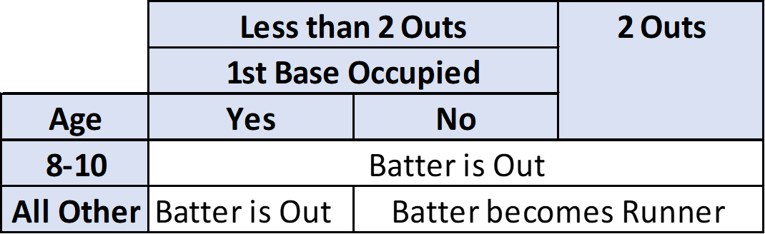
3rd Strike Not Caught
Notes:
Next Slide is . . .

Slide 30
One Foot in the Batter’s Box
If the batter leaves the batter’s box or delays play and none of the exceptions apply, the umpire shall warn the batter.
  This is umpire judgment
After one warning on the batter, the umpire shall call a strike.
Any number of strikes can be called until the batter re-enters the batter’s box, or until the third strike is called.
Notes:
Next Slide is . . .

Slide 31
Intentional Base on Balls
If the defensive team wishes to give the batter an intentional base on balls:
Manager must request time and inform plate umpire
No pitches need to be thrown, but any remaining pitches will be added to pitch count
Batter will be awarded first base
  The ball is dead - - no other runners may advance (unless forced)
Notes:
Next Slide is . . .

Slide 32
Intentional Base on Balls
An “unpitched” intentional base on balls is allowed to each player only once per game
All other “unintentional/intentional” walks requires pitches to be thrown
Notes:
Next Slide is . . .

Slide 33
Pitching Limitations
Under no circumstances shall a player pitch in three (3) consecutive days
Notes:
Next Slide is . . .

Slide 34
Pitching Limits - Baseball
Maximum number of pitches in a day
Note that the limitation is based on league age and not level of play
Age | 7-8 | 9-10 | 11-12 | 13-16
Maximum Pitches per Day | 50 | 75 | 85 | 95
Age | 7-8 | 9-10 | 11-12 | 13-16
Maximum Pitches per Day | 50 | 75 | 85 | 95
Notes:
Next Slide is . . .

Slide 35
Days Rest - Baseball
Mandatory days rest based on pitch count, and level of play
Age | 1-20 | 21-35 | 36-50 | 51-65 | 66+
Juniors and Below | 0 | 1 | 2 | 3 | 4
Age | 1-30 | 31-45 | 46-60 | 61-75 | 76+
Seniors | 0 | 1 | 2 | 3 | 4
Notes:
Next Slide is . . .

Slide 36
Days Rest - Baseball
If the pitcher reaches a days of rest threshold while facing a batter, the pitcher will only be required to observe the calendar days of rest for the threshold he/she achieved prior to the at bat.
Example:
A pitcher has thrown 33 pitches. The next better comes in and fouls off 10 pitches before he gets a base hit. The manager removes the pitcher. The pitcher is required to rest 1 day.
Age | 1-20 | 21-35 | 36-50 | 51-65 | 66+
Up to 14 | 0 | 1 | 2 | 3 | 4
Notes:
Next Slide is . . .

Slide 37
Switching Pitchers and Catchers - Baseball
Any player that has caught 4 or more innings is not eligible to pitch that calendar day
Any player that has caught 3 or more innings and thrown 21 or more pitches cannot return to catcher that calendar day
Any player that has thrown 41 or more pitches cannot catch that calendar day (subject to the threshold exceptions)
NOTE: A single pitch shall constitute an inning
Notes:
Next Slide is . . .

Slide 38
Extra Innings (no 1 extra regular inning)
If at the end of regulation, the score is tied, the following will be applied to that, and each subsequent, inning:
The next scheduled batter shall bat and is considered the first batter for that inning.
The last scheduled batter for that inning shall be placed at 2nd base.
Rules regarding substitutions for the runner at 2nd base still apply.
Notes:
Next Slide is . . .

Slide 39
Points of Emphasis
Notes:
Next Slide is . . .

Slide 40
Unsportsmanlike Behavior
Bat Flips
Flipping the bat, or other demonstrations, may be deemed unsportsmanlike behavior and can result in ejection.
Throwing Equipment
Throwing or slamming down equipment is also considered unsportsmanlike behavior.
Just don’t do it!
Notes:
Next Slide is . . .

Slide 41

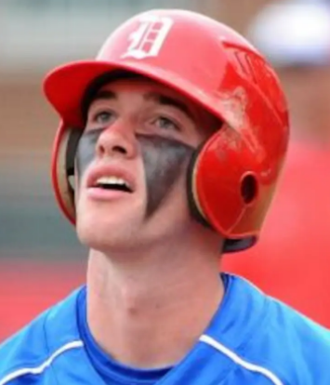
Player decorum
Eye Black
Allowed
Not Allowed
Notes:
Next Slide is . . .

Slide 42
Line-Up Card
A properly completed line-up card is required to be presented to the home plate umpire at the plate meeting
Player first and last name
Player number
Player position
Notes:
Next Slide is . . .

Slide 43
Line-Up Card
Lineup cards must be turned in to the scorekeeper 30 minutes prior to the game
Turn in a complete line-up card
(All four copies)
Notes:
Next Slide is . . .

Slide 44
Must Slide Rule
There is no “must-slide” rule . . . It does not exist
Runner must:
  Slide
  Avoid
  Retreat
  Surrender
Notes:
Next Slide is . . .

Slide 45
Base Coach’s Box
Base Coaches are required to stay in their box, unless necessary to avoid being in the play
Base coaches must also provide a working area for the umpires
Notes:
Next Slide is . . .

Slide 46
Calling Time
No player or manager can call “time-out”
  Players and managers request a time-out
  Only Umpires can call a time-out
Umpires are under no obligation to grant a time-out request
Umpires will not grant requests for time-out to kill the play, or to protect runners
Notes:
Next Slide is . . .

Slide 47
Defensive Visits
The manager may request time and visit with any member of the defense.
A visit with ANY member of the defense is a charged visit to the pitcher
On the 2nd charged visit in any inning, the pitcher MUST be removed.
On the 3rd charged visit during the game, the pitcher MUST be removed.
  Visits start over upon change of pitcher.
  8/9/10 – 3rd charged visit in an inning or 4th in a game
Notes:
Next Slide is . . .

Slide 48
Defensive Visits
Injury visits do not count as charged visits, however . . .
If an umpire hears any discussion other than the status of the injury and the health of the player, the visit will count as a charged visit.
  Yes . . . the umpires will accompany the manager during the injury visit
Side note: should a player come out of the game due to injury or illness, that player cannot return without written clearance from trained medical personnel
Notes:
Next Slide is . . .

Slide 49
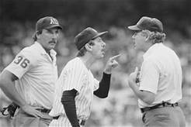
Appeals
Appeals must be made during a live-ball situation
Appeals must be made before the next pitch or play
Appeals will NOT be considered for umpire judgment
Notes:
Next Slide is . . .

Slide 50
Asking for Help
By rule, umpire judgment cannot be appealed or protested
However, umpires want all calls to be correct . . .
Notes:
Next Slide is . . .

Slide 51
Asking for Help
Should you wish to discuss a call with an umpire
Request time - - - from any umpire
When granted time, approach the umpire who made the call
Discuss the issue
Return to dugout and await the decision
Notes:
Next Slide is . . .

Slide 52
Asking for Help
Asking for help for judgement is not a valid question.
  “Hey blue, I think he was safe. Can you get some help?”
Asking for help because of something factual may be considered
  “I think the 1st baseman pulled his foot”
Remember, the umpires will get the call right as best as possible… Be kind courteous and approachable and you will be treated the same way.
Notes:
Next Slide is . . .

Slide 53
Protests
Protests for improper rule application must be made before next pitch or play
  If a protest is filed, play will cease until a ruling is made
Protests for the use of an ineligible player must be made prior to the next game
  The use of an ineligible player shall result in the team being disqualified and removed from the International Tournament
Protests will NOT be considered for rulings involving umpire judgment
Notes:
Next Slide is . . .

Slide 54
Protest Procedure
Manager calls time and informs an umpire of a RULE being protested.
Umpires on field will confer and present on field ruling to manager.
Manager decides, “I don’t agree” can request escalation.
Umpires will confer with tournament director for a ruling.
Manager decides, “I don’t agree” can request escalation.
Tournament director will call West Region Headquarters for a ruling.
Manager decides, “I don’t agree” can request escalation.
Tournament director wakes up someone in Williamsport and gets ruling.
Williamsport ruling is final
NOTE: Procedure can be stopped at any time by manager protesting by withdrawing protest or accepting the ruling
Notes:
Next Slide is . . .

Slide 55
Between Innings
Pitcher has up to one (1) minute or up to eight (8) warm-up pitches
  The clock starts upon the 3rd out
Leadoff batter only is permitted in front of their dugout
Managers/coaches are not allowed in fair ball territory
Base coaches must stay in their dugouts until catcher throws to 2nd base
Notes:
Next Slide is . . .

Slide 56
Good Luck!

