Slide 1
FCCLA Affiliation

Slide 2
Affiliation Portal
QUICK TIP
Bookmark the portal for easy access. Your affiliation portal will have many resources located in it.
Affiliation Portal is located on National FCCLA - fcclainc.org (bookmark)
Click on Login, (top header).

Slide 3
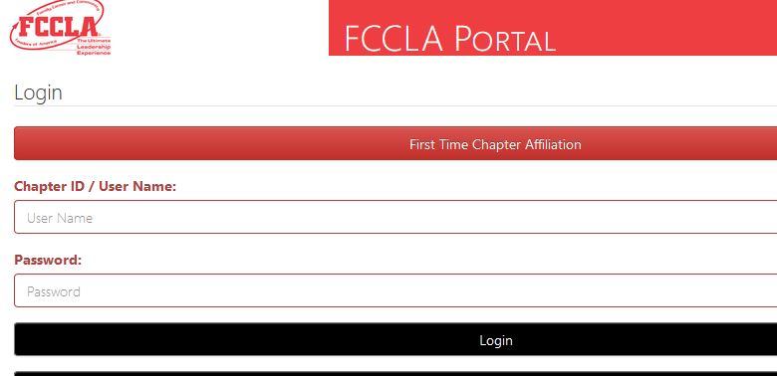
Chapter ID/User Name: and Password will be given to you by Gail Taylor
When you open portal:
Enter your Chapter ID and password and click on Login in
Do Not click here unless told to by Okla. FCCLA Staff
Enter your chapter number here
Enter password here

Slide 4
Graduating Preferences:
Middle School Chapters:
Graduation Preferences - this will be the highest grade of your Chapter
Treat Graduation member - Move on to various chapter
High School Chapters:
Graduation Preferences - 12
Treat Graduation member - Eligible for Alumni & Associate

Slide 5
When you login for the first time you will need to check all Chapter and school information - Any box that is red will need information in it.
Double check your email
School Address
Chapter Affiliation Type:
Comprehensive

Slide 6
COLLECTING MEMBERS INFORMATION
Upload Member Affiliation Information Sheet into a Google Form. If you link your form to google sheet you can download and upload into affiliation portal.
If you need assistance with Google forms please call Gail @ 405.743.5472 or Brittani @405.743.5467 we can walk you through the process.
Notes:
You can add T-shirt sizes for Chapter t-shirts. If they are interested in a STAR event – which event? This information is for you only, it will need to be edited out, before uploading into Affiliation Data base.

Slide 7
Oklahoma Affiliation Date: October 10th
(Your chapter will not be affiliated until Nat’l recives payment. Using a credit card will instantly affiliate your chapter)
Not to be confused with National’s affiliation date, November 1. If your chapter is not affiliated by this date you will not be able to access any teaching or competitive event resources!
There is a 12 member minimum when you affiliate. FCS allows you to use your 412 monies in the amount of $168. This will affiliate 12 members @ $14 each($9 – National, $5 – State). Adviser dues are $24 – National ($9), State ($5) and Oklahoma FCCLA Alumni membership Dues ($10)
Notes:
If you have just a few members interested in the beginning go ahead and affiliate them. You can add members as they join, because you have the 12 member minimum does not mean you have to wait for twelve to join.

Slide 8
Contact us
Brittani - 405-743-5467
brittani.phillips@careertech.ok.gov or Gail - 405-743-5472
gail.taylor@careertech.ok.gov

Slide 9
Resources
Oklahoma FCCLA Website
Registration for Oklahoma FCCLA events
Oklahoma FCCLA Adviser resources
National Website
National events registration:
Affiliation Portal
Register for National Events

