Slide 1
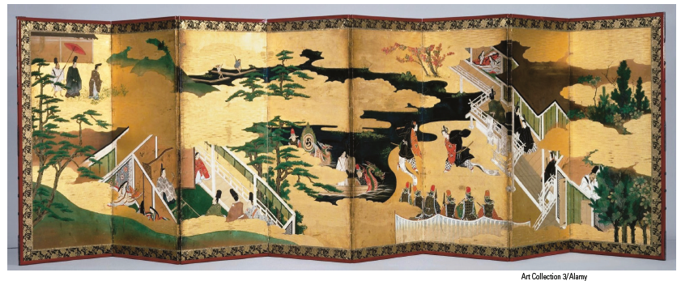
Chapter 12
Responding to Literature
The Tale of Genji, written in eleventh-century Japan by Lady Murasaki Shikibu, is the world’s first novel. As it chronicles the life and many loves of Prince Genji, the novel deals with the universal themes of coming of age, desire, and the passage of time, making it relevant even to today’s readers. The decorative screen shown here is illustrated with scenes from the novel. What stories do you see? What aspects about those stories might you relate to?

Slide 2
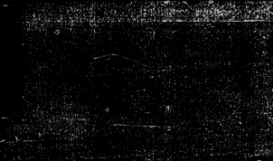

Close Reading
Typically, a writing assignment in a literature or humanities course requires you to read closely a literary work (short story, novel, play, or poem) and then to divide it into elements, explain its meaning, and support your interpretation with evidence from the work. You might also be asked to evaluate a selection or to compare and contrast several readings. Such analysis is not an end; its purpose is to illuminate the meaning of the work, to help you and others understand it better.

Slide 3
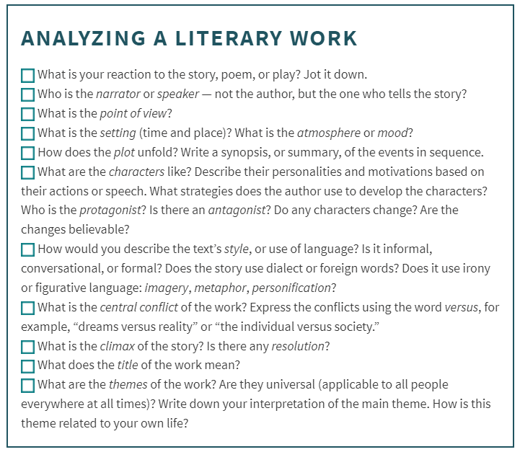
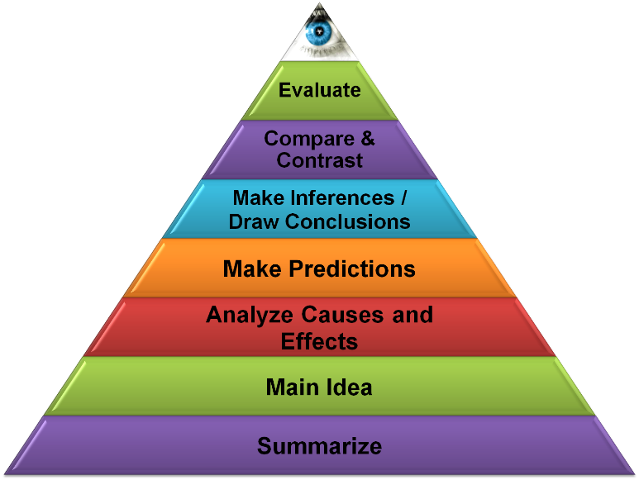

Slide 4
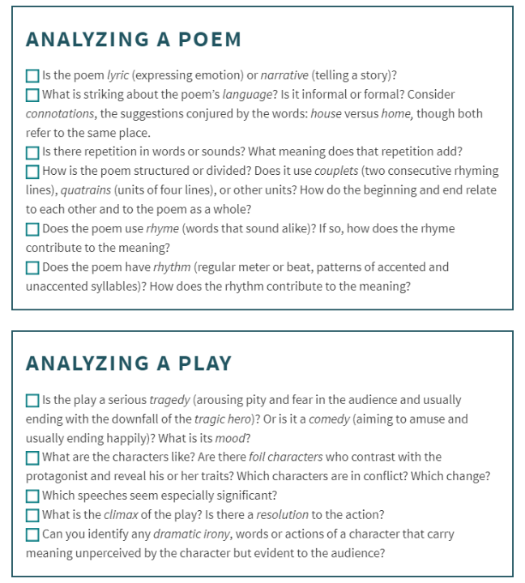
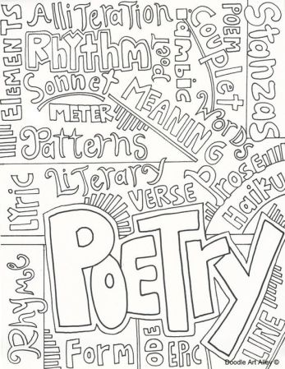

Slide 5
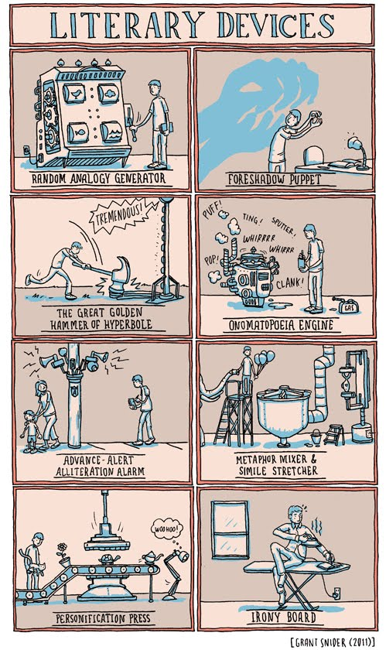
Glossary of Terms for Literary Analysis
Characters
Figures of speech
Imagery
Irony
Plot
Point of view
Setting
Symbols
Theme

Slide 6
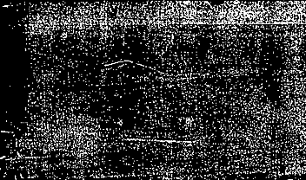
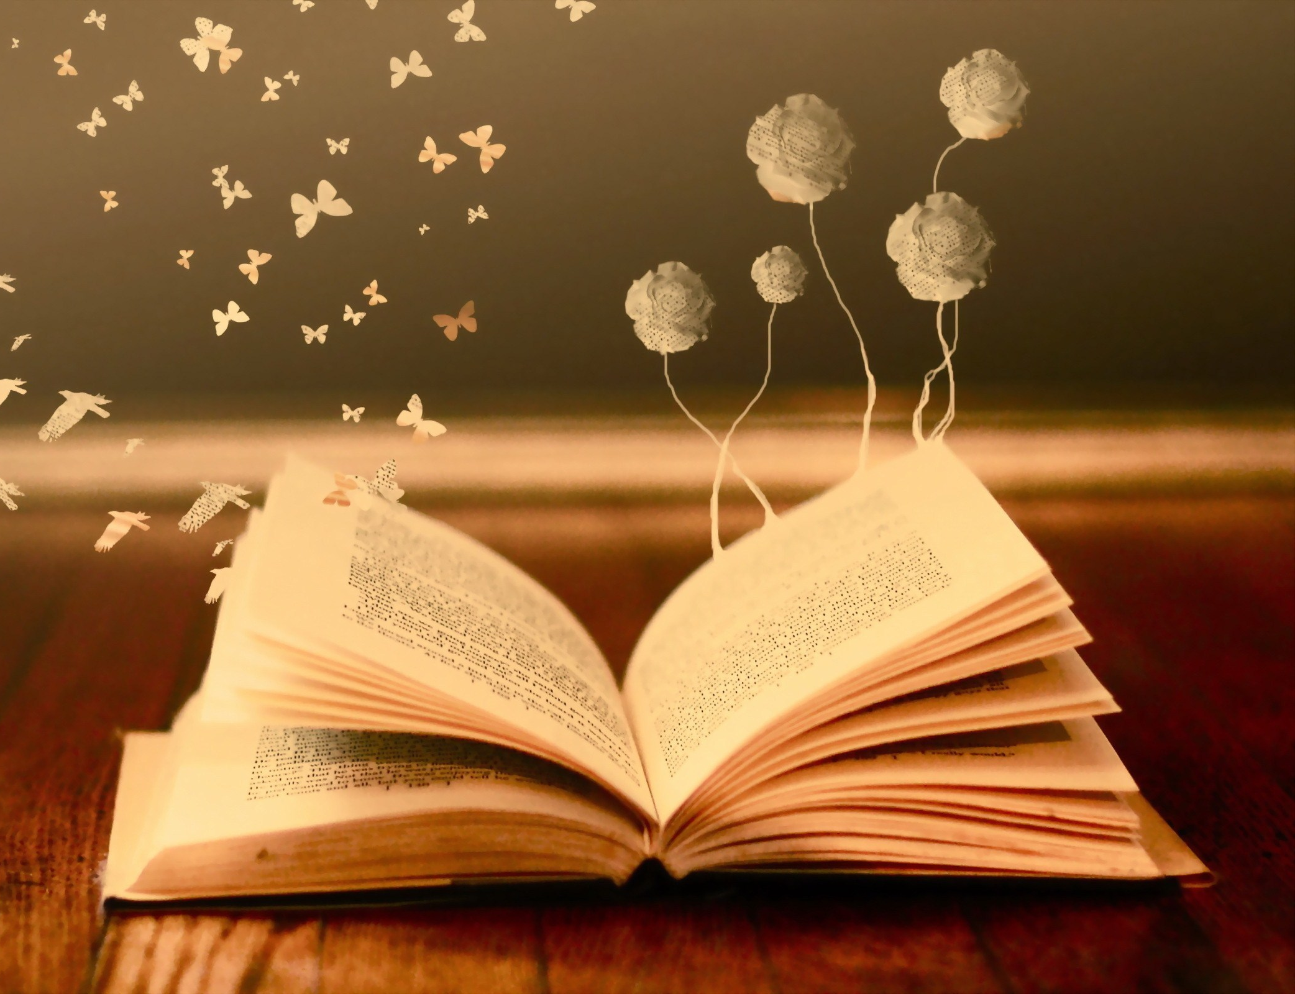

Learning by Writing:
Literary Analysis
Critique a literary piece by analyzing, interpreting, and evaluating
Deepen readers’ understanding of the piece
Focus on one major aspect of the work
Analyze ideas, rather than retelling what happens
Study the checklists in the chapter

Slide 7
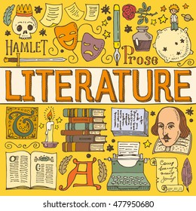
Introduction
To start your essay:
  Focus on a character’s universality– or lack thereof…
  Focus on a theme’s universality – or lack thereof…
  Quote a striking line from the work
  Make a statement about the work’s point
  Ask a question about the story

Slide 8

For example

Slide 9
Do Good Fences Make Good Neighbors?
A Close
“Re-reading” of
The Poetry of
Robert Frost

Slide 10
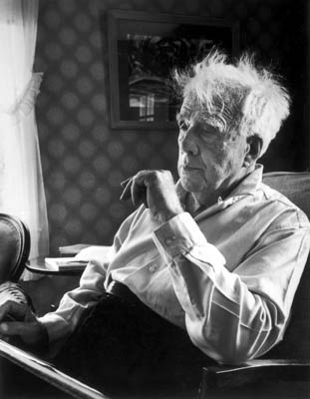
Robert Frost
Frost drew his images from the New England countryside and his language from New England speech. Although Frost’s images and voice often seem familiar and old, his observations have an edge of skepticism and irony that make his work, upon rereading, never as old-fashioned, easy, or carefree as it first appears. In being both traditional and skeptical, Frost’s poetry helped provide a link between the American poetry of the 19th century and that of the 20th century.
About Frost, President John F. Kennedy said, “He has bequeathed his nation a body of imperishable verse from which Americans will forever gain joy and understanding.” Considered himself inspired by the poetry of Emily Dickinson.
(1874-1963)

Slide 11
Surprised by
Frost-y poetry
Frost emphasizes that he wants to be just as surprised by the poem as is the reader. Frost contrasts scholars, who get their knowledge “with conscientious thoroughness along projected lines of logic,” with poets, who get theirs “cavalierly and as it happens in and out of books.”
So can we be “surprised” by America’s Poet Laureate?
Even his poem “The Road Not Taken” can be seen as darker than it usually is interpreted– maybe it makes no difference which road you take, cause they’re both “just as fair”…think about it…

Slide 12
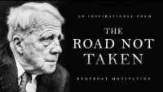

Slide 13
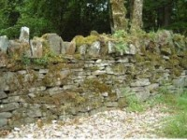
Question for thought
Question: Do walls protect us or isolate us? What does Frost’s narrator actually say? You need to close read. But let’s see one possible reading.

Slide 14
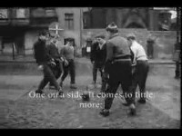
Can you see how the connections are made?
Pay attention to imagery in this video which will be repeated in others…

Slide 15
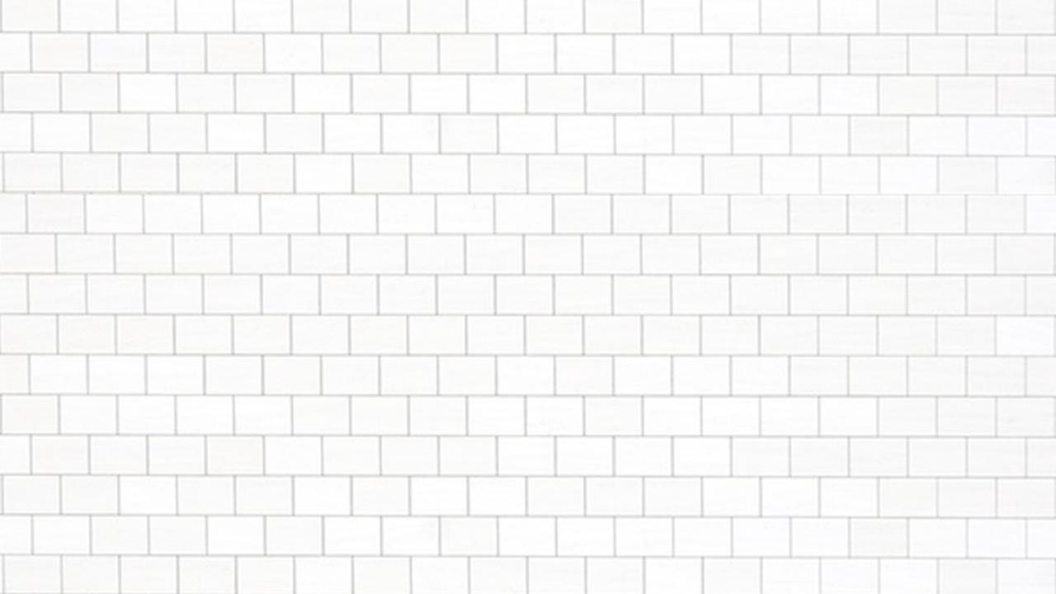
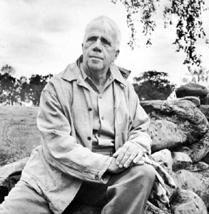
Thematic Interpretive Link:
Walls As Isolation or Protection?
Humankind erects and maintains real and symbolic barriers to protect and defend opposing stances, beliefs and territories. The resulting lack of communication often then reinforces those barriers. Is it often to detrimental effect?
“Something there is that doesn’t love a wall…”

Slide 16
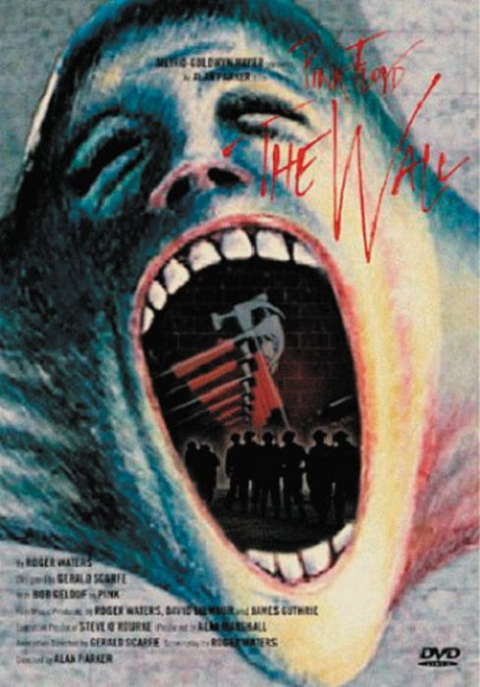
What does Pink Floyd have to do with it?
Another Brick in the Wall
We don’t need no education
We don’t need no thought control
No dark sarcasm in the classroom
Teachers leave them kids alone
Hey teacher leave them kids alone!
All in all it's just another brick in the wall
All in all you're just another brick in the wall
[chorus at end by pupils from the Fourth
Form Music Class Islington
Green School, London]
We don’t need no education
We don’t need no thought control
No dark sarcasm in the classroom
Teachers leave them kids alone
Hey teacher! leave us kids alone!
All in all you're just another brick in the wall!
All in all you're just another brick in the wall.

Slide 17
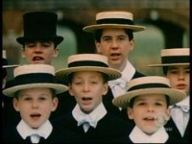

Slide 18
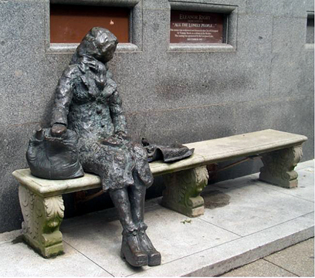
Now we’ll look at The Beatles’ “Eleanor Rigby.”
This song is considered by many to be a masterful psychological portrait of two lonely people, cut off from most human contact. Speculation on what barriers turned these individuals into loners.
From Liverpool. Does the statue invite company? Does it fight isolation?

Slide 19
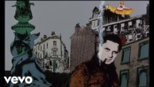

Slide 20
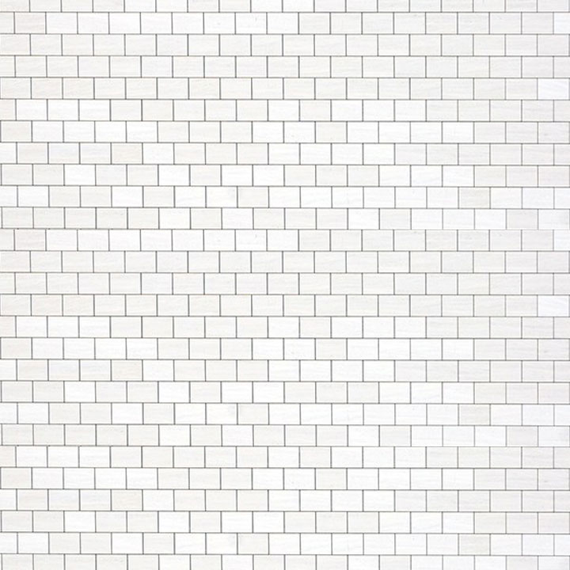

Think about
  Actual walls in history
    Great Wall of China,
    Berlin Wall
    Iron Curtain? Bamboo Curtain?
  Symbolic walls?
    Glass ceilings
    Cultural/class barriers?
    Geographic Borders?
  What do walls represent physically, psychologically, and politically.
  What kind of barriers in communication in today’s world (i.e. language, overuse(?) of technology)

Slide 21
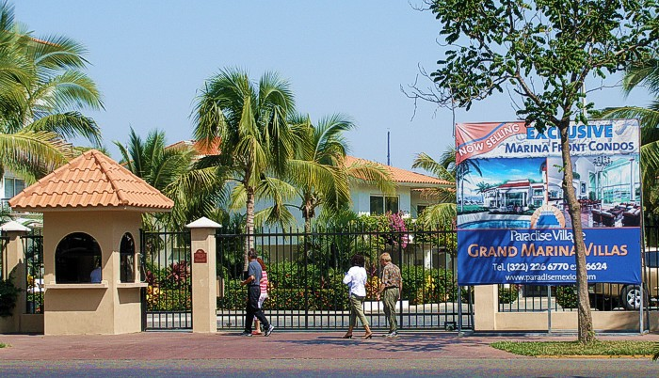
What else do we use walls for?
Other kinds of walls here in the U.S.?

Slide 22


Slide 23
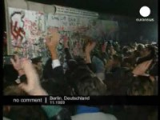

Slide 24

Walls? Should we as a society continue to “tear them down”? In some ways, this speech is viewed as an incredible moment of American History. Is it Literature? Is it poetry?
And then such a text enters the Popular Culture, and gets changed. What is the image of “The Great Communicator” here? Why?
What is our final verdict on walls, then? Literature, movies, music, all have themes related to isolation & walls. Something there is that doesn’t love them, in pop culture.
Frost may seem old fashioned, “nice” poetry, at first, but he really addresses an important modern issue. Isolation? Or Protection? Which is it? Can it be both?
Or, sometimes, walls can be used for symbolic functions, too, which can represent healing…

Slide 25

can walls “heal” too?

Slide 26
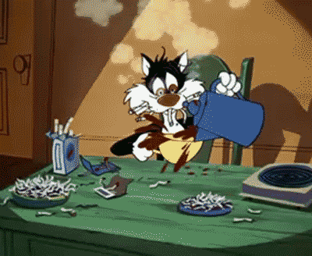
Homework
Writing: Finish your narrative essay, due Friday, midnight.
Prepare for your Midterm Review Essay, next Tuesday in GH 216, which will then be due Oct 24.
Weekend Reading, Bedford CH 13, 14 & 15.

