Slide 1

aB/DL DIY and Building the Play Space of your Dreams
Presented By: Baby Jp

Slide 2
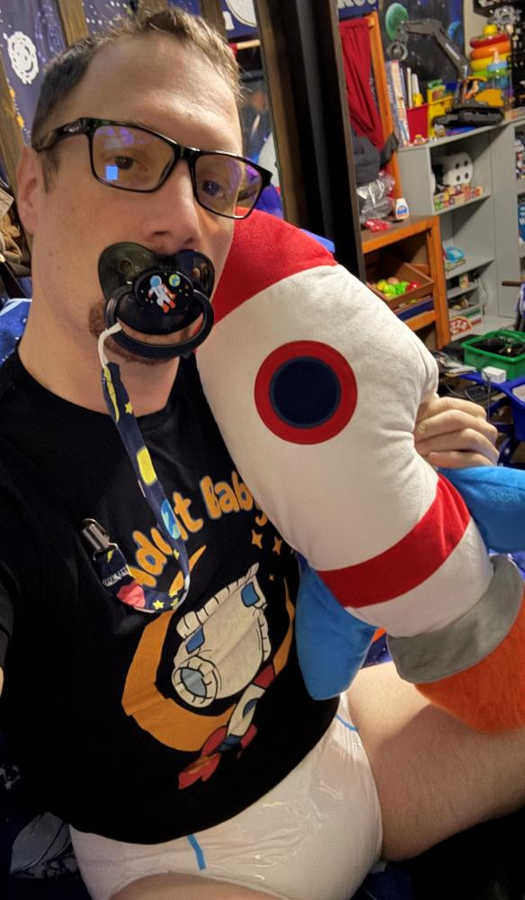
A Little about Me
(Age play Community)
+20 Years active in the AB/DL Community
AB/DL Furniture Designer
Part Owner of Lake Erie Age Players (LEAP) Community
Writer and AB/DL Informative Content Creator
Owner, Operator, and Editor of “Adult Baby Steps” a Free Informational AB/DL website and YouTube Channel.
24/7 AB/DL for 7 Years

Slide 3

A Big About ME
(Adulting Side)
Ex-Commissioned Army Officer and Military Academy Graduate
Completed a Masters Degree in Education (English)
Built and Operates a “Makerspace” & Workshop
Avid Cyclist, Kayaker, and Reader

Slide 4
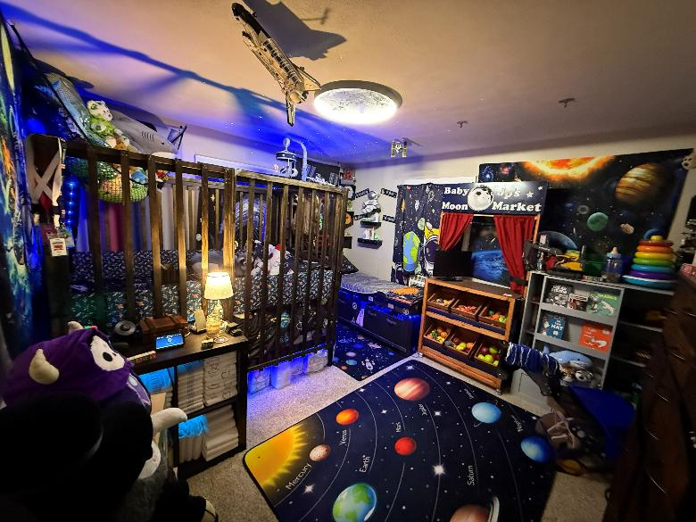
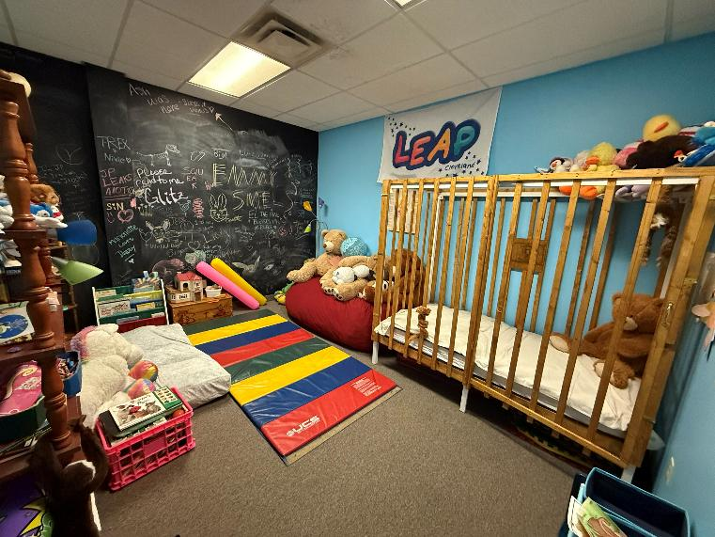
Play space Planning
Starting out, approach building your Nursery or play space like an interior designer. Take some time to select a central theme, color palette and bookmarking design elements and figuring out a room layout. This prior work will pay dividends in the long-term.
Elements to consider:
Theme
Lighting
Playmats
Paint colors
Wall Hangings
Furniture
Special considerations
  If you are planning on installing a jolly jumper, you’ll need to trouble shoot how to structurally secure it to joists or plan for an A-frame
  A crib and a changing table might be in the future, but you can take measurements to determine where it will go years before making such an investment

Slide 5
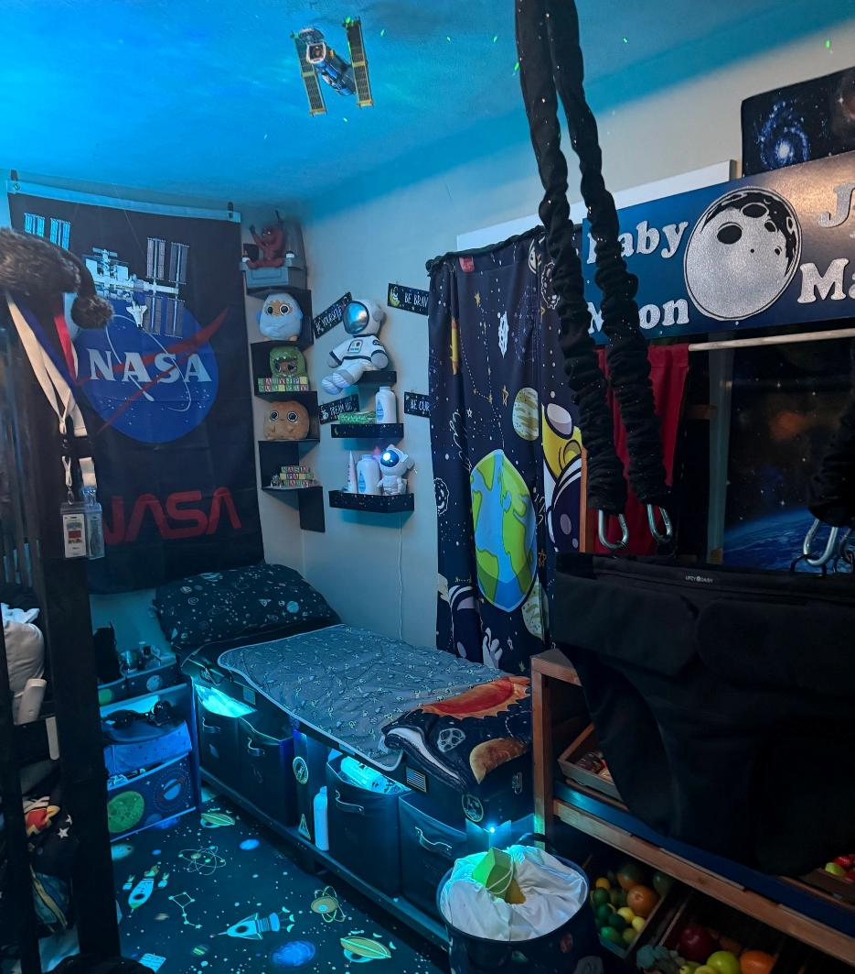
Picking a Theme
When building an immersive play space, you’ll want to select a central theme and color palette that can assist in tying everything together. The theme should be something important to the nursery’s occupants.
Before settling on a theme, some things to consider:
What resources and products are available to build your theme?
  Are there Lighting elements that compliment the theme?
  Wall and ceiling hangings and décor elements?
  Playmats?
The more popular and broader the theme the easier it is to create a themed nursery.
  Space
  Dinosaurs
  Trains
  Princess
  Tea party
  Sharks
  Paw Patrol
  90’s Cartoons
  Bluey

Slide 6
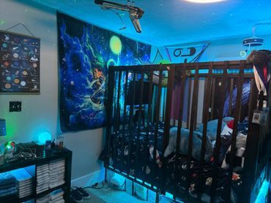
Walls
The Nursery Walls can be a feature to your play space more than just simply painted in your favorite color. If you enjoy being a little artist, you can paint a wall with whiteboard or chalkboard paint.
Shelves are great for displaying favorite toys and décor… also hanging shelves near the changing table for changing supplies within caregiver or personal reach are great for functional use.
Wall hangings, posters, and pictures can help create an immersive environment
Custom made flags, Pride, Trans, or AB/DL flags makes a great wall backdrop
A stuffie hammock is great to keep the floors clear and adds a wonderful design element

Slide 7
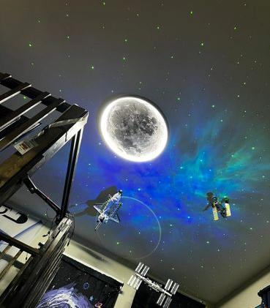
Lighting and Ceiling
  Changing the central lighting element can transform a simple room into an immersive play space. When looking on changing the lighting picking a lighting element that can be remote controlled or voice controlled by a home device is a great creature comfort.
  RGB light strips can add an additional visual element that can accent while also add a functional element for areas like changing supplies, and furniture.
  Monofilament fishing line and small eyelet screws are great to add visual stimuli in the ceiling
  Star Generators are a cheap and creative way to add an exciting element to bedtime and dimly lit playtimes.

Slide 8
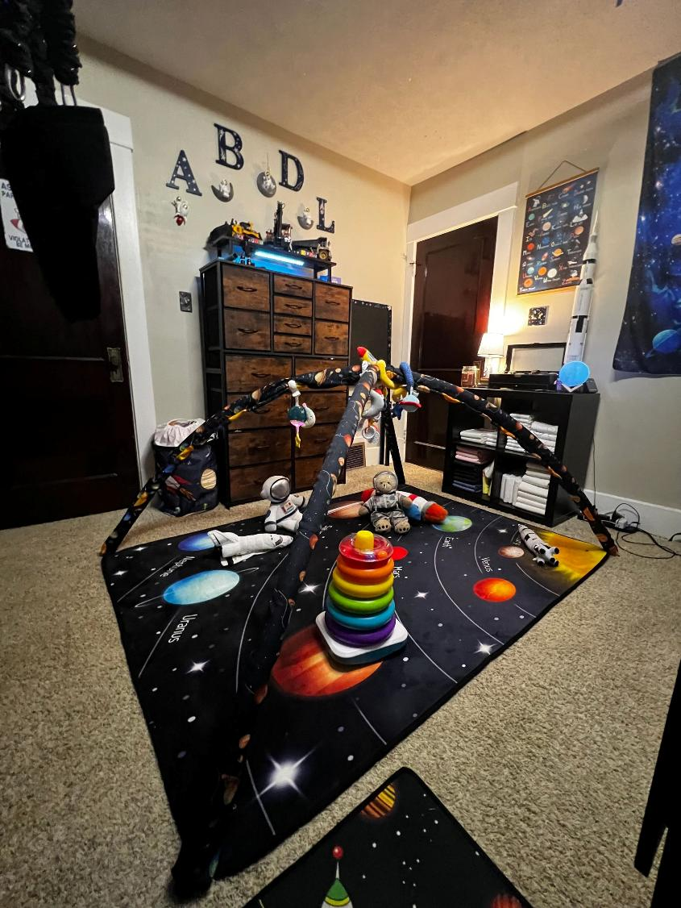
Playmats
Tummy time is all the better when the floor is more than simple carpet and a play mat adds visual stimuli. The playmat can also double as an AB/DL baby gym. (Design can be found www.adultbabysteps.com)
Playmats also are ideal for littles that enjoy playing with toys like Legos that can get lost in plush carpets.

Slide 9
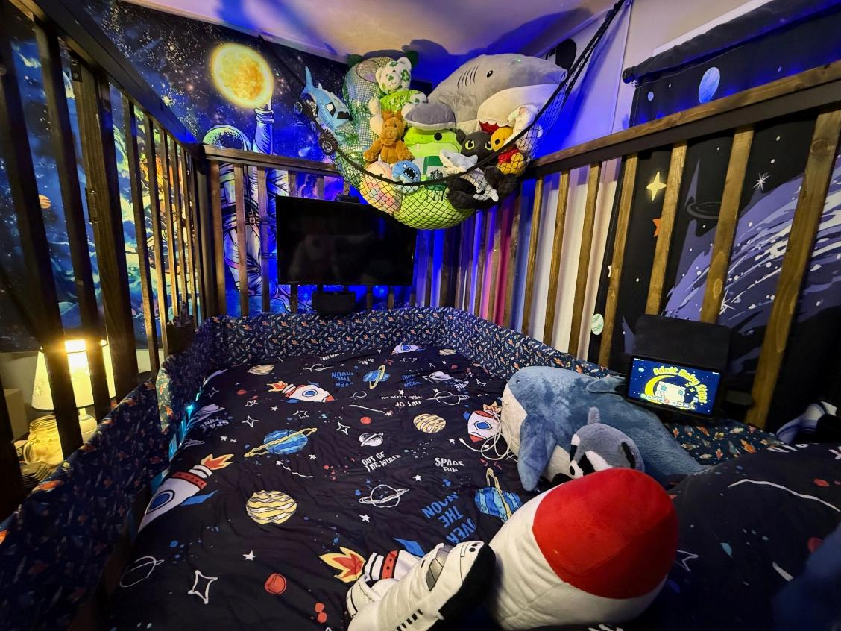
AB/DL Furniture Builds
Building your own AB/DL furniture is not only possible, but it is less complicated than you’d realize. “Hybrid building” takes something that is structurally sound like a bed frame or high-backed chair and with modification converts the initial item into your desired outcome. Doing this keeps the furniture safe while also making the build as uncomplicated as possible and inexpensive as it does not require high end tools or carpentry skills.
Free Designs, parts lists, and walkthroughs can be found at www.AdultBabySteps.com The designs we currently have are for:
Crib
Highchair
Block Shelves
Rocking horse (Monkey rocker variant)
Baby Gym
Changing Table
Activity Center

Slide 10
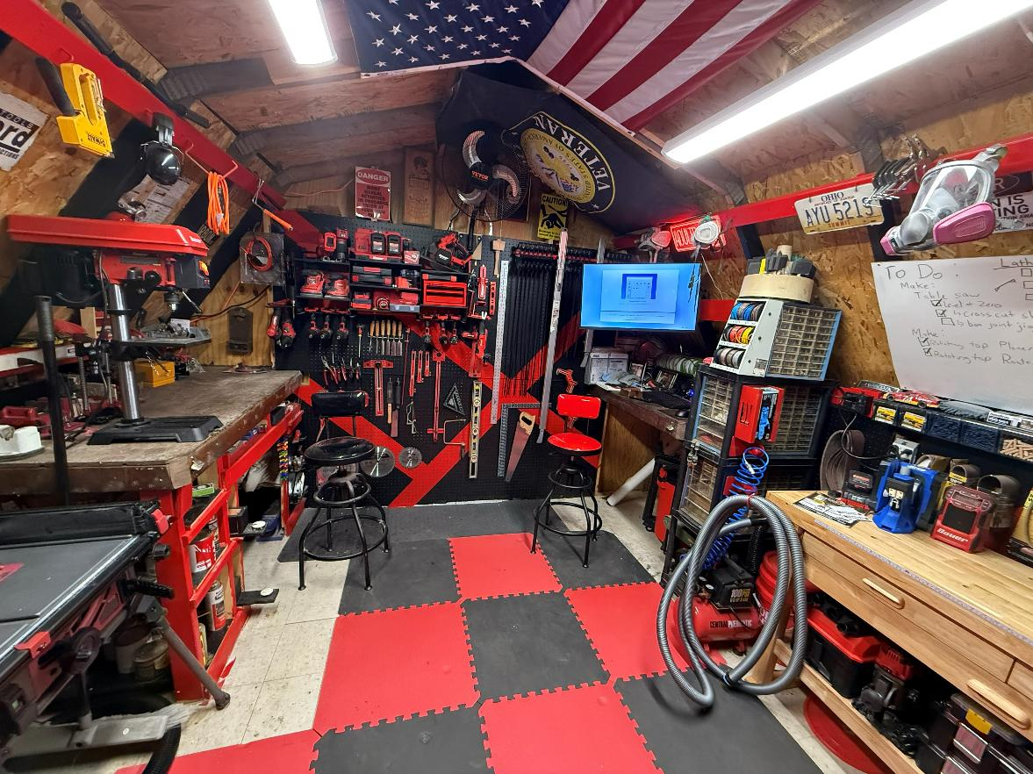
Building a basic tool Kit
Building AB/DL furniture DOES NOT require a workshop, Engineering degree, or unhealthy obsession with watching “New Yankee Workshop” Nearly all AB/DL furniture builds can be created with a basic tool kit.
Basic Tools required:
Power drill or impact driver
Basic saw
Sander
Measuring tape
Clamps

Slide 11
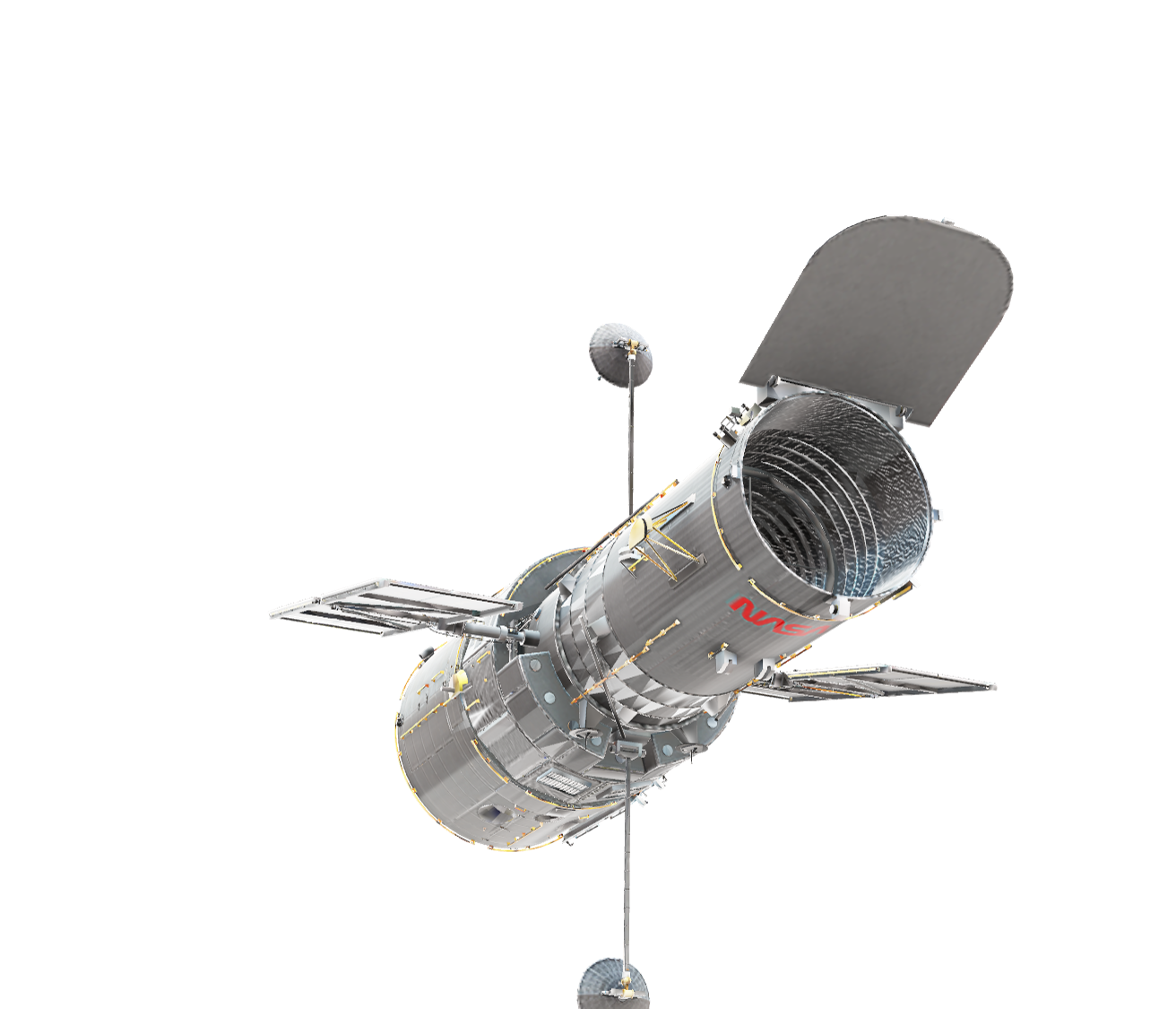
Let’s Talk About Some Builds!

Slide 12
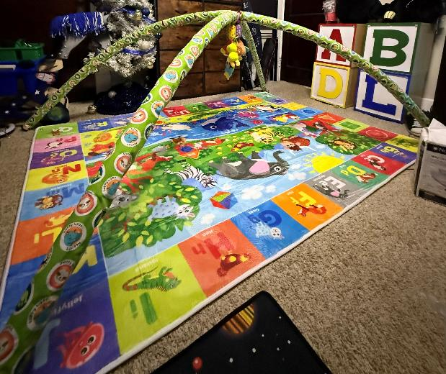
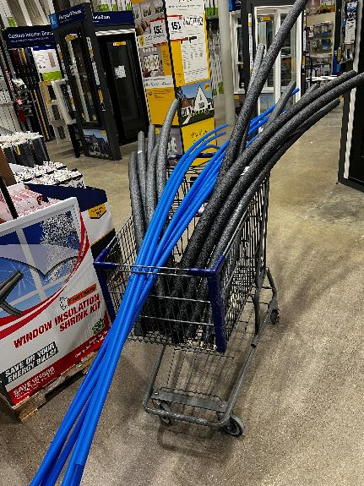
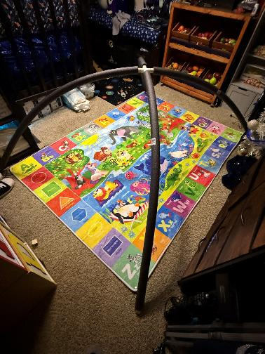
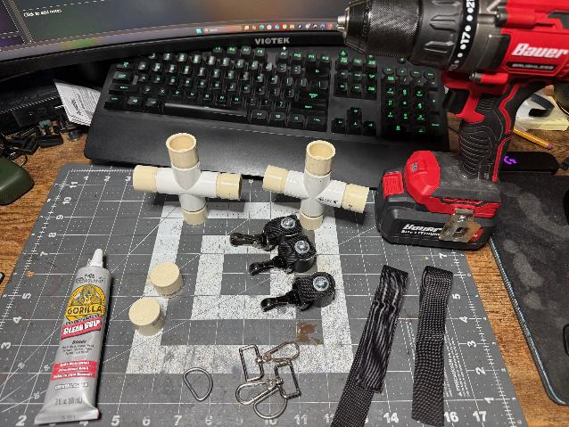
AB/DL Baby Gym
Building an AB/DL Baby Gym is a great starting project for creating a play space/nursery as it adds a large play mat to the space when not in use and it is relatively inexpensive and requires minimal tools.
The Gym is created using standard Plumbing PEX pipes and fittings and requires no serious cutting and can be completed in an afternoon of work.

Slide 13
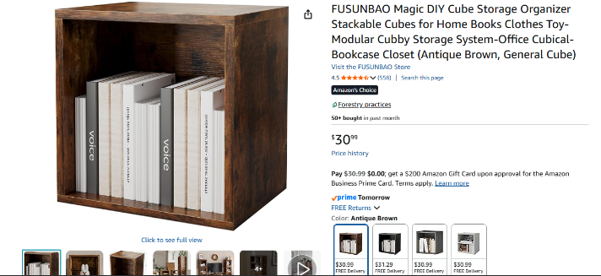
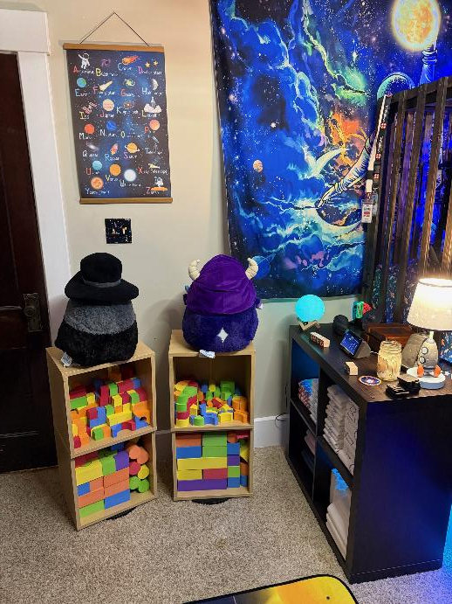
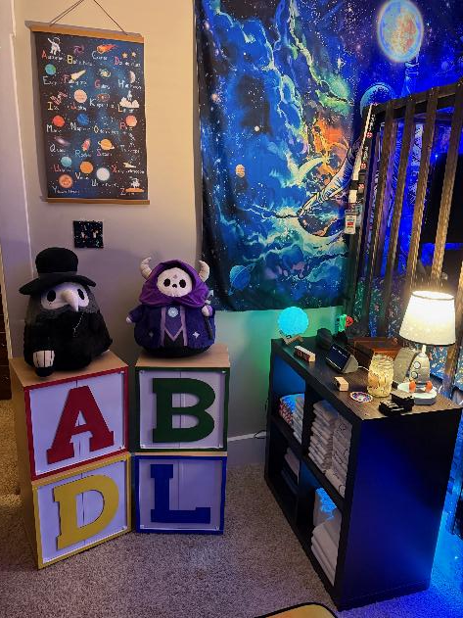
Building Block Shelves
Need a place to store your Block collection or all your favorite toys but also want to add a unique décor element to your developing nursery space? Giant Building Block storage shelves are a fun, uncomplicated build that you can make for your nursery and all it requires is some basic single cube shelves, some paint and some large wooden letters from a craft store. These Shelves are light enough to easily move around, but you can also place them on a Lazy Susan turntable to make them rotate.

Slide 14
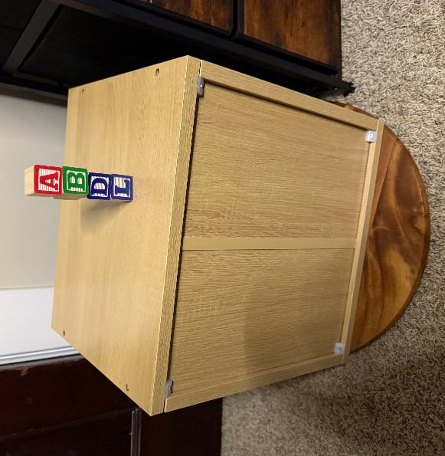
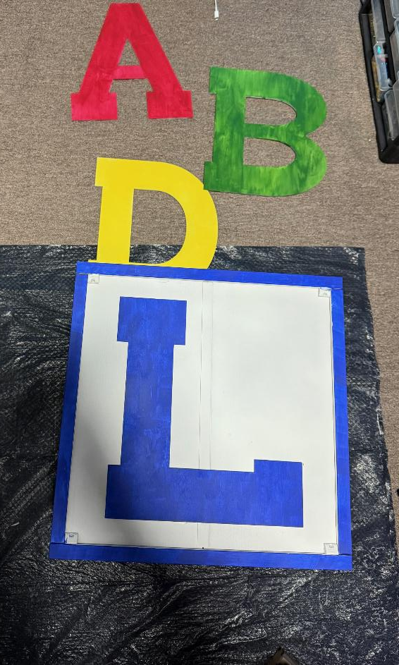
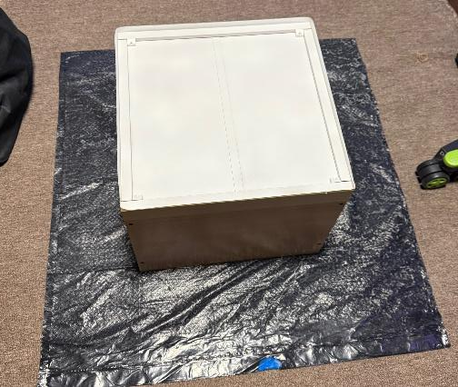
The Building Block Shelf is simple enough to create and takes only a few steps.
Build the Shelf Block
Spray paint the back side a solid flat white
Paint the edge of the Block and the letter of choice your decided color. Acrylic craft paints are great for this. (For best results use multiple coats)
Center and glue the letter in place
Clear Coat to create a protective coating in Flat or Semi Gloss.
Lather, Rinse, and Repeat

Slide 15
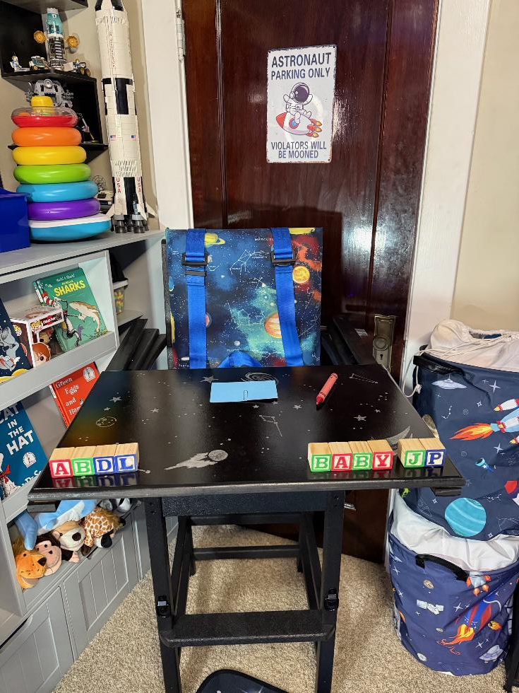
The Highchair
A highchair is something many AB/DLs desire to add to their play space, but building a structurally sound chair can be a challenge. A simple highchair can be created with a director’s chair and a wheelchair tray, but it’s not the same or as comfortable as a true highchair. Using the Hybrid build method a High-backed deck chair can be used as the base for the perfect AB/DL Highchair and a safety harness can be easily added to create an even more immersive experience.
There are several variants this chair build can be create at with increasing levels of difficulty.

Slide 16
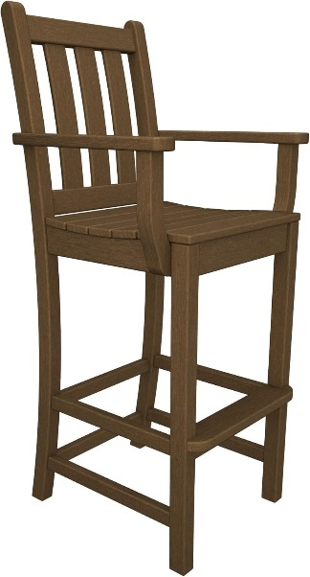
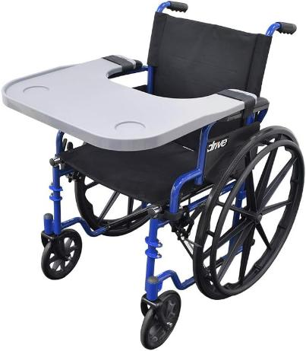
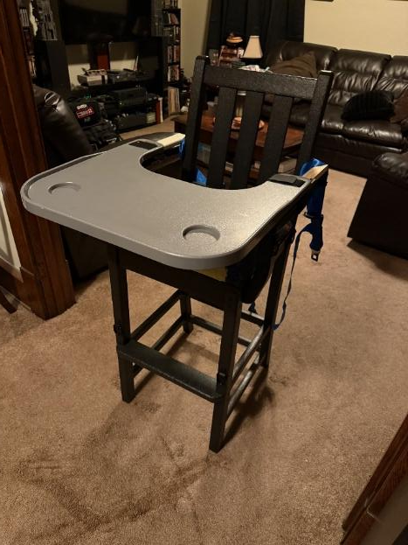
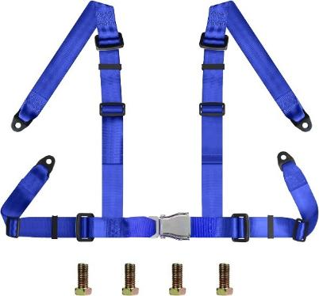
Simple Build
A highbacked Deck chair + a Wheel Chair tray is all that is needed to make a simple highchair with no tools required.
A Go Kart harness can be added with the use of a power drill and some basic hardware.

Slide 17
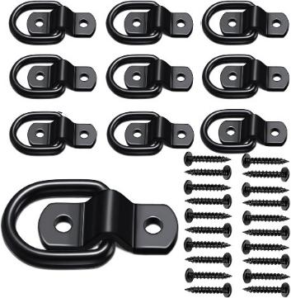
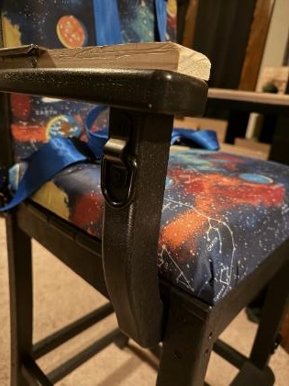
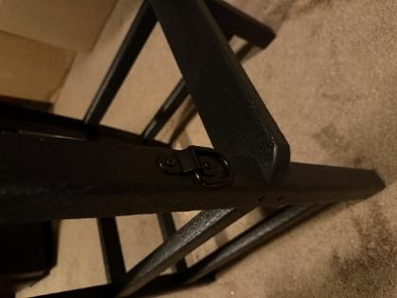
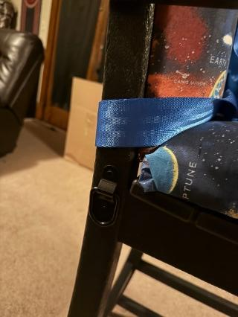
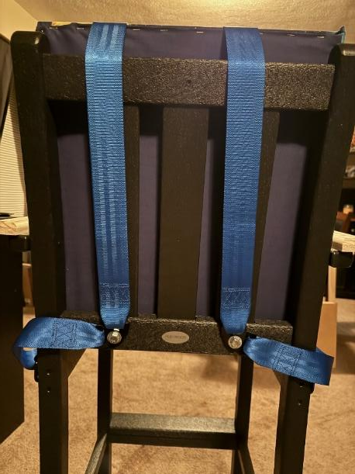
Adding a Dark age play element
Adding Anchor points is easy with some basic hardware, screws, and a drill to keep naughty hands and feet in place.

Slide 18
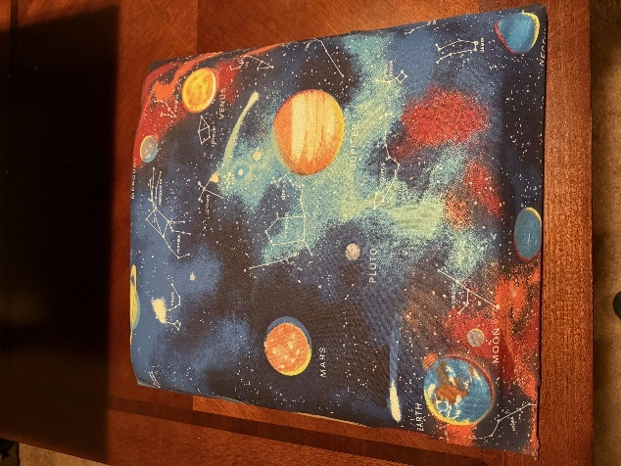
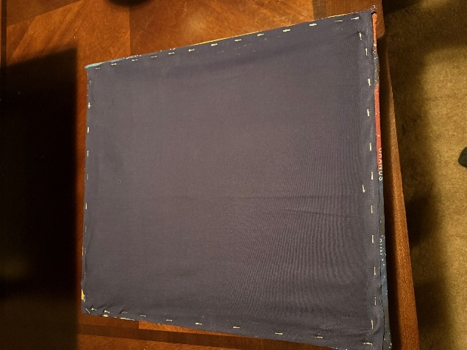
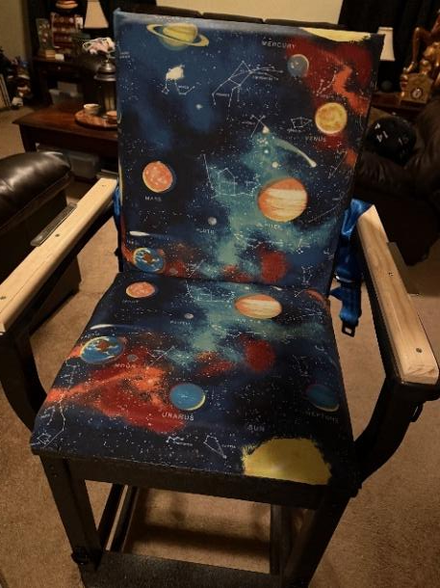
Upholstered Seats
It may seem challenging, but doing come basic Upholstering is as simple as operating a staple gun.
Two MDF boards need to be cut that match the seat and back, then adding furniture cushion padding and your chosen outer fabric, simply lay down the fabric, padding and then the board and kneeling on the board to pull the fabric tight, staple the fabric to the board.

Slide 19
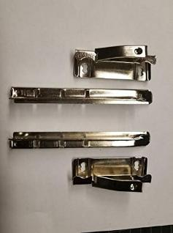
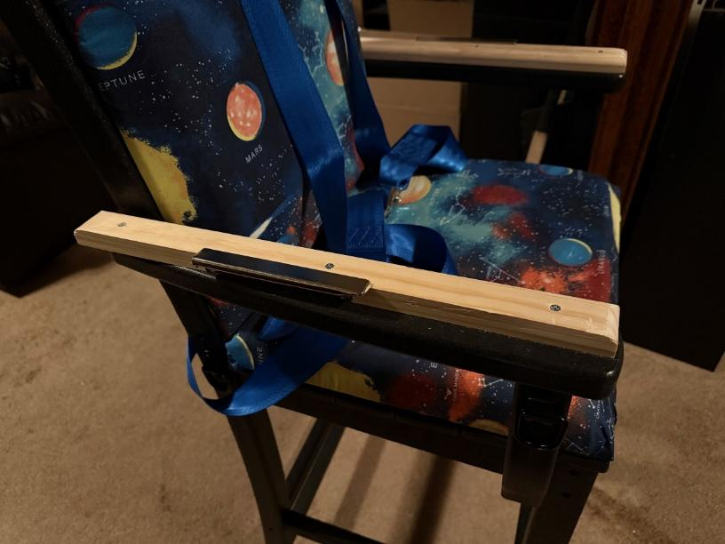
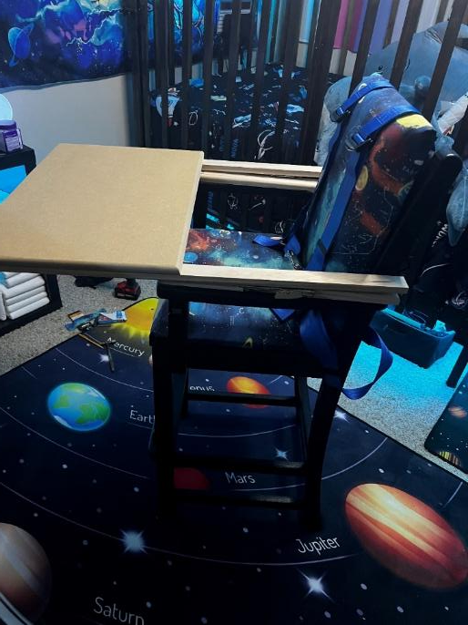
Adding a custom tray
Building a custom tray that incorporates genuine highchair hardware isn’t as complicated as it sounds but does require some adjusting and planning.
Two wooden one-inch risers need to be made for the arms
A tray and two one-inch-thick extensions that will connect need to be created.
Using clamps, you need to line everything up and mark where to secure and once determined, secure everything.
Disassemble, paint and clear coat (If you are using MDF for the tray the board must be completely sealed or it will absorb liquid.)

Slide 20
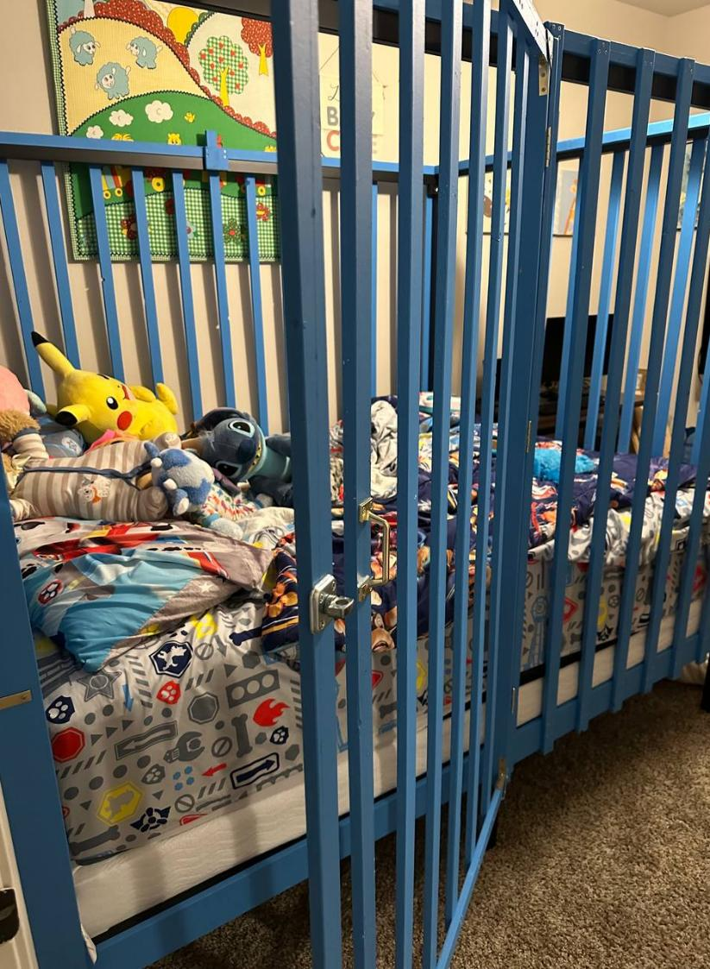
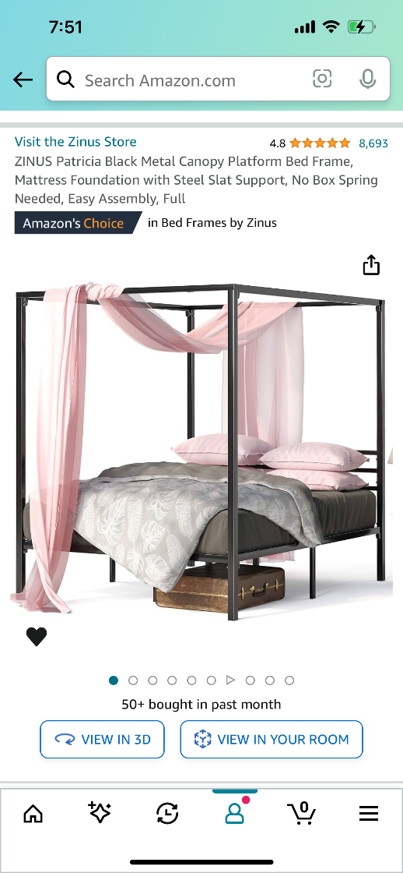
Building a Crib
To build the crib you first need to select a bed size.
Queen – Full – Twin
This build incorporates a canopy platform bed that is rated for 700lbs. The crib experience is best experienced when using a box spring and mattress together.

Slide 21
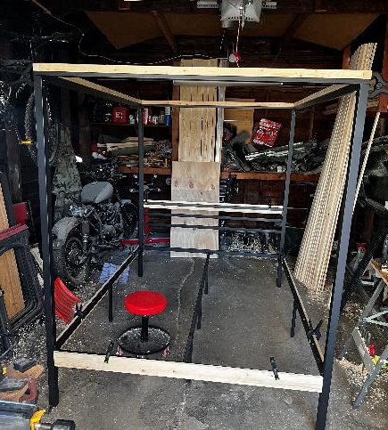
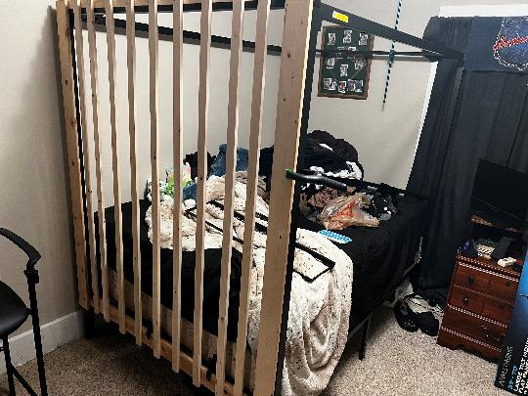
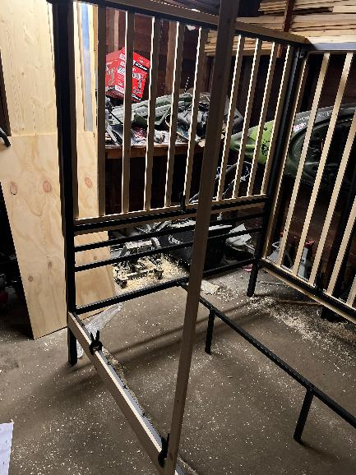
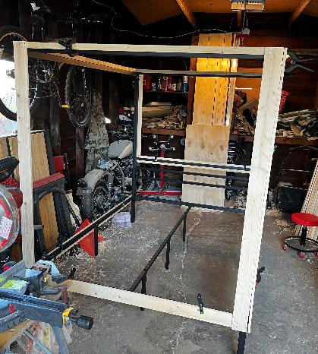
1. Building the crib takes some trial and error. The key is getting the measurements right before cutting. Once that is done, use clamps to hold the rails in place.
3. Installing the rails is tedious, but measuring is key. Start the first rail from the middle of the frame. The spacing should be 4” in between each rail. Depending on what size crib you are building there will be 3-4” of space on the end rails.
2. The crib is built in 4 sections, Headboard, footboard, rail side and gate side. Secure the top and bottom rails with the corner frames. (Think like a puzzle doing the edge first)
4. The headboard of the crib will be nearly a foot and a half shorter than the other rails due to the bedframe design, but with a box spring and mattress this isn’t noticeable.

Slide 22
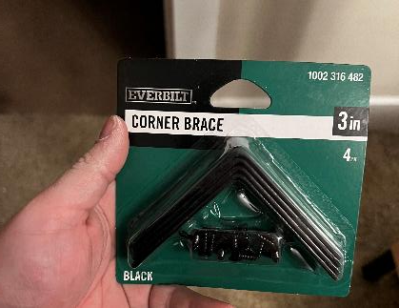
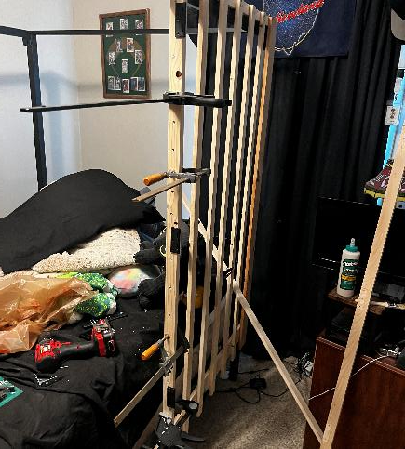
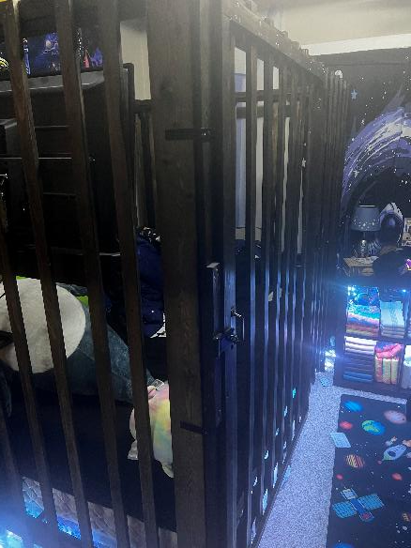
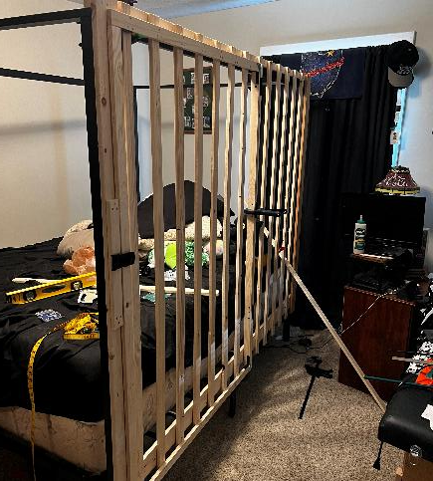
5. The gate side is constructed in two halves. The immovable side is the same as the other rails except the middle rail has an additional piece perpendicular that the hinges and swinging gate will attach.
7. Once all four sides are completed, they can all be hung together and secured with 12 corner brace brackets. Three to each side. These brackets will hold the four sides of the crib together.
6. It is recommended to take measurements of the gate and to build it separately on a flat surface. It will make the build process easier.
8. The brackets should be high middle and low on all four corners to prevent instability. Once the Brackets are installed you should be done.

Slide 23
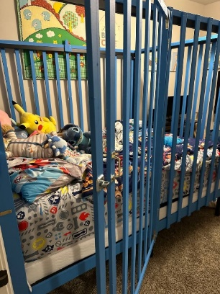

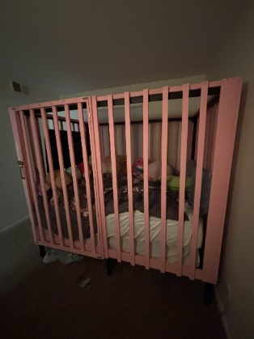
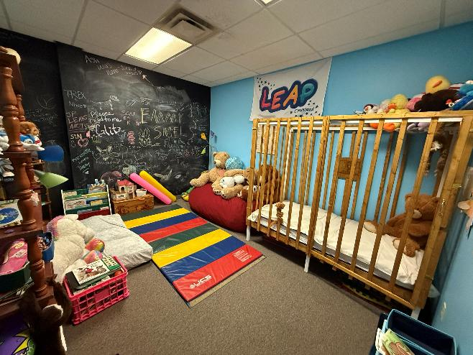
Several AB/DLs have Built a Crib and you can too!
Some accessories and additions you can add to your crib.
Hanging TV
Gaming Console (Switch)
Hanging Mobile
Dark age play elements
  Strap restraints
  Crib gate lock
  Time locks
Underside Diaper Storage
Crib Liner
RGB Lighting
Tablet Mount

Slide 24
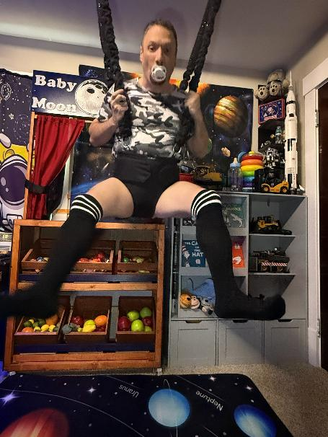






Some Nursery Furniture Ideas

Slide 25




Slide 26

Builds that are being developed in 2026
Future builds will be featured on Adult Baby Steps YouTube Channel
AB/DL Bead Maze
Hanging Crib activity center
Traditional Rocking Horse
Modular Crib revisit
Changing table Revisit

Slide 27

Questions?
More designs and articles can be found and I can be reached on any of my socials found at www.adultbabysteps.com
You can also email me Jp@adultbabysteps.com

