Slide 1

It’s All Just Baby Steps… Working towards your Goals
Presented by: Baby Jp

Slide 2
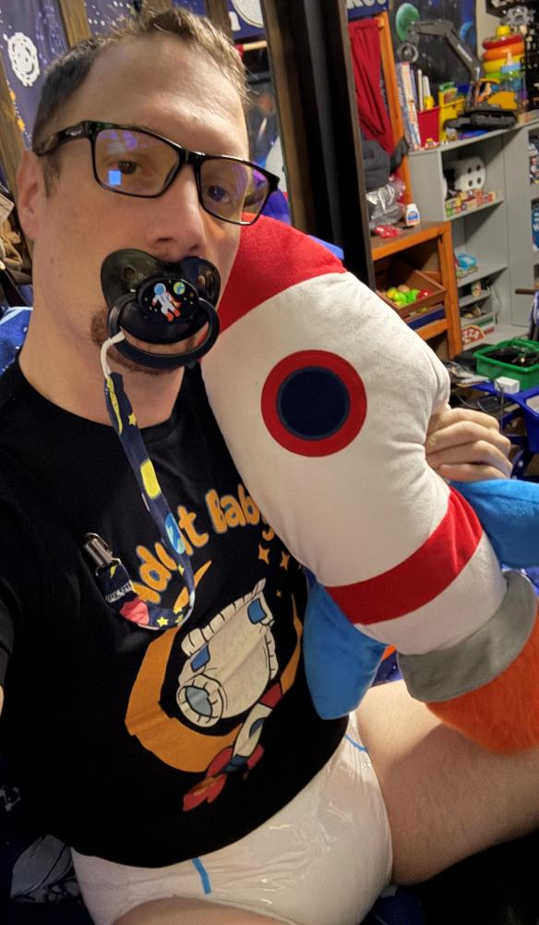
A Little about Me
(Age play Community)
+20 Years active in the AB/DL Community
AB/DL Furniture Designer
Part Owner of Lake Erie Age Players (LEAP) Community
Writer and AB/DL Informative Content Creator
Owner, Operator, and Editor of “Adult Baby Steps” a Free Informational AB/DL website and YouTube Channel.
24/7 AB/DL for 7 Years

Slide 3
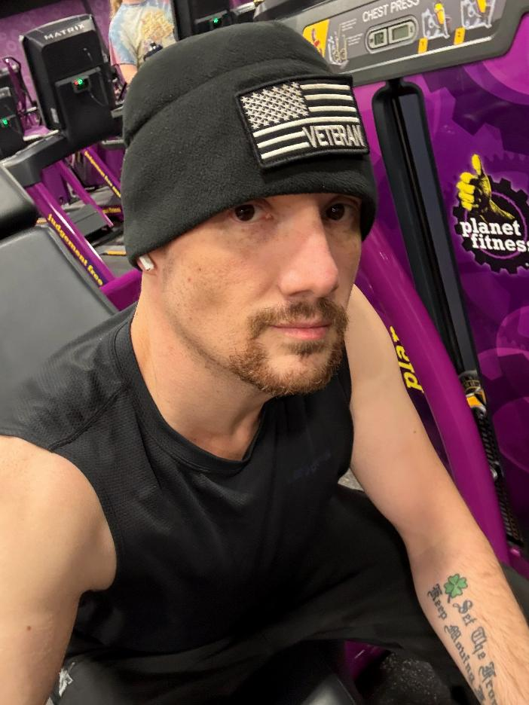
A Big About ME
(Adulting Side)
Ex-Commissioned Army Officer and Military Academy Graduate
Completed a Masters Degree in Education (English)
Built and Operates a “Makerspace” & Workshop
Avid Cyclist, Kayaker, and Reader

Slide 4
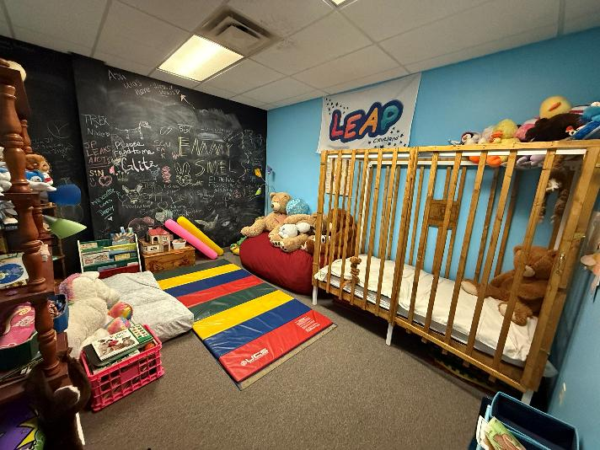
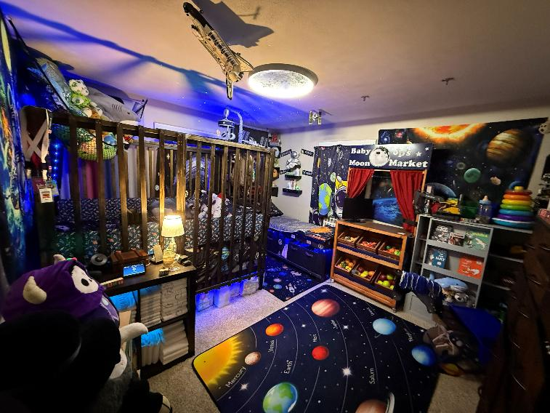
“The Journey of a thousand miles begins with a single step” – Lao Tzu
What are your Goals?
Diapers 24/7
Better Career
Build a Play Space
Fitness Change
Buy a House
Join or Start an AB/DL Community

Slide 5
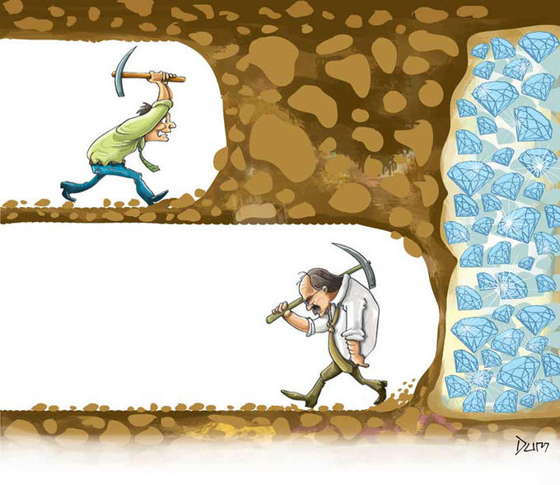
Achieving Goals comes down to one big thing… your determination.
Personal Goals can only be Accomplished by You!
Remove Self Imposed Obstacles:
  The Self Doubts
  The Can Nots
  The Excuses
  The Negativity
  Understand that failures aren’t an End… they are a lesson to learn from for next time

Slide 6
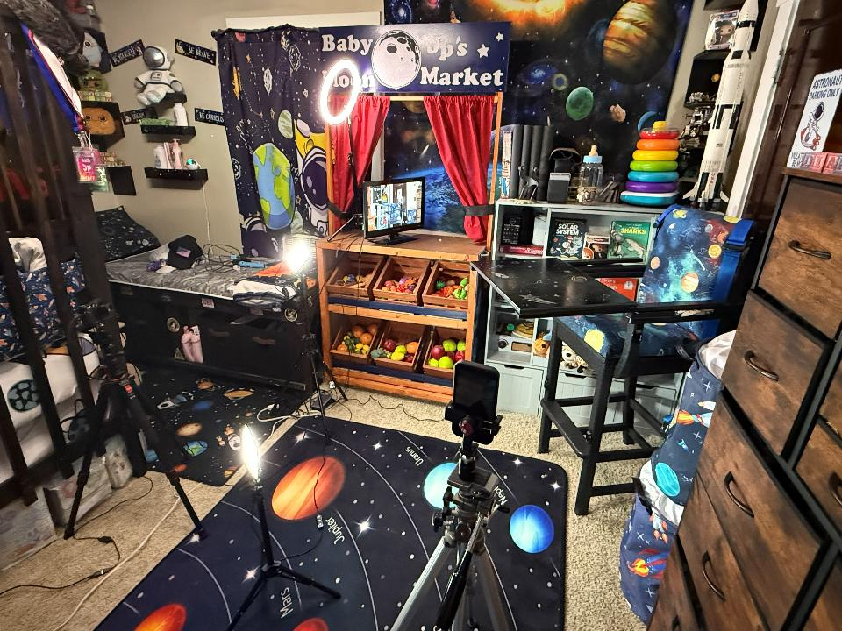
Short-Term Goals verses Long-Term Goals
Short-Term Goals are the steppingstones to Achieve a Long-Term Goal
Short-Term
  Days, Weeks, or Months time frame
  Requires little to no planning
  Example: Completing a workout
Long-Term
  One, Five, or Ten-Year time frame
  Can require long-term research and planning
  Example: Reaching a Weight loss goal

Slide 7
Goal Planning
Identify:
What Change you want to Make
Research:
How you can Accomplish the Goal
Plan:
Set up a Step-by-Step guide with Short-term Goals to Achieve the Long-term Goal
Adjust:
Account for issues. Don’t give up for a bump along the road
Measure:
Try to measure and gauge progress
Motivation:
Find or create a way to keep your “eye on the prize”

Slide 8
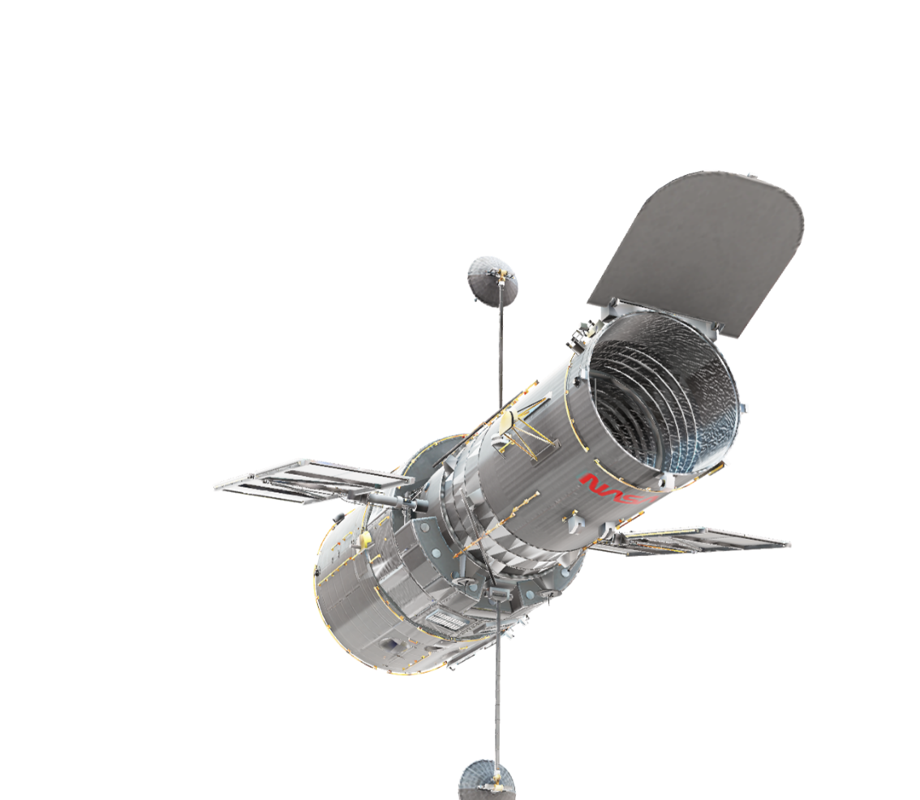
Let’s Talk about some Goals and Ways to accomplish them

Slide 9

Finding a Better Career
The Job hunt can be a daunting one, but in the famous words of Commander Peter Quincy Taggart… “Never Give Up… Never Surrender.”
Things to look for in a new Career:
Benefits
FSA/HSA
Hours
Ladder for Growth
Positive Environment
401k/Retirement
Other career goals
-Tailor your Resume and Cover Letter for every career application
-Sets goals Recommend applying 3-5 jobs a day or a week.
-Go in with the expectation of learning and starting a new life.

Slide 10
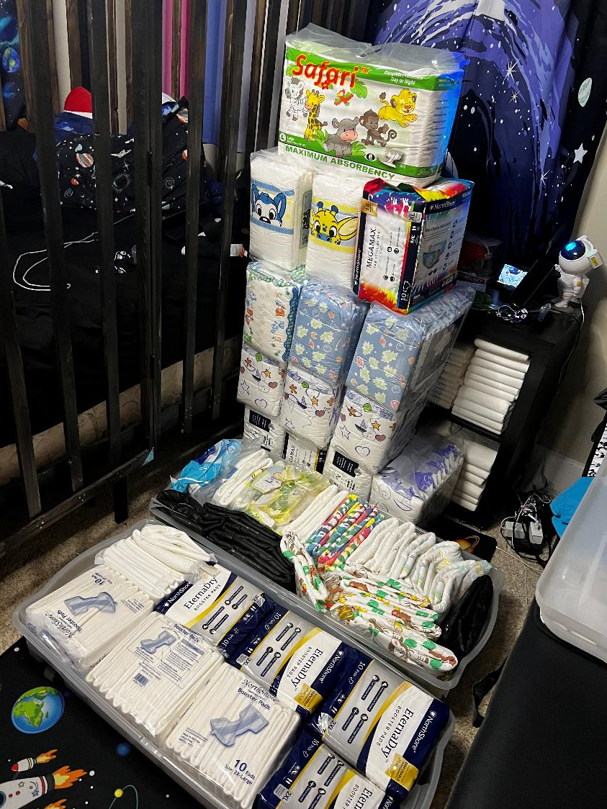
Going AB/DL 24/7
Wearing diapers 24/7 or living the AB/DL lifestyle daily presents many challenges. But to each Challenge there is a potential solution.
Financial
  FSA/HSA
Public wear
Wearing to work
Family & Friends
Personal Play Space
AB/DL Supportive clothing/Accessories
Social Media
Community Interactions

Slide 11

Buy a House or Move Out
Moving out or buying a house is the goal of all AB/DLs but if you are seeking to indulge in your kink freely there are certain terms that can make it challenging.
Financing a house can be a real challenge but there are some financial tactics you can use to make it affordable.
College Room and Board student loan
401k Personal Loan
Roommates
If you are seeking to purchase a place this is often a long- term goal. Some things to work towards:
Building Credit
Savings

Slide 12
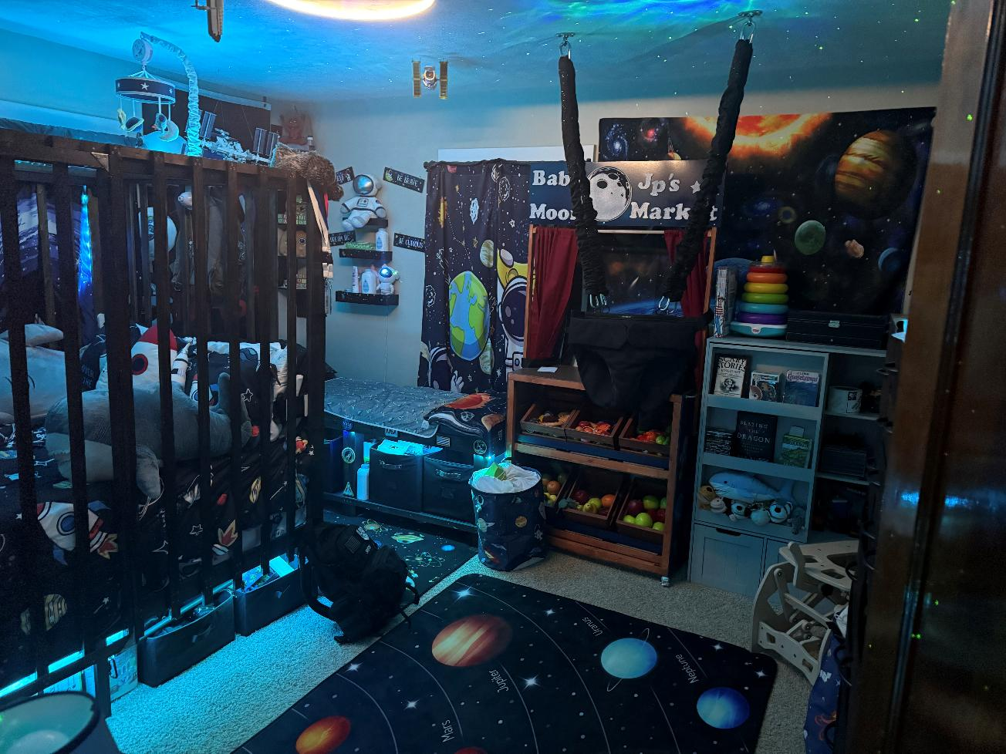
Building a Play Space
Building a Play space is something that isn’t out of the realm of possibility. It is a long-term that can be accomplished over time.
Some things to consider:
Research and pick a theme
Free AB/DL furniture build designs are available at www.adultbabysteps.com
Websites like Amazon are ideal for bookmarking wish lists and backward planning Playroom components
Get Creative with the space. Lighting, Wall hangings, Play mats and hanging toys can create an immersive play space.
It can take years to build the space of your dreams… Its all just “Baby Steps”

Slide 13
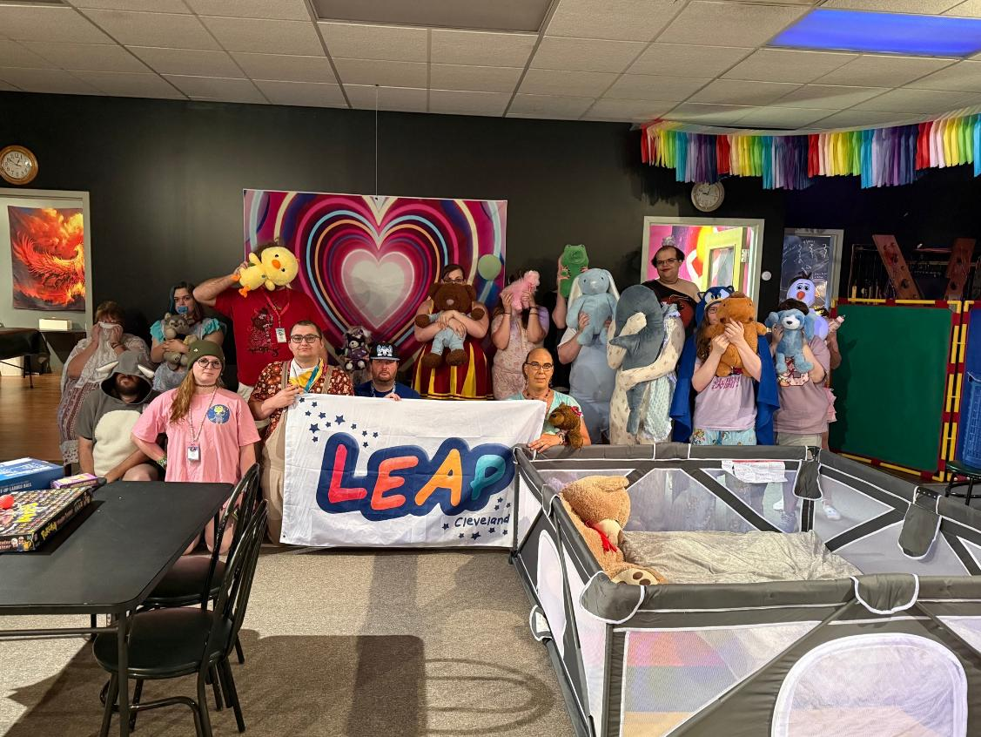
Join or Start an AB/DL Community
Meeting other AB/DLs and cultivating an in real life friend group doesn’t need to be limited to CapCon. There are several organized AB/DL communities around the world.
Meeting in person isn’t the limit to community participation. There are various free opportunities to get involved both informational as well as creating a social network.
AB/DL Social Media/Websites
  Daily-Diapers.com
  Diaper-bois.com
  Fetlife.com
  Adultbabysteps.com
AB/DL Podcasts
  Love in Brief
  Usuals Bet
  Dear Jazzie
  Mean Mommy Podcast
  Toy Box Talks
  In the Nook
YouTube Channels
  Diaperperv
  DiaperTV
  Adult Baby Steps

Slide 14
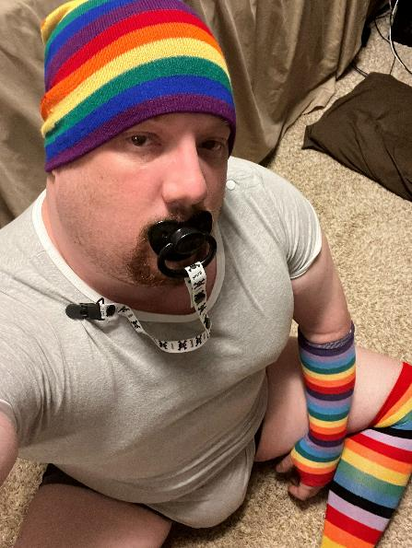
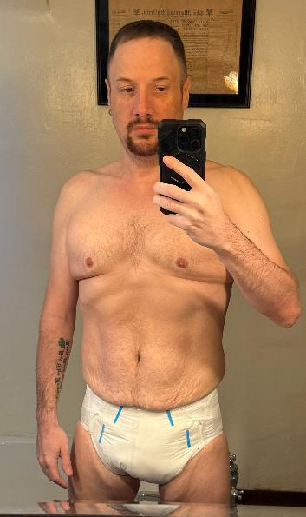
Fitness Change
Before:
CapCon 2024 - 280 lbs.
We are all perfect just the way we are, but personal health is something we can all work to improve. Working towards weight loss and personal fitness doesn’t require becoming a gym rat.
Some techniques for a personal health change:
Nutritional journal
Caloric Deficit ***
Cutting Sugar and Bad Calories
Medicinal Assistance
Low impact high caloric burn workouts
The Diaper Motivator
Personal Accountability
Some Advice/Facts:
There is no such thing as “targeted fat burning”
Diets are temporary, real change requires a lifestyle change
Set personal goals to motivate
Plateaus are normal and will happen as the body goes into Survival mode. Don’t let them discourage you.
Resource article on my personal fitness can be found on my website www.adultbabysteps.com
After:
CapCon 2026 – 165 lbs.

Slide 15
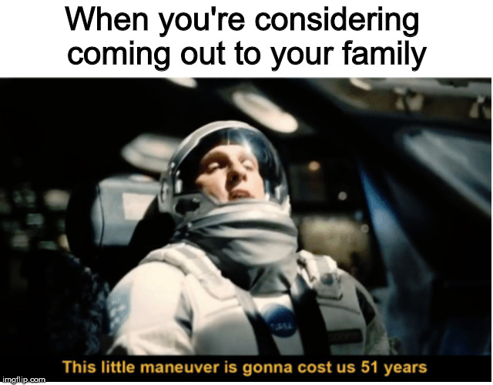
Coming Out
To Tell or Not to Tell… That is the Question…
Some Resources with discussions on coming out:
Toy Box Talks Podcast: Episode 24 Coming Out & Episode 25 Being Outed
www.AdultBabySteps.com article “Coming Out” under “AB/DL Resources” > “Articles & Games”

Slide 16
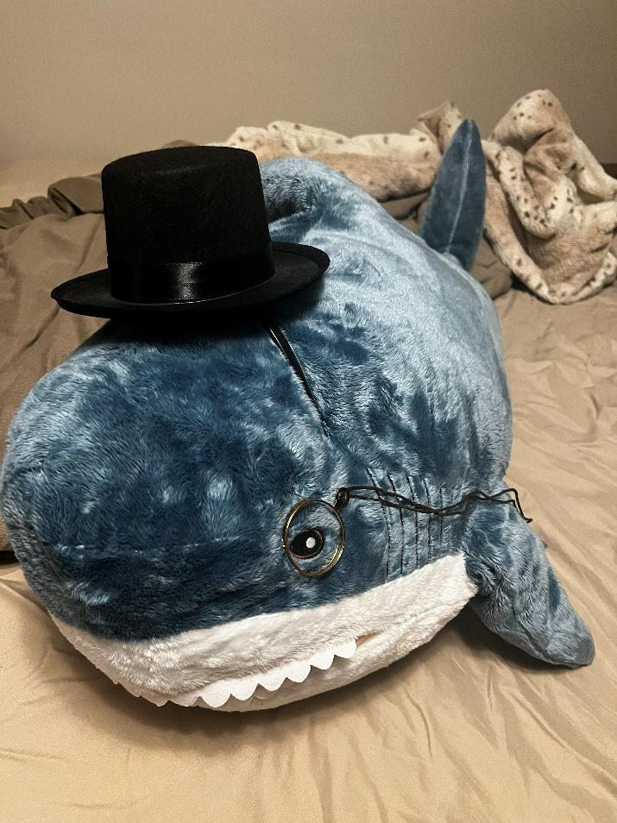
Questions?
I can be reached on any of my socials found at www.adultbabysteps.com
You can also email me Jp@adultbabysteps.com

