Slide 1

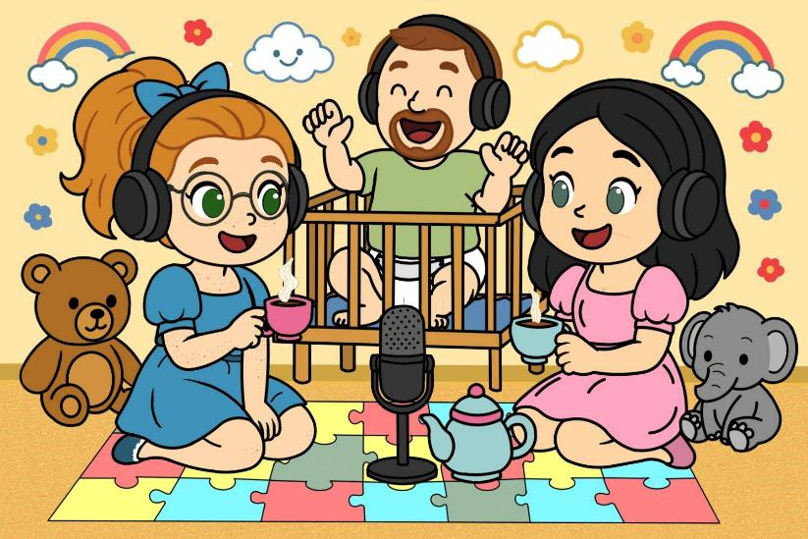

Starting your Own Local AB/DL Group
Presented By:
Baby Jp of “Adult Baby Steps”
Riley Cabbage Patch & Taylor Tot of “Toy Box Talks” Podcast

Slide 2
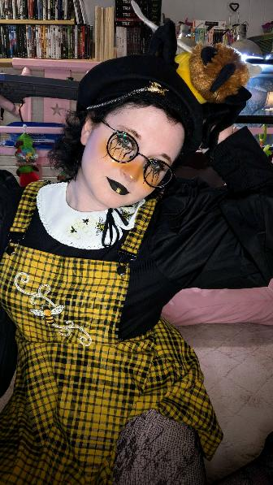
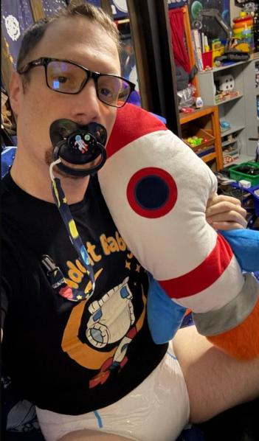
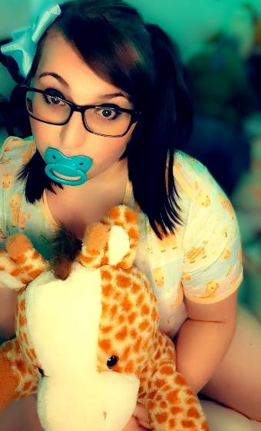
A Little about the Presenters
A Combined +35 Years of Active Participation in the AB/DL community
Combined nearly 10 years in AB/DL Group Leadership
Active AB/DL Content Creators offering guidance through free media on YouTube, Podcasts, Interviews, articles and websites
Current Owners and Board Members of Lake Erie Age Players (LEAP) based in Cleveland, Ohio.

Slide 3
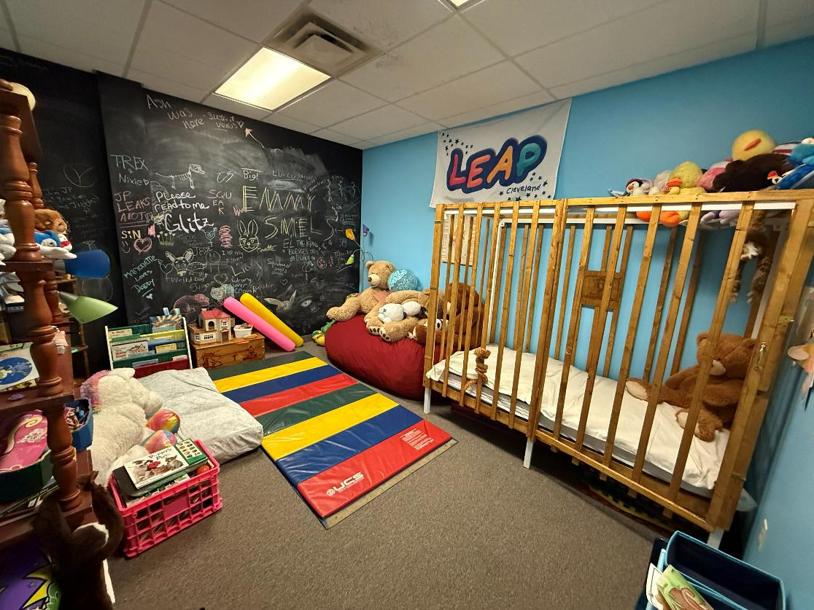
Starting a group
Starting an AB/DL community may seem like a daunting task but it is doable but requires a lot of work and commitment.
Nearly all groups start small and over time grow. It can usually start from a group of friends that decide to have a get together or “Munch” and it just evolves from there.
Websites like “Fetlife” are ideal for starting out. You can create a group through their groups section and plan meet-ups through their events page.
Some important things to consider when starting out. If someone has a bad experience in their first get together it could end a group before starts. This isn’t a “Go Big or Go Home situation. Munches at a restaurant, public parks, or to see a movie without any scenes or age play helps set the groundwork and is great way for people to meet and build the foundation for trust to do more in the future.

Slide 4
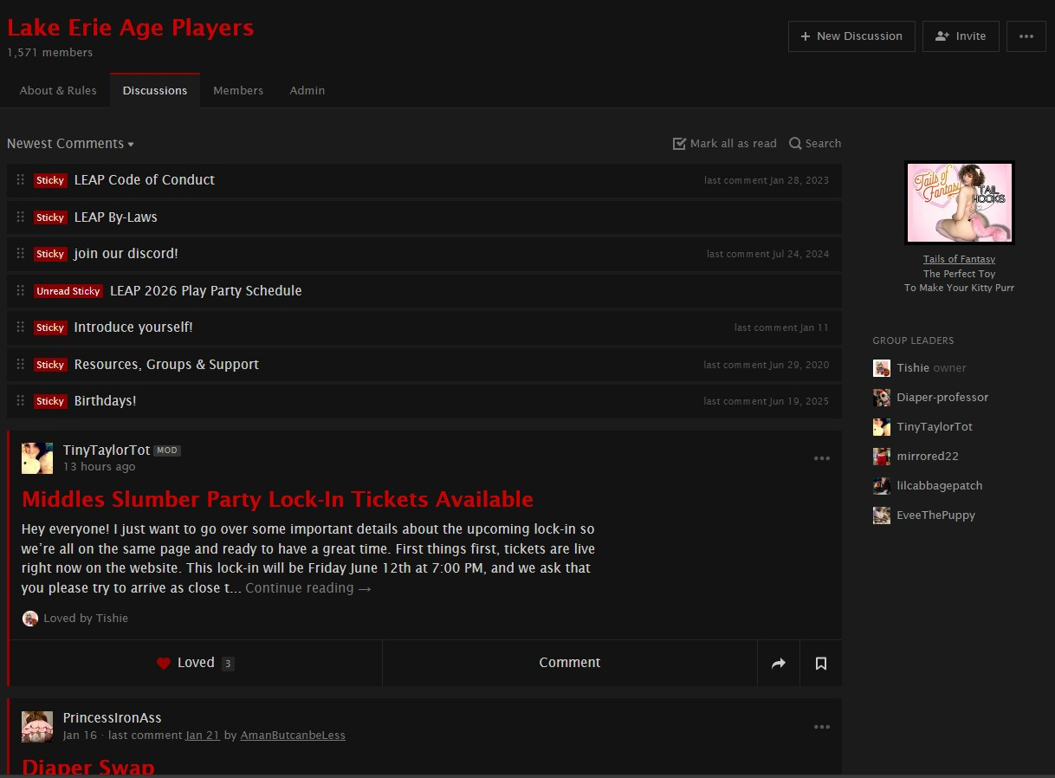
Connecting to the Community
Fetlife has the tools, such as Rules, Events, Forums and discussions to help build interest in you budding group and another positive is it is a kinkster website so there isn’t the risks with other social media that could suddenly decided to delete a kink community on a whim.
You need to put in the effort. Just creating a group page isn’t enough. You need to create safe and fun opportunities for people to engage both in real life as well as online.

Slide 5
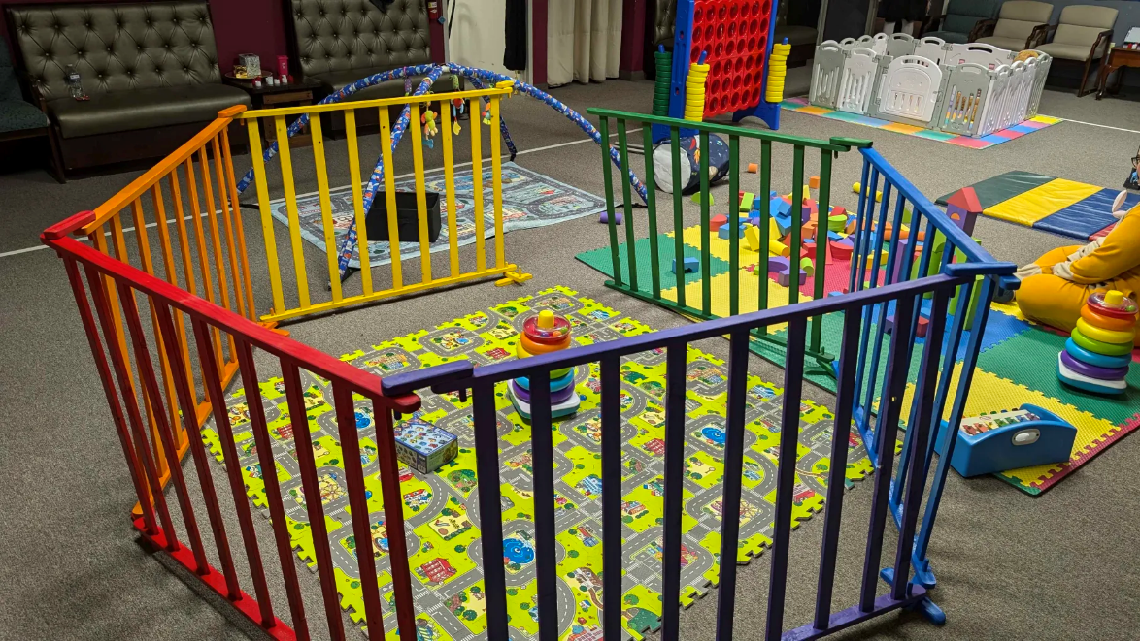
Munches
Munches are a great starting point. Meeting monthly or bi-monthly and on weekends are ideal to give opportunities for potential attendees to make arrangements if they wish to attend.
Changing up the venue and costs to best cater to as many as possible. You may host a bowling event that has costs to attend one month and attend a free museum or public park the next.
Some successful Munches we’ve hosted in the past:
Bowling
Minor League Baseball Game
Park Outings
Museums
Laser Tag
Drive in movie
Restaurant gatherings
Haunted House
Ren faire
Arcade
Corn maze

Slide 6
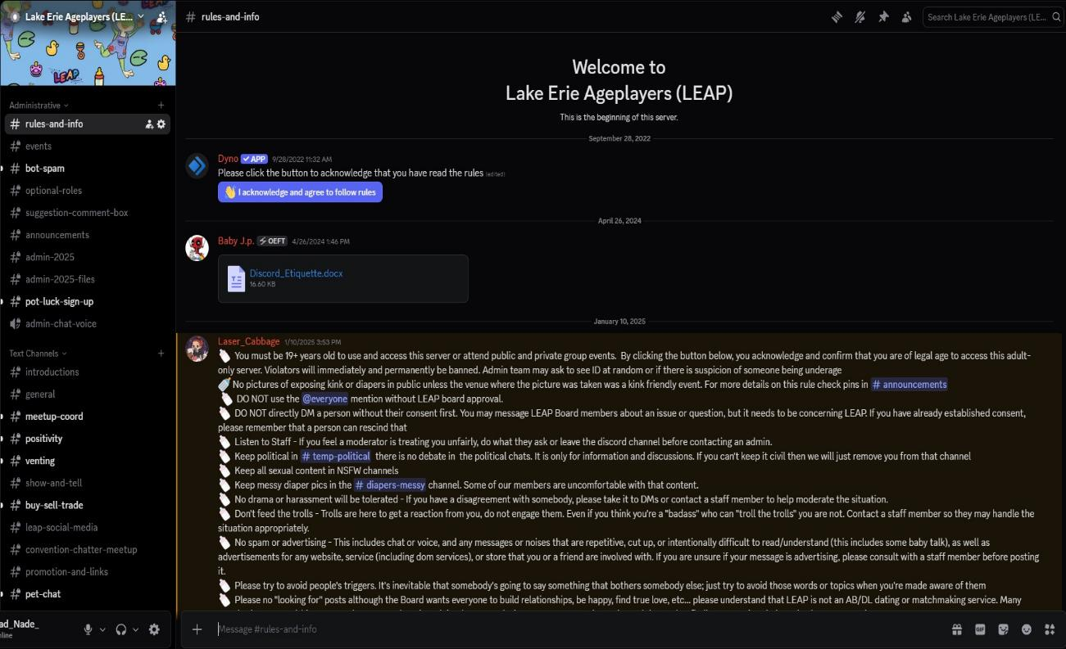
Creating a 24/7 Community
Although Fetlife is great for getting started, the group communication aspect is less than ideal as it is more like a group forum. Creating an alternative chat group in addition to your Fetlife page is a great way to offer continual community in real time.
Applications like Signal, Telegram and Discord are great chat applications with their own strengths and weaknesses. Currently LEAP uses Discord. The main appeal for Discord over Signal or Telegram is that it offers multiple channels which can allow various topics to be discussed at once in separate channels rather than a single room where following a discussion can become difficult.

Slide 7
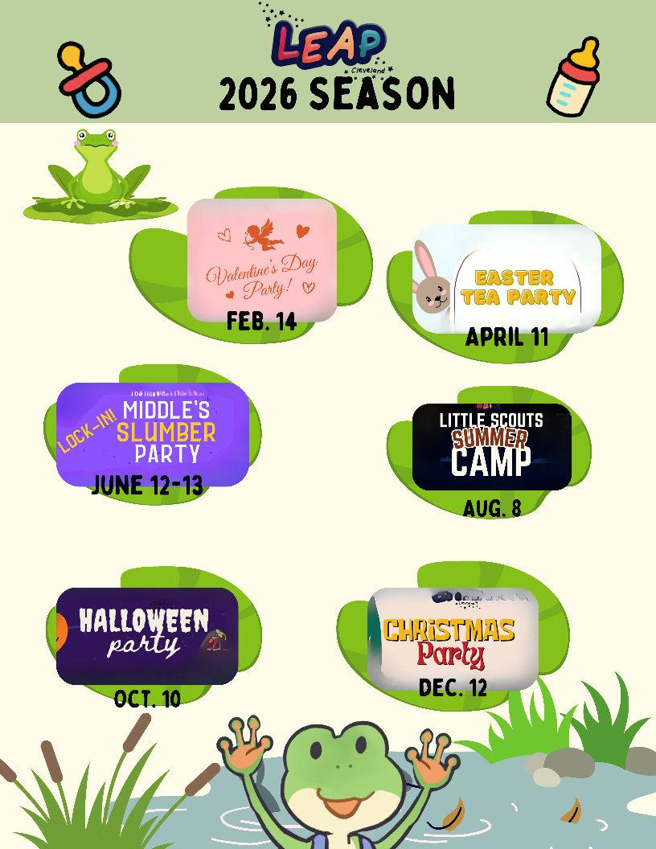
Planning Events
Planning a Private Party or Event is a step-up from a Munch. Some things to consider when planning an event:
Finding a Venue
Themes or Event concepts
Optional Activities
Vetting
Get the community involved with volunteers
Donations or Tickets to invest in the group (This shouldn’t ever be a money making venture)
Make the event so you also enjoy it
Socialize and Welcoming
Consistent Rules
Be mindful and aware of local laws and ordnances

Slide 8
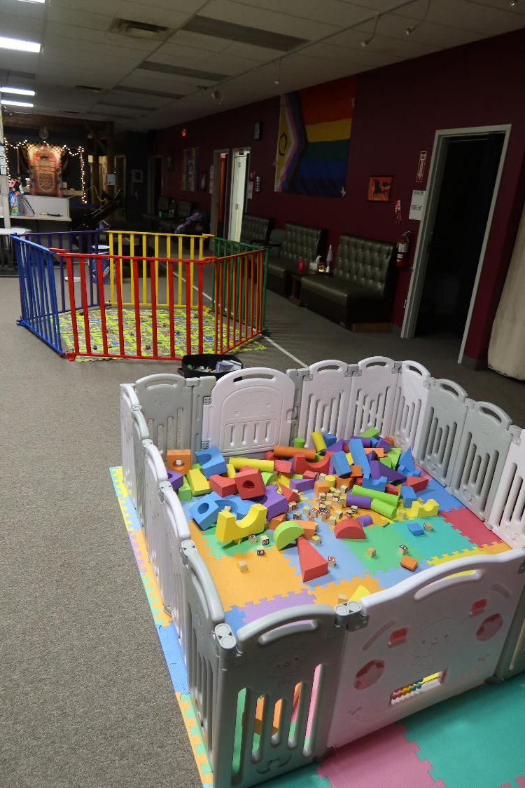
Becoming an LLC
At some point with running events, you’ll reach a point where a banking account is needed. This is when becoming an LLC formally is important. Some considerations:
Pros
Ticket providers
Banking accounts
Legal protection as an LLC
More control (Instead of Nonprofit)
Formally recognized which can draw sponsors
Opens up opportunities for storage units
Cons
Legal paperwork
Responsibility
Taxes
Owners are locked in to the group

Slide 9
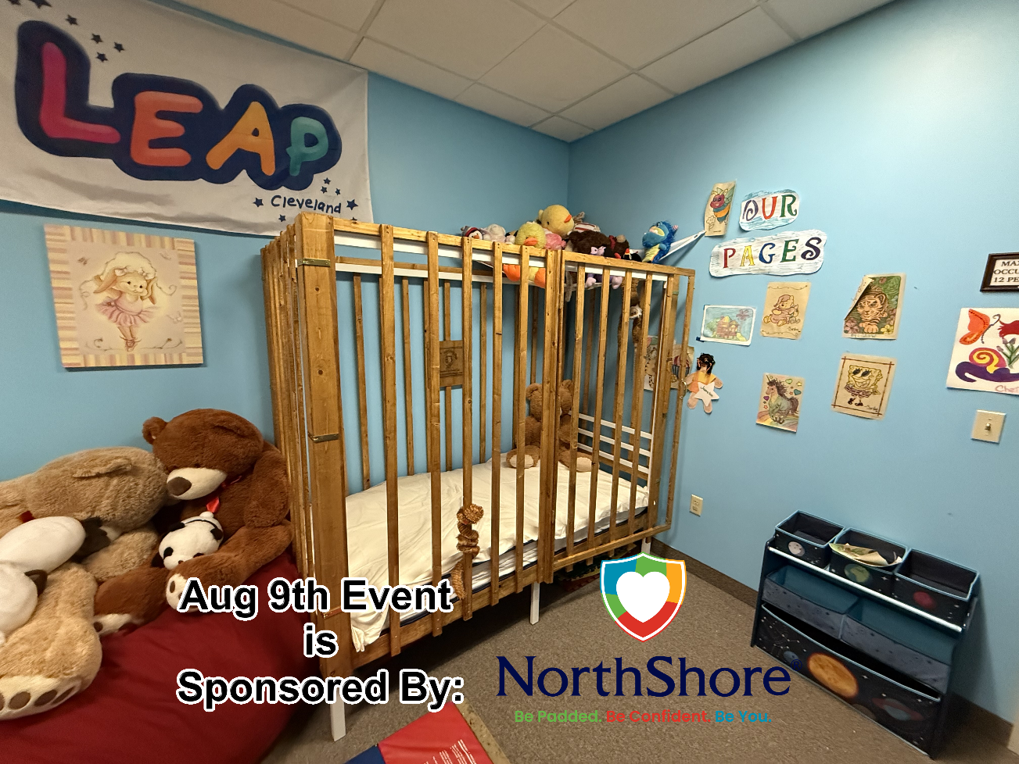
Sponsors & Merch
Reaching out to companies once your group has solid footing and regular events and attendance is an excellent draw to grow your community. Also creating Merch, promotions and art is another great way to get your community’s awareness out there.
Some things to keep in mind:
Is it a company your community trusts
Networking
Are there strings attached
For Merch, what are the initial costs and potential returns
Storage and distribution

Slide 10
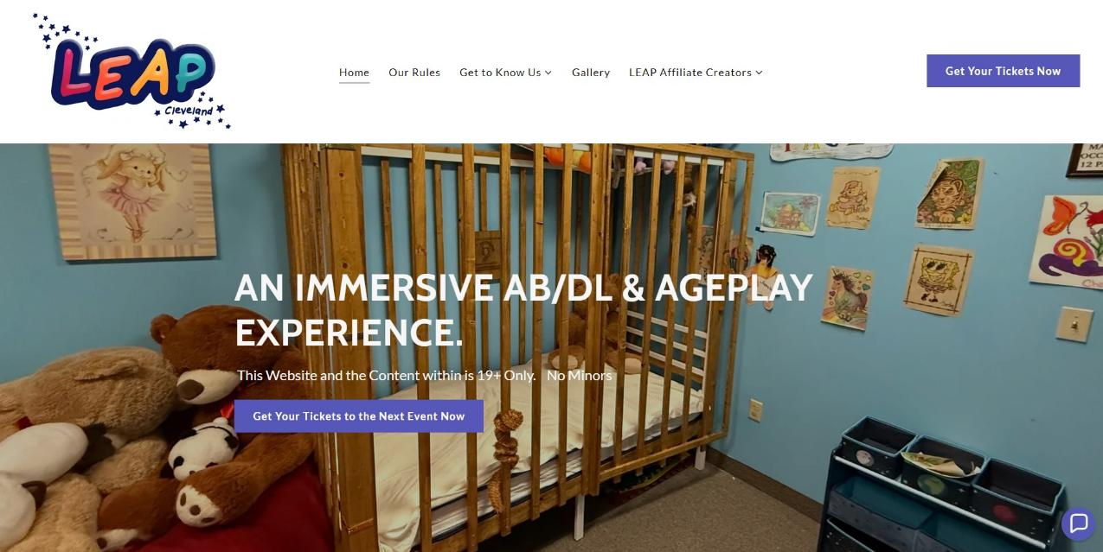
Creating a Website
Creating a website dedicated to your group offers tracking for interactions, a venue for merch and ticket sales, events and schedules as well as sources for other media directly tied to your community.
It is important before deciding on creating a website whether if it suits your needs and is worth the investment.
Website designers like Go Daddy or Square Space can make the process easy and creating a custom domain and having dedicated emails tied to your community can keep all your community information separate from your private life, but for a cost.

Slide 11
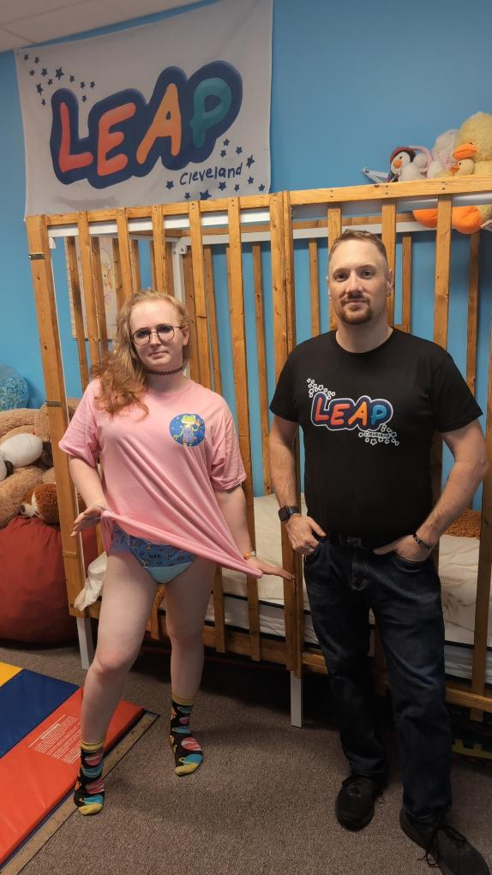
Goals and Timelines
Setting short-term and long-term goals for your community can keep you on the path for growing your community. Once you achieve a goal you move on to the next one. One of the Long-Term Goals that LEAP has had for years is to Host a convention. With each success of a short term goal we move closer to achieving that goal.
Some goals LEAP has had as examples can be:
Hosting your first event
Breaking 50 attendees at an event
Create Merch
Become an LLC
Host monthly events and Munches for a year
Get a Crib for your venue
Get a Storage unit
Get sponsors for an event

Slide 12

Drama and Issues
Drama and Problems are unavoidable… No matter how much or well you plan someone will not be happy.
Some things you can do to try to avoid issues
Clear Rules and Expectations that attendees or group participants must agree to prior to any event or activities begin.
Try to plan activities or events that are inclusive to the majority of the attendees.
Don’t add to the drama. When an issue happens be objective, get the facts not the feelings and utilize your rules and objective board members to discuss and then directly address the issue.
Never call someone out publicly and when you address an issue have a witness to avoid a “he said she said” situation.
Surveys and feedback from attendees is ideal to improve and see what works and what doesn’t.
Don’t let drama or issues disparage you.
Accept that you can’t please everyone. Set realistic expectations for yourself.
After care for group leaders after an event or munch is a must.

Slide 13
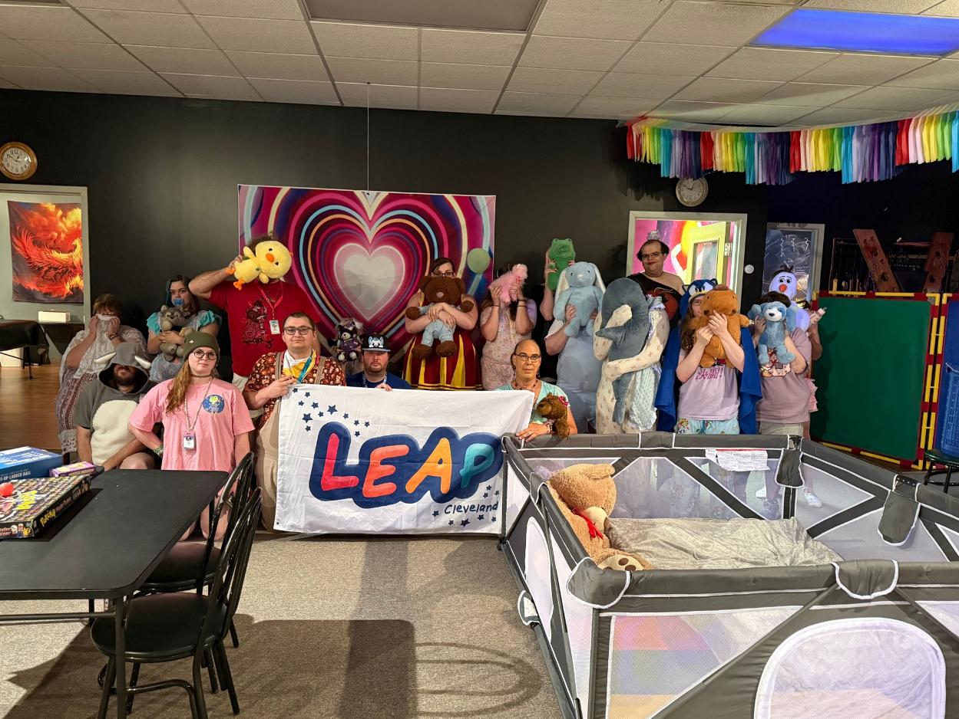
Panel discussion and Questions

