Slide 1
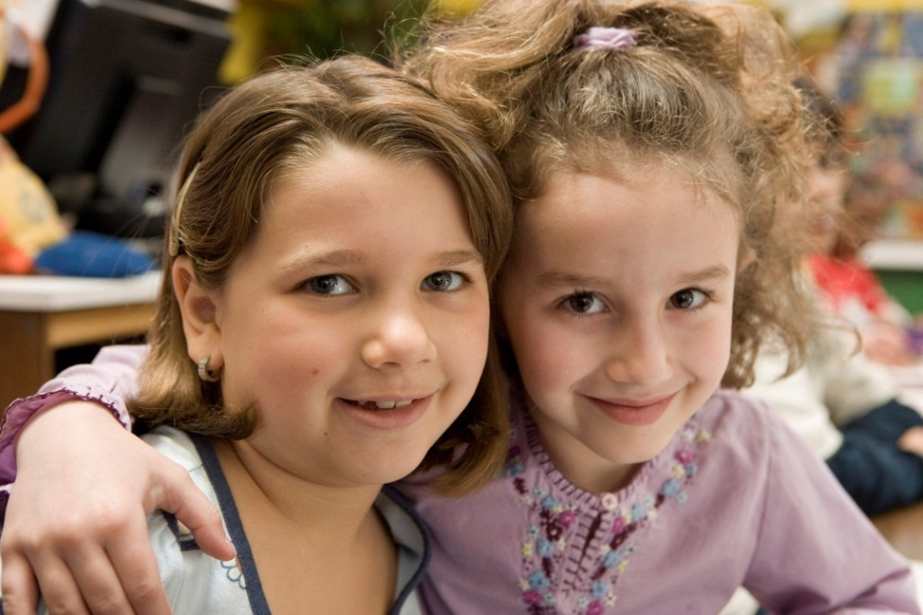
Workforce Readiness | Entrepreneurship | Financial Literacy
Welcome to Junior Achievement!
Our mission: to inspire and prepare young people to succeed in a global economy
Getting Started:
Please review pages 1 – 3 in your JA Volunteer Training Guide.
On page 3, record your hopes, fears and questions about your upcoming JA experience.
Like JA of Arizona and Check-in on Social Media.
Housekeeping:
Turn cell phones off
Refreshments & Restrooms
Modeling Teaching Techniques
Two of the millions of students that JA served worldwide last year!

Slide 2
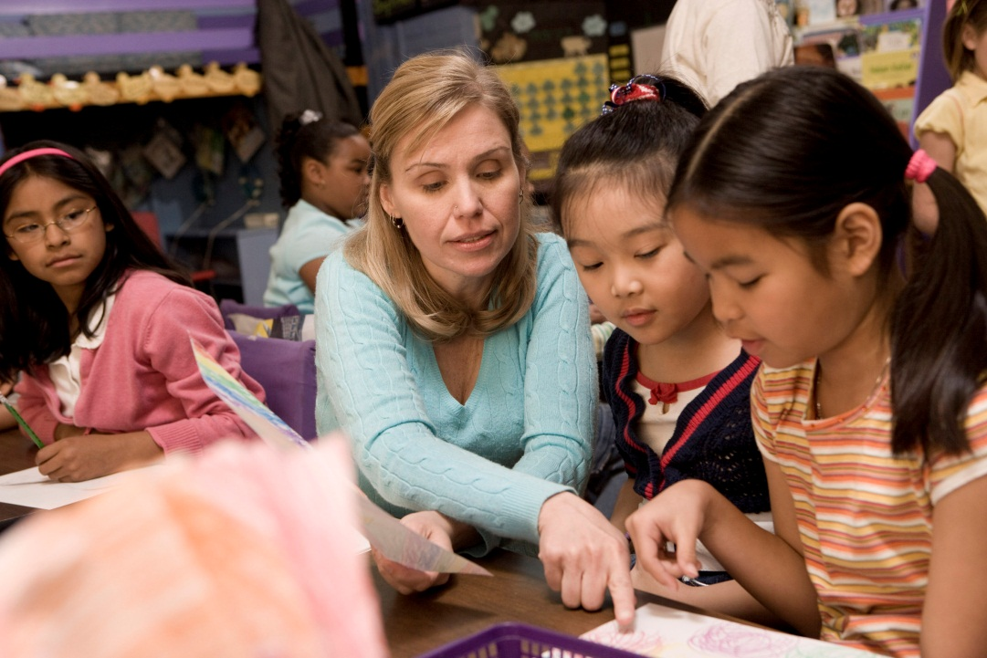
Agenda
Introduction
Workshop 1: Student Engagement Strategies
Workshop 2: Session Planning
Workshop 3: Session Practice
Closing & Evaluation
Junior Achievement Tour
Workforce Readiness | Entrepreneurship | Financial Literacy

Slide 3
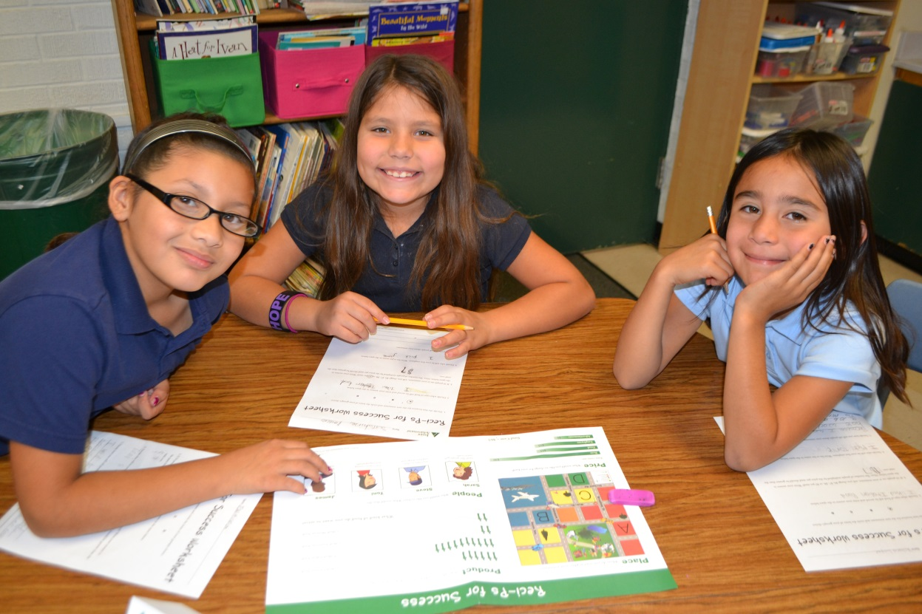
What is Junior Achievement?
Click HERE to play video
Workforce Readiness | Entrepreneurship | Financial Literacy
Notes:
Play Overview Video(or click “What is Junior Achievement?” to play the video online)

Slide 4
Did you know?
With one of the highest dropout rates in the nation, Arizona’s kids are dropping out at a rate of 48 per day.
Of every 10 students entering Arizona high schools, only 7 graduate.
According to Money Management International, young people ages 21-25 are one of the fastest growing groups filing for bankruptcy.
Employers report that nearly 70% of high school graduates are deficient in critical thinking and problem solving.
Economic education is only a half credit requirement upon graduation in Arizona, thus reducing the focus on the global economy and personal finance for students in our schools.
Sources – AZ Community Foundation, United Way Human Resource Professionals,
& Ellis Center for Educational Excellence
Workforce Readiness | Entrepreneurship | Financial Literacy
Notes:
As our partner, you represent your school and JA when you welcome volunteers into your classroom, encourage student participation, and represent our mission in the community.

Slide 5
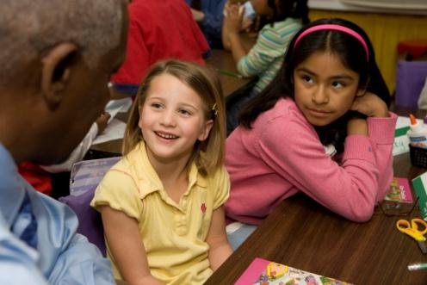
You + JA = The Solution
JA students outperform other non-JA students on objective-referenced tests and have a more positive self-concept and higher self-esteem.
JA students are more likely to graduate high school (93% versus 70%)
JA students are more likely to attend college (73% versus 60%).
Students who receive JA are more likely to graduate from high school and obtain a Bachelor’s degree or higher (69% versus 27%).
Junior Achievement is one of a few nonprofits to use independent, third-party evaluators to gauge the impact of its programs.
Workforce Readiness | Entrepreneurship | Financial Literacy

Slide 6
Making a Long-term Impact
Click HERE to play video
We invite you to sponsor a student like MJ today for only $36 or
sponsor 3 JA students for only $108. Thank you for your support!
Workforce Readiness | Entrepreneurship | Financial Literacy
Notes:
SAMPLE STUDENT STORY: For Selene Lares, Junior Achievement has been a way to gain work readiness skills, and put them into action. Selene was selected in 2011 and 2012 to participate in the JA You're Hired!™ Internship Professional Development Program. "It is a great way to get work experience and knowledge," Selene says. "I would encourage students to take the opportunity to get an internship through Junior Achievement".
All of Junior Achievement's programs are made possible through the time and commitment of JA volunteers who make a true impact in the lives of students. "The best part are the Junior Achievement volunteers, like Anita, who take time to help us students grow," Selene says.
Selene graduated in 2012 from Maryvale High School and hopes to finish college with a degree in business with aspirations to complete her masters. Last summer during Selene’s JA presentation, she connected with someone at the Governor’s office and followed up with them regarding the possibility of an internship. This past fall she was accepted as an intern at the Governor’s office during her first semester of college. From her JA experience and her drive to succeed, Selene now has a part time job with the Department of Economic Security. Even in Selene’s busy schedule, she gives back to JA by volunteering a few hours every week with various JA projects.

Slide 7
Student Engagement Volunteer Conduct Standards
As a youth serving organization, Junior Achievement reached almost 96,000 students in Arizona and over 10 million worldwide.
We care about the young people we serve and our volunteers and teachers.
The Volunteer Conduct and Social Media policies are renewed annually and are meant to protect Junior Achievement students and volunteers.
Workforce Readiness | Entrepreneurship | Financial Literacy
Notes:
10 minutes, Mandatory Video “Working with the JA Staff”
Direct volunteers to review the Volunteer Conduct and Social Media Policies in their packets. Tell volunteers that Junior Achievement establishes policies to protect the youth we serve and our volunteers. New volunteers must view this video and agree to abide by the policy. Returning volunteers must review and sign the Volunteer Conduct Policy each school year.
Show the Working with the JA Staff video (mandatory) to help volunteers understand our volunteer conduct standards when working with young people.
If the Volunteer Conduct Policy (VCP) and Social Media Policy were not reviewed and signed by all volunteers prior to the training session, pass them out. Ask them review the document(s) and complete the volunteer information forms.
Collect the white copy of the VCP and the Social Media Policy. Invite volunteers to keep the yellow copy of the VCP for their records.

Slide 8
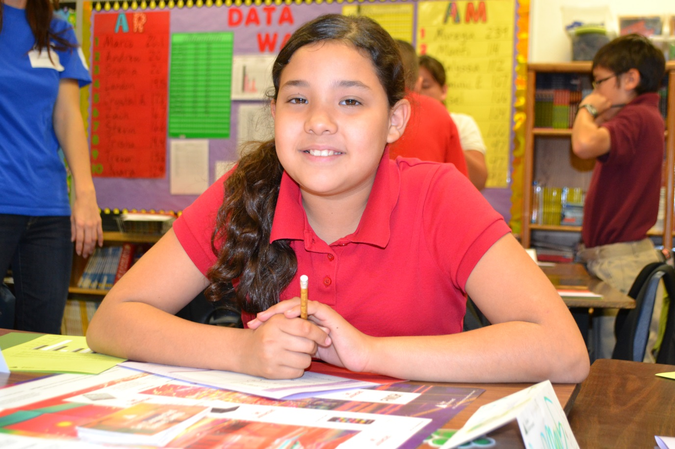
Volunteer Conduct Standards Volunteer Conduct Policy & Social Media Policy
As a youth serving organization, we care about the young people, volunteers, and teachers we serve.
Click HERE to play video
These policies are renewed annually and are meant to protect Junior Achievement students and volunteers.
Workforce Readiness | Entrepreneurship | Financial Literacy
Notes:
10 minutes, Mandatory Video “Working with the JA Staff”
Direct volunteers to review the Volunteer Conduct and Social Media Policies in their packets. Tell volunteers that Junior Achievement establishes policies to protect the youth we serve and our volunteers. New volunteers must view this video and agree to abide by the policy. Returning volunteers must review and sign the Volunteer Conduct Policy each school year.
Show the Working with the JA Staff video (mandatory) to help volunteers understand our volunteer conduct standards when working with young people.
If the Volunteer Conduct Policy (VCP) and Social Media Policy were not reviewed and signed by all volunteers prior to the training session, pass them out. Ask them review the document(s) and complete the volunteer information forms.
Collect the white copy of the VCP and the Social Media Policy. Invite volunteers to keep the yellow copy of the VCP for their records.

Slide 9
Teaching Techniques How do I engage the students? (Pages 6-12)
Review and discuss your assigned topic (#1 - #5)
Record notes on your topic on page 13.
Select a speaker to report out 2 key ideas from your topic.
Audience - Record key ideas on page 13.
Workforce Readiness | Entrepreneurship | Financial Literacy

Slide 10
Student Characteristics
What will the students
I work with be like?
Characteristics depend on ages and stages
Your observation or teacher meeting will provide invaluable insight
After today: View the Volunteer Training video on Student Characteristics at www.ja.org
Workforce Readiness | Entrepreneurship | Financial Literacy

Slide 11
What You Will Teach
What is the workshop Model of Instruction?
(Page 15)
What’s in a Junior Achievement kit?
How do I use the Volunteer Guide?
How do I best prepare?
(Session Planning Tool – page 16)
Workforce Readiness | Entrepreneurship | Financial Literacy

Slide 12
What Will I Teach? Activity
Instructions
Find materials needed for Session 1 and review Session1 in your Volunteer Guide
Be prepared to SHOW materials and TELL us about your first session
Not sure what to focus on? Use page 16 in your Training Packet as a guide
Workforce Readiness | Entrepreneurship | Financial Literacy

Slide 13
What You Will Teach Sharing and Reflection
Show & Tell
Share session overview, session materials, and workplace connections
Teaching Tips video at www.ja.org
Click on: Get Involved; Volunteers; Volunteer Orientation DVD; Teaching Tips
Preparation
(Session Plan - page 17)
Workforce Readiness | Entrepreneurship | Financial Literacy

Slide 14
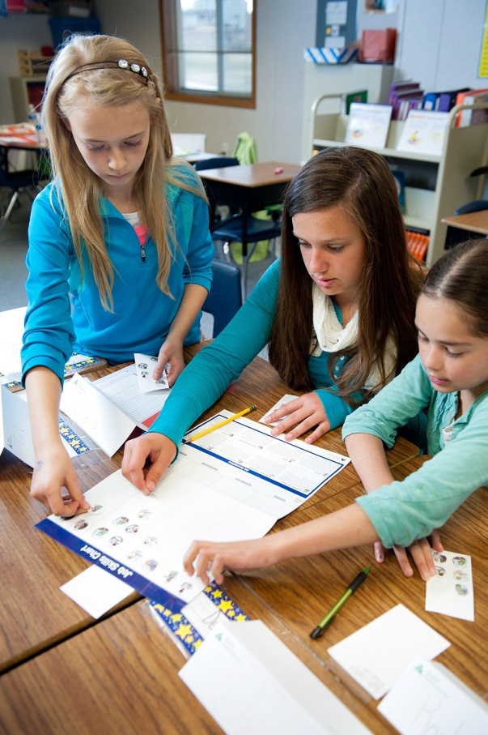
K-12 Program Overview
JA Ourselves
JA Our Families
JA Our Community
JA Our City
JA Our Region
JA Our Nation
JA Global Marketplace
JA It’s My Future
JA More than Money
JA America Works
JA It’s My Business!
JA Economics for Success
JA Be Entrepreneurial
JA Personal Finance
JA Titan
JA Company Program
JA Economics
JA Exploring Economics
JA Career Success
JA You’re Hired
JA Map Your Success
JA Student Stock Market Challenge
Workforce Readiness | Entrepreneurship | Financial Literacy
Notes:
As our partner, you represent your school and JA when you welcome volunteers into your classroom, encourage student participation, and represent our mission in the community.

Slide 15
What Are My Next Steps?
What is the plan for ongoing communication?
What do I do with the materials after completing the JA program?
What questions does the group still have?
How do I verify that I finished all of the JA sessions and give feedback?
Workforce Readiness | Entrepreneurship | Financial Literacy

Slide 16
Connect With Us!
Like our Facebook Page!
Junior Achievement of Arizona
https://www.facebook.com/JAArizona
Follow us on Twitter
Junior Achievement of Arizona
https://twitter.com/JAArizona
Link to our Group and Follow us
Junior Achievement of Arizona
Visit the Junior Achievement of Arizona website at www.jaaz/org
Please be sure to turn in all paperwork and your training
evaluation (page 18) before you leave. Thank you!
Workforce Readiness | Entrepreneurship | Financial Literacy

