Slide 1
Suicide Prevention Training
Updated 4/24/14

Slide 2
The goal today….
We want to build your confidence in helping someone that might be suicidal.

Slide 3
There isn’t a script for helping someone having suicidal thoughts…
“You can plan a monologue but you can’t plan a dialogue.”

Slide 4
Risk factors for suicide
Previous attempts
History of mental disorders
History of substance abuse
Family history
History of child abuse
Feeling hopeless
Impulsive
loss
Physical illness
Access to method
Unwilling to seek help
Isolated
Concrete plans
Belief others would be better off
Wanting to join deceased loved one
Prolonged stress due to financial difficulties, unemployment, etc.
Notes:
Previous attempt – between 20-50% of people who kill themselves had previously attempted suicide.
At least 90% of those that kill themselves have a diagnosable and treatable psychiatric illness
Depression – people with major depression are at risk for suicide about 20x vs. general population. Individuals who have had multiple epides of depression are at greater risk for suicide vs. those with one episode of depression.

Slide 5
Warning signs:
A suicidal person may show signs by saying something like, “I just want the pain to end” or “I can see a way out.”
May become socially isolated or withdrawn.
May act irritable or agitated.
Lose interest in things.
Have the feeling of being a burden to others.
Look for ways to kill themselves such as hoarding medicine.

Slide 6
80% of people suicidal display warning signs

Slide 7
IS PATH WARM?
Ideation—Threatened or communicated
Substance abuse—Excessive or increased
Purposeless—No reasons for living
Anxiety—Agitation/Insomnia
Trapped—Feeling there is no way out
Hopelessness
Withdrawing—From friends, family, society
Anger (uncontrolled)—Rage, seeking revenge
Recklessness—Risky acts, unthinking
Mood changes (dramatic)
Notes:
http://www.suicidology.org/resources/mutlimedia-resources/suicide-warning-signs

Slide 8
Here are some possible questions to follow up with someone suicidal:
How often do you have thoughts of harming yourself?
When is the last time you’ve had these thoughts?
When did these thoughts start for you?
Do you notice when you have them? (i.e. if you can’t get the baby to stop crying? When you haven’t been able to sleep? Etc.)
Have you had these thoughts before?
When you have these thoughts, do you have a plan how you might harm yourself?
Do you have access to this plan?
Have you ever tried to harm yourself before?
Tell me about your support system. Do you have anyone you can call to ask for help?
Are you seeing a mental health provider?
I want to make sure you’re safe. Would you be willing to sign a no harm agreement? This means you will call the numbers on the agreement if you have these thoughts again.
Would you be willing to go for an assessment?

Slide 9
Ways to respond to someone suicidal
DO:
Be direct
Talk openly
Work to create support
Get involved
Seek help from supervisor
Be nonjudgmental
Take action
DO NOT
Do not act shocked
Do not promise to keep a secret
Do not try to cheer the person up
Do not assume that the person will not attempt suicide
Notes:
Suicide is preventable.
It is important to know your agency’s policy.
Crisis ph #:
Lifeline: 1-800-273-TALK – second to have link on google with red phone (after poison control)
From 2007 to 2008, Lifeline has seen a 36% increase in call volume
In a news release on 8/31/09 – Lifeline reports receiving 50,000 calls per month from people in crisis.
Operates 24/7
Hopeline: 1-800-SUICIDE

Slide 10
Protective Factors for a suicidal person:
Receiving effective mental health care.
Positive connections: family, friends, support system!!
The skills and ability to solve problems.
Notes:
Protective factors have been shown to help a suicidal person even when issues have gone on long term.

Slide 11
Tools you can use
EPDS
Personal Safety Plan

Slide 12
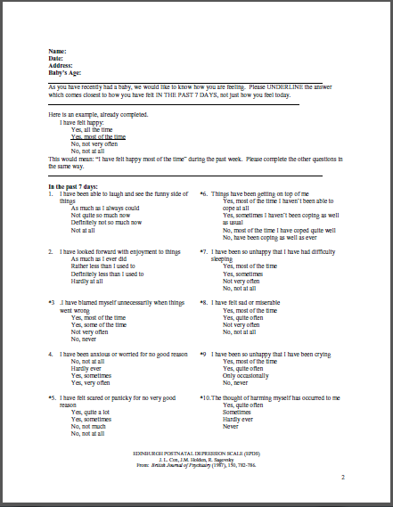
EPDS:

Slide 13
Personal Safety Plan:

Slide 14
What are your questions/experiences?
How could you address:
I think about suicide but I wouldn’t do it.
I attempted suicide two weeks ago by cutting my wrist and then I took pills.
I miss ____ and I think about wanting to be with them.
I have thoughts of hurting myself. I was driving and I thought about driving my car into a tree.
Will CPS be called on me for going to the hospital for an assessment?
What if the hospital wants to keep me (institutionalize)?

Slide 15
Remember
YOU can and do make a difference…

Slide 16
Resources:
1-800-273 TALK (8255)
National Mental Health Association
NAMI: National Alliance on Mental Illness

Slide 17
Resources
Suicide Prevention Resources
http://www.nmha.org/ - Mental Health America
PSI Warmline at 1-800-944-4PPD (4773)
www.postpartum.net – Postpartum Support International
PSI is Postpartum Support International
The PSI Warmline is a toll-free telephone number anyone can call to get basic information on postpartum depression and resources. Dial extension 1 for Spanish and extension 2 for English. The Warmline is answered Monday through Friday, 8am to 4:30pm Pacific. You are always welcome to leave a confidential message any time, however, and your call will be returned as soon as possible.
Suicide Hotline – 1-800-273-TALK
http://www.nimh.nih.gov/health/topics/women-and-mental-health/index.shtml - National Institute of Mental Health
http://www.womenshealth.gov/faq/depression-pregnancy.cfm - The National Women’s Health Information Center
http://www.webmd.com – WebMD
http://www.mededppd.com – MedEd
http://www.suicidology.org - American Association of Suicidology
http://www.suicidepreventionlifeline.org/ - National Suicide Prevention Lifeline
http://postpartumdadsproject.org/ - Postpartum Dads Project
http://www.postpartumdads.org/ - Postpartum Dads
PSI – Weekly Phone Forums for dads – every Monday (info on www.postpartum.net)
http://postpartummen.com/forum/ - Postpartum Men Online Forum
www.womensmentalhealth.com – Massachusetts General Hospital
Books:
This Isn’t What I Expected, Karen Kleiman, MSW and Valerie Raskin, MD
The Mother to Mother Postpartum Depression Support Book, Sandra Poulin
The Postpartum Husband: Practical Solutions for Living with Postpartum Depression, Karen Kleiman, MSW
Beyond the Blues: A Guide to Understanding and Treating Prenatal and Postpartum Depression, Pec Indman, MFT and Shoshanna Bennett, PhD
What Am I thinking? Having a Baby After Postpartum Depression., Karen Kleiman, MSW
Pregnancy Blues: What Every Woman Needs to Know About Depression During Pregnancy, Shaila Misri, MD
Non-Pharmacologic Treatments for Depression in New Mothers, Kathleen Kendall-Tacket PhD, IBCLC
Thirteen Reasons Why, Jay Asher

